Slide 1
vehicles_analysis
File created on: 4/5/26 10:29:27 PM PDT

Slide 2
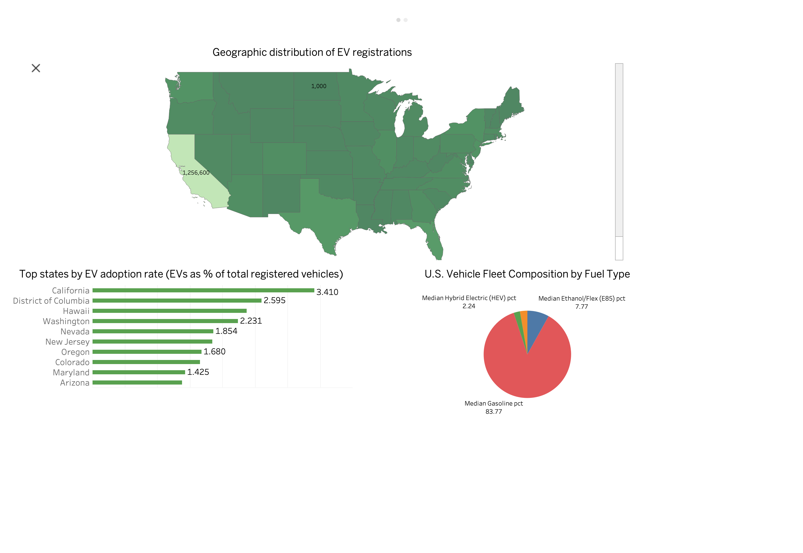

Slide 3
