Slide 1

Our team
COGENT PROJECT
Alexandra Ferreira - Hiba Hammi - Lallana Pérez Inés - Ledegen Lieven - Ontiveros Elena

Slide 2
What is the need ?
COGENT Project main goal : Create a PoC tourist/art guide through Gent
Provide the customer with a quick and easy way to find out about the location of museums and the events that match their tastes and interests during a certain period.

Slide 3
Our approach
Interactive tool that allows users to enter filters for the events they wish to see and provides them with a map displaying museums and events.

Slide 4
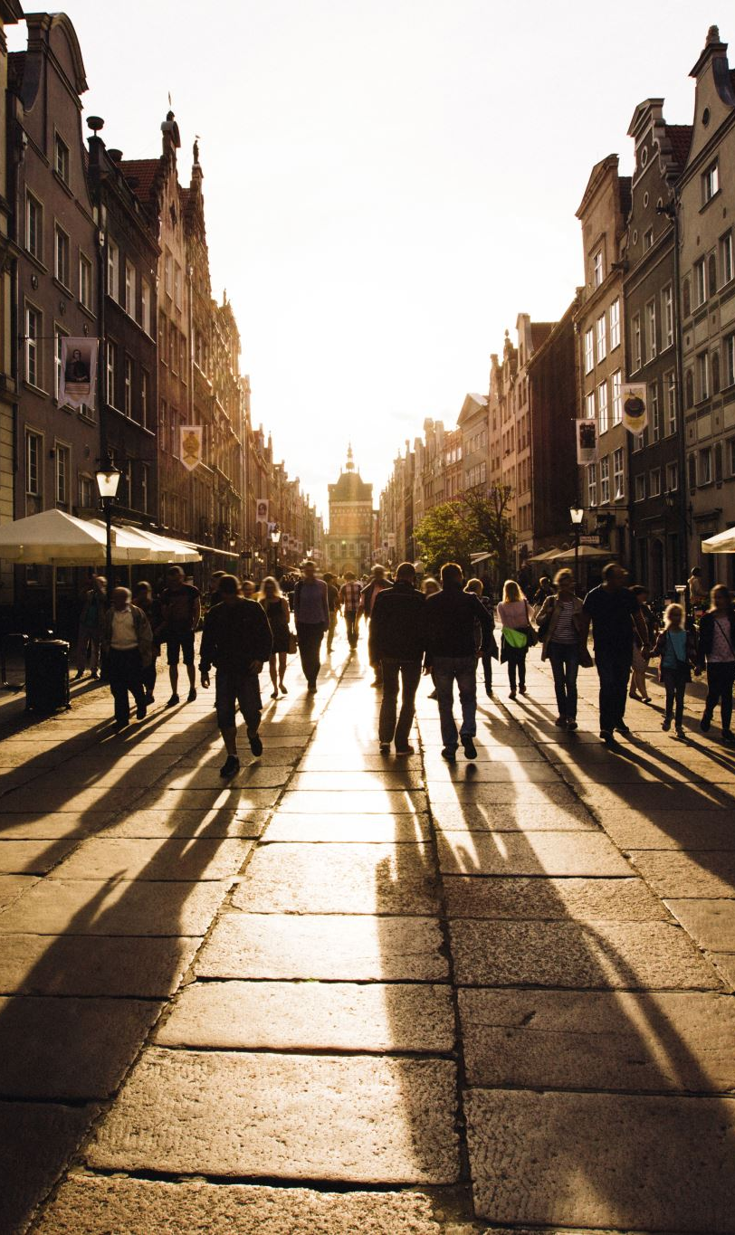
Our target
Tourists travelling to Ghent for a certain period of time and wanting to visit museums and participate in interesting events.
Market size
998620 nights were reserved for tourism in Ghent in 2016

Slide 5
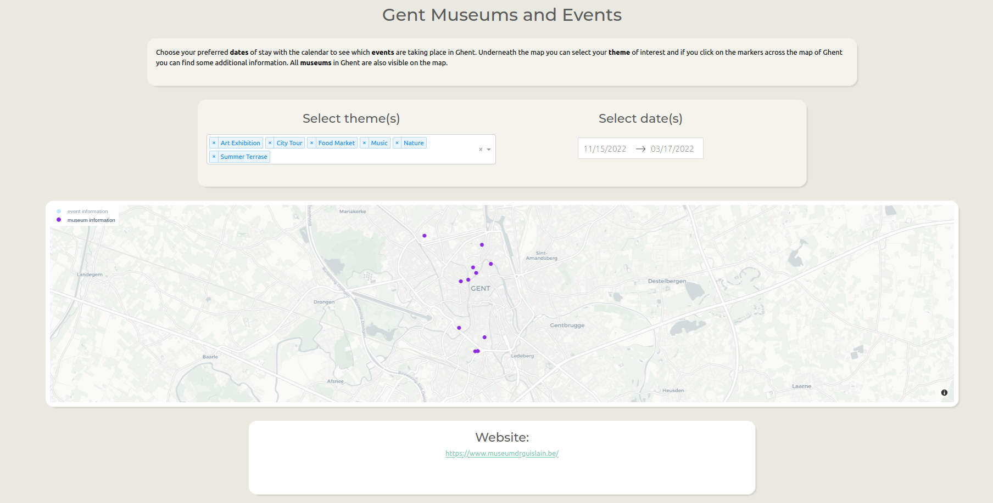
Our product

Slide 6
Our resources
Collectie gent database for the museums
Stad gent database for the events

Slide 7
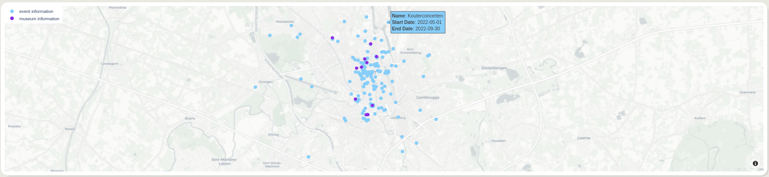

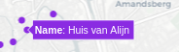

Interactive map
Information displayed
Events
Museums
Event or Museum website link

Slide 8
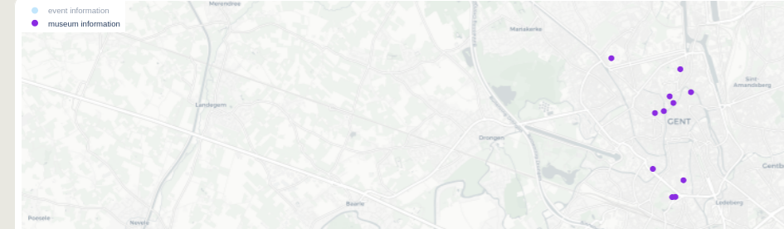
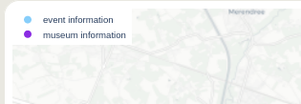
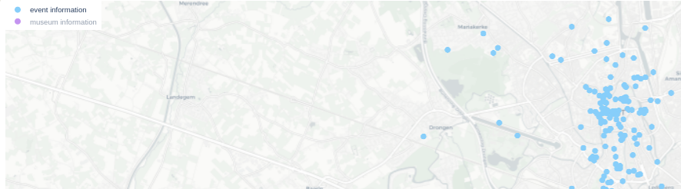
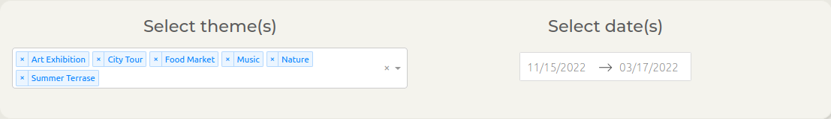
Filters

Slide 9
Advantages
Enjoyable
Easy
Reliable

Slide 10

Thank you for your attention

