Slide 1








×
AIMS
Artificial Intelligence & Multimodal Systems
A research group building AI systems that learn from
images, video, text, speech and sensor data, and stay
reliable under uncertainty.
Scan for papers, projects and people
ComputerVision
VisionLanguageModels
RAG
aimsresearchlab.com
ConversationalMemory
AIAgents
TrustworthyAI
aimsresearchlab.com
github.com/aimsresearchlab
TEC 340, Hattiesburg, MS
Directed by Dr. Rabab Abdelfattah

Slide 2


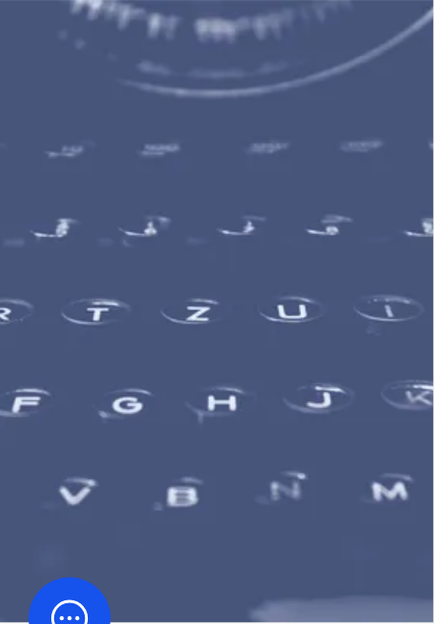
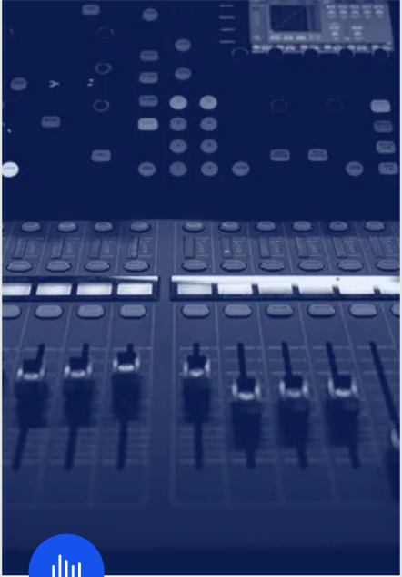
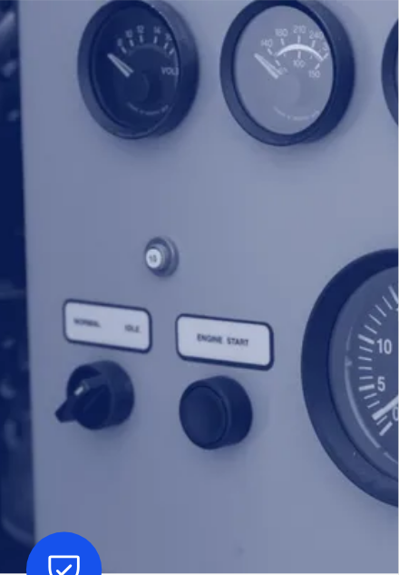






WHAT WE DO
AIMS
Five lines of work
13
17
6
researchers
papers
active projects
Computer Vision
Language &
Agents
Multimodal AI
Trustworthy AI
Human-Centered
AI
Seeing and interpreting the
visual world.
Text, image, audio and
sensor data together.
Evaluation that stays valid
under pressure.
Models that reason, act,
and recover from failure.
Systems people can direct,
inspect and correct.

Slide 3

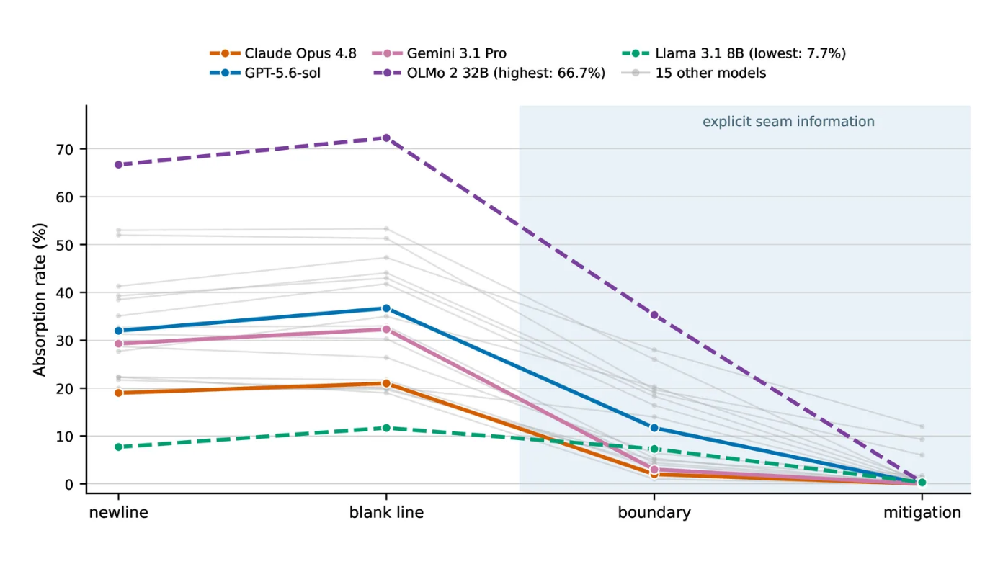


PROJECT
AIMS
SEAM
#HumanCenteredAI
#LLMEditing
Measuring how much typed user
speech gets absorbed into edited
artifacts at unmarked within-turn
seams.
Demo
Code
Scan for the project page

Slide 4

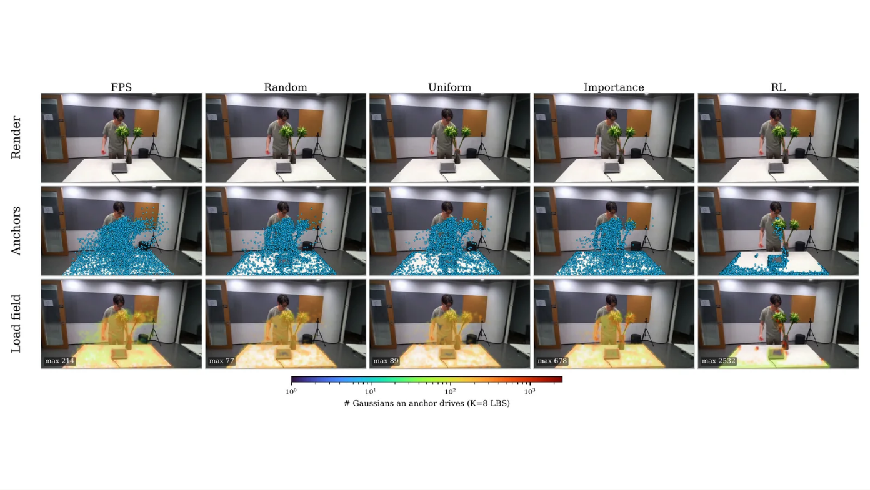


PROJECT
AIMS
4D Gaussian Streaming
#ComputerVision
#GaussianSplatting
Which Gaussians you pick as
anchors barely matters: cheap
samplers match the default strategy
at deployment budgets, so the
standard 8,192-anchor choice over-
spends compute.
Does It Matter Which Gaussians You Pick in 4D
Gaussian Streaming?
arXiv
Scan for the project page

Slide 5

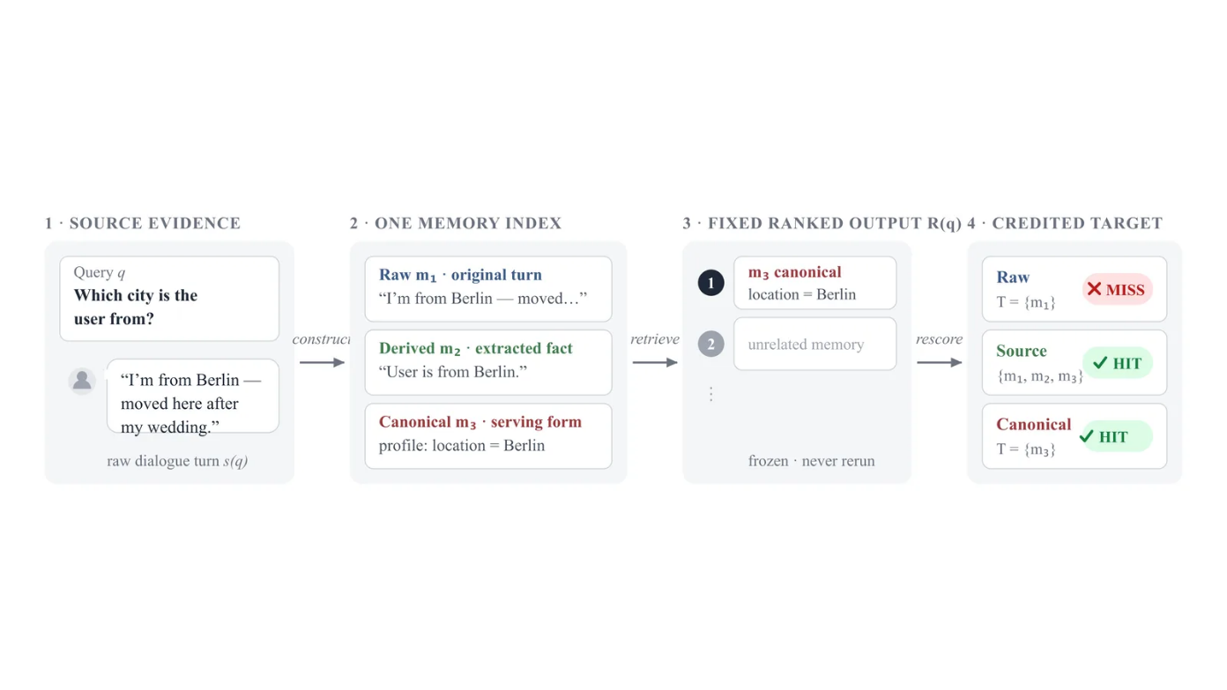


PROJECT
AIMS
Same Ranking, Different Winner
#ConversationalMemory
#Evaluation
The scoring target a memory
benchmark picks can flip which
LLM wins, even when the overall
ranking looks stable.
Same Ranking, Different Winner: How Scoring
Targets Shape LLM Memory Benchmarks
arXiv
Code
Scan for the project page

Slide 6

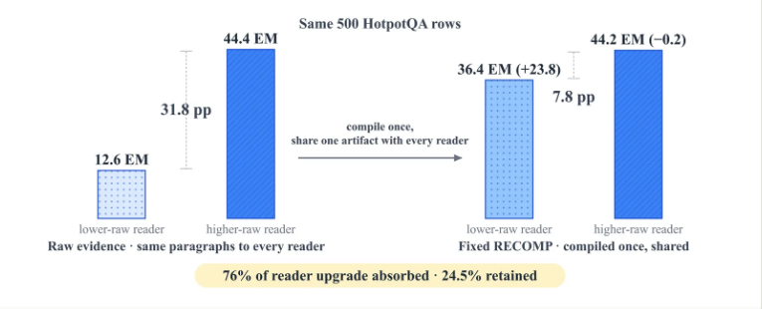








PROJECTS
AIMS
#RAG
#Evaluation
#AIAgents
#TrustworthyAI
#ComputerVision
#FoundationModels
Fixed RAG Compression
Outcome Monitors
Thin-Object Segmentation
A fixed compression layer in a RAG
pipeline collapses the reader-scaling trend
that the uncompressed setup shows.
Recovery affordances that let an agent
notice and repair tool calls that failed
silently.
A cross-domain survey of power-line, crack,
and retinal-vessel segmentation, from
classical pipelines to promptable foundation
models.
Fixed RAG Compression Collapses Measured
Reader Scaling
Outcome Monitors: Recovery Affordances for
Silent Tool Failures
From Classical Pipelines to Promptable
Foundation Models: A Cross-Domain Survey of
Thin-Object Segmentation for Power Lines,
Cracks, and Retinal Vessels
arXiv
Code
arXiv
Paper

Slide 7

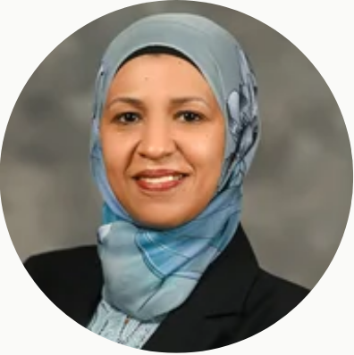

PEOPLE
AIMS
Direction
Dr. Rabab Abdelfattah
Dr. Sarah Lee
Director, AIMS Lab
Director, School of Computing Sciences and
Computer Engineering
School of Computing Sciences and Computer Engineering
University of Southern Mississippi

Slide 8

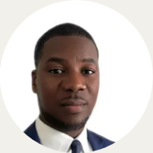

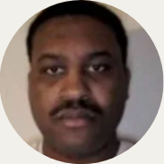


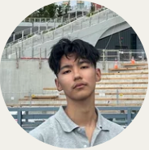
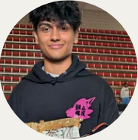
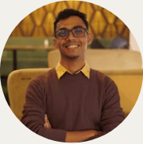
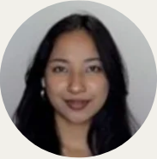
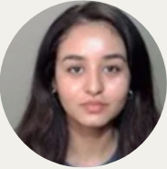
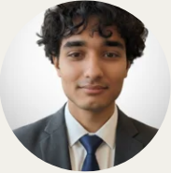
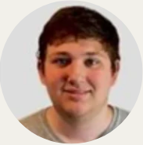

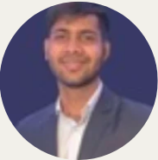
PEOPLE
AIMS
The lab
PhD Students
Olanrewaju
Muili
Siyan Luo
Ticauris
Stokes
Undergraduates
Ashim
Dahal
Sugam
Panthi
Nhoojah
Maharjan
Sakshyam
Sigdel
Muhaiminul
Yeamin
Rashika
Karmacharya
Bishesta
Bohara
Shrabya
Bhattarai
Joshua
Johnston
Alumni
Akram
Hossain
Murad
Hasan
Spring 2026
Spring 2026

Slide 9







PUBLICATIONS
AIMS
Selected papers
From Classical Pipelines to Promptable
Foundation Models: A Cross-Domain
Survey of Thin-Object Segmentation for
Power Lines, Cracks, and Retinal
Vessels
Same Ranking, Different Winner: How
Scoring Targets Shape LLM Memory
Benchmarks
S. Panthi, R. Abdelfattah
Findings of EMNLP 2026 · 2026
A. Hossain, N. Maharjan, M. Hasan, R. Abdelfattah, M.
Ezz-Eldin, X. Wang, M. M. Fouda, K. Abdelfattah
IEEE Internet of Things Journal · 2026
Gaussian Splatting for Real-Time Scene
Reconstruction: Methods, Systems, and Trade-offs
Bayesian Optimization-Aided Hybrid
Deep Learning Model for Lightweight
UAV-Based Smoke Detection
A. Dahal, R. Abdelfattah, N. Rahimi
Pattern Recognition (under major revision) · 2026
R. Abdelfattah, K. Abdelfatah, M. M. Fouda, Z. M.
Fadlullah, M. Abouyoussef, M. I. Ibrahem
IEEE Internet of Things Journal · 2025
Full list: aimsresearchlab.com/publications/

Slide 10






NEWS
Recently
aimsresearchlab.com
github.com/aimsresearchlab
TEC 340 · Hattiesburg, MS
Sep 10, 2026
Lab website launched at aimsresearchlab.com
AIMS
Aug 20, 2026
"Same Ranking, Different Winner" accepted to Findings of
EMNLP 2026
Artificial Intelligence &
Multimodal Systems
Aug 19, 2026
New preprint: "Outcome Monitors: Recovery Affordances for
Silent Tool Failures"
Jun 19, 2026
New preprint: "Fixed RAG Compression Collapses Measured
Reader Scaling"
Mar 18, 2026
New preprint: "Does It Matter Which Gaussians You Pick in 4D
Gaussian Streaming?"

