Slide 1
EmoJourn
Learning in the Open - Case study of a noob and what not to do.

Slide 2

Emojourn
AI Powered Mental Wellness Through Personalized Journal Analysis
Mental Health Challenges
1 in 5 adults experience mental health issues yearly
Limited access to professional support - for whatever reason
High cost or therapy
Stigma surrounding mental health

Slide 3
The Software Solution
Key Features
Secure Journaling
6 Specialize AI Agents
Movie Character Personas
Personalized Metal Health Insights
Progress Tracking
End to End Encryption

Slide 4
Meet the Agents
Yoda: Deep Empathy and Emotional Validation
Dr. Strange: Cognitive Behavioral therapist
Morpheus: Acceptance and Commitment Therapy
Tony Stark: Habit formation and behavior coach
Picard: Goal setting and achievement therapist
The Architect: Orchestrates and Synthesizes insights

Slide 5
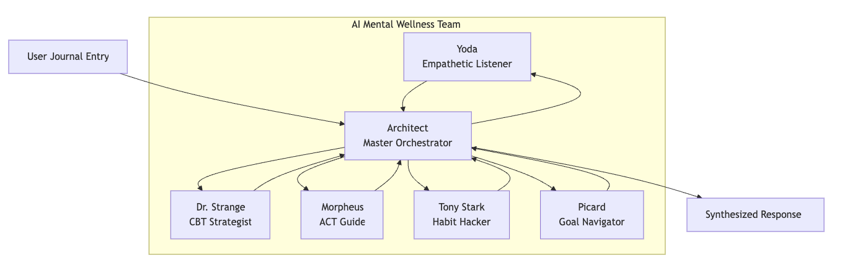
Agent Flow Diagram

Slide 6
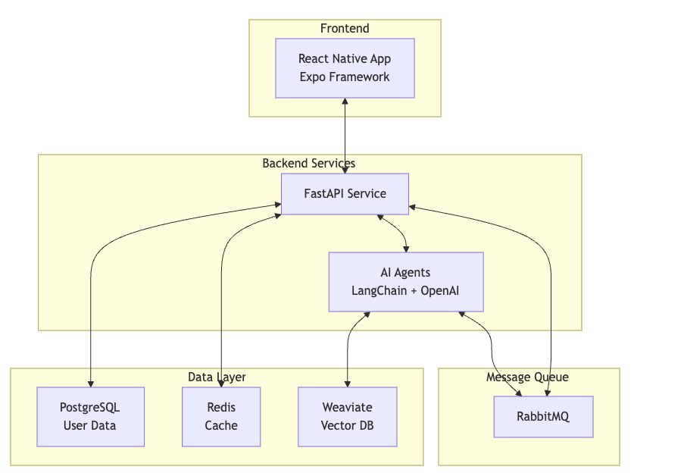
High Level Architecture

Slide 7
Technology Stack
Frontend
Framework: React Native + Expo
State Management: React Context + Hooks
Navigation: React Navigation
Testing: Jest + React Native Testing Libraries
Backend
Framework: FastAPI (Python)
AI/LLM: LangChain + OpenAI GPT-4
Authentication: JWT Tokens
API: RESTful + Websocket
Infrastructure
Containerization: Docker
Message Queue: RabbitMQ
Databases: Postgres, Redis, Weaviate
Deployment: Docker Compose -> Kubernetes (planned)

Slide 8
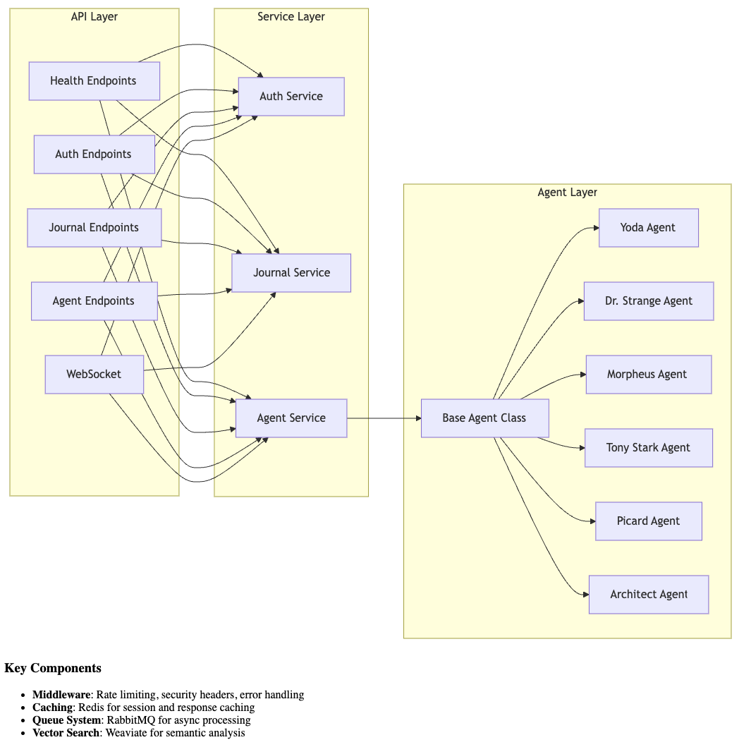
Backend - Deeper View

Slide 9
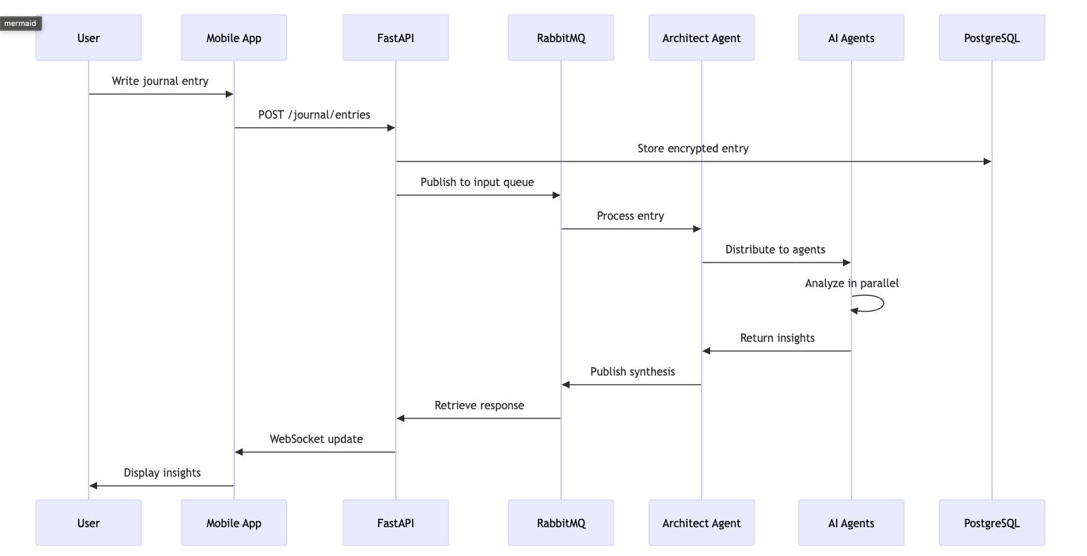
Data Flow and Processing

Slide 10
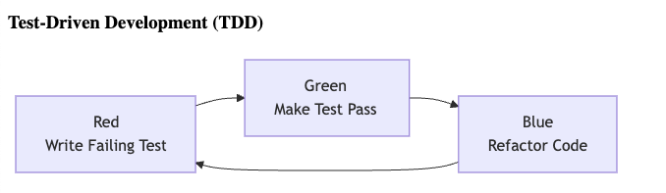
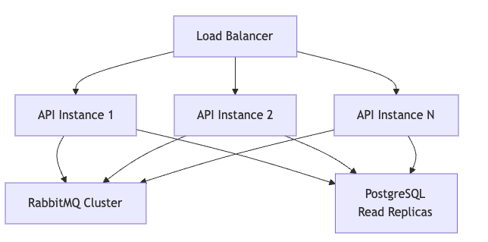
Methodologies
Deployment Considerations
Test Driven Development
How do you scale these agents into the world
How do you support multiple users and multiple sets of agents
Where do you go when the agents start to fail… and they will!
Where do you begin?
How difficult is it to get from agent to completion

Slide 11
Challenges
Challenge 1: Governance
I have learned that governance is one of the most critical aspects of agentic development
Agents like to break the rules, access files outside of the project
Observability, Observability, Observability
DataDog
Fluentd
LangSmith
Process and Disk Isolation
Tooling - The agents will use every tool they can to outsmart your rules

Slide 12
Challenges
Challenge 2: Context and Rules
Even the best laid plans are laid to waste by agents, they will eventually ignore every rule you give them.
When the agents compact the conversation to fit the API data into api sized chunks, they will lose context, rules and design requirements
Regardless of instructions, they will eventually stop using subagents and you will be back to single agents - not actually a bad thing for claudecode

Slide 13
Challenges
Challenge 3: Design Constraints
The agents will eventually lose enough context that they will start duplicating work, and implementations
Even instructions like “Use TDD always” are not enough, The agents may end up mocking your entire service implementations in production to “pass” the tests.
Be explicit: Tell them the frameworks to use, what methodologies and most importantly explain the why…. Treat them like the exceptional children they are

Slide 14
What to do better
Planning
Break up very complex tasks into multiple phases and user stories - use SCRUM to limit the size of the “ask” and therefore limit the issues with lost context on long running tasks.
Utilize architectures that work well with agentic development
GitHub trees
Vertical slice / Horizontal Layers
Regression Management - Implement regression analysis and provide feedback to the agents when they go off script and forget to follow the rules.
Design and Project Management - Implement agents to analyze and maintain the forward progress of the project, given he specific design criteria.
Architecture
Use real agents - not claudecode/windsurf/cursor. Real agents in a running process can be scaled and deployed into modern architecture
Containerize each agent, limit tooling and enforce governance will use of pre-commit hooks and custom tooling
Implement observability for the agents - Automate agent feedback
Costs and Speed
If you can afford it, develop your own local models, running in hardware. Use plugins and custom code to interface with them using AI-UX and other standards to provide a claudecode like interface.

Slide 15
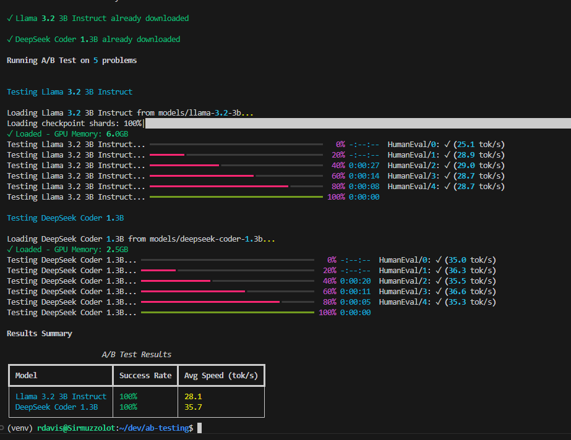
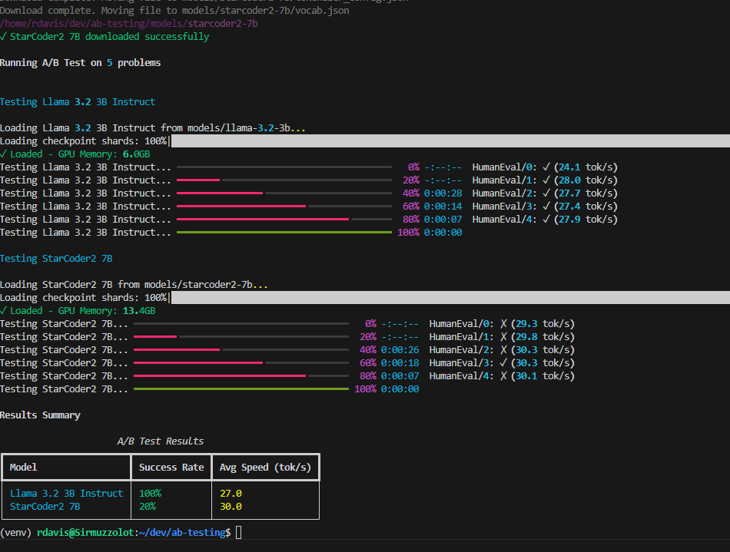
A/B Testing - Real Agents

Slide 16
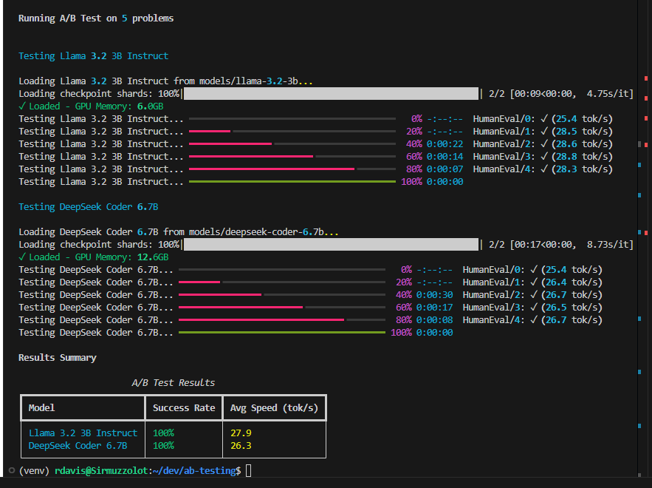
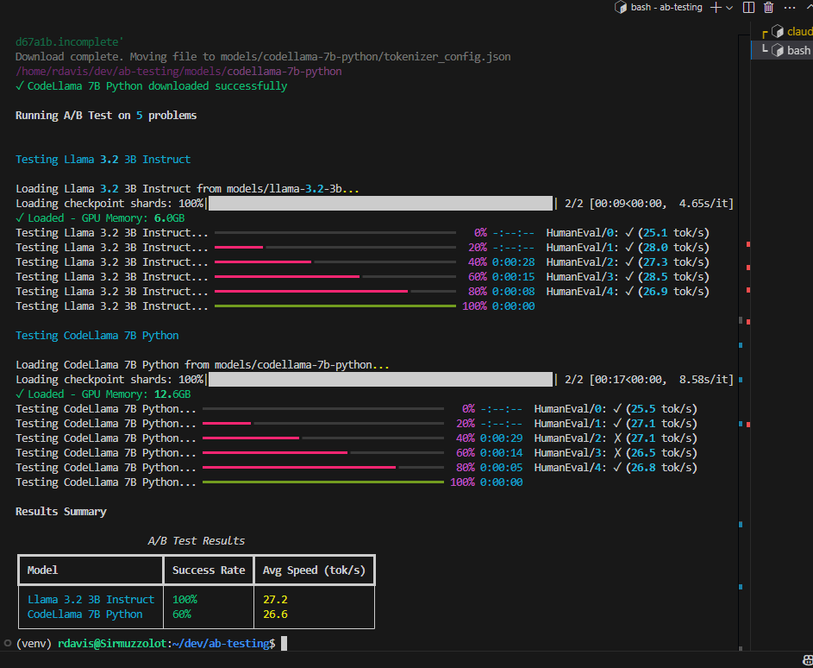
A/B Testing - Real Agents

