Slide 1
MOVEINSYNC HACKATHON 2026 · AGENTIC INTELLIGENCE & REPORTING
Agentic Intelligence &
Reporting Layer for
Enterprise Mobility
A metric without context is just a number. This agent reasons, decides, and
acts on enterprise mobility data — with a human in the loop only where it matters.
Team: [Your Team Name]
Java (Spring Boot) · Angular · PostgreSQL — 100% local Docker demo
1 / 12

Slide 2
THE PROBLEM
A metric without context is just a number
The brief's own example — one dashboard number, two very different reads.
✕
Before — a bare dashboard number
✓
After — this agent's answer
On-Time Arrival Rate
“The fleet on-time arrival rate for the 28-day period was 78.4%, breaching the 90% SLA by 11.6 points and declining 5.0 points versus the prior period. Vendors V1 and V5 were responsible for 71% of all late trips — 44% and 27% respectively — with driver lateness the dominant cause for both.”
78.4%
...and that's it. Is that good? Bad? Who's responsible? A manager still has to pull a report, filter by vendor, and eyeball reason codes to find out.
— real narrated output, captured live from this build (sample-outputs/01)
2 / 12

Slide 3
WHAT WE BUILT
One explicit loop: sense → reason → decide → act
A plain Java pipeline in Spring Boot today - the same named stages become an AWS Step Functions state machine tomorrow, with no redesign.
1
2
3
4
SENSE
REASON
DECIDE
ACT
→
→
→
Scheduler (or a manual
“run cycle now”) triggers a pass
over the canonical schema
Benchmarking (6 KPIs × trend/
SLA/peer) + deterministic
attribution - no LLM yet
Policy tiers the finding:
auto-fire, log internally, or
hold for one human click
Narrated, pushed live to the
dashboard over WebSocket,
written to an audit trail
+ REMEMBER — every decision writes to a Postgres audit trail, so the same issue never re-fires the next cycle
3 / 12

Slide 4
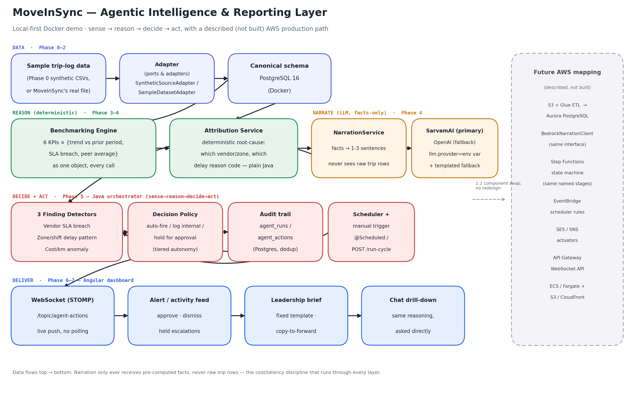
ARCHITECTURE
Local-first Docker stack, with a described AWS production path
4 / 12

Slide 5
DESIGN DISCIPLINE
The LLM only ever phrases facts - it never computes them
This split is what keeps inference cost and latency low and predictable - directly what gets graded, and what survives a flaky venue wifi connection.
1
Deterministic (plain Java + SQL)
2
Narration only (SarvamAI / OpenAI)
6 KPIs, each returned with trend / SLA / peer context as one object - every call, not assembled per-caller
Receives a small pre-computed facts block - never a raw trip row
Attribution: which vendor/zone, which delay reason code - decomposed with plain SQL, fully testable
Provider swapped with one config line (llm.provider=sarvam|openai) - tested both ways before judging
3 finding detectors + a decision policy that tiers autonomy - zero LLM involvement
Any failure (bad key, outage, rate limit) falls back to a templated sentence - the pipeline never breaks
5 / 12

Slide 6
LIVE, ON THIS DATASET
One worked example, end to end
78.4% On-Time Arrival Rate vs 90% SLA • -5.0 pts vs prior period
Real fleet-wide number pulled live from the seeded dataset - see sample-outputs/01-on-time-gap-attribution.json
1
Attribution
2
Decision
3
Narration
4
Delivered
V1: 44% of late trips (-9.0 pts)
V5: 27% of late trips (-8.6 pts)
Both: driver_late dominant
Vendor-facing → held
PENDING_APPROVAL, not
auto-sent
“Vendors V1 and V5 were
responsible for 71% of all
late trips...” (SarvamAI)
Pushed to the Angular alert
feed over WebSocket the
instant it's decided
→
→
→
6 / 12

Slide 7
MINIMAL HUMAN PROMPTING, BY DESIGN
Three findings, three decisions - all from one dataset pass
Not a trigger-happy agent: the decide stage reasons about WHAT action fits a finding, not just whether to fire one.
PENDING_APPROVAL
AUTO_FIRED
LOGGED_INTERNAL
Vendor A / Vendor E - OTA SLA breach
Marathahalli / Night Shift - delay pattern
Vendor B - cost/km creep (+12.6%)
Vendor-facing escalation. Sustained decline (≥3 pt drop) + material share of late trips → drafted in full, held for one human click before it ever reaches a vendor.
Internal, low-stakes, structural (holds across the whole period, not a blip) → posted straight to the ops activity feed. No approval needed.
No fixed SLA to point to, so less certain → opened as an internal billing-review item rather than escalated. Confidence-appropriate, not maximal.
All three verified live, captured in sample-outputs/02-agent-actions-audit-trail.json
7 / 12

Slide 8
ROBUSTNESS
Real exports are messy. This pipeline expects that.
Every planted data-quality issue is flagged and audited on ingestion - never silently dropped, never a crash.
Duplicate trips
Unmatched riders
~0.5% of trip_ids appear twice
~2.5% of trip_employees reference
a missing employee_id
Deduped in every query via DISTINCT ON, not rejected at load
Loaded and flagged in data_quality_issues, not dropped
Incomplete rosters
Missing GPS / timestamps
~4% of employees missing
shift_id / pickup_zone
Sparse GPS traces, null
actual_pickup_time on no-shows
Nullable by design in the canonical schema
Handled as absence-of-signal, not an ingestion failure
8 / 12

Slide 9
ONE REASONING LAYER, THREE SURFACES
Proactive alerts, a leadership brief, and conversational drill-down
Not three separate pipelines - one shared attribution/benchmarking/narration layer, three thin surfaces on top.
1
2
3
Alert / activity feed
Leadership brief
Chat drill-down
Operational manager
Transport & facilities head
Anyone, on demand
Live over WebSocket - no polling, no refresh. Approve or dismiss held escalations with one click.
Fixed-template, no jargon, forward-ready. “Copy brief” produces something genuinely emailable.
“Why did OTA drop?” gets the identical reasoning the alert feed already used - asked directly instead of waited for.
9 / 12

Slide 10
MAPPED TO THE BRIEF
Every evaluation criterion has a concrete, working answer
Feasibility & deployability
docker-compose up - one command, no AWS account or cloud credentials needed to run or judge
Relevance & business impact
Three real planted operational stories found and explained without being told where to look
Technical implementation
Deterministic reasoning / LLM narration split; provider-swappable in one config line; graceful degradation everywhere
Degree of automation
Auto-fires low-stakes findings, drafts and holds vendor-facing ones, deduplicates - genuine tiered autonomy, not a fixed script
Bonus: multiple output forms
Proactive alerts + leadership narrative + conversational chat, over one shared reasoning layer
10 / 12

Slide 11
ROADMAP
Same architecture, production-scale when it's needed
Every local component maps 1:1 to an AWS-managed equivalent behind the same interface - described in the architecture document, deliberately not built for this demo.
PostgreSQL (Docker)
→
Aurora PostgreSQL
Java orchestrator
→
Step Functions state machine
@Scheduled triggers
→
EventBridge Scheduler rules
SarvamAI / OpenAI client
→
BedrockNarrationClient (same interface)
Mocked/logged actuators
→
SES (email) / SNS (push)
Spring STOMP WebSocket
→
API Gateway WebSocket API
11 / 12

Slide 12
THANK YOU
A metric without context
is just a number.
This agent gives it one - and acts on it, with minimal human prompting.
Try it now:
docker-compose up --build → http://localhost:4200
No AWS account, no cloud credentials, no external dependency but an LLM API key (falls back gracefully without one).
12 / 12

