Slide 1
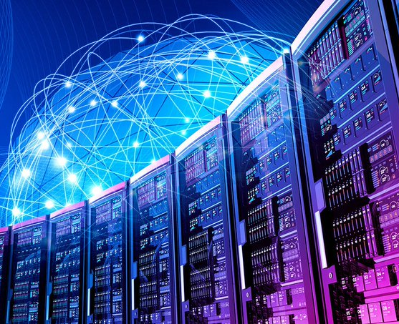


DSC650: Data Technology and Future Emergence
Lecture 6 : Searching & Indexing Big Data
Dr. Khairul Anwar Sedek
Faculty of Computer and Mathematical Sciences
Universiti Teknologi MARA
Perlis Branch

Slide 2
  Lecture 6: Searching & Indexing Big Data
  Full Text Indexing and Searching
  Indexing with Lucene
  Distributed Searching with Elastic Search
At the end of the lecture, students should be able to;
CLO1: Demonstrate an understanding on the basic concepts and practices of big data technology
Source:
Shahi, D. (2015) Apache Solr: A Practical Approach to Enterprise Search. Apress.

Slide 3

Search
Search is ubiquitous and has become part of our digital life!
Open an e-commerce web site, and the search box appears right at the center or top of the page.
Basically, every portal that has data to expose needs a search engine.

Slide 4

How Search Works

Slide 5

Search Engines
Search engines are one of the most widely used implementations of information retrieval systems.

Slide 6
Search Engines categories
Web search:
This crawls through the World Wide Web, extracts the contents from HTML tags, and indexes the information to make it searchable.
Some engines also crawl for images and other associated files, and before indexing process the text for other interesting information and links.
DuckDuckGo is a typical example of a web search engine developed using Solr.
Vertical search:
Vertical search addresses a specific domain, an area of information or industry such as healthcare or finance.
The information is generally available in a primary database or data source such as a Word document or PDF file.
Desktop search:
This is designed to index the files in a user's PC and make it searchable. Some search engines also index the file content along with the metadata to make it searchable. Spotlight in Mac OS X is a typical example.
Others:
Information retrieval is no longer limited to text and is being widely used for searching image, audio fingerprints, and in speech recognition.

Slide 7
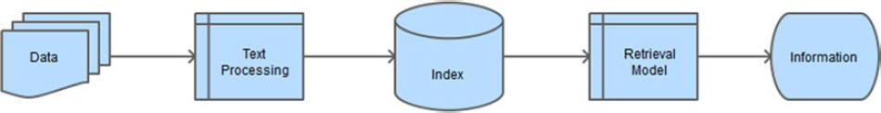
Search Engines
A search system
The goal of any information retrieval system is to turn data into actionable information that satisfies the users' needs.
In case of search engines, information pertains to relevant documents that are retrieved for search requests.

Slide 8
Solr and Lucene
Solr (pronounced solar), is an enterprise-ready, blazingly fast, and highly scalable search platform built using Apache Lucene.
Solr is written in Java and runs as a stand-alone server.
Apache Lucene is a popular open-source search library written entirely in Java.
It is widely used for indexing a large collection of documents and supporting full-text search.

Slide 9
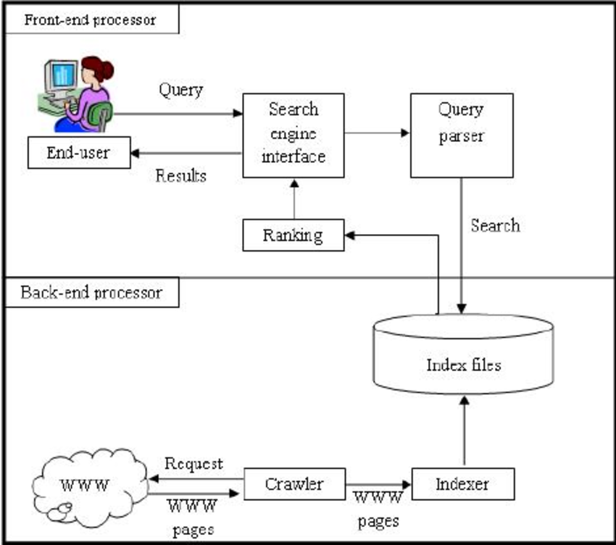
Architecture and main components of standard search engine model.
https://www.researchgate.net/publication/220717128_A_web_search_engine_model_based_on_index-query_bit-level_compression

Slide 10
History - Solr and Lucene
Solr 1.x: This was an enterprise-ready version of the product.
Solr 1.3 was released in January 2007. Solr 1.4 was released in November 2009 with enhancements to indexing, searching, replication, and rich document indexing and better database integration.
Solr 3.x: In March 2011, development of Solr and Lucene projects merged, so there was no 2.x version of Solr.
The next release of Solr was directly labeled 3.1 to match the Lucene version. Solr 3.x was focused on feature additions such as spatial search, and integrations such as UIMA for processing pipelines, Velocity for the UI, and so on.
Solr 4.x: Solr 4.0 was primarily about distributed search and about SolrCloud making Solr even more reliable, fault-tolerant, and scalable.
Solr 5.x: Solr 5.0 was released in February 2015 with a focus on ease of use and hardening.
Recent releases have focused on security, analytics and extending the APIs. Refer to the next section for details.
Most recent Apache Solr 8.5.1 (May 2020)
In March 2019
Solr nodes can now listen and serve HTTP/2 requests
Solr 7.0 released in Sept 2017
dded support multiple replica types, auto-scaling, and a Math engine.
including the new SolrCloud feature

Slide 11
Lucene vs Solr
A simple way to conceptualize the relationship between Solr and Lucene:
  Solr is that of a car
  and its engine is Lucence.
You can't drive an engine, but you can drive a car.
Similarly, Lucene is a programmatic library which you can't use as-is, whereas Solr is a complete application which you can use out-of-box.

Slide 12
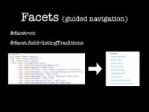
Introducing Apache Solr

Slide 13

Apache Solr

Slide 14
Major Building Block/Components
Request Handler:
All the requests that you make to Solr are processed by one of the classes implementing SolrRequestHandler.
You configure the handler to map to a specific URI endpoint, and the requests made to this endpoint start getting served by it.
Search Component:
A search component defines the logic to implement the features provided by the search handler.
These components should be registered in a SearchHandler, a request handler which serves the user query.
For example, features such as query, spell-checking, faceting, and hit-highlighting are implemented as components and are registered to SearchHandler.
Multiple components can be registered to a search handler.
Query Parser:
This translates the user query into instructions that Lucene understands.
They are generally registered in the SearchComponent, a component that defines the logic for performing a search.

Slide 15
Lucence Major Building Block/Components
Similarity:
This class determines how Lucene weights terms and scores a document.
If you want to change the scoring behavior, this is the class to extend.
Response Writer:
This decides how the response to the user query should be formatted.
For each response type such as XML, JSON, or Velocity, there exists a separate response writer.
Analyzer/tokenizer:
The smallest unit of data that Lucene understands is a token.
The implementations of Analyzer, tokenizer or TokenFilter decide how to break the text into tokens.
Update Request Processor:
While indexing your document, you can invoke a set of UpdateRequestProcessor as part of your chain to perform custom actions upon your data.

Slide 16
Information Retrieval Component & Process
Text/context extraction
Document preparation
Post and commit
Document preprocessing
Field analysis
Index

Slide 17
Information Retrieval Component & Process: Solr Indexing Process
Text extraction:
  to extract the text for indexing.
  The text can be acquired, for example, by reading files, querying databases, crawling web pages, or reading RSS feeds. Extraction can be performed by your Java client application or Solr components.
Document preparation:
  The extracted text should be transformed into a Solr document for ingestion.
  The prepared document should adhere to the native format specified, for example, for XML or JSON.
Post and commit:
  During this process, you post the document to the appropriate Solr endpoint with required parameters.
  Solr - provided extraction capabilities are performed based on the endpoint you invoke.
Document pre-processing:
  You might want to do clean-up, enrichment, or validation of text received by Solr.
Field analysis:
  Field analysis converts the input stream into terms.
  This step refers to the analysis chain of analysers, tokenizers and token filters that are applied on the fieldType definition, which you read about in the previous chapter.
Index:
  The terms output from field analysis are finally indexed; the inverted index is created.
  These indexed terms are used for matching and ranking in search requests.
  After you trigger the post operation (mentioned in Step 3), the pre-processing and field analysis defined in Solr will be triggered automatically and documents will be indexed.

Slide 18
Information Retrieval Component & Process: Context extraction
File Formats | Open Source Tools
PDF | Apache POI Apache PDFBox
Microsoft Word/Excel/PowerPoint | Apache POI Apache OpenOffice
HTML | jsoup HTMLCleaner
XML | Apache Xerces Java Architecture for XML Binding (JAXB) Dom4j Many other SAX and DOM parsers are available Solr DataImportHandler
OCR | Tesseract
Geospatial | Geospatial Data Abstraction Library (GDAL)
E-mail | JavaMail API
Web crawling | Apache Nutch
is the first process in information flow.
In this process, you extract the content from the data source and convert it into indexable documents.
In Solr, the process can be performed inside it or in the client application that indexes the documents.

Slide 19

Information Retrieval Component & Process: Text Processing
Raw documents received from the database or text extracted from binary documents, require processing before being indexed.
The processing tasks can be for cleansing, normalization, enrichment, or aggregation of text.
  The processes are generally chained together to achieve the desired output, and the pipeline depends on your processing needs, which varies depending on the nature and quality of data and the desired output.
In Solr, text processing can be performed at two steps, by the analysis process and update request processors.
  The purpose of these steps is to address various text-processing needs.
The analysis process caters to individual field-level tokenization and analysis,
update request processor is for other text-processing needs and is scoped to the entire document.
  Update request processors are also called preprocessors or document processors.

Slide 20
Information Retrieval Component & Process: Text Processing
Cleansing and Normalization
  Not all data is important, and some important data needs normalization and transformation before being indexed.
  Common cleansing and normalization tasks include removal of punctuation marks, removal of stop words (a, the), lowercasing, conversion to the nearest ASCII character, and stemming.

Slide 21
Information Retrieval Component & Process: Text Processing
Text enrichment
  Text enrichment is the phase of analysing and mining of content to find patterns for enrichment, annotation, entity extraction, and applying a variety of intelligence to make the content more usable, understandable, and relevant
  Entity extraction: If the content being indexed is unstructured, or any of the fields is full-text, you may want to extract entities such as person, organization, and location and annotate the content.
  Part-of-speech tagging: Words in any language can be classified as a predefined part of speech
  Thesauri Ontologies: An ontology is a formal representation of concepts and its relationships

Slide 22
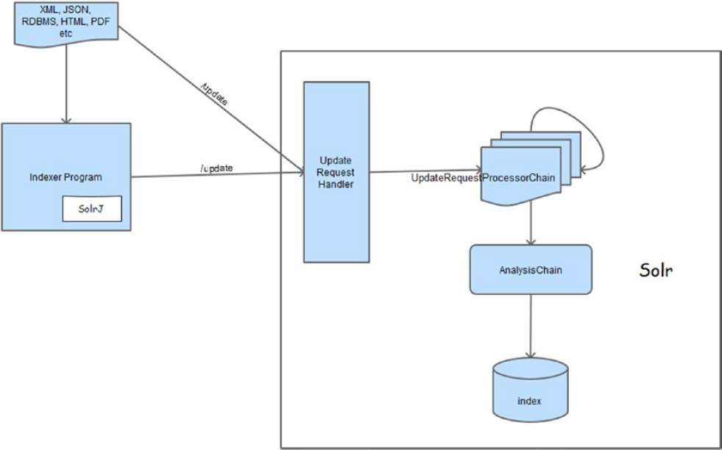
Information Retrieval Component & Process: Solr Indexing Process

Slide 23
Information Retrieval Component & Process:
Inverted Index
The data extracted from your data source should be indexed for fast and accurate retrieval.
Solr internally uses Lucene, and when you add documents, it creates an inverted index to make the information searchable.
An inverted index is the primary data structure in a typical search engine, which maintains a dictionary of all the unique terms and mapping to all the documents in which they appear.
Each term is a key, and its value is a postings list, which is the list of documents the term appears in.
An inverted index is similar to the index at the end of a book, which contains a list of words and corresponding pages in which the words occur.

Slide 24
Information Retrieval Component & Process:
Retrieval Models
Retrieval Models
  To search relevant documents, you need a retrieval model.
  A retrieval model is a framework for defining the retrieval process by using mathematical concepts.
    Boolean Model
    Vector Space Model
    Probabilistic Model
    Language Model
  It provides a blueprint for determining documents relevant to a user need, along with reasoning of why a document ranks above another.

Slide 25

ElasticSearch
Elasticsearch is a popular and widely used open source search engine since its release 2010.
Both Solr and Elasticsearch are built on top of Lucene
Solr aces Elasticsearch in terms of Lucene -development of Solr and Lucene are merged, Solr always has the same version as Lucene.
Solr is more focused on text search and supporting features.
But when it comes to analytics and monitoring, Elasticsearch excels.

Slide 26
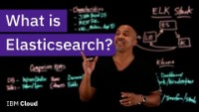
What is Elasticsearch?

Slide 27
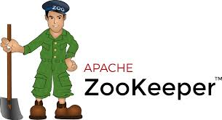


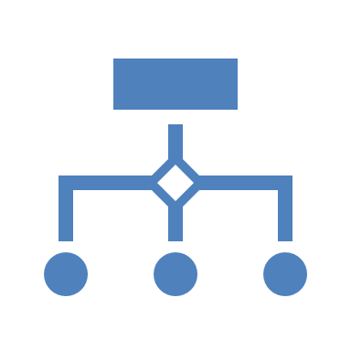

Related Technologies
Apache ZooKeeper:
This controls the heartbeat of SolrCloud. It is a central service for maintaining cluster configurations, store statuses, and synchronization information in a fault-tolerant and highly available manner. For SolrCloud to function, at least one ZooKeeper instance should be up and running.
Apache OpenNLP:
This is a Java library for natural language processing of text. It supports tasks to understand and interpret text written in human languages.
Apache UIMA:
If your data is unstructured, the Solr UIMA contrib module can be used to give structure to the data. UIMA allows us to define a custom pipeline for analyzing a large volume of unstructured text and annotating the extracted metadata, which can be added to Solr fields.
Carrot clustering:
You can cluster your similar or semantically related search results together by using Carrot2, and you can do so with just a few changes in your XML configuration.
Apache Tika:
This toolkit provides a framework for parsing and extracting contents and metadata from files in many different formats such as Word, PPT and PDF. Solr provides a Solr Cell framework which uses this toolkit for indexing contents and metadata from such files.

