Slide 1







ANSIBLE – An Introduction
Abhishek Inani
Harleen Kaur

Slide 2
Agenda
Introduction - What is Ansible ?
Why Ansible?
Ansible Vs Other CM tools
Ansible - Use Cases
Ansible Architecture - How Ansible Works?
Ansible Terminologies/Concepts
Ansible – Playbooks
Ansible – Role
Ansible in PadTec (Ekinops) Project
Demo
Integration with Jenkins
Ansible Popularity (2017 Community Review)
References
Q & A
Copyright @ Altran Technologies India Pvt. Ltd 2019. All rights reserved.

Slide 3

Introduction – What is Ansible ?
An opensource configuration management and provisioning tool
Simply written over Python and supports SSH to complete any task locally or remotely
Ansible lets you control and configure nodes from a single machine
Ansible, Inc. (originally AnsibleWorks, Inc.) was the company set up to commercially support and sponsor Ansible
Ansible was founded by Michael DeHaan in 2013 and later bought by RedHat in 2015
Ansible Tower (formerly ‘AWX’) is a web-based solution that makes Ansible even more easy to use. Tower is a commercial product.
Copyright @ Altran Technologies India Pvt. Ltd 2019. All rights reserved.

Slide 4

Why Ansible ?
Simple, powerful and tiny learning curve
Agent-less – No need for agent installation and management
Secure – SSH based connection
Highly flexible and configuration management of systems.
Large number of ready to use modules available
Declarative – Tasks are written in declarative way instead of procedural way
Idempotent – Many inbuilt modules are intelligent enough to not repeat the same task if it’s state is already completed
Copyright @ Altran Technologies India Pvt. Ltd 2019. All rights reserved.

Slide 5
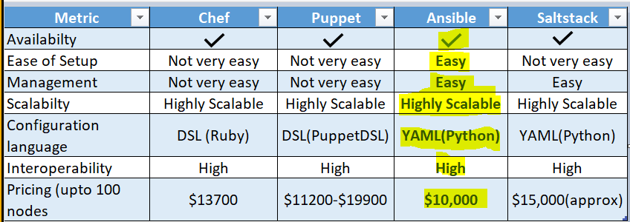
Ansible vs Other CM tools
Copyright @ Altran Technologies India Pvt. Ltd 2019. All rights reserved.

Slide 6
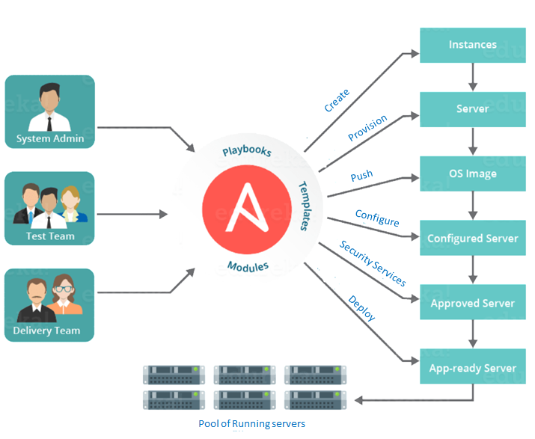
Ansible- Use Cases

Slide 7

Ansible- Use Cases
Provisioning Example: install apache on a server
Configuration Management Example: Changing properties files in a server
Orchestration
Example: Provisioning, configuration management on multiple servers
App Deployment
Example: Installing end-to-end application
Security
Example: Role based access control (e.g. admin and test users) provided by Ansible Tower
Continuous Delivery
Example: Integration with Jenkins pipeline
Ad hoc commands
Command blaster: Easy to write, user can run commands across multiple hosts.
Service license agreements: Mistakes cost time and money. Ansible eliminate errors that can crop up in detailed software contracts.
Example: Down time multiple production sites can be reduced exponentially

Slide 8
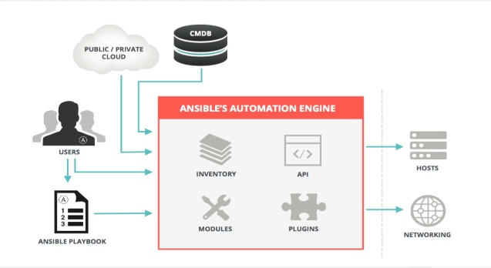
Ansible Architecture - How Ansible Works?
User writes playbooks (YAML) or Ad hoc commands
Ansible read these playbooks or ad hoc commands and extract the related modules to perform these tasks
Reads hosts/nodes from inventory file and push commands in form of “Ansible Modules” to these hosts
Executes these modules (over SSH by default)
Copyright @ Altran Technologies India Pvt. Ltd 2019. All rights reserved.

Slide 9
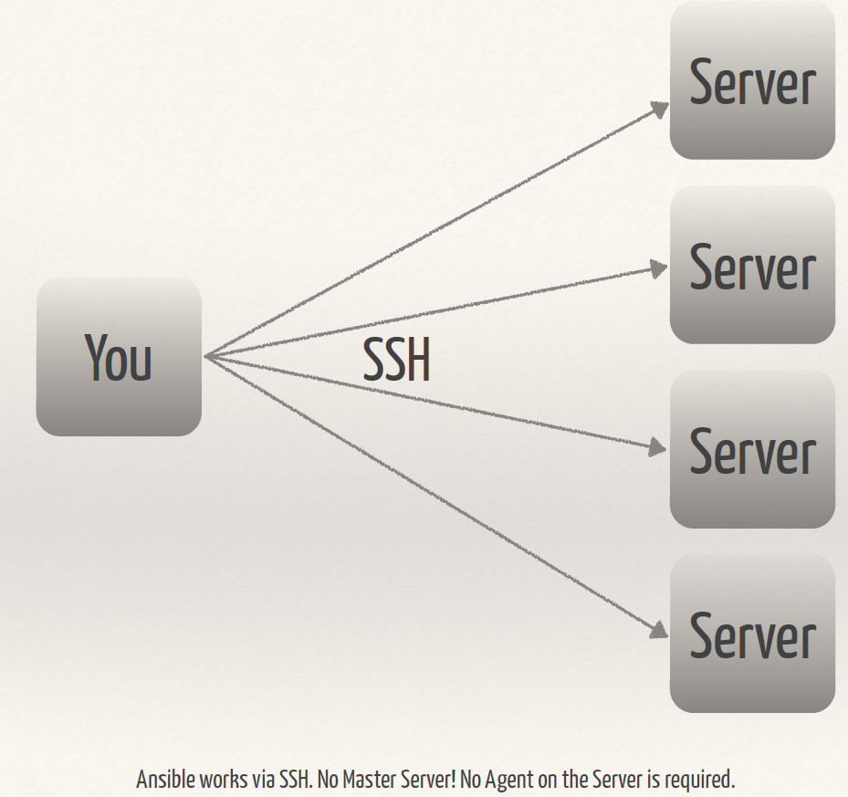

Ansible Architecture (Simplified)
Copyright @ Altran Technologies India Pvt. Ltd 2019. All rights reserved.

Slide 10
Ansible Terminologies/Concepts
Inventory Simple text file where you declare the list of hosts, groups and hosts/groups variables
Modules Ansible ships with a number of modules (called the 'module library') that can be executed directly on remote hosts or through Playbooks. There are over 1000 modules provided by Ansible to automate every part of the environment. Users can also write their own modules
Playbooks – Play, Tasks and Modules
A playbook is a yaml file where you run series of tasks on the hosts.
Variables
Ansible provides a mechanism to declare variables and use them further in any other playbooks
Roles
Roles are ways of automatically loading certain vars_files, tasks, and handlers based on a known file structure. Grouping
content by roles also allows easy sharing of roles with other users.
Copyright @ Altran Technologies India Pvt. Ltd 2019. All rights reserved.

Slide 11
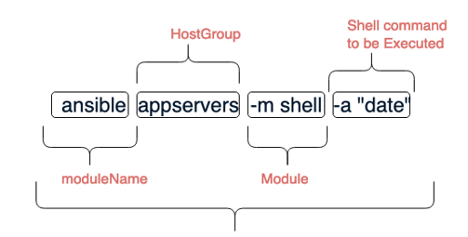
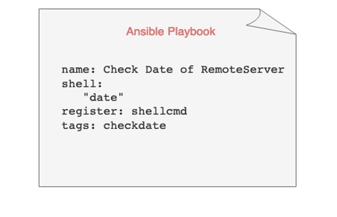
Ad Hoc Command
CLI & Playbook
Playbook
Copyright @ Altran Technologies India Pvt. Ltd 2019. All rights reserved.

Slide 12
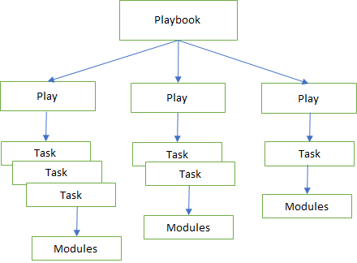
Ansible Playbooks
A playbook is consists of multiple plays
A play consists of at-least task
A task is nothing but just a call to an ansible module
Playbooks are simple YAML format
In a nutshell, Playbook is just collections of multiple tasks targeted to a particular hosts groups from inventory
Copyright @ Altran Technologies India Pvt. Ltd 2019. All rights reserved.

Slide 13
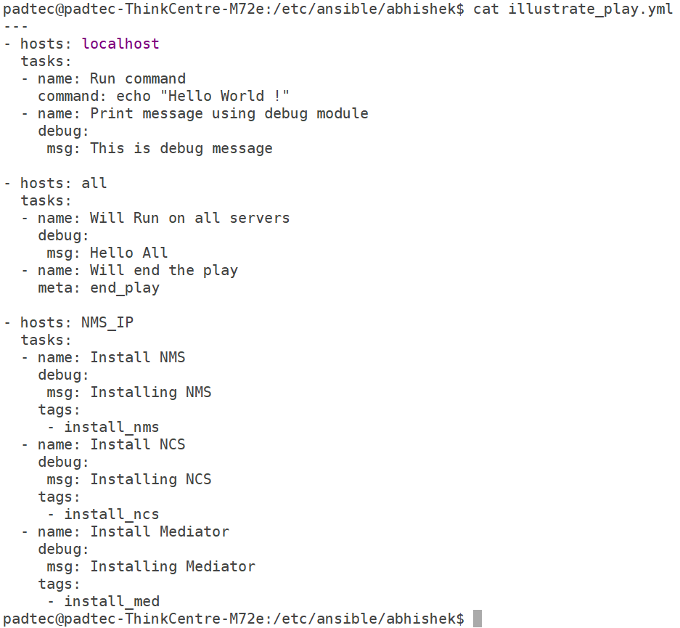
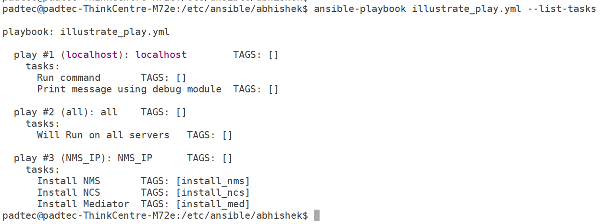
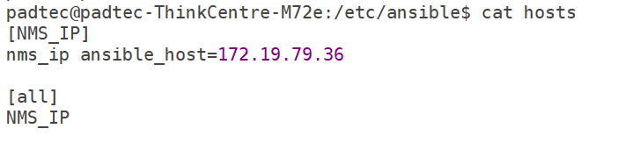
Playbooks – Plays, Tasks, Modules and Tags
Copyright @ Altran Technologies India Pvt. Ltd 2019. All rights reserved.

Slide 14

Ansible Roles
Roles are collection of tasks / handlers used to tackle larger set of tasks - e.g. uninstall, setup, install, configure
Roles simplifies writing complex playbooks, and it makes them easier to reuse.
Each role is limited to a particular functionality or desired output
Copyright @ Altran Technologies India Pvt. Ltd 2019. All rights reserved.

Slide 15
PNMS installation automated through Ansible playbooks and running successfully on Multiple Single node servers
Device Cleanup and verification automated through Ansible playbooks and running successfully for multiple devices.
Ansible has been integrated with Jenkins pipeline as part of Continuous Delivery
Ansible Use Cases in PadTec
PNMS installation automation on different nodes
Card Cleanup for Devices (CC, LC, SC etc) can be automated
Installation and upgrades of Cards (CC, LC, SC etc)
Yocto Image upgrade (Feasibility study needed)
Future plans in PadTec
Copyright @ Altran Technologies India Pvt. Ltd 2019. All rights reserved.

Slide 16
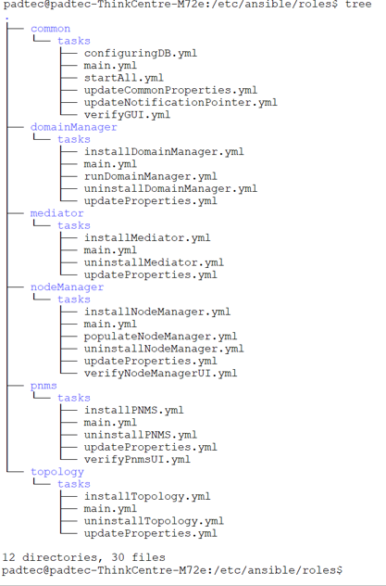
Ansible in PadTec (Ekinops) Project
Copyright @ Altran Technologies India Pvt. Ltd 2019. All rights reserved.

Slide 17

Copyright @ Altran Technologies India Pvt. Ltd 2019. All rights reserved.

Slide 18
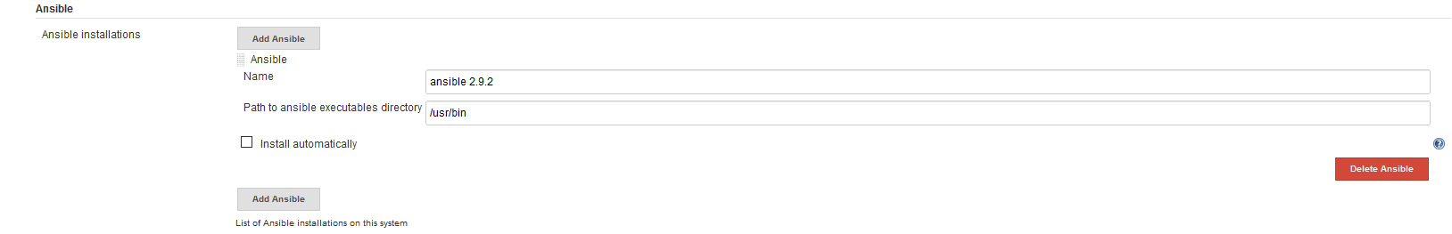
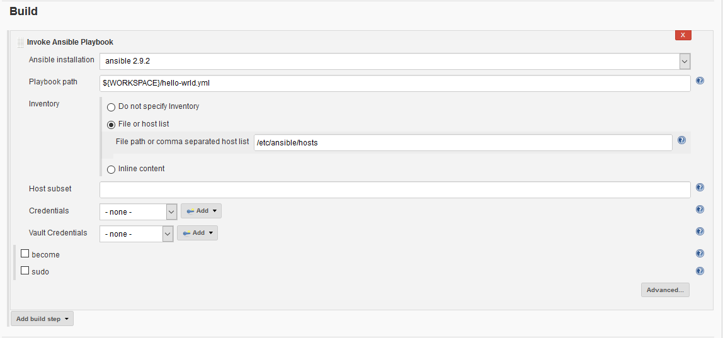
Integration with Jenkins (CI tool)
Install Ansible plugin for Jenkins https://plugins.jenkins.io/ansible
Add Ansible in Jenkins as Ansible Installation : Jenkins → Manage Jenkins → Global Tools configurations
Configure installed Ansible in Jenkins job
Copyright @ Altran Technologies India Pvt. Ltd 2019. All rights reserved.

Slide 19
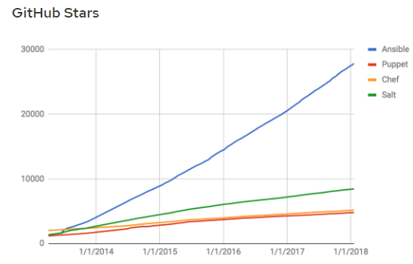
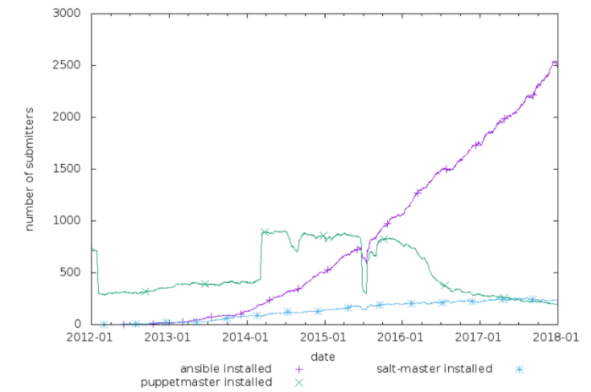
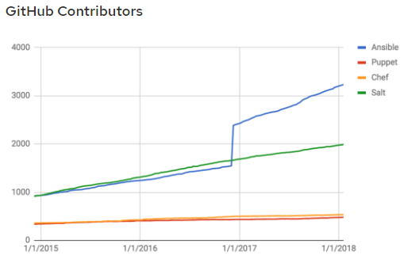
Ansible Popularity (2017 Community Review)
Copyright @ Altran Technologies India Pvt. Ltd 2019. All rights reserved.

Slide 20
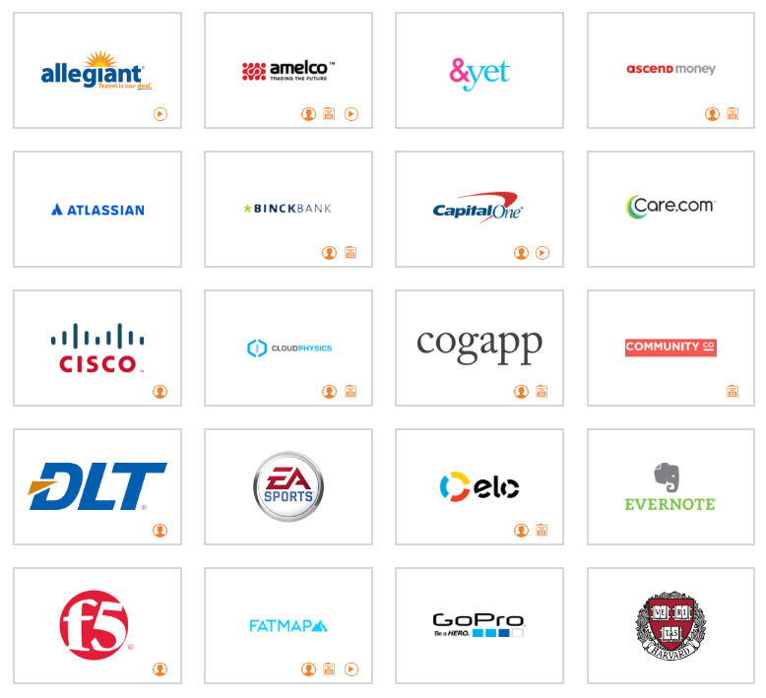

Companies using Ansible
Copyright @ Altran Technologies India Pvt. Ltd 2019. All rights reserved.

Slide 21
References
https://docs.ansible.com
Everything about Ansible is available under single umbrella, Ansible’s official documentation.
Ansible Community – Most popular and active community
https://www.ansible.com/blog/2017-community-year-in-review
Every year they review the Ansible progress and challenges
Ansible Galaxy is a free site for finding, downloading, and sharing community developed roles.
https://galaxy.ansible.com/
Copyright @ Altran Technologies India Pvt. Ltd 2019. All rights reserved.

Slide 22


Slide 23
Get /applause HTTP/1.1
200 OK Thank you!

