Slide 1
Ansible Introduction
    Presented By
    - Avinash Pawar

Slide 2
Agenda
1. Ansible Introduction
2. Why Ansible?
3. Ansible Architecture / How Ansible Works?
4. Ansible Components/Concepts
5. Ansible – Playbooks
6. Ansible – Role
7. Demo

Slide 3

Introduction - What is Ansible?
“ Simple, agent-less and powerful open source IT automation Tool ”
Provisioning
Configuration Management
Application Deployment
Continuous Delivery
Security & Compliance
Orchestration
Products:
Ansible CLI
Ansible Tower

Slide 4
Why Ansible?
It is very simple and powerful
Agent-less – No need for agent installation and management
Secure – SSH based connection
Python / yaml based
Highly flexible and configuration management of systems.
Large number of ready to use modules available for system management
Custom modules can be added if needed
Human readable & Self documenting
Idempotent

Slide 5
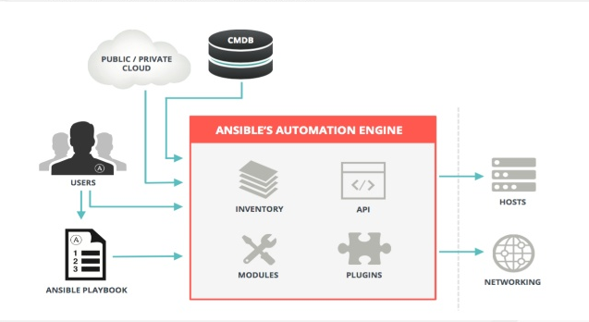
How Ansible Works?
Ansible works by connecting to your nodes and pushing out small programs, called “Ansible Modules” to them. Ansible then executes these modules (over SSH by default) and removes then when finished.

Slide 6
Ansible Components/Concepts
Inventory
File where you declare the list of hosts and groups
Modules
Ansible ships with a number of modules (called the 'module library') that can be executed directly on remote hosts or through Playbooks. Users can also write their own modules
Playbooks – Play, Tasks and Modules
A playbook is a yaml file where you run series of tasks on the hosts
Variables
Ansible provides a mechanism for overriding variables.
Templates
Templates are a powerful resource for generating files on the hosts. A template will have a common structure and it will be populated with specify variable values at runtime.
Roles
Roles are ways of automatically loading certain vars_files, tasks, templates, and handlers based on a known file structure. Grouping content by roles also allows easy sharing of roles with other users.

Slide 7
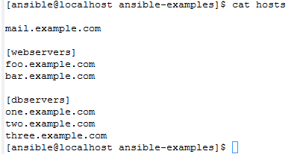
Inventory / Host file
Group
Hosts/Nodes

Slide 8
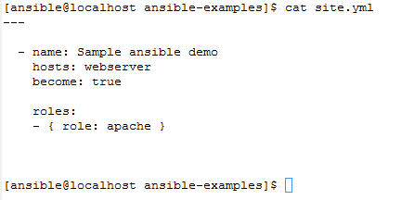
Playbook Structure
Play
Role

Slide 9
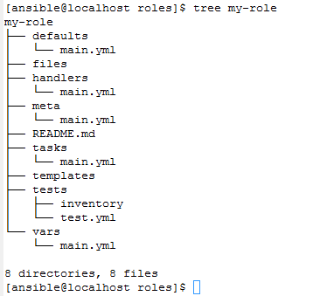
Roles Directory Structure

Slide 10
Demo…

Slide 11
Thank you…

