Slide 1

An Introduction
Abhishek Inani Harleen kaur

Slide 2
Agenda
Introduction - What is Ansible ?
Why Ansible?
Ansible Vs Other CM tools
Ansible - Use Cases
Ansible Architecture - How Ansible Works?
Ansible Terminologies/Concepts
Ansible – Playbooks
Ansible – Role
Ansible in PadTec (Ekinops) Project
Integration with Jenkins
Ansible Popularity (2017 Community Review)
References
Demo
Q & A

Slide 3
Introduction – What is Ansible ?
An opensource configuration management and provisioning tool
Simply written over Python and supports SSH to completes any tasks locally or remotely
Use case: Continuous Delivery (in DevOps)

Slide 4
Why Ansible ?
Simple, powerful and tiny learning curve
Agent-less – No need for agent installation and management
Secure – SSH based connection
Highly flexible and configuration management of systems.
Large number of ready to use modules available
Declarative – Tasks are written in declarative way instead of procedural way
Idempotent – Many inbuilt modules are intelligent enough to not repeat the same task if it’s state is already completed

Slide 5
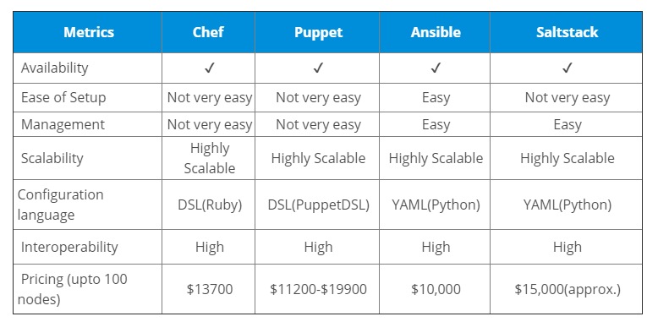
Ansible vs Other CM tools

Slide 6
Ansible – Use Cases
Provisioning Ex: install httpd in 100 servers
Configuration Management Ex: Changing several properties files in 100 servers
App Deployment
Continuous Delivery
Orchestration

Slide 7
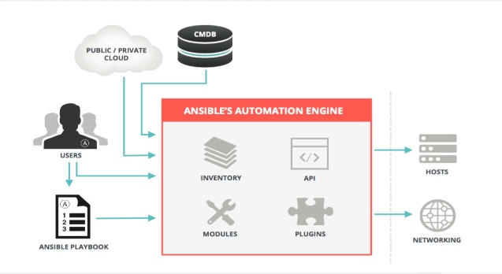
Ansible Architecture - How Ansible Works?
User writes playbooks (YAML) or Ad hoc commands
Ansible read these playbooks or ad hoc commands and extract the related modules to perform these tasks
Reads hosts/nodes from inventory file and push commands in form of “Ansible Modules” to these hosts.
Executes these modules (over SSH by default) and removes when task is finished.

Slide 8
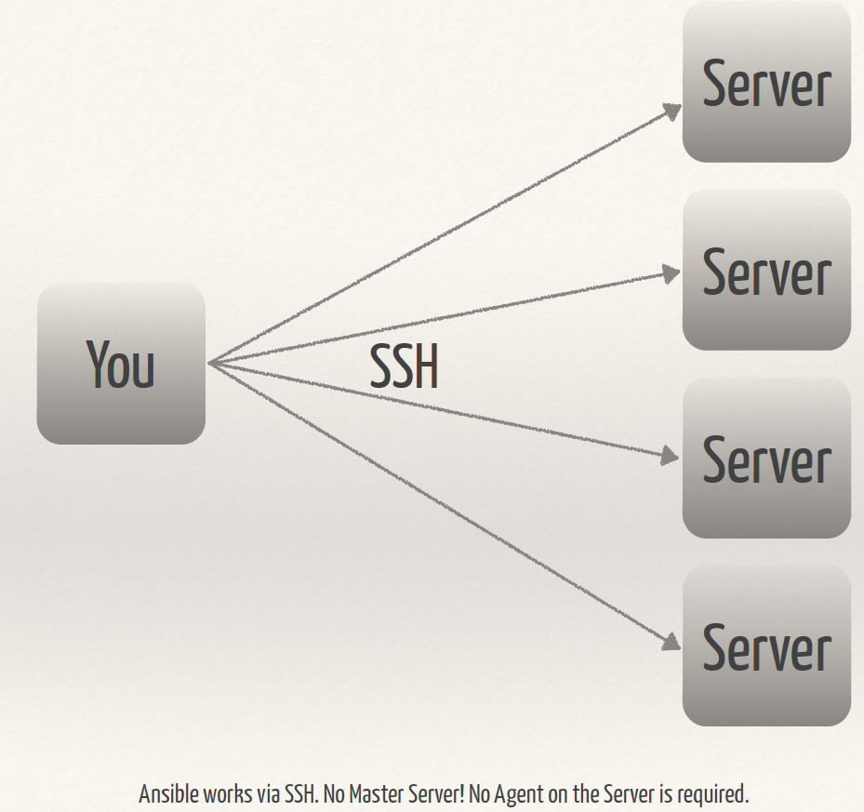
Ansible Architecture (Simplified)
Ansible Master
Ansible master node will connect to all other target nodes via ssh. So for that we need to share ssh keys between ansible master to target nodes.

Slide 9
Ansible Terminologies/Concepts
Inventory Simple text file where you declare the list of hosts, groups and hosts/groups variables
Modules Ansible ships with a number of modules (called the 'module library') that can be executed directly on remote hosts or through Playbooks. Users can also write their own modules
Playbooks – Play, Tasks and Modules
A playbook is a YAML file which consists of multiple plays. Each play will have at least one task.
Variables
Ansible provides a mechanism to declare variables and use them further in any other playbooks
Templates
Templates are a powerful resource for generating files on the hosts. A template will have a common structure and it will be populated with specify variable values at runtime.
Roles
Roles are ways of automatically loading certain vars_files, tasks, templates, and handlers based on a known file structure. Grouping content by roles also allows easy sharing of roles with other users.

Slide 10
Ansible Playbooks
A playbook is consists of multiple plays
A play is consist of at least task
A task is nothing but just a call to an ansible module
So, Playbook is just collections of multiple tasks targeted to a particular hosts groups from inventory
Playbooks are expressed in YAML format

Slide 11
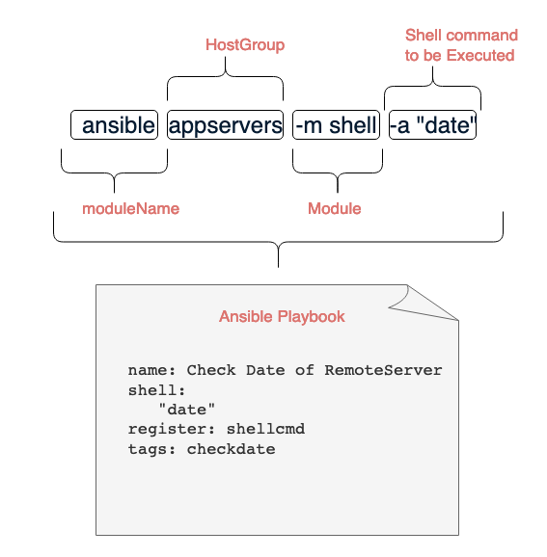
CLI & Playbook
Ad Hoc Command
Playbook

Slide 12
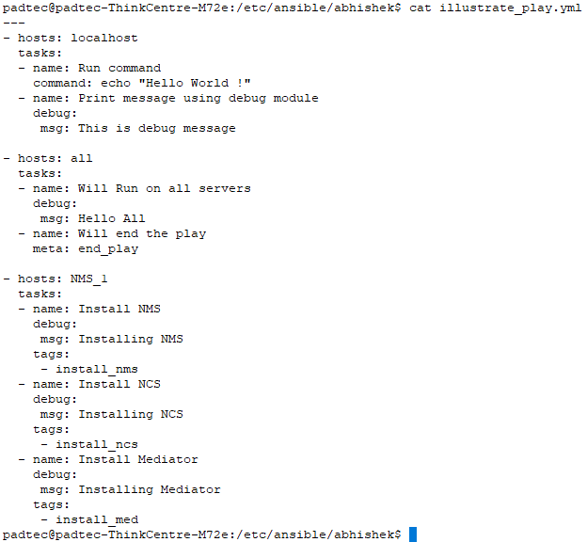
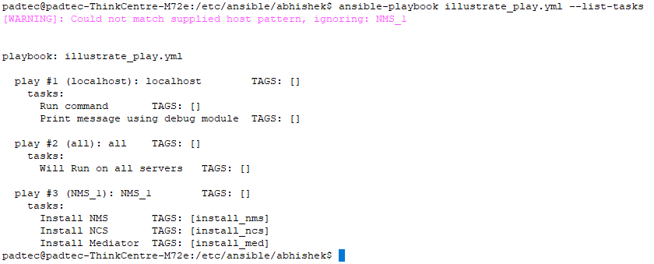
Playbooks – Plays, Tasks and Tags

Slide 13
Ansible Roles

Slide 14
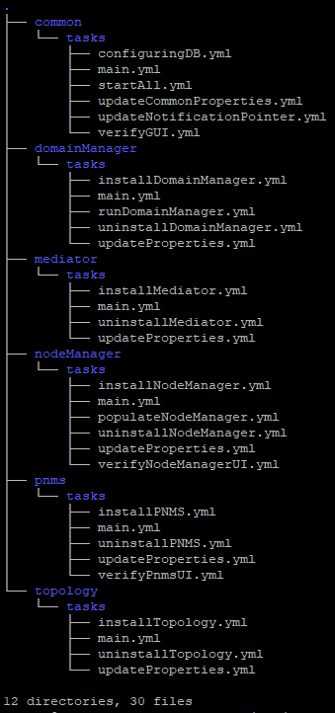
Ansible in PadTec (Ekinops) Project

Slide 15
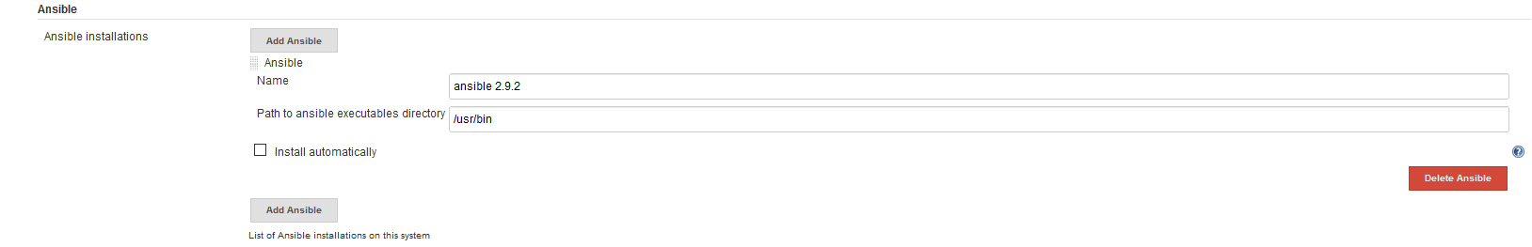
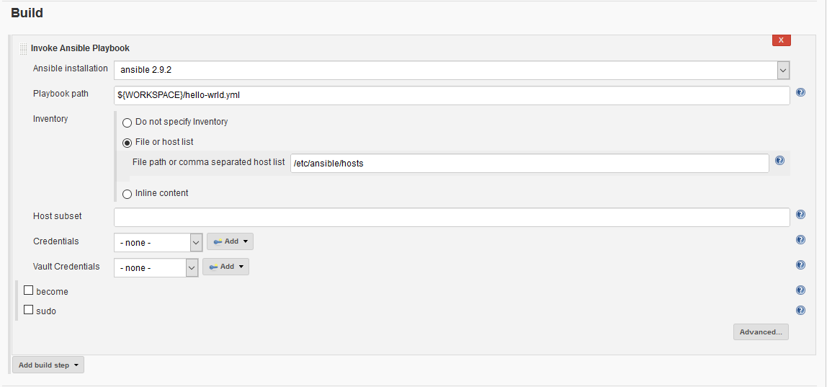
Integration with Jenkins (CI tool)
Install Ansible plugin for Jenkins https://plugins.jenkins.io/ansible
Add Ansible in Jenkins as Ansible Installation : Jenkins → Manage Jenkins → Global Tools configurations
Configure installed Ansible in Jenkins job

Slide 16
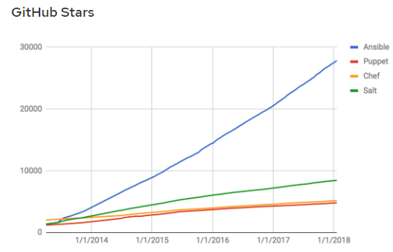
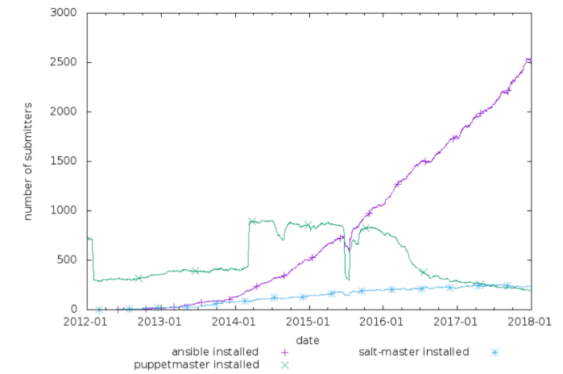
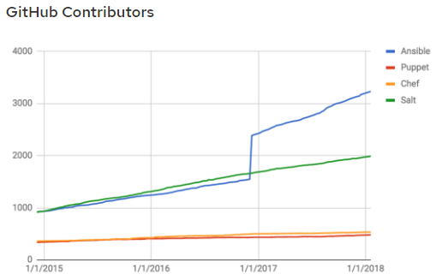
Ansible Popularity (2017 Community Review)

Slide 17
References
https://docs.ansible.com
Everything about Ansible is available under single umbrella, Ansible’s official documentation.
Ansible Community – Most popular and active community https://www.ansible.com/blog/2017-community-year-in-review
Every year they review the Ansible progress and challenges

Slide 18
Thank you…

