Slide 1
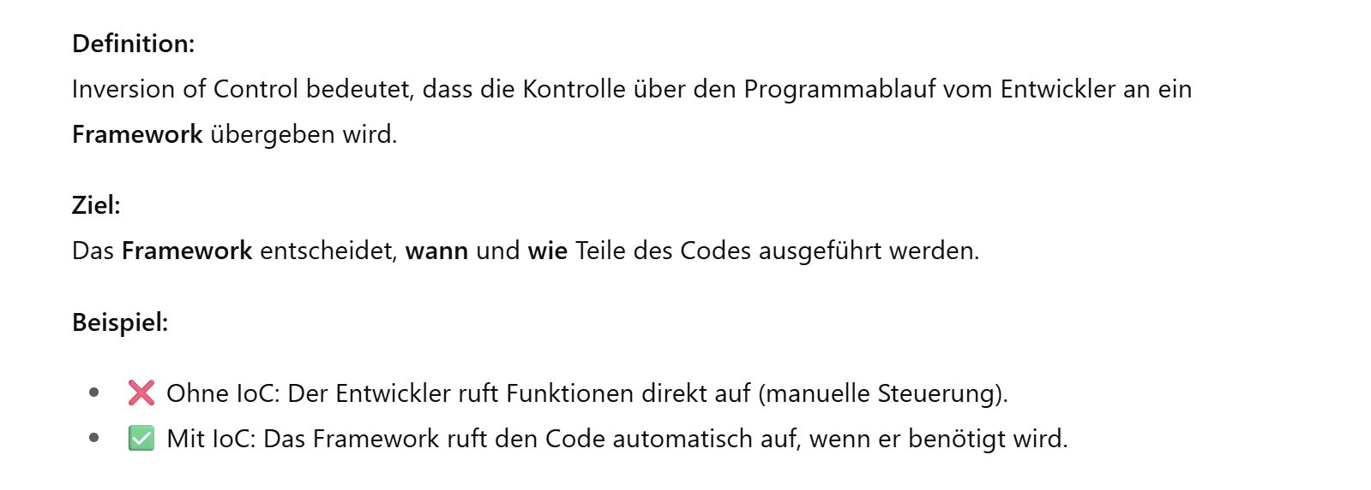
Was is Inversion of Control (IoC)?

Slide 2
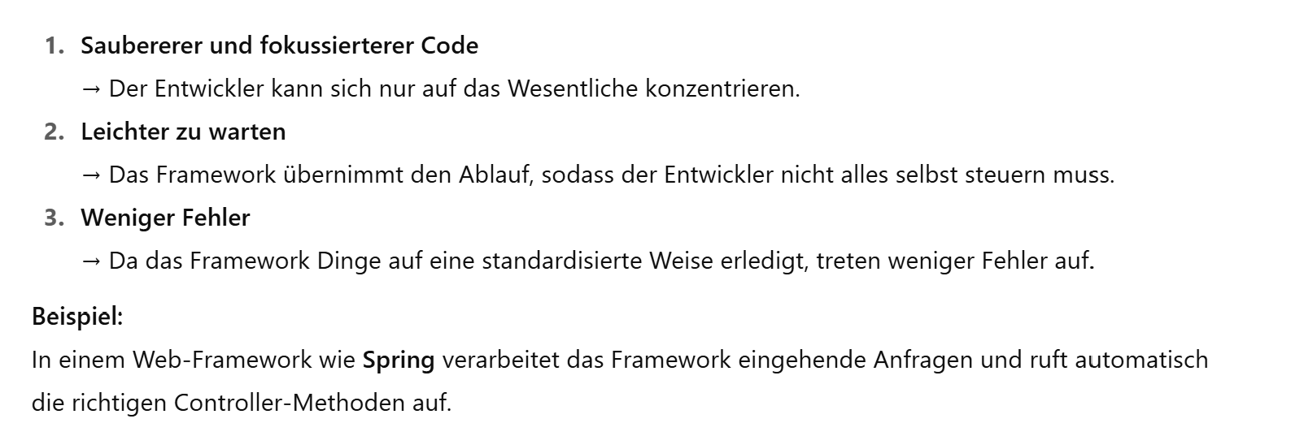
Vorteile der Inversion of Control (IoC)

Slide 3

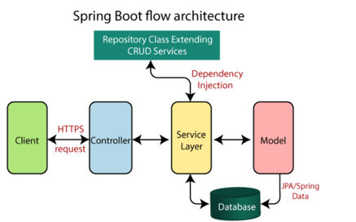

Spring Boot Flow Architecture

Slide 4


Spring Boot Architecture

Slide 5

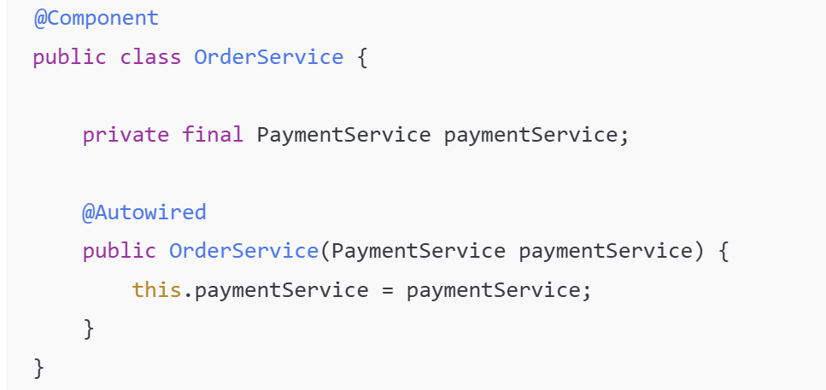

Constructor-Based Dependency Injection

Slide 6

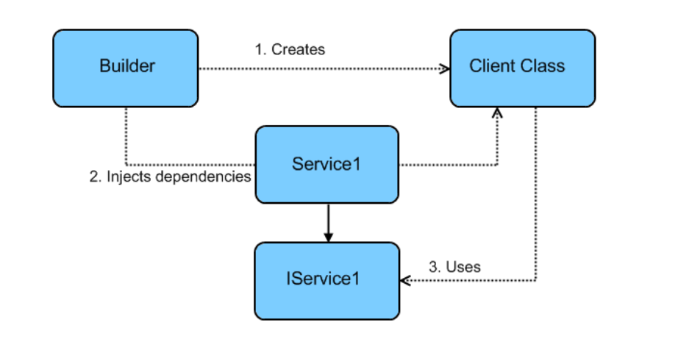
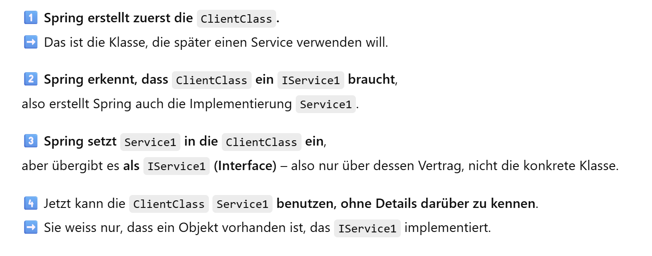
Dependency Injection

