Slide 1

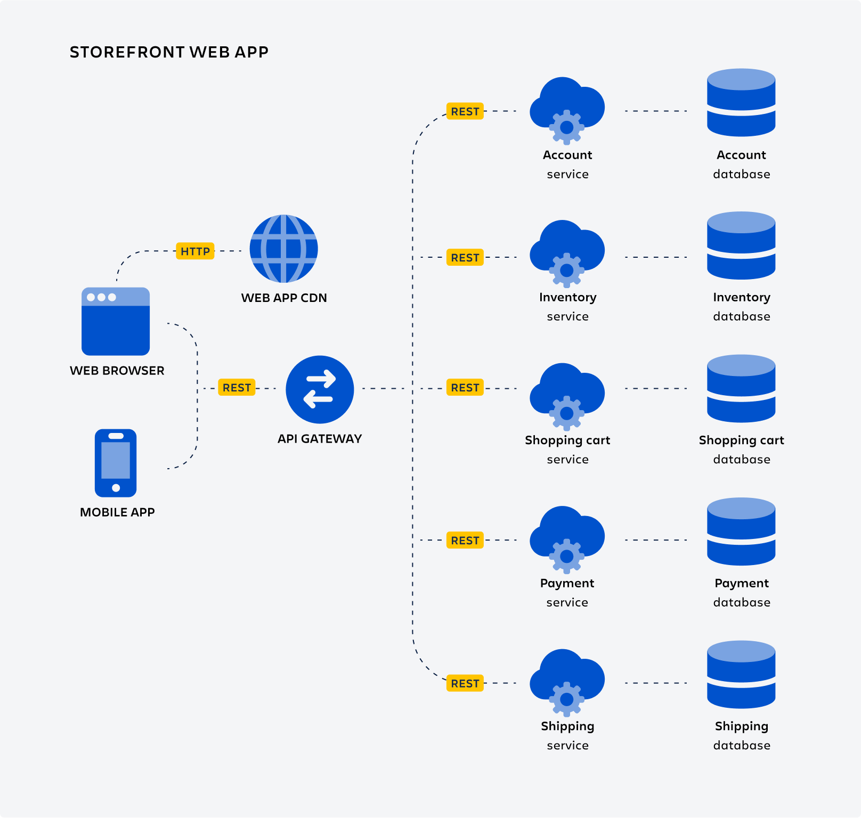
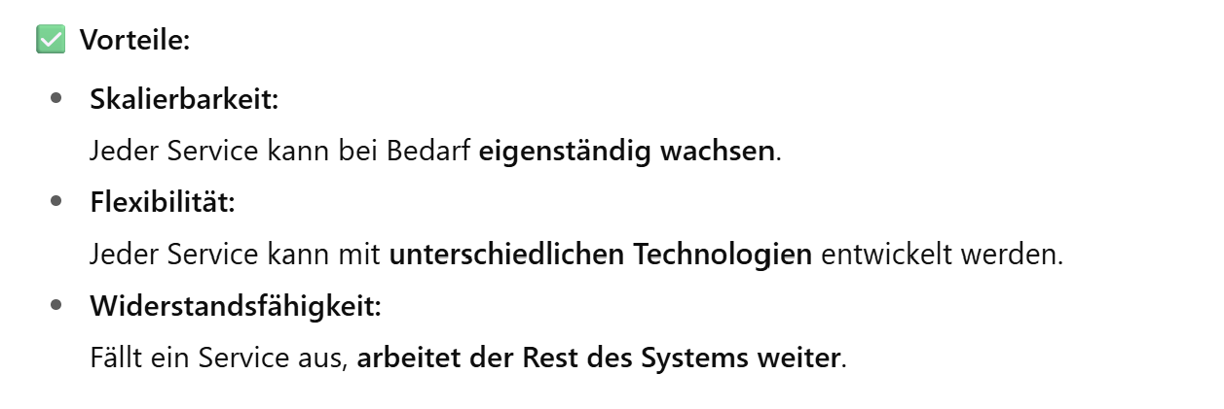

Microservices

Slide 2
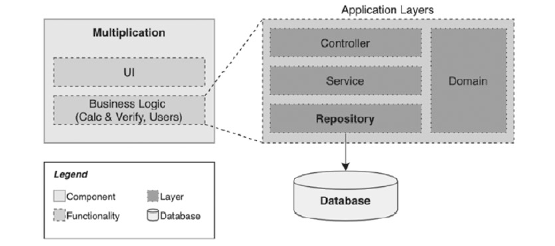

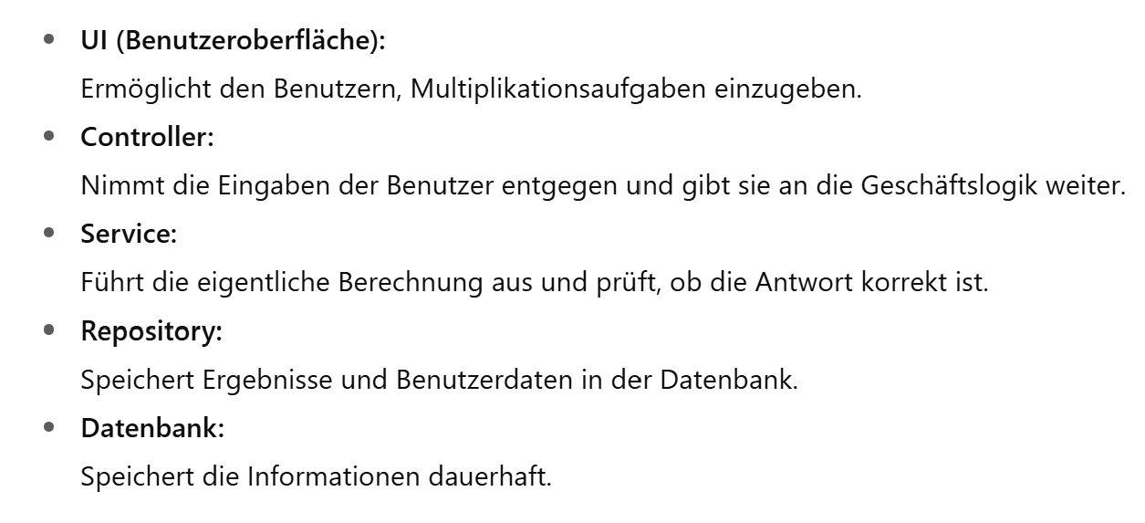
Multiplication Microservice

Slide 3

Multiplikations-Microservice
- src
- main
- java
- com.example.multiplication
- controller
- service
- domain
- repository
- resources
- application.properties

Slide 4
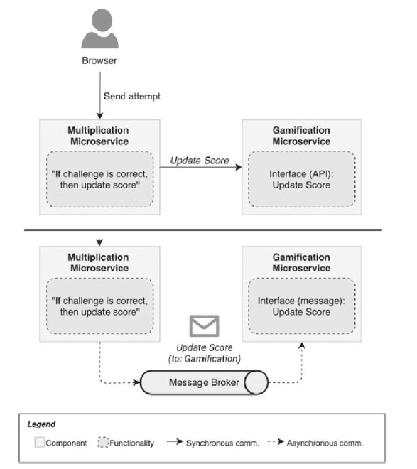

Microservices communication

Slide 5
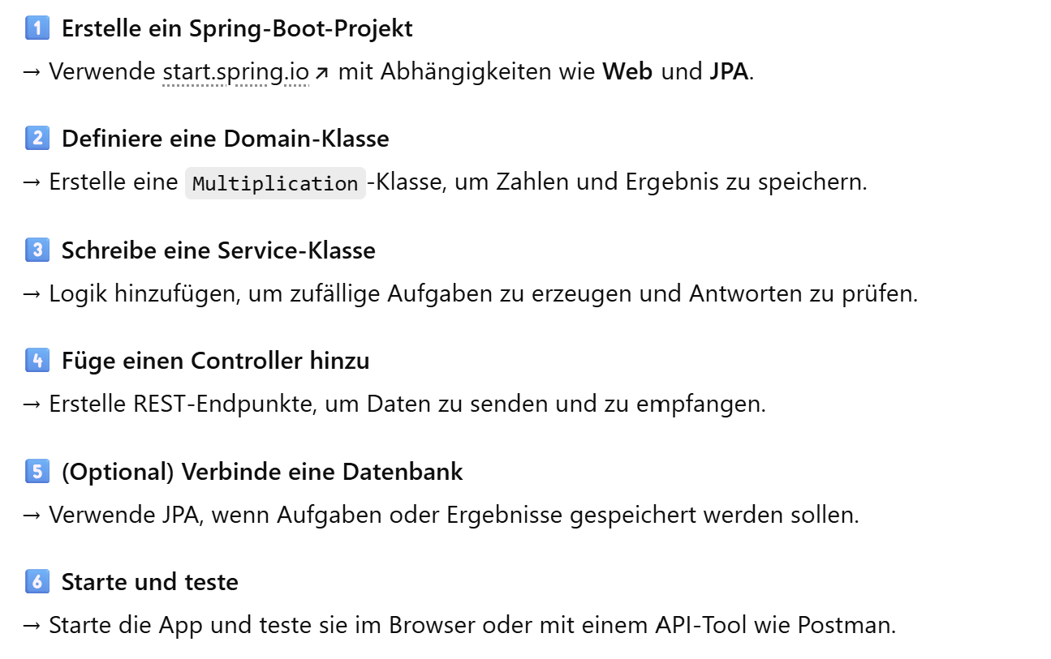
Spring Boot Projekt

Slide 6
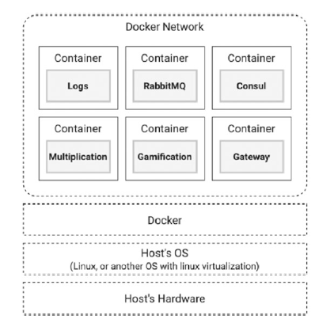
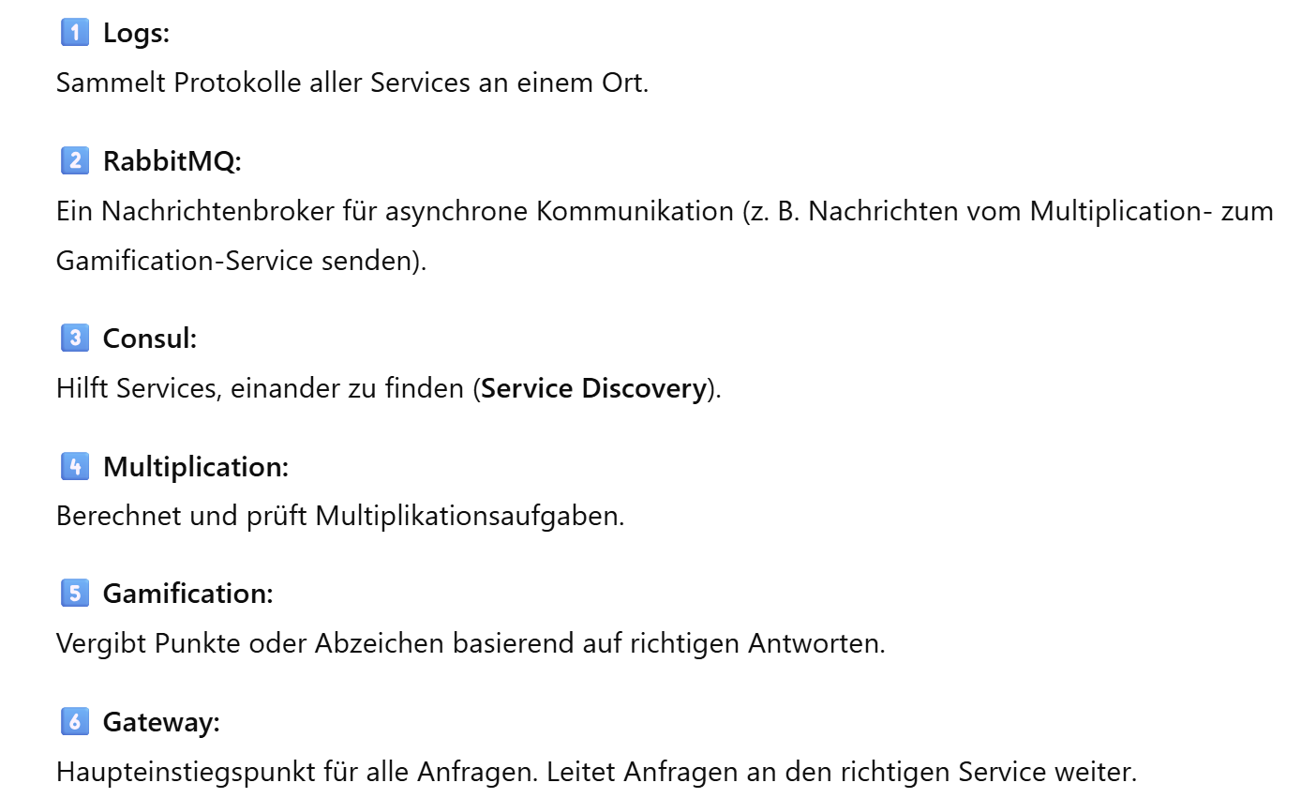


Microservices Containerization

