Slide 1
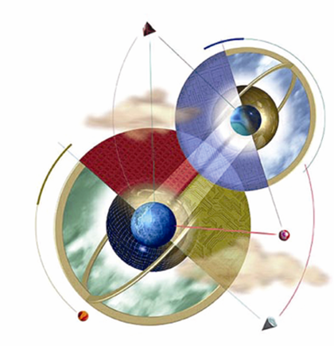
Chapter 2:
The Representation of Knowledge
Expert Systems: Principles and Programming, Fourth Edition

Slide 2
What is the study of logic?
Logic is the study of making inferences – given a set of facts, we attempt to reach a true conclusion.
An example of informal logic is a courtroom setting where lawyers make a series of inferences hoping to convince a jury / judge .
Formal logic (symbolic logic) is a more rigorous approach to proving a conclusion to be true / false.

Slide 3
Why is Logic Important
We use logic in our everyday lives – “should I buy this car”, “should I seek medical attention”.
People are not very good at reasoning because they often fail to separate word meanings with the reasoning process itself.
Semantics refers to the meanings we give to symbols.

Slide 4
The Goal of Expert Systems
We need to be able to separate the actual meanings of words with the reasoning process itself.
We need to make inferences w/o relying on semantics.
We need to reach valid conclusions based on facts only.

Slide 5
Knowledge vs. Expert Systems
Knowledge representation is key to the success of expert systems.
Expert systems are designed for knowledge representation based on rules of logic called inferences.
Knowledge affects the development, efficiency, speed, and maintenance of the system.

Slide 6
Arguments in Logic
An argument refers to the formal way facts and rules of inferences are used to reach valid conclusions.
The process of reaching valid conclusions is referred to as logical reasoning.

Slide 7
How is Knowledge Used?
Knowledge has many meanings – data, facts, information.
How do we use knowledge to reach conclusions or solve problems?
Heuristics refers to using experience to solve problems – using precedents.
Expert systems may have hundreds / thousands of micro-precedents to refer to.

Slide 8
Epistemology
Epistemology is the formal study of knowledge .
Concerned with nature, structure, and origins of knowledge.

Slide 9
Categories of Epistemology
Philosophy | A priori
A posteriori | Procedural
Declarative | Tacit

Slide 10
A Priori Knowledge
“That which precedes”
Independent of the senses
Universally true
Cannot be denied without contradiction

Slide 11
A Posteriori Knowledge
“That which follows”
Derived from the senses
Now always reliable
Deniable on the basis of new knowledge w/o the necessity of contradiction

Slide 12
Procedural Knowledge
Knowing how to do something:
      Fix a watch
      Install a window
      Brush your teeth
      Ride a bicycle

Slide 13
Declarative Knowledge
Knowledge that something is true or false
Usually associated with declarative statements
E.g., “Don’t touch that hot wire.”

Slide 14
Tacit Knowledge
Unconscious knowledge
Cannot be expressed by language
E.g., knowing how to walk, breath, etc.

Slide 15
Knowledge in Rule-Based Systems
Knowledge is part of a hierarchy.
Knowledge refers to rules that are activated by facts or other rules.
Activated rules produce new facts or conclusions.
Conclusions are the end-product of inferences when done according to formal rules.

Slide 16
Expert Systems vs. Humans
    Expert systems infer – reaching conclusions as the end product of a chain of steps called inferencing when done according to formal rules.
    Humans reason

Slide 17
Expert Systems vs. ANS
ANS does not make inferences but searches for underlying patterns.
Expert systems
  Draw inferences using facts
  Separate data from noise
  Transform data into information
  Transform information into knowledge

Slide 18
Metaknowledge
Metaknowledge is knowledge about knowledge and expertise.
Most successful expert systems are restricted to as small a domain as possible.
In an expert system, an ontology is the metaknowledge that describes everything known about the problem domain.
Wisdom is the metaknowledge of determining the best goals of life and how to obtain them.

Slide 19
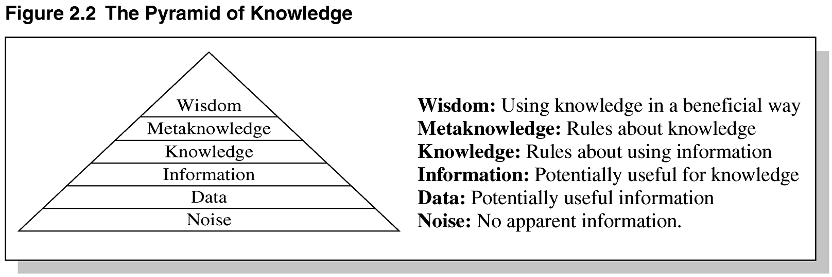
Figure 2.2 The Pyramid of Knowledge

Slide 20
Productions
A number of knowledge-representation techniques have been devised:
      Rules
      Semantic nets
      Frames
      Scripts
      Logic
      Conceptual graphs

Slide 21
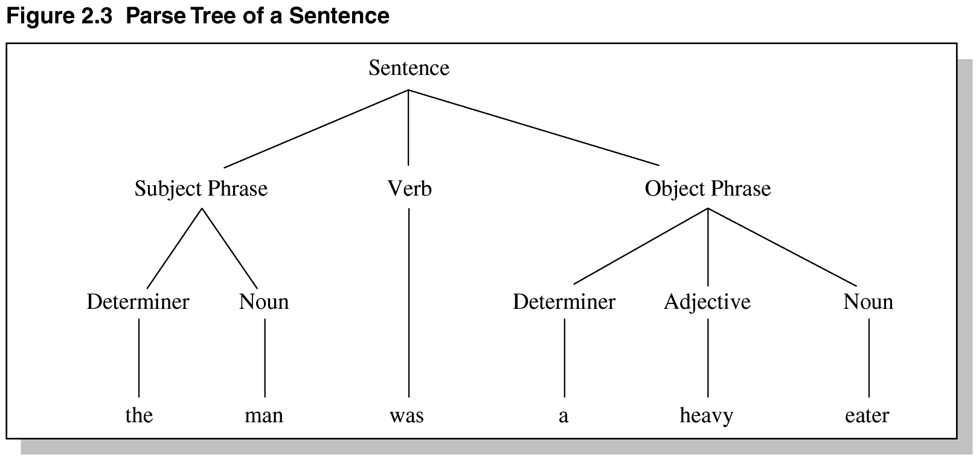
Figure 2.3 Parse Tree of a Sentence

Slide 22
Semantic Nets
A classic representation technique for propositional information
Propositions – a form of declarative knowledge, stating facts (true/false)
Propositions are called “atoms” – cannot be further subdivided.
Semantic nets consist of nodes (objects, concepts, situations) and arcs (relationships between them).

Slide 23
Common Types of Links
IS-A – relates an instance or individual to a generic class
A-KIND-OF – relates generic nodes to generic nodes

Slide 24
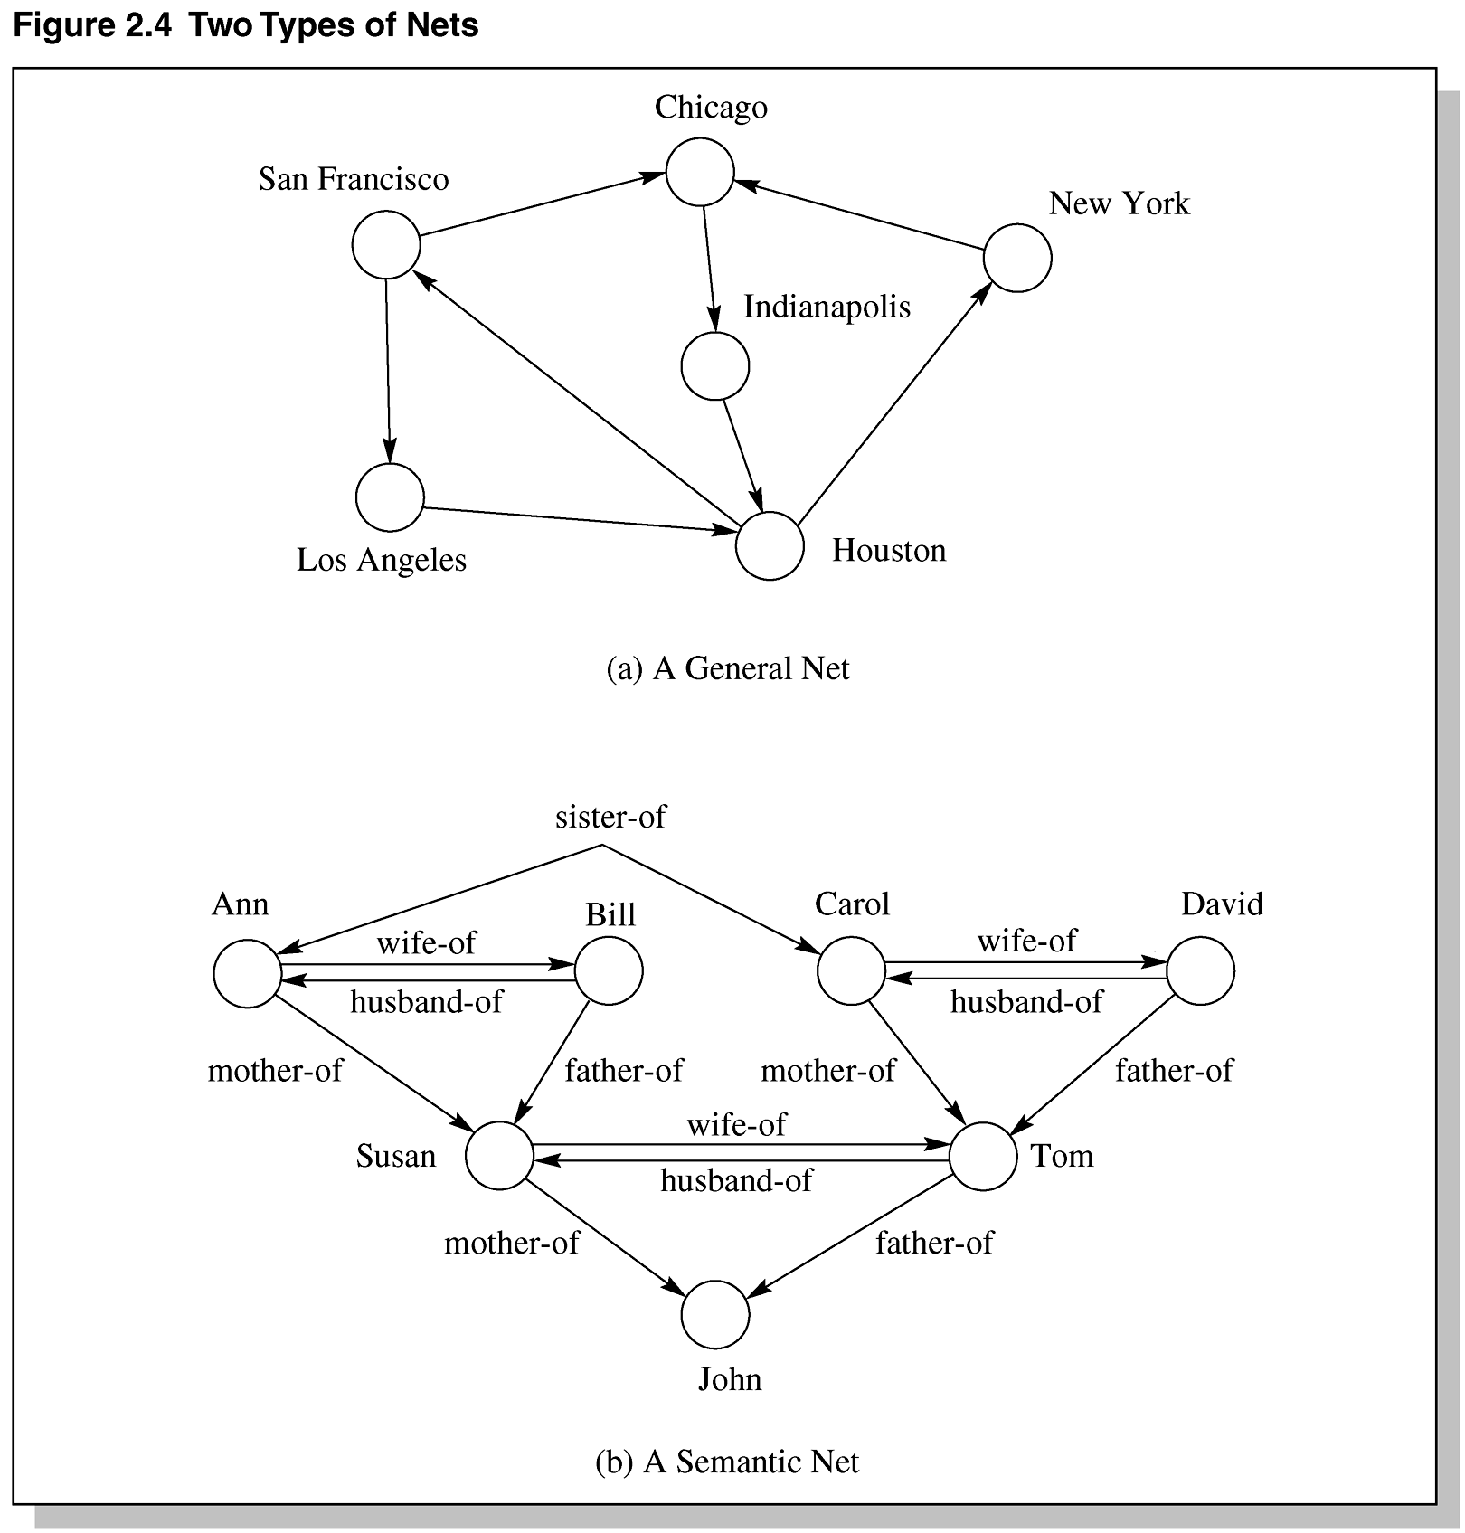
Figure 2.4 Two Types of Nets

Slide 25
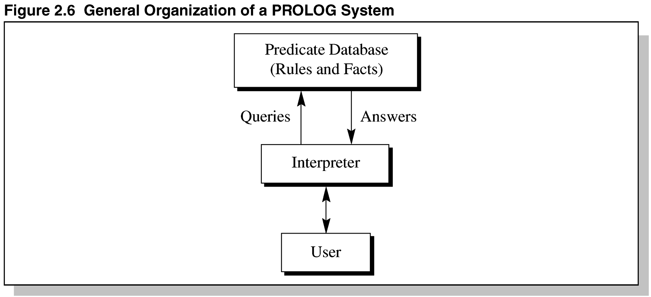
Figure 2.6: General Organization of a PROLOG System

Slide 26
PROLOG and Semantic Nets
In PROLOG, predicate expressions consist of the predicate name, followed by zero or more arguments enclosed in parentheses, separated by commas.
Example:
mother(becky,heather)
means that becky is the mother of heather

Slide 27
PROLOG Continued
Programs consist of facts and rules in the general form of goals.
General form: p:- p1, p2, …, pN
p is called the rule’s head and the p_{i} represents the subgoals
Example:
spouse(x,y) :- wife(x,y)
x is the spouse of y if x is the wife of y

Slide 28
Object-Attribute-Value Triple
One problem with semantic nets is lack of standard definitions for link names (IS-A, AKO, etc.).
The OAV triplet can be used to characterize all the knowledge in a semantic net.

Slide 29
Problems with Semantic Nets
To represent definitive knowledge, the link and node names must be rigorously defined.
A solution to this is extensible markup language (XML) and ontologies.
Problems also include combinatorial explosion of searching nodes, inability to define knowledge the way logic can, and heuristic inadequacy.

Slide 30
Schemata
Knowledge Structure – an ordered collection of knowledge – not just data.
Semantic Nets – are shallow knowledge structures – all knowledge is contained in nodes and links.
Schema is a more complex knowledge structure than a semantic net.
In a schema, a node is like a record which may contain data, records, and/or pointers to nodes.

Slide 31
Frames
One type of schema is a frame (or script – time-ordered sequence of frames).
Frames are useful for simulating commonsense knowledge.
Semantic nets provide 2-dimensional knowledge; frames provide 3-dimensional.
Frames represent related knowledge about narrow subjects having much default knowledge.

Slide 32
Frames Continued
A frame is a group of slots and fillers that defines a stereotypical object that is used to represent generic / specific knowledge.
Commonsense knowledge is knowledge that is generally known.
Prototypes are objects possessing all typical characteristics of whatever is being modeled.
Problems with frames include allowing unrestrained alteration / cancellation of slots.

Slide 33
Logic and Sets
Knowledge can also be represented by symbols of logic.
Logic is the study of rules of exact reasoning – inferring conclusions from premises.
Automated reasoning – logic programming in the context of expert systems.

Slide 34
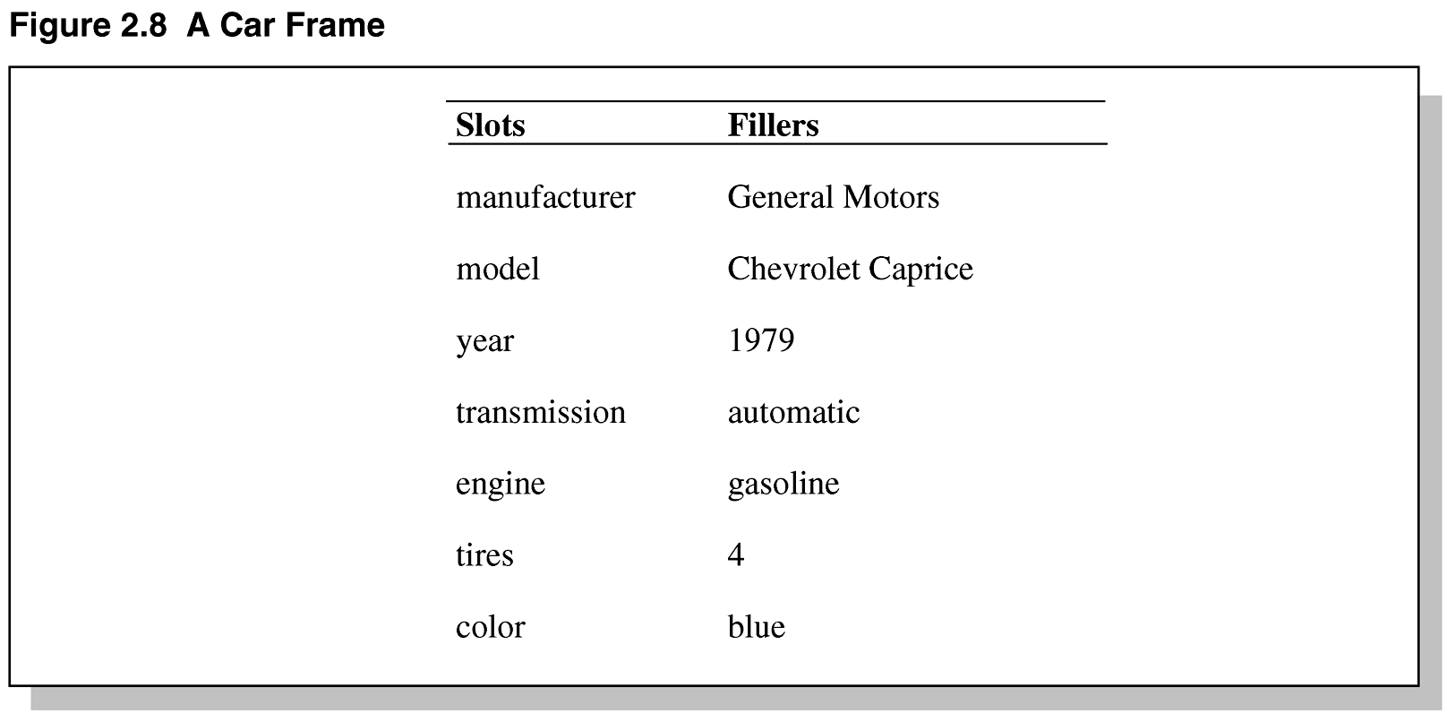
Figure 2.8 A Car Frame

Slide 35
Forms of Logic
Earliest form of logic was based on the syllogism – developed by Aristotle.
Syllogisms – have two premises that provide evidence to support a conclusion.
Example:
  Premise: All cats are climbers.
  Premise: Garfield is a cat.
  Conclusion: Garfield is a climber.

Slide 36
Venn Diagrams
Venn diagrams can be used to represent knowledge.
Universal set is the topic of discussion.
Subsets, proper subsets, intersection, union , contained in, and complement are all familiar terms related to sets.
An empty set (null set) has no elements.

Slide 37
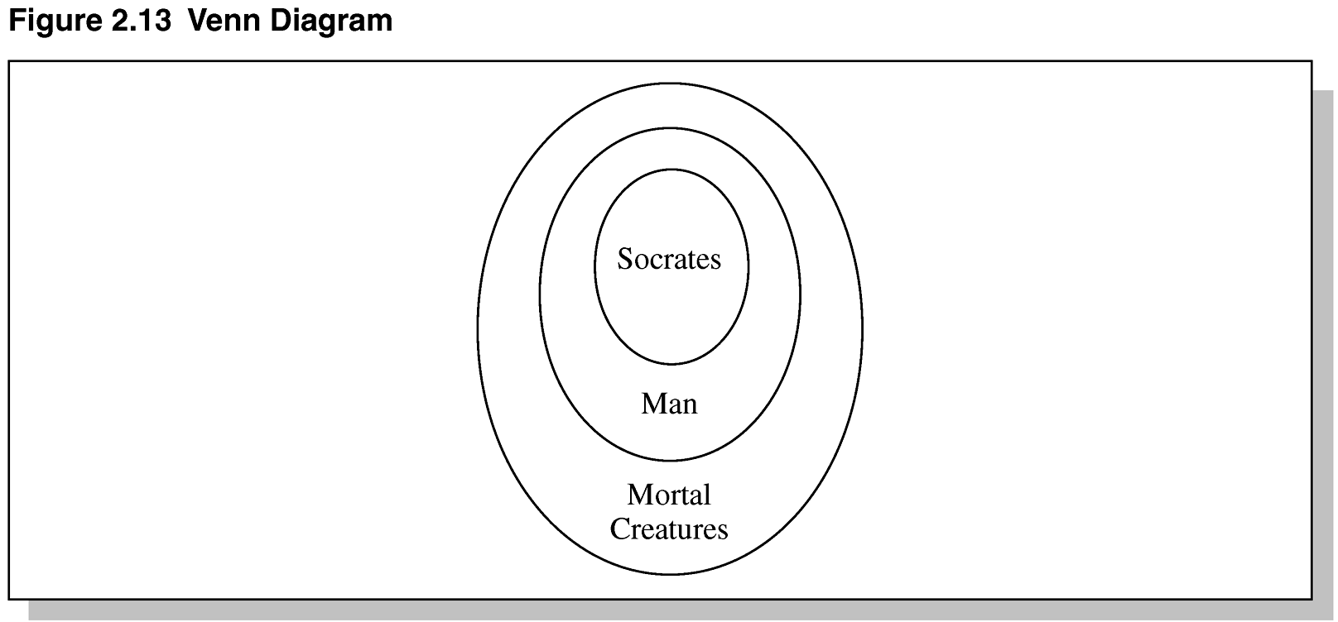
Figure 2.13 Venn Diagrams

Slide 38
Syllogism 三段論法
Premise: All men are mortal
Premise: Socrates is a man
Conclusion: Socrates is mortal
Only the form is important.
Premise: All X are Y
Premise: Z is a X
Conclusion: Z is a Y

Slide 39
Categorical Syllogism
Syllogism: a valid deductive argument having two premises and a conclusion.
major premise: All M are P
minor premise: All S is M
Conclusion: All S is P
M middle term
P major term
S minor term

Slide 40
Categorical Statements
Form | Schema | Meaning
A | All S is P | universal affirmative
E | No S is P | universal negative
I | Some S is P | particular affirmative
O | Some S is not P | particular negative

Slide 41
Figure | 1 | 2 | 3 | 4
Major Premise | M P | P M | M P | P M
Minor Premise | S M | S M | M S | M S
Mood
AAA-1 EAE-1 IAI-4
All M is P No M is P Some P is M
All S is M All S is M All M is S
All S is P No S is P Some S is P

Slide 42
Propositional Logic
Formal logic is concerned with syntax of statements, not semantics.
Syllogism:
  All goons are loons.
  Zadok is a goon.
  Zadok is a loon.
The words may be nonsense, but the form is correct – this is a “valid argument.”

Slide 43
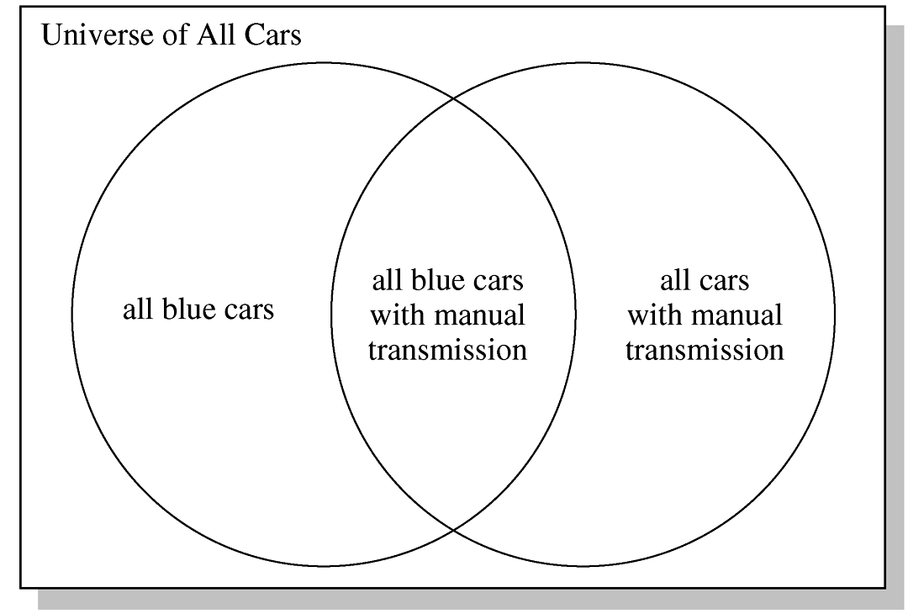
Figure 2.14 Intersecting Sets

Slide 44
Boolean Logic
Defines a set of axioms consisting of symbols to represent objects / classes.
Defines a set of algebraic expressions to manipulate those symbols.
Using axioms, theorems can be constructed.
A theorem can be proved by showing how it is derived from a set of axioms.

Slide 45
Features of Propositional Logic
Concerned with the subset of declarative sentences that can be classified as true or false.
We call these sentences “statements” or “propositions”.
Paradoxes – statements that cannot be classified as true or false.
Open sentences – statements that cannot be answered absolutely.

Slide 46
Features Continued
Compound statements – formed by using logical connectives (e.g., AND, OR, NOT, conditional, and biconditional) on individual statements.
Material implication – p  q states that if p is true, it must follow that q is true.
Biconditional – p  q states that p implies q and q implies p.

Slide 47
Features Continued
Tautology – a statement that is true for all possible cases.
Contradiction – a statement that is false for all possible cases.
Contingent statement – a statement that is neither a tautology nor a contradiction.

Slide 48
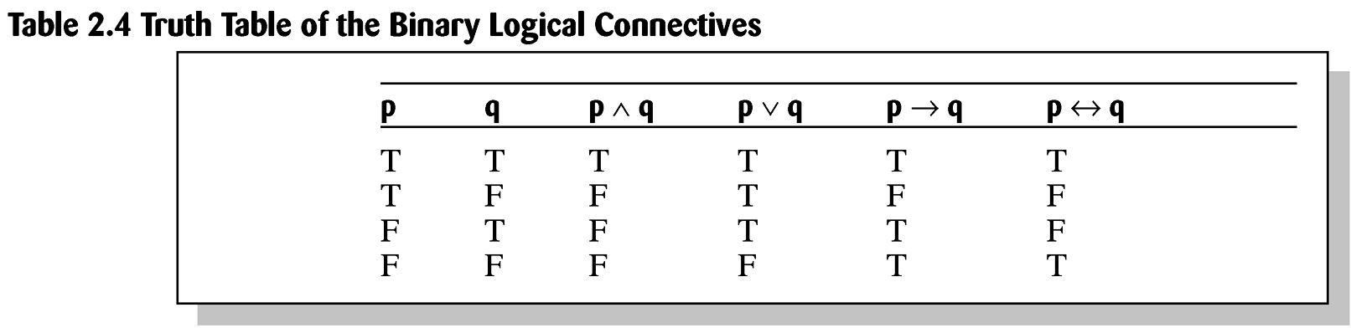
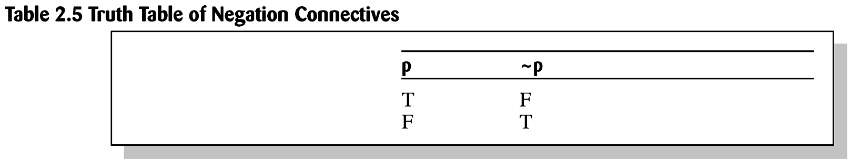
Truth Tables

Slide 49
Rule of Inference
Modus ponens, way assert
direct reasoning, law of detachment
assuming the antecedent
Modus tollens, way deny
indirect reasoning, law of contraposition
assuming the antecedent

Slide 50
Modus Ponens
If there is power, the computer will work
There is power
------------------------------
The computer will work
A → B p, p ->q; q
A
--------------
B

Slide 51
Modus tollens
p → q conditional p -> q
~q converse q -> p
-------------- inverse ~p -> ~q
~ p contrapositive
~q -> ~p

Slide 52
Formal Logic Proof
Chip prices rise only if the yen rises.
The yen rises only if the dollar falls and
if the dollar falls then the yen rises.
Since chip prices have risen,
the dollar must have fallen.
C → Y C = chip prices rise
(Y → D) ^ (D → Y) Y = yen rises
C D = dollar falls
-------------------------
D

Slide 53
Formal Logic Proof
C → Y
(Y → D) ^ (D → Y)
C
D
1. C → Y premise
2. (Y → D) ^ (D → Y) premise
3. C
4. Y == D 2 Equivalence
5. C → D 1 Substitution
6. D 3,5 modus ponens

Slide 54
Resolution
Normal form
Conjunctive normal form
(P1vP2v…)^(Q1vQ2…)^…(Z1vZ2…)
Kowalski clausal form
A1, A2, …., An → B1, B2, …., Bm
Horn clause
A1, A2, …., An → B

Slide 55
Method of Contradiction
A v B (AvB)^(Av~B)
A v ~B A v (B^~B)
-------------- A
A

Slide 56
Forward Reasoning
T: A → B
B → C ➔ CONCLUSION?
C → D
A
Resolve by modus ponens

Slide 57
Backward Reasoning
What if T is very large?
T may support all kinds of inferences
which have nothing to do with
the proof of our goal
Combinational explosion
➔ Use Backward Reasoning

Slide 58
Resolution Refutation
To refute something is to prove it false
Refutation complete:
Resolution refutation will terminate in
a finite steps if there is a contradiction
Example: Given the argument
A → B
B → C
C → D
-------------
A → D

Slide 59
Example
A → B
B → C
C → D
-------------
A → D
To prove that A → D is a theorem by resolution refutation:
A → D equ ~A v D convert to disjunction form
~(~A v D) equ A ^ ~D negate the conclusion
3. A → B equ ~A v B
B → C equ ~B v C
C → D equ ~C v D
(~A v B) ^ (~B v C ) ^ (~C v D) ^ A ^ ~D resolution
=> nil false

Slide 60
Method of Contradiction
A v B (AvB)^(Av~B)
A v ~B A v (B^~B)
-------------- A
A

Slide 61
Propositional Logic
Symbolic logic for manipulating proposition
Proposition, Statement, Close sentence:
a sentence whose truth value can be
determined.
Open Sentence: a sentence which contains variables
Combinational explosion
Can not prove argument with quantifiers

Slide 62
Predicate Logic
Predicates with arguments
on-top-of(A, B)
Variables and Quantifiers
Universal (∀x)(Rational(x) → Real(x))
Existential (∃x)(Prime(x))
Functions of Variables
(∀x)(Satellite(x)) → (∃y)(closest(y, earth)^on(y,x))
(∀x)(man(x) → mortal(x))
^ man(Socrates)
=> mortal(Socrates)

Slide 63
Universal Quantifier
The universal quantifier, represented by the symbol ∀ means “for every” or “for all”.
(∀x) (x is a rectangle  x has four sides)
The existential quantifier, represented by the symbol ∃ means “there exists”.
(∃x) (x – 3 = 5)
Limitations of predicate logic – most quantifier.

Slide 64
First Order Predicate Logic
Quantification not over predicate or function symbols
No MOST quantifier, (counting required)
Can not express things that are sometime true
=> Fuzzy Logic

Slide 65
Syllogism in Predicate Logic
Type Scheme Predicate Representation
A All S is P (∀x)(S(x) -> P(x))
E No S is P (∀x)(S(x) -> ~P(x))
I Some S is P (∃x)(S(x) ^ P(x))
A Some S is not P (∃x)(S(x) ^ ~P(x))

Slide 66
Rule of Universal Instantiation
(∀x)p(x) => p(a) p: any proposition or
propositional function
a: an instance

Slide 67
Formal Proof
(∀x)(H(x)->M(x)) All men are mortal
H(s) Socrates is a man
M(s) => Socrates is mortal
(∀x)(H(x)->M(x)) premise
H(s)
H(s)->M(s) universal instantiation
4. M(s) 2,3 modus ponens

Slide 68
Well-formed Formula
An atom is a formula
If F and G are formula, then ~(F), (FvG),
(F^G),(F->G), and (F<->G) are formula
3. If F is a formula, and x is a free variable in F, then (∀x)F and (∃x)F are formula
4. Formula are generated only by a finite number of applications of 1,2 and 3

Slide 69
Summary
We have discussed:
  Elements of knowledge
  Knowledge representation
  Some methods of representing knowledge
Fallacies may result from confusion between form of knowledge and semantics.
It is necessary to specify formal rules for expert systems to be able to reach valid conclusions.
Different problems require different tools.

