Slide 1

Chapter 4:
Reasoning Under Uncertainty
Expert Systems: Principles and Programming, Fourth Edition

Slide 2
Objectives
Learn the meaning of uncertainty and explore some theories designed to deal with it
Find out what types of errors can be attributed to uncertainty and induction
Learn about classical probability, experimental, and subjective probability, and conditional probability
Explore hypothetical reasoning and backward induction

Slide 3
Objectives
Examine temporal reasoning and Markov chains
Define odds of belief, sufficiency, and necessity
Determine the role of uncertainty in inference chains
Explore the implications of combining evidence
Look at the role of inference nets in expert systems and see how probabilities are propagated

Slide 4
How to Expert Systems Deal with Uncertainty?
Expert systems provide an advantage when dealing with uncertainty as compared to decision trees.
With decision trees, all the facts must be known to arrive at an outcome.
Probability theory is devoted to dealing with theories of uncertainty.
There are many theories of probability – each with advantages and disadvantages.

Slide 5
What is Uncertainty?
Uncertainty is essentially lack of information to formulate a decision.
Uncertainty may result in making poor or bad decisions.
As living creatures, we are accustomed to dealing with uncertainty – that’s how we survive.
Dealing with uncertainty requires reasoning under uncertainty along with possessing a lot of common sense.

Slide 6
Theories to Deal with Uncertainty
    Bayesian Probability
    Hartley Theory
    Shannon Theory
    Dempster-Shafer Theory
    Markov Models
    Zadeh’s Fuzzy Theory

Slide 7
Dealing with Uncertainty
Deductive reasoning – deals with exact facts and exact conclusions
Inductive reasoning – not as strong as deductive – premises support the conclusion but do not guarantee it.
There are a number of methods to pick the best solution in light of uncertainty.
When dealing with uncertainty, we may have to settle for just a good solution.

Slide 8
Errors Related to Hypothesis
Many types of errors contribute to uncertainty.
  Type I Error – accepting a hypothesis when it is not true – False Positive.
  Type II Error – Rejecting a hypothesis when it is true – False Negative

Slide 9
Errors Related to Measurement
Errors of precision – how well the truth is known
Errors of accuracy – whether something is true or not
Unreliability stems from faulty measurement of data – results in erratic data.
Random fluctuations – termed random error
Systematic errors result from bias

Slide 10
Errors in Induction
Where deduction proceeds from general to specific, induction proceeds from specific to general.
Inductive arguments can never be proven correct (except in mathematical induction).
Expert systems may consist of both deductive and inductive rules based on heuristic information.
When rules are based on heuristics, there will be uncertainty.

Slide 11
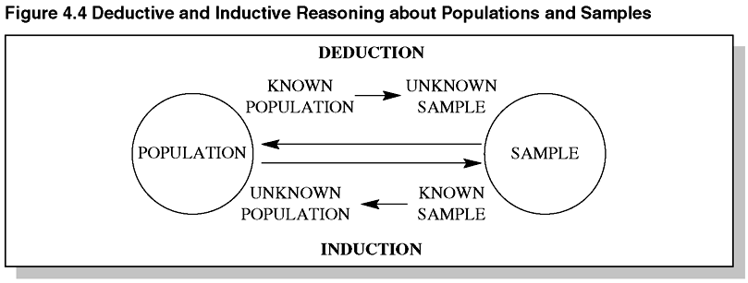
Figure 4.4 Deductive and Inductive Reasoning about Populations and Samples

Slide 12
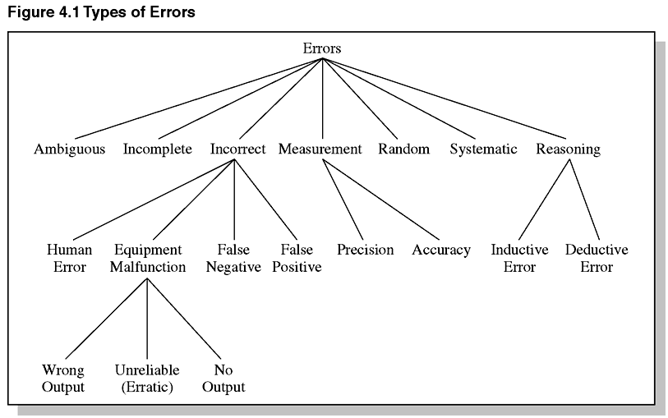
Figure 4.1 Types of Errors

Slide 13
Classical Probability
First proposed by Pascal and Fermat in 1654
Also called a priori probability because it deals with ideal games or systems:
  Assumes all possible events are known
  Each event is equally likely to happen
Fundamental theorem for classical probability is P = W / N, where W is the number of wins and N is the number of equally possible events.

Slide 14
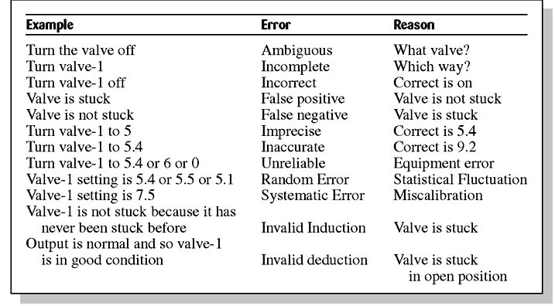
Table 4.1 Examples of Common Types of Errors

Slide 15
Deterministic vs. Nondeterministic Systems
When repeated trials give the exact same results, the system is deterministic.
Otherwise, the system is nondeterministic.
Nondeterministic does not necessarily mean random – could just be more than one way to meet one of the goals given the same input.

Slide 16
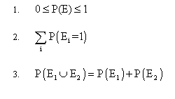
Three Axioms of Formal
Theory of Probability

Slide 17

Experimental and Subjective Probabilities
Experimental probability defines the probability of an event, as the limit of a frequency distribution:
Subjective probability deals with events that are not reproducible and have no historical basis on which to extrapolate.

Slide 18

Compound Probabilities
Compound probabilities can be expressed by:
S is the sample space and A and B are events.
Independent events are events that do not affect each other. For pairwise independent events,

Slide 19
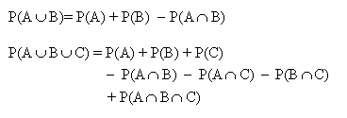
Additive Law

Slide 20
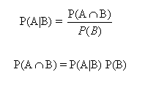
Conditional Probabilities
The probability of an event A occurring, given that event B has already occurred is called conditional probability:

Slide 21
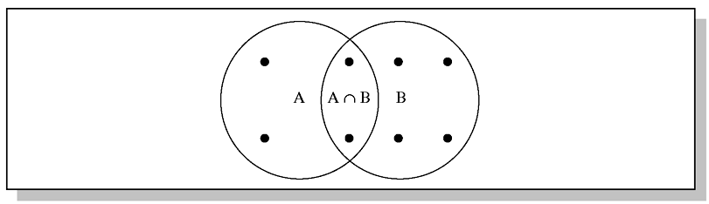
Figure 4.6 Sample Space of
Intersecting Events

Slide 22
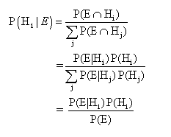
Bayes’ Theorem
This is the inverse of conditional probability.
Find the probability of an earlier event given that a later one occurred.

Slide 23
Hypothetical Reasoning
Backward Induction
Bayes’ Theorem is commonly used for decision tree analysis of business and social sciences.
PROSPECTOR (expert system) achieved great fame as the first expert system to discover a valuable molybdenum deposit worth $100,000,000.

Slide 24
Temporal Reasoning
Reasoning about events that depend on time
Expert systems designed to do temporal reasoning to explore multiple hypotheses in real time are difficult to build.
One approach to temporal reasoning is with probabilities – a system moving from one state to another over time.
The process is stochastic if it is probabilistic.

Slide 25
Markov Chain Process
Transition matrix – represents the probabilities that the system in one state will move to another.
State matrix – depicts the probabilities that the system is in any certain state.
One can show whether the states converge on a matrix called the steady-state matrix – a time of equilibrium

Slide 26
Markov Chain Characteristics
The process has a finite number of possible states.
The process can be in one and only one state at any one time.
The process moves or steps successively from one state to another over time.
The probability of a move depends only on the immediately preceding state.

Slide 27

Figure 4.13 State Diagram
Interpretation of a Transition Matrix

Slide 28
The Odds of Belief
To make expert systems work for use, we must expand the scope of events to deal with propositions.
Rather than interpreting conditional probabilities P(A!B) in the classical sense, we interpret it to mean the degree of belief that A is true, given B.
We talk about the likelihood of A, based on some evidence B.
This can be interpreted in terms of odds.

Slide 29


Sufficiency and Necessity
The likelihood of sufficiency, LS, is calculated as:
The likelihood of necessity is defined as:

Slide 30
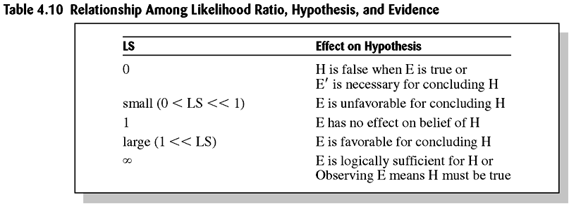
Table 4.10 Relationship Among Likelihood Ratio, Hypothesis, and Evidence

Slide 31
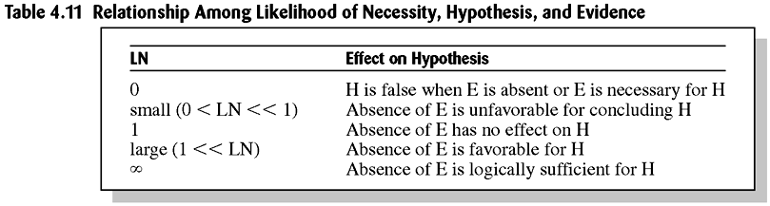
Table 4.11 Relationship Among Likelihood of Necessity, Hypothesis, and Evidence

Slide 32
Uncertainty in Inference Chains
Uncertainty may be present in rules, evidence used by rules, or both.
One way of correcting uncertainty is to assume that P(H|e) is a piecewise linear function.

Slide 33
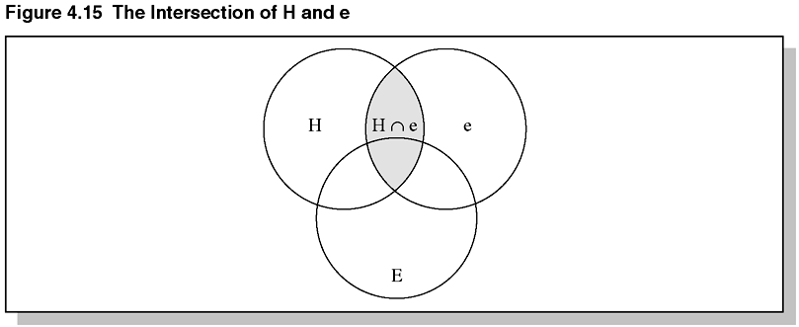
Figure 4.15 Intersection of H and e

Slide 34
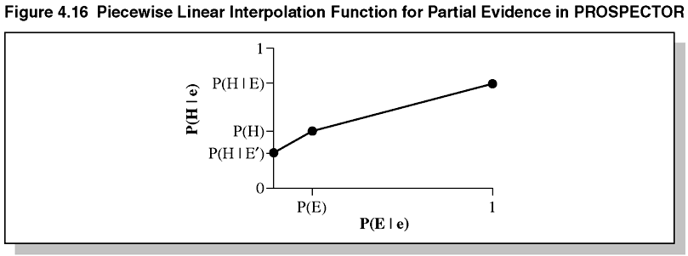
Figure 4.16 Piecewise Linear Interpolation Function for Partial Evidence in PROSPECTOR

Slide 35
Combination of Evidence
The simplest type of rule is of the form:
  IF E THEN H
where E is a single piece of known evidence from which we can conclude that H is true.
Not all rules may be this simple – compensation for uncertainty may be necessary.
As the number of pieces of evidence increases, it becomes impossible to determine all the joint and prior probabilities or likelihoods.

Slide 36
Combination of Evidence Continued
If the antecedent is a logical combination of evidence, then fuzzy logic and negation rules can be used to combine evidence.

Slide 37
Types of Belief
Possible – no matter how remote, the hypothesis cannot be ruled out.
Probable – there is some evidence favoring the hypothesis but not enough to prove it.
Certain – evidence is logically true or false.
Impossible – it is false.
Plausible – more than a possibility exists.

Slide 38
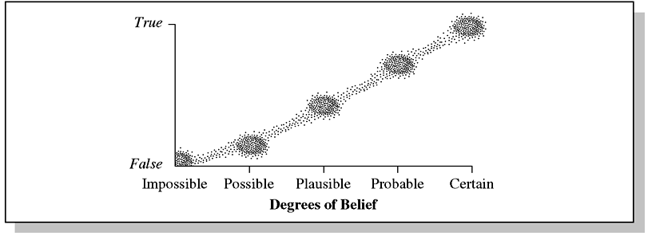
Figure 4.20 Relative Meaning of Some Terms Used to Describe Evidence

Slide 39
Propagation of Probabilities
The chapter examines the classic expert system PROSPECTOR to illustrate how concepts of probability are used in a real system.
Inference nets like PROSPECTOR have a static knowledge structure.
Common rule-based system is a dynamic knowledge structure.

Slide 40
Summary
In this chapter, we began by discussing reasoning under uncertainty and the types of errors caused by uncertainty.
Classical, experimental, and subjective probabilities were discussed.
Methods of combining probabilities and Bayes’ theorem were examined.
PROSPECTOR was examined in detail to see how probability concepts were used in a real system.

Slide 41
Summary
An expert system must be designed to fit the real world, not visa versa.
Theories of uncertainty are based on axioms; often we don’t know the correct axioms – hence we must introduce extra factors, fuzzy logic, etc.
We looked at different degrees of belief which are important when interviewing an expert.

