Slide 1

Chapter 5:
Inexact Reasoning
Expert Systems: Principles and Programming, Fourth Edition

Slide 2
Objectives
Explore the sources of uncertainty in rules
Analyze some methods for dealing with uncertainty
Learn about the Dempster-Shafer theory
Learn about the theory of uncertainty based on fuzzy logic
Discuss some commercial applications of fuzzy logic

Slide 3
Uncertainty and Rules
We have already seen that expert systems can operate within the realm of uncertainty.
There are several sources of uncertainty in rules:
  Uncertainty related to individual rules
  Uncertainty due to conflict resolution
  Uncertainty due to incompatibility of rules

Slide 4
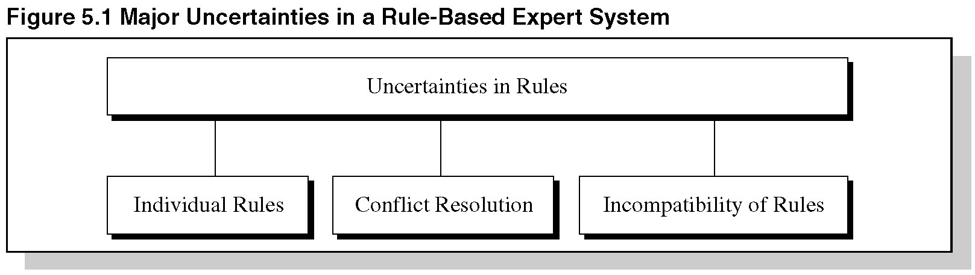
Figure 5.1 Major Uncertainties in Rule-Based Expert Systems

Slide 5
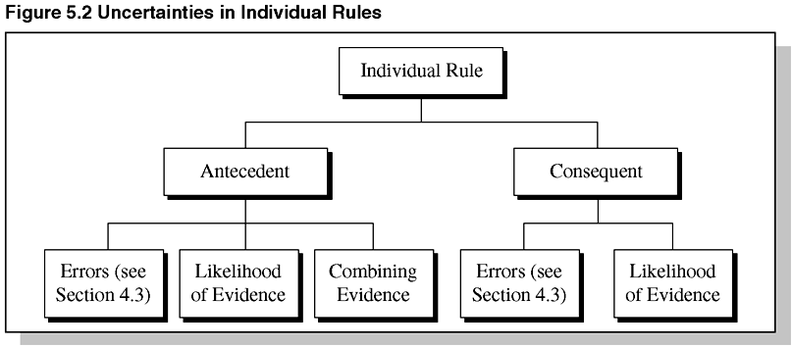
Figure 5.2 Uncertainties in Individual Rules

Slide 6
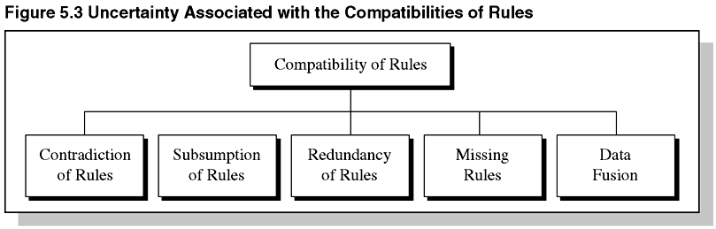
Figure 5.3 Uncertainty Associated with the Compatibilities of Rules

Slide 7
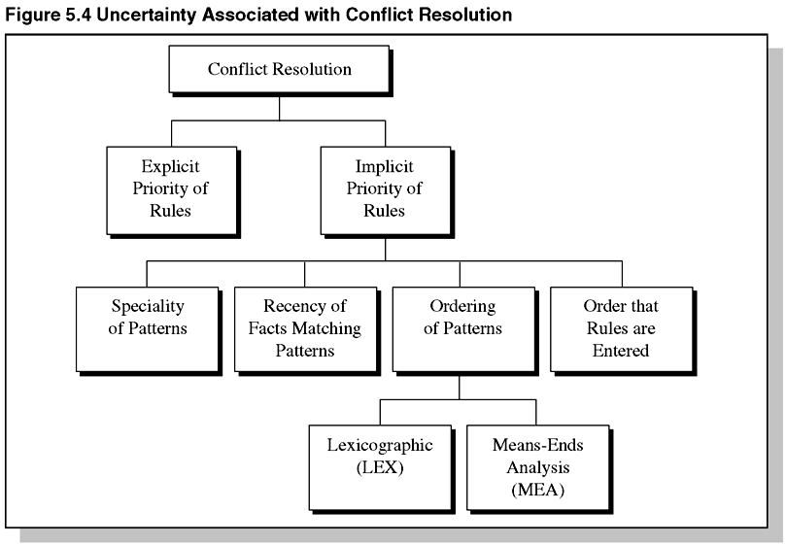
Figure 5.4 Uncertainty Associated with Conflict Resolution

Slide 8
Goal of Knowledge Engineer
The knowledge engineer endeavors to minimize, or eliminate, uncertainty if possible.
Minimizing uncertainty is part of the verification of rules.
Verification is concerned with the correctness of the system’s building blocks – rules.

Slide 9
Verification vs. Validation
Even if all the rules are correct, it does not necessarily mean that the system will give the correct answer.
Verification refers to minimizing the local uncertainties.
Validation refers to minimizing the global uncertainties of the entire expert system.
Uncertainties are associated with creation of rules and also with assignment of values.

Slide 10
Ad Hoc Methods
The ad hoc introduction of formulas such as fuzzy logic to a probabilistic system introduces a problem.
The expert system lacks the sound theoretical foundation based on classical probability.
The danger of ad hoc methods is the lack of complete theory to guide the application or warn of inappropriate situations.

Slide 11
Sources of Uncertainty
Potential contradiction of rules – the rules may fire with contradictory consequents, possibly as a result of antecedents not being specified properly.
Subsumption of rules – one rules is subsumed by another if a portion of its antecedent is a subset of another rule.

Slide 12
Uncertainty in Conflict Resolution
There is uncertainty in conflict resolution with regard to priority of firing and may depend on a number of factors, including:
  Explicit priority rules
  Implicit priority of rules
    Specificity of patterns
    Recency of facts matching patterns
    Ordering of patterns
      Lexicographic
      Means-Ends Analysis
    Ordering that rules are entered

Slide 13
Uncertainty
When a fact is entered in the working memory, it receives a unique timetag – indicating when it was entered.
The order that rules are entered may be a factor in conflict resolution – if the inference engine cannot prioritize rules, arbitrary choices must be made.
Redundant rules are accidentally entered / occur when a rule is modified by pattern deletion.

Slide 14
Uncertainty
Deciding which redundant rule to delete is not a trivial matter.
Uncertainty arising from missing rules occurs if the human expert forgets or is unaware of a rule.
Data fusion is another cause of uncertainty – fusing of data from different types of information.

Slide 15
Certainty Factors
Another method of dealing with uncertainty uses certainty factors, originally developed for the MYCIN expert system.

Slide 16
Difficulties with Bayesian Method
The Bayesian method is useful in medicine / geology because we are determining the probability of a specific event (disease / location of mineral deposit), given certain symptoms / analyses.
The problem is with the difficulty / impossibility of determining the probabilities of these givens – symptoms / analyses.
Evidence tends to accumulate over time.

Slide 17
Belief and Disbelief
Consider the statement:
“The probability that I have a disease plus the probability that I do not have the disease equals one.”
Now, consider an alternate form of the statement:
“The probability that I have a disease is one minus the probability that I don’t have it.”

Slide 18
Belief and Disbelief
It was found that physicians were reluctant to state their knowledge in the form:
“The probability that I have a disease is one minus the probability that I don’t have it.”
Symbolically, P(H|E) = 1 – P(H’|E), where E represents evidence

Slide 19
Likelihood of Belief / Disbelief
The reluctance by the physicians stems from the likelihood of belief / disbelief – not in the probabilities.
The equation, P(H|E) = 1 – P(H’|E), implies a cause-and-effect relationship between E and H.
The equation implies a cause-and-effect relationship between E and H’ if there is a cause-and-effect between E and H.

Slide 20
Measures of Belief and Disbelief
The certainty factor, CF, is a way of combining belief and disbelief into a single number.
This has two uses:
  The certainty factor can be used to rank hypotheses in order of importance.
  The certainty factor indicates the net belief in a hypothesis based on some evidence.

Slide 21
Certainty Factor Values
Positive CF – evidence supports the hypothesis
CF = 1 – evidence definitely proves the hypothesis
CF = 0 – there is no evidence or the belief and disbelief completely cancel each other.
Negative CF – evidence favors negation of the hypothesis – more reason to disbelieve the hypothesis than believe it

Slide 22
Threshold Values
In MYCIN, a rule’s antecedent CF must be greater than 0.2 for the antecedent to be considered true and activate the rule.
This threshold value minimizes the activation of rules that only weakly suggest the hypothesis.
This improves efficiency of the system – preventing rules to be activated with little or no value.
A combining function can be used.

Slide 23
Difficulties with Certainty Factors
In MYCIN, which was very successful in diagnosis, there were difficulties with theoretical foundations of certain factors.
There was some basis for the CF values in probability theory and confirmation theory, but the CF values were partly ad hoc.
Also, the CF values could be the opposite of conditional probabilities.

Slide 24
Dempster-Shafer Theory
The Dempster-Shafer Theory is a method of inexact reasoning.
It is based on the work of Dempster who attempted to model uncertainty by a range of probabilities rather than a single probabilistic number.

Slide 25
Dempster-Shafer
The Dempster-Shafer theory assumes that there is a fixed set of mutually exclusive and exhaustive elements called environment and symbolized by the Greek letter :
   = {₁, ₂, …, _{N}}

Slide 26
Dempster-Shafer
The environment is another term for the universe of discourse in set theory.
Consider the following:
= {rowboat, sailboat, destroyer, aircraft carrier}
These are all mutually exclusive elements

Slide 27
Dempster-Shafer
Consider the question:
“What are the military boats?”
The answer would be a subset of  :
{₃, ₄} = {destroyer, aircraft carrier}

Slide 28
Dempster-Shafer
Consider the question:
“What boat is powered by oars?”
The answer would also be a subset of  :
{₁} = {rowboat}
This set is called a singleton because it contains only one element.

Slide 29
Dempster-Shafer
Each of these subsets of  is a possible answer to the question, but there can be only one correct answer.
Consider each subset an implied proposition:
  The correct answer is: {₁, ₂, ₃)
  The correct answer is: {₁, _{3}}
All subsets of the environment can be drawn as a hierarchical lattice with  at the top and the null set  at the bottom

Slide 30
Dempster-Shafer
An environment is called a frame of discernment when its elements may be interpreted as possible answers and only one answer is correct.
If the answer is not in the frame, the frame must be enlarged to accommodate the additional knowledge of element..

Slide 31
Dempster-Shafer
Mass Functions and Ignorance
In Bayesian theory, the posterior probability changes as evidence is acquired. In Dempster-Shafer theory, the belief in evidence may vary.
We talk about the degree of belief in evidence as analogous to the mass of a physical object – evidence measures the amount of mass.

Slide 32
Dempster-Shafer
Dempster-Shafer does not force belief to be assigned to ignorance – any belief not assigned to a subset is considered no belief (or non-belief) and just associated with the environment.
Every set in the power set of the environment which has mass > 0 is a focal element.
Every mass can be thought of as a function:
m: P ( )  [0, 1]

Slide 33
Dempster-Shafer
Combining Evidence
Dempster’s rule combines mass to produce a new mass that represents the consensus of the original, possibly conflicting evidence
The lower bound is called the support; the upper bound is called the plausibility; the belief measure is the total belief of a set and all its subsets.

Slide 34
Dempster-Shafer
The moving mass analogy is helpful to understanding the support and plausibility.
  The support is the mass assigned to a set and all its subsets
  Mass of a set can move freely into its subsets
  Mass in a set cannot move into its supersets
  Moving mass from a set into its subsets can only contribute to the plausibility of the subset, not its support.
  Mass in the environment can move into any subset.

Slide 35
Approximate Reasoning
This is theory of uncertainty based on fuzzy logic and concerned with quantifying and reasoning using natural language where words have ambiguous meaning.
Fuzzy logic is a superset of conventional logic – extended to handle partial truth.
Soft-computing means computing not based on classical two-valued logics – includes fuzzy logic, neural networks, and probabilistic reasoning.

Slide 36
Fuzzy Sets and Natural Language
A discrimination function is a way to represent which objects are members of a set.
  1 means an object is an element
  0 means an object is not an element
Sets using this type of representation are called “crisp sets” as opposed to “fuzzy sets”.
Fuzzy logic plays the middle ground – like human reasoning – everything consists of degrees – beauty, height, grace, etc.

Slide 37
Fuzzy Sets and Natural Language
In fuzzy sets, an object may partially belong to a set measured by the membership function – grade of membership.
A fuzzy truth value is called a fuzzy qualifier.
Compatibility means how well one object conforms to some attribute.
There are many type of membership functions.
The crossover point is where  = 0.5

Slide 38
Fuzzy Set Operations
An ordinary crisp set is a special case of a fuzzy set with membership function [0, 1].
All definitions, proofs, and theorems of fuzzy sets must be compatible in the limit as the fuzziness goes to 0 and the fuzzy sets become crisp sets.

Slide 39
Fuzzy Set Operations
Set equality | Set Complement
Set Containment | Proper Subset
Set Union | Set Intersection
Set Product | Power of a Set
Probabilistic Sum | Bounded Sum
Bounded Product | Bounded Difference
Concentration | Dilation
Intensification | Normalization

Slide 40
Fuzzy Relations
A relation from a set A to a set B is a subset of the Cartesian product:
A × B = {(a,b) | a  A and b  B}
If X and Y are universal sets, then
R = {_{R}(x, y) / (x, y) | (x, y)  X × Y}

Slide 41
Fuzzy Relations
The composition of relations is the net effect of applying one relation after another.
For two binary relations P and Q, the composition of their relations is the binary relation:
R(A, C) = Q(A, B)  P(B, C)

Slide 42
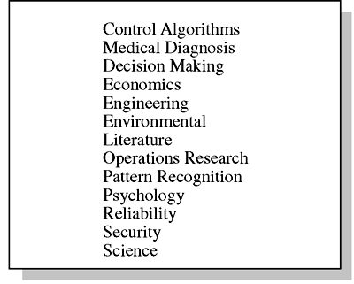
Table 5.7 Some Applications of Fuzzy Theory

Slide 43
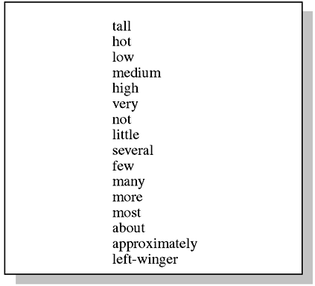
Table 5.8 Some Fuzzy Terms of Natural Language

Slide 44
Linguistic Variables
One application of fuzzy sets is computational linguistics – calculating with natural language statements.
Fuzzy sets and linguistic variables can be used to quantify the meaning of natural language, which can then be manipulated.
Linguistic variables must have a valid syntax and semantics.

Slide 45
Extension Principle
The extension principle defines how to extend the domain of a given crisp function to include fuzzy sets.
Using this principle, ordinary or crisp functions can be extended to work a fuzzy domain with fuzzy sets.
This principle makes fuzzy sets applicable to all fields.

Slide 46
Fuzzy Logic
Just as classical logic forms the basis of expert systems, fuzzy logic forms the basis of fuzzy expert systems.
Fuzzy logic is an extension of multivalued logic – the logic of approximate reasoning – inference of possibly imprecise conclusions from a set of possibly imprecise premises.

Slide 47
Possibility and Probability and Fuzzy Logic
In fuzzy logic, possibility refers to allowed values.
Possibility distributions are not the same as probability distributions – frequency of expected occurrence of some random variable.

Slide 48
Translation Rules
Translation rules specify how modified or composite propositions are generated from their elementary propositions.
1. Type I modification rules
2. Type II composition rules
3. Type III quantification rules
4. Type IV quantification rules

Slide 49
State of Uncertainty
Commercial Applications
There are two mountains – logic and uncertainty
Expert systems are built on the mountain of logic and must reach valid conclusions given a set of premises – valid conclusions given that –
  The rules were written correctly
  The facts upon which the inference engine generates valid conclusions are true facts
Today, fuzzy logic and Bayesian theory are most often used for uncertainty.

Slide 50
Summary
In this chapter, non-classical probability theories of uncertainty were discussed.
Certainty factors, Dempster-Shafer and fuzzy theory are ways of dealing with uncertainty in expert systems.
Certainty factors are simple to implement where inference chains are short (e.g. MYCIN)
Certainty factors are not generally valid for longer inference chains.

Slide 51
Summary
Dempster-Shafer theory has a rigorous foundation and is used for expert systems.
Fuzzy theory is the most general theory of uncertainty formulated to date and has wide applicability due to the extension principle.

