Slide 1

Chapter 7:
Introduction to CLIPS
Expert Systems: Principles and Programming, Fourth Edition

Slide 2
What is CLIPS?
CLIPS is a multiparadigm programming language that provides support for:
  Rule-based
  Object-oriented
  Procedural programming
Syntactically, CLIPS resembles:
  Eclipse
  CLIPS/R2
  JESS

Slide 3
Other CLIPS Characteristics
CLIPS supports only forward-chaining rules.
The OOP capabilities of CLIPS are referred to as CLIPS Object-Oriented Language (COOL).
The procedural language capabilities of CLIPS are similar to languages such as:
  C
  Ada
  Pascal
  Lisp

Slide 4
CLIPS Characteristics
CLIPS is an acronym for C Language Integrated Production System.
CLIPS was designed using the C language at the NASA/Johnson Space Center.
CLIPS is portable – PC → CRAY.

Slide 5
CLIPS Notation
Symbols other than those delimited by < >, [ ], or { } should be typed exactly as shown.
[ ] mean the contents are optional and < > mean that a replacement is to be made.
* following a description means that the description can be replaced by zero or more occurrences of the specified value.

Slide 6
CLIPS Notation
Descriptions followed by + mean that one or more values specified by description should be used in place of the syntax description.
A vertical bar | indicates a choice among one or more of the items separated by the bars.

Slide 7
Fields
To build a knowledge base, CLIPS must read input from keyboard / files to execute commands and load programs.
During the execution process, CLIPS groups symbols together into tokens – groups of characters that have the same meaning.
A field is a special type of token of which there are 8 types.

Slide 8
Numeric Fields
The floats and integers make up the numeric fields – simply numbers.
Integers have only a sign and digits.
Floats have a decimal and possibly “e” for scientific notation.

Slide 9
Symbol Fields
Symbols begin with printable ASCII characters followed by zero or more characters, followed by a delimiter.
CLIPS is case sensitive.

Slide 10
String Fields
Strings must begin and end with double quotation marks.
Spaces w/in the string are significant.
The actual delimiter symbols can be included in a string by preceding the character with a backslash.

Slide 11
Address Fields
External addresses represent the address of an external data structure returned by a user-defined function.
Fact address fields are used to refer to a specific fact.
Instance Name / Address field – instances are similar to facts addresses but refer to the instance rather than a fact.

Slide 12
Entering / Exiting CLIPS
The CLIPS prompt is: CLIPS>
This is the type-level mode where commands can be entered.
To exit CLIPS, one types: CLIPS> (exit) 
CLIPS will accept input from the user / evaluate it / return an appropriate response:
CLIPS> (+ 3 4)  → value 7 would be returned.

Slide 13
Facts and CLIPS
To solve a problem, CLIPS must have data or information with which to reason.
Each chunk of information is called a fact.
Facts consist of:
  Relation name (symbolic field)
  Zero or more slots w/associated values

Slide 14
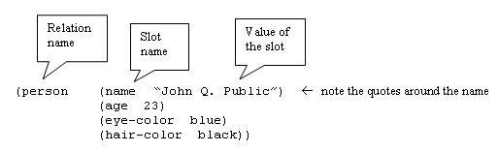
Example Fact in CLIPS

Slide 15
Deftemplate
Before facts can be constructed, CLIPS must be informed of the list of valid slots for a given relation name.
A deftemplate is used to describe groups of facts sharing the same relation name and contain common information.

Slide 16


Deftemplate General Format

Slide 17
Deftemplate vs. Ordered Facts
Facts with a relation name defined using deftemplate are called deftemplate facts.
Facts with a relation name that does not have a corresponding deftemplate are called ordered facts – have a single implied multifield slot for storing all the values of the relation name.

Slide 18
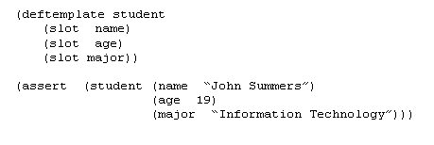
Adding Facts
CLIPS store all facts known to it in a fact list.
To add a fact to the list, we use the assert command.

Slide 19
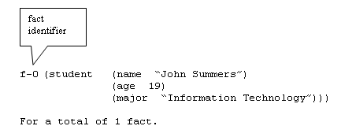
Displaying Facts
CLIPS> (facts) 

Slide 20
Removing Facts
Just as facts can be added, they can also be removed.
Removing facts results in gaps in the fact identifier list.
To remove a fact:
  CLIPS> (retract 2) 

Slide 21
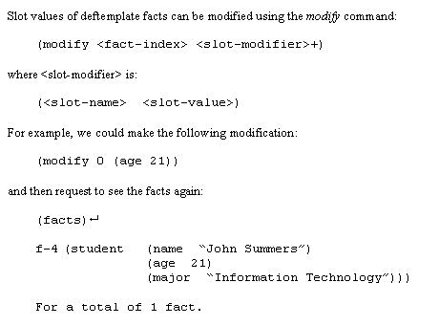
Modifying Facts
Slot values of deftemplate facts can be modified using the modify command:

Slide 22
Results of Modification
A new fact index is generated because when a fact is modified:
  The original fact is retracted
  The modified fact is asserted
The duplicate command is similar to the modify command, except it does not retract the original fact.

Slide 23
Watch Command
The watch command is useful for debugging purposes.
If facts are “watched”, CLIPS will automatically print a message indicating an update has been made to the fact list whenever either of the following has been made:
  Assertion
  Retraction

Slide 24
Deffacts Construct
The deffacts construct can be used to assert a group of facts.
Groups of facts representing knowledge can be defined as follows:
(deffacts <deffacts name> [<optional] comment]
<facts> * )
The reset command is used to assert the facts in a deffacts statement.

Slide 25
The Components of a Rule
To accomplish work, an expert system must have rules as well as facts.
Rules can be typed into CLIPS (or loaded from a file).
Consider the pseudocode for a possible rule:
  IF the emergency is a fire
  THEN the response is to activate the sprinkler system

Slide 26
Rule Components
First, we need to create the deftemplate for the types of facts:
  (deftemplate emergency (slot type))
  -- type would be fire, flood, etc.
Similarly, we must create the deftemplate for the types of responses:
  (deftemplate response (slot action))
  -- action would be “activate the sprinkler”

Slide 27
Rule Components
The rule would be shown as follows:
(defrule fire-emergency “An example rule”
(emergency (type fire))
=>
(assert (response
(action activate-sprinkler-system))))

Slide 28
Analysis of the Rule
The header of the rule consists of three parts:
  Keyword defrule
  Name of the rule – fire-emergency
  Optional comment string – “An example rule”
After the rule header are 1+ conditional elements – pattern CEs
Each pattern consists of 1+ constraints intended to match the fields of the deftemplate fact

Slide 29
Analysis of Rule
If all the patterns of a rule match facts, the rule is activated and put on the agenda.
The agenda is a collection of activated rules.
The arrow => represents the beginning of the THEN part of the IF-THEN rule.
The last part of the rule is the list of actions that will execute when the rule fires.

Slide 30
The Agenda and Execution
To run the CLIPS program, use the run command:
  CLIPS> (run [<limit>])
  -- the optional argument <limit> is the maximum number of rules to be fired – if omitted, rules will fire until the agenda is empty.

Slide 31
Execution
When the program runs, the rule with the highest salience on the agenda is fired.
Rules become activated whenever all the patterns of the rule are matched by facts.
The reset command is the key method for starting or restarting .
Facts asserted by a reset satisfy the patterns of one or more rules and place activation of these rules on the agenda.

Slide 32
What is on the Agenda?
To display the rules on the agenda, use the agenda command:
  CLIPS> (agenda) 
Refraction is the property that rules will not fire more than once for a specific set of facts.
The refresh command can be used to make a rule fire again by placing all activations that have already fired for a rule back on the agenda.

Slide 33
Command for Manipulating Constructs
The list-defrules command is used to display the current list of rules maintained by CLIPS.
The list-deftemplates displays the current list of deftemplates.
The list-deffacts command displays the current list of deffacts.
The ppdefrule, ppdeftemplate and ppdeffacts commands display the text representations of a defrule, deftemplate, and a deffact, respectively.

Slide 34
Commands
The undefrule, undeftemplate, and undeffacts commands are used to delete a defrule, a deftemplate, and a deffact, respectively.
The clear command clears the CLIPS environment and adds the initialfact-defacts to the CLIPS environment.
The printout command can also be used to print information.

Slide 35
Other Commands
Set-break – allows execution to be halted before any rule from a specified group of rules is fired.
Load – allows loading of rules from an external file.
Save – opposite of load, allows saving of constructs to disk

Slide 36
Commenting and Variables
Comments – provide a good way to document programs to explain what constructs are doing.
Variables – store values, syntax requires preceding with a question mark (?)

Slide 37
Fact Addresses, Single-Field Wildcards, and Multifield Variables
A variable can be bound to a fact address of a fact matching a particular pattern on the LHS of a rule by using the pattern binding operator “<-”.
Single-field wildcards can be used in place of variables when the field to be matched against can be anything and its value is not needed later in the LHS or RHS of the rule.
Multifield variables and wildcards allow matching against more than one field in a pattern.

Slide 38
Summary
In this chapter, we looked at the fundamental components of CLIPS.
Facts make up the first component of CLIPS, made up of fields – symbol, string, integer, or float.
The deftemplate construct was used to assign slot names to specific fields of a fact.
The deffacts construct was used to specify facts as initial knowledge.

Slide 39
Summary
Rules make up the second component of a CLIPS system.
Rules are divided into LHS – IF portion and the RHS – THEN portion.
Rules can have multiple patterns and actions.
The third component is the inference engine – rules having their patterns satisfied by facts produce an activation that is placed on the agenda.

Slide 40
Summary
Refraction prevents old facts from activating rules.
Variables are used to receive information from facts and constrain slot values when pattern matching on the LHS of a rule.
Variables can store fact addresses of patterns on the LHS of a rule so that the fact bound to the pattern can be retracted on the RHS of the rule.
We also looked at single-field wildcards and multifield variables.

