Slide 1

Chapter 8:
Advanced Pattern Matching
Expert Systems: Principles and Programming, Fourth Edition

Slide 2
Field Constraints
In addition to pattern matching capabilities and variable bindings, CLIPS has more powerful pattern matching operators.
Consider writing a rule for all people who do not have brown hair:
  We could write a rule for every type of hair color that is not brown.
  This involves testing the condition in a roundabout manner – tedious, but effective.

Slide 3
Field Constraints
The technique for writing a rule for all non-brown hair colors implies that we have the ability to supply all hair colors – virtually impossible.
An alternative is to use a field constraint to restrict the values a field may have on the LHS – the THEN part of the rule.

Slide 4
Connective Constraints
Connective constraints are used to connect variables and other constraints.
Not connective – the ~ acts on the one constraint or variable that immediately follows it.
Or constraint – the symbol | is used to allow one or more possible values to match a field or a pattern.
And constraint – the symbol & is useful with binding instances of variables and on conjunction with the not constraint.

Slide 5
Combining Field Constraints
Field constraints can be used together with variables and other literals to provide powerful pattern matching capabilities.
Example #1: ?eyes1&blue|green
  This constraint binds the person’s eye color to the variable, ?eyes1 if the eye color of the fact being matched is either blue or green.
Example #2: ?hair1&~black
  This constraint binds the variable ?hair1 if the hair color of the fact being matched is not black.

Slide 6
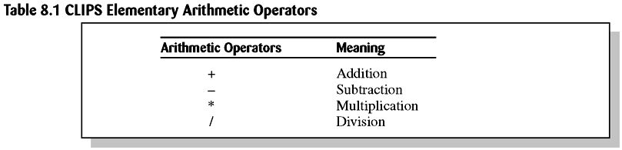
Functions and Expressions
CLIPS has the capability to perform calculations.
The math functions in CLIPS are primarily used for modifying numbers that are used to make inferences by the application program.

Slide 7
Numeric Expressions in CLIPS
Numeric expressions are written in CLIPS in LISP-style – using prefix form – the operator symbol goes before the operands to which it pertains.
Example #1:
  5 + 8 (infix form) → + 5 8 (prefix form)
Example #2:
  (infix) (y2 – y1) / (x2 – x1) > 0
  (prefix) (> ( / ( - y2 y1 ) (- x2 x1 ) ) 0)

Slide 8
Return Values
Most functions (addition) have a return value that can be an integer, float, symbol, string, or multivalued value.
Some functions (facts, agenda commands) have no return values – just side effects.
Division results are usually rounded off.
Return values for +, -, and * will be integer if all arguments are integer, but if at least one value is floating point, the value returned will be float.

Slide 9
Variable Numbers of Arguments
Many CLIPS functions accept variable numbers of arguments.
Example:
  CLIPS> (- 3 5 7)  returns 3 - 5 =-2 - 7 = -9
There is no built-in arithmetic precedence in CLIPS – everything is evaluated from left to right.
To compensate for this, precedence must be explicitly written.

Slide 10
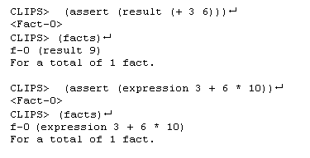
Embedding Expressions
Expressions may be freely embedded within other expressions:

Slide 11
Summing Values Using Rules
Suppose you wanted to sum the areas of a group of rectangles.
  The heights and widths of the rectangles can be specified using the deftemplate:
(deftemplate rectangle (slot height) (slot width))
The sum of the rectangle areas could be specified using an ordered fact such as:
(sum 20)

Slide 12
Summing Values
A deffacts containing sample information is:
(deffacts initial-information
(rectangle (height 10) (width 6))
(rectangle (height 7) (width 5)
(rectangle (height 6) (width 8))
(rectangle (height 2) (width 5))
(sum 0))

Slide 13
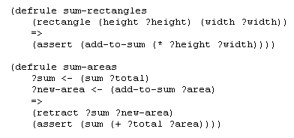
Summing Values

Slide 14
The Bind Function
Sometimes it is advantageous to store a value in a temporary variable to avoid recalculation.
The bind function can be used to bind the value of a variable to the value of an expression using the following syntax:
  (bind <variable> <value>)

Slide 15

I/O Functions
When a CLIPS program requires input from the user of a program, a read function can be used to provide input from the keyboard:

Slide 16
Read Function from Keyboard
The read function can only input a single field at a time.
Characters entered after the first field up to the  are discarded.
To input, say a first and last name, they must be delimited with quotes, “xxx xxx”.
Data must be followed by a carriage return to be read.

Slide 17
I/O from/to Files
Input can also come from external files.
Output can be directed to external files.
Before a file can be accessed, it must be opened using the open function:
  Example:
  (open “mydata.dat” data “r”)
mydata.dat – is the name of the file (path can also be provided)

Slide 18
I/O from/to Files
data – is the logical name that CLIPS associates with the file
“r” – represents the mode – how the file will be used – here read access
The open function acts as a predicate function
  Returns true if the file was successfully opened
  Returns false otherwise

Slide 19
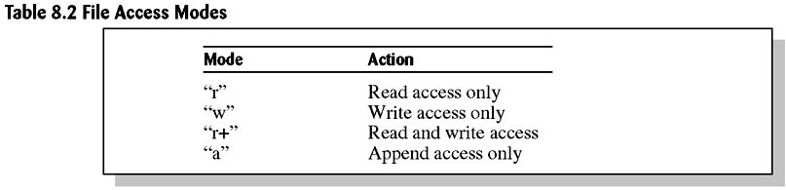
Table 8.2 File Access Modes

Slide 20
Close Function
Once access to the file is no longer needed, it should be closed.
Failure to close a file may result in loss of information.
General format of the close function:
(close [<file-ID>])
  (close data) ← example

Slide 21
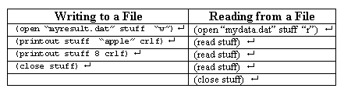
Reading / Writing to a File
Which logical name used, depends on where information will be written – logical name t refers to the terminal (standard output device).

Slide 22
Formatting
Output sent to a terminal or file may need to be formatted – enhanced in appearance.
To do this, we use the format function which provides a variety of formatting styles.
General format:
(format <logical-name> <control-string> <parameters>*)

Slide 23
Formatting
Logical name – t – standard output device; or logical name associated with a file.
Control string:
  Must be delimited with quotes
  Consists of format flags to indicate how parameters should be printed
  1 – 1 correspondence between flags and number of parameters – constant values or expressions
  Return value of the format function is the formatted string – nil can be used to suppress printing.

Slide 24
Formatting
Example:
(format nil “Name: %-15s Age: %3d” “Bob Green” 35) 
Produces the results:
“Name: Bob green Age: 35”

Slide 25
Specifications of Format Flag
%-m.Nx
The “-” means to left justify (right is the default)
M – total field width – no truncation occurs
N – number of digits of precision – default = 6
x – display format specification

Slide 26
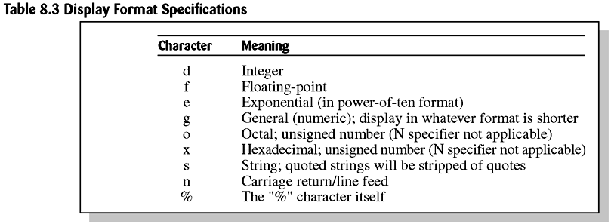
Table 8.3 Display Format Specifications

Slide 27
Readline Function
To read an entire line of input, the readline function can be used:
(readline [<logical-name>])
Example:
(defrule get-name
  =>
  (printout t “What is your name? “
  (bind ?response (readline))
  (assert (user’s-name ?response)))

Slide 28
Predicate Functions
A predicate function is defined to be any function that returns:
  TRUE
  FALSE
Any value other than FALSE is considered TRUE.
We say the predicate function returns a Boolean value.

Slide 29
The Test Conditional Element
Processing of information often requires a loop.
Sometimes a loop needs to terminate automatically as the result of an arbitrary expression.
The test condition provides a powerful way to evaluate expressions on the LHS of a rule.
Rather than pattern matching against a fact in a fact list, the test CE evaluates an expression – outermost function must be a predicate function.

Slide 30
Test Condition
A rule will be triggered only if all its test CEs are satisfied along with other patterns.
(test <predicate-function>)
Example:
(test (> ?value 1))

Slide 31
Predicate Field Constraint
The predicate field constraint : allows for performing predicate tests directly within patterns.
The predicate field constraint is more efficient than using the test CE.
It can be used just like a literal field constraint – by itself or part of a complex field.
The predicate field constraint is always followed by a function for evaluation (predicate function).

Slide 32
Return Value Constraint
The return value constraint = allows the return value of a function to be used for comparison inside a pattern.
The return value constraint must be followed by a function (not necessarily a predicate function).
The function must have a single-field return value.

Slide 33
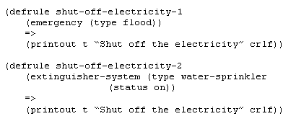
The OR Conditional Element
Consider the two rules:

Slide 34
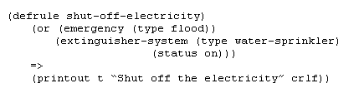
OR Conditional Element
These two rules can be combined into one rule – or CE requires only one CE be satisfied:

Slide 35
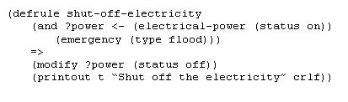
The And Conditional Element
The and CE is opposite in concept to the or CE – requiring all the CEs be satisfied:

Slide 36
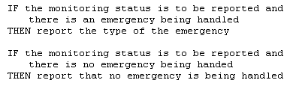
Not Conditional Element
When it is advantageous to activate a rule based on the absence of a particular fact in the list, CLIPS allows the specification of the absence of the fact in the LHS of a rule using the not conditional element:

Slide 37
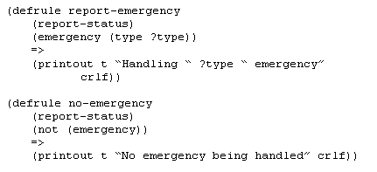
Not Conditional
We can implement this as follows:

Slide 38
The Exists Conditional Element
The exists CE allows one to pattern match based on the existence of at least one fact that matches a pattern without regard to the total number of facts that actually match the pattern.
This allows a single partial match or activation for a rule to be generated based on the existence of one fact out of a class of facts.

Slide 39
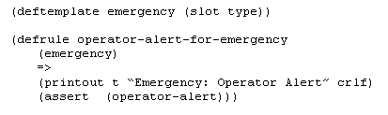
Exists Conditional

Slide 40
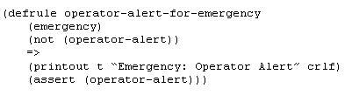
Exists
When more than one emergency fact is asserted, the message to the operators is printed more than once. The following modification prevents this:

Slide 41
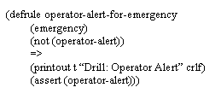
Exists
This assumes there was already an alert – triggered by an operator-emergency rule. What if the operators were merely placed on alert to a drill:

Slide 42
Exists
Now consider how the rule has been modified using the exists CE:
(defrule operator-alert-for-emergency
(exists (emergency))
(not (operator-alert))
=>
(printout t “Emergency: Operator Alert” crlf)
(assert (operator-alert))))

Slide 43
Forall / Logical
Conditional Elements
The forall CE allows one to pattern match based on a set of CEs that are satisfied for every occurrence of another CE.
The logical CE allows one to specify that the existence of a fact depends on the existence of another fact or group of facts.

Slide 44
Summary
We have introduced the concept of field constraints – not, and, and or.
Functions are entered into CLIPS top-level command loop or are used on the LHS or RHS of a rule.
  Many functions have variable number of arguments
  Function calls can be nested w/in other function calls

Slide 45
Summary
CLIPS provides several I/O functions.
  Open / close
  Printout / read / readline
  Format
Various concepts for controlling the flow of execution are available
Also included in the discussion were the following CEs:
  Test, And, Or, Exists, Forall, and logical

