Slide 1

Chapter 9:
Modular Design, Execution Control, and Rule Efficiency
Expert Systems: Principles and Programming, Fourth Edition

Slide 2
Deftemplate Attributes
CLIPS provides slot attributes which can be specified when deftemplate slots are defined.
Slot attributes provide strong typing and constraint checking.
One can define the allowed types that can be stored in a slot, range of numeric values.
Multislots can specify min / max numbers of fields they can contain.
Default attributes can be provided for slots not specified in an assert command.

Slide 3
Type Attribute
Defines the data types can be placed in a slot
Example:
  (deftemplate person
  (multislot name (type SYMBOL))
  (SLOT AGE (TYPE integer)))
Once defined, CLIPS will enforce these restrictions on the slot attributes
  name – must store symbols
  age – must store integers

Slide 4
Static and Dynamic Constraint Checking
CLIPS provides two levels of constraint checking
  Static constraint checking
    Performed when CLIPS parses expression / constant
    Can be disabled by calling the set-static-constraint-checking function and passing it FALSE
  Dynamic constraint checking
    Performed on facts when they are asserted
    Can be enabled / disabled with set-dynamic-constraint-checking

Slide 5
Allowed Value Attributes
CLIPS allows one to specify a list of allowed values for a specific type – 8 are provided:
Symbols | Strings
Lexemes | Integers
Floats | Numbers
Instance-names | Values

Slide 6
Range Attributes
This attribute allows the specification of minimum and maximum numeric values.
Example:
  (deftemplate person
  (multislot name (type SYMBOL))
  (slot age (type INTEGER)
  (range 0 ?VARIABLE)))

Slide 7
Default Attribute
Previously, each deftemplate fact asserted had an explicit value stated for every slot.
It is often convenient to automatically have a specified value stored in a slot if no value is explicitly stated in an assert command.
  Example:
    (default <default-specification>)
    
    can be either ?DERIVE or ?NONE or single expression, zero or more expressions

Slide 8
Default-Dynamic Attribute
When the default attribute is used, the default value for a slot is determined when the slot definition is parsed or when the fact that will use the default value is asserted.

Slide 9
Conflicting Slot Attributes
CLIPS does not allow you to specify conflicting attributes for a slot.

Slide 10
Salience
CLIPS provides two explicit techniques for controlling the execution of rules:
  Salience
  Modules
Salience allows the priority of rules to be explicitly specified.
The agenda acts like a stack (LIFO) – most recent activation placed on the agenda being first to fire.

Slide 11
Salience
Salience allows more important rules to stay at the top of the agenda, regardless of when they were added.
Lower salience rules are pushed lower on the agenda; higher salience rules are higher.
Salience is set using numeric values in the range -10,000 → +10,000 – zero is intermediate priority.
Salience can be used to force rules to fire in a sequential fashion.

Slide 12
Salience
Rules of equal salience, activated by different patterns are prioritized based on the stack order of facts.
If 2+ rules with same salience are activated by the same fact, no guarantee about the order in which they will be place on the agenda.

Slide 13
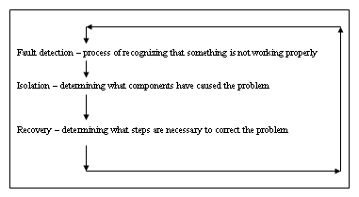
Phases and Control Facts

Slide 14
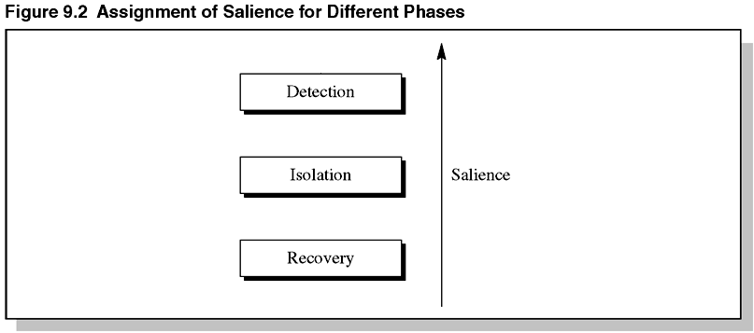
Figure 9.2 Assignment of Salience for Different Phases

Slide 15
Implementation of System
Approaches:
  Embed the control knowledge directly into the rules.
  Example:
  Detection rules would include rules indicating when the isolation phase should be entered. Each group of rules would be given a pattern indicating in which phase it would be applicable.

Slide 16
Implementation
  Use salience to organize the rules.
  Separate the control knowledge from the domain knowledge. Each rule is given a control pattern that indicates its applicable phase. Control rules are then written to transfer control between the different phases.

Slide 17
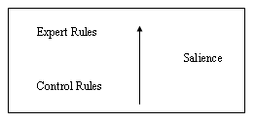
Salience Hierarchy
Salience hierarchy is a description of the salience values used by an expert system.
Each level corresponds to a specific set of rules whose members are all given the same salience.
When rules for detection / isolation / recovery are zero, salience hierarchy is:

Slide 18
Misuse of Salience
Because salience is such a powerful tool, allowing explicit control over execution, there is potential for misuse.
Well-designed rule-based programs should allow inference engine to control firings in an optimal manner.
Salience should be used to determine the order when rules fire, not for selecting a single rule from a group of rules when patterns can control criteria for selection.

Slide 19
Rule of Thumb
No more than seven salience values should ever be required for coding an expert system – bested limited to 3 – 4.
For large expert systems, programmers should use modules to control the flow of execution – limited to 2 – 3 salience values.

Slide 20
The Defmodule Construct
Up to now, all defrules, deftemplates, and deffacts have been contained in a single work space.
CLIPS uses the defmodule construct to partition a knowledge base by defining the various modules.
Syntax:
  (defmodule <module-name> [<comment>])

Slide 21
The MAIN Module
By default, CLIPS defines a MAIN module as seen below:
CLIPS>(clear)
CLIPS>(DEFTEMPLATE SENSOR (SLOT NAME))
CLIPS>(PPDEFTEMPLATE sensor)
CLIPS>(DEFTEMPLATE MAIN::sensor (slot name))
CLIPS>
The symbol :: is called the module separator

Slide 22
Examples of Defining Modules
Examples:
  CLIPS> (defmodule DETECTION) 
  CLIPS> (defmodule ISOLATION) 
  CLIPS> (defmodule RECOVERY) 
By default, CLIPS puts newly defined constructs in the current module – MAIN, when CLIPS starts or is cleared.
When a new modules is defined, it becomes current.

Slide 23
Examples
To override this, the module where the construct will be placed can be specified in the construct’s name:
CLIPS> (defule ISOLATION::example2 =>) 
CLIPS> (ppdefrule example2) 
(defrule ISOLATION::example2 =>)
CLIP>

Slide 24
Examples
To find out which module is current:
  CLIPS> (get-current-module) 
To change the current module:
  CLIPS> (set-current-module DETECTION) 
Specifying modules in commands:
CLIPS> (list-defrules RECOVERY) 

Slide 25
Specifying Modules in Commands
By default, most CLIPS commands operating on a construct work only on the constructs contained in the current module.
CLIPS> (list-defrules RECOVERY) 
Note the list-defrules command accepts a module name as an optional argument.

Slide 26
Importing and Exporting Facts
Just as constructs can be partitioned by placing them in separate modules, facts can also be partitioned.
Asserted facts are automatically associated with the module in which their corresponding deftemplates are defined.
The facts command can accept a module name as an argument:
(facts [<module-name>]
[<start> [<end> [<maximum>]]])

Slide 27
Importing/Exporting Facts
Unlike defrule and deffacts constructs, deftemplate constructs can be shared with other modules.
A fact is “owned” by the module in which its deftemplate is contained.
The owning module can export the deftemplate associated with the fact making that fact and all other facts using that deftemplate visible to other modules.

Slide 28
Importing/Exporting Facts
It is not sufficient just to export the deftemplate to make a fact visible to another module.
To use a deftemplate defined in another module, a module must also import the deftemplate definition.
A construct must be defined before it can be specified in an import list, but it does not have to be defined before it can be specified in an export list; so, it is impossible for two modules to import from each other.

Slide 29
Modules and Execution Control
The defmodule construct can be used to control the execution of rules.
Each module defined in CLIPS has its own agenda.
Execution can be controlled by deciding which module’s agenda is selected for executing rules.

Slide 30
The Agenda Command
To display activations for the current module:
CLIPS> (agenda) 
To display activations for the DETECTION module:
CLIPS> (agenda DETECTION) 

Slide 31
The Focus Command
Assume there are rules on several agendas – when the run command is issued, no rules fire.
CLIPS maintains a current focus that determines which agenda the run command uses during execution.
The reset and clear commands automatically set the current focus to the MAIN module.
The current focus does not change when the current module is changed.

Slide 32
The Focus Command
To change the current focus:
  CLIPS> (focus <module-name>+)
Example:
  CLIPS> (focus DETECTION) 
  TRUE
  CLIPS> (run)
Now rules on the DETECTION module will be fired.

Slide 33
The Focus Command
The focus command also recalls the previous value of the current focus – the top of the stack data structure called the focus stack.
When the focus command changes the current focus, it is pushing a new current focus onto the top of the stack.
As rules execute, the current focus becomes empty, is popped from the focus stack, the next module becomes the current focus until empty.

Slide 34
Manipulating/Examining the Focus Stack
CLIPS provides several commands for manipulating the current focus and stack:
Clear-focus-stack – removes all modules from focus stack
Get-focus – returns module name of current focus or FALSE if empty
Pop-focus – removes current focus from stack or FALSE if empty

Slide 35
Manipulating/Examining the Focus Stack
Get-focus-stack – returns a multifield value containing the modules on the focus stack
Watch command – can be used to see changes in the focus stack
Return command – terminate execution of a rule’s RHS, remove current focus from focus stack, return execution to next module
Auto-focus – changes default that a rule’s module is not auto focused upon when that rule is activated.

Slide 36
The Rete Pattern-Matching Algorithm
Rule-based languages like CLIPS use the Rete Pattern-Matching Algorithm for matching facts against the patterns in rules to determine which rules have had their conditions satisfied.
If the matching process occurs only once, the inference engine simply examines each rule and then searches the set of facts to see if the rule’s patterns have been satisfied – if so it is place on the agenda.

Slide 37
Rete Algorithm
In rule-based languages, the matching process takes place repeatedly and the fact list is modified on each cycle of the execution.
Such changes can cause previously unsatisfied patterns to be satisfied or vice versa – as facts are added/removed, the set of rules must be updated/maintained.
Checking rules against facts each cycle is a slow process.

Slide 38
Rete Algorithm
Unnecessary computation can be avoided by remembering what has already been matched from cycle to cycle and computing only necessary changes.
The Rete algorithm uses temporal redundancy to save the state of the matching process from cycle to cycle, recomputing changes in this state only for the change that occurred in the fact list.

Slide 39
Rete Algorithm
The Rete algorithm also takes advantage of structural similarity in a rules.

Slide 40
Pattern Network
Problems related to matching facts can be divided into two steps:
  When facts are added and removed it must be determined which patterns have been matched.
  Comparison of variable bindings across patterns must be checked to determine the partial matches for a group of patterns.
  This process is performed in the pattern network – similar to a tree.

Slide 41
Join Network
Once it has been determined which patterns have been matched by facts, comparison of variable binding across patterns must be checked to ensure that variables used in more than one pattern have consistent values.
This is done in the join network which takes advantage of structural similarity by sharing joins between rules.

Slide 42
Importance of Pattern Order
Because the Rete algorithm saves the state from one cycle to the next, it is important to make sure that rules do not generate large numbers of partial matches.

Slide 43
Guidelines for Ordering Patterns
Guidelines:
  Place the most specific pattern toward the front of the LHS of a rule.
  Patterns matching against facts frequently added/removed from fact list should be placed toward the end of the LHS of a rule.
  Patterns that will match very few facts in the fact list should be placed near the front of the rule.

Slide 44
General Rules vs. Specific Rules
Specific rules tend to isolate much of the pattern-matching process in the pattern network, reducing the amount of work in the join network.
General rules often provide more opportunity to sharing in the pattern and join networks.
A single rule can also be more maintained than a group.
General rules need to be written carefully.

Slide 45
Simple Rules vs. Complex Rules
The easiest way to code a problem in a rule-based language is not necessarily the best.
The number of comparisons performed can often be reduced by using temporary facts to store data.

Slide 46
Summary
We discussed various CLIPS features to aid in developing more robust expert systems.
Deftemplate attributes permit enforcement of type and value constraints.
Salience provides a mechanism for more complex control structures to prioritize rules.
The defmodule construct allows a knowledge base to be partitioned.
We demonstrated the importance of matching facts against rules efficiently.

Slide 47
Summary
Rules are converted into data structures in a rule network consisting of a pattern network and a join network.
Ordering of patterns can have a significant effect on the performance of rules.
The most specific patterns and patterns matching the fewest facts should be placed first in the LHS of a rule, volatile patterns last in the LHS of a rule.

