Slide 1

Chapter 12:
Expert Systems Design Examples
Expert Systems: Principles and Programming, Fourth Edition

Slide 2
Summary
Learn about incorporating uncertainty into CLIPS
The use of decision trees to provide a useful paradigm
Learn how to emulate backward chaining in a CLIPS program
Constructing a framework of simpler expert systems into one large program

Slide 3
Uncertainty Factors
Although CLIPS has no built-in capabilities for handling uncertainty, it is possible to incorporate uncertainty into CLIPS by placing information dealing with uncertainty directly into the facts and rules.
We begin by exploring how uncertainty was incorporated into the expert system MYCIN.

Slide 4
MYCIN and Uncertainty
MYCIN represents factual information as object-attribute-value (OAV) triplets.
MYCIN also associates with each fact a certainty factor (CF) which represents a degree of belief in the fact.
  -1 means the fact is false
  0 means no information is known about the fact
  1 means the fact is known to be true

Slide 5
MYCIN and Uncertainty
Because CLIPS does not handle uncertainty factors automatically, a slot in each fact will be used to represent the uncertainty factor.
MYCIN allows the same OAV triple to be derived by separate rules. The OAV triples are then combined producing a single OAV triple that combines the certainty factors.

Slide 6
MYCIN and Uncertainty
In order to allow identical OAV triples to be asserted with the same certainty factors, the set-fact-duplication command can be used to disable the CLIPS behavior preventing duplicated facts from being asserted.
MYCIN combines two identical OAV triples into a single OAV triple with a combined uncertainty, computed as:
  New Uncertainty = (CF₁ + CF₂) – (CF₁ * CF₂)

Slide 7
MYCIN and Uncertainty
Since CLIPS does not automatically handle certainty factors for facts, it does not automatically combine two OAV triplets derived from different rules. The combination is handled by a rule that searches the fact list for identical OAV triples to be combined.
Next, it is necessary to link the certainty factors of the facts that match the LHS of the rule to the certainty factors of the facts asserted by the RHS of the rule – CF of
LHS < 0.2 will not fire.

Slide 8

MYCIN and Uncertainty
The certainty factor of a fact asserted from the RHS of a rule is derived by multiplying the CF of the assertion by the certainty factor of the LHS of the rule.

Slide 9
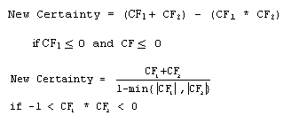
MYCIN and Uncertainty
The single combine-certainties method handles only the case where both certainty factors are positive. By additional methods the other cases of certainty can be handled.

Slide 10
Decision Trees
Decision trees provide a useful paradigm for solving certain types of classification problems.
Decision trees derive solutions by reducing the set of possible solutions with a series of decisions or questions that prune their search space.
Problems suitable for decision trees are those that provide the answer to a problem from a predetermined set of possible answers.

Slide 11
Decision Trees
Decision trees consist of nodes and branches, connecting parent nodes to child from the top to bottom. The top node (root) has no parent. Every other node has only one parent. Nodes with no children are leaves.
Leaf nodes represent all possible solutions that can be derived from the tree – answer nodes. All other nodes are decision nodes.

Slide 12
Decision Trees
In general, a decision node may use any criteria to select which branch to follow as long as it yields only one branch. The branch selected may be a set or range of values, etc.
The procedure to traverse a tree to reach an answer is simple – begin at root, if the current node is decision, answer the question – YES, move left, NO, move right. When answer node is current location value is derived from the decision tree.

Slide 13
Decision Trees with
Multiple Branches
A binary decision tree may prove inefficient – not allowing for a set of responses or a series of cases.
A modified decision tree allows for multiple branches – giving a series of possible decisions.

Slide 14
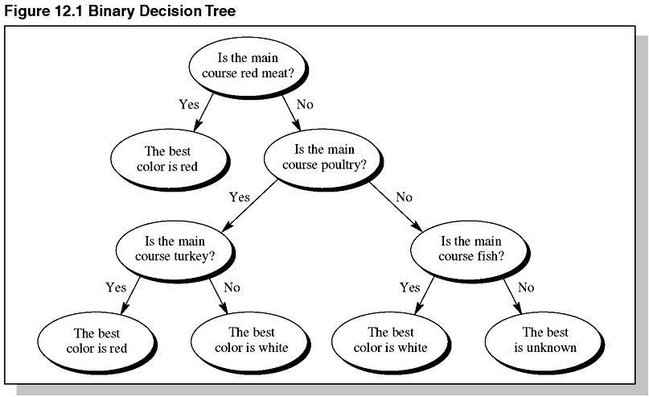
Figure 12.1 Binary Decision Tree

Slide 15
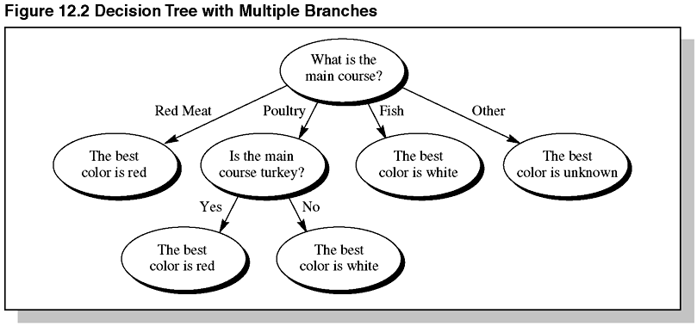
Figure 12.2 Decision Tree with Multiple Branches

Slide 16
Decision Trees
That Learn
Sometimes it is useful to add new knowledge to a decision tree.
Learning can result in the decision tree becoming unbalanced – efficient decision trees are balanced.

Slide 17
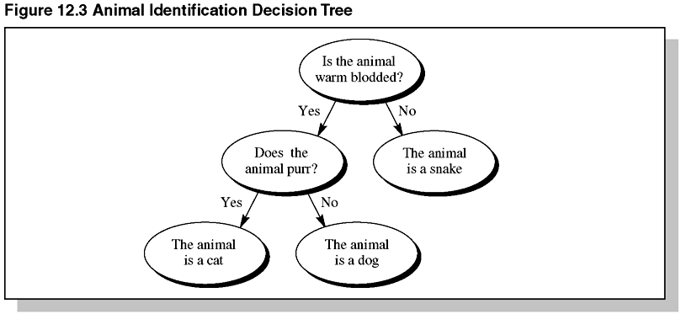
Figure 12.3 Animal Identification
Decision Tree

Slide 18
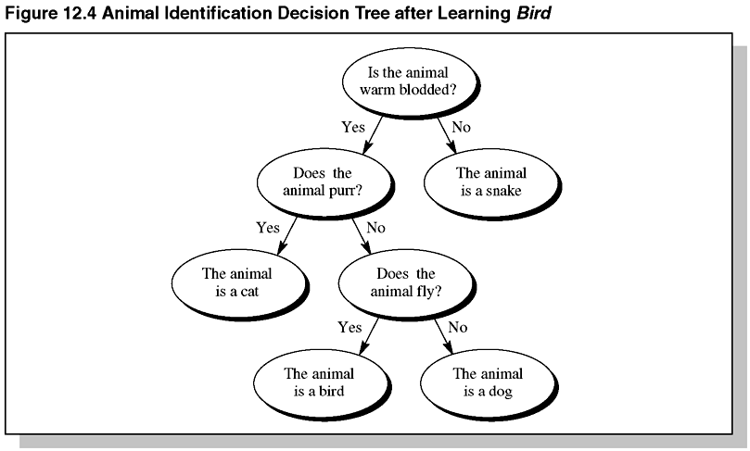
Figure 12.4 Animal Identification
Decision Tree After Learning Bird

Slide 19
A Rule-Based
Decision Tree Program
The first step implementing the learning process in a decision tree in CLIPS is to decide how knowledge should be represented.
Since the tree should learn, the tree should be represented as facts instead of rules – facts are easily added / deleted from a tree.
A set of CLIPS rules can be used to traverse the decision tree by implementing the Solve_Tree_and_Learn algorithm using rule-based approach.

Slide 20
A Rule-Based
Decision Tree Program
Each node of the tree should be represented by a fact.
From one run to the next, information about what has been learned will be stored in a file.
The rules for traversal of the tree must be determined.

Slide 21
Backward Chaining
CLIPS does not directly implement backward chaining but it can be emulated using forward chaining CLIPS rules.
Backward chaining rules are represented as facts and acted on by the CLIPS backward-chaining inference rules.

Slide 22
Backward Chaining
Backward chaining rules are represented as facts so the antecedents and consequents can be examined by rules that will act as a backward chaining inference engine.
As backward chaining proceeds, subgoals will be generated to determine the value of attributes. A fact will be needed to represent information about goal attributes. Ordered facts will be used to represent goal attributes.

Slide 23
Backward Chaining
The backward chaining inference engine can be implemented with two sets of rules.
  The first group generates goals for attributes and asks the user to supply attribute values when these values cannot be determined by rules.
  The second group of rules will perform update operations, including modifying rules when their conditions have been satisfied and removing goals when they have been satisfied.

Slide 24
A Monitoring Program
Problem Statement:
The problem to be solved is an example of a simple monitoring system – well suited for forward chaining rule-based languages.
  Input consists of sensor values read during program cycles.
  Inference occurs until all possible conclusions can be derived from the input data are reached.

Slide 25
A Monitoring Program
The Details Needed to Begin:
Several problem specifications are necessary before an expert system for any example can be built.
  First, the expected behavior of the expert system should be specified.
  Decisions should be made regarding whether or not to broaden specifications to allow future modifications or upgrading.
  It must be determined how data is to be retrieved.

Slide 26
A Monitoring Program
Knowledge Definitions:
Determine how the knowledge should be represented.

Slide 27
A Monitoring Program
Control of Execution:
Determine the phases of the monitoring process –
  Read values from sensors, associate guard line and red line conditions for sensor values and determine developing trends.
  After trends have been established, the system should issue warnings, shut down, restart, etc.

Slide 28
A Monitoring Program
Reading the Raw Sensor Values:
Sensor values will be read from a file.

Slide 29
A Monitoring Program
Detecting a Trend:
Determine the current state of the sensors and calculate trends that may be developing.

Slide 30
A Monitoring Program
Issue Warnings:
The final phase is the warning phase.
  Sensors having entered red line regions will have their associated devices shut off.
  Sensors staying w/in guard line region for a number of cycles will have their devices shut off.
  Sensors in guard line region and did not have their devices shut off will have a warning issued

Slide 31
Summary
This chapter demonstrated a technique for representing MYCIN-style certainty factors in CLIPS.
Facts are used to represent OAV triplets.
An additional slot in each fact represents the certainty factor of the fact.
Rules are used to compute certainty values for newly asserted facts on the on RHS of a rule using certainty factors bound in the LHS of rule.

Slide 32
Summary
Decision trees can be represented using the forward chaining paradigm of CLIPS.
There are several algorithms for traversing decision trees.
The algorithm for a multiple-branch decision tree that learns is implemented in CLIPS.
CLIPS can emulate backward chaining inference strategy; backward chaining rules are represented as facts and acted on by backward chaining inference rules.

Slide 33
Summary
The final example was a simple monitoring expert system.

