Slide 1


End-User Programming
(using Examples & Natural Language)
Sumit Gulwani
sumitg@microsoft.com
Microsoft Research, Redmond
August 2013
Marktoberdorf Summer School Lectures: Part 2

Slide 2
Potential Users of Synthesis Technology
Algorithm
Designers
Software Developers
Most Useful Target
End-Users
Students and Teachers
Vision for End-users: Enable people to have (automated) personal assistants.

Slide 3
Generic Methodology for End User Programming
Problem Definition: Identify a vertical domain of tasks that users struggle with.
Domain-Specific Language (DSL): Design a DSL that can succinctly describe tasks in that domain.
Synthesis Algorithm: Develop an algorithm that can efficiently translate intent into likely concepts in DSL.
Machine Learning: Rank the various concepts.
User Interface: Provide an appropriate interaction mechanism to resolve ambiguities.
CACM 2012: “Spreadsheet Data Manipulation using Examples”, Gulwani, Harris, Singh

Slide 4
Syntactic String Transformations (from Examples)
Flash Fill feature in Excel 2013
Reference:
Automating String Processing in Spreadsheets using
Input-Output Examples, POPL 2011, Gulwani

Slide 5
Demo

Slide 6
Syntactic String Transformations: Language
Guarded Expr G := Switch((b₁,e₁), …, (b_{n},e_{n}))
Boolean Expr b := c₁ Æ … Æ c_{n}
Predicate c := Match(v_{i},k,r)
Trace Expr e := Concatenate(f₁, …, f_{n})
Base Expr f := s // Constant String
| SubStr(v_{i}, p₁, p₂)
Position Expr p := k // Constant Integer
| Pos(r₁, r₂, k) // k^{th} position in string whose
left/right side matches with r₁/r₂
Regular Expr r := TokenSeq(T₁,...,T_{n})
Notation: SubStr2(v_{i},r,k) ´ SubsStr(v_{i},Pos(²,r,k),Pos(r,²,k))
Denotes k^{th} occurrence of regular expression r in v_{i}

Slide 7
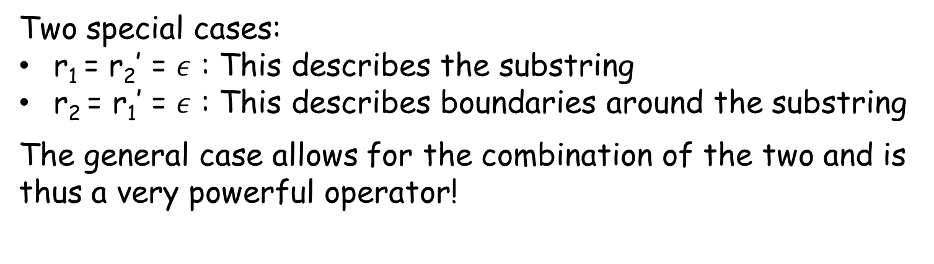
Substring Operator
Let w = SubString(s, p, p’)
where p = Pos(r_{1,} r₂, k) and p’ = Pos(r₁’, r₂’, k’)
w₁
w₂
w₁’
w₂’
r₁ matches w₁
r₂ matches w₂
r₁’ matches w₁’
r₂’ matches w₂’
p
p’
w
s
Two special cases:
r₁ = r₂’ = $ε$ : This describes the substring
r₂ = r₁’ = $ε$ : This describes boundaries around the substring
The general case allows for the combination of the two and is thus a very powerful operator!

Slide 8
Syntactic String Transformations: Example
Format phone numbers
Input v₁ | Output
(425)-706-7709 | 425-706-7709
510.220.5586 | 510-220-5586
235 7654 | 425-235-7654
745-8139 | 425-745-8139
Switch((b₁, e₁), (b₂, e₂)), where
b₁ ´ Match(v₁,NumTok,3), b₂ ´ :Match(v₁,NumTok,3),
e₁ ´ Concatenate(SubStr2(v₁,NumTok,1), ConstStr(“-”),
SubStr2(v₁,NumTok,2), ConstStr(“-”),
SubStr2(v₁,NumTok,3))
e₂ ´ Concatenate(ConstStr(“425-”),SubStr2(v₁,NumTok,1),
ConstStr(“-”),SubStr2(v₁,NumTok,2))

Slide 9
Key Synthesis Idea: Divide and Conquer
Reduce the problem of synthesizing expressions into sub-problems of synthesizing sub-expressions.
Reduction requires computing all solutions for each of the sub-problems:
This also allows to rank various solutions and select the highest ranked solution at the top-level.
A challenge here is to efficiently represent, compute, and manipulate huge number of such solutions.
Three applications of this idea in the talk.
Read the paper for more tricks!

Slide 10
Synthesizing Guarded Expression
Goal: Given input-output pairs: (i₁,o₁), (i₂,o₂), (i₃,o₃), (i₄,o₄), find P such that P(i₁)=o₁, P(i₂)=o₂, P(i₃)=o₃, P(i₄)=o₄.
Algorithm:
1. Learn set S₁ of string expressions s.t. 8e in S₁, [[e]] i₁ = o₁. Similarly compute S₂, S₃, S₄. Let S = S₁ ÅS₂ ÅS₃ ÅS₄.
2(a) If S ≠ ; then result is Switch((true,S)).
Application #1: We reduce the problem of learning guarded expression P to the problem of learning trace expressions for each input-output pair.

Slide 11
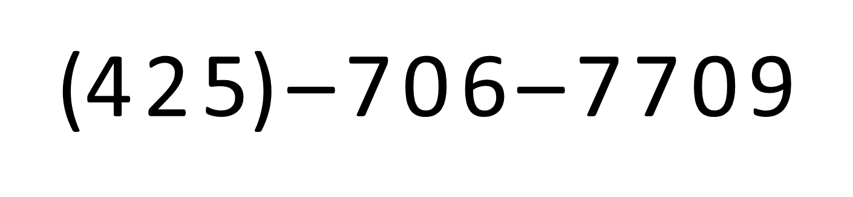
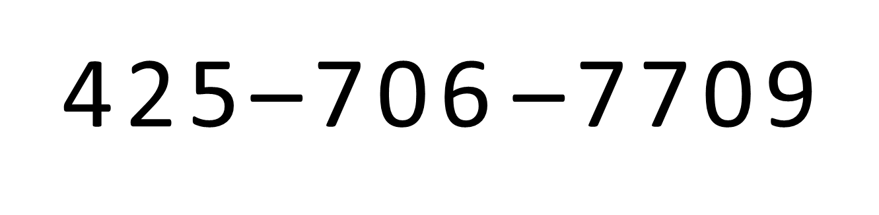
Too many choices for a Trace Expression
Input
Output
Constant
Constant
Constant

Slide 12
Synthesizing Trace Expressions
Number of all possible trace expressions (that can construct a given output string o₁ from a given input string i₁) is exponential in size of output string.
# of substrings is just quadratic in size of output string!
We use a DAG based data-structure, and it supports efficient intersection operation!
Application #2: To represent/learn all string expressions, it suffices to represent/learn all base expressions for each substring of the output.

Slide 13
Too many choices for a SubStr Expression
Various ways to extract “706” from “425-706-7709”:
Chars after 1st hyphen and before 2nd hyphen.
Substr(v₁, Pos(HyphenTok,²,1), Pos(²,HyphenTok,2))
Chars from 2nd number and up to 2nd number.
Substr(v₁, Pos(²,NumTok,2), Pos(NumTok,²,2))
Chars from 2nd number and before 2nd hyphen.
Substr(v₁, Pos(²,NumTok,2), Pos(²,HyphenTok,2))
Chars from 1st hyphen and up to 2nd number.
Substr(v₁, Pos(HyphenTok,²,1), Pos(²,HyphenTok,2))


Slide 14
Synthesizing SubStr Expressions
The number of SubStr(v,p₁,p₂) expressions that can extract a given substring w from a given string v can be large!
This allows for representing and computing O(n₁*n₂) choices for SubStr using size/time O(n₁+n₂).
Application #3: To represent/learn all SubStr expressions, we can independently represent/learn all choices for each of the two index expressions.

Slide 15
Back to Synthesizing Guarded Expression
Goal: Given input-output pairs: (i₁,o₁), (i₂,o₂), (i₃,o₃), (i₄,o₄), find P such that P(i₁)=o₁, P(i₂)=o₂, P(i₃)=o₃, P(i₄)=o₄.
Algorithm:
Learn set S₁ of trace expressions s.t. 8e in S₁, [[e]] i₁ = o₁. Similarly compute S₂, S₃, S₄. Let S = S₁ ÅS₂ ÅS₃ ÅS₄.
2(a). If S ≠ ; then result is Switch((true,S)).
2(b). Else find a smallest partition, say {S₁,S₂}, {S₃,S₄}, s.t. S₁ ÅS₂ ≠ ; and S₃ ÅS₄ ≠ ;.
3. Learn boolean formulas b₁, b₂ s.t.
b₁ maps i₁, i₂ to true and i₃, i₄ to false.
b₂ maps i₃, i₄ to true and i₁, i₂ to false.
4. Result is: Switch((b₁,S₁ ÅS₂), (b₂,S₃ ÅS₄))

Slide 16
Ranking
General Principles
Prefer shorter programs.
Fewer number of conditionals.
Shorter string expression, regular expressions.
Prefer programs with less number of constants.
Strategies
Baseline: Pick any minimal sized program using minimal number of constants.
Manual: Break conflicts using a weighted score of various program features.
Machine Learning: Weights are identified using gradient descent over training data.

Slide 17
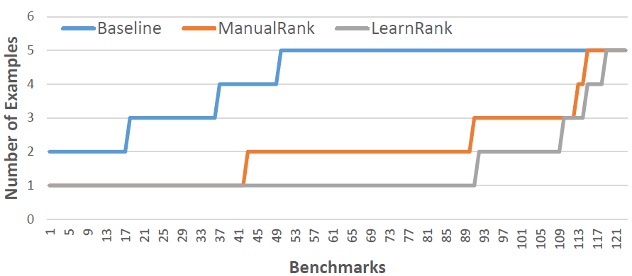
Experimental Comparison of various Ranking Strategies
Strategy | Average # of examples required
Baseline | 4.17
Manual | 2.09
Learning | 1.48
Reference: Predicting a correct program in Programming by Example, Technical Report, Singh, Gulwani

Slide 18
Semantic String Transformations
(from Examples)
Reference:
Learning Semantic String Transformations from Examples, VLDB 2012, Singh, Gulwani

Slide 19
Demo

Slide 20
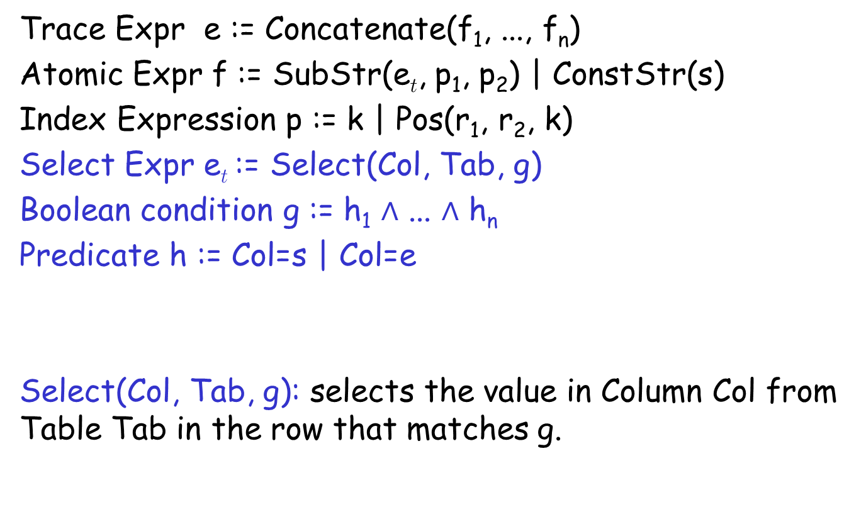
Semantic String Transformations: Language
Trace Expr e := Concatenate(f₁, ..., f_{n})
Atomic Expr f := SubStr(e_{t}, p₁, p₂) | ConstStr(s)
Index Expression p := k | Pos(r₁, r₂, k)
Select Expr e_{t} := Select(Col, Tab, g)
Boolean condition g := h₁ $∧$ ... $∧$ h_{n}
Predicate h := Col=s | Col=e
Select(Col, Tab, g): selects the value in Column Col from Table Tab in the row that matches g.
| e_{t}

Slide 21
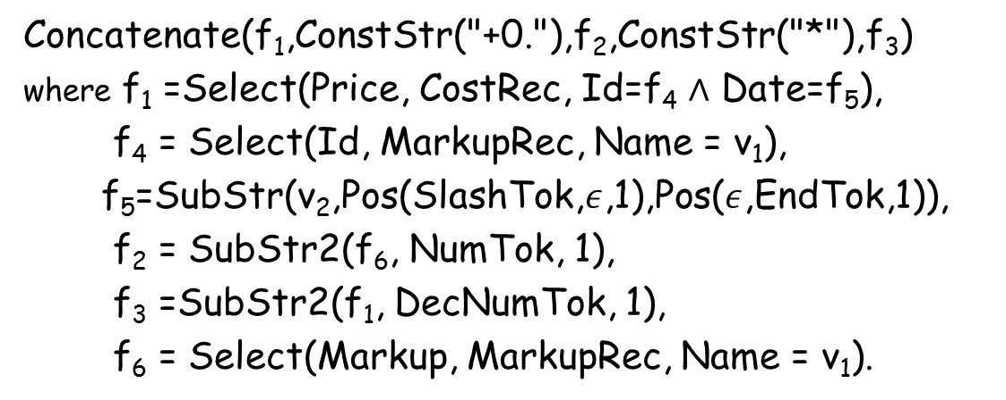
Semantic String Transformations: Example
MarkupRec Table
Input v₁ | Input v₂ | Output (Price+ Markup*Price)
Stroller | 10/12/2010 | $145.67+0.30*145.67
Bib | 23/12/2010 | $3.56+0.45*3.56
Diapers | 21/1/2011
Wipes | 2/4/2009
Aspirator | 23/2/2010
Id | Name | Markup
S33 | Stroller | 30%
B56 | Bib | 45%
D32 | Diapers | 35%
W98 | Wipes | 40%
A46 | Aspirator | 30%
... | .... | ...
Concatenate(f₁,ConstStr("+0."),f₂,ConstStr("*"),f₃)
where f₁ =Select(Price, CostRec, Id=f₄ $∧$ Date=f₅),
f₄ = Select(Id, MarkupRec, Name = v₁),
f₅=SubStr(v₂,Pos(SlashTok,$ε$,1),Pos($ε$,EndTok,1)),
f₂ = SubStr2(f₆, NumTok, 1),
f₃ =SubStr2(f₁, DecNumTok, 1),
f₆ = Select(Markup, MarkupRec, Name = v₁).
CostRec Table
Id | Date | Price
S33 | 12/2010 | $145.67
S33 | 11/2010 | $142.38
B56 | 12/2010 | $3.56
D32 | 1/2011 | $21.45
W98 | 4/2009 | $5.12
... | ... | ...

Slide 22
Semantic String Transformations: Synthesis Algorithm
Idea 1: Suppose the language consists of only select exprs.
A reachability hyper-graph, where nodes are strings and edges are labeled with appropriate select expression, represents the set of all programs.
We use the same trick for synthesizing loop bodies of vectorized code [PPoPP 2013]!
Idea 2: Observe that the synthesis algorithm for syntactic transformations identifies, for each substring of the output, various expressions that can generate it.
We now account for the possibility that a substring can also be generated by using a select expr.

Slide 23
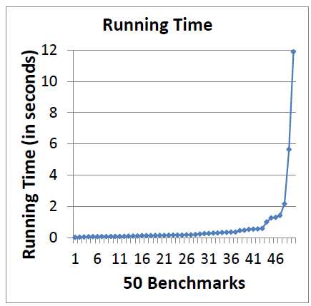
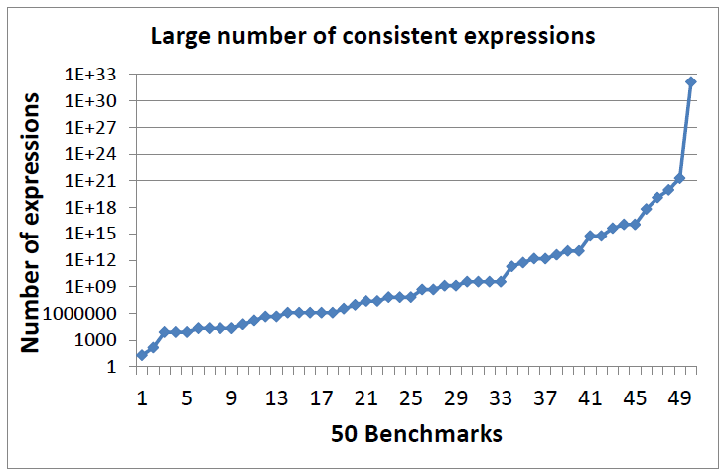
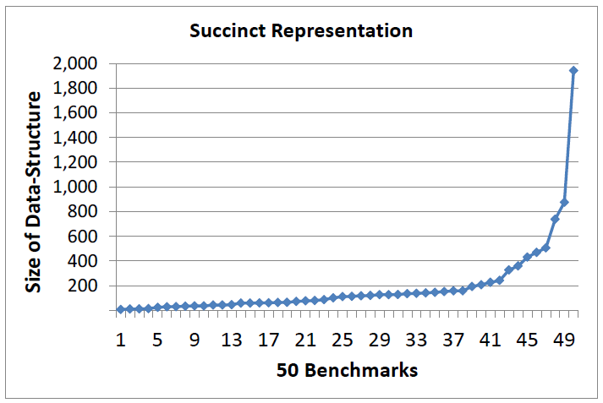
Semantic String Transformations: Experimental Results

Slide 24
Table Layout Transformations
(from Examples)
Reference:
Spreadsheet Table Transformations from Examples,
PLDI 2011, Harris, Gulwani

Slide 25
Demo

Slide 26
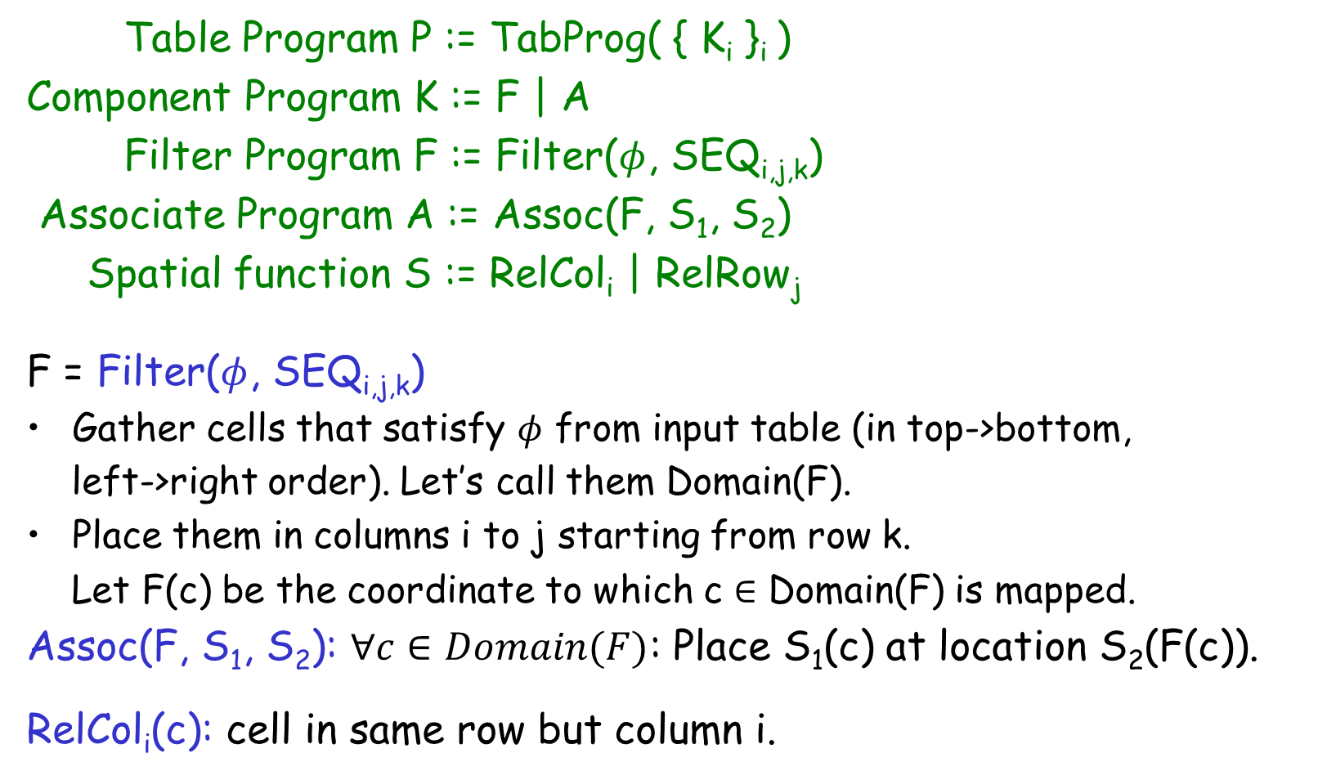
Table Layout Transformations: Language
Table Program P := TabProg( { K_{i} }_{i} )
Component Program K := F | A
Filter Program F := Filter($φ$, SEQ_{i,j,k})
Associate Program A := Assoc(F, S₁, S₂)
Spatial function S := RelCol_{i} | RelRow_{j}
F = Filter($φ$, SEQ_{i,j,k})
Gather cells that satisfy $φ$ from input table (in top->bottom,
left->right order). Let’s call them Domain(F).
Place them in columns i to j starting from row k.
Let F(c) be the coordinate to which c ∈ Domain(F) is mapped.
Assoc(F, S₁, S₂): $∀c∈Domain(F)$: Place S₁(c) at location S₂(F(c)).
RelCol_{i}(c): cell in same row but column i.

Slide 27
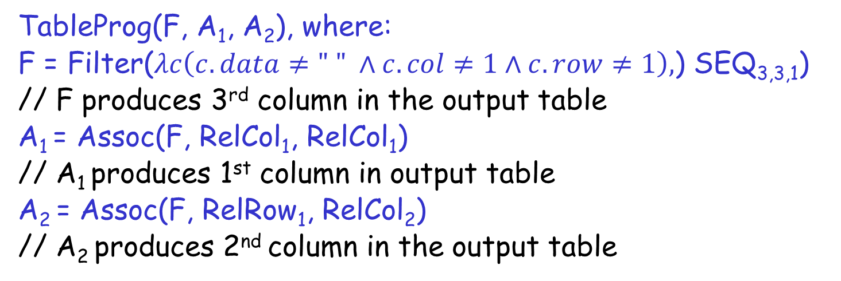
Table Layout Transformation: Example
Andrew | Qual 1 | 01.02.2003
Andrew | Qual 2 | 27.06.2008
Andrew | Qual 3 | 06.04.2007
Ben | Qual 1 | 31.08.2001
Ben | Qual 3 | 05.07.2004
Carl | Qual 2 | 18.04.2003
Carl | Qual 3 | 09.12.2009
 | Qual 1 | Qual 2 | Qual 3
Andrew | 01.02.2003 | 27.06.2008 | 06.04.2007
Ben | 31.08.2001 |  | 05.07.2004
Carl |  | 18.04.2003 | 09.12.2009
TableProg(F, A₁, A₂), where:
F = Filter($λc\left(c.data≠\text{" " }∧c.col≠1∧c.row≠1\right),$) SEQ_{3,3,1})
// F produces 3rd column in the output table
A₁ = Assoc(F, RelCol₁, RelCol₁)
// A₁ produces 1st column in output table
A₂ = Assoc(F, RelRow₁, RelCol₂)
// A₂ produces 2nd column in the output table

Slide 28
Table Layout Transformations: Synthesis Algorithm
For each example, generate the set all component programs that are consistent with the output table.
First generate filter programs and then associative programs.
Intersect the sets (from step 1) for various examples.
Pick any subset of the resultant set (from step 2) that covers each of the output tables.
This is quite similar to how we synthesize graph algorithms [OOPSLA ‘10], where also a program is a set of sub-programs!

Slide 29
Table Layout Transformations: Experimental Results
Benchmark: 51 Tasks
# of benchmark tasks | # of examples required
42 | 1
4 | 2
5 | 3
# of benchmark tasks | Synthesis time
31 | <1 second
17 | 1-5 seconds
3 | 5-10 seconds

Slide 30
SmartPhone Scripts
(from Natural Language)
Reference:
SmartSynth: Synthesizing Smartphone Automation Scripts from Natural Language, MobiSys 2013, Le, Gulwani, Su

Slide 31
Demo

Slide 32
Examples of SmartPhone Scripts
When I receive an SMS message, reply “I am driving” to the sender.
Take a picture, add to it the current location and upload to Facebook.
Silent at night, but ring for important contacts.
Speak the current weather every morning at 8am.
Send current location to a friend via SMS.
Turn off ringer by turning the phone down.

Slide 33
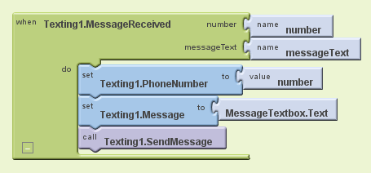
Google AppInventor Programming Model
When I receive an SMS message, Reply “I am driving” to the sender.

Slide 34
SmartScript Language
SmartPhone Program $P$ := $I when E U if C then M$
Parameter $I$ := $Input(i1, …, in) | ε$
Event $E$ :=$\vec{x}≔EventName() | ε$
Side-effect Free Computation $U$ := $F_{1};…{; F}_{n};$
Utility Function $F$ := $x≔UtilityName\left(\vec{a}\right)$
Argument $a$ := $i \left| c \right| x | s$
Condition $C$ := $π_{1}∧ …∧π_{n}$
Predicate $π$ := $PredicateName\left(\vec{a}\right) \left| a1=a2 \right| a1∈a2$
Body $M$ := $Stmt1; … Stmtn;$
Statement $Stmt$ :=$S$ | $foreach x∈a do S1; … Sm; od$
Atomic Statement $S$ :=$A | F$
Action $A$ := $\vec{x} ≔ActionName\left(\vec{a}\right)$

Slide 35
Example
When I receive a new SMS, if the phone is connected to my car’s bluetooth, read the message content and reply to the sender “I’m driving.”
Synthesis
when (number, content) := MessageReceived()
if (IsConnectedToBTDevice(Car_BT) then
Speak(content);
SendMessage(number, "I'm driving");

Slide 36
Synthesis Approach: Key Insights
Script = Components + Relations/Connections
Component = API or Entity,
where Entity = API return value, constant, or input
Relation = <Entity, API parameter> pair
as in synthesis of bit-vector algorithms!
Discover components & relations using NLP techniques and type-based synthesis.
Identify likely set of components & relations using NLP engine.
Refine components using feedback from synthesis engine.
Infer missing relations using type-based synthesis.
Select among multiple candidates using ranking.

Slide 37
Component Discovery
Map all phrases to components.
as in FlashFill, where we map all substrings in output to corresponding programs!
We use various features to identify such a mapping and its confidence:
Regular expressions
Bag of words
Phrase length
Punctuation
Parse tree (NLP parser)

Slide 38
Component Discovery: Example
When I receive a new SMS, if the phone is connected to my car’s bluetooth, read the message content and reply to the sender “I’m driving.”
Phrase | Desired Component mapping
When I receive a new SMS | MessageReceived
if the phone is connected to | IsConnectedToBTDevice
my car’s Bluetooth | Car_BT
read | Speak
message content | MessageReceived.Text_{O}
reply | SendMessage
the sender | MessageReceived.Number_{O}
“I’m driving” | "I'm driving"

Slide 39
Component Discovery: Example (more details)
When I receive a new SMS, if the phone is connected to my car’s bluetooth, read the message content and reply to the sender “I’m driving.”
Phrase | Initial Component Mapping
receive
SMS
When I receive a new SMS
if the phone is connected to
my car’s Bluetooth
reply
...
MessageReceived
EmailReceived, ...
MessageReceived,
SendMessage, ...
MessageReceived
IsConnectedToWifiNetwork
IsConnectedToBTDevice, ...
Car_BT
SendMessage, SendEmail, ...
Component mapping is refined by feedback from synthesis engine.

Slide 40
Relation Discovery
Relation between components = <Entity, API parameter> pair
Rule-based relation discovery.
Relative locations of components
C1 | TypeOf(C2) | TypeOf(C3) | Relations
IsConnectedToBTDevice | BT |  | <C₂, C₁.BT>
ReadText | Text |  | <C₂, C₁.Text>
SendMessage | Number | Text | <C₂, C₁.Number> <C₃, C₁.Text>
Missing relations are discovered using type-based synthesis.
In case of multiple high-ranked solutions, interactive Q&A can be performed with the user.

Slide 41
Relation Discovery: Example
Entity | API Parameter
Car_BT | IsConnectedToBTDevice.Text_{I}
MessageReceived.Text_{O} | Speak.Text_{I}
MessageReceived.Number_{O} | SendMessage.Number_{I}
“I’m driving” | SendMessage.Text_{I}

Slide 42
Relation Discovery: Interactive Q&A
Distinguishing multiple choice questions in case of multiple high-ranked alternative.
Similar to idea of “Distinguishing input” used in programming (of bit-vector algorithms) by example.
Question: API parameter
Multiple choices: Equally-likely type-consistent entities
What do you want the phone to speak?
The received message content
“I’m driving”

Slide 43
Synthesis Architecture
User
Natural Language Description
Natural Language Q&A
Desired Script
Feedback on Description
Components + their Relations
Synthesis Engine
NLP Engine
Feedback on component mapping

Slide 44
Results
640 English descriptions for 50 help-forum tasks (Tasker, AppInventor, TouchDevelop)
Component Discovery
Only NLP features: 70%
With Synthesis engine feedback: 90%
Relation Discovery
Only NLP features: 76%
With synthesis engine: 100%
Overall
Only NLP Techniques: 58%
With Synthesis Engine: 90%

Slide 45
Results: Component Discovery

Slide 46
Results: Relation Discovery

Slide 47
Results: Overall

Slide 48
Script Generation
After having identified components (colored text below), and relations (colored edges below),
we need to now generate a script in the underlying DSL.
when (number, content) := MessageReceived()
if (IsConnectedToBTDevice(Car_BT) then
Speak(content);
SendMessage(number, "I'm driving");
See paper for some of these interesting details!

Slide 49
Results: Synthesis Time

