Slide 1

MNC Selection Process - Data Visualization using Ext JS –the chart
An ext-js DEMO

Slide 2
PROJECT OVERVIEW
A web application to visualize the recruitment data of an MNC.
Used Ext JS for UI components and layout.
Chart.js for rendering charts to visualize the recruitment stages.
Data shows how candidates progress through the hiring process.

Slide 3
Project Structure
HTML: Provides the page structure and canvas for the charts.
Ext JS: Used for layout and UI management (e.g., creating windows and panels).
Chart.js: Used for rendering line, bar, and pie charts.
CSS: Styling for layout, responsiveness, and design of the charts.

Slide 4
Ext JS & Chart.js Integration
Ext JS provides the layout and containers (Windows, Panels) where Chart.js charts are rendered.
Chart.js charts are embedded in the Ext JS panels, creating a clean and professional dashboard for the user.
Example:Line Chart in an Ext JS panel with labels, data points, and a custom tooltip.
Bar Chart showing the number of selected vs rejected candidates at various stages.

Slide 5
Demo of the Web App
Include screenshots.
Show the different charts:
Line Chart: Recruitment timeline.
Bar Chart: Comparison of candidates.
Pie Chart: Source of candidates.

Slide 6
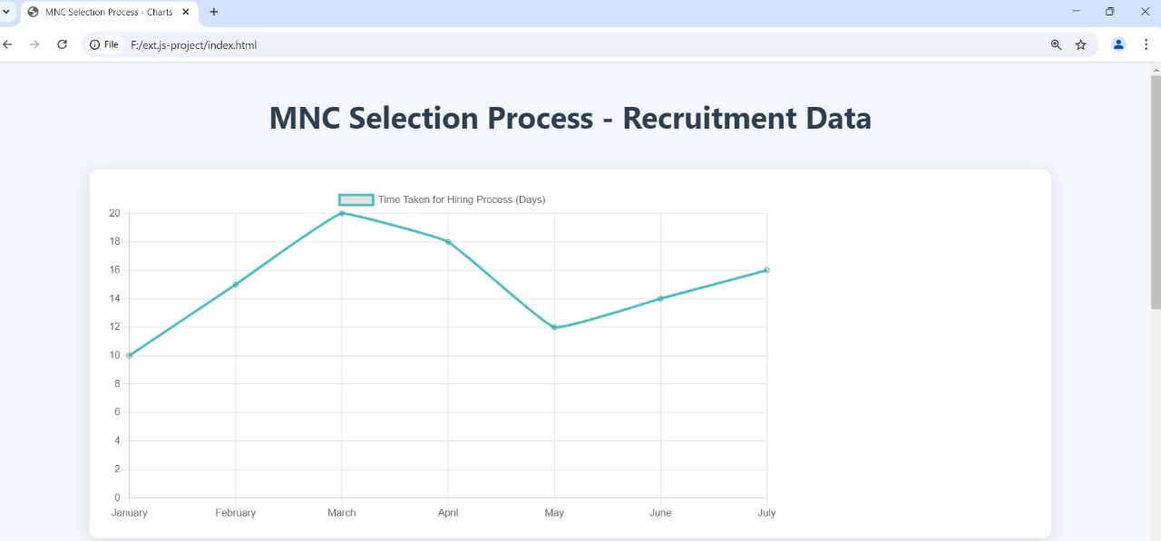
LINE CHART

Slide 7
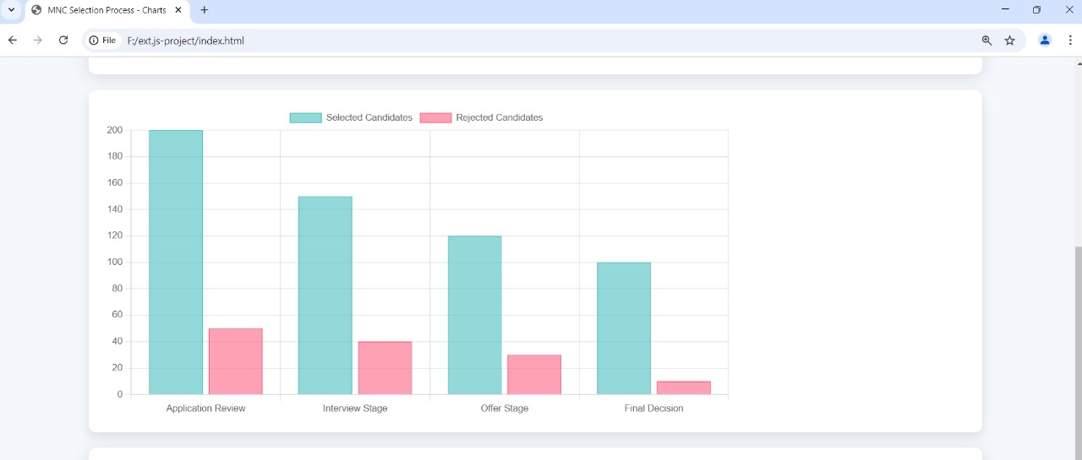
BAR CHART

Slide 8
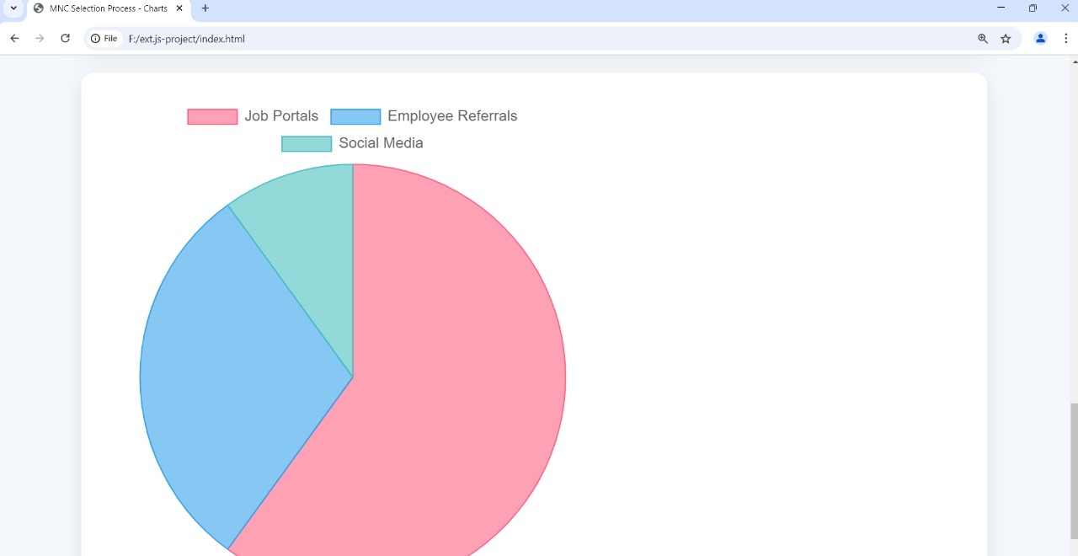
PIE CHART

Slide 9
Technical Implementation
Ext JS Components:A Window is created using Ext.create('Ext.window.Window') to hold the charts.
Panels are created to wrap each chart using xtype: 'panel'.Chart.js Setup:Used the Line, Bar, and Pie chart types from Chart.js.
Data and options are passed to the charts using JavaScript.
CSS: Styled the charts and layout to make it responsive and visually appealing.

Slide 10
Conclusion
This project demonstrates how to combine Ext JS for UI layout and Chart.js for data visualization to create an informative dashboard.It shows how modern JavaScript frameworks can work together to build dynamic web applications.

