Slide 1
COURSE UNIT: MATHS IST 1106 SEMESTER:1 LECTURER: BYANSI DAVID GROUP: D
NAME | REGISTRATION NO. | STUDENT NO.
AINEBYONA VICTOR | 26/U/04227/PSA | 2600703692
ACHUDA FREDRICK | 26/U/29544/PSA | 2600729544
AKAMPURIRA IAN | 26/U/03698/PS | 2600703698
MBABAALI EDRINE | 26/U/30208/PS | 2600730208
KAKANDE UMAR | 26/U/04111/PS | 2600703831
ODOI VINCENT | 26/U/30208/PS | 2600730208
KAWUMI JEREMY DAVID | 26/U/03862/PS | 2600703862
PETO MICROS | 26/U/04146/PSA

Slide 2
QUESTIONS
List the main Boolean Algebra Laws.
Outline De Morgan’s Laws and when you apply them.
Out line how distributive /absorption laws can be used to simplify expressions.
Provide a short “cheat sheet” for equivalences you consider most useful.
Provide guidance on using truth tables to verify equivalence.

Slide 3
NUMBER ONE: FUNDAMENTALS OF BOOLEAN ALGEBRA
Boolean Algebra is a branch of mathematics that deals with logical values, these being either true(1) or false(0).
Below are the laws:
Identity law
Null law
Idempotent/Complement law
Complement law
Commutative law
Associative law
Distributive Law
Absorption law
De morgan’s law
Double negation law

Slide 4
1.Identity Law
FOR MULTIPLICATION | FOR ADDITION
A*1 = A | A+0 =A
E.g. if; A= 1
Then; 1*1 =1
Its also true on the addition side.
If; A= 0
Then; 0+0 =0

Slide 5
2.Null Law
FOR MULTIPLICATION | FOR ADDITION
A*0 = 0 | A+1=A
E.g. if; A= 1
Then; 1*0 =0
Its also true on the addition side
If; A = 0
Then; 0+1 =1

Slide 6
3.Idempotent Law
FOR MULTIPLICATION | FOR ADDITION
A*A= A | A+A=A
E.g. if A= 1
1*1 =1
its also true on the addition side
if A= 0
0+0= 0
Since, in Boolean algebra, we deal with 0’s and 1’s it must be true for 1 +1 = 1.Which will leave out 2.

Slide 7
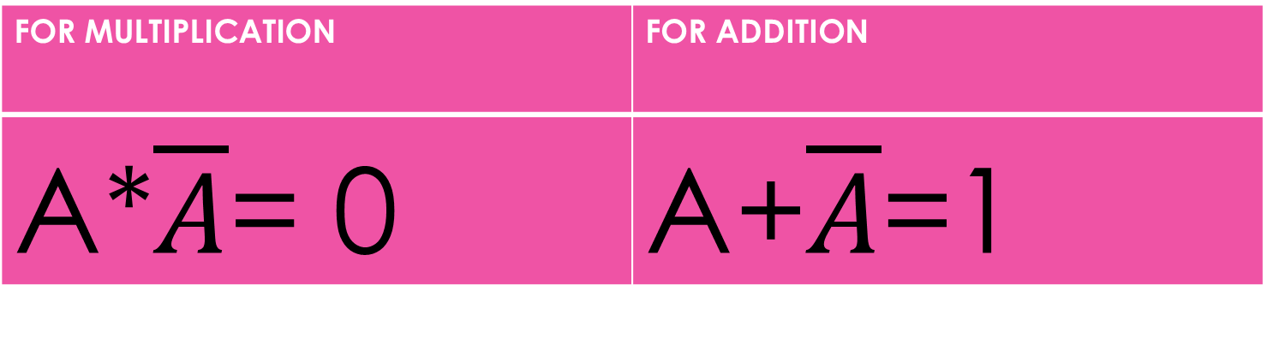
4.Complement law
FOR MULTIPLICATION | FOR ADDITION
A*$\overline{A}$= 0 | A+$\overline{A}$=1
E.g. if A= 1
Then 1*0 = 0
its also true on the addition side
if A= 0
0+1 =1

Slide 8
5.Commutative law
FOR MULTIPLICATION | FOR ADDITION
A*B= B*A | A+B=B+A
E.g. if A = 1 and B = 0
A+B = B+ A
1+O = 0+1
1=1
In this case, the value positions can be interchanged without the equation losing meaning.

Slide 9
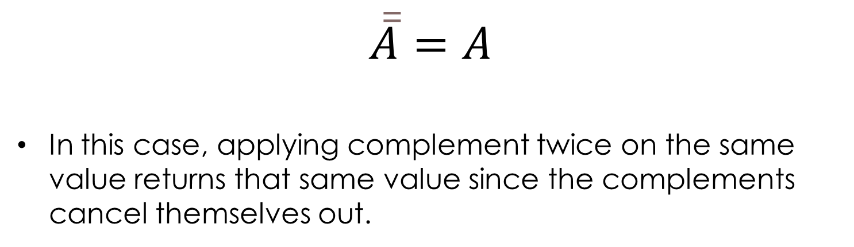
6.Double negation law
$$\overline{\overline{A}}=A$$
In this case, applying complement twice on the same value returns that same value since the complements cancel themselves out.

Slide 10
7.Associative law
FOR MULTIPLICATION | FOR ADDITION
A*(B*C)=(A* B)*C | A+(B+C)=(A+B)+C
E.g. if A = 1 ,B = 0,C=1
A+(B+C) =( A+ B)+C
1+(O +1) = (1+0)+1
1= 1(NOT = 2)
N.B: When grouping 3 o more variables with the same operator, the order of grouping doesn’t change the outcome.

Slide 11
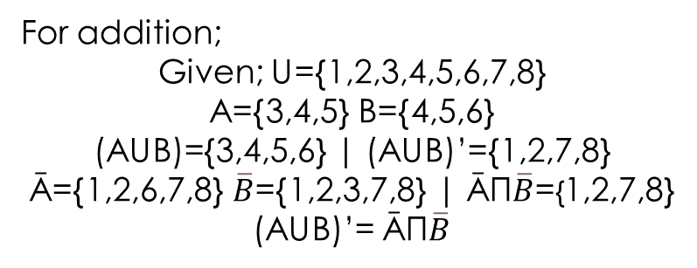
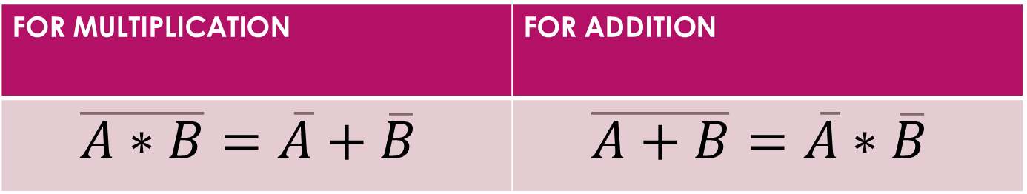
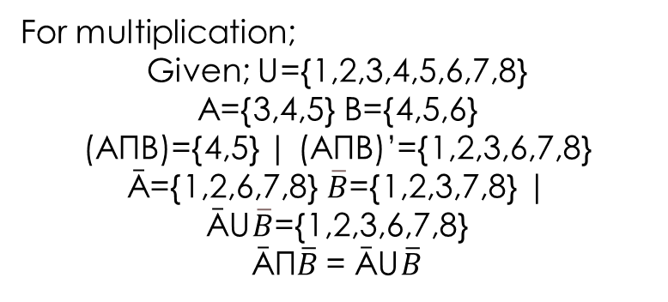
NUMBER TWO: De MORGAN’S LAW
De Morgan’s Laws explain how statements behave when a negation(“NOT”) is applied.
FOR MULTIPLICATION | FOR ADDITION
$$\overline{A∗B}=\overline{A}+\overline{B}$$ | $$\overline{A+B}=\overline{A}∗\overline{B}$$
For multiplication;
Given; U={1,2,3,4,5,6,7,8}
A={3,4,5} B={4,5,6}
(AΠB)={4,5} | (AΠB)’={1,2,3,6,7,8}
Ā={1,2,6,7,8} $\overline{B}$={1,2,3,7,8} | ĀU$\overline{B}$={1,2,3,6,7,8}
ĀΠ$\overline{B}$= ĀU$\overline{B}$
For addition;
Given; U={1,2,3,4,5,6,7,8}
A={3,4,5} B={4,5,6}
(AUB)={3,4,5,6} | (AUB)’={1,2,7,8}
Ā={1,2,6,7,8} $\overline{B}$={1,2,3,7,8} | ĀΠ$\overline{B}$={1,2,7,8}
(AUB)’= ĀΠ$\overline{B}$

Slide 12
When to apply De Morgan’s Laws
When converting between AND and OR expressions.
When simplifying Boolean Expressions.
When working with computer programming conditions.
When designing digital logic circuits.

Slide 13
NUMBER THREE(A): ABSORPTION LAW
First Law
A+(A*B)=A
Second Law
A(A+B)=A
Extended Absorption Law
A+(Ā*B)=A+B
A*(Ā+B)=A*B
N.B: Only the complemented A is absorbed

Slide 14
NO.3(B):Distributive law
FOR MULTIPLICATION | FOR ADDITION
A+(B*C)=(A+B)*(A+C) | A*(B+C)=(A*B)+(A*C)
N.B: This works just like; x(y+z)=xy+xz from high school.

Slide 15
NUMBER FOUR: CHEAT SHEET
SYMBOL | MEANING
∩ , ∧ , · | “AND” or “INTERSECTION”
∪ , ∨ , + | “OR” or “UNION”
A’, Ā , ¬A , ~A , A' | “NOT” or “COMPLEMENT”
(A ∩ B)’ , ¬(A ∧ B) | NAND
(A ∪ B)’ , ¬(A ∨ B) | NOR
∈ , ⊨ | ELEMENT OF

Slide 16
NUMBER FOUR: CHEAT SHEET
1.The identity and null rules ( quick reduction)
x ˄ 1 = X
X ˅ 0 = X
X ˄ 0 = 0
X ˅ 1 = 1
2.The complement rules ( canceling out)
X˄¬X = 0
X˅¬X = 1
¬(¬X) = X

Slide 17
NUMBER FIVE: TRUTH TABLES
Truth Tables prove that the part of the equation on the right side is equal to the part on the left side of the equal(=) sign. E.g. Given A+ĀB=A+B ,it shows that both side produce the same output hence the statement is true.
A | B | A+B | Ā | ĀB | A+ĀB
0 | 0 | 0 | 1 | 0 | 0
0 | 1 | 1 | 1 | 1 | 1
1 | 0 | 1 | 0 | 0 | 1
1 | 1 | 1 | 0 | 0 | 1

Slide 18
CONCLUSION
Most of these laws can be applied in Set Theory to be understand much more.
As seen from the Cheat Sheet Side, the symbols can change from those in Set Theory to those in Logic but the meaning remains the same.

