Slide 1
COURSE UNIT: MATHS IST 1106
SEMESTER:1
LECTURER: BYANSI DAVID
2026-GROUP: D
ASSIGNMENT .3
NAME | REGISTRATION NO. | STUDENT NO.
AINEBYONA VICTOR | 26/U/04227/PSA | 2600703692
ACHUDA FREDRICK | 26/U/29544/PSA | 2600729544
AKAMPURIRA IAN | 26/U/03698/PS | 2600703698
MBABAALI EDRINE | 26/U/30208/PS | 2600730208
KAKANDE UMAR | 26/U/03831/PS | 2600703831
ODOI VINCENT | 26/U/04111/PSA | 2600704111
KAWUMI JEREMY DAVID | 26/U/03862/PS | 2600703862
PETO MICROS | 26/U/04146/PSA | 2600704146
ABOKU GEORGE PHILIP | 26/U/03678/PSA | 2600703678

Slide 2
RELATIONS AND FUNCTIONS
f:A---->B
Math can be use to define relationships between different numbers using relations and functions.
Functions are also called Mappings or transformations.
A relation f from A to B is a function if;
Every element of A is related to some elements of B
An element A can not be related to more than one element of B.

Slide 3
(many to one)A function
(one to many)Not a function
A
B
A
B
1
2
3
4
a
b
c
1
2
3
4
a
b
c

Slide 4
CODOMAIN, DOMAIN AND RANGE
Let f be the function defined by the rule f(x)=X²
X² =Y is a function from x to y
Domain is{0,1,2}
Codomain is{0,1,2,4,9}
So f(0)=0 , f(1) =1 and f(2)=4
Range is{0,1,4}
setX(domain)
setY(codomain)
0
1
2
0
1
2
4
9

Slide 5
Note
Domain are all possible input values.
Codomain are the possible out put values.
Range are all actual out put values in the codomain.

Slide 6
INJECTIVE,SURJECTIVE AND BIJECTIVE FUCTIONS
INJECTIVE FUNCTION
SURJECTIVE FUNCTION
Also known as (ONE TO ONE)
Also known as (ON TO)
A
B
A
B
1
2
3
a
b
c
1
9
2
4
9

Slide 7
Bi –means two
BIJECTIVE FUNCTION
NOT ON TO FUNCTION.
Has both injective and surjective features
It is also known as one to one correspondence.
If an elements in the codomain are left out the function is “Not on to fuction”
Also known as “In to” function.
A
B
A
B
1
2
3
4
a
b
c
a
b
c
1
3
9
5

Slide 8
QN.1)Consider a function with codomain {a,b,c} and mapping X->a for two different inputs, and one input maps to b, but no input to c. classify the function as one of: Onto, not onto, bijective. State briefly why.
Codomain is {a,b,c}
Let the two different inputs be 1 and 2
Let 3 map to b
Thus the Domain {1,2,3}
Since c is in the codomain is not mapped to any in put of x.
It is “Not onto function” or “Into function”.
(domain)
(codomain)
1
2
3
a
c
b

Slide 9
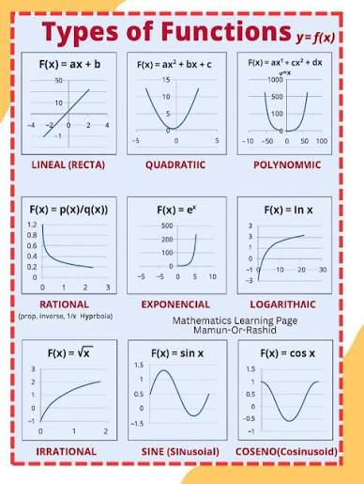

Slide 10
Qn.2) identify the function type from its equation y=4X -9.Is it linear? If so, state the slope and intercept.
y=4x-9
Compare with the general equation of a straight line y =mx +c
Slope/gradient, m =4
Intercept, c =-9
Therefore the function is linear with slope=4 and intercept c =-9

Slide 11
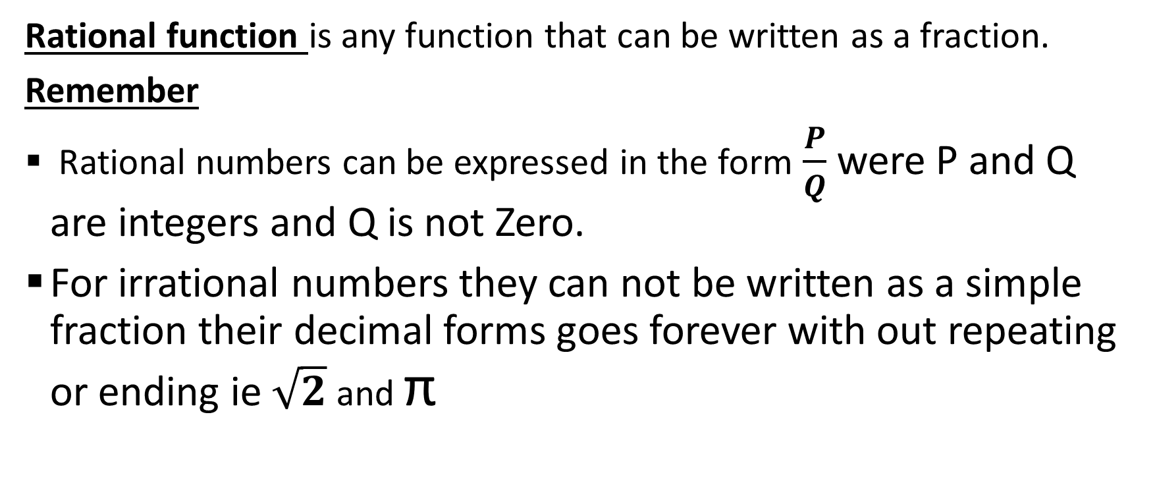
Rational and irrational functions
Rational function is any function that can be written as a fraction.
Remember
Rational numbers can be expressed in the form $\frac{P}{Q}$ were P and Q are integers and Q is not Zero.
For irrational numbers they can not be written as a simple fraction their decimal forms goes forever with out repeating or ending ie $\sqrt{2}$ and π

Slide 12
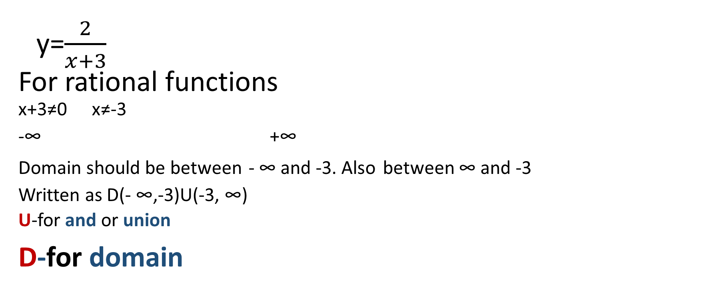
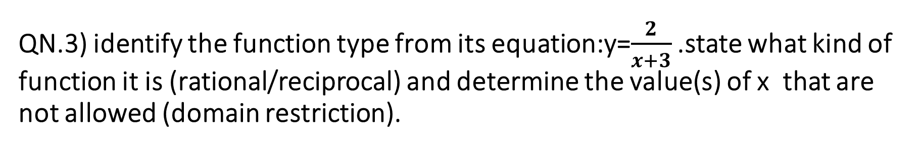
QN.3) identify the function type from its equation:y=$\frac{2}{x+3}$ .state what kind of function it is (rational/reciprocal) and determine the value(s) of x that are not allowed (domain restriction).
y=$\frac{2}{x+3}$
For rational functions
^{x+3≠0} ^{x≠-3}
-∞ +∞
^{Domain should be between} ^{- ∞ and -3. Also} ^{between ∞ and -3}
^{Written as D(- ∞,-3)U(-3, ∞)}
^{U-for and or union}
D-for domain
-3

Slide 13
Qn.4)A graph passes through (0,2) and (3,5) and is a straight line. Write the equation of the line .
Equation of A straight line is given by y=mx+c
For(0,2) and (3,5)
Using (0,2)
X=0 and y =2
But y = mx +c
2=m(0) +c
C=2

Slide 14
Using c =2 and (3,5)
X=3 and y=5
Putting then in
y=mx +c
5=m(3)+2
m= 1
Thus y=(1)X +2
Y=X +2 is the equation of the line

Slide 15
Vertical and horizontal asymptotes
1.Vertical asymptotes

Slide 16
Horizontal asymptotes.

Slide 17

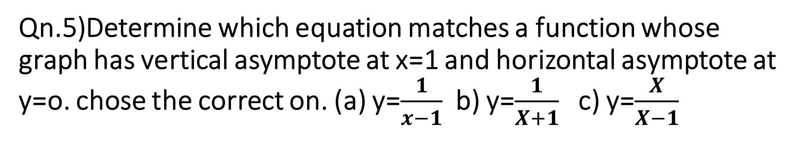
Qn.5)Determine which equation matches a function whose graph has vertical asymptote at x=1 and horizontal asymptote at y=o. chose the correct on. (a) y=$\frac{1}{x−1}$ b) y=$\frac{1}{X+1}$ c) y=$\frac{X}{X−1}$
For vertical asymptote denominator = 0
For y=$\frac{1}{x−1}$
X-1=0
X=1 ,so its true
For y=$\frac{1}{X+1}$
X+1=0
X=-1 ,so its false

Slide 18

For y=$\frac{X}{X−1}$
X-1=0
X=1 , it is true
For horizontal asymptote

Slide 19
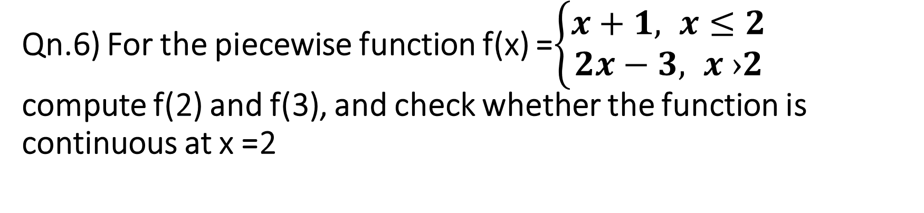
Qn.6) For the piecewise function f(x) =$\left\{\begin{aligned}x+1, x≤2 \\ 2x−3, x ›2\end{aligned}\right.$ compute f(2) and f(3), and check whether the function is continuous at x =2
For f(2) x ≤ 2
f(x) = X+1
f(2)= 2+1
f(2)=3
For f(3) x›2
f(x)= 2X-1
f(3) = 2(2)-1
f(3) =3

Slide 20
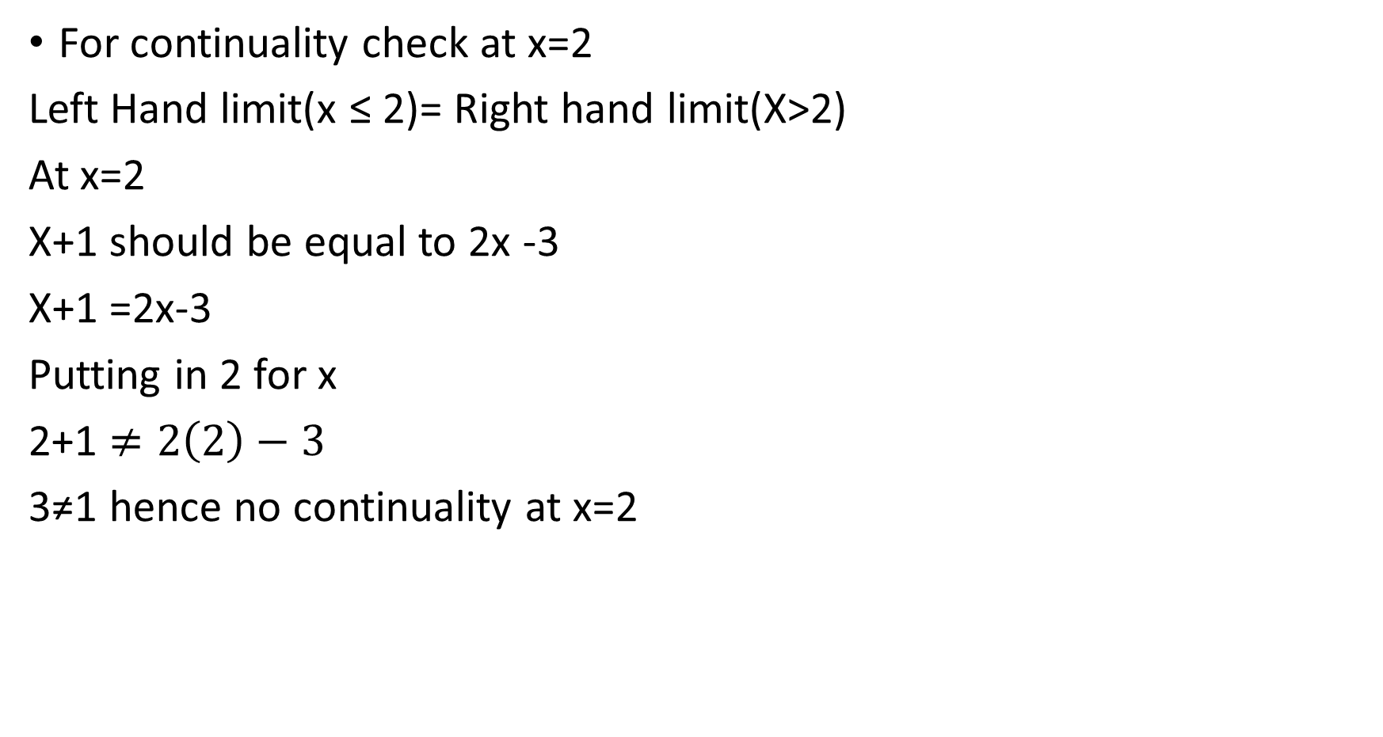
For continuality check at x=2
Left Hand limit(x ≤ 2)= Right hand limit(X>2)
At x=2
X+1 should be equal to 2x -3
X+1 =2x-3
Putting in 2 for x
2+1 $≠2\left(2\right)−3$
3≠1 hence no continuality at x=2

