Slide 1
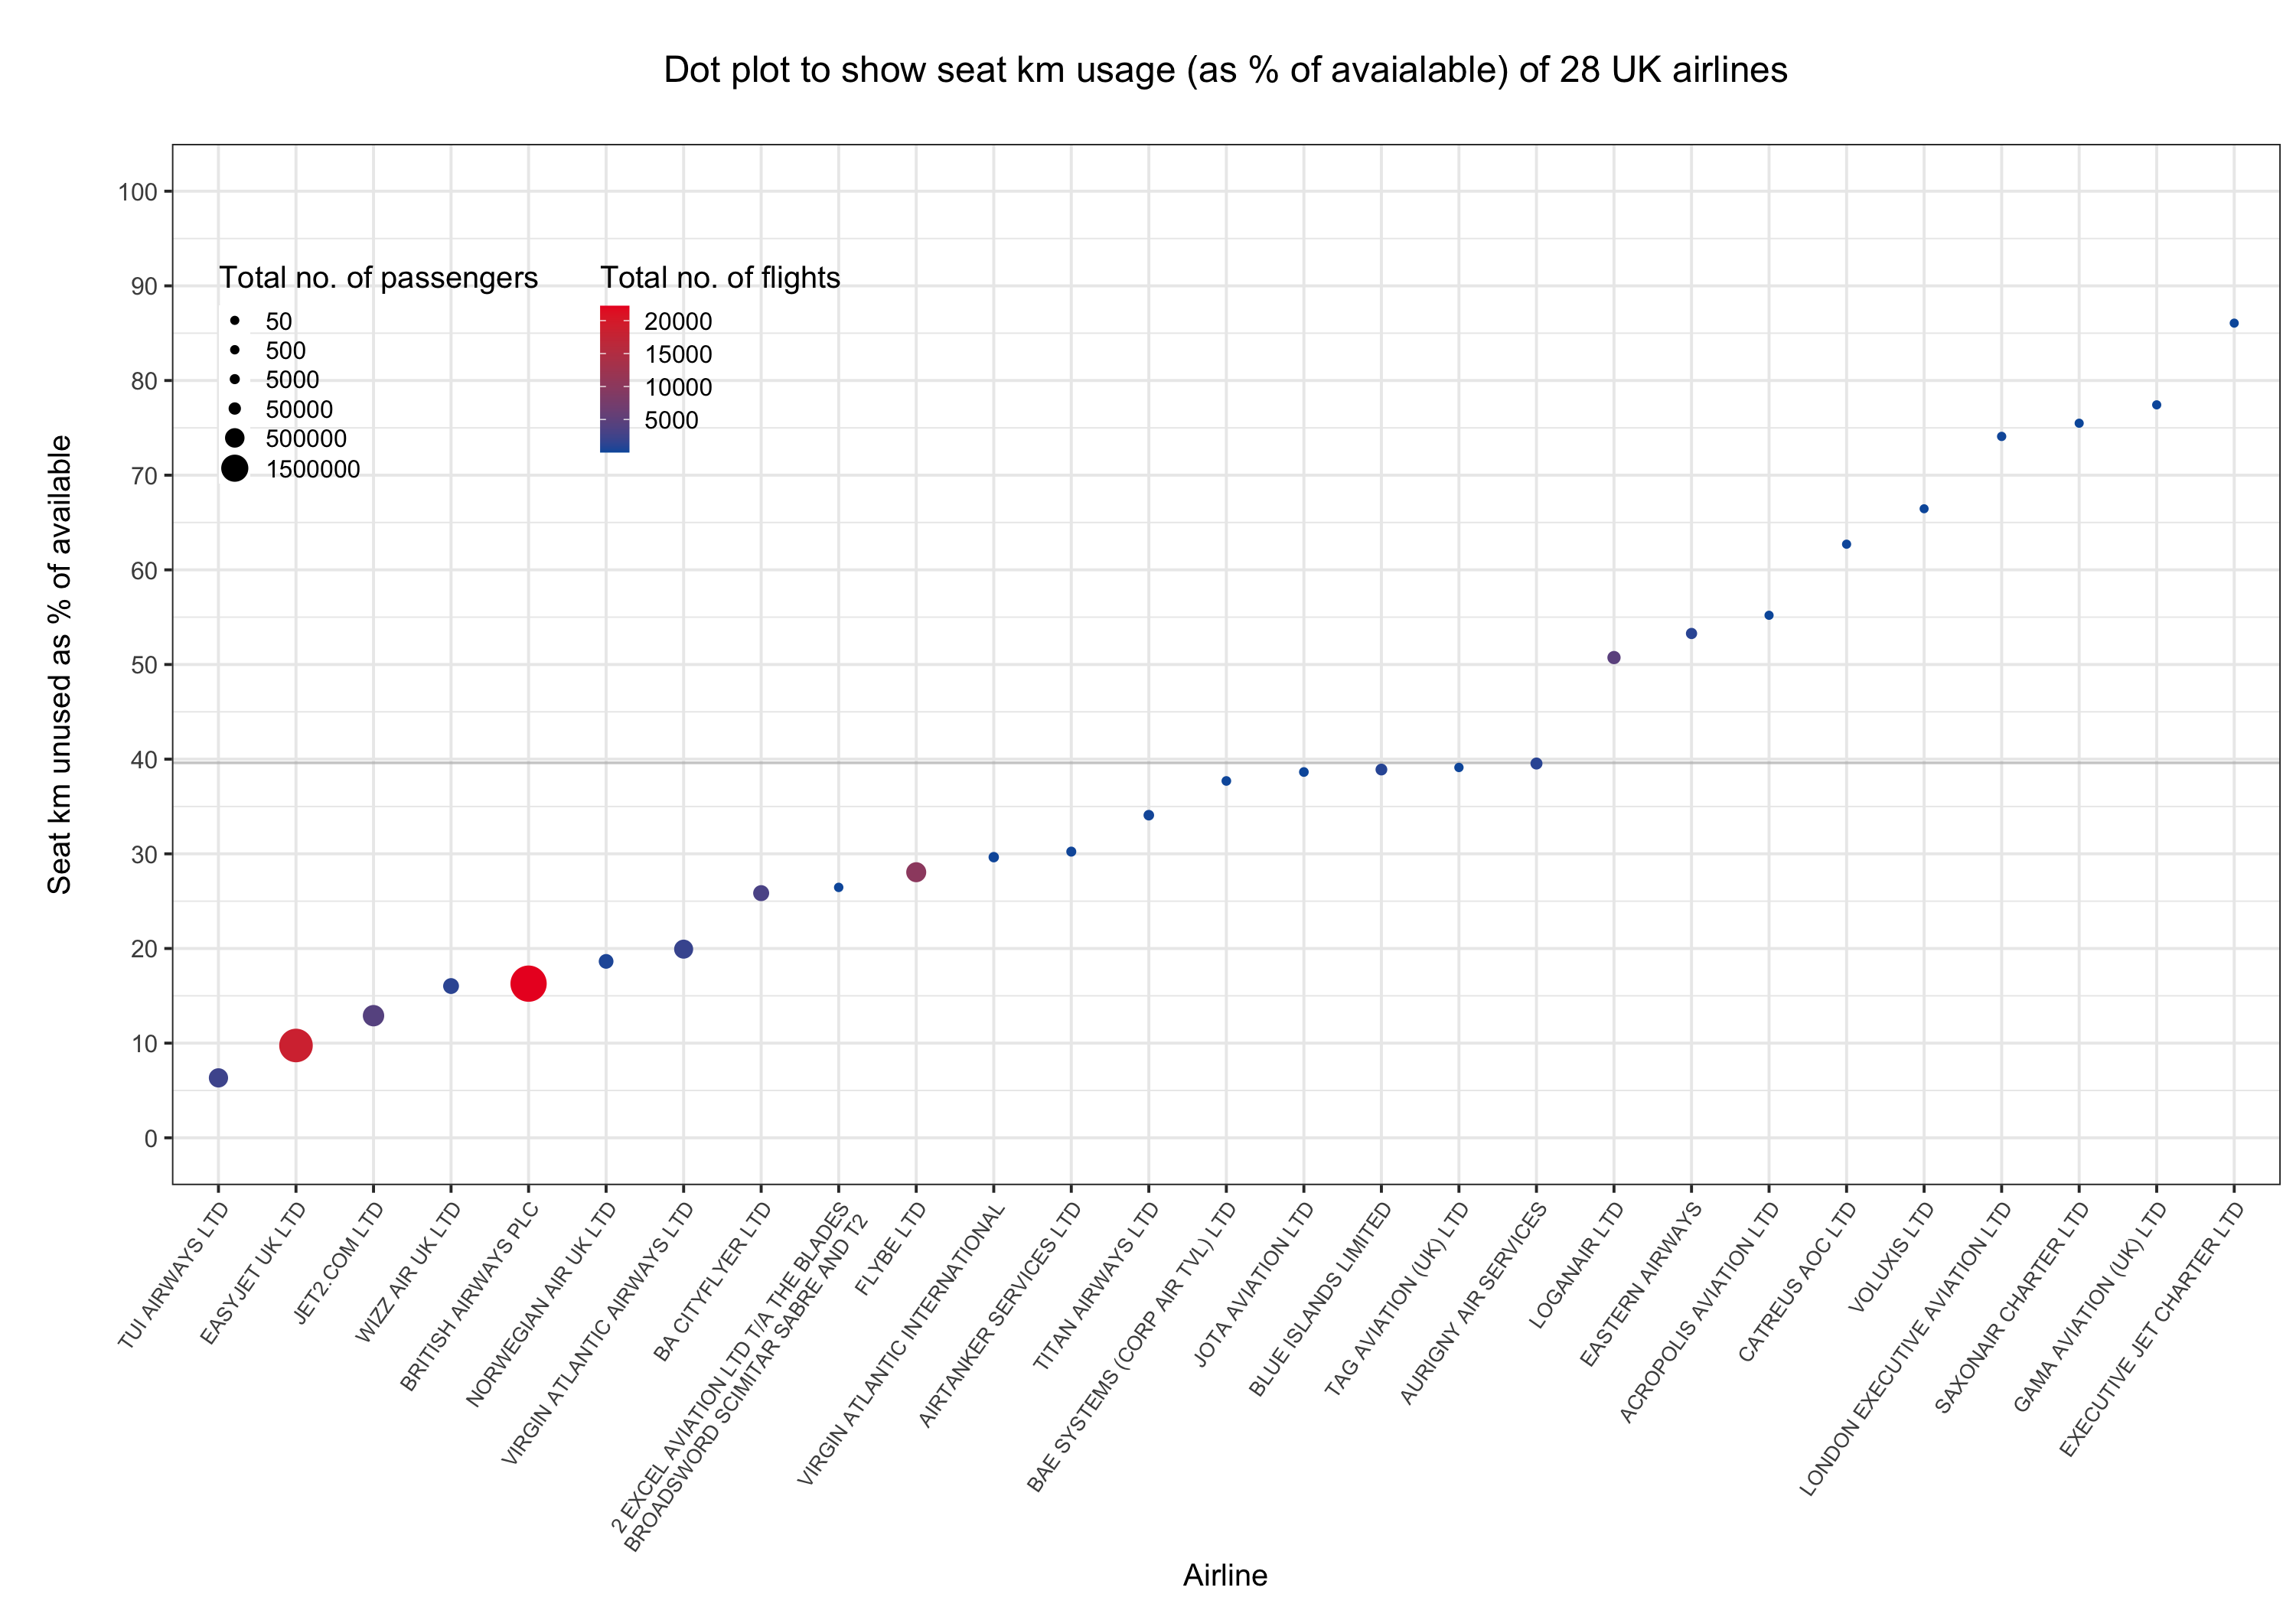
Notes:
November 2019 – pre-pandemic, 80%

Slide 2
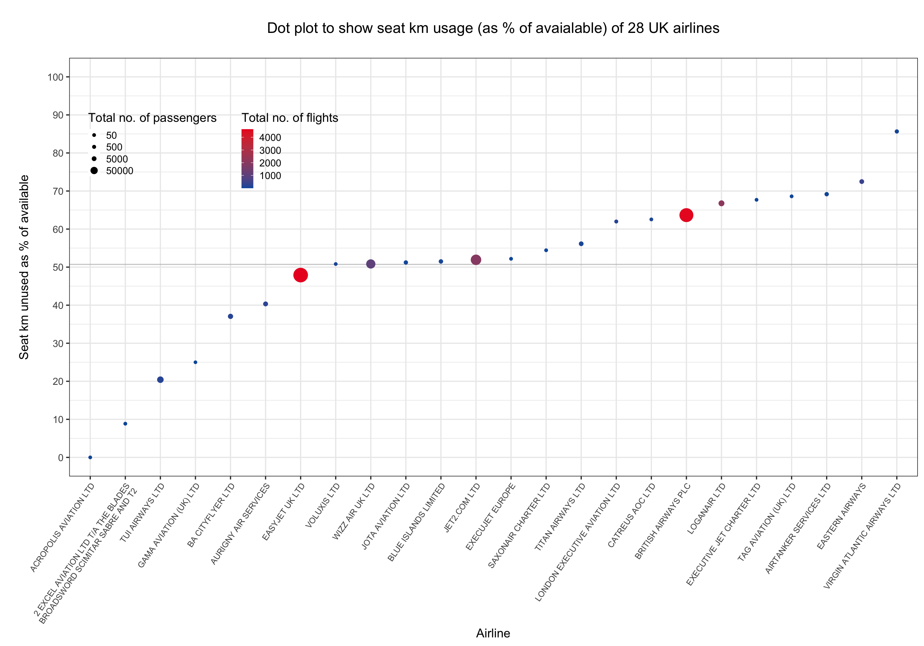
Notes:
July 2020 – 0%

Slide 3
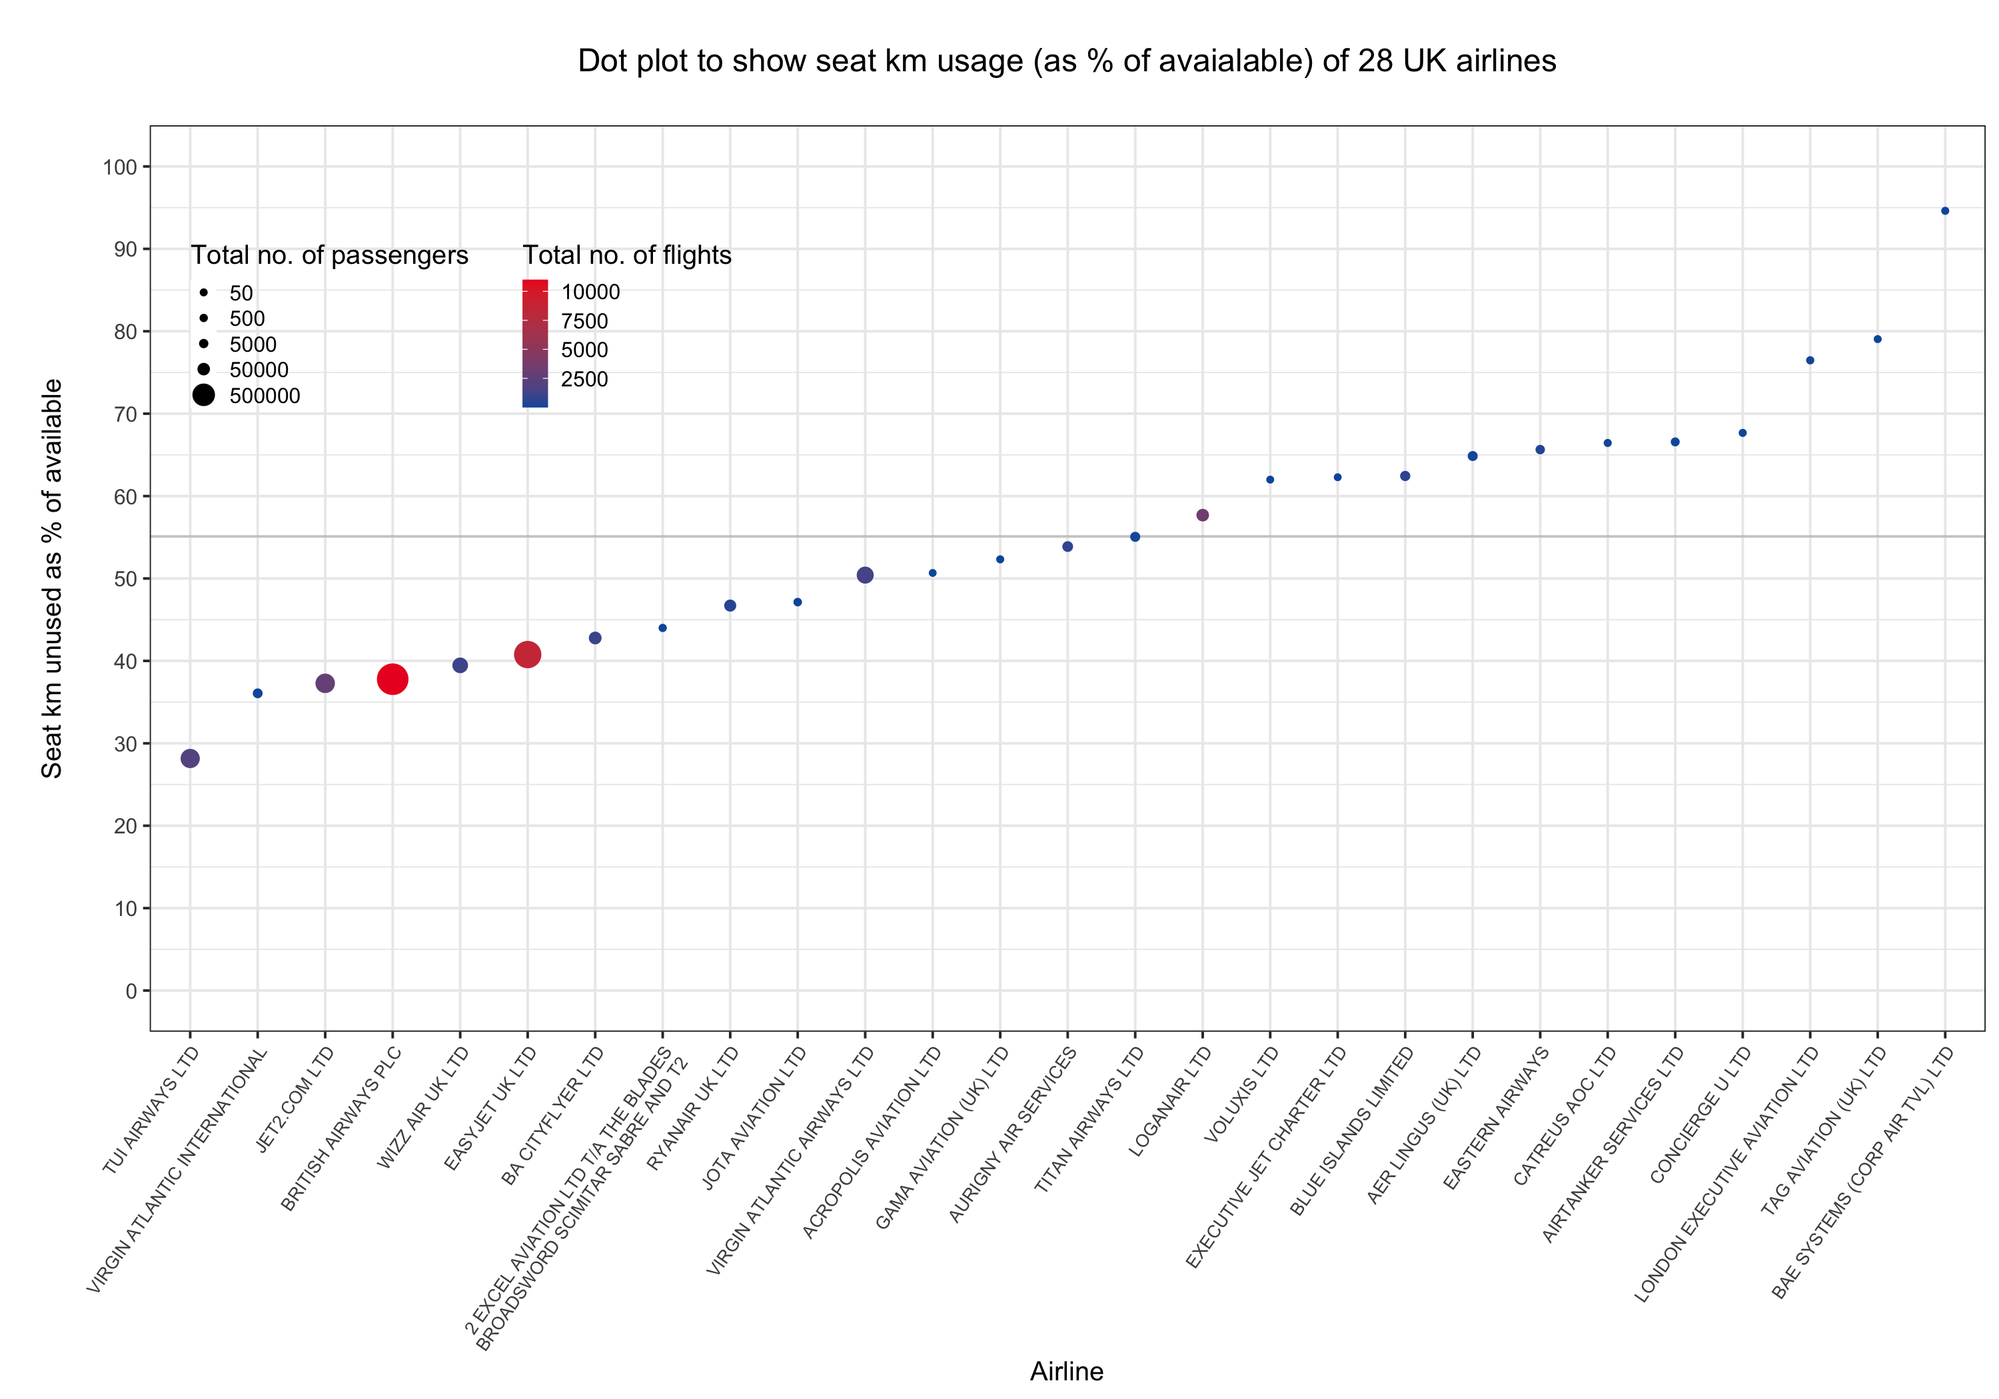
Notes:
Jan 2022 – 50%

