Slide 1
BOAT SALES DATA ANALYSIS
Andrés Ingelmo Poveda
Notes:
Hello, my name is Andrés Ingelmo and I’m going to present you the boat sales website data analysis.
The objective of this presentation is to show the head of the marketing team common patterns and characteristics regarding the most viewed listings in the last 7 days.
Let’s start!

Slide 2




METHODOLOGY
STEP 01
STEP 02
Load the dataset in Python Pandas
Clean the dataset with Pandas
STEP 04
STEP 03
Make data visualizations with Matplotlib and Seaborn
Retrieve a new dataset with the top 1% of the most viewed listings
Notes:
First default, I would like to talk to you about the methodology. I know you are not a technical person but I would make it as easy as I can.
The first step I took was loading the data in Pandas, which is the equivalent of Excel on Python, a programming language. The second step was cleaning and normalizing the data with this tool, same you would do with Excel but cleaner and faster.
Third, I made new dataset filtering the top 1% values of the most viewed listings. Why the top 1%? Because they represent almost 7% of the total views.
Last, but not least, I made visualizations with Matplotlib and Seaborn, again, like Excel chart builder functionality but more customizable.

Slide 3
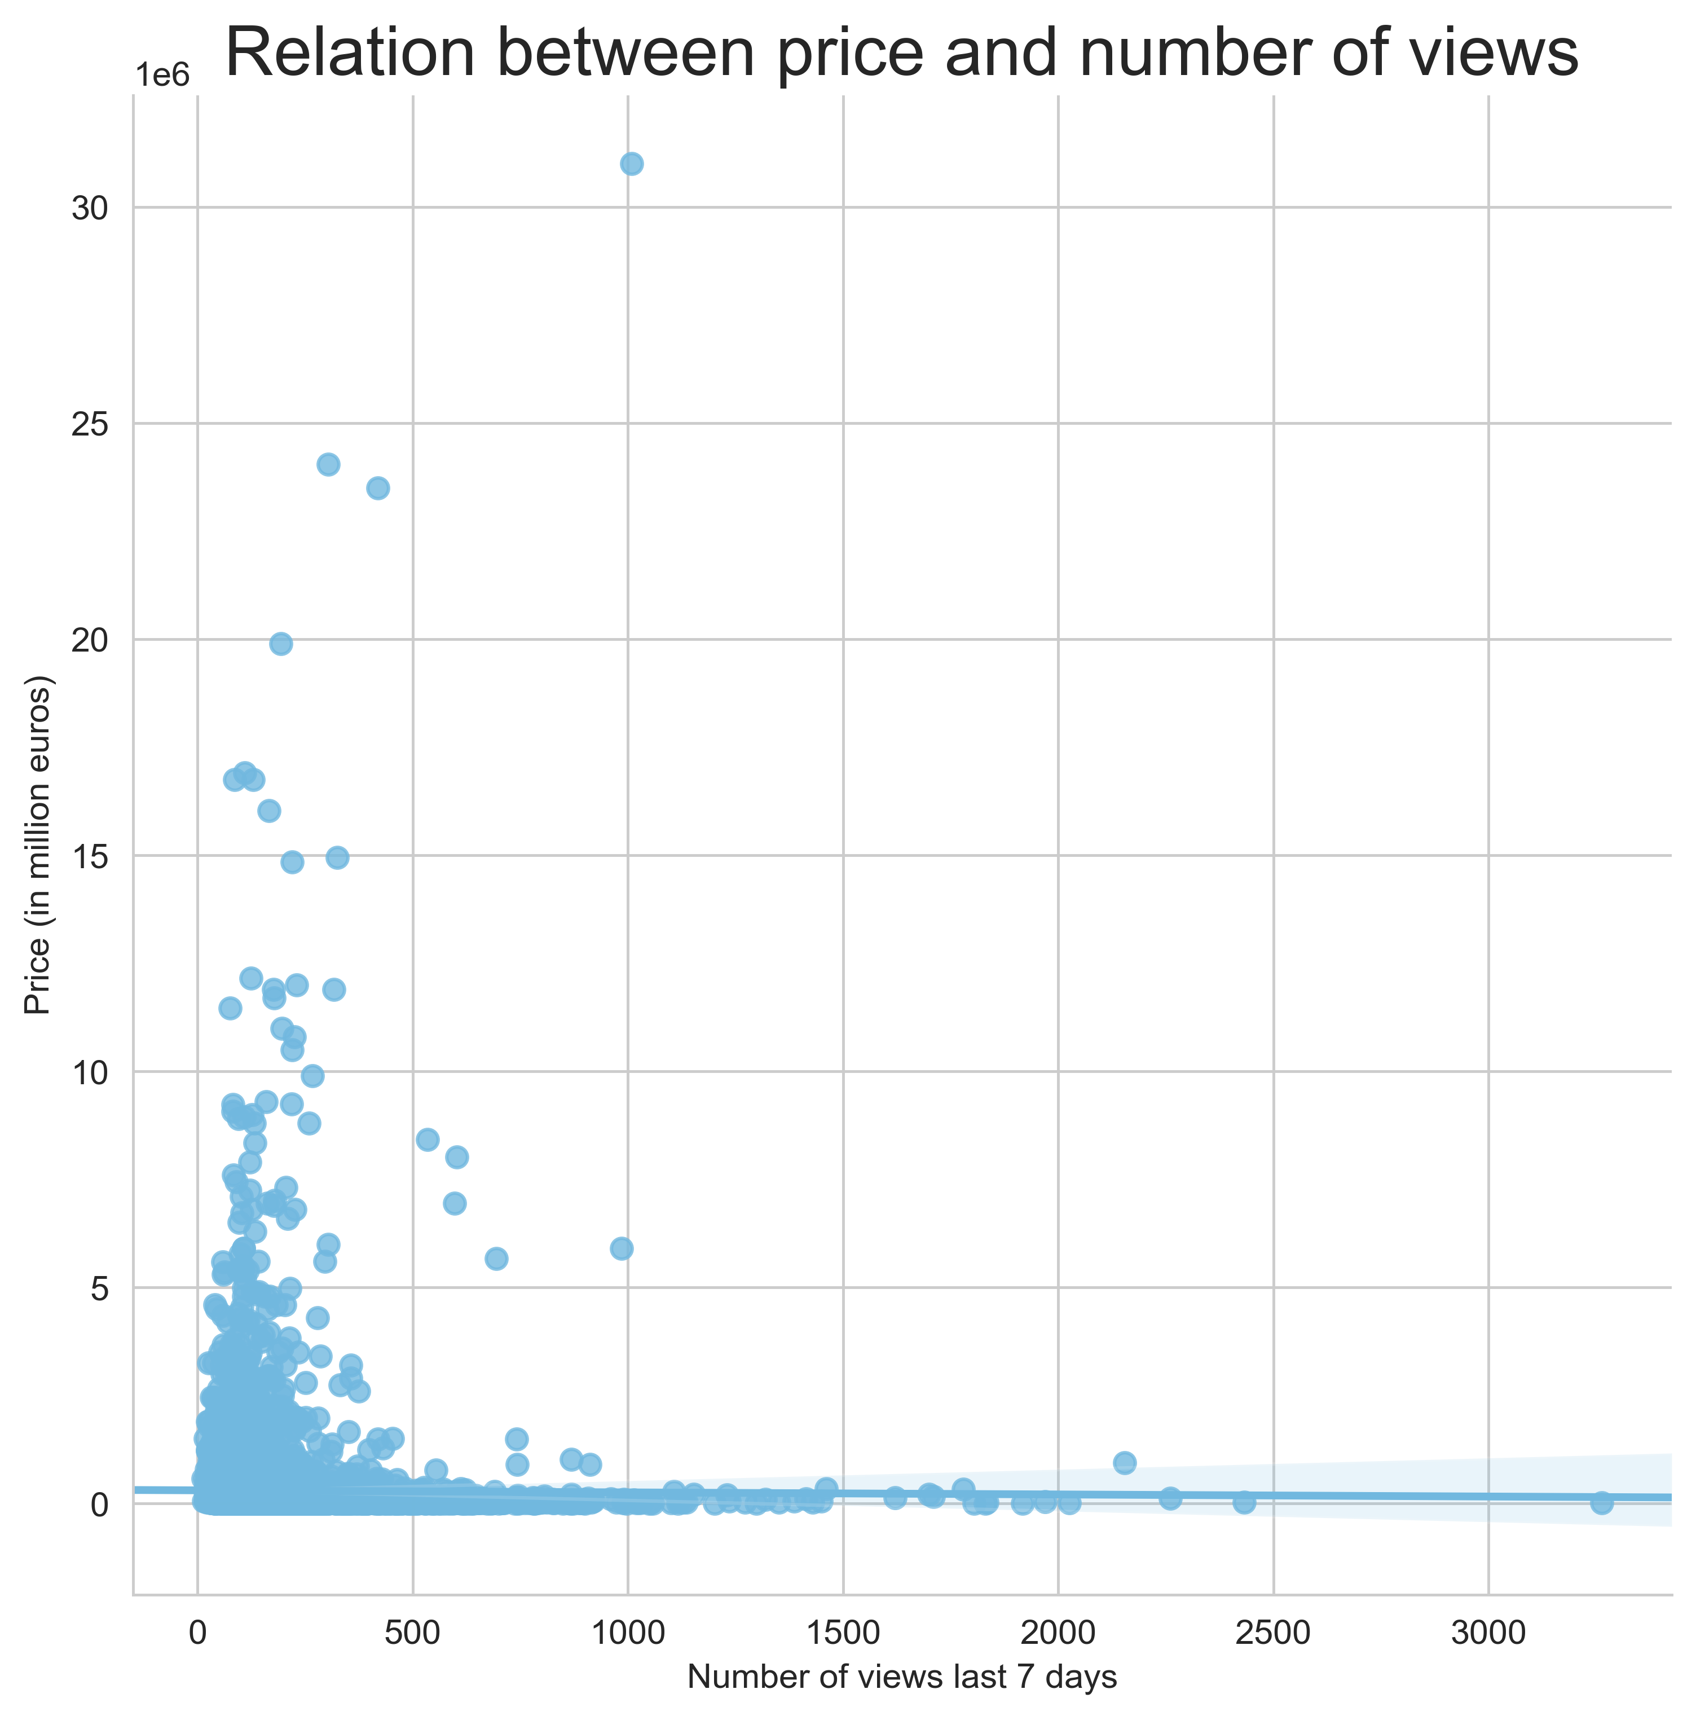
RESULTS ANALYSIS
INSIGHT
No relation between the number of views and the price. In fact, a lot of the most viewed boats have low prices.
Notes:
I would like to begin asking you: do you think the most expensive boats made the top views? And the answer is no. They don’t. As we can see in this chart, number of views on the bottom and price in million euros on the left, we cannot see any relation between the two. In fact, the line that shows the relation is flat. This means that there isn’t any relation between both. The most expensive boats are not the most viewed ads.

Slide 4
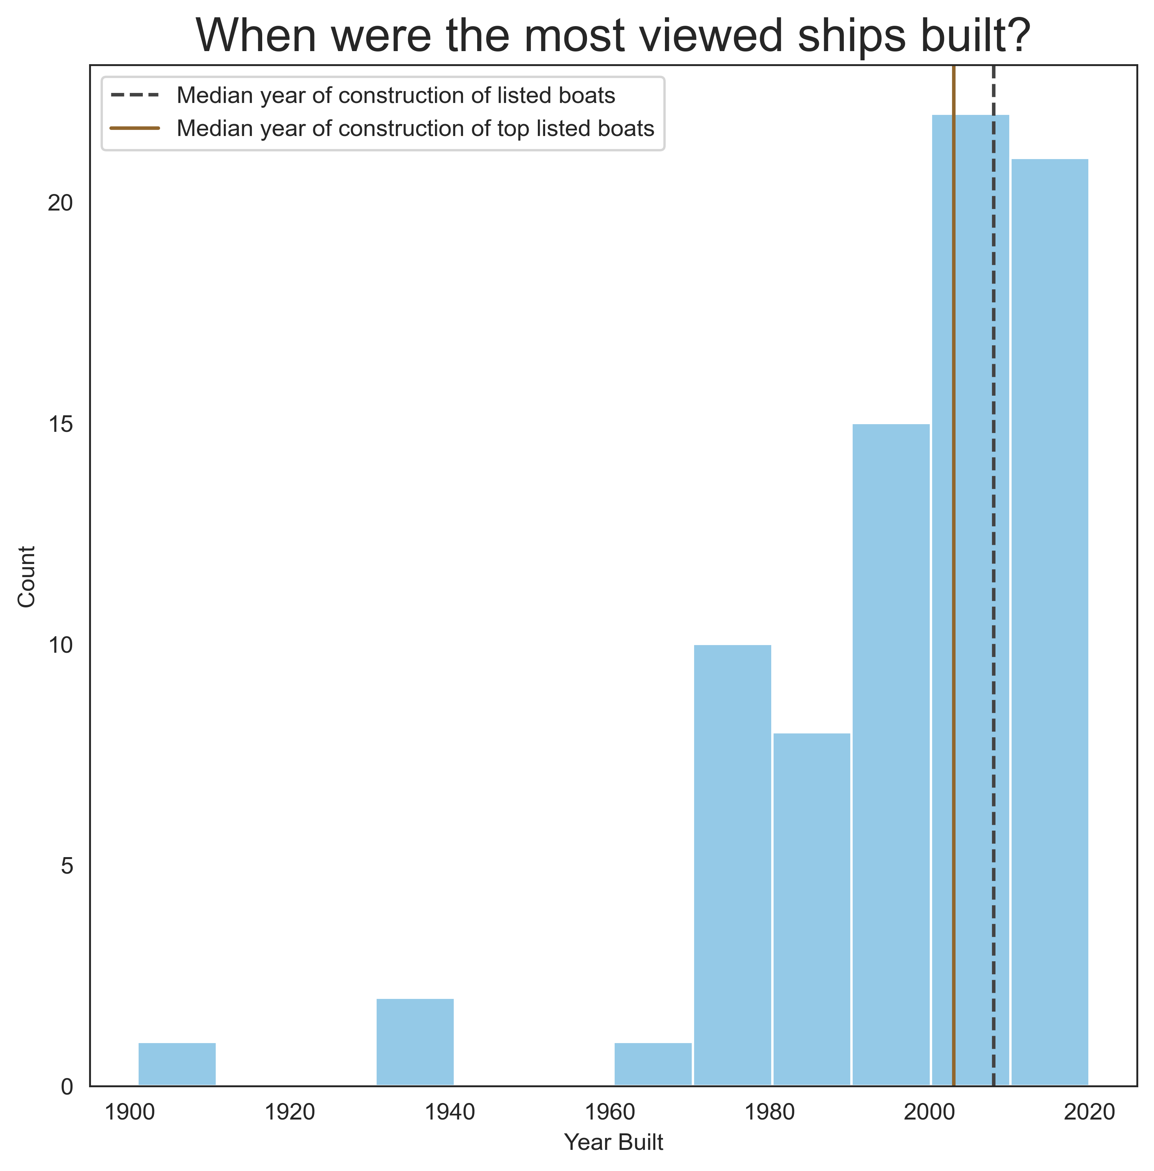
RESULTS ANALYSIS
INSIGHT
The most viewed ads are from boats that are older than the median of the dataset
Notes:
This lead us to the second question: When were the most viewed ships built? Are they old or young? In the following graph we can see the top 80 observation. Most of them were built between 2000 and 2020 being the median (the value that leaves 50% of the values to the right and 50% to the left, 2003. That is the brown line and, as we can see, is place in an older year than the dotted line. This means that the most viewed ads are from boats that are older than the median of the whole dataset.

Slide 5
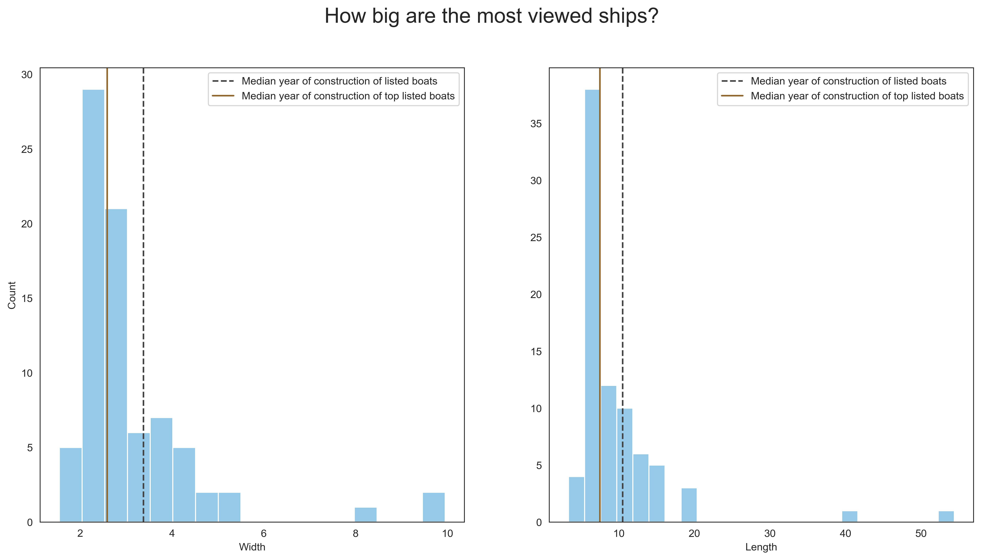
RESULTS ANALYSIS
INSIGHT
The most viewed ads are from boats that are smaller than the median of the dataset
Notes:
Do users prefer bigger ships? This data shows us the opposite. Again, the median width and length were smaller than the median of the whole dataset. This means that the most viewed ads are from boats that are smaller than the ones posted in the whole dataset.

Slide 6
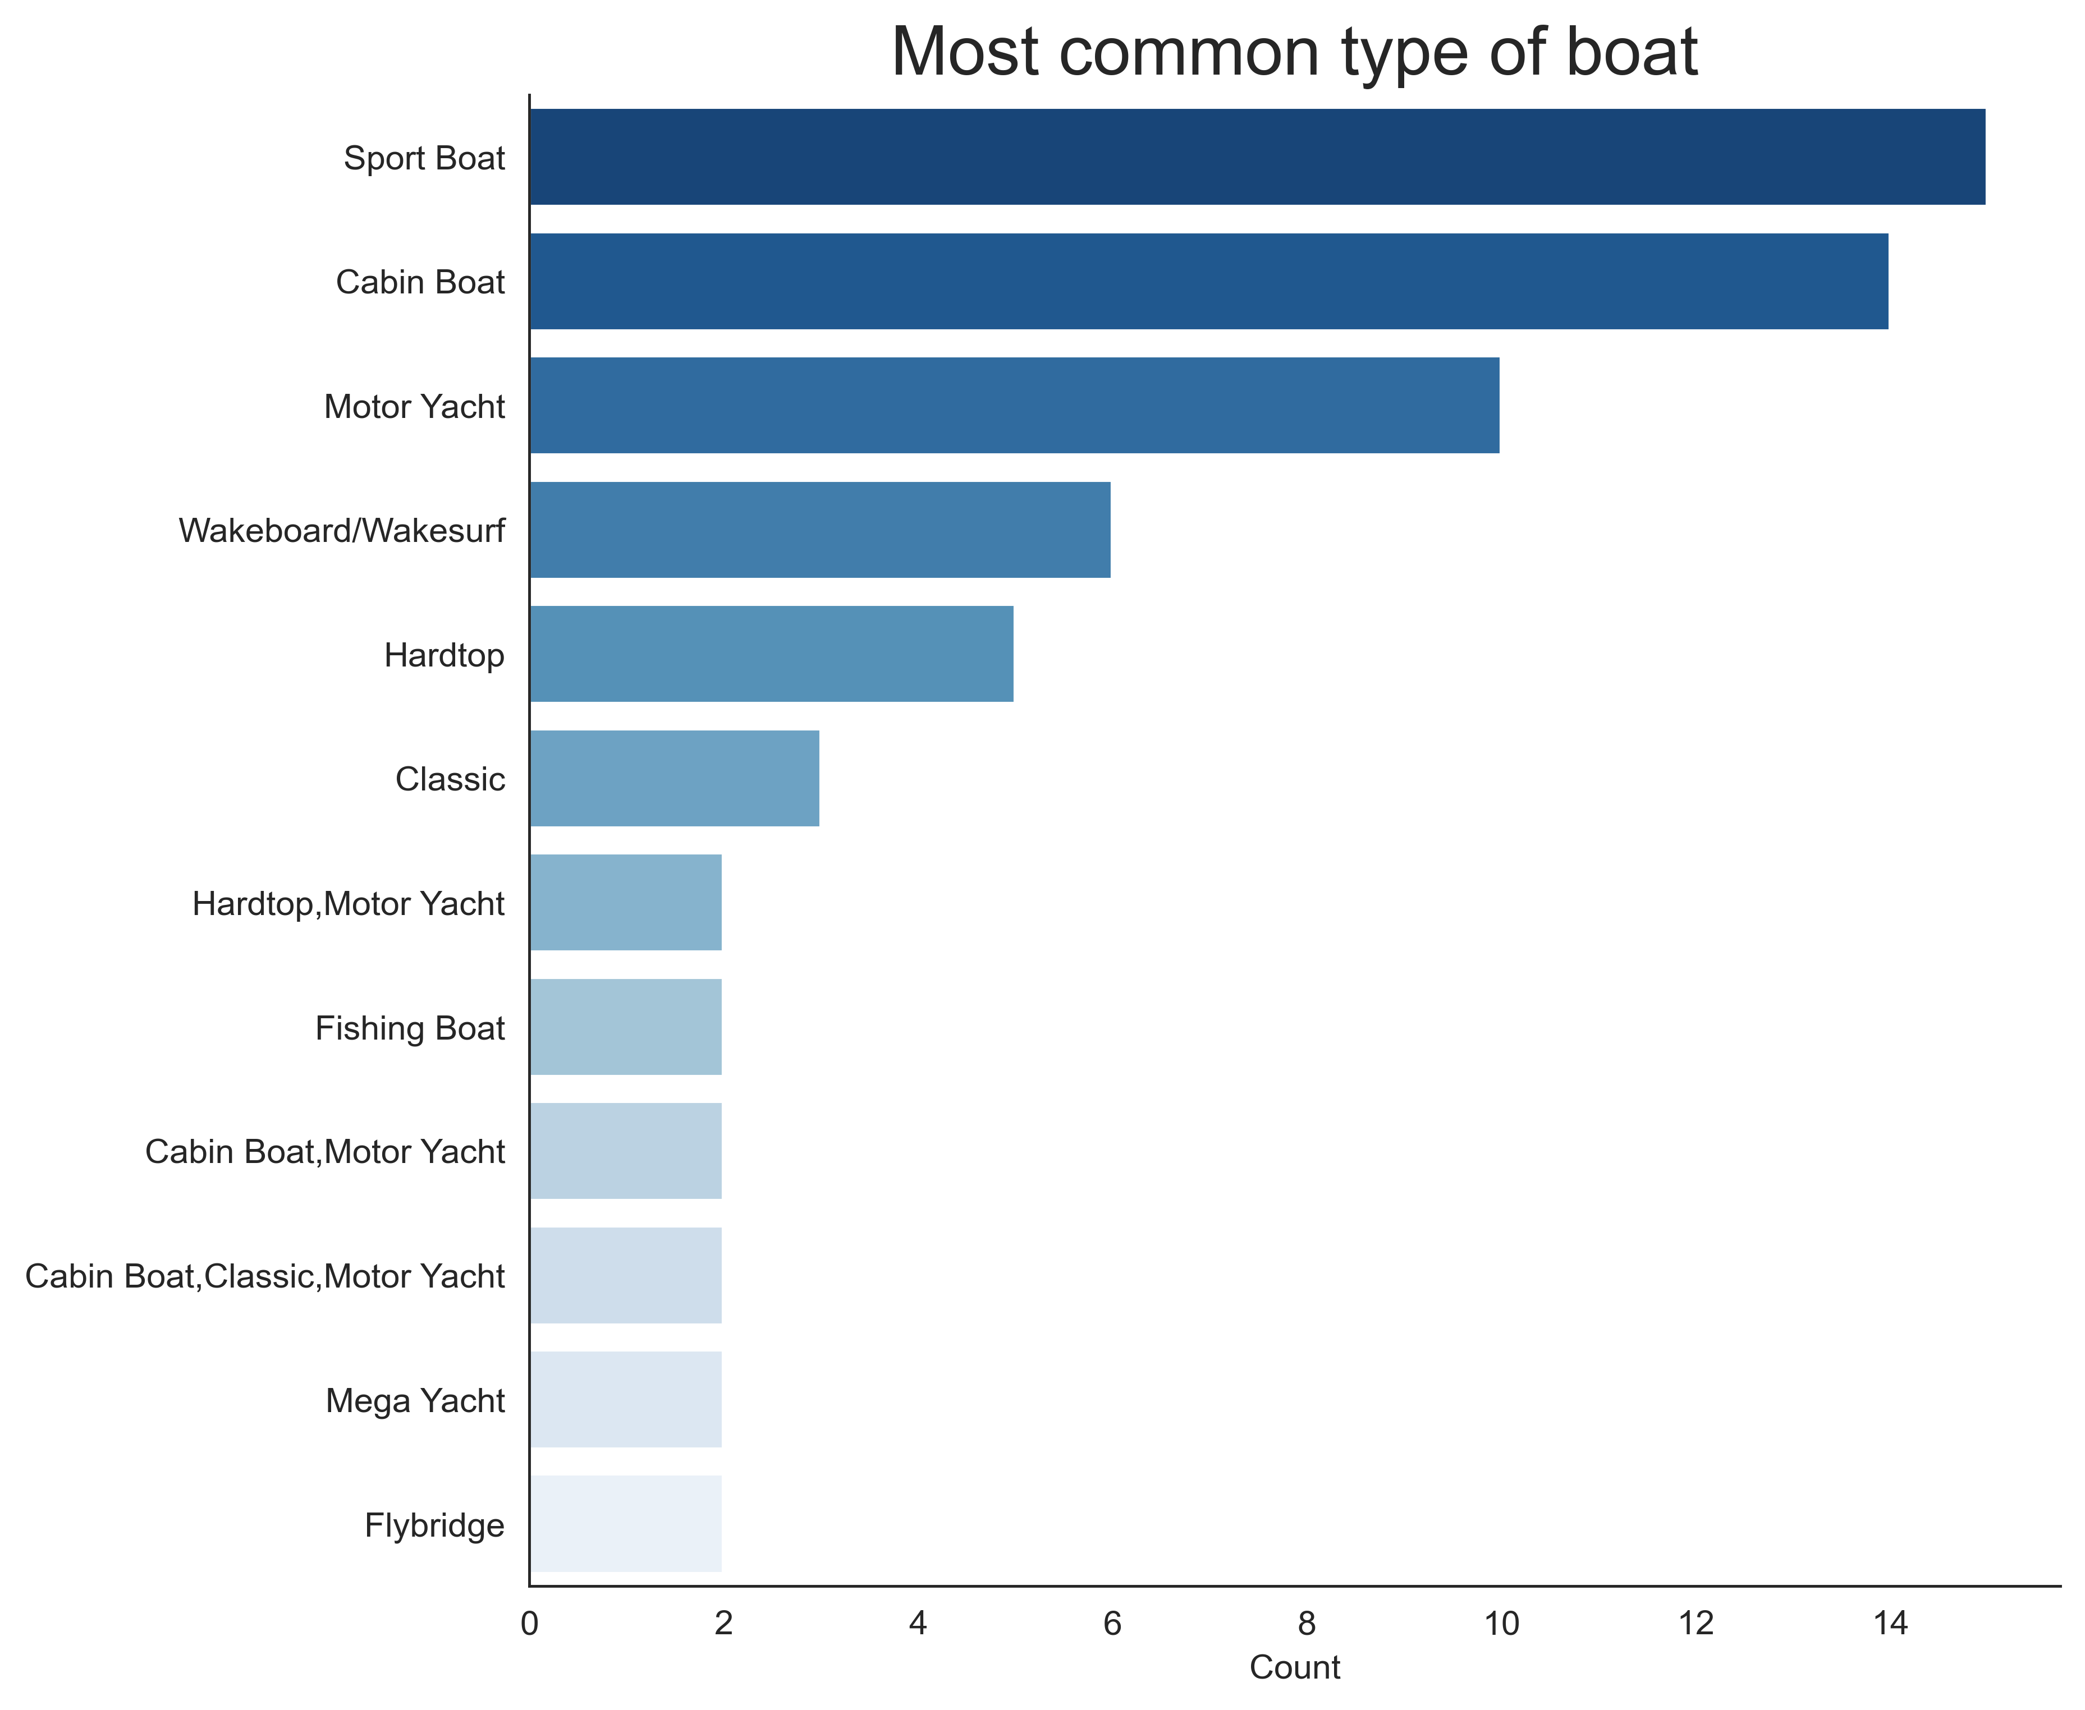
RESULTS ANALYSIS
INSIGHT
The most viewed ads are from sport boats and cabin boats.
Notes:
Now that we know that users like older and smaller boats, let’s figure out what are the most popular boats. As we can see, the most viewed boats are sport and cabin boats. Probably because they are more affordable.

Slide 7
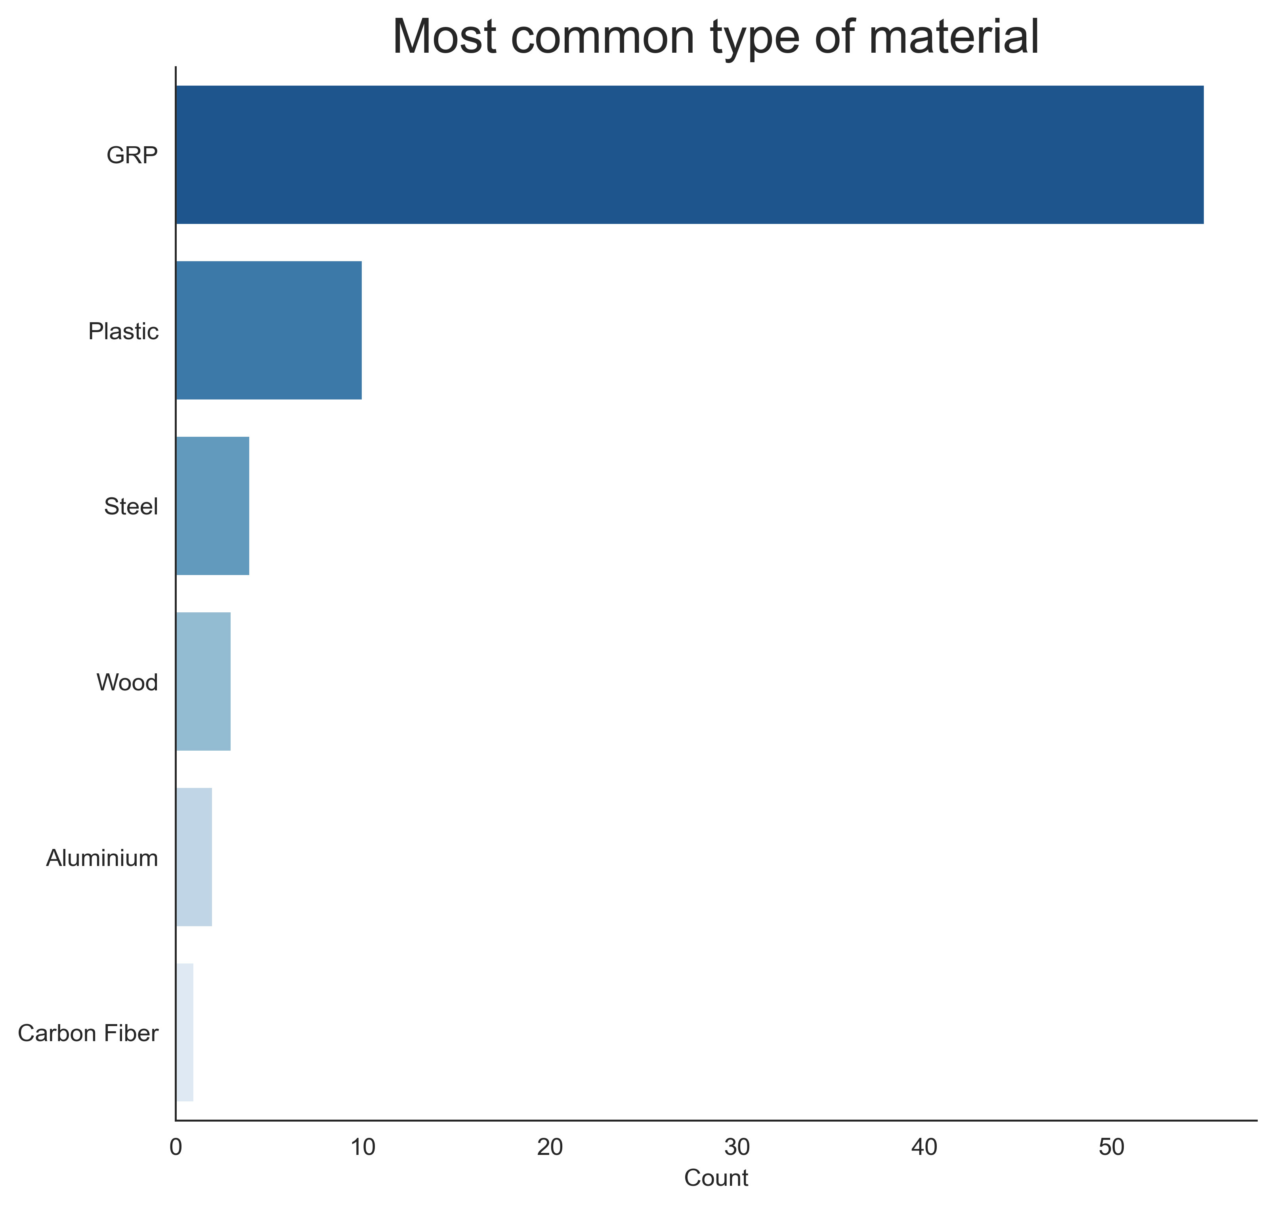
RESULTS ANALYSIS
INSIGHT
The most viewed ads are from boats made of GRP
Notes:
The most common material of the boat supports our last statement. Sport and cabin boats are usually made of GRP, or Glass Reinforced Plastic.

Slide 8
CONCLUSION
Users of the site prefer cheaper boats, probably because they are more afordable. This may be the reason why sports and cabin boats, usually made of GRP, are popular.
So, sellers should be promoting small sports and cabin boats to get more views in their ads. And, who knows, maybe more conversion rate.
Notes:
Users of the site prefers cheaper boats, probably because they are more affordable. This may be the reason why sports and cabin boats are popular, because they are smaller and cheaper. Also, this boats are usually made of GRP.
So, to get sellers more views in their ads, they should promote small sports and cabin boats.

