Slide 1



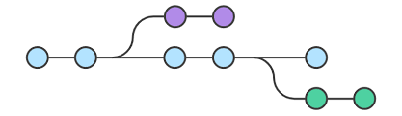

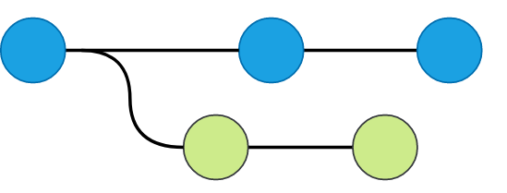








.R
Commit, Push
Clone/Fork
Pull Request
Merge
.R
.R
Broader Research Community
Researchers/Authors
CDC web portal
CDC web portal
NHANES Data

Slide 2
.R
Commit, Push
Clone/Fork
Pull Request
Merge
.R
.R
Broader Research Community
Researchers/Authors
NHANES Data

Slide 3
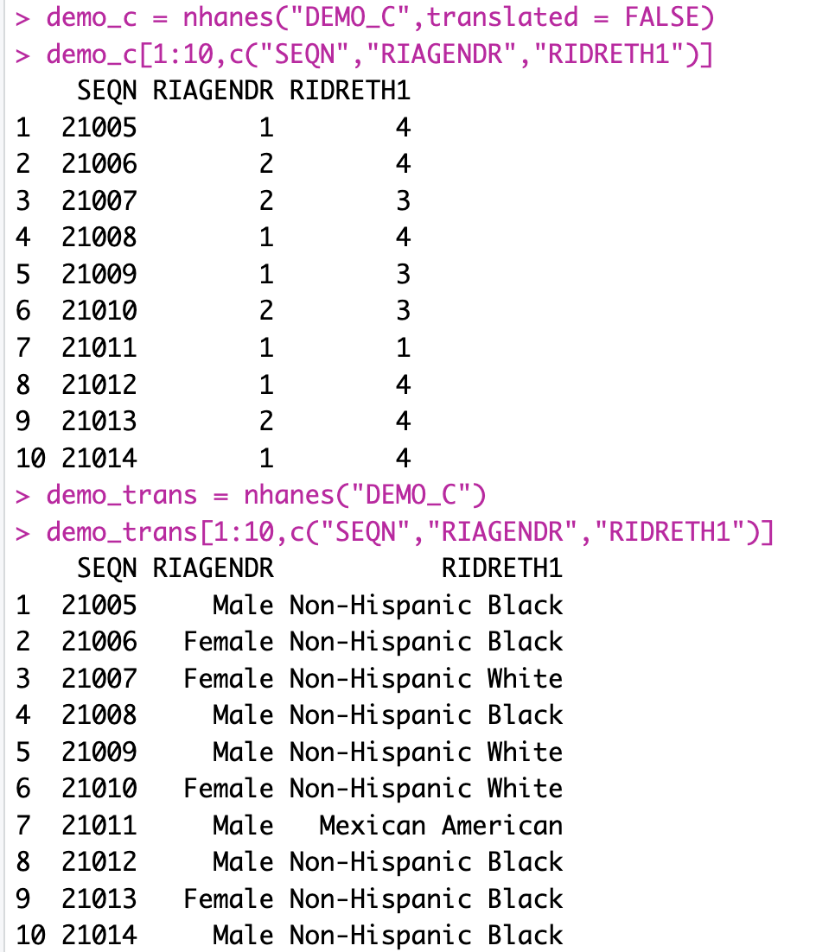
a)
b)

