Slide 1

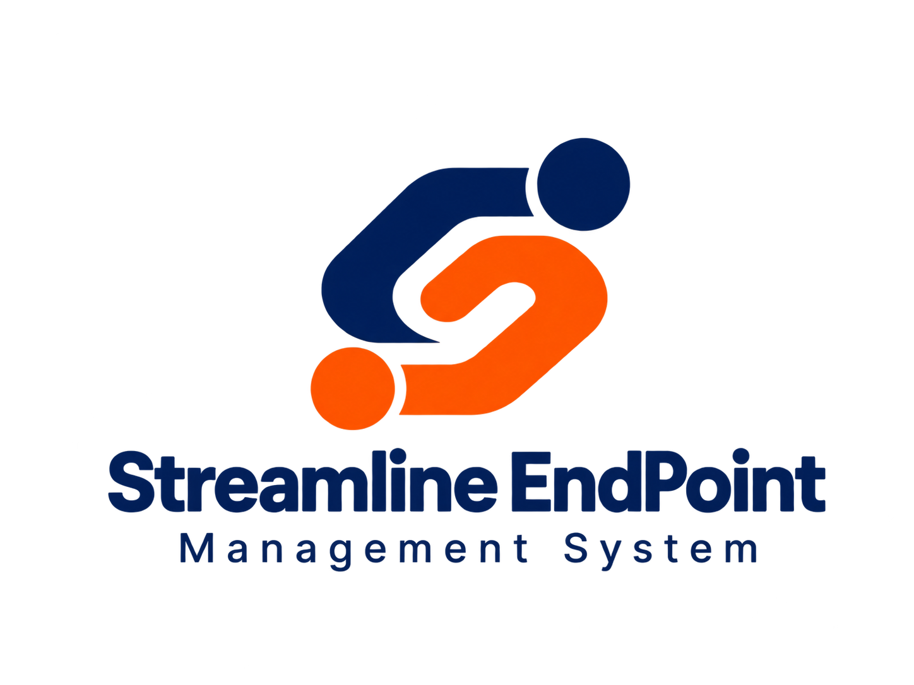


STREAMLINE
END-POINT
Simplify Management. Improve Efficiency. Achieve Optimal Performance.
Presented by

Slide 2

One platform for daily IT operations
SEP connects device information, asset records and support tickets.
Central oversight
Live visibility
Manage endpoints, equipment and support activity in one place.
Review device health, configuration and compliance status.
Less manual work
Faster support
Automate updates, alerts and approval workflows.
Give IT teams the information they need to respond sooner.
Streamline End Point
02
Notes:
Source: supplied SEP presentation. Original content for this slide:
Introduction to SEP
Smart Endpoint Management for Modern Operations
SEP brings device monitoring, asset tracking and service support together in one seamless platform.
By eliminating manual processes and fragmented systems, SEP improves operational efficiency, reduces risk and speeds up IT response across the organisation.
Centralised Control of devices, assets and support tickets
Real-Time Visibility into device health and compliance
Automated Workflows that replace repetitive manual updates
Faster Support Response to improve employee productivity
Audit-Ready Compliance with accurate, up-to-date asset records
SEP Value

Slide 3
SEP modules
Connected capabilities across the IT device lifecycle
01
Endpoint Management
02
IT Service Desk
Automatic device data collection and updates.
Issue reporting, ticket tracking and SLA alerts.
03
System Monitoring
04
Smart Analytics
Device security status and hardware changes.
AI-assisted issue detection and escalation.
05
IT Asset Management
06
Workflow Automation
Endpoints and their connected peripherals.
Digital deployment records and approvals.
Streamline End Point
03
Notes:
Source: supplied SEP presentation. Original content for this slide:
Core Modules
Automates device data collection and updates for seamless monitoring.
1. Endpoint Management
Monitors device security and performance for rapid issue detection.
3. System Monitoring
Manages IT equipment and peripherals by linking them to connected devices.
5. IT Asset Management
Report issues directly, with automatic alerts for unresolved tickets.
2. IT Service Desk
Automatically creates alerts or tickets for detected anomalies.
4. Smart Analytics
From Manual Setup to Fully Automated Deployment Operations
Workflow Automation

Slide 4
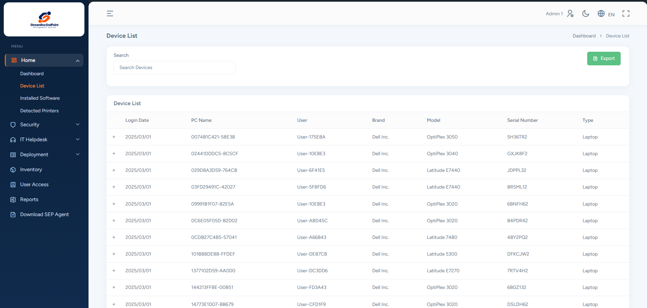
Endpoint Management
Automatic records and a central view of endpoint status.
Automated data collection
Collect device information in a central repository.
Live endpoint updates
Monitor device status, configuration and potential issues.
Streamline End Point
04
Notes:
Source: supplied SEP presentation. Original content for this slide:
Ciri Utama
This module automates device data collection and provides real-time updates for efficient monitoring and control.
Automated Data Collection
Collects device information and sends it to a central repository for accurate, up-to-date records.
Real-Time Updates
Continuously monitors endpoints and provides immediate updates on status, configuration and potential issues.
Endpoint Management
Summary
Workplace photograph is an AI-generated illustration.

Slide 5
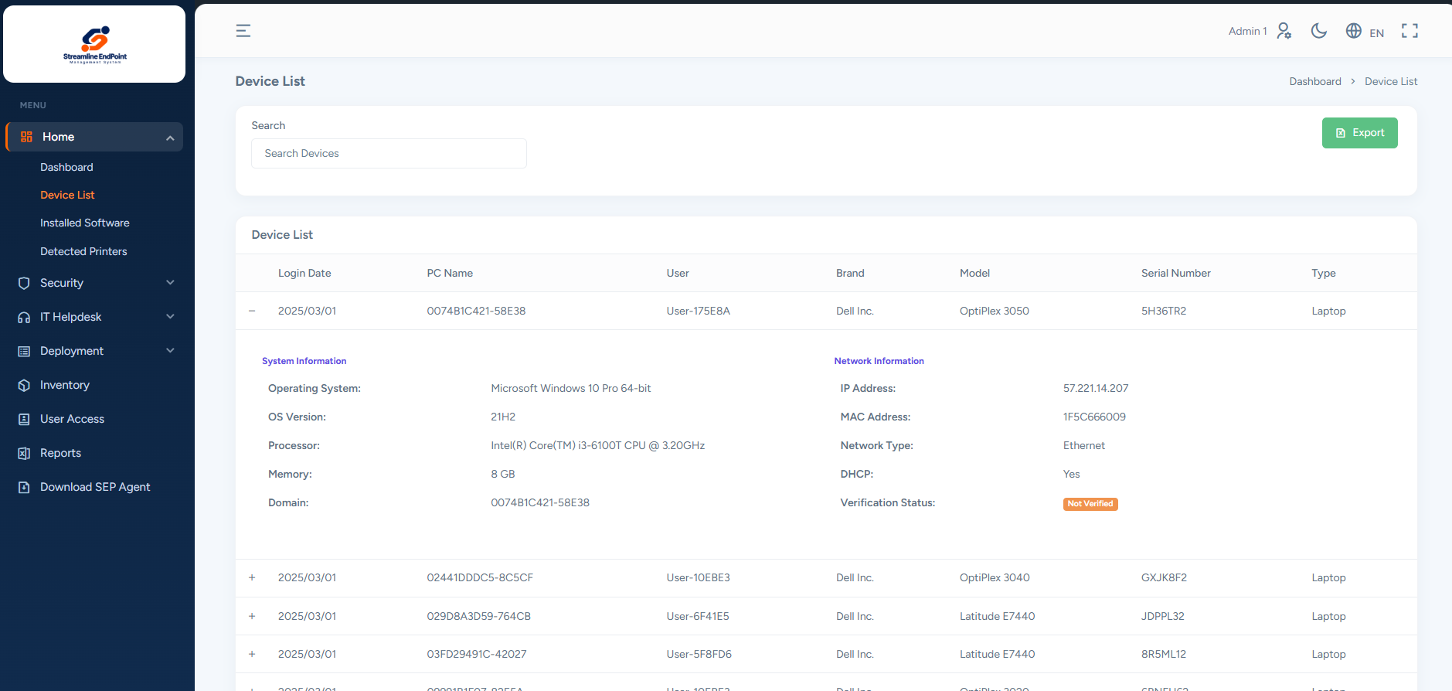
Endpoint Management benefits
Operational benefits
Less manual administration
Reduce time spent tracking and updating device records.
Better decisions
Use live information to prioritise action.
Centralised oversight
Support reporting and audit readiness.
Lower disruption
Proactive maintenance helps reduce downtime and costs.
Streamline End Point
05
Notes:
Source: supplied SEP presentation. Original content for this slide:
Benefits
1
2
3
4
Improved Efficiency
Better Decision-Making
Centralized Oversight
Cost Savings
Reduces manual effort in tracking and updating endpoint information, saving time and resources.
Real-time data helps IT teams respond quickly to issues or make proactive changes.
A unified repository improves compliance, reporting and audit readiness.
Proactive maintenance reduces downtime and IT costs.
End Point Management

Slide 6
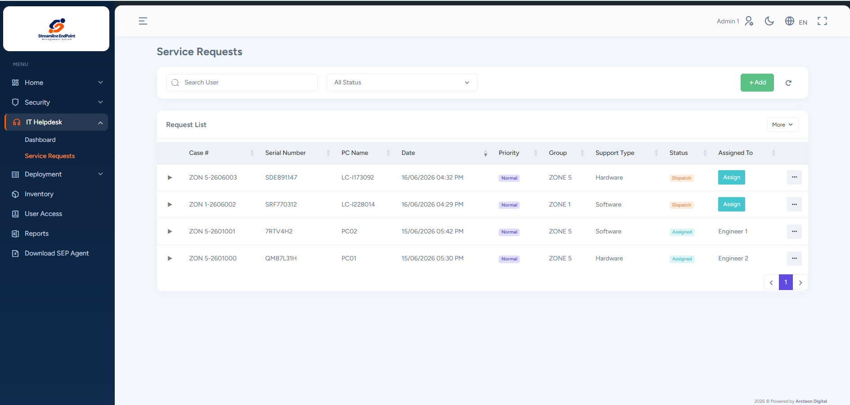
IT Service Desk
Issue reporting and support tracking in one place.
Direct issue reporting
Employees open cases from the SEP agent on their computers.
Screenshots for diagnosis
Attach error screenshots to help IT teams understand the issue.
SLA monitoring
Track resolution times and alert teams to overdue tickets.
Streamline End Point
06
Notes:
Source: supplied SEP presentation. Original content for this slide:
Features
This module simplifies issue reporting and improves IT support efficiency through user-friendly tools and integrated ticket management.
Direct Issue Reporting
End users can report issues or open cases directly from their computers through a dedicated agent, ensuring fast, accurate reporting.
IT Service Desk
Summary
Upload Error Screenshots
Users can upload screenshots of error messages through the agent, helping IT teams understand and resolve issues faster.
SLA Monitoring & Alerts
The IT Service Desk portal tracks ticket resolution times and alerts teams when tickets exceed their SLA, supporting timely resolution and accountability.
Workplace photograph is an AI-generated illustration.

Slide 7
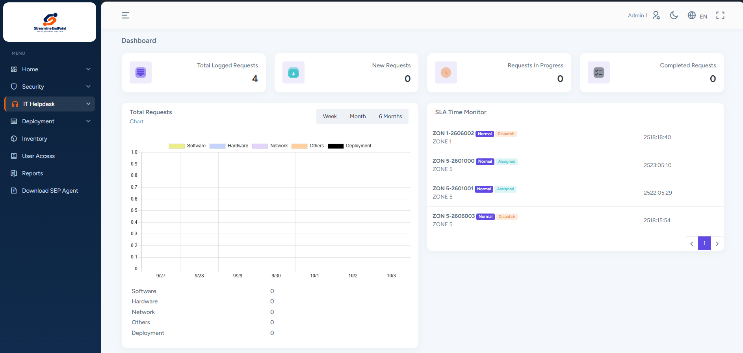
IT Service Desk benefits
Operational benefits
Easier reporting
Give employees a clear way to request help.
Faster diagnosis
Provide support teams with useful issue details.
Clear priorities
SLA alerts help teams prioritise critical cases.
Greater transparency
Track support activity and communication centrally.
Streamline End Point
07
Notes:
Source: supplied SEP presentation. Original content for this slide:
Benefits
1
2
3
4
Better User Experience
Faster Resolution
Proactive IT Management
Greater Transparency
Simplifies issue reporting and reduces frustration for end users.
Gives IT teams details such as error screenshots to resolve issues more efficiently.
SLA alerts help teams meet targets and priorities critical cases to minimize downtime.
A central portal tracks every issue, improving communication and reporting.
IT Service Desk

Slide 8

System Monitoring
Visibility into device security and hardware configuration.
Security status
Monitor antivirus, system updates, USB policies and drive encryption.
Hardware changes
Track changes to components in registered devices.
Streamline End Point
08
Notes:
Source: supplied SEP presentation. Original content for this slide:
Features
This module offers comprehensive monitoring tools to strengthen security and maintain control over system hardware and software configurations.
Security Monitoring
Detects and monitors antivirus agent status to ensure it remains active and up to date.
Tracks system updates to verify compliance with security protocols.
Monitors USB restriction policies and hard drive encryption to prevent unauthorized data access.
Hardware Monitoring
Detects and tracks changes to components in registered devices to protect asset integrity and comply with organizational policies.
System Monitoring
Summary
Workplace photograph is an AI-generated illustration.

Slide 9
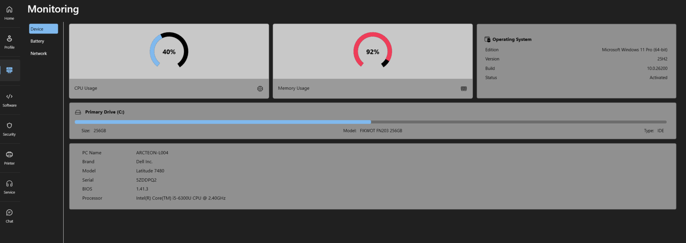
System Monitoring benefits
Operational benefits
Stronger oversight
Review device security status continuously.
Earlier action
Identify missed updates and potential risks.
Accurate asset records
Track hardware changes and investigate discrepancies.
Compliance support
Maintain monitoring records for reporting and audits.
Streamline End Point
09
Notes:
Source: supplied SEP presentation. Original content for this slide:
Benefits
1
2
3
4
Stronger Security
Proactive Issue Resolution
Improved Asset Management
Regulatory Compliance
Helps protect systems through real-time monitoring of antivirus, encryption and USB policies.
Identifies and alerts teams to missed updates or potential security risks before they escalate.
Tracks hardware changes to prevent unauthorized modifications and keep inventory records accurate.
Supports compliance through continuous monitoring and accurate records.
System Monitoring

Slide 10

Smart Analytics
AI-assisted monitoring helps IT teams identify issues sooner.
Early issue detection
Identify unusual patterns, specification mismatches and agent faults.
Automatic escalation
Create alerts or support tickets for detected issues.
Configurable monitoring
Set rules and alert levels to suit operational needs.
Streamline End Point
10
Notes:
Source: supplied SEP presentation. Original content for this slide:
Features
Works seamlessly with System Monitoring, using AI to detect issues in real time and trigger automated responses, reducing downtime, costs and IT workload.
Smart Hardware Monitoring
Integrated Real-Time Monitoring
AI analyses live system data to detect unusual patterns early.
Automates alerts and corrective actions to reduce manual work.
Dynamically adjusts monitoring rules based on system behaviour.
Smart Analytics
Summary
Automatically flags hardware issues such as specification mismatches or faulty agents.
Creates IT support tickets immediately for a fast response and minimal disruption.
Maintains compliance and hardware integrity through continuous AI validation.
(AI-Powered Monitoring for Efficient IT Operations)
Workplace photograph is an AI-generated illustration.

Slide 11
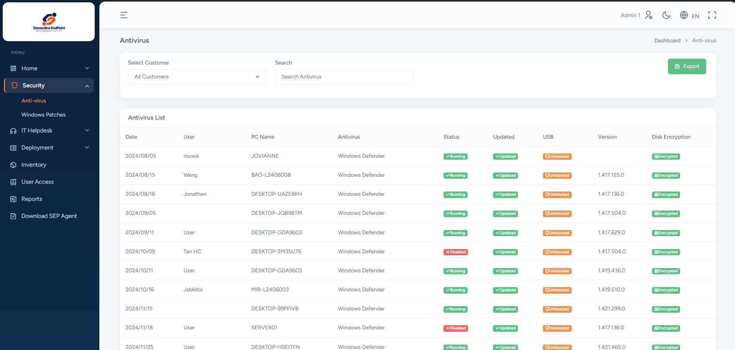
Smart Analytics benefits
Operational benefits
Proactive support
Identify and escalate issues sooner.
Less manual monitoring
Give IT teams more time for other priorities.
Improved reliability
Support timely resolution of critical issues.
Relevant alerts
Customise alert types and levels for the organisation.
Streamline End Point
11
Notes:
Source: supplied SEP presentation. Original content for this slide:
Benefits
1
2
3
4
Proactive IT Support
Greater Efficiency
Improved Reliability
Customisable Alerts
Automatically identifies and escalates issues, shortening response times and preventing operational disruption.
Reduces manual monitoring and intervention, letting IT teams focus on strategic work.
Resolves critical issues quickly to maintain system integrity and uptime.
Lets organisations set alert types and levels to match operational needs and internal priorities.
Smart Analytics

Slide 12
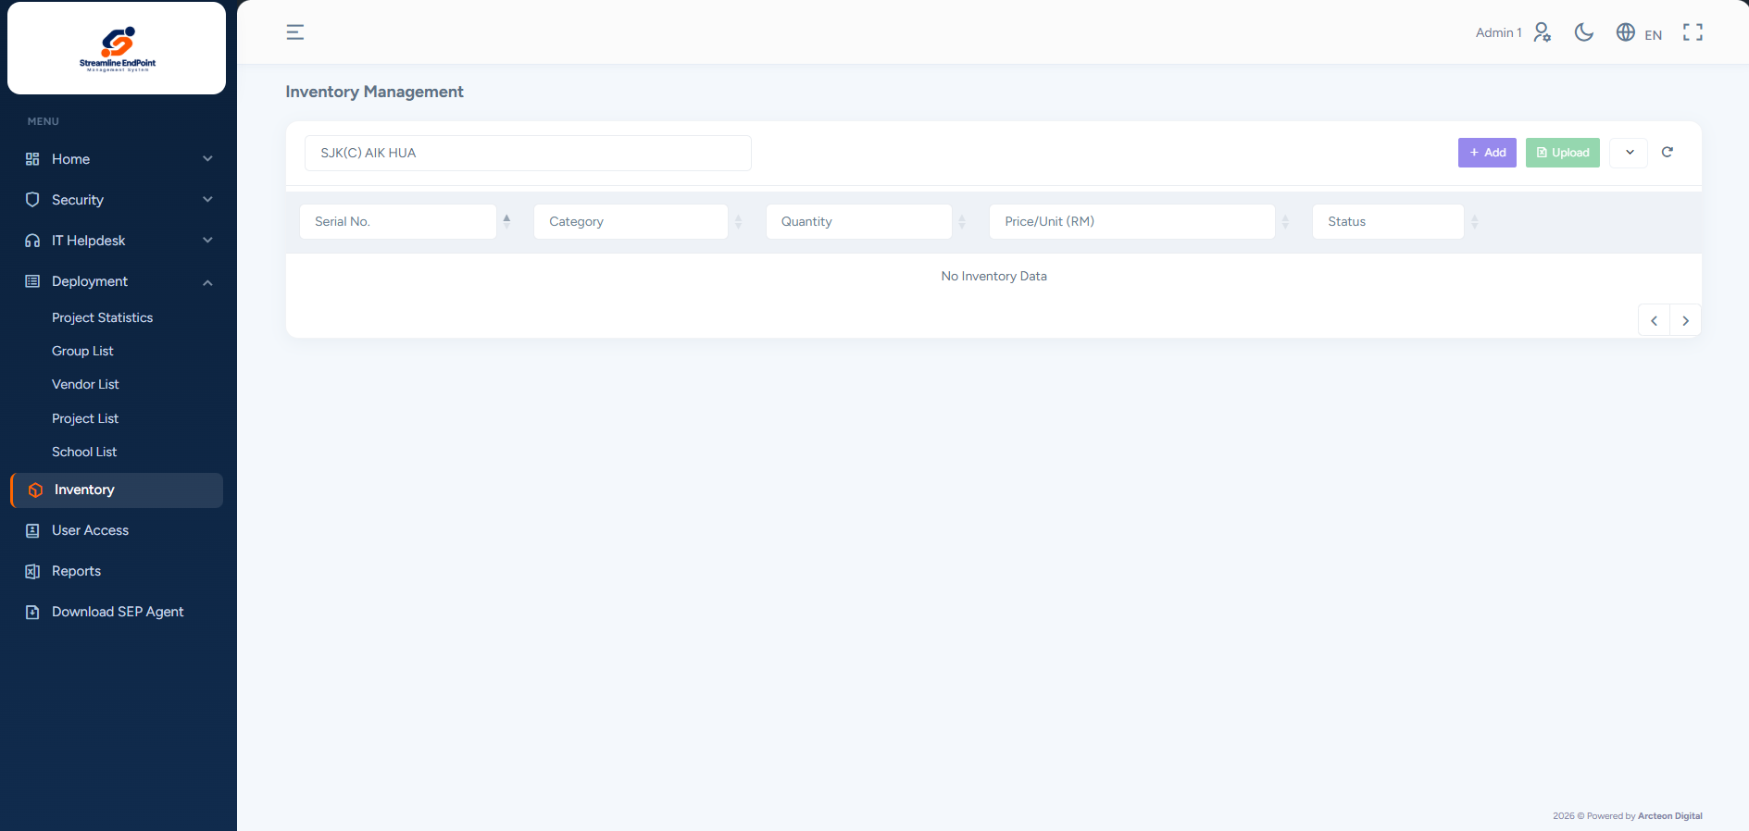
IT Asset Management
A central record of IT equipment and its connected endpoints.
Peripherals in the inventory
Record printers, scanners and other IT equipment.
Linked device records
Associate peripherals with PCs or laptops using endpoint serial numbers.
Clear equipment relationships
For example, link a printer to the PC that uses it.
Streamline End Point
12
Notes:
Source: supplied SEP presentation. Original content for this slide:
Features
This module provides a central system to track and manage all IT equipment, with seamless integration into Endpoint Management for comprehensive asset monitoring.
Track IT Peripherals
Connected Devices, Unified Control
Links IT equipment to connected PCs or laptops using endpoint serial numbers for easier inventory management.
Example: A printer connected to a PC is tagged and tracked with that machine in the inventory system.
IT Asset Management
Summary
Tracks IT equipment such as printers, scanners and other peripherals for a complete view of organizational assets.
Workplace photograph is an AI-generated illustration.

Slide 13
IT Asset Management benefits
Operational benefits
Clear accountability
Link equipment to its associated endpoint.
Simpler tracking
Group related devices for easier audits and updates.
Inventory visibility
Review equipment records, status and recorded locations.
Coordinated maintenance
Maintain peripherals alongside their connected endpoints.
Streamline End Point
13
Notes:
Source: supplied SEP presentation. Original content for this slide:
Benefits
1
2
3
4
Improved Asset Management
Simplified Tracking
Real-Time Visibility of All IT Equipment
Efficient Maintenance
Creates clear links between peripherals and endpoints for better asset organisation and accountability.
Groups related equipment under one device to simplify audits and updates.
Shows the location and status of all IT equipment in real time.
Ensures connected devices are recorded and maintained alongside their associated endpoints.
IT Asset Management

Slide 14

Paperless operations
Digital approvals and automated maintenance checks
Workflow approvals
Replace printed forms and manual sign-offs with digital records and traceable approvals.
Preventive maintenance
Verify required checks before allowing approval to proceed.
Streamline End Point
14
Notes:
Source: supplied SEP presentation. Original content for this slide:
Towards Paperless, Environmentally Friendly Operations
SEP introduces two new modules designed to remove manual documentation, reduce errors and support the national “Go Green” digital transformation vision.
SEP Innovations 2025
Go Digital. Stay Compliant. Protect the Planet.

Slide 15
Digital forms and approvals
Workflow Processing with Digital Signature Approval
Customisable forms
Digital sign-off
Design forms and approval steps around business processes.
Capture SAP and UAT approvals with signer verification.
Progress and audit trail
Paperless documentation
Track approval status and retain the supporting records.
Reduce printing, manual filing and repeated follow-ups.
Streamline End Point
15
Notes:
Source: supplied SEP presentation. Original content for this slide:
Fully customisable digital forms and approval workflows designed around your business processes.
Outcome: Faster approvals, better compliance and no paperwork.
1
Workflow Processing with Digital Signature Approval
Digitise and simplify SAP and UAT approvals for a faster, paperless process that is easy to track.
Built-in digital signatures provide verified, standards-compliant and more secure approvals.
Replace printing, manual signatures and paper filing with a faster, more efficient digital approval process.
Real-time tracking and an audit trail in one powerful dashboard.

Slide 16
Preventive Maintenance
Automated checks before digital approval
01
Run the checklist
A one-click check verifies the required maintenance items.
02
Resolve failed items
If an item fails, approval remains blocked until the requirement is met.
03
Retain the record
Keep maintenance results available for governance and audit.
Streamline End Point
16
Notes:
Source: supplied SEP presentation. Original content for this slide:
A one-click system check verifies that all maintenance requirements have been met.
Outcome:
Fewer errors, no missed checks and stronger governance.
2
Preventive Maintenance with Automated Compliance Checks
Ensure compliance before approval, every time.
If even one item fails, digital approval is blocked.
Keeps asset maintenance error-free and audit-ready.

Slide 17
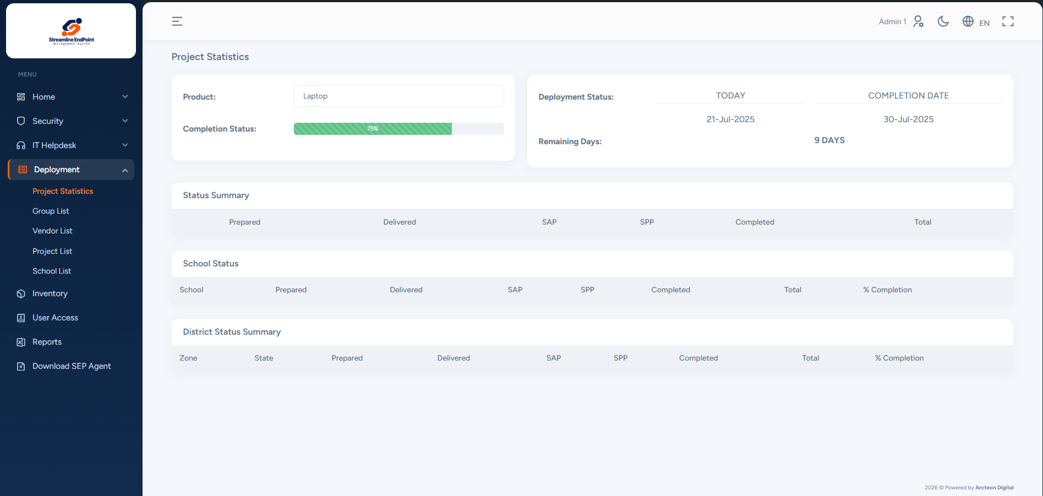
IT device deployment
Less manual administration throughout the deployment process.
Automatic recordkeeping
Update device and deployment records with less manual input.
Digital forms and signatures
Capture approvals with a clear record of progress.
Project visibility
View deployment status and download reports from the web portal.
Streamline End Point
17
Notes:
Source: supplied SEP presentation. Original content for this slide:
IT Device
Deployment Process
A major benefit of deploying SEP is an improved device deployment process.
The system automates tasks previously handled manually, significantly improving operational efficiency, accuracy and data traceability.
Less manual work
Fewer human errors
Digital forms and automatic recordkeeping
Integrated approvals and signatures
Greater operational efficiency
Better data management
Key Advantage
Workplace photograph is an AI-generated illustration.

Slide 18
Current deployment process
Manual records and signature follow-ups create waiting time.
01
02
03
04
Receive devices
Prepare devices
Prepare documents
Deliver devices
Excel register and serial-number scanning
Install, configure and update Excel
Pack stock. Print labels, DO, SAP and SPP.
Deliver equipment and obtain DO/SAP sign-off
08
07
06
05
Project closure
Onsite support
Follow-up sign-off
Checkout submission
Consolidate reports and submit to BPM
Distribute devices. Obtain SPP/UAT sign-off.
Reminders, corrections and PPD/JPN escalation
Verify signatures, stamps and dates
Streamline End Point
18
Notes:
Source: supplied SEP presentation. Original content for this slide:
Current process flow
Receive Devices
1
Prepare/Setup Device
Prepare Documents
Deliver Devices
2
3
4
Load boxes
Deliver equipment
Obtain sign-off for DO and SAP
Project Closure
8
Onsite Engineer
Followup SignOff
Checkout Submission
7
6
5
Create an Excel file to track items
Scan each item’s serial number
Deployment Process Flow
Install and configure devices
Manually update Excel to track setup progress
Count stock and pack IT devices
Create and print a delivery label for each box
Prepare and print DO, SAP and SPP documents
Return to obtain signatures for SPP and UAT
Prepare reports
Manually consolidate and file documents
Submit documents to BPM for payment
Provide on-site support during device distribution to departments
Manually update and track deployed devices
Obtain signatures for SPP and UAT
Return to obtain SAP sign-off if errors are found
Send reminders to the SAP signatories
Manually escalate to PPD and JPN
Check all SAP signatures, stamps, dates and required details
Obtain all required signatures before proceeding
Verify the SAP has been signed, stamped and dated
Highlighted steps must be completed before the next step. They often create long waiting times.

Slide 19
Deployment with SEP
Automatic tracking and online approvals reduce repeated administration.
01
02
03
04
Receive devices
Prepare devices
Prepare documents
Deliver devices
Register devices. Scan non-PC serial numbers.
Install SEP and track progress automatically
Generate labels and print the DO only
Deliver equipment and obtain DO sign-off
07
06
05
Digital approvals include OTP verification, reminders and escalation.
Project closure
Onsite support
Checkout submission
Download reports and submit digital records to BPM
Automatic tracking and online SPP/UAT approval
Online SAP approval, OTP and automatic reminders
Streamline End Point
19
Notes:
Source: supplied SEP presentation. Original content for this slide:
Improvise Process flow
Receive Devices
1
Prepare/Setup Device
Prepare Documents
Deliver Devices
2
3
4
Load boxes
Deliver equipment
Obtain sign-off for DO
Project Closure
Onsite Engineer
Checkout Submission
7
6
5
Create an Excel file to track items
Scan serial numbers for non-PC devices
Deployment Process Flow
Install and configure devices
Install SEP on PCs
Automatically update and track progress
View progress on the web portal dashboard
Pack IT devices
Create computer-generated delivery labels
Prepare and print the DO only
Download reports from the web portal
Automatically consolidate data and generate documents
Submit digital documents for BPM payment processing
Provide on-site support during device distribution to departments
Automatically update and track deployed devices
Submit SPP and UAT sign-offs online
Verify signers through OTP
Automatically send SPP sign-off reminders
Signatories receive approval notifications
Sign off SAP online
Verify signers through OTP
Automatically send SAP sign-off reminders
Automatically escalate to PPD and JPN
Highlighted steps are improved through automation or digital methods, reducing manual work and the time required.

Slide 20
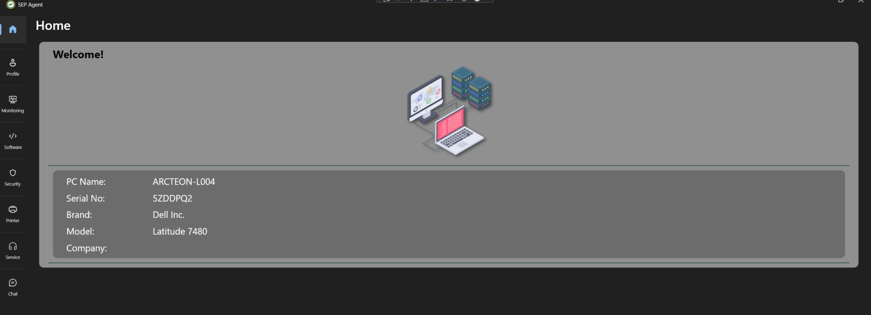
SEP agent device tagging
Device records begin during installation and setup.
Device tagging
Tag devices as part of installation and configuration.
Automatic data capture
The SEP agent collects device information and stores it in the backend system.
Streamline End Point
20
Notes:
Source: supplied SEP presentation. Original content for this slide:
Appendix
1
2
SEP Agent Device Tagging
Simplified Tracking
Devices are tagged during installation and setup.
The SEP agent collects device information and stores it in the backend system.
Appendix
Workplace photograph is an AI-generated illustration.

Slide 21
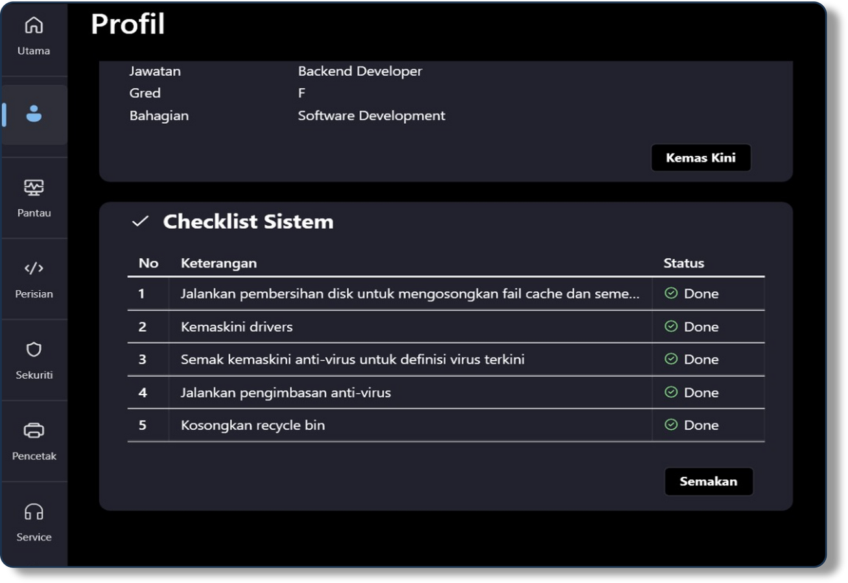
Deployment checklist
A consistent check of required items and activities.
Automated verification
Use the system checklist to confirm that required deployment activities are complete.
Clear completion status
Review checklist results before the next approval step.
Streamline End Point
21
Notes:
Source: supplied SEP presentation. Original content for this slide:
Appendix
1
Deployment Checklist
SEP provides an automated system checklist to verify that all required items and activities are complete.
Appendix
Workplace photograph is an AI-generated illustration.

Slide 22
CONTACT US
Contact us for a quotation or consultation
https://arcteon-digital.com/
+603 9226 8079
Kuala Lumpur, Malaysia
enquiry@arcteondigital.com.my

