Slide 1
ENGI 301 Hifi Music Player Proposal
19 Feb 2024
Nithit Bunchatheravate (Ai)

Slide 2
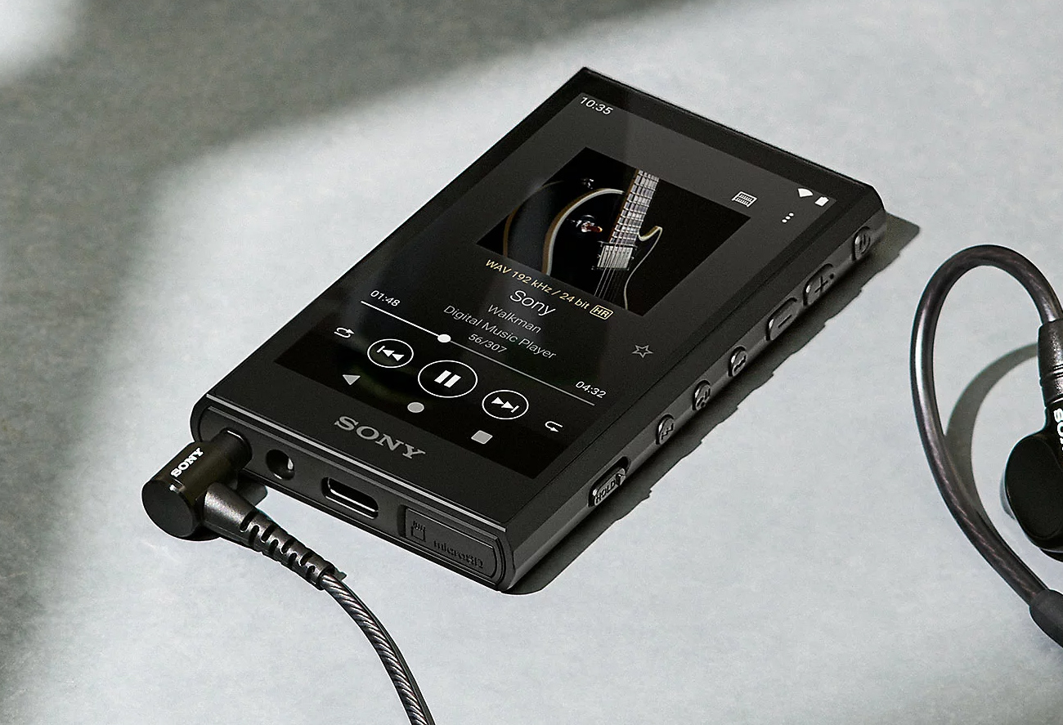
Background Information
In a world where music has become a part of everyone’s lifestyle from using airpods with iPhones to custom in-ear monitors with the Sony Walkmans, each individual finetunes their music to their own taste. As an audiophile, the ability to adjust every single aspect of your listening experience is what turns a good music session to a great one. This can be accomplished in one of two ways: tuning the listening devices or utilizing an equalizer (EQ) within the music player. Being able to customize and tune your EQ is a feature missing on most devices (excluding high-end models) and you would have to rely on the streaming service EQ functions. As such, this project aims to implement a detailed EQ with lossless audio files to provide the user with the best listening experience.
Notes:
Other aspects to consider
- Adding effects (as an alternative to quality) → reverb, rock,

Slide 3
Existing Projects
Music player for USB-Speaker (No DAC)
https://www.hackster.io/432580/usb-music-player-with-the-pocketbeagle-0b1624
Music player with DAC
https://www.hackster.io/logan-baldridge/spotify-pod-streaming-music-to-the-pocketbeagle-57a180

Slide 4
Improvements
Hardware
Two customizable buttons
Possible programming options include EQ profiles, brightness, shuffle/loop/single loop → gives the user more control and personality into their device so that the listening experience is enhanced
Software
Personalized equalizer system built into the device (much more specific) → user can finetune their audio to their own liking for different music genres and switch between them using the customizable buttons

Slide 5
Battery
Pocket Beagle
PowerBoost 1000c
GPIO (P2.1)
on/off
USB Port (USB1)
volume up
GPIO (P2.2)
USB Hub
(<900 mA)
GPIO (P2.4)
volume down
GPIO (P2.6)
play/pause/skip/replay
GPIO (P2.8)
custom 1
SPI Screen
GPIO (P2.10)
custom 2
USB with downloaded music
D/C (P1.4)
CS (P1.6)
CLK (P1.8)
MISO (P1.10)
MOSI (P1.12)
Bela mini
Note: Bela mini is soldered onto the pocketbeagle

Slide 6
Battery
5 V
Pocket Beagle
PowerBoost 1000c
3.3 V GPIO (P2.1)
on/off
3.3 V BAT Vin (P2.14)
GND (P2.15)
3.3 V GPIO (P2.2)
volume up
USB Hub
(<900 mA)
3.3 V GPIO (P2.4)
volume down
5 V
<6 mA
USB Port (USB1)
3.3 V GPIO (P2.6)
play/pause/skip/replay
3.3 V GPIO (P2.8)
custom 1
5 V
350 mA
SPI Screen
(<150 mA)
3.3 V GPIO (P2.10)
custom 2
USB with downloaded music
3.3 V (P1.14)
GND (P1.16)
Bela mini
Note: Bela mini is soldered onto the pocketbeagle

Slide 7
Components / Budget
Component | ENGI301 to Buy? | Cost
SPI Screen | Yes | 29.95
USB Hub (only need 1 port) | No | 19.99
Bela Mini | No | 89.00
USB Audio | Yes | 8.99
PowerBoost 1000c | No | 19.95
Total |  | 167.88

Slide 8
Helpful Links
https://www.pimusicbox.com/
https://www.beagleboard.org/projects/volumio → music control
https://learn.bela.io/products/bela-boards/bela-mini/#:~:text=On%20your%20Bela%20Mini%20cape,slot%20aligned%20on%20the%20other. → attaching bela to pocketbeagle

Slide 9
Component Selection (Remove slide for submission)
All components must be from either: Amazon, Adafruit, Sparkfun, Digi-Key, or Mouser
Select no more than two (2) components that are not on approved component spreadsheet
See Canvas → Files → assignments → ENGI301_project_01_parts_list.xlsx
If there is a cheaper part that you would like to use, we can discuss in the project meeting
All components needed for the project should be listed on Slide 5
All components should have links to the website where they can be purchased
Please trim URLs for links to Amazon
ENGI301 will supplement $25 to $35 dollars for components
Please indicate what components need to be purchased by ENGI301
If you have a special request, we can discuss in the project meeting

