Slide 1
ENGI 301 Hifi Music Player Proposal
19 Feb 2024
Nithit Bunchatheravate (Ai)

Slide 2
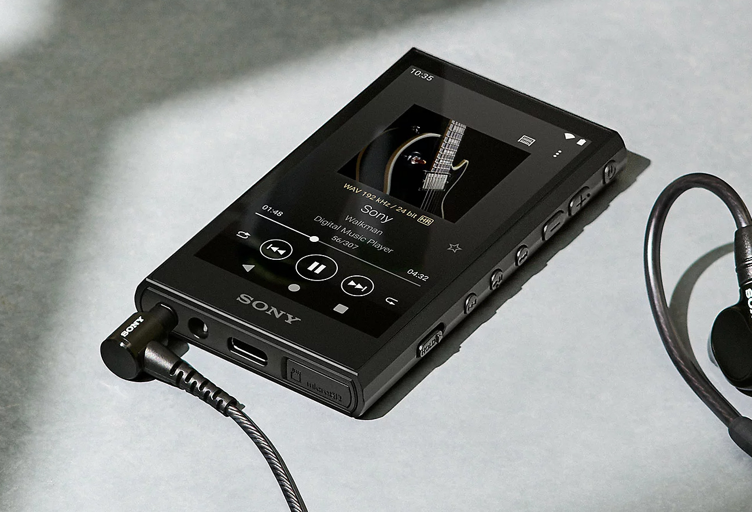
Background Information
In a world where music has become a part of everyone’s lifestyle from using airpods with iPhones to custom in-ear monitors with the Sony Walkmans, each individual finetunes their music to their own taste. As an audiophile, the ability to adjust every single aspect of your listening experience is what turns a good music session to a great one. This can be accomplished in one of two ways: tuning the listening devices or utilizing an equalizer (EQ) within the music player. Being able to customize and tune your EQ is a feature missing on most devices (excluding high-end models) and you would have to rely on the streaming service EQ functions. As such, this project aims to implement a detailed EQ with lossless audio files to provide the user with the best listening experience.
Notes:
Other aspects to consider
- Adding effects (as an alternative to quality) → reverb, rock,

Slide 3
Existing Projects
Music player for USB-Speaker (No DAC)
https://www.hackster.io/432580/usb-music-player-with-the-pocketbeagle-0b1624
Music player with DAC
https://www.hackster.io/logan-baldridge/spotify-pod-streaming-music-to-the-pocketbeagle-57a180

Slide 4
Improvements
Hardware
Two customizable buttons
Possible programming options include EQ profiles, brightness, shuffle/loop/single loop → gives the user more control and personality into their device so that the listening experience is enhanced
Software
Personalized equalizer system built into the device (much more specific) → user can finetune their audio to their own liking for different music genres and switch between them using the customizable buttons

Slide 5
Pocket Beagle
5V Battery Pack
GPIO (P2.1)
on/off
USB Port (USB1)
volume up
GPIO (P2.2)
GPIO (P2.4)
volume down
USB with downloaded music
USB Port (On BELA mini)
GPIO (P2.6)
play/pause/skip/replay
GPIO (P2.8)
custom 1
SPI Screen
with TSC2007
GPIO (P2.10)
custom 2
D/C (P1.4)
CS (P1.6)
CLK (P1.8)
MISO (P1.10)
MOSI (P1.12)
Bela mini
Note: Bela mini is soldered onto the pocketbeagle

Slide 6
Pocket Beagle
5 V Battery Pack
3.3 V GPIO (P2.1)
on/off
3.3 V BAT Vin (P2.14)
GND (P2.15)
3.3 V GPIO (P2.2)
volume up
3.3 V GPIO (P2.4)
volume down
USB with downloaded music
5 V
350 mA
<6 mA
USB Port (BELA Mini)
3.3 V GPIO (P2.6)
play/pause/skip/replay
3.3 V GPIO (P2.8)
custom 1
SPI Screen
with TSC2007
(<150 mA)
3.3 V GPIO (P2.10)
custom 2
3.3 V (P1.14)
GND (P1.16)
Bela mini
Note: Bela mini is soldered onto the pocketbeagle

Slide 7
Song File Class
Power on
Shows home screen (files with songs and EQ settings)
Equalizer Class
Use touch screen to select song files
Use touch screen to select EQ settings
Custom Buttons Class
Opens the song files screen
Opens the EQ settings screen
Press on custom EQ button (hardware)
Uses custom EQ settings
Use touch screen to select song file
Edit EQ settings using touch screen
Press save button on touchscreen
Saves custom EQ settings
Song plays
Press back button on touch screen
Play/pause/skip/replay button pressed
Volume up/down button pressed
Song play, pauses, skips, or replays
Volume increases/decreases by 10%
Set Buttons Class

Slide 8
Components / Budget
Component | ENGI301 to Buy? | Cost
SPI Screen | Yes | 29.95
TSC2007 | Yes | 4.95
Bela Mini | No | 89.00
5V battery pack | No | 13.99

Slide 9
Helpful Links
https://www.pimusicbox.com/
https://www.beagleboard.org/projects/volumio → music control
https://learn.bela.io/products/bela-boards/bela-mini/#:~:text=On%20your%20Bela%20Mini%20cape,slot%20aligned%20on%20the%20other. → attaching bela to pocketbeagle

