Slide 1
Open Day · Waterloo
RESEARCH AREAS AND PROJECTS · NOVEMBER 2026
Intelligent Agents for Software Engineering
Agentic software engineering and its challenges: how agents work, how many agents build one project together, how they keep a mental model of the software, how that knowledge is stored as a graph, and how they learn from their own mistakes.
01
02
03
04
05
06
Agents
Software Factory
Orchestration
Mental model
Artifact Graph
Self-evolution
a model in a loop
from engineer to agent team
many agents, one project
memory that persists
knowledge as a graph
learning from mistakes
Event
Date
Open Day, Waterloo
November 2026
Notes:
Welcome, and thank you for coming. Software is now written, tested and fixed by artificial intelligence agents, and my lab studies how to make that work well.
In the next 20 minutes I will show 6 parts. What an agent is. How a software engineer's work maps to a team of agents. How we run many agents on one project. How an agent can remember a project the way an engineer does. How that knowledge is stored as a graph that many agents can share. And how agents can learn from their own mistakes. By the end you will see them as one system.

Slide 2
CONTENTS
6 parts, one system
From a single agent to a team that remembers and improves.
01
Agents
The language model underneath, and what an agent is
2 slides
02
Software Factory
The Vee model and where agents stand today
2 slides
03
Orchestration
Team, task graph, a real run, when more agents hurt
4 slides
04
Mental model
What engineers remember and agents forget
4 slides
05
Artifact Graph
A graph store of project knowledge, shared by many agents
3 slides
06
Self-evolution
Learning from mistakes, evidence and risks
2 slides

Slide 3
01 · AGENTS
What is a large language model?
It reads text, turns it into numbers, and predicts the next token, over and over.
1
Input layer
4
5
Output head
Transformer blocks
prompt: "Explain artificial
is
intelligence"
has
Self-attention layer
can
understands relationships between tokens
probability of the next token
2
Tokenization
6
Token generation
Feed-forward network (MLP)
selects the next token
Explain
artificial
intelligence
processes and transforms the information
and repeats the process
words or word pieces
3
Normalization + residual connections
Embedding layer
help stabilize the flow of information and training
Final response
human-readable text:
Repeated many times (x N)
"Artificial intelligence is ..."
tokens become vectors of numbers
dozens or hundreds of blocks
the new token is appended to the text, and the whole process runs again
INPUT
TRANSFORMER
OUTPUT
The prompt is split into tokens, and each token becomes a vector of numbers.
Blocks of attention and feed-forward layers, repeated many times, relate the tokens to each other.
The model picks the next token, appends it, and repeats until the answer is complete.
[1] Vaswani et al., "Attention Is All You Need," arXiv:1706.03762, 2017.
[2] Sennrich et al., "Neural Machine Translation of Rare Words with Subword Units," arXiv:1508.07909, 2016.
[3] Brown et al., "Language Models are Few-Shot Learners," arXiv:2005.14165, 2020.
Notes:
Before the agent, the engine inside it: a large language model. It is a very large function that reads text and predicts what comes next. Here is the path of one request.
First, the input: a prompt such as "Explain artificial intelligence". Second, tokenization: the text is split into tokens, which are words or pieces of words. Third, an embedding layer turns each token into a vector of numbers, so the model can compute with it.
Fourth, the transformer blocks, the heart of the model. In each block, a self-attention layer works out how the tokens relate to each other. A feed-forward network processes and transforms that information. Normalization and residual connections keep the information flowing steadily and make training stable. This block is repeated many times: a model may have dozens or hundreds of them.
Fifth, the output head calculates a probability for every possible next token. Sixth, token generation: the model picks one token, appends it to the text, and runs the whole process again, one token at a time, until the final response, human-readable text, is complete.
That is all a language model does. An agent, as we will see next, wraps this engine in a loop with tools.

Slide 4
01 · AGENTS
What is an agent?
A language model in a loop: read, decide, act with a tool, observe, repeat.
A language model in a loop: read, decide, act with a tool, observe, repeat.
Loop: the result becomes part of the next step
1
Task
2
3
4
5
6
Build context
Model reasons
Choose action
Run tool
Observe
from the user
instructions, memory,
decides the next
tool call
read, edit, search,
output goes back
history so far
step
or finish
run tests
into the context
finish
7
Stop and report
finished or out of budget
The parts around the loop
Model
Instructions
Tools
Memory
Environment
Stop rule
the reasoning engine
role, rules, goal
what it can do
what it can recall
code, terminal, files
when to end
LOOP
PARTS
DESIGN
Reason, act, observe, and repeat until the task is done or a limit is reached.
Instructions, tools, memory, an environment and a stop rule surround the model.
Tools built for the agent, not for a human, change the result.
[4] Yao et al., "ReAct: Synergizing Reasoning and Acting in Language Models," arXiv:2210.03629, 2022.
[5] Anthropic, "Building effective agents," anthropic.com/engineering, Dec. 2024.
[6] Yang et al., "SWE-agent: Agent-Computer Interfaces Enable Automated Software Engineering," arXiv:2405.15793, 2024.
[7] Anthropic, "How Claude Code works," code.claude.com/docs.
Notes:
A chatbot answers once and stops. An agent works in a loop.
It starts with a task from a person, say: fix this bug. It builds its context: its instructions, what it remembers, and everything that has happened so far. The language model reads that and reasons about the next step. Then it chooses an action: call a tool, or finish.
A tool is something the agent can do in the project: read a file, edit code, search, run the tests. The tool runs in the environment, here the project's files and a terminal. The result comes back as an observation and joins the context. Then the loop repeats. This reason, act, observe cycle is the idea behind ReAct, and almost every coding agent works this way.
It stops when the task is done, or a limit is hit, such as a maximum number of steps.
Look at the parts around the loop: the model, the instructions, the tools, the memory, the environment, the stop rule. Researchers have shown that tools designed for the agent, not for a human, make a real difference. Everything else in this talk connects, extends or improves these parts.

Slide 5
02 · SOFTWARE FACTORY
From software engineer to coding agent
The same lifecycle: humans do every stage today, and a team of agents can do them tomorrow.
Needs and requirements
validates
Acceptance, deployment
System design
verifies
System verification
Detailed design
verifies
Integration test
Coding
Unit test
Who does it
Requirements
Design
Coding
Testing
Verification
Deployment
Today
Analyst
Architect
Developer
Tester
QA engineer
Release engineer
human roles
Future
Requirements agent
Design agent
Coding agent
Test agent
Verification agent
Deploy agent
agent team
LIFECYCLE
PAIRING
VISION
Needs, design, code, test, verify, deploy.
Each design level has a matching test level on the way up.
One agent per stage, each checking the work of the others.
[8] Mooz and Forsberg, "The Relationship of Systems Engineering to the Project Cycle," INCOSE/ASEM, 1991 (see SEBoK, "Vee (V) Model").
Notes:
To compare a coding agent with a software engineer, look at the Vee model, which systems engineers have used since 1991.
Read it like a V. Top left: the needs of the people who will use the system. Going down the left side, needs become requirements, then a system design, then a detailed design, and at the bottom we write the code. Climbing the right side, we test each unit, then the pieces together, then verify the whole system, and at the top right the users accept it and we deploy.
The dotted lines matter. Each design level has a matching test level: requirements are checked by acceptance, system design by system verification, detailed design by integration testing. You plan the check when you do the design.
Today humans fill every box: analyst, architect, developer, tester, quality engineer, release engineer. The second lane is the vision: a team of agents, one for each stage, each checking the work of the others.

Slide 6
02 · SOFTWARE FACTORY
Where coding agents are today
Coding is the most measured stage; the rest of the lifecycle is earlier or harder.
Stage
How far agents have come
What the studies show
Source
Requirements
Early research prototypes
ReqElicitGym, Elicitron,
iReDev
Design
A whole-lifecycle benchmark: models
DevEval (2024)
fail to solve it
Coding
The most measured stage; most real
SWE-bench, SWE-Lancer
tasks still unsolved
(1,400+ tasks)
Testing and verification
Part of lifecycle benchmarks; hard
DevEval (2024)
for current models
Deployment and operations
Agents struggle with build and
DevOps-Gym (ICLR 2026)
monitoring
Bars show a qualitative reading (more filled = more studied and more capable), not a measured score.
CODING
BEYOND CODE
SO
The most measured stage, and most real freelance tasks are still unsolved.
Design, verification and operations remain hard for current models.
One super-agent is not enough. We need teams.
[9] Miserendino et al., "SWE-Lancer," arXiv:2502.12115, 2025.
[10] Li et al., "DevEval: Prompting LLMs to Tackle the Full Software Development Lifecycle," arXiv:2403.08604, 2024.
[11] Tang et al., "DevOps-Gym," arXiv:2601.20882, ICLR 2026.
[12] Meyer et al., "Today was a Good Day: The Daily Life of Software Developers," IEEE TSE, 2021.
Notes:
Where are coding agents on that V today? Mostly at the bottom, at the coding stage. Benchmarks such as SWE-bench and SWE-Lancer measure exactly this. On SWE-Lancer, more than 14 hundred real freelance tasks, the authors report that frontier models still fail to solve most of them.
The other boxes are harder. A benchmark that covers the whole lifecycle, design through acceptance testing, finds that strong models fail to solve it. For operations, a benchmark of build, monitoring and issue tasks reports that agents struggle with monitoring and build configuration. And working out what people really need is still at research-prototype stage.
Remember that coding is only part of the job: studies of developers' days find they spend little of it writing code. So one super-agent will not be enough. We need teams.

Slide 7
03 · ORCHESTRATION
How the team works
An orchestrator splits the goal, workers build in parallel, and nothing reaches main untested.
Orchestrator
turns the goal into tasks
Planner
defects go back to the planner
one plan, sized for workers
fix and rebuild
in parallel
Worker A
Worker B
Worker C
writes code on its own branch
writes code on its own branch
writes code on its own branch
Tester
PASS
Tester
PASS
Tester
REJECT
PASS
Integrator
merges main into the branch, checks the merged result, merges only after the tester passed
main
A rejected branch goes back through the planner and the worker; only a tested branch reaches main
SPLIT
PARALLEL
CHECK
An orchestrator turns the goal into tasks; a planner sizes the work.
Workers run at the same time, each on its own branch.
A tester checks every branch before the integrator merges it into main.
[13] Anthropic, "How we built our multi-agent research system," anthropic.com/engineering, 2025.
[14] Geng and Neubig, "Effective Strategies for Asynchronous Software Engineering Agents," arXiv:2603.21489, 2026.
[15] Hong et al., "MetaGPT," arXiv:2308.00352, 2023.
[16] Qian et al., "ChatDev," arXiv:2307.07924, 2023.
Notes:
One agent can fix one bug. A real project has hundreds of tasks, and one agent working alone is slow and loses track. So we orchestrate.
At the top, an orchestrator reads the goal and turns it into tasks. A planner makes one plan and sizes the work so each part fits one worker. Then several workers run at the same time, each on its own branch of the code, so they cannot overwrite each other. Researchers call this an orchestrator-worker pattern, and recent coding work uses the same shape, with workers in isolated git worktrees.
The key step comes before anything reaches the main branch. A tester agent, separate from the worker that wrote the code, checks each branch against the specification. Only a branch that passes goes to the integrator, which brings it up to date with main and merges it.

Slide 8
03 · ORCHESTRATION
The task graph: wide and shallow
Independent tasks run side by side. A task waits only for what it truly needs.
Slice A
Tester
types
Slice B
Tester
parser
Spec
Skeleton
C waits for B
Main
the goal
shared names and
Slice C
Tester
merged and
the main path
commands
tested
Slice D
Tester
help text
Slice E
Tester
config
Split along dependencies, not by file or by line count. A bad split costs more than it saves.
SKELETON
SLICES
RULE
The shared names and the main path come first.
Independent slices run in parallel; a slice waits only when it must.
Split along dependencies, not by file or by line count.
[17] Yang et al., "When Parallelism Pays Off: Cohesion-Aware Task Partitioning for Multi-Agent Coding," arXiv:2606.00953, 2026.
Notes:
How do you split the work? Not by file, and not by an arbitrary number of lines. We build a graph of tasks.
First, a skeleton: it defines every name that more than one part will use, and the main path through the program. Then the remaining work becomes slices that start from the skeleton and run side by side. A slice waits for another only when it truly cannot be tested without it, like slice C waiting for slice B here. We keep the graph wide and shallow, so most work runs in parallel.
Each slice has its own tester, and only tested work reaches main. The aim is simple: the right split, and a check at every step.

Slide 9
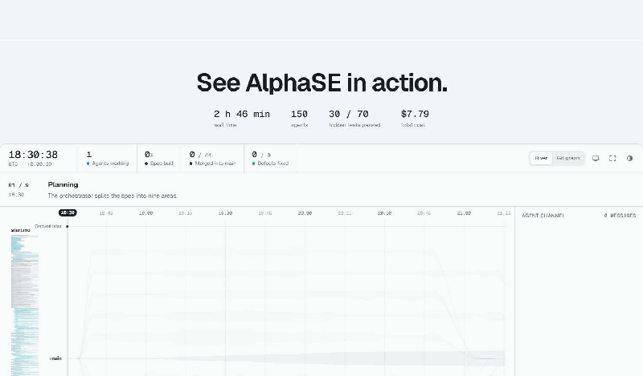
03 · ORCHESTRATION
A real run
Our system builds a Python command-line library from a specification of about 2,000 lines. Press the replay buttons to explore.
SCALE
CONTROL
HONEST SCORE
150 agents, 2 h 46 min and $7.79 in total.
44 merges; 17 of 17 defects found by testers were fixed.
30 of 70 hidden tests passed on this run.
Notes:
This is not a diagram. It is a real run of our system building a Python command-line library from a specification of about 2 thousand lines. 2 hours and 46 minutes of work, played back here in under a minute.
The orchestrator first splits the specification into 9 areas. Then, in about 3 minutes, it creates 53 issues, and work starts in every area at once. Each stream here is an area; the width shows how many agents are working in it.
Things go wrong, and the system handles it. A planner hits its output limit twice, and the orchestrator re-plans. Testers check main and every defect gets an owner. 3 agents hit the same gap in the specification, and one planner makes the decision. A merge that did not happen is caught and done for real. At the end every area is tested again on main.
The result: 44 merges and 17 defects found and fixed, for a total cost of 7 dollars 79. On the hidden tests this run passed 30 of 70, so there is more to do, and I will not pretend otherwise.

Slide 10
03 · ORCHESTRATION
More agents: when it helps, when it hurts
The split and the checks matter more than the number of agents.
Compared with one agent (260 setups, 6 benchmarks)
Tokens used, compared with a chat
Chat
1x
Decomposable financial reasoning
+80.8%
Single agent
4x
-70.0%
Multi-agent system
15x
Sequential planning
How you split the code work (28 tasks, one model)
One agent per file
Split along the dependency graph
cost +44% to +60%
cost down to 35% lower
pass rate up only 1 to 3 points
pass rate up to +14 points, up to 2.1x faster
Sources: Kim et al. 2025; Anthropic 2025; Yang et al. 2026. Different studies, tasks and models: compare the pattern, not the numbers.
THE TASK DECIDES
COST
THE SPLIT
Against one agent, results range from +80.8% to -70.0%.
A multi-agent system uses about 15 times the tokens of a chat.
Splitting along the dependency graph beats one agent per file.
[18] Kim et al., "Towards a Science of Scaling Agent Systems," arXiv:2512.08296, 2025.
[13] Anthropic, "How we built our multi-agent research system," anthropic.com/engineering, 2025.
[17] Yang et al., "When Parallelism Pays Off: Cohesion-Aware Task Partitioning for Multi-Agent Coding," arXiv:2606.00953, 2026.
Notes:
So are more agents always better? No. A large study of 260 agent setups found that, compared with one agent, results ranged from about 80 percent better on tasks that split cleanly, to 70 percent worse on tasks that must be done in order.
There is also a cost. Anthropic reports that multi-agent systems use about 15 times the tokens of a chat, and agents alone about 4 times. They note that most coding tasks have fewer parts that can really run in parallel than research tasks do.
How you split matters. A 2026 paper on partitioning code work found that one agent per file raised cost by 40 to 60 percent for little gain, while splitting along the dependency graph improved pass rate by up to 14 points, ran up to 2 times faster, and cut cost by up to 35 percent.
Our own results point the same way: in our runs, the more workers a project used, the lower its score. Orchestration is not more agents. It is the right split and a check at every step.

Slide 11
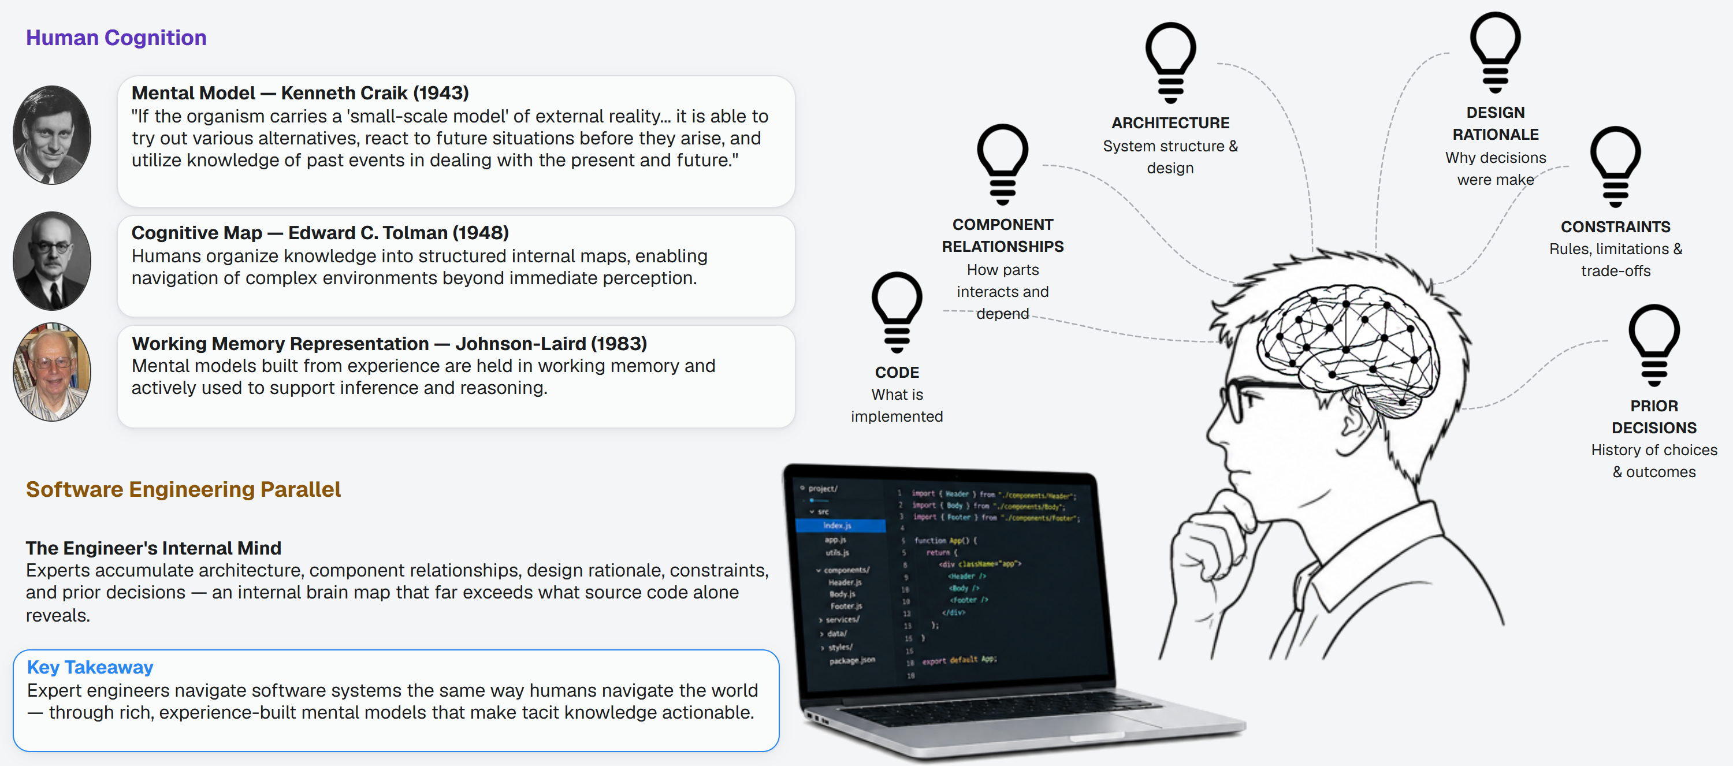
04 · MENTAL MODEL
From human mental models to software knowledge
People reason with models of the world. Expert engineers do the same with software.
[19] Craik, The Nature of Explanation, Cambridge Univ. Press, 1943.
[20] Tolman, "Cognitive maps in rats and men," Psychological Review, 55(4), 1948.
[21] Johnson-Laird, Mental Models, Harvard Univ. Press, 1983.
[22] LaToza et al., "Maintaining Mental Models: A Study of Developer Work Habits," ICSE 2006.
Notes:
Think about what a good engineer carries in their head. The idea is old. In 1943 the psychologist Kenneth Craik suggested that the mind builds small-scale models of reality, so it can try out options before acting. In 1948 Edward Tolman showed that animals form cognitive maps. In 1983 Philip Johnson-Laird described mental models built from experience and held in working memory.
Expert engineers do the same with software. They keep in mind what is built, how the parts depend on each other, the structure of the system, why decisions were made, the constraints, and what was decided before. That is a map far richer than the source code. It is how experts move through a large system the way you and I move through a familiar city.

Slide 12
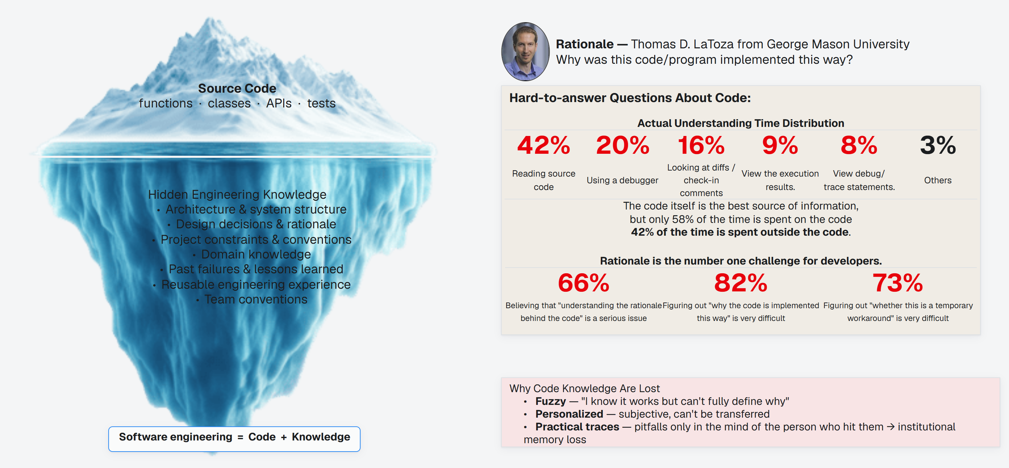
04 · MENTAL MODEL
Software engineering beyond source code
The code says what the system does. It rarely says why.
[22] LaToza et al., "Maintaining Mental Models: A Study of Developer Work Habits," ICSE 2006.
Notes:
The code is only the visible part. Below the surface sits the knowledge that makes it understandable: the architecture, the decisions and their reasons, the constraints and conventions, the domain knowledge, the failures of the past and what we learned. Software engineering is code plus knowledge.
The questions developers find hardest to answer are about why. Why was this written this way? What else was tried, and why was it dropped? What breaks if I change it?
And that knowledge is easily lost. It is fuzzy: I know it works, but I cannot say exactly why. It is personal: hard to hand over. And it is silent: the pitfalls live only with whoever hit them. When people move on, the knowledge goes with them. That is institutional memory loss, and agents have it in the extreme.

Slide 13
04 · MENTAL MODEL
Agents forget
An agent is stateless: when a session ends, everything it learned is gone.
write: lessons, decisions, facts
Session 1
Session 2 without memory
Mental model
context window fills up
starts almost empty
outside the context window
Architecture understood
Architecture and structure
Re-read the repository
Decisions and rationale
Bug root cause found
session ends
Repeat the exploration
Conventions and constraints
Code patterns learned
context cleared
Past fixes: lost
Past failures and fixes
Design decision made
retrieve only what is needed
Session 2 with memory
starts with the right knowledge, in a small amount; experience accumulates
STATELESS
REPEATED WORK
MEMORY
The context window is cleared when a session ends.
The next session re-reads the repository and repeats the exploration.
A persistent store outside the context window keeps what matters.
[23] Packer et al., "MemGPT: Towards LLMs as Operating Systems," arXiv:2310.08560, 2023.
[24] Zhang et al., "A Survey on the Memory Mechanism of LLM-based Agents," arXiv:2404.13501, 2024.
Notes:
Now think about an agent. A coding agent is stateless. In session one it explores the repository, finds the root cause of a bug, learns the code patterns, and makes a design decision. All of it sits in its context window. When the session ends, the window is cleared. In session 2 the agent starts almost empty. It reads the repository again, repeats the exploration, and the earlier fix is lost. Experience does not accumulate.
The context window is also limited in size. Research such as MemGPT treats this like a computer's memory: a small fast memory and a larger slower one that the agent manages itself.
Our answer is a mental model for coding agents: a store that lives outside the context window. After each session the agent writes down what it learned. At the start of the next one, it receives only the knowledge it needs, in a small amount.

Slide 14
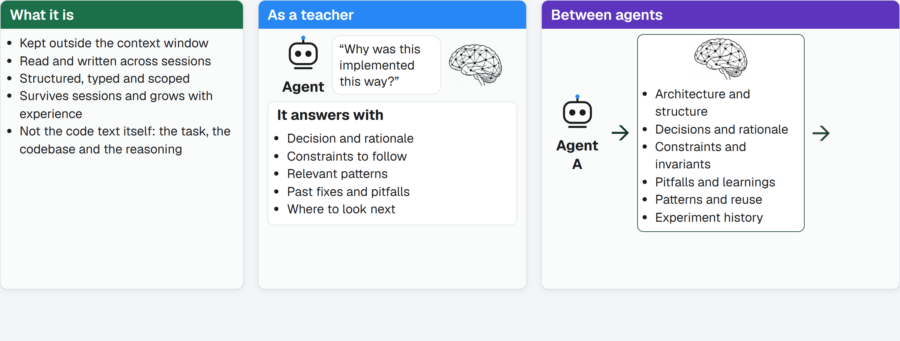
04 · MENTAL MODEL
The Mental Model
A persistent, cross-session knowledge store for coding agents.
[25] Shen et al., "Structurally Aligned Subtask-Level Memory for Software Engineering Agents," arXiv:2602.21611, 2026.
Notes:
We call it the Mental Model. It is persistent: it survives across sessions. It is structured: knowledge is typed and scoped, for example architecture and structure, decisions and rationale, constraints, pitfalls and learnings, patterns, and experiment history. It is grounded in the task, the codebase and the agent's reasoning, not in the code text itself.
It works like a teacher. Whenever the agent needs insight, say why was this implemented this way, it asks the Mental Model. It also passes knowledge between agents: Agent A writes its discoveries and decisions, and Agent B picks up from there, with no re-discovery and no repeated mistakes.
Retrieval is the hard part. The model decides when knowledge is delivered, how much, and how relevant it is. Early results are encouraging but modest: one study of memory built from earlier subtasks reports about 4 to 5 points better pass rate on SWE-bench Verified. What to store and how to keep it correct as code changes are still open questions.

Slide 15
05 · ARTIFACT GRAPH
Project knowledge as a graph
A database-like layer that turns specifications, designs, decisions, tasks and scenarios into typed, traceable nodes and edges.
Change
coherent evolution
CONTAINS
CONTAINS
Specification
Design
expected behavior
solution rationale
DEFINES
DEFINES
RECORDS
RECORDS
RECORDS
DETAILS · .87
REQUIRES · .91
Requirement
Requirement
Decision
Risk
Task
outcome + constraint
outcome + constraint
why this choice
what could go wrong
ordered work
EVIDENCED BY
EVIDENCED BY
Scenario
Scenario
observable evidence
observable evidence
CONFLICTS_WITH · .72
extracted from the documents, with provenance
inferred: a confidence and a rationale, not a proof
TYPED NODES
TYPED EDGES
DOCUMENTS STAY THE SOURCE
Requirements, designs, decisions, tasks and scenarios, each linked to its source document.
Contains, defines, evidenced by, records. Inferred edges carry a confidence and a rationale.
People keep writing documents; the graph makes their knowledge addressable.
[26] Edge et al., "From Local to Global: A Graph RAG Approach to Query-Focused Summarization," arXiv:2404.16130, 2024.
[27] Piskala, "Spec-Driven Development: From Code to Contract in the Age of AI Coding Assistants," arXiv:2602.00180, 2026.
Notes:
A mental model for software also needs a place to live. Artifact Graph is one: a database-like layer for the artifacts of spec-driven development, the specifications, requirements, designs, decisions, tasks and scenarios that people write. The documents stay the source of truth. Artifact Graph turns their content into a graph. Each artifact becomes a typed node, and each relationship a typed edge: a change contains a specification and a design, a specification defines requirements, a requirement is evidenced by a scenario, and a design records decisions, risks and tasks. Every node keeps a link back to its source. Then it infers relationships nobody wrote down, such as requires, details or conflicts with, each with a confidence and a reason. The dashed edges are inferred: a hint with a score, not a proof.

Slide 16
05 · ARTIFACT GRAPH
Retrieval: the smallest sufficient subgraph
More project knowledge does not mean better context. Find entry points by meaning, expand along relationships, reveal more only on a gap.
1
Locate by meaning
semantic search picks the
entry nodes
2
Expand by structure
edges bring in dependencies,
constraints, decisions
Task
Reveal on a gap
3
evidence is added only where
reasoning needs it
The smallest sufficient,
high-signal context
Example from the briefing: 247 candidate artifacts, of which only a small, traceable subgraph is loaded.
LOCATE
EXPAND
REVEAL
Semantic search finds the entry nodes, even when the wording differs.
Edges bring in dependencies, constraints, decisions and history.
Core first, then related, then evidence. Stop when the context is enough.
[28] Liu et al., "Lost in the Middle: How Language Models Use Long Contexts," arXiv:2307.03172, 2023.
[26] Edge et al., "From Local to Global: A Graph RAG Approach to Query-Focused Summarization," arXiv:2404.16130, 2024.
[29] Liu et al., "CodexGraph: Bridging Large Language Models and Code Repositories via Code Graph Databases," arXiv:2408.03910, 2024.
Notes:
Why a graph? Because more project knowledge does not give better context. One change adds requirements, designs, decisions, tasks and scenarios, and the pool grows faster than a prompt can hold; in the briefing's example, 247 candidate artifacts for a single task. Loading everything hands the filtering problem to the model. Artifact Graph retrieves instead, in 3 steps. First, locate by meaning: semantic search finds the entry nodes, even when the task and the documents use different words. Second, expand by structure: the edges bring in the dependencies, constraints, decisions and history around those entry points. Third, reveal on a gap: it starts with a minimal core, and adds related items and then evidence only where the agent's reasoning shows something is missing. The goal is not maximum context. It is the smallest sufficient, high-signal context, and every item carries its type, its path and its source.

Slide 17
05 · ARTIFACT GRAPH
Many agents, one graph: staged updates
Each agent proposes a change; it is staged, checked and committed as one update. Measured on 16 coding problems.
Staging area
Project knowledge
Agent A
+ node, + edge
isolated from shared retrieval
shared by every agent
edits a requirement
Inspect and
validate
Agent B
structure
edits a design
+ node, + edge
consistency
conflict: held for review
conflicts
revises, then proposes again
traceability
Agent C
+ node, + edge
adds a task
new version, history kept
Isolate, inspect, validate, publish: half-finished edits never reach shared context.
CONTEXT
COST
QUALITY
26.8% less per checkpoint, lower on 16 of 16 problems.
14.2% less per checkpoint, lower on 16 of 16 problems.
No clear change: every interval crosses zero.
[30] Yu et al., "Multi-Agent Memory from a Computer Architecture Perspective: Visions and Challenges Ahead," arXiv:2603.10062, 2026.
[31] Khan, "S-Bus: Automatic Read-Set Reconstruction for Multi-Agent LLM State Coordination," arXiv:2605.17076, 2026.
[32] Orlanski et al., "SlopCodeBench: Benchmarking How Coding Agents Degrade Over Long-Horizon Iterative Tasks," arXiv:2603.24755, 2026.
Notes:
This also gives many agents one shared memory. When several agents edit the knowledge at the same time, half-finished edits would pollute everyone's context. So updates are staged. Each agent's change becomes a candidate set of nodes and edges, kept out of shared retrieval. It is inspected for structure, consistency, conflicts and traceability. A change that conflicts is held for review and sent back. The rest are committed as one logical update, and earlier versions stay available. Did it help? On 16 SlopCodeBench problems, with an OpenSpec-only workflow as the baseline, Artifact Graph used 26.8 percent less context, 14.2 percent less cost and 9.2 percent fewer tokens per checkpoint. The quality differences were small and every interval crossed zero, so I read them as no clear change, not as a gain. Artifact Graph does not scan the repository, index the code, or guarantee that the artifacts are correct; tests and review still matter.

Slide 18
06 · SELF-EVOLUTION
Learning from mistakes
Review what went wrong, write the lesson down, use it next time, and test every change.
1
Act
do the task
Outer loop
improve its own tools,
prompts and code
5
2
strongest form
Update memory
Evaluate
store it
tests and review
Inner loop
Test gate
learn from mistakes
keep a change only if the
benchmark score does not drop
4
3
Risks
Write lesson
Reflect
gaming the test, drift,
rule or skill
why did it fail?
forgetting earlier skills
INNER LOOP
OUTER LOOP
GATE
Act, evaluate, reflect, write a lesson, update memory.
The strongest form changes its own tools, prompts and code.
Keep a change only if the score does not drop.
[33] Shinn et al., "Reflexion," arXiv:2303.11366, 2023.
[34] Wang et al., "Voyager," arXiv:2305.16291, 2023.
[35] Zhao et al., "ExpeL," arXiv:2308.10144, AAAI 2024.
[36] Fang et al., "A Comprehensive Survey of Self-Evolving AI Agents," arXiv:2508.07407, 2025.
Notes:
So far the agent follows rules we wrote. The last area asks: can an agent get better by itself?
The simplest form is the loop on the left. The agent acts. We evaluate the result with tests and review. If it failed, the agent reflects: why? It writes the lesson down in plain words, stores it in memory, and uses it on the next try. Methods such as Reflexion, Voyager and ExpeL work this way: they keep reflections, reusable code skills, or knowledge distilled from experience, and none of them retrains the model.
The stronger form is on the right: the agent changes itself, its own tools, prompts, even its own code. And the test gate is essential. A change is kept only if the benchmark score does not drop. Surveys describe the general loop the same way: inputs, the agent, its environment, and an optimizer that updates the agent from feedback.

Slide 19
06 · SELF-EVOLUTION
The evidence, and the risks
Each pair of bars is one paper, before and after. Compare within a row, not across.
Reflexion
GPT-4 alone
80%
writes lessons in words; HumanEval
with reflection
91%
Self-Improving Coding Agent
before
17%
edits its own code; SWE-bench Verified subset
53%
after
Darwin Godel Machine
before
20%
archive of self-modified agents; SWE-bench
after
50%
Darwin Godel Machine
before
14.2%
same agents; Polyglot
after
30.7%
Keep a human and a sandbox in the loop
Optimizing only for a benchmark can introduce vulnerabilities (Darwin Godel Machine, Section 5).
REFLEXION
SELF-MODIFYING AGENTS
RISK
80% to 91% on HumanEval with written reflections.
17% to 53% and 20% to 50% on SWE-bench variants.
Optimizing only for a benchmark can introduce vulnerabilities.
[33] Shinn et al., "Reflexion," arXiv:2303.11366, 2023.
[37] Robeyns et al., "A Self-Improving Coding Agent," arXiv:2504.15228, 2025.
[38] Zhang et al., "Darwin Godel Machine," arXiv:2505.22954, 2025.
Notes:
Does it work? Each pair of bars is one paper, before and after. In Reflexion, GPT-4 reached 80 percent on the HumanEval coding benchmark; with written reflections it reached 91. The Self-Improving Coding Agent, editing its own code, went from 17 to 53 percent on a subset of SWE-bench Verified. The Darwin Gödel Machine kept an archive of agents, let them modify themselves, and tested every change: from 20 to 50 percent on SWE-bench, and from 14 to 31 on Polyglot.
These are different benchmarks, so compare within a row, not across.
And there are risks. If you optimize only for a benchmark, the agent may learn to game the test or introduce vulnerabilities, and it can drift or forget earlier skills. The authors of the Darwin Gödel Machine say this themselves, and they ran their experiments with sandboxing and human oversight. That is why the test gate and the human stay in the loop.
Put the 4 areas together and you have the system: an agent in a loop, a team of agents orchestrated across a project, a mental model that remembers, and a loop that learns. Thank you. I am happy to take questions.

Slide 20
07 · CHALLENGES
4 challenges ahead
What has to be true for agentic software engineering to work on real projects.
01
02
03
04
Orchestration
Mental model
Artifact Graph
Self-evolution
How must orchestration happen?
How must a mental model be made, and how must it help?
How must project knowledge be structured and shared?
How must self-evolution work?
Split along the dependency graph.
Store what the code cannot say.
Make the knowledge a graph of typed records.
Learn in an inner loop.
A skeleton first, then slices that run side by side and wait only where a test needs another slice. Not by file, and not by line count. [17]
Architecture, decisions and their reasons, constraints, pitfalls, patterns and history, typed and scoped, outside the context window.
Requirements, designs, decisions, tasks and scenarios become typed nodes and edges, each traced to its source document. Inferred links carry a confidence and are not proof. [26][27]
Reflect on each failure, write the lesson down, store it, and reuse it. [33][35]
Isolate and check every branch.
Deliver the right knowledge at the right time.
Retrieve the smallest sufficient context.
Change itself only through a test gate.
A separate tester sits between each worker and main; merge only after it passes. [14]
Decide when it is retrieved and how much, so the context stays small. [23][26]
Find entry points by meaning, follow edges to dependencies and constraints, and reveal more only where reasoning shows a gap. [28][29]
Keep a change only if the benchmark score does not drop. [37][38]
Add agents only where the task splits cleanly.
Pass it on, and keep it correct.
Let many agents update it safely.
Keep a sandbox and a human in the loop.
A multi-agent system can use about 15 times the tokens of a chat, and tasks that must be done in order can get much worse. [13][18]
Share it between sessions and agents so nothing is rediscovered, and keep it right as the code changes. This last part is still an open problem. [25][30]
Stage each change, inspect it for structure, conflicts and traceability, commit it as one update, and hold conflicting changes for review. [30][31]
Optimizing only for a benchmark can introduce vulnerabilities. [38]
[17] Yang et al., "When Parallelism Pays Off: Cohesion-Aware Task Partitioning for Multi-Agent Coding," arXiv:2606.00953, 2026.
[14] Geng and Neubig, "Effective Strategies for Asynchronous Software Engineering Agents," arXiv:2603.21489, 2026.
[13] Anthropic, "How we built our multi-agent research system," anthropic.com/engineering, 2025.
[18] Kim et al., "Towards a Science of Scaling Agent Systems," arXiv:2512.08296, 2025.
[23] Packer et al., "MemGPT: Towards LLMs as Operating Systems," arXiv:2310.08560, 2023.
[26] Edge et al., "From Local to Global: A Graph RAG Approach to Query-Focused Summarization," arXiv:2404.16130, 2024.
[25] Shen et al., "Structurally Aligned Subtask-Level Memory for Software Engineering Agents," arXiv:2602.21611, 2026.
[30] Yu et al., "Multi-Agent Memory from a Computer Architecture Perspective: Visions and Challenges Ahead," arXiv:2603.10062, 2026.
[27] Piskala, "Spec-Driven Development: From Code to Contract in the Age of AI Coding Assistants," arXiv:2602.00180, 2026.
[28] Liu et al., "Lost in the Middle: How Language Models Use Long Contexts," arXiv:2307.03172, 2023.
[29] Liu et al., "CodexGraph: Bridging Large Language Models and Code Repositories via Code Graph Databases," arXiv:2408.03910, 2024.
[31] Khan, "S-Bus: Automatic Read-Set Reconstruction for Multi-Agent LLM State Coordination," arXiv:2605.17076, 2026.
[33] Shinn et al., "Reflexion," arXiv:2303.11366, 2023.
[35] Zhao et al., "ExpeL," arXiv:2308.10144, AAAI 2024.
[37] Robeyns et al., "A Self-Improving Coding Agent," arXiv:2504.15228, 2025.
[38] Zhang et al., "Darwin Godel Machine," arXiv:2505.22954, 2025.
Notes:
So what has to be true for agentic software engineering to work on real projects? I see 4 challenges, one for each of the areas we have just seen.
First, orchestration. Split the work along the dependency graph: a skeleton first, then slices that run side by side and wait only where a test needs another slice, not by file and not by line count. Isolate every branch, and put a separate tester between each worker and main, so nothing merges until it passes. And add agents only where the task splits cleanly: a multi-agent system can use about 15 times the tokens of a chat, and tasks that must be done in order can get much worse.
Second, the mental model. It must store what the code cannot say: architecture, decisions and their reasons, constraints, pitfalls, patterns and history, typed and scoped, outside the context window. It must deliver the right knowledge at the right time, deciding when it is retrieved and how much, so the context stays small. And it must be passed between sessions and agents so nothing is rediscovered, and kept correct as the code changes. That last part is still an open problem.
Third, the Artifact Graph. Project knowledge must be a graph of typed records, each traced to its source document, with inferred links marked as inferred and not as proof. Retrieval must return the smallest sufficient context: find entry points by meaning, follow the edges, and reveal more only where reasoning shows a gap. And many agents must be able to update it safely: each change is staged, inspected, and committed as one update, and a conflicting change is held for review.
Fourth, self-evolution. In the inner loop the agent reflects on each failure, writes the lesson down, stores it, and reuses it. When it changes itself, whether its tools, its prompts or its code, a change is kept only if the score does not drop: a test gate. And a sandbox and a human stay in the loop, because optimizing only for a benchmark can introduce vulnerabilities.
Put the 4 answers together and you have the system. Thank you; I am happy to take questions.

