Slide 1
Tech Insight
Report
Key AI Innovations 2025
LLM Applications, Multi-Agent Systems & Safety Considerations
Online · February 28, 2025
Format
Online
Date
February 28, 2025
Focus
LLM applications, single- & multi-agent systems, evaluations & guardrails

Slide 2
CONTENTS
Topics covered, by theme
A · LLM-based systems & industry applications
C · Multi AI agent systems
01
LLMs Across Industries: The Landscape
08
Multi-Agent: Rationale & Applications
02
Personalization, Recommendation & Content Generation
09
Multi-Agent: Collaboration, Coordination & Orchestration
03
Customer Service, Data Analysis & Software Development
10
Multi-Agent: Development Frameworks & Workflow
04
Security, Risk Management & Assistant Applications
D · Evaluations & guardrails
B · Single AI agent systems
11
LLM Evaluation: Criteria, Metrics & Frameworks
05
Single Agent: Definition & Architecture Methods
12
RAG Evaluation: Targets, Metrics & Benchmarks
06
Single Agent: RAG and Advanced RAG
13
LLM-as-a-Judge: Methodology, Attributes & Frameworks
07
Single Agent: Memory, Tools & Tool Learning

Slide 3
AT A GLANCE
LLM Applications, Multi-Agent Systems & Safety Considerations
Feb 28, 2025
81 companies
13 topics
LLM systems
Online
surveyed
deep-dived here
the theme
About: An online talk surveying how LLM-based systems are built and deployed across industry, the move from single- to multi-agent architectures, and the evaluation and guardrail practices that make them trustworthy.
Three threads: LLMs are everywhere in industry (personalization, service, code, security); systems are moving from single agents (RAG, memory, tools) to collaborating multi-agent frameworks; and evaluation & guardrails — LLM / RAG evaluation and LLM-as-a-Judge — are now first-class.

Slide 4
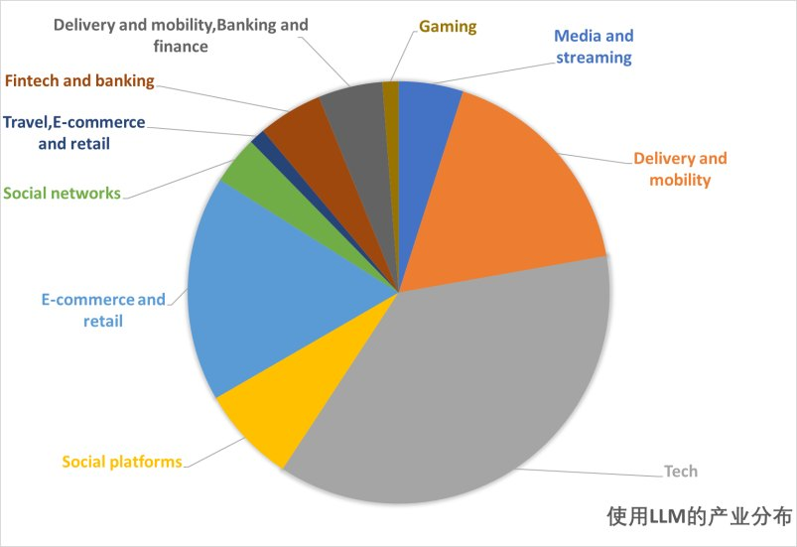
INSIGHT 01 · LLM-based systems & industry applications
LLMs Across Industries: The Landscape
Industry survey · 81 companies across 7 categories
SCOPE OF ADOPTION
• A survey of ~81 companies integrating LLMs to improve productivity, user experience and innovation
• Seven application categories: personalization, customer service, content, data analysis, software dev, security, assistants
REPRESENTATIVE DEPLOYMENTS
• Personalization / recommendation: Instacart, Pinterest, Spotify, Swiggy
• Customer service: Airbnb, Doordash, Intercom; internal collaboration via Slack & GitHub
• Content generation: Amazon, eBay, Wayfair, Walmart, Yelp; Grammarly, Vimeo
ANALYSIS, DEV, SECURITY & ASSISTANTS
• Data analysis & decision support: Grab, Uber, Thomson Reuters
• Software development: GitHub, GitLab, Replit (Copilot now a standard tool)
• Security: Zillow, Whatnot, Google; assistants: Coinbase, Digits, SumUp, TomTom, NVIDIA
A survey of ~81 companies deploying LLMs, by application category.
[1] “LLM-based Application and Industry Overview,” Key AI Innovations talk, 2025.

Slide 5
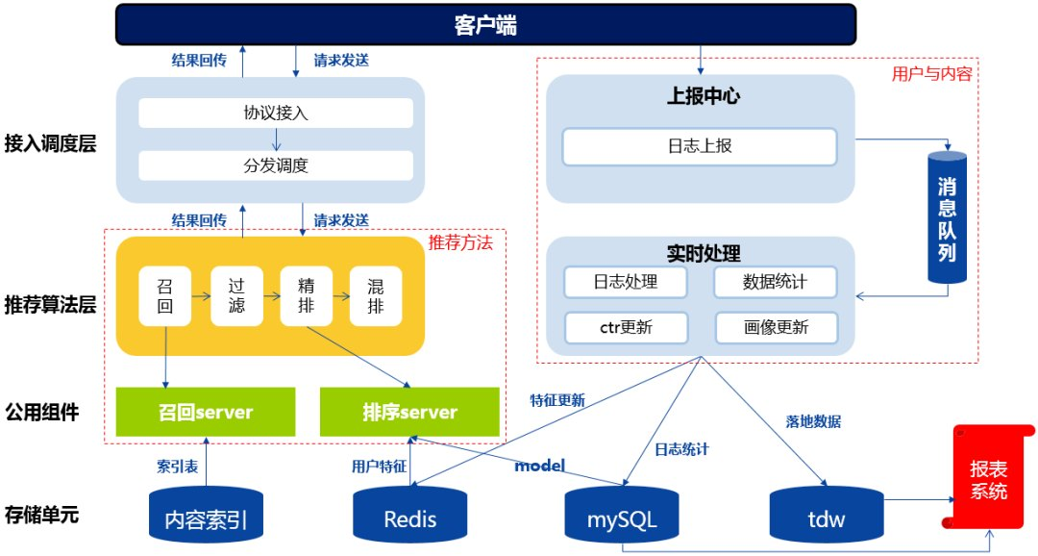
INSIGHT 02 · LLM-based systems & industry applications
Personalization, Recommendation & Content Generation
Amazon · Instacart · Pinterest · Grammarly · personalization & content
RECOMMENDATION CHALLENGES
• Data sparsity from limited user context; cold-start for new users/items; weak explainability
• Legacy collaborative filtering / matrix decomposition struggle with sparsity and high-dimensional context
LLM-BASED SOLUTIONS
• Natural-language understanding extracts deep preferences and mitigates sparsity
• Zero/few-shot transfer solves cold start; NL generation gives explainable recommendations
• Examples: Amazon COSMO common-sense knowledge, Instacart recommendation, Pinterest Text-to-SQL, Walmart attribute extraction
CONTENT GENERATION & OPTIMIZATION
• Challenges: quality control, deduplication/plagiarism, brand-tone consistency, automation vs manual
• Tech: quality assessment, cosine/Jaccard dedup, style fine-tuning to brand, human-review workflows
• Examples: Grammarly CoEdIT (SOTA editing, fewer parameters), Vimeo RAG for video knowledge
From sparse signals to explainable recommendations with LLMs.
[2] “Personalization, Recommendation & Content Generation,” Key AI Innovations talk, 2025.

Slide 6
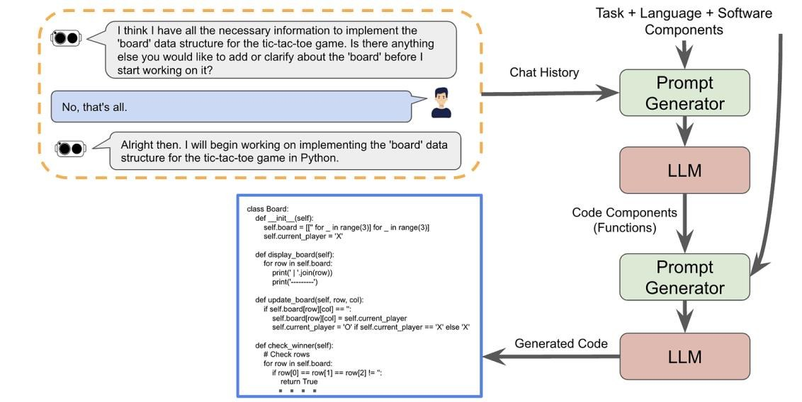
INSIGHT 03 · LLM-based systems & industry applications
Customer Service, Data Analysis & Software Development
Airbnb · Uber · GitHub · Grab · service, analytics & code
CUSTOMER SERVICE & DIALOGUE
• Challenges: multi-round context tracking, weak domain adaptability, social-engineering risk, latency at scale
• Tech: dialog-state tracking, domain knowledge graphs, security rules, caching / async processing
• Examples: Airbnb Automation Platform v2, LinkedIn Hiring Assistant, Uber Genie AI copilot
DATA ANALYSIS & DECISION SUPPORT
• Challenges: data noise, multi-source integration, weak reasoning, black-box explainability
• Tech: data cleaning, SQL engines & graph DBs, inference engines, explainable AI (LIME, SHAP)
• Examples: Uber QueryGPT multi-agent architecture, Grab automated data analysis
SOFTWARE DEVELOPMENT & CODE
• Challenges: cross-file consistency, security flaws (SQL injection, XSS), optimization, train-vs-real gap
• Tech: static analysis (SonarQube), profiling, template/library integration, automated security auditing
• Examples: Replit AI Debugger, GitLab Duo, GitHub Copilot
An LLM code-generation pipeline — prompts drive code components and generated code.
[3] “Customer Service, Data Analysis & Software Development,” Key AI Innovations talk, 2025.

Slide 7
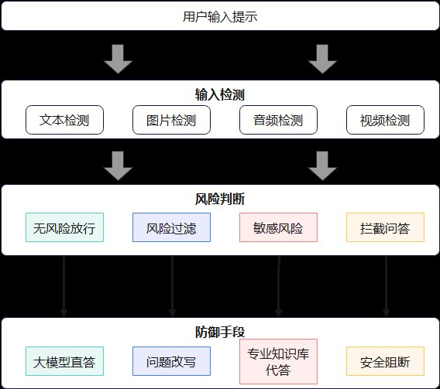
INSIGHT 04 · LLM-based systems & industry applications
Security, Risk Management & Assistant Applications
Google SAIF · Microsoft · NVIDIA · security & assistants
SECURITY & RISK MANAGEMENT
• Challenges: disguised malicious input, evolving threats, insufficient context sensitivity
• LLM advantages: deep semantic understanding, broad threat knowledge, adaptive via fine-tuning/prompting, explanatory feedback
• Examples: Zillow Fair Housing Classifier, Whatnot Rule Engine++, Google's Secure AI Framework (SAIF)
ASSISTANT APPLICATIONS
• Advantages: cross-domain generalization, long-context tracking, prompt/fine-tune scalability, NL interfaces
• Deployment modes: localized (privacy/latency), cloud (small teams), hybrid (finance/enterprise)
• Examples: Microsoft 365 Copilot, Instacart Ava, NVIDIA Morpheus, Digits accountant assistant
Security and assistant deployments — localized, cloud and hybrid.
[4] “Security, Risk Management & Assistant Applications,” Key AI Innovations talk, 2025.

Slide 8
INSIGHT 05 · Single AI agent systems
Single Agent: Definition & Architecture Methods
Single-agent architecture · ReAct · Reflexion · LATS
WHAT AN AI AGENT IS
• An LM-based entity that plans and iteratively executes tasks, taking environment inputs and triggering actions
• Composition: Brain (reasoning), Perception (I/O), Action (tool execution); capabilities: memory, tools, planning, persona
• “An AI agent cannot be just a single LLM” — reasoning limits push from single- toward multi-agent
ARCHITECTURE METHODS
• ReAct (reason + act) — documents thought but can loop and stall
• Reflexion — self-reflection + verbal RL to cut hallucinations; AutoGPT+P — detector + classical planner
• LATS — Monte-Carlo Tree Search for plan / reflect / correct
CAPABILITY MATURITY LADDER
• LLM → +Memory/RAG → +short-term planning (CoT) → +tools / function calling
• → +feedback (computer use, copilots) → +long-term planning → +self-learning → full task autonomy
[5] “Single AI Agent System: Architecture,” Key AI Innovations talk, 2025.

Slide 9
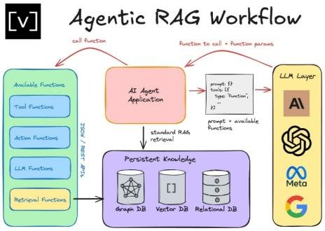
INSIGHT 06 · Single AI agent systems
Single Agent: RAG and Advanced RAG
RAG & Agentic RAG · retrieval-augmented generation
RAG OBJECTIVE
• RAG reduces LLM limitations such as hallucination; workflows evolved simple → advanced → modular
• Goal: adjust retrieval per task, let the LLM decide retrieval strategy, use interactive feedback, integrate multiple sources
LIMITS OF TRADITIONAL RAG
• Relies on vector similarity, ignoring structural relationships between documents
• Lacks global consistency; weak multi-step reasoning; fixed workflows with no behavior adjustment
GRAPH RAG & AGENTIC RAG
• Graph RAG: model document/entity relationships as a graph (entity ID → relation extraction → knowledge graph → optimization)
• Agentic RAG: autonomous selection of relevant data, interactive retrieval/generation, multi-step reasoning and planning
Agentic RAG workflow — autonomous retrieval, reasoning and generation.
[6] “Single AI Agent System: Advanced RAG,” Key AI Innovations talk, 2025.

Slide 10
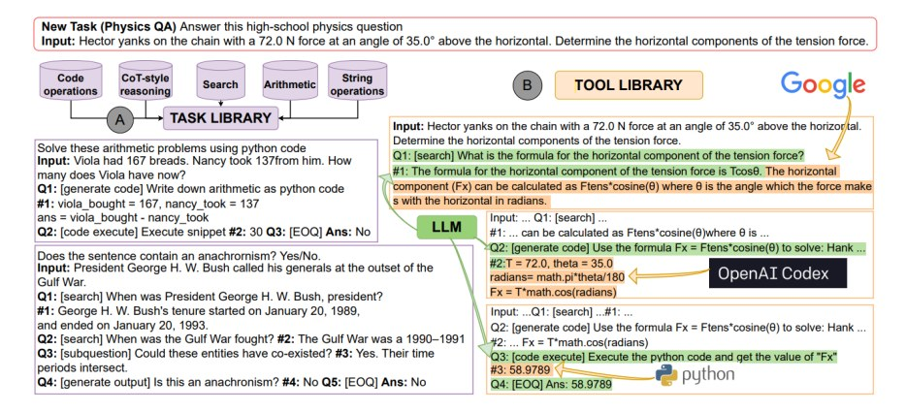
INSIGHT 07 · Single AI agent systems
Single Agent: Memory, Tools & Tool Learning
Memory & tools · compute interface · tool learning
MEMORY MODULE
• Retrieval: short-term full content; long-term filtered by Recency / Relevance / Importance; user-editable
• Storage: natural language, embedding vectors, triplets (ChatDB, DB-GPT); eviction when full
• Reflection: hierarchical summarization and self-improvement; a central agent coordinates memory
TOOL USAGE (COMPUTE INTERFACE)
• A tool is an external function: Perception (get_time), Action (web POST, file edits), Computation (code, calculator)
• Design: modular plug-in connectors, dynamic binding, security (sandboxing, permissions)
• Example: computer use — reads the screen, clicks, types, self-corrects across apps
TOOL CALLING & LEARNING
• Calling: ad-hoc (tool in prompt, parse) vs native function calling (interrupt → call → resume)
• Learning: in-context (task library, docs in prompt) vs training-time (self-supervised API learning, e.g. ToolFormer)
A tool library connecting agents to external tools (tool learning).
[7] “Single AI Agent System: Tool Learning Paradigms,” Key AI Innovations talk, 2025.

Slide 11
INSIGHT 08 · Multi AI agent systems
Multi-Agent: Rationale & Applications
Multi-agent systems · roles & applications
WHY MULTI-AGENT
• Role differentiation: agents specialize (collection, analysis, decision) and divide complex problems
• Collaboration gives diverse perspectives, fault tolerance (no single point of failure), scalability
• Single-agent limits: limited specialization, no collaboration, bottleneck, less flexibility
PROBLEM-SOLVING APPLICATIONS
• Software dev (ChatDev, MetaGPT), research (Agent Laboratory), long-context (Chain of Agents)
• AutoGen, StrategyLLM, TradingGPT, Mora (video); healthcare & policy, embodied/robotic agents
WORLD-SIMULATION APPLICATIONS
• Society (Generative Agents, Lyfe Agents), economy / trading (TradingGPT, AI Hedge Fund), war-gaming (WarAgent)
• Gaming (Werewolf, Avalon, Diplomacy), recommenders (AgentCF), epidemic modeling, digital twins
[8] “Multi AI Agent Systems: Applications,” Key AI Innovations talk, 2025.

Slide 12
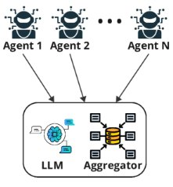
INSIGHT 09 · Multi AI agent systems
Multi-Agent: Collaboration, Coordination & Orchestration
Collaboration & orchestration · protocols & structures
COLLABORATION TYPES
• Cooperation: aligned objectives leverage each agent's expertise
• Competition / adversarial: conflicting objectives drive adaptive strategies (debate, games)
• Coopetition / mixed: a blend balancing trade-offs (negotiation)
COLLABORATION STRATEGIES
• Rule-based: predefined rules — efficient/predictable but low adaptability
• Role-based: segmented by expertise — modular/reusable but rigid if roles unclear
• Model-based: probabilistic decisions — adaptable/robust but complex and compute-heavy
COMMUNICATION STRUCTURES
• Centralized (simple/efficient, but central failure collapses the system)
• Decentralized/distributed (resilient, scalable: swarm, MetaGPT, ChatDev) and hierarchical (DyLAN)
• Static vs dynamic channels: predefined domain channels vs real-time adaptive management
Multi-agent coordination — specialized agents, an LLM and an aggregator.
[9] “Multi AI Agent Systems: Collaboration & Coordination,” Key AI Innovations talk, 2025.

Slide 13
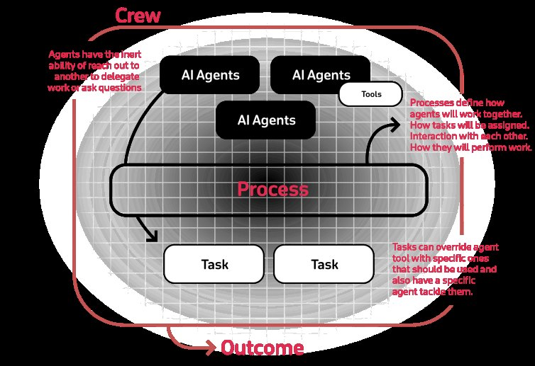
INSIGHT 10 · Multi AI agent systems
Multi-Agent: Development Frameworks & Workflow
LangGraph · CrewAI · AutoGen · agent frameworks
WHAT FRAMEWORKS PROVIDE
• Tools for agent-to-agent communication, orchestration, workflow management, tool use and decision-making
• Enable low/no-code application building; most popular: LangGraph, CrewAI, AutoGen
LANGGRAPH & CREWAI
• LangGraph: graph-organized (agents = nodes, steps = edges), shared typed State, state persistence for recovery
• CrewAI: Agents + Tasks grouped in a Crew; a 'flow' coordinates workflows with a manager pattern
AUTOGEN
• Layered: Core API (message passing, runtime), Agent Chat (prototyping), Extensions (LLM clients, RAG tools)
• Async message workflow; single or distributed runtime; serializable messages, direct-send or topic broadcast
Agent development frameworks — LangGraph, CrewAI and AutoGen.
[10] “Multi AI Agent Systems: Development Frameworks,” Key AI Innovations talk, 2025.

Slide 14
INSIGHT 11 · Evaluations & guardrails
LLM Evaluation: Criteria, Metrics & Frameworks
LLM evaluation · criteria, metrics & frameworks
KEY CRITERIA
• Accuracy (vs gold/expert), Ethicality (privacy, misinformation, fairness, transparency), Fairness (bias mitigation)
• Generalization (unseen data), Robustness (adversarial resilience), Reasoning (logical / causal inference)
METRIC FAMILIES
• Classification: Accuracy, Recall, Precision, F1, Micro/Macro-F1
• Token-similarity: Perplexity, BLEU, ROUGE, BERTScore; QA: strict/lenient accuracy, MRR
FRAMEWORKS
• Evidently AI: text stats/patterns, model-based evals (semantic similarity, toxicity, BERTScore)
• Aporia: restricted phrases, prompt-injection DB, Text-to-SQL security, DoS / cost / RAG access control
• Ragas: string similarity, context precision/recall, noise sensitivity, topic adherence
[11] “LLM Evaluation: Frameworks,” Key AI Innovations talk, 2025.

Slide 15
INSIGHT 12 · Evaluations & guardrails
RAG Evaluation: Targets, Metrics & Benchmarks
RAG evaluation · targets, metrics & benchmarks
EVALUATION TARGETS
• Traditional-RAG problems: retrieval errors (irrelevant docs, fixed retrieval) and hallucination despite relevant data
• Pre-generation judges retrieval quality; post-generation validates output against retrieved docs
ASPECTS & METRICS
• Retrieval quality (context relevance) and generation quality (faithfulness, answer relevance)
• Also noise robustness, negative rejection, information integration, counterfactual robustness
• Metrics: Exact Match, Recall/Precision, Cosine Similarity, Hit Rate, MRR, NDCG, BLEU, ROUGE-L
FRAMEWORKS & BENCHMARKS
• Tools: RAGAS, ARES, TruLens
• Benchmarks: RGB, CRUD (BLEU/ROUGE-L/BertScore/RAGQuestEval), RECALL (reappearance rate)
[12] “RAG Evaluation: Metrics & Frameworks,” Key AI Innovations talk, 2025.

Slide 16
INSIGHT 13 · Evaluations & guardrails
LLM-as-a-Judge: Methodology, Attributes & Frameworks
LLM-as-a-Judge · evaluation by models
CONCEPT & FORMATS
• LLMs judge candidate outputs; reliability concern shifts to the judge itself
• Input: point-wise vs pair/list-wise; output: score-, ranking-, or selection-based (rubric or pairwise)
METHODOLOGY
• Model tuning: manual vs synthetic feedback; supervised fine-tuning, preference / meta-rewarding
• Prompting: position-bias swapping, multi-agent (peer rank, debate, voting), rule augmentation, multi-turn
• Mitigate positional bias with order-swapping and highest-log-probability selection
ATTRIBUTES, USES & FRAMEWORKS
• Attributes: helpfulness, harmlessness, reliability (HALU-J), relevance, feasibility, quality
• Uses: reasoning-path selection (CoT, debate, Tree-of-Thoughts), retrieval ranking, self-judging
• Frameworks: Evidently AI, Aporia, Ragas; worked examples CRAG (self-corrective RAG) and SELF-RAG (self-reflective RAG)
[13] “LLM-as-a-Judge: Methodology & Frameworks,” Key AI Innovations talk, 2025.

Slide 17
CONCLUSIONS
Synthesis
INSIGHTS
VISION
IMPLICATIONS FOR US
• LLMs are pervasive in industry — personalization, customer service, content, data analysis, code and security — across ~81 surveyed companies.
• Systems are moving from single agents (RAG, memory, tools) toward collaborating multi-agent frameworks.
• Evaluation and guardrails — LLM evaluation, RAG evaluation and LLM-as-a-Judge — are now first-class engineering concerns.
• Agentic RAG and graph RAG that reason over structured knowledge, not just vector similarity.
• Multi-agent frameworks (LangGraph, CrewAI, AutoGen) as the default way to build complex AI systems.
• Automated, model-based evaluation (LLM-as-a-Judge) woven into the development loop.
• Pick the deployment mode (local / cloud / hybrid) to match privacy, latency and scale.
• Design agents with memory, sandboxed tools and explicit guardrails from the start.
• Evaluate retrieval and generation separately, and treat the judge's own reliability as a risk.

