Slide 1
Tech Insight
Tech Insight Report
HKSTP 2024 — Symposium on Innovative Robotics
2024 HKSTP Symposium on Innovative Robotics and Applications
Hong Kong Science Park (INNO²), Hong Kong · 23 May 2024
Location
Hong Kong Science Park (INNO²), Hong Kong
Date
23 May 2024
Focus
Innovative Robotics — Foundation Models, Grasping & Human-Robot Collaboration

Slide 2
CONTENTS
Talks covered, by theme
A · Foundation models for grasping & control
C · Robust autonomy & smart transport
01
Generalizable Task-Oriented Grasping with Foundation Models
07
Enabling Autonomy with Robust Perception and Remote Intervention
02
Robotics in the Artificial Intelligence Era
08
Technological Development for Smart Transport in Hong Kong
03
Learning Dynamic Legged Loco-Manipulation
B · Human-robot collaboration & sensing
04
Collaboration & Interaction of Human-Robot and Robot-Robot
05
Logistics Application of Tactile Sensing with Smart Grippers
06
Amoeba-Inspired Self-Healing Electronic Slime as Wearable Motion Sensors

Slide 3
SYMPOSIUM AT A GLANCE
2024 HKSTP Symposium on Innovative Robotics and Applications
23 May 2024
HKSTP · INNO²
12 talks
Robotics × AI
Hong Kong
organizer
8 deep-dived here
the theme
About: A one-day HKSTP symposium at Hong Kong Science Park's INNO², pairing academic robotics talks with industry perspectives on robotics and applications.
The dominant thread is fusing foundation models (LLMs / VLMs) with robot perception, planning and manipulation — especially task-oriented grasping, human-robot collaboration & safety, and tactile / wearable sensing — alongside robust autonomy and smart transport for Hong Kong.

Slide 4
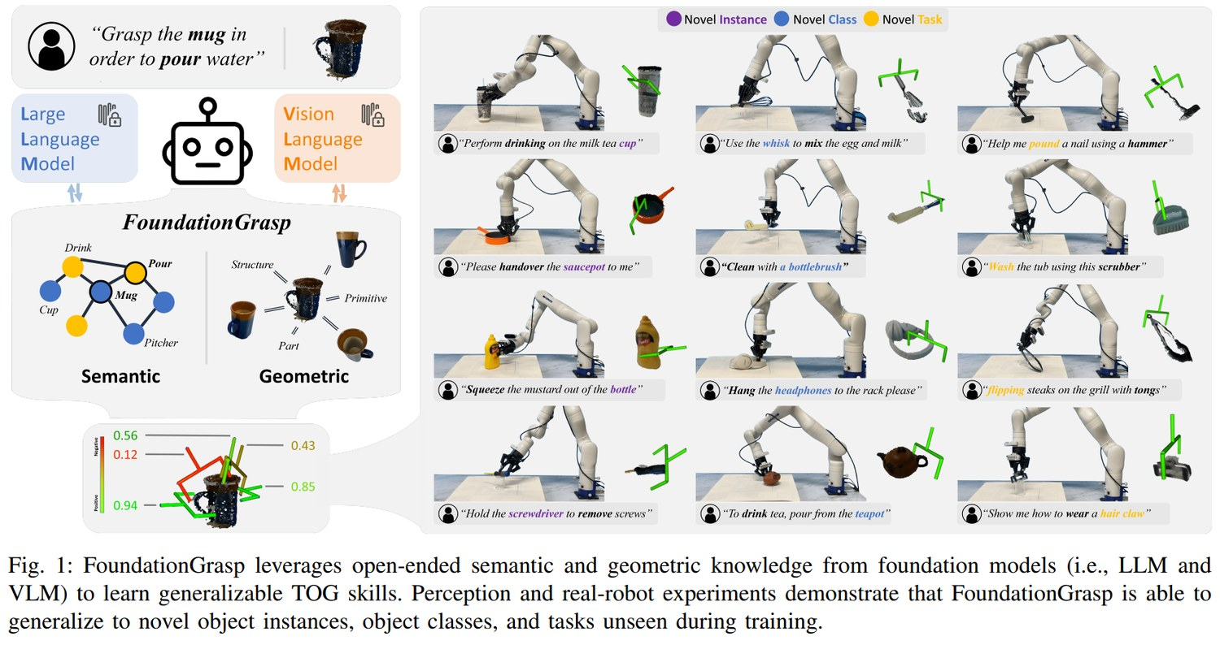
INSIGHT 01 · Foundation models for grasping & control
Generalizable Task-Oriented Grasping with Foundation Models
Hong Zhang · task-oriented grasping · FoundationGrasp
THE PROBLEM
• Task-Oriented Grasping (TOG) = decide which object to grasp and how; learning beats classical grasping but is data-hungry
• Use foundation models (LLMs + VLMs) to transfer knowledge and generalize across novel objects, tasks and grippers
• Goal: from an RGB image + a language instruction (object + task) + gripper geometry, output a 6-DoF grasp pose
GRASPGPT / FOUNDATIONGRASP
• Pipeline: data generation → multi-modal feature representation → task-oriented grasp evaluation → loss
• Object/grasp encoder (PointNet++), semantic encoder (BERT), geometric encoder (CLIP), trained with binary cross-entropy
• LLM prompts generate language descriptions; web image retrieval augments visual diversity
RESULTS & LIMITS
• GraspCLIP reaches ~83% mAP but struggles on novel classes; FoundationGrasp adds commonsense reasoning
• ~90% grasp success across nine manipulation tasks, but full-manipulation success ~67% (limited relative-pose modeling, no force feedback)
• Ablations: geometric knowledge is key for novel instances, semantic knowledge for novel tasks
FoundationGrasp — LLM + VLM knowledge drives generalizable task-oriented grasping across novel objects and tasks.
[1] H. Zhang, “Generalizable Task-Oriented Grasping with Foundation Models,” HKSTP Symposium on Innovative Robotics & Applications, 2024.

Slide 5
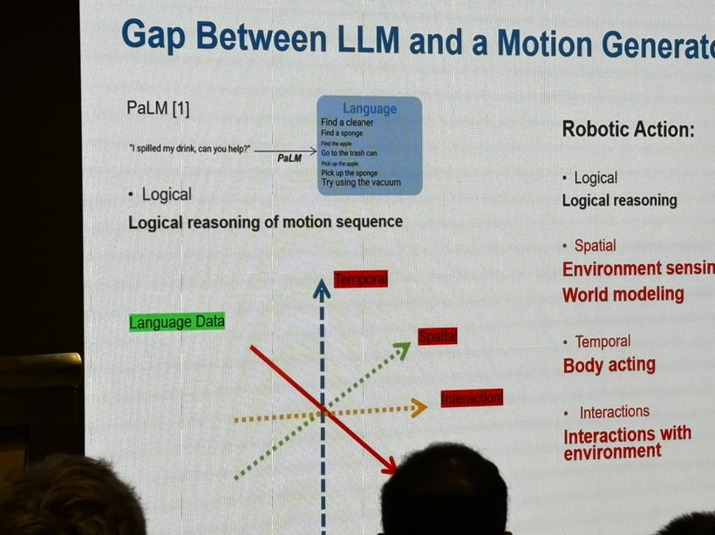
INSIGHT 02 · Foundation models for grasping & control
Robotics in the Artificial Intelligence Era
Ning Xi · LLM-driven robot control
FROM TASK PLANNING TO LLMS
• Classical approach: build a task-plan sequence, then actions per task, executed by sensors + a control system
• Now LLMs can control the robot directly, supplying the logical relationships and reasoning between actions
WHAT AN LLM MUST CAPTURE
• Temporal relationships (e.g. past trajectory) and interactive spatial relationships (e.g. force to grasp a coffee cup)
• Needs a new way to represent information, including unstructured constraints; control should be vision-based, not vector-based
THE GAP
• LLM logical reasoning of motion (PaLM-style) vs robotic action: spatial sensing, world modeling, temporal/body acting, environment interaction
• Framed as a Data-Driven vs Model-Driven challenge in AI
The gap between an LLM's logical reasoning and a robot motion generator's spatial / temporal / interactive needs.
[2] N. Xi, “Robotics in the Artificial Intelligence Era,” HKSTP Symposium on Innovative Robotics & Applications, 2024.

Slide 6
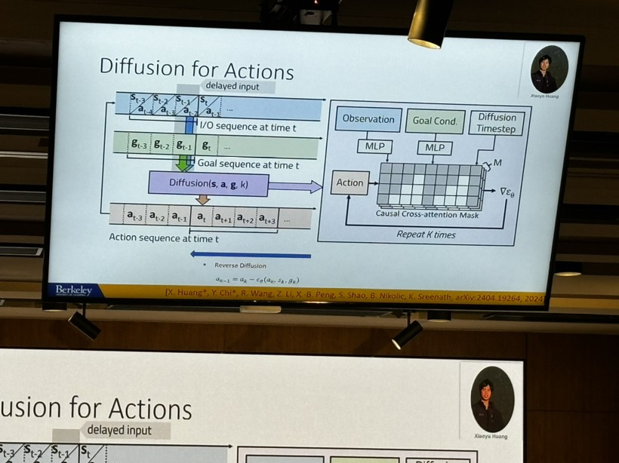
INSIGHT 03 · Foundation models for grasping & control
Learning Dynamic Legged Loco-Manipulation
Koushil Sreenath · UC Berkeley
LLM AS A FEEDBACK CONTROLLER
• Frame the LLM as a discrete-time nonlinear dynamic feedback controller with defined state, input and output
• An LLM-interaction loop generates responses that close the control loop
ACTION GENERATION
• ‘Diffusion for Actions’ generates actions for dynamic legged loco-manipulation
‘Diffusion for Actions’ — generating actions for dynamic legged loco-manipulation.
[3] K. Sreenath, “Adventures in Learning Dynamic Legged Loco-Manipulation,” HKSTP Symposium on Innovative Robotics & Applications, 2024.

Slide 7
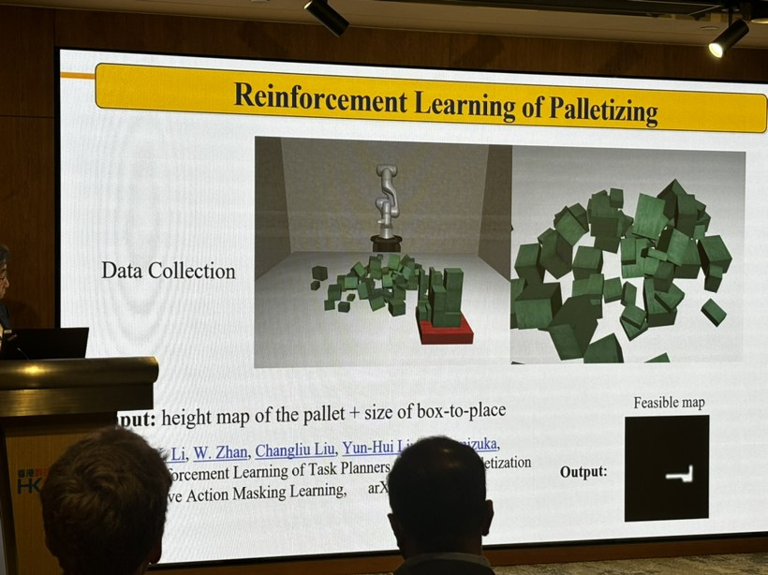
INSIGHT 04 · Human-robot collaboration & sensing
Collaboration & Interaction of Human-Robot and Robot-Robot
Masayoshi Tomizuka · UC Berkeley · Mechanical Systems Control Lab
EFFICIENT, NON-CONSERVATIVE CO-ROBOTS
• Robots raise efficiency, but automated robots tend to become conservative and slow the whole system
• Challenge: design co-robot behavior so efficiency isn't sacrificed for safety
THE SEROCS FRAMEWORK
• Safe & Efficient Robot Collaboration System in three tasks: environment monitoring, task planning, safe control
• Trade-off framed as Efficiency vs Safety under Computation vs Uncertainty
CONTROLLER & LEARNING
• A two-part controller with a safety-checker stage; uses an offline-learned human-motion prediction + nominal optimal control
• RL for palletizing: pallet height-map + box size → feasibility map; task planning via RL with action masking
• Methods: SERoCS, Conditional Behavior Prediction, Courteous Autonomous Cars
The SERoCS controller structure — a two-part controller with human-motion prediction and a safety-checker stage.
[4] M. Tomizuka, “Collaboration and Interaction of Human-Robot and Robot-Robot,” HKSTP Symposium on Innovative Robotics & Applications, 2024.

Slide 8
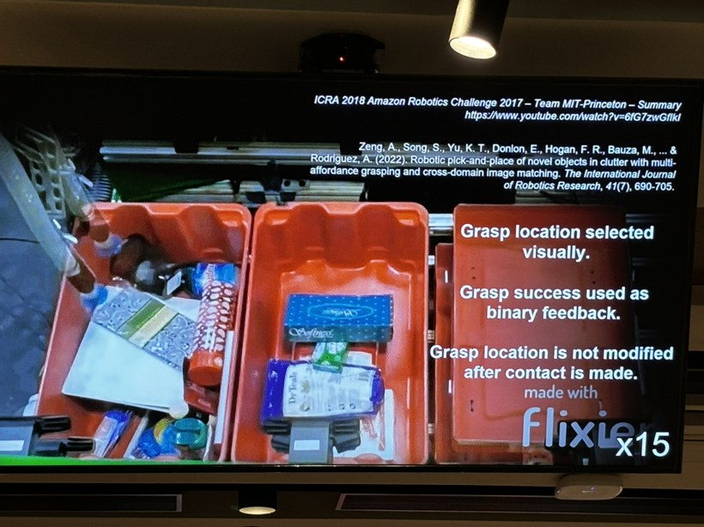
INSIGHT 05 · Human-robot collaboration & sensing
Logistics Application of Tactile Sensing with Smart Grippers
Hannah Stuart · UC Berkeley · Embodied Dexterity Group
GRASPING WITHOUT VISION
• Flexible logistics application of tactile sensing with smart grippers; one gripper alone may not suffice
• Goal: find the optimum grasp position without an image sensor, using tactile feedback
THE VISUAL-TACTILE GRASP LOOP
• Grasp location is selected visually; grasp success is used as binary feedback
• Grasp location is not modified after contact is made (ICRA 2015, Amazon Picking Challenge)
Visual-tactile grasping — grasp location chosen by vision with binary success feedback (ICRA 2015).
[5] H. Stuart, “Logistics Application of Tactile Sensing with Smart Grippers,” HKSTP Symposium on Innovative Robotics & Applications, 2024.

Slide 9
INSIGHT 06 · Human-robot collaboration & sensing
Amoeba-Inspired Self-Healing Electronic Slime as Wearable Motion Sensors
Wen Jung Li · wearable MEMS sensing
AMOEBA-INSPIRED SELF-HEALING SENSOR
• A self-healing electronic ‘slime’ material for wearable motion sensing, inspired by amoeba
• Monitors motion / behavior (demonstrated on a mouse) with a wearable MEMS sensor
FABRICATION & USE
• Skin-conformal sensor fabricated via micro 3D printing
• Targets human–robot interaction through wearable motion capture
[6] W. J. Li, “Amoeba-Inspired Self-Healing Electronic Slime as Wearable Motion Sensors for Human-Robot Interaction,” HKSTP Symposium, 2024.

Slide 10
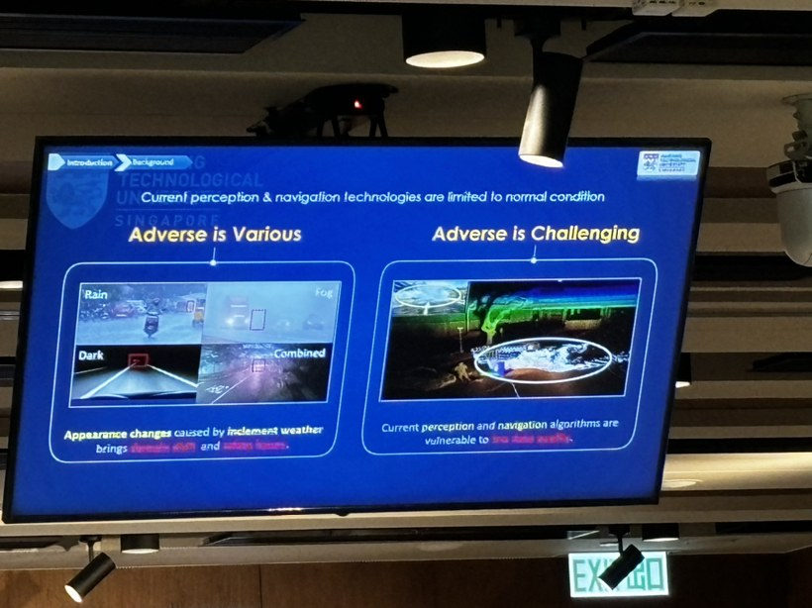
INSIGHT 07 · Robust autonomy & smart transport
Enabling Autonomy with Robust Perception and Remote Intervention
Dan Wei Wang · robust perception & autonomy
ROBUST PERCEPTION UNDER ADVERSE CONDITIONS
• Current perception & navigation technologies are limited to normal conditions
• ‘Adverse is various, adverse is challenging’: inclement weather causes appearance change, domain shift and urban haze
• Perception and cognition algorithms are vulnerable to adverse events — motivating remote intervention as a fallback
‘Adverse is challenging’ — inclement weather causes the domain shift that degrades perception.
[7] D. W. Wang, “Enabling Autonomy with Robust Perception and Remote Intervention,” HKSTP Symposium on Innovative Robotics & Applications, 2024.

Slide 11
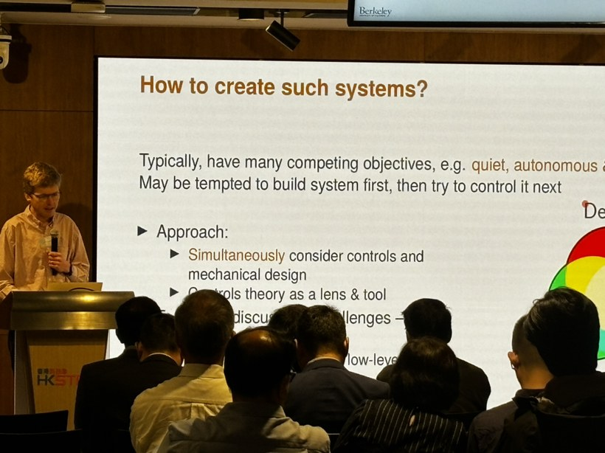
INSIGHT 08 · Robust autonomy & smart transport
Technological Development for Smart Transport in Hong Kong
Chun Hung Cheng · LSCM
SYSTEM-DESIGN PHILOSOPHY
• Systems typically have many competing objectives (e.g. quiet, autonomous)
• Don't build the system first and try to control it afterwards — co-design controls and mechanical design simultaneously
• Treat control theory as a lens and a tool from the very start
Designing smart-transport systems — co-design controls and mechanical design for competing objectives.
[8] C. H. Cheng, “LSCM's Perspective on Technological Development for Smart Transport in Hong Kong,” HKSTP Symposium, 2024.

Slide 12
CONCLUSIONS
Synthesis across the symposium
TRENDS
VISION
IMPLICATIONS FOR US
• Foundation models are moving into the loop: LLMs / VLMs replace hand-built task-planning pipelines, supplying semantic, spatial, temporal and commonsense knowledge.
• Task-oriented grasping is the benchmark problem — generalizing across novel objects, tasks and grippers via multi-modal fusion (BERT + CLIP + PointNet++).
• Tactile and wearable sensing push perception beyond cameras (smart grippers, self-healing skin sensors).
• Reframe the LLM itself as a dynamic feedback controller and the reasoning layer for motion — from planner to closed-loop element.
• Universal, generalizable manipulation policies usable across many household robots and gripper types.
• Robots that collaborate safely and efficiently with humans, without defaulting to conservative behavior.
• Persistent gaps (efficiency-vs-safety; ~90% grasp vs ~67% full-manipulation success) show autonomy is bottlenecked by force feedback, relative-pose modeling and conservatism — not perception alone.
• Robustness under adverse conditions and remote intervention are needed before deployment at scale.
• Co-design control with mechanical design — treat control theory as a tool from the start, not an afterthought.

