Slide 1
Tech Insight
Tech Insight Report
IJCAI 2025
34th International Joint Conference on Artificial Intelligence
Montreal, Canada · August 16–22, 2025
Location
Montreal, Canada
Dates
August 16–22, 2025
Focus
Trustworthy and Explainable AI

Slide 2
CONTENTS
Papers covered, by theme
A · Safety & reasoning foundations
C · Trustworthy & fair LLMs / MLLMs
01
AI Safety: Risks of General-Purpose AI (Keynote)
05
Mitigating Linguistic Discrimination in LLMs
02
Graphical Models Meet Heuristic Search (Keynote)
06
Modality-Fair Preference Optimization for MLLMs
07
Token-Level Accept or Reject: Micro Alignment
B · Explainability & robustness
03
Explainable Medical Reasoning with ILP
08
Hallucination Reduction in Video-Language Models
04
Robust Compression Boundary for Embodied AI

Slide 3
CONFERENCE STATISTICS
34th International Joint Conference on Artificial Intelligence — Montreal, Canada
5,404
1,042
19.3%
Top-5
submissions
accepted
acceptance rate
AI venue
Also: One of the top AI conferences (alongside ICML, AAAI, NeurIPS). Highlights included keynotes by Yoshua Bengio (AI safety) and Rina Dechter (Research Excellence Award).
Threads across the program: AI safety and governance; explainable, interpretable reasoning (ILP, graphical models); robustness for embodied AI; and trustworthy, fair alignment of LLMs and multimodal models.

Slide 4

INSIGHT 01 · Safety & reasoning foundations
AI Safety: Risks of General-Purpose AI (Keynote)
Yoshua Bengio (keynote) · International AI Safety Report
GOAL
Map what general-purpose AI can do, the risks it brings, and the techniques that mitigate them.
CHALLENGE
Capable, general models bring severe risks — loss of human control, decentralized misuse, and concentration of power.
METHOD
Synthesize evidence from ~100 experts across 30 countries (+ EU / UN / OECD) · Classify risks by source: misuse, human imitation, RL side-goals, reward hacking, self-preservation · Set safety requirements, e.g. never assert a false claim with confidence
NOVELTY
A shared, international evidence base for AI risk — not a single lab's opinion.
The International AI Safety Report — the backdrop for Bengio's keynote on risks and mitigations.
IMPACT
A common reference for governance and safe-deployment decisions as adoption rises.
[1] Y. Bengio et al., “International AI Safety Report,” IJCAI 2025 keynote.

Slide 5
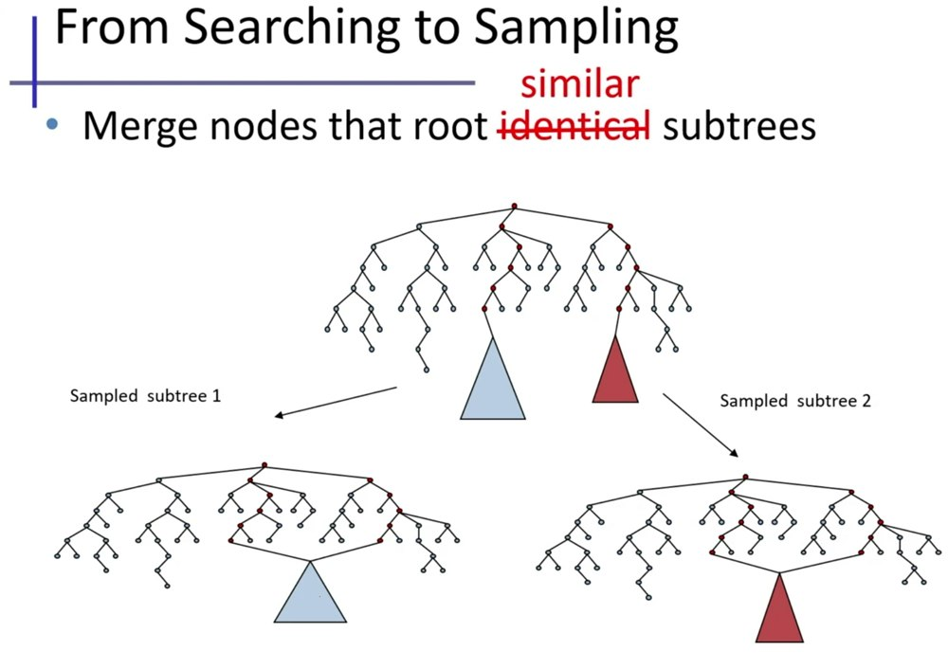
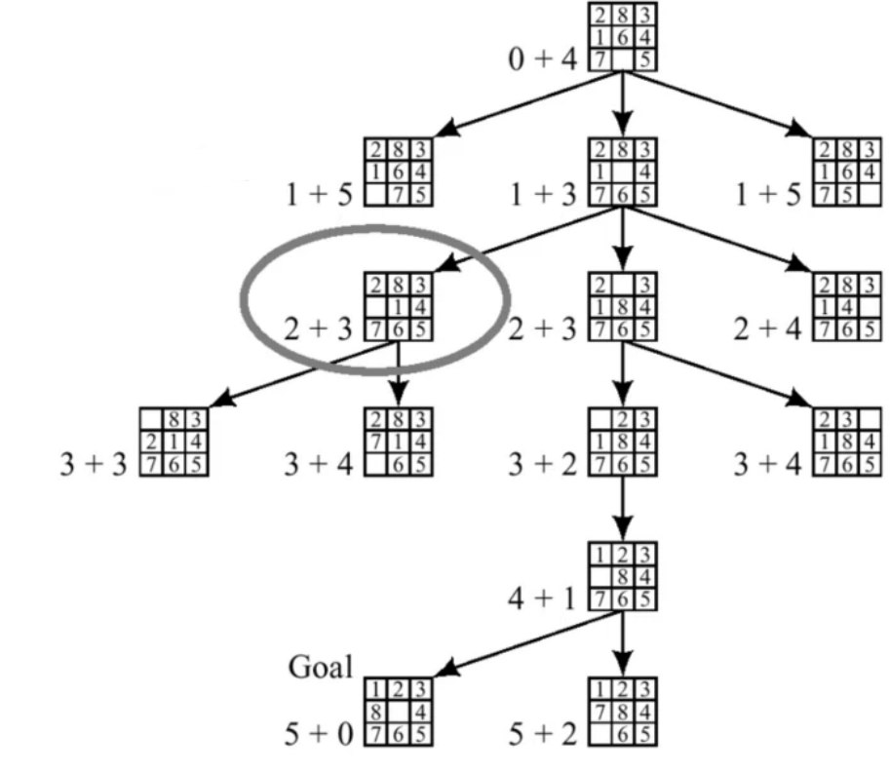
INSIGHT 02 · Safety & reasoning foundations
Graphical Models Meet Heuristic Search (Keynote)
Rina Dechter (keynote) · UC Irvine
GOAL
Solve hard reasoning and inference by combining probabilistic graphical models with heuristic search.
CHALLENGE
Generic solvers struggle on very hard inference; pure search ignores the problem's structure.
METHOD
Find ‘tractable islands’ — subproblems you can solve exactly or efficiently · Use them as heuristics to guide search and Monte-Carlo sampling · Run anytime: a feasible result early, refined toward exact given more time
NOVELTY
The tractable-islands paradigm unifies exact inference, search, bounding and sampling.
IMPACT
Anytime solvers with guaranteed bounds — valuable when time or compute is limited.
[2] R. Dechter et al., “Graphical Models Meet Heuristic Search: A Personal Journey into Automated Reasoning,” IJCAI 2025 keynote.

Slide 6
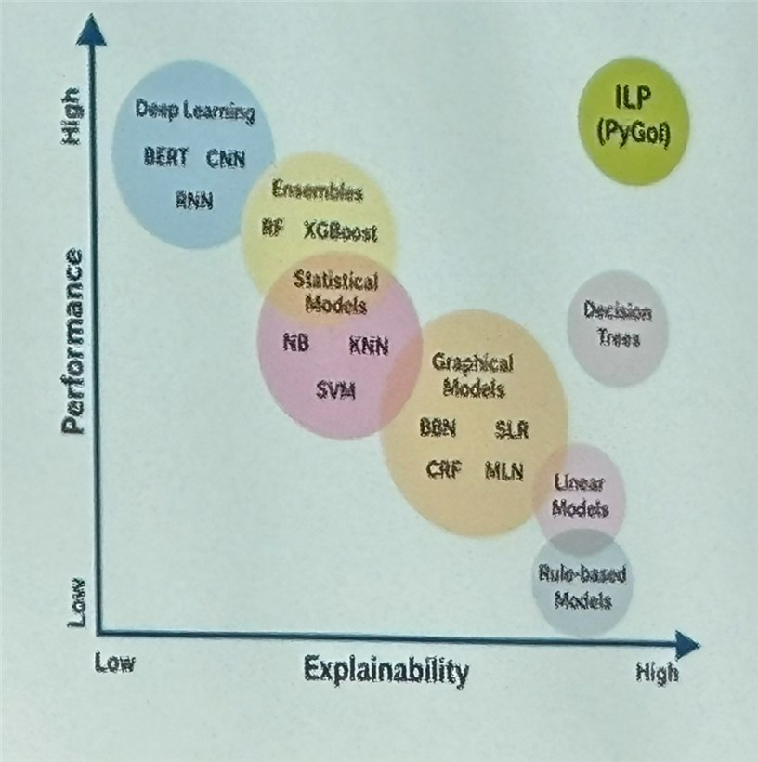
INSIGHT 03 · Explainability & robustness
Explainable Medical Reasoning with ILP
Dany Varghese et al. · University of Surrey, UK
GOAL
Test whether Inductive Logic Programming can match black-box ML while staying interpretable.
CHALLENGE
Medical AI is often accurate but a black box, which limits transparency and clinician trust.
METHOD
Learn symbolic if-then rules with the PyGol ILP system · Use Cleveland Heart Disease data (13 features, 303 patients) + medical background knowledge · Compare accuracy and global interpretability against standard ML
NOVELTY
Rule models reach comparable accuracy and align with real clinical logic — explainable by design.
Performance vs. explainability — ILP rule models match ML accuracy while staying interpretable.
IMPACT
For clinical adoption, transparent rules can matter more than marginal accuracy; points to neuro-symbolic hybrids.
[3] D. Varghese et al., “Explainable Medical Reasoning: From Data to Transparent, Trustworthy Clinical Insights,” IJCAI 2025.

Slide 7
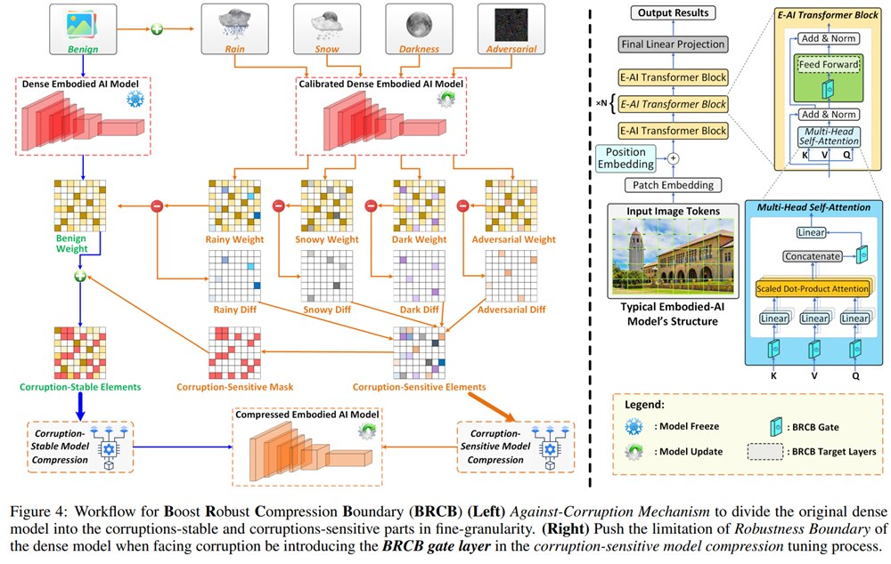
INSIGHT 04 · Explainability & robustness
Robust Compression Boundary for Embodied AI
Chong Yu et al. · Fudan University
GOAL
Compress embodied-AI models while keeping accuracy, efficiency AND robustness at once.
CHALLENGE
On-device robots and vehicles need small, fast models that stay robust to real-world corruptions (noise, blur, weather).
METHOD
Characterize the ‘robust compression boundary’ — how far you can prune/quantize before robustness drops · Fold robustness constraints into the compression objective · Evaluate on embodied vision/robotics tasks vs accuracy-only baselines
NOVELTY
Treats robustness as a third axis alongside accuracy and efficiency, jointly optimized.
The robust compression boundary — how far a model compresses before robustness to corruptions drops.
IMPACT
Lower memory/latency deployment on constrained platforms without losing robustness.
[4] C. Yu et al., “Boost Embodied AI Models with Robust Compression Boundary,” IJCAI 2025.

Slide 8
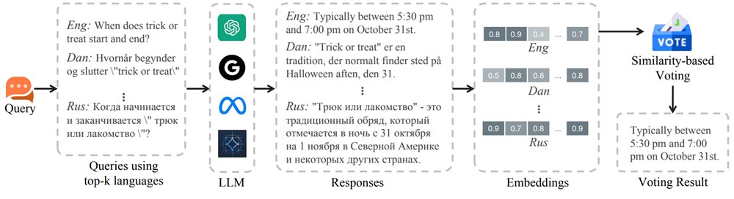
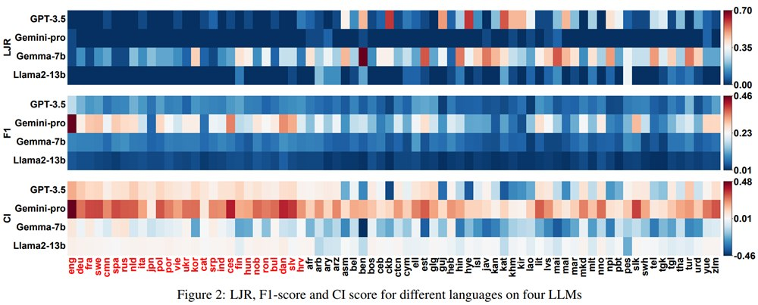
INSIGHT 05 · Trustworthy & fair LLMs / MLLMs
Mitigating Linguistic Discrimination in LLMs
Guoliang Dong et al. · SMU & Zhejiang University
GOAL
Measure and reduce how an LLM's safety and quality vary across languages.
CHALLENGE
LLMs answer the same question differently by language — a safety- and knowledge-equity gap.
METHOD
Use metamorphic testing: same-meaning inputs in different languages should give same-meaning outputs · At inference, translate a query into k languages and answer each, then translate back · Pick the reply most consistent with the others by cosine similarity (voting)
NOVELTY
A translate-answer-vote wrapper that improves safety and quality with no retraining.
IMPACT
Lower jailbreak rates and higher F1 across languages — fairer, safer multilingual deployment.
[5] G. Dong et al., “Evaluating and Mitigating Linguistic Discrimination in Large Language Models,” IJCAI 2025.

Slide 9
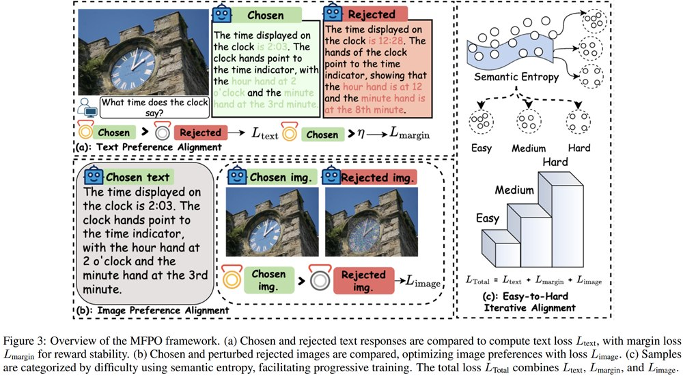
INSIGHT 06 · Trustworthy & fair LLMs / MLLMs
Modality-Fair Preference Optimization for MLLMs
Songtao Jiang et al. · Zhejiang University & NUS
GOAL
Make multimodal LLMs rely fairly on both the image and the text.
CHALLENGE
MLLMs often lean on text and under-use the image, which hurts trustworthiness.
METHOD
Perturb key image regions (text fixed) to build chosen vs rejected image pairs · Train a modality-fair loss aligning text and image preferences with a stability margin · Use keyword-guided region selection and easy-to-hard iterative training
NOVELTY
Balances preference alignment across modalities rather than text-only DPO.
Modality-fair preference optimization — perturb key image regions to build chosen / rejected pairs.
IMPACT
Better-grounded, more trustworthy multimodal answers.
[6] S. Jiang et al., “Modality-Fair Preference Optimization for Trustworthy MLLM Alignment,” IJCAI 2025.

Slide 10
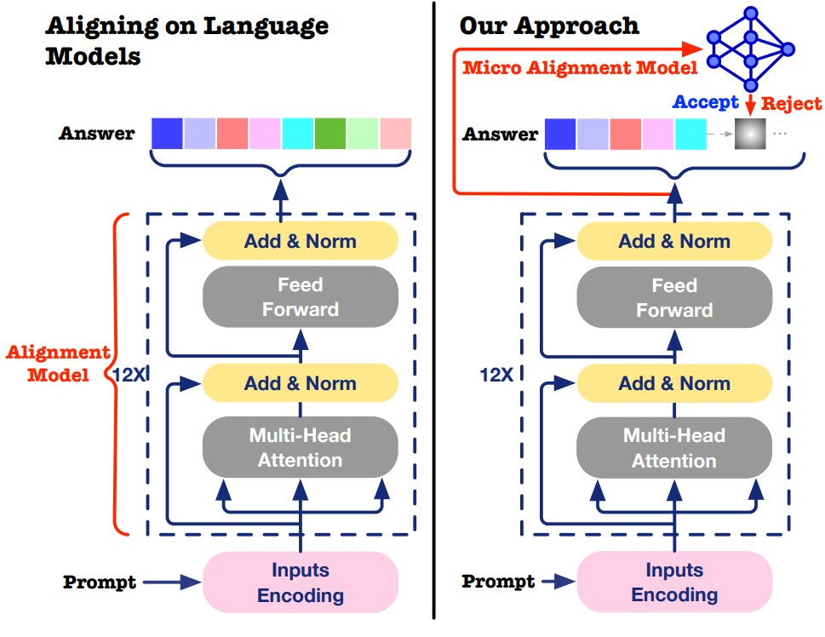
INSIGHT 07 · Trustworthy & fair LLMs / MLLMs
Token-Level Accept or Reject: Micro Alignment
Yang Zhang et al. · Hong Kong Polytechnic University
GOAL
Align an LLM without fine-tuning it — accept or reject each candidate token with a tiny model.
CHALLENGE
RLHF/DPO fine-tune billions of parameters (costly) and align at the sentence level (coarse).
METHOD
Keep the LLM frozen; a small 3-layer accept/reject model filters each candidate token · Frame it as an MDP (accept/reject) with an alignment + divergence reward · Use top-k/top-p truncation for speed, with a fallback if all tokens are rejected
NOVELTY
Moves alignment from full fine-tuning to a lightweight, token-granular controller.
A small accept/reject model filters candidate tokens after the frozen LLM.
IMPACT
Much cheaper, more controllable alignment that retains or improves quality.
[7] Y. Zhang et al., “Token-Level Accept or Reject: A Micro Alignment Approach for Large Language Models,” IJCAI 2025.

Slide 11
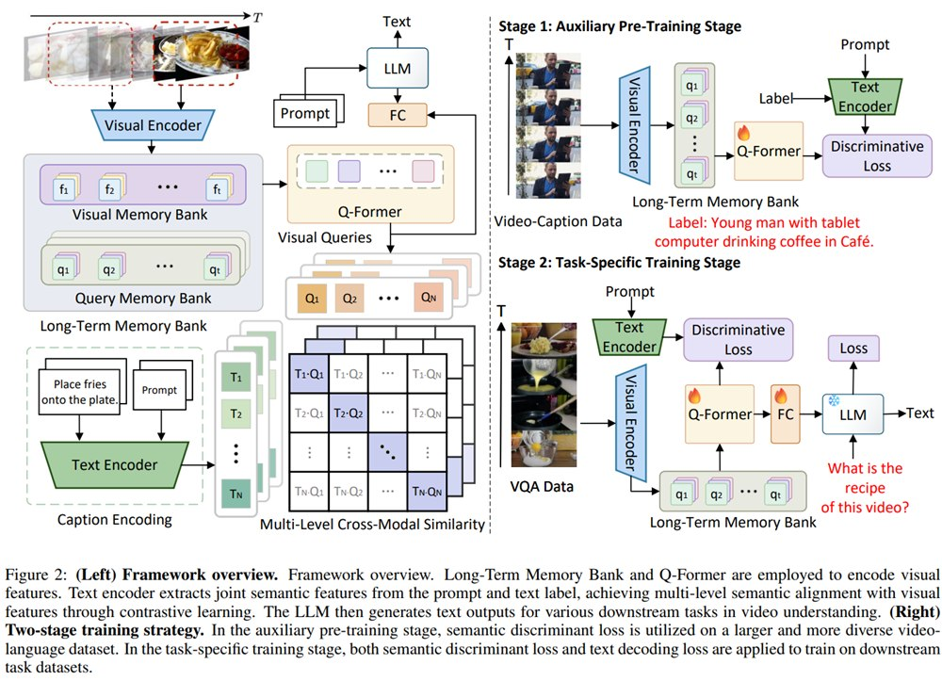
INSIGHT 08 · Trustworthy & fair LLMs / MLLMs
Hallucination Reduction in Video-Language Models
Jisheng Dang et al. · Lanzhou Univ., SYSU, NUS, HKU
GOAL
Improve semantic alignment between video and text to cut hallucinations.
CHALLENGE
Video-language models hallucinate when visual and language semantics are poorly aligned.
METHOD
Add a contrastive loss matching correct video-text pairs and separating mismatches · Two-stage training: broad video-language pre-training, then task fine-tuning · Inject text-semantic supervision into the visual Q-Former
NOVELTY
Hierarchical multimodal consistency makes visual features more semantically discriminative.
Hierarchical multimodal consistency — align video and text to reduce hallucinations.
IMPACT
Fewer hallucinations and better video understanding for captioning and QA.
[8] J. Dang et al., “Hallucination Reduction in Video-Language Models via Hierarchical Multimodal Consistency,” IJCAI 2025.

Slide 12
CONCLUSIONS
Synthesis across the papers
INSIGHTS
VISION
IMPLICATIONS FOR US
• Trustworthy AI is maturing — explainability need not cost accuracy (e.g. ILP rule models).
• Robustness is emerging as a third design axis beyond accuracy and efficiency.
• Lightweight alignment and fairness (token-level, modality-fair) work without full retraining.
• A unified trust framework combining symbolic reasoning, probabilistic inference and neural learning.
• AI agents with long-term memory, reasoning and self-monitoring.
• More international AI governance around power concentration, bias and misuse.
• Embed explainability and transparency modules into products.
• Treat robustness-to-corruption as a first-class metric for embodied / edge AI.
• Adopt cheap alignment (token-level, multilingual voting) for safer deployment.

