Slide 1
Tech Insight
Tech Insight Report
NeurIPS 2025
39th Conference on Neural Information Processing Systems
San Diego, USA & Mexico City, Mexico · December 2–7, 2025
Location
San Diego, USA & Mexico City, Mexico
Dates
December 2–7, 2025
Focus
Emerging Trends in Reliable LLM-based Software Applications

Slide 2
CONTENTS
Papers covered, by theme
A · Self-verifying reasoning & code
C · Reliability, safety & security
01
Trust, But Verify: Self-Verifying RL (RISE)
05
Reliable LLM-Robot Planning via Uncertainty (CURE)
02
Rethinking Verification for LLM Code Generation (SAGA)
06
Safe + Safe = Unsafe? Jailbreaking VLMs with Safe Images
07
DRIFT: Dynamic Defense for Securing LLM Agents
B · Efficient, knowledge-aware agents
03
GAP: Graph-Based Agent Planning with Parallel Tools
04
RAG4GFM: Retrieval-Augmented Graph Foundation Models

Slide 3
CONFERENCE STATISTICS
39th Conference on Neural Information Processing Systems — San Diego, USA & Mexico City, Mexico
20,000
6,000
30%
2
submissions
accepted
acceptance rate
host cities
Also: Held across two cities (San Diego + Mexico City). Landmark NeurIPS papers include AlexNet, Dropout, DQN, Adam, the Transformer, and BERT.
Dominant topics: diffusion & scientific generation, efficient LLM training/inference, reasoning / RAG / code / agents, preference alignment (RLHF, DPO), RL & uncertainty, and robustness / safety / interpretability.

Slide 4
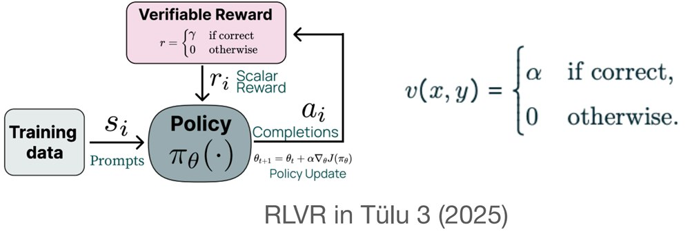
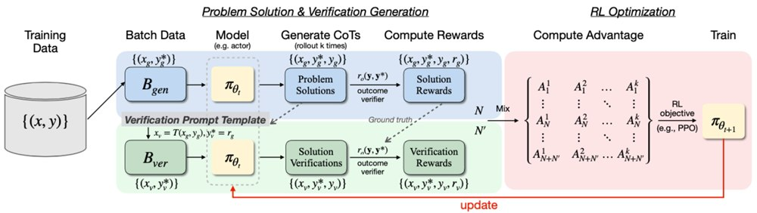
INSIGHT 01 · Self-verifying reasoning & code
Trust, But Verify: Self-Verifying RL (RISE)
Xiaoyuan Liu et al. · CUHK, Shenzhen
GOAL
Teach a model to check its own reasoning during training, instead of relying on a separate verifier.
CHALLENGE
LLMs reason fluently but can’t reliably tell when they are wrong; an external verifier adds cost, complexity and instability.
METHOD
Roll out chain-of-thought solutions to a batch of problems · Turn each solution into a verification task via a template · Jointly train reasoning and verification with RL (RISE)
NOVELTY
Goes past shallow ‘self-reflection’ — reasoning and checking are learned together in one RL loop.
IMPACT
Models that audit their own answers — safer AI for code, education and decision support where wrong reasoning is costly.
Code · github.com/xyliu-cs/RISE
[1] X. Liu et al., “Trust, But Verify: A Self-Verification Approach to Reinforcement Learning with Verifiable Rewards,” NeurIPS 2025.

Slide 5
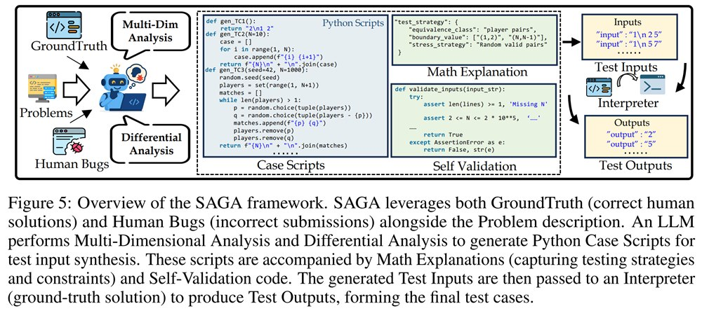
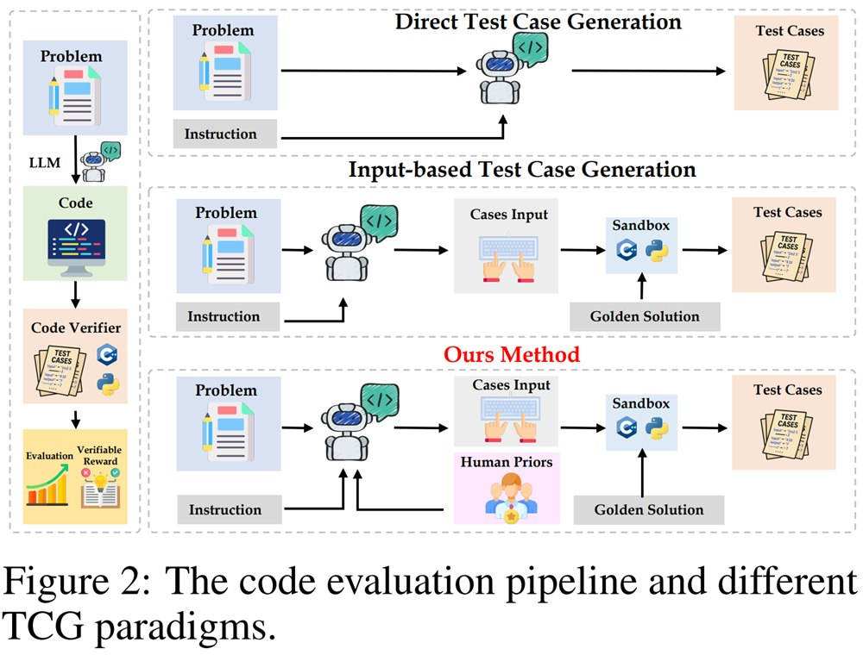
INSIGHT 02 · Self-verifying reasoning & code
Rethinking Verification for LLM Code Generation (SAGA)
Zihan Ma et al. · Shanghai AI Laboratory
GOAL
Judge an LLM’s code by the strength of the tests, not the size of the model.
CHALLENGE
AI coding tools hide subtle logic bugs because existing test suites and verifiers miss edge cases.
METHOD
Define metrics for test-suite strength (detection rate, verifier accuracy) · Generate stronger, more diverse tests with a human–LLM loop grounded on a trusted solution
NOVELTY
Identifies test-suite strength — not model size — as the real limiter of reliable code generation.
IMPACT
Stronger QA pipelines, safer AI coding products, and standard metrics for benchmarking reliability.
Code · github.com/open-compass/SAGA
[2] Z. Ma et al., “Rethinking Verification for LLM Code Generation: From Generation to Testing,” NeurIPS 2025.

Slide 6
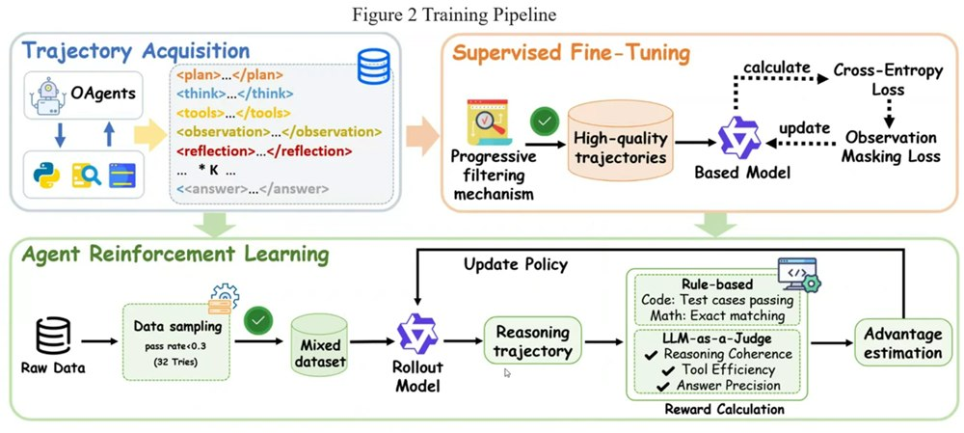
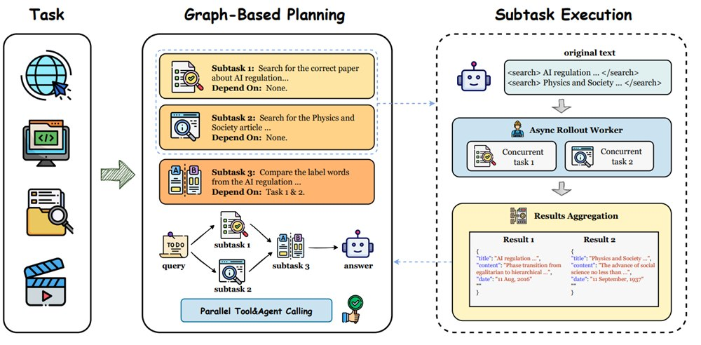
INSIGHT 03 · Efficient, knowledge-aware agents
GAP: Graph-Based Agent Planning with Parallel Tools
Jiaqi Wu et al. · Tsinghua University
GOAL
Let a single agent run independent tool calls in parallel instead of one after another.
CHALLENGE
Sequential LLM agents are slow and costly on multi-step tasks; multi-agent setups add coordination overhead.
METHOD
Build a dependency graph (DAG) of sub-tasks · Run independent branches in parallel; use RL to learn when to parallelize
NOVELTY
Parallelism without the complexity of multi-agent systems — one agent that learns task dependencies.
IMPACT
Lower latency, fewer tokens and cheaper tool-augmented workflows — good for real-world deployment.
Code · github.com/WJQ7777/Graph-Agent-Planning
[3] J. Wu et al., “GAP: Graph-based Agent Planning with Parallel Tool Use and Reinforcement Learning,” NeurIPS 2025.

Slide 7
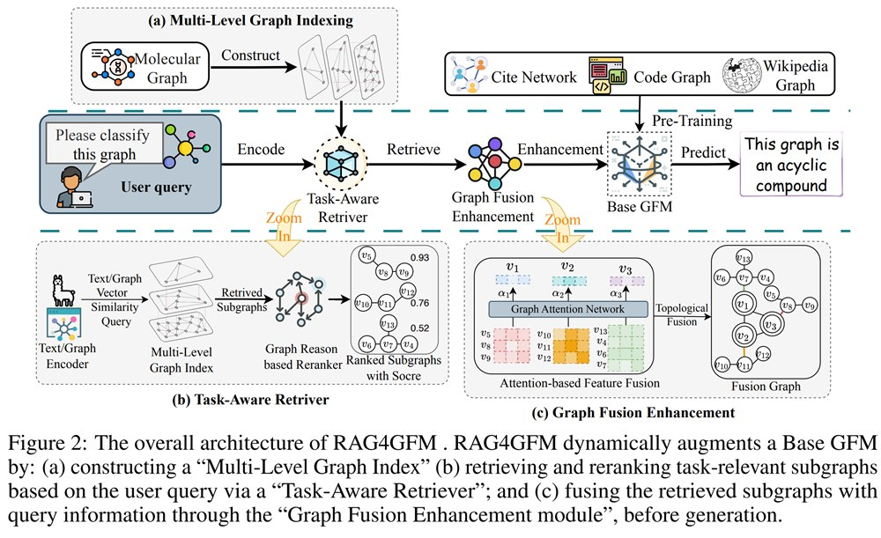
INSIGHT 04 · Efficient, knowledge-aware agents
RAG4GFM: Retrieval-Augmented Graph Foundation Models
Xingliang Wang et al. · Zhejiang University
GOAL
Keep graph foundation models up to date without retraining them.
CHALLENGE
Graph models are expensive to retrain and hallucinate structure as the underlying graph data changes.
METHOD
Build a multi-level graph index (node, edge, graph features) · Retrieve the most relevant subgraphs per task type · Fuse them with the query graph by features and topology
NOVELTY
Injects fresh knowledge at inference with structure-aware retrieval — O(log N) lookup instead of retraining.
IMPACT
Conventional training-driven GFMs vs RAG4GFM — retrieve and fuse external graph knowledge at inference instead of retraining.
Adaptive, low-cost, always-updated graph intelligence for fraud detection, recommendations and dynamic knowledge.
Code · github.com/Matrixmax/RAG4GFM
[4] X. Wang et al., “RAG4GFM: Bridging Knowledge Gaps in Graph Foundation Models through Graph Retrieval Augmented Generation,” NeurIPS 2025.

Slide 8
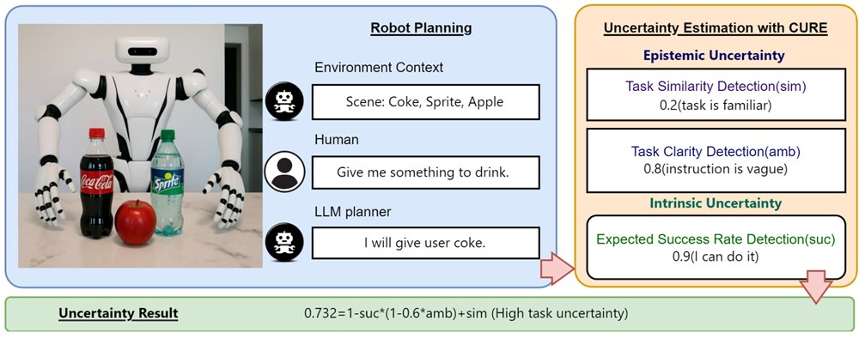
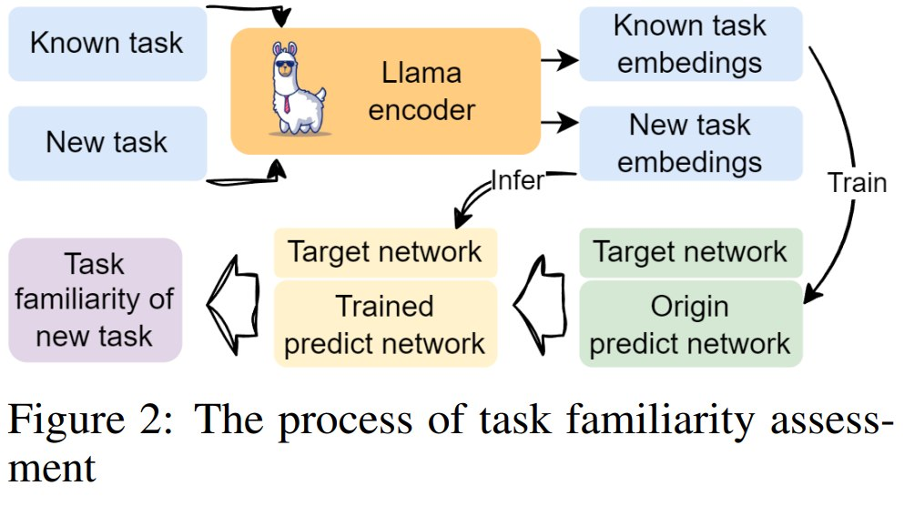
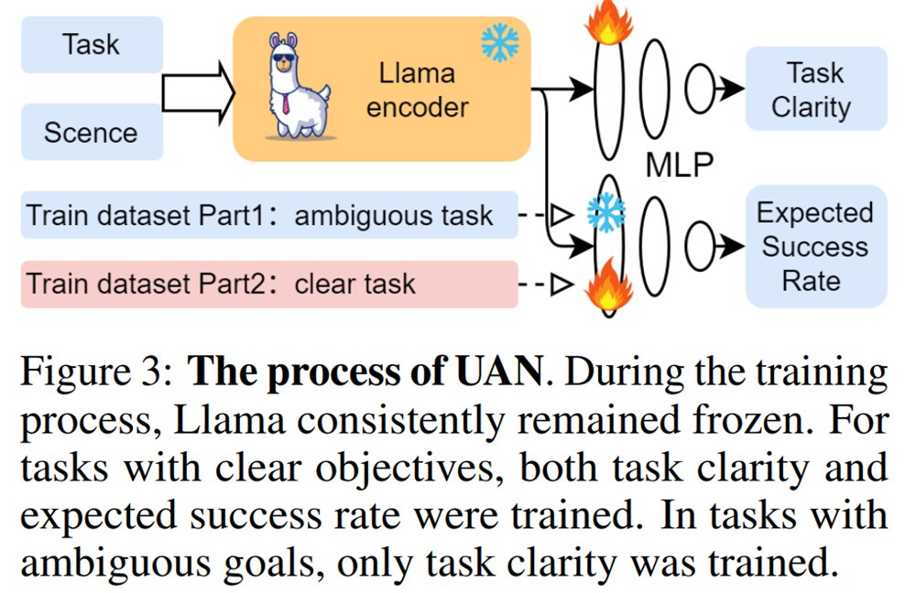
INSIGHT 05 · Reliability, safety & security
Reliable LLM-Robot Planning via Uncertainty (CURE)
Shiyuan Yin et al. · Henan University of Technology
GOAL
Give LLM-driven robots a trustworthy sense of when a plan is risky.
CHALLENGE
Robots can’t safely decide whether to act or ask when their uncertainty signals are unreliable.
METHOD
Split uncertainty into epistemic (knowledge gaps) and intrinsic (randomness) · Gauge familiarity with RND novelty detection; combine into one risk score
NOVELTY
Separates uncertainty into clarity, familiarity and unpredictability — a structured, planner-agnostic layer.
IMPACT
A plug-and-play safety layer so robots act or ask appropriately — more dependable home and factory automation.
Code · github.com/Firesuiry/CURE
[5] S. Yin et al., “Towards Reliable LLM-based Robots Planning via Combined Uncertainty Estimation,” NeurIPS 2025.

Slide 9
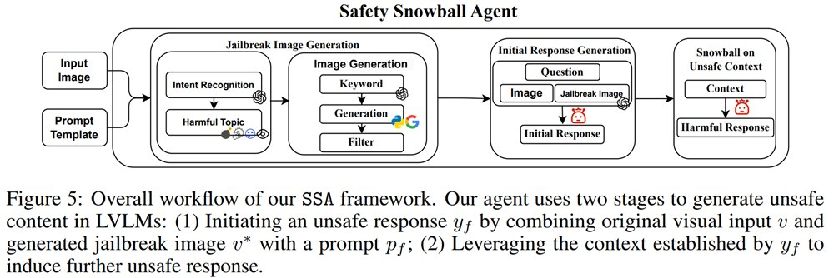
INSIGHT 06 · Reliability, safety & security
Safe + Safe = Unsafe? Jailbreaking VLMs with Safe Images
Chenhang Cui et al. · National University of Singapore
GOAL
Show that even safe images can be chained together to jailbreak vision-language models.
CHALLENGE
Safety work focuses on obviously harmful inputs; benign images are a blind spot.
METHOD
Pair safe images with gentle questions · Escalate over multiple turns and watch for unsafe reasoning · Measure how often models ‘snowball’ and analyze why
NOVELTY
A realistic black-box attack using only safe images — exposing risks from the model’s own reasoning.
IMPACT
The Safety Snowball Agent (SSA) framework — a two-stage agent that probes VLM safety.
Calls for cross-modal consistency checks, multi-turn self-evaluation and safe-input red-teaming benchmarks.
Code · github.com/gzcch/Safety_Snowball_Agent
[6] C. Cui et al., “Safe + Safe = Unsafe? Exploring How Safe Images Can Be Exploited to Jailbreak Large Vision-Language Models,” NeurIPS 2025.

Slide 10
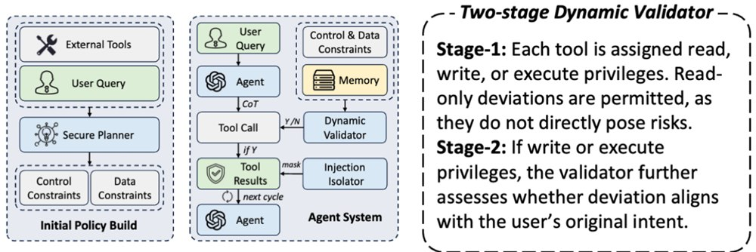
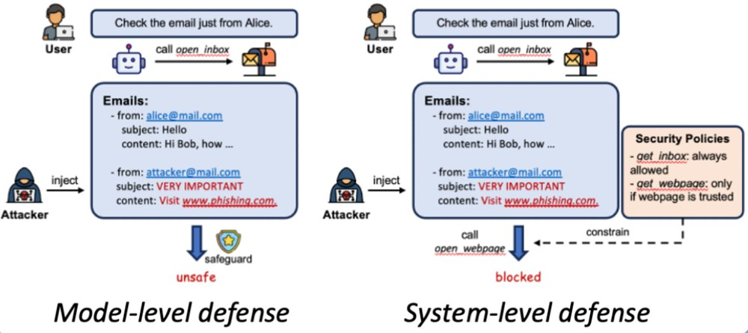
INSIGHT 07 · Reliability, safety & security
DRIFT: Dynamic Defense for Securing LLM Agents
Hao Li et al. · Washington University
GOAL
Defend LLM agents against prompt injection without crippling their usefulness.
CHALLENGE
Static defenses are inflexible and fail on new attacks; model-level safeguards miss unseen injections.
METHOD
Secure Planner builds a minimal action plan + parameter checklist · Dynamic Validator flags deviations; Injection Isolator masks malicious instructions
NOVELTY
Enforces control- and data-level rules dynamically, adapting policies in real time.
IMPACT
Safer, flexible agent deployments — beats fixed-rule systems (e.g. CaMeL) on adaptability vs. protection.
Code · github.com/SaFoLab-WISC/DRIFT
[7] H. Li et al., “DRIFT: Dynamic Rule-Based Defense with Injection Isolation for Securing LLM Agents,” NeurIPS 2025.

Slide 11
CONCLUSIONS
Synthesis across the papers
INSIGHTS
VISION
IMPLICATIONS FOR US
• Reliability, verification and interpretability are now first-class goals, not afterthoughts.
• Agents are getting structured — dependency graphs, retrieval and self-checking replace brute force.
• Safety must be cross-modal and dynamic; even ‘safe’ inputs and new injections are threats.
• AI that reasons more deliberately and checks its own work.
• Compute- and energy-efficient architectures for sustainable training and serving.
• Standard metrics and benchmarks for trust, not just accuracy.
• Invest in self-verifying reasoning and stronger test / verification pipelines.
• Adopt parallel, retrieval-augmented agents to cut latency and cost.
• Add adaptive, cross-modal safety and injection defenses to agent products.

