Slide 1
Tech Insight
Tech Insight Report
HKSTP 2024 — Systems Engineering Workshop
2024 HKSTP Systems Engineering Workshop for Complex Intelligent Systems
Hong Kong Science Park, Hong Kong · May 2024
Location
Hong Kong Science Park, Hong Kong
Date
May 2024
Focus
Dependability & Trustworthiness of Complex Intelligent Systems

Slide 2
CONTENTS
Talks covered, by theme
A · Dependability & reliability modeling
C · Trustworthy & cognitive AI
01
Reliability & Availability Modeling of Complex Systems in Practice
05
From Trustworthy Systems to Trustworthy AI
02
Early Detection of Degraded Systems: Self-Healing with Time Delay
06
Data-centric Quality Assurance for AI & LLM Systems
B · Testing, verification & formal methods
07
System Science & Autonomous AI Systems
03
Combinatorial Testing for Complex Systems
D · Autonomous systems in the real world
04
Trusted AI & Probabilistic Model Checking
08
Ensuring Reliability of Autonomous Vehicular Systems
09
Safe Learning for Autonomous Systems
10
Digital Twins for Complex Systems
11
Artificial Intuition, Research Portfolios & Decision Systems

Slide 3
WORKSHOP AT A GLANCE
2024 HKSTP Systems Engineering Workshop for Complex Intelligent Systems
May 2024
HKSTP
11 talks
Dependable AI
Hong Kong
organizer
deep-dived here
the theme
About: Hosted by Hong Kong Science & Technology Parks (HKSTP), the workshop gathered systems- and software-engineering researchers on making complex intelligent systems dependable and trustworthy.
Classical dependability tools are being combined with data-driven methods (LLMs, RL, Gaussian processes); distribution shift and uncertainty recur across control, testing and LLM talks; and trustworthiness — safety, reliability, fairness, explainability — is treated as the gate for deploying AI.

Slide 4
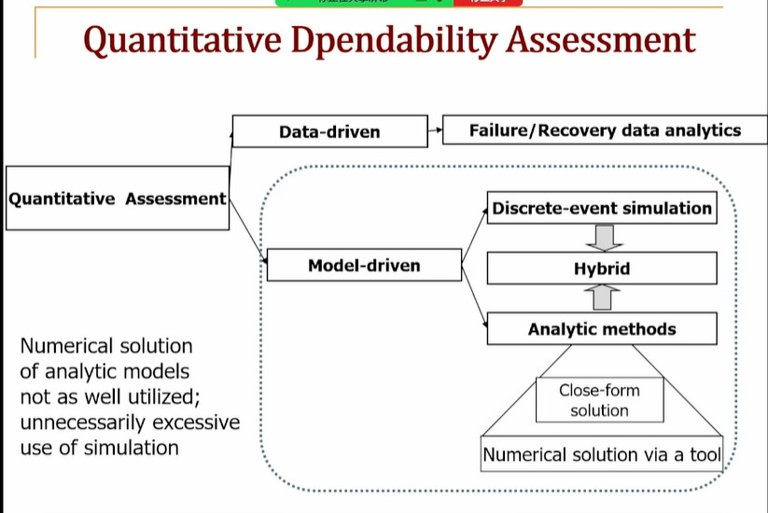
INSIGHT 01 · Dependability & reliability modeling
Reliability & Availability Modeling of Complex Systems in Practice
Dependability modeling · RBD · fault trees · Markov chains
DEPENDABILITY FUNDAMENTALS
• Dependability = justified reliance on the delivered service; a taxonomy of Attributes (availability, reliability, safety, maintainability), Means and Threats
• The causal chain Fault → Error → Failure
• Four means: fault prevention, removal (debugging), tolerance (redundancy), forecasting
QUANTITATIVE ASSESSMENT
• Data-driven vs model-driven paths; discrete-event vs analytic simulation; prefer a numerical solution over simulation when feasible
• Complexity dimensions: huge models (100s–1000s of components), user-oriented measures, non-exponential distributions (SMP, MRGP), performability
METHODS & STATE-SPACE EXPLOSION
• Simple methods (RBD, fault trees, reliability graphs) assume independence — fast but miss dependencies (shared repair, spares, imperfect coverage)
• State-space methods (DTMC/CTMC, SMP, phase-type) capture dependency but explode; mitigate via hierarchical composition or fixed-point iteration
CASE STUDY — IBM HA SIP
Quantitative dependability assessment — data-driven and model-driven paths to a numerical reliability solution.
• A high-availability SIP system on IBM BladeCenter + WebSphere for a telco customer
• Quantify steady-state availability and a user-oriented DPM (defects-per-million) metric
[1] “Reliability and Availability Modeling of Complex Systems in Practice,” HKSTP Systems Engineering Workshop, 2024.

Slide 5
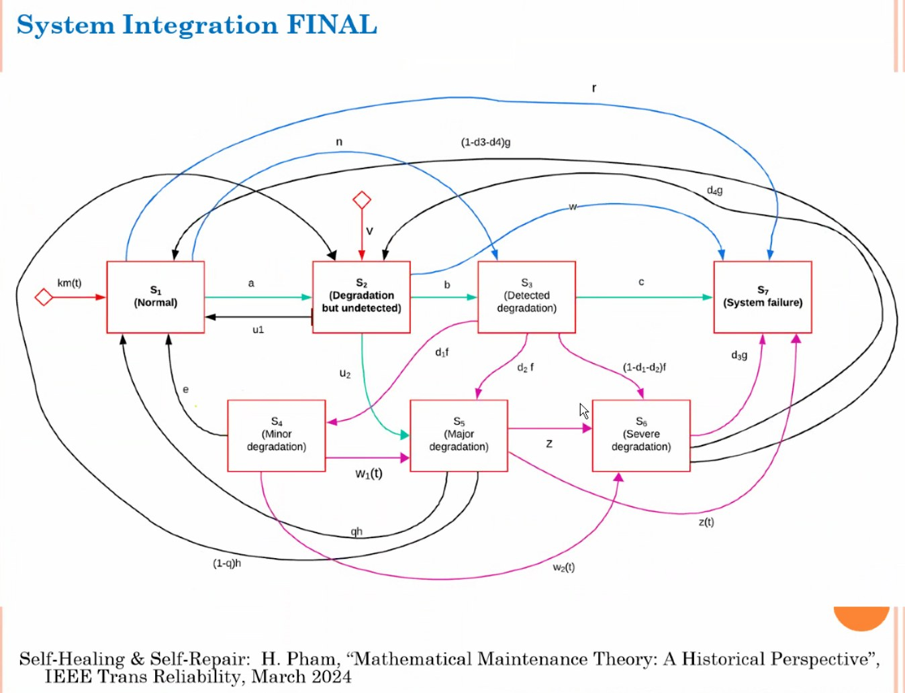
INSIGHT 02 · Dependability & reliability modeling
Early Detection of Degraded Systems: Self-Healing with Time Delay
Hoang Pham · Rutgers University
WHY DEGRADATION MATTERS
• Many systems degrade rather than fail outright; the danger is a degraded-but-undetected state revealed only after a random delay
• Scale: a 10,000-machine data center sees ~1,000 crashes/day; ~4% of machines hit undetected errors (Google)
RELIABILITY MODEL WITH DELAY
• Reliability R(t) = P1(t) + P2(t): operating normally OR degraded-but-undetected; availability sums the available states
• A self-healing / self-repair state diagram with delayed, dependent transitions (Pham, IEEE Trans. Reliability, 2024)
A BIOLOGICAL ANALOGUE
A self-healing / self-repair state diagram with delayed, dependent degradation and recovery transitions.
• Models Healthy cells (H), Infected cells (I) and Virus (V) with delayed transitions — a self-healing analogy
[2] H. Pham, “Early Detection of Degraded Complex Systems: Self-Healing in Uncertain Situations with Time Delay,” HKSTP SE Workshop, 2024.

Slide 6
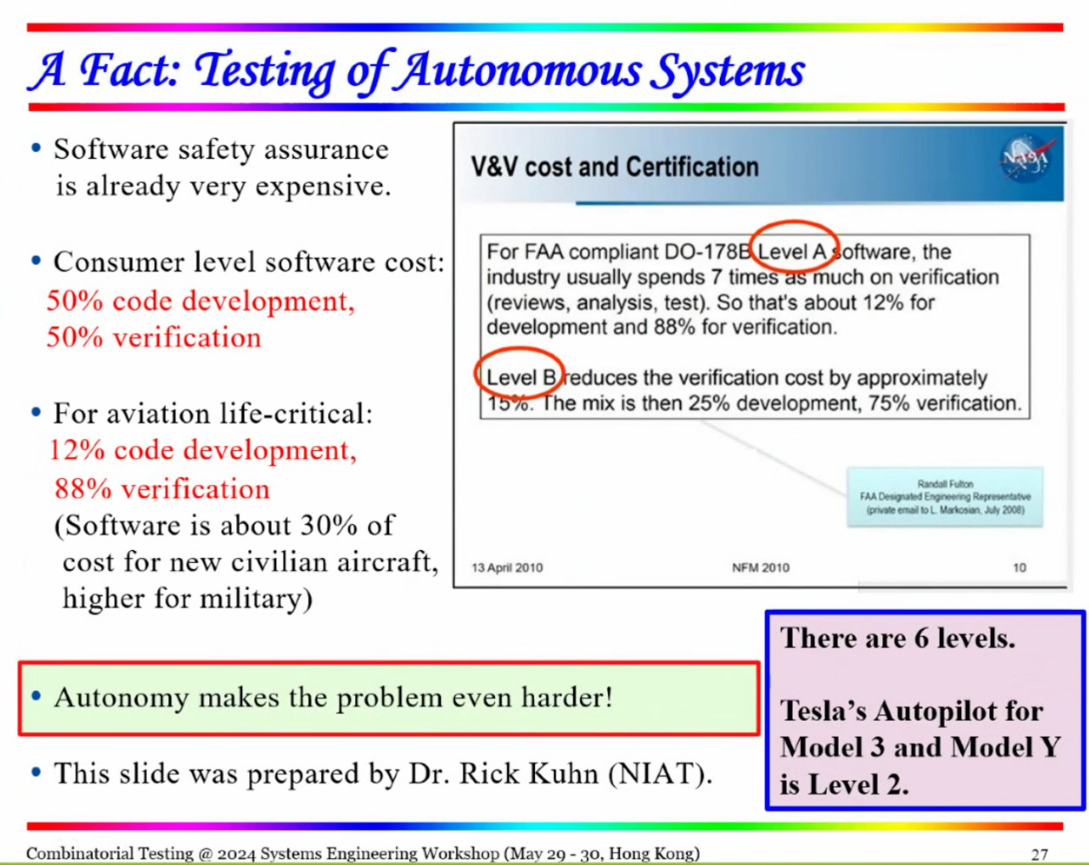
INSIGHT 03 · Testing, verification & formal methods
Combinatorial Testing for Complex Systems
W. Eric Wong · University of Texas at Dallas
METHOD: CT + RBD + BVA
• Security attributes differ from reliability (vulnerability vs probability of failure-free operation)
• Combine Combinatorial Testing with Reliability-Block-Diagram structure and Boundary Value Analysis to generate efficient test cases
RESULTS
• Across packages, combinatorial coverage finds more — and different — bugs with fewer test cases than exhaustive runs
• Claimed ~50% less development and ~90% less maintenance effort for autonomous-system assurance
DEPENDS ON THE INPUT MODEL
• Effectiveness hinges on input-space model quality: number of parameters, values per parameter, cases generated, bugs detected
• AV example: primary vs backup sensors, emergency braking, ‘abnormal sensor’ cases, sun glare, and expansion paths
Combinatorial-testing bug-detection results — fewer test cases catching more (and different) bugs.
[3] W. E. Wong, “Combinatorial Testing for Complex Systems: Functional and Non-Functional Perspectives,” HKSTP SE Workshop, 2024.

Slide 7
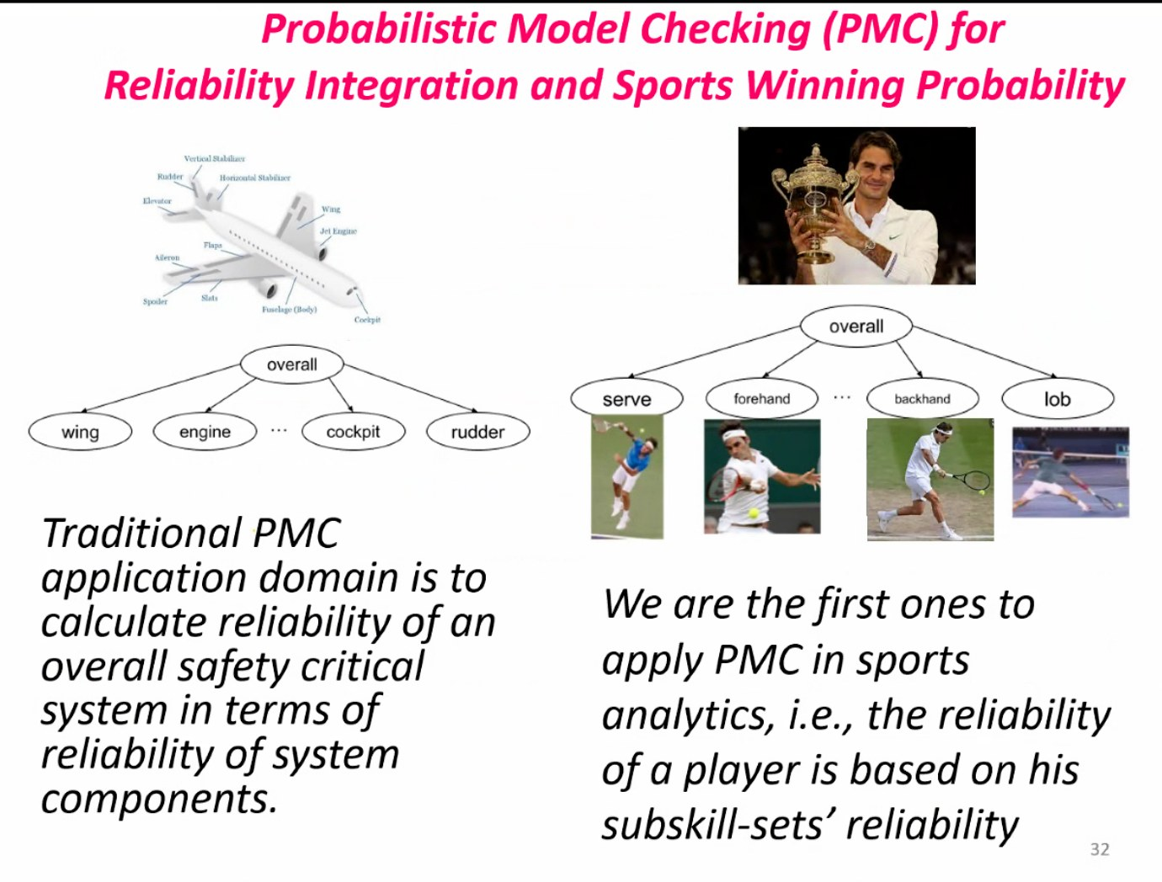
INSIGHT 04 · Testing, verification & formal methods
Trusted AI & Probabilistic Model Checking
Jin-Song Dong · National University of Singapore
AI FAILURES → FORMAL METHODS
• AI has big wins but costly, unexplained failures (Knight Capital, Microsoft Tay, Tesla/Amazon incidents)
• Model checking works: 2007 ACM Turing Award; Microsoft SLAM finds Windows driver bugs; the PAT toolkit has 400k+ downloads
PROBABILISTIC MODEL CHECKING
• PMC computes system reliability from component reliability; here applied to sports-winning probability
• ‘Tennis strategy is an MDP’ (ICDCS 2015): compute winning probability and the optimal strategy
LLMS IN THE LOOP
An LLM / GPT-4 sports-analytics pipeline: video statistics → extraction → model → winning probability & strategy.
• A GPT-4 sports-analytics pipeline: video statistics → vision-language extraction → model processor → outcome prediction and strategy
[4] J.-S. Dong, “Trusted AI and Beyond: ChatGPT Reasoning with Sport Analytics Application,” HKSTP SE Workshop, 2024.

Slide 8
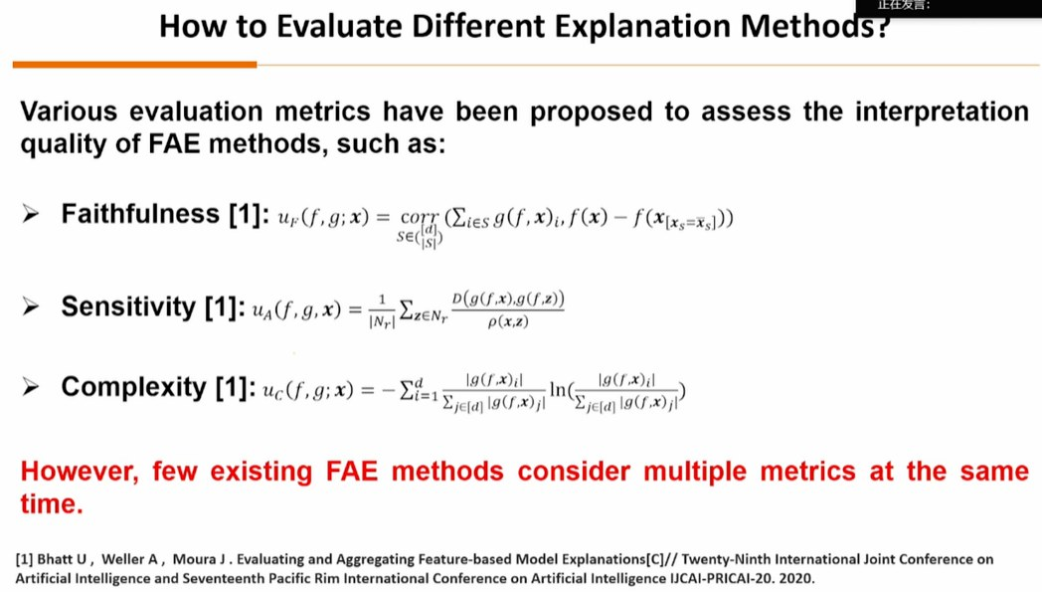
INSIGHT 05 · Trustworthy & cognitive AI
From Trustworthy Systems to Trustworthy AI
Xin Yao · trustworthy & evolutionary AI
TRUST & REQUIREMENTS
• Trust and trustworthiness are asymmetrically bidirectional, context-dependent and learnable
• Six attributes of trustworthy systems: resilience, security, privacy, safety, reliability, availability
TRUSTWORTHY & FAIR AI
• AI ethics is hierarchical (individual / society / environment); map each principle to a technique — transparency→explainable AI, fairness→fair AI, non-maleficence→safe/robust AI, privacy→federated/differential learning
• 20+ fairness metrics in five families; feature-attribution explanations judged by faithfulness, sensitivity and complexity
AN EVOLUTIONARY APPROACH
• A multi-objective evolutionary method (MOFAE) optimizes explanations across metrics; evolutionary constrained learning regulates ML behavior
• Evolutionary computation is a promising engine for fair, explainable and safe AI
AI ethics as a hierarchical, multi-dimensional map from principles to research directions.
[5] X. Yao, “From Trustworthy Systems to Trustworthy Artificial Intelligence,” HKSTP SE Workshop, 2024.

Slide 9
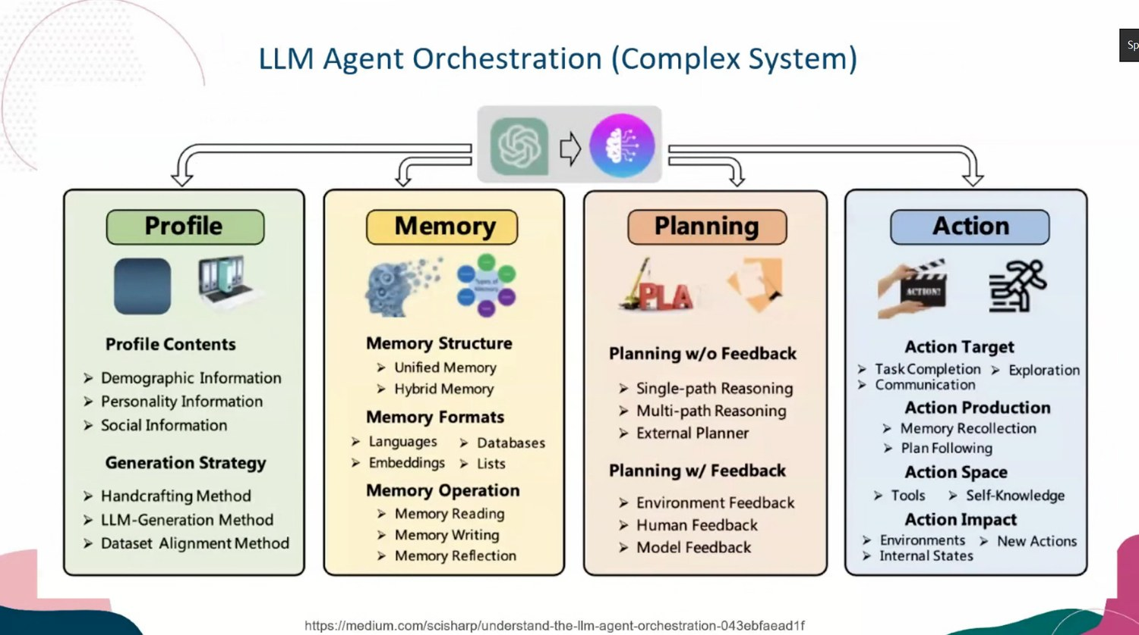
INSIGHT 06 · Trustworthy & cognitive AI
Data-centric Quality Assurance for AI & LLM Systems
Fujitsu / SEI · data-centric AI quality assurance
A NEW AI-SYSTEM PARADIGM
• Modern AI systems combine 30+ AI models and 50+ traditional components (e.g. STT → NLP intent → response generation → TTS); a ‘Universal AI-CPS’ on NVIDIA Omniverse
• ISR-LLM: an iterative self-refined LLM for long-horizon task planning (ICRA 2024)
• Behavior is learned, not specified → explainability is key and new QA methods are needed
THREE CORE DIRECTIONS
• Unit level: quality across the ML lifecycle; DeepGauge test-coverage criteria; data-centric out-of-distribution & uncertainty analysis
• System level: quality assurance and reliability support at integration and system stages
• Human-centered, explainable MLSysOps across data, model, code and system
GENAI / LLM ASSURANCE
• LLM trustworthiness is at a very early stage; internals are hard to test and debug
• Tools: the LUNA model-analysis framework; LLM-agent orchestration decomposed into Profile, Memory, Planning and Action
LLM-agent orchestration as a complex system — Profile, Memory, Planning and Action modules.
[6] “Data-centric Quality Assurance for Trustworthy AI and LLM Systems,” HKSTP SE Workshop, 2024 (Fujitsu / SEI).

Slide 10
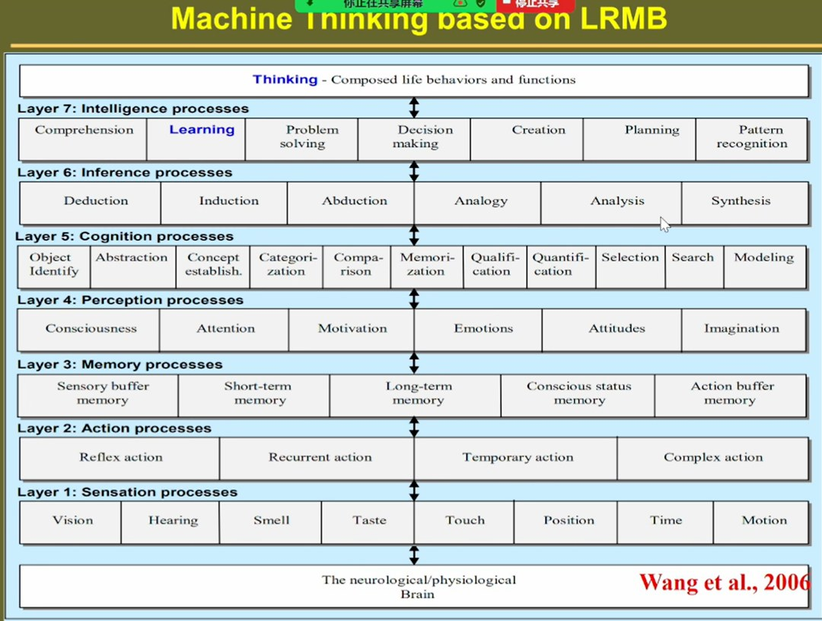
INSIGHT 07 · Trustworthy & cognitive AI
System Science & Autonomous AI Systems
Yingxu Wang · University of Calgary
A HYPERSTRUCTURAL MODEL
• A formal abstract system S ≜ (C, B, Rᶜ, Rᵇ, Rᶠ, Rⁱ, Rᵒ): components, behaviors and internal/external relation sets
• Abstract intelligence transfers information / knowledge into behavior
AUTONOMY CLASSIFICATION
• System autonomy by cognitive × behavioral axes: reflexive, imperative, adaptive, autonomous — autonomous intelligence is the 4th (quaternary) level
• Machine thinking via LRMB (Layered Reference Model of the Brain): sensation, action, perception, memory, cognition, inference, intelligence
TRUSTWORTHINESS OF AUTONOMOUS SYSTEMS
• A tripartite model: structural, behavioral and dynamic trustworthiness
• A formal model links levels of system intelligence by inclusion
The tripartite model of autonomous-system trustworthiness — structural, behavioral, dynamic.
[7] Y. Wang, “System Science and Autonomous AI Systems,” HKSTP SE Workshop, 2024.

Slide 11
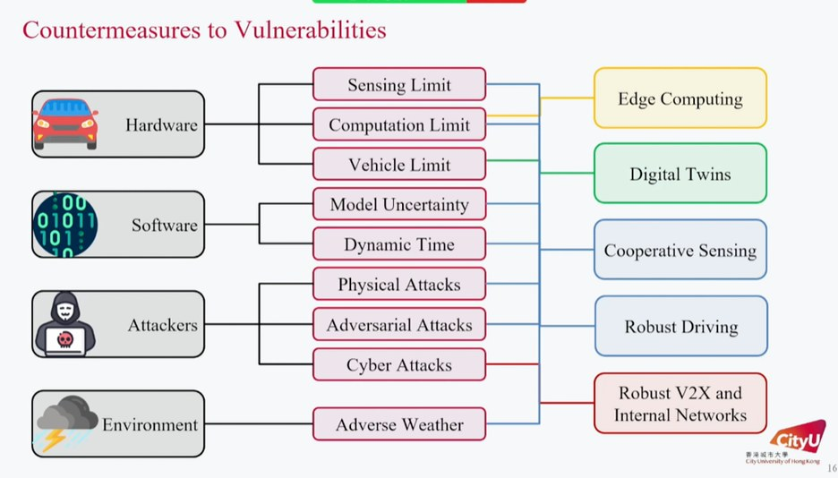
INSIGHT 08 · Autonomous systems in the real world
Ensuring Reliability of Autonomous Vehicular Systems
Jianping Wang · City University of Hong Kong
ARCHITECTURE & VULNERABILITIES
• The AD stack on a driving OS (Apollo 3.5/5.0): perception → localization → prediction → planning → control
• Vulnerabilities: perception-model uncertainty, dynamic per-module compute time, and adverse weather (fog/rain/snow degrade cameras, LiDAR and comms)
COUNTERMEASURES BY LAYER
• Hardware limits → edge computing; software (model uncertainty, timing) → digital twins & cooperative sensing
• Attacks (physical / adversarial / cyber) → robust driving; adverse weather → robust V2X
ROBUST DRIVING & SCHEDULING
• Adversarial-attack-aware motion planning stays safe where naive planning fails; multi-agent prediction + camera/LiDAR/radar fusion handle occlusion
• Onboard scheduling uses an Age-of-Information metric and an RL agent (reward ∝ 1/AoI), improving miss ratio and response vs Apollo baselines
Countermeasures mapped to AV vulnerabilities — edge computing, digital twins, cooperative sensing, robust V2X.
[8] J. Wang, “Ensuring Reliability of Autonomous Vehicular Systems and Beyond,” HKSTP SE Workshop, 2024.

Slide 12
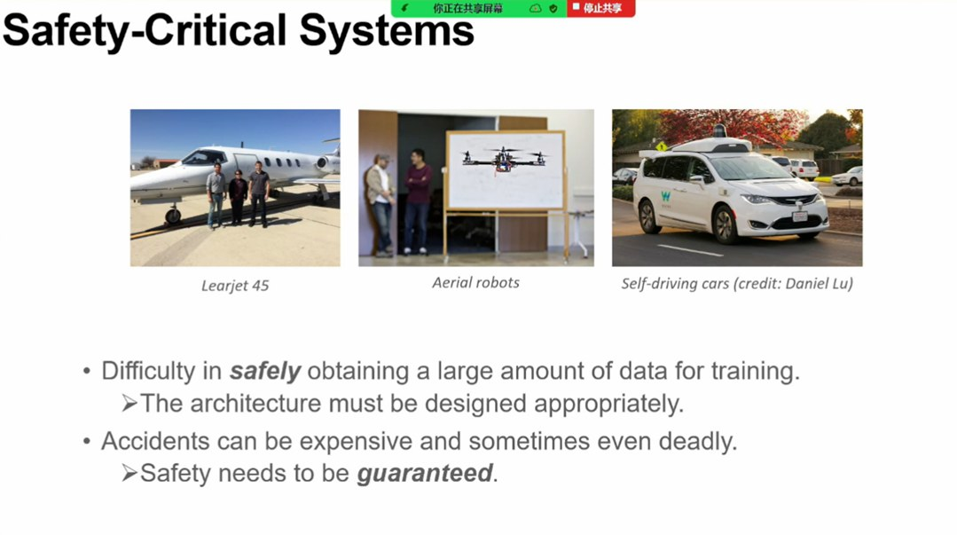
INSIGHT 09 · Autonomous systems in the real world
Safe Learning for Autonomous Systems
Naira Hovakimyan · University of Illinois Urbana-Champaign
CONTROL THEORY VS ML
• Safety-critical systems need guarantees because failures can be deadly; safely obtaining training data is hard
• Control-theoretic tools (structured, deterministic) are strong on safety/robustness; ML tools (general, stochastic) are strong on empirical performance
DISTRIBUTIONAL ROBUSTNESS
• Train-vs-real distribution shift can break the control objective; control the size of the guaranteed set, or be agnostic to the training distribution
• Distributionally robust optimization with finite samples; verified by Monte-Carlo; incremental stochastic stability
L1 ADAPTIVE CONTROL + LEARNING
• L1 adaptive control gives guaranteed uniform performance bounds, decoupling estimation from control (small-gain + Lyapunov)
• Commercialized with NASA, Caterpillar and JOUAV; extended via contraction metrics, L1-MPC, and contraction-L1 with Gaussian-process learning
Control-theoretic tools (safety & robustness) versus data-driven ML tools (empirical performance).
[9] N. Hovakimyan, “Safe Learning for Autonomous Systems,” HKSTP SE Workshop, 2024.

Slide 13
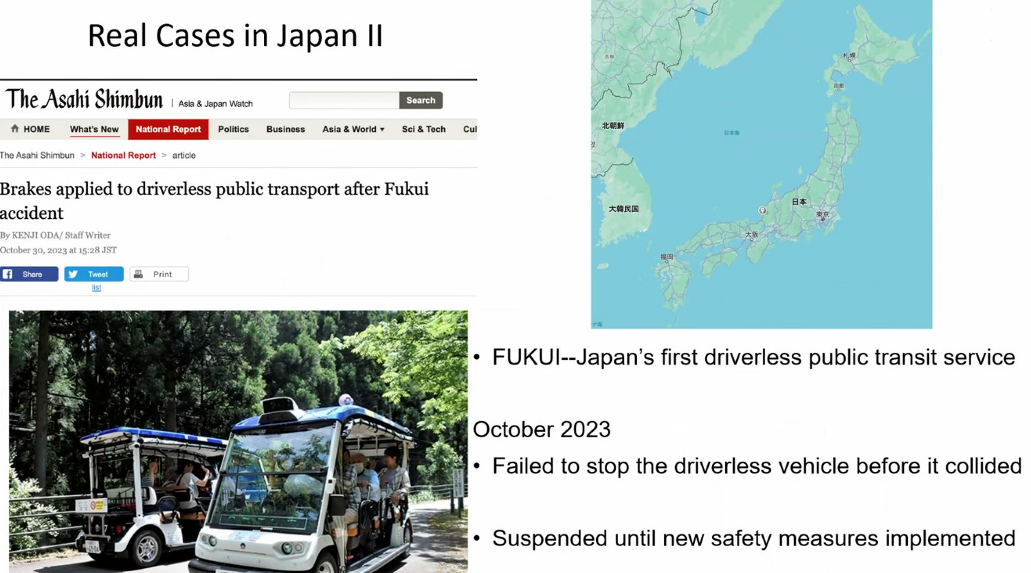
INSIGHT 10 · Autonomous systems in the real world
Digital Twins for Complex Systems
Ajith Parlikad · University of Cambridge
WHAT A DIGITAL TWIN IS
• An integrated multi-physics, multi-scale, probabilistic simulation updated by sensors (NASA 2012); a digital replica that improves decision-making (CDBB 2018)
• A twin should see, learn, think, act, communicate, cooperate and achieve
COLLABORATIVE TWINS
• Connected assets help each other ‘in times of trouble’ via shared information / computation — faster, coordinated recovery
• Spans robotics, AI, V2X, perception and blockchain across cyber-physical and cyber-cyber systems
REAL CASES
Collaborative digital twins helping each other recover ‘in times of trouble’.
• Japan’s FUKUI self-driving public transit; an Oct 2023 incident where an AV failed to stop and collided, triggering new safety measures
[10] A. Parlikad, “Digital Twins for Complex Systems,” HKSTP SE Workshop, 2024.

Slide 14
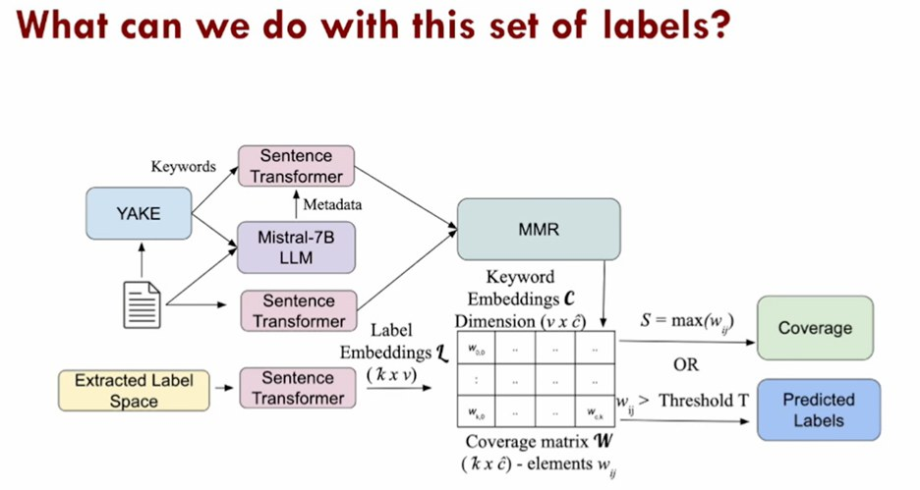
INSIGHT 11 · Autonomous systems in the real world
Artificial Intuition, Research Portfolios & Decision Systems
Andrea Belz · research-portfolio analytics
FIND THE TECH BEFORE INVESTING
• An NLP pipeline compiles and augments abstracts, clusters research portfolios, then evaluates clusters and removes redundancy
• Pipeline: documents → YAKE keywords → Mistral-7B metadata → Sentence-Transformer embeddings → labeled clusters (optics, flight system, remote sensing…)
CHOOSING THE NUMBER OF CLUSTERS
• Too few clusters = poor coverage; too many = overlap
• A new redundancy measure R = max cosine similarity between label vectors, plotted vs the number of clusters to pick the knee
USING THE LABELS
An NLP portfolio pipeline — YAKE + Mistral-7B + Sentence-Transformer → clustering → coverage labels.
• A k×ĉ coverage matrix yields coverage scores / predicted labels when similarity exceeds a threshold (MMR)
[11] A. Belz, “Artificial Intuition, Research Portfolios and Decision Systems,” HKSTP SE Workshop, 2024.

Slide 15
CONCLUSIONS
Synthesis across the workshop
TRENDS
VISION
IMPLICATIONS FOR US
• Classical dependability tools (RBD, fault trees, Markov chains, combinatorial testing, probabilistic model checking) are being combined with data-driven methods — not replaced.
• Distribution shift and uncertainty quantification recur across the control, testing and LLM talks.
• Autonomous driving is the shared case study grounding abstract reliability and safety methods.
• Trustworthiness — resilience, security, privacy, safety, reliability, availability, fairness, explainability — is the gate for deploying AI.
• Self-aware, cooperative systems: self-healing degradation, cognitive autonomy models, and collaborative digital twins.
• Formal and guaranteed methods (L1 control, model checking) scaled to data-driven systems.
• Treat explainability and formal / guaranteed methods as prerequisites, not add-ons (L1 guarantees, PAT/SLAM, DeepGauge, LUNA).
• Govern the ML lifecycle with data-centric quality assurance and out-of-distribution analysis.
• GenAI / LLM assurance is immature — the biggest open frontier is testing agentic systems whose behavior is learned, not specified.

