Slide 1
Tech Insight
Tech Insight Report
IEEE SysCon 2024 — Systems Engineering Insights
18th Annual IEEE International Systems Conference (SysCon 2024)
Montréal, Québec, Canada · April 15–18, 2024
Location
Montréal, Québec, Canada
Dates
April 15–18, 2024
Focus
Innovations across Autonomous Systems, AI, Digital Twins & MBSE

Slide 2
CONTENTS
Papers covered, by theme
A · Autonomous navigation & SLAM
C · Prediction, AI & neuromorphic
01
Optimized UAV Localization & Autonomous Navigation for Tightly Closed Industrial Spaces
10
Vehicle Trajectory Prediction with Deep Learning for ADAS & AVs
02
AUV Kalman-Filter Trajectory Estimation from Acoustic + Inertial Sensors
11
Deep RL Agents for Decision Making in Cooperative Gameplay
03
3D EKF-SLAM Using Cylindrical & Planar Features with Multilevel Mapping
12
3D Convolutional Spiking Neural Network for Human Action Recognition
B · Autonomous planning, routing & safety
D · Digital twins & MBSE
04
Constant-Time-Delay Leader Following for Wheeled Robots (Uncertainty-Tuned MPC)
13
Trainee Perspectives on VR Environments with Haptic Feedback
05
Graph Neural Network for Dynamic Emergency-Vehicle Routing
14
Next-Generation Digital-Twin Robotic Frameworks for Cyber-Human-Physical Contexts
06
Optimal Path Generation & Real-time Scheduling for Autonomous Mobile Platforms
15
Model-Driven Cloud-Based Healthcare App Using Colored Petri Nets
07
On-Demand Triple Modular Redundancy for Automotive Applications
16
Towards Automating MBSE in Industry — An Experience Report
08
Safeguarding Autonomous UAV Navigation with Evolving Behavior Trees
17
MBSE for eVTOL Development in Air-Ambulance Service
09
Autonomous Vehicle Development as a System of Systems

Slide 3
CONFERENCE STATISTICS
18th Annual IEEE International Systems Conference (SysCon 2024)
300
160
15
600
submitted
accepted
countries
reviews
Also: The 18th Annual IEEE International Systems Conference, Delta Hotels Montreal. 300 submissions, 160 accepted across 18 topic areas; this report covers 17 papers.
Autonomous systems dominate — localization / SLAM, routing, redundancy and safety, and trajectory prediction — alongside energy-efficient AI (spiking networks), digital twins for cyber-human-physical systems, and MBSE from Colored Petri Nets to eVTOL air ambulances.

Slide 4
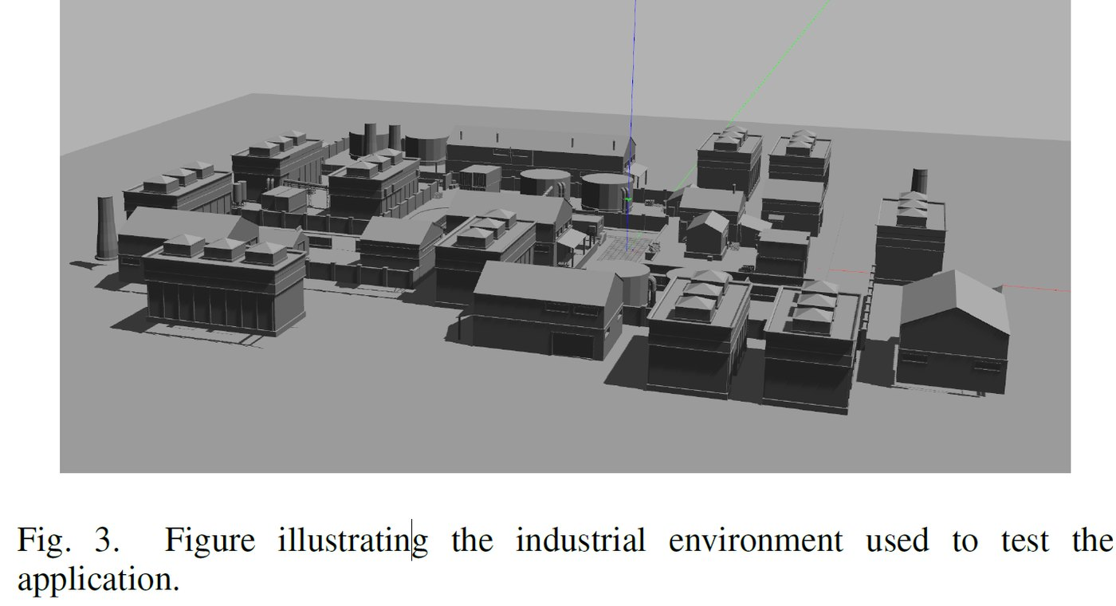
INSIGHT 01 · Autonomous navigation & SLAM
Optimized UAV Localization & Autonomous Navigation for Tightly Closed Industrial Spaces
Robin Havås et al. · University of Agder, Norway
GOAL
• Build a UAV navigation stack for precise localization and cost-effective autonomy in GPS-denied industrial spaces.
CHALLENGE
• Industrial inspection/surveillance needs navigation without GPS, using affordable off-the-shelf components.
METHOD
• Integrate SLAM with obstacle detection / avoidance and real-time performance
• Use off-the-shelf sensors, edge devices and UAV control
• Test in ROS + Gazebo with an IRIS 3DR drone across environments
NOVELTY
• A cost-effective, off-the-shelf navigation stack tuned for GPS-denied industrial inspection.
IMPACT
UAV navigation stack tested in ROS / Gazebo for GPS-denied industrial localization.
• Enables automated inspection in Industry-4.0 settings without costly infrastructure.
[1] R. Havås et al., “Optimized UAV Localization and Autonomous Navigation Stack for Tightly Closed Industrial Spaces,” IEEE SysCon 2024.

Slide 5
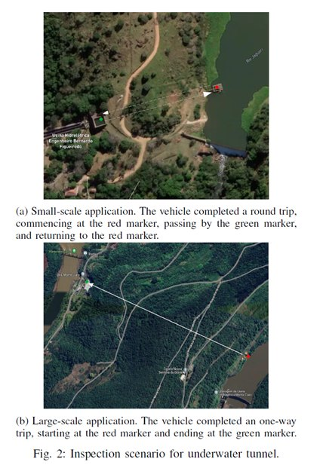
INSIGHT 02 · Autonomous navigation & SLAM
AUV Kalman-Filter Trajectory Estimation from Acoustic + Inertial Sensors
Juan de França Silva et al. · Instituto Tecnológico de Aeronáutica, Brazil
GOAL
• Estimate AUV trajectories accurately in confined underwater spaces such as tunnels.
CHALLENGE
• Acoustic positioning fails in confined spaces due to reflections and scattering, so AUVs rely on internal sensors.
METHOD
• Fuse DVL, IMU, magnetometer and depth sensor with a Kalman Filter
• Validate in confined tunnels and autonomous dam inspections
• Compare against GPS-RTK and dead-reckoning trajectories
NOVELTY
• A KF sensor fusion that significantly beats dead reckoning for confined-space AUVs.
IMPACT
Kalman-filter fusion of DVL, IMU and depth for confined-space AUV trajectory estimation.
• Reliable underwater inspection (dams, tunnels) where acoustic / GPS positioning is unavailable.
[2] J. de França Silva et al., “AUV Kalman Filter-Based Trajectory Estimation Using Acoustic and Inertial Sensors,” IEEE SysCon 2024.

Slide 6
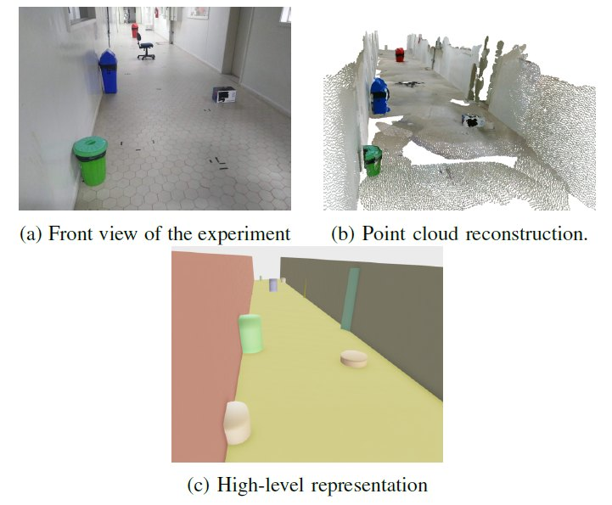
INSIGHT 03 · Autonomous navigation & SLAM
3D EKF-SLAM Using Cylindrical & Planar Features with Multilevel Mapping
Leonardo Mariga et al. · Aeronautics Institute of Technology, Brazil
GOAL
• Build accurate 3D maps for mobile robots using geometric features.
CHALLENGE
• 3D SLAM must robustly extract and match features for localization in real environments.
METHOD
• RGBD camera; RANSAC for planes and DBSCAN for cylinders within an EKF
• Hessian-normal-form planes + centroid-radius cylinders; Mahalanobis matching
• Simulate in ROS / Gazebo; real tests with the Omni robot
NOVELTY
• Combines planar and cylindrical features with multilevel mapping in EKF-SLAM.
IMPACT
3D EKF-SLAM extracting planar and cylindrical features for multilevel maps.
• Better structured-environment mapping for domestic, exploration and surveillance robots.
[3] L. Mariga et al., “3D EKF-SLAM Using Cylindrical and Planar Features With Multilevel Mapping Representation,” IEEE SysCon 2024.

Slide 7
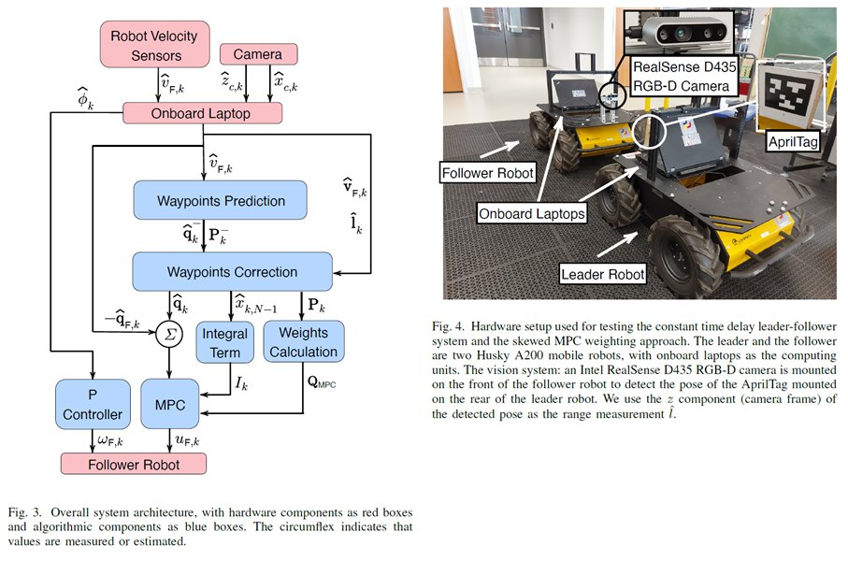
INSIGHT 04 · Autonomous planning, routing & safety
Constant-Time-Delay Leader Following for Wheeled Robots (Uncertainty-Tuned MPC)
Kai Wang et al. · Queen's University, Canada
GOAL
• Let a follower robot trail a leader's path at a fixed time delay (e.g. military convoys).
CHALLENGE
• The follower must reconstruct and track the leader's past trajectory despite uncertainty.
METHOD
• Estimate a sequence of leader waypoints
• Bridge estimator and controller with a model predictive controller (MPC)
• Tune the MPC for uncertainty in the estimated waypoints
NOVELTY
• An uncertainty-tuned MPC coupling a waypoint estimator to a constant-delay follower.
IMPACT
A constant-time-delay leader–follower with an uncertainty-tuned MPC.
• Validated indoors with acceptable position/velocity error — practical convoying.
[4] K. Wang et al., “Monkey See, Monkey Do: Constant Time Delay Leader Following for Wheeled Mobile Robots using Uncertainty-Tuned MPC,” IEEE SysCon 2024.

Slide 8
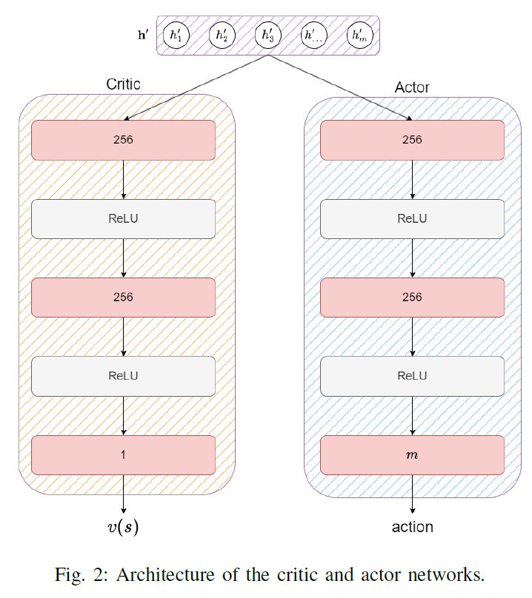
INSIGHT 05 · Autonomous planning, routing & safety
Graph Neural Network for Dynamic Emergency-Vehicle Routing
Jean-Alexis Delamer et al. · St. Francis Xavier University, Canada
GOAL
• Reduce emergency-vehicle response time to traffic accidents.
CHALLENGE
• Routing must adapt dynamically to changing accident and traffic conditions.
METHOD
• Deep RL with PPO and a graph attention network
• Model as a Dynamic Travelling Repairman Problem (an MDP)
• Use probabilistic accident models from Toronto / Halifax open data
NOVELTY
• An MDP + graph-attention formulation of dynamic emergency-vehicle routing.
IMPACT
Graph-attention deep-RL routing of emergency vehicles on a city road network.
• Faster emergency response — directly life-saving.
[5] J.-A. Delamer et al., “Graph Neural Network to Solve the Dynamic Emergency Vehicles Routing Problems,” IEEE SysCon 2024.

Slide 9
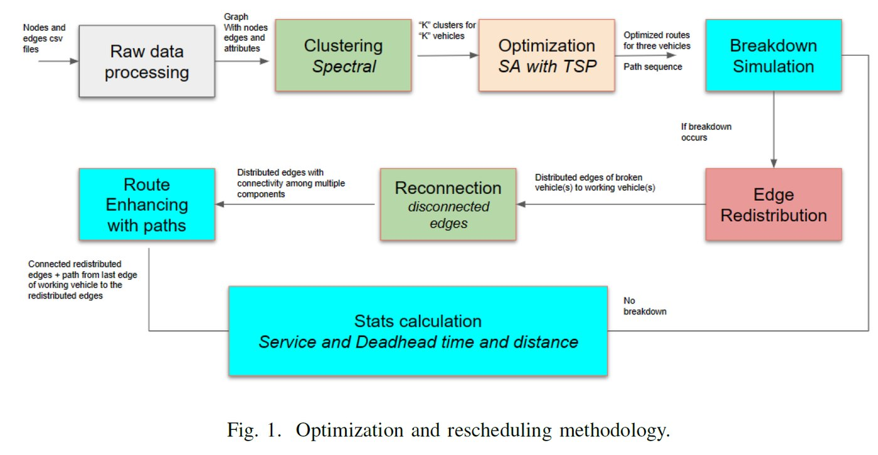
INSIGHT 06 · Autonomous planning, routing & safety
Optimal Path Generation & Real-time Scheduling for Autonomous Mobile Platforms
Abdullah Rasul et al. · OntarioTech University, Canada
GOAL
• Plan and schedule routes for autonomous sweeping trucks, including breakdown scenarios.
CHALLENGE
• Routes must be re-planned in real time when a vehicle breaks down.
METHOD
• Model as a Capacitated Arc Routing Problem (CARP)
• Cluster-first / optimize-second: spectral clustering + TSP with simulated annealing
• Real-time breakdown handling via Kernighan-Lin bisection and Dijkstra reconnection
NOVELTY
• Combines CARP, clustering and real-time edge redistribution for resilient routing.
IMPACT
Capacitated arc routing with real-time re-scheduling around vehicle breakdowns.
• Seamless autonomous street-sweeping that recovers from breakdowns.
[6] A. Rasul et al., “Optimal Path Generation and Real-time Scheduling for Autonomous Mobile Platforms,” IEEE SysCon 2024.

Slide 10
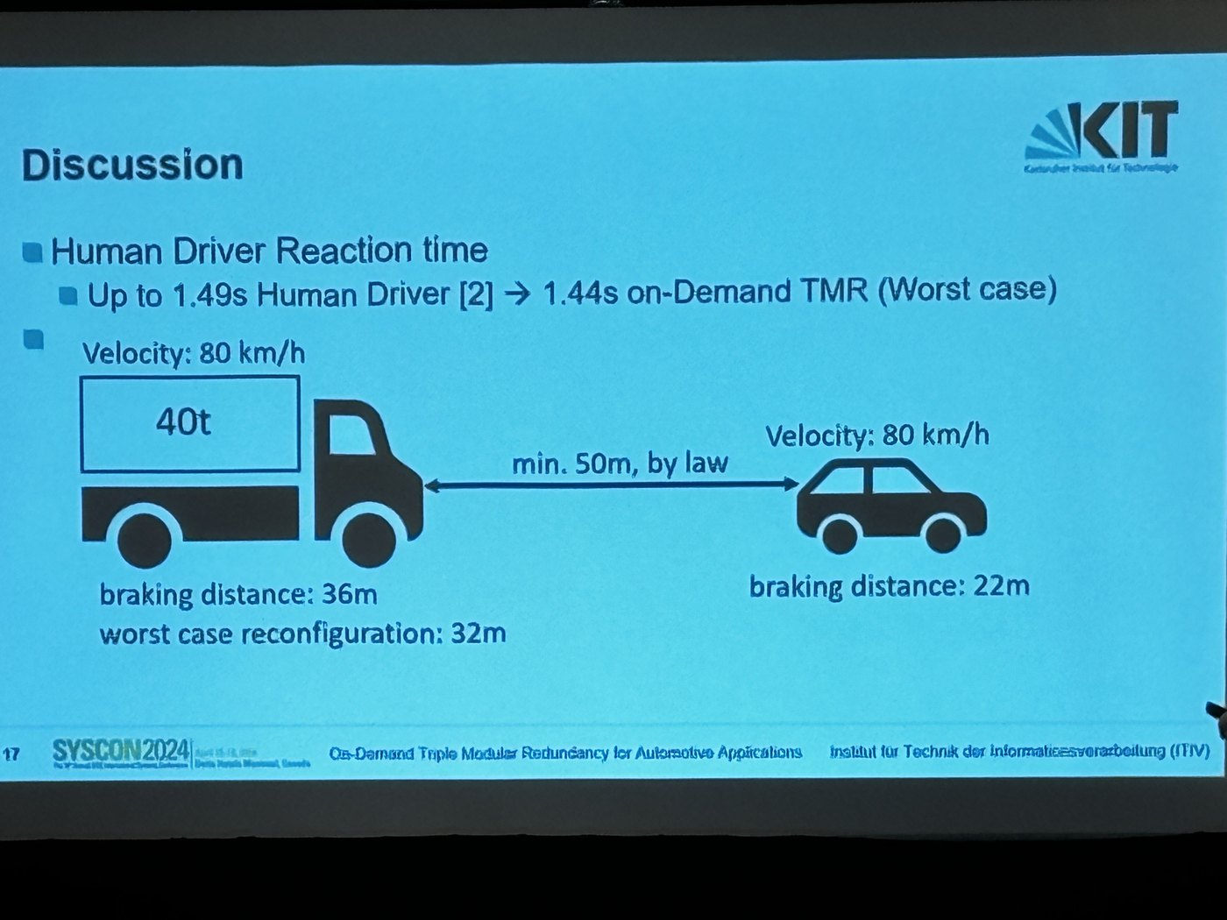
INSIGHT 07 · Autonomous planning, routing & safety
On-Demand Triple Modular Redundancy for Automotive Applications
Martin J. Stoffel et al. · Karlsruhe Institute of Technology, Germany
GOAL
• Achieve fail-operational autonomy without a human fallback.
CHALLENGE
• AVs need high reliability / availability; >500M lines of code and ISO 26262 leave technical redundancy open.
METHOD
• On-demand TMR: redundant apps across multiple ECUs
• Fail-silent architecture on service-oriented ECUs with ROS2 Galactic
• Inspired by avionic redundancy; use-cases from AV sensors and data rates
NOVELTY
• Redundancy applied on-demand to minimize overhead in a fail-operational E/E architecture.
IMPACT
On-demand triple-modular-redundancy across service-oriented automotive ECUs.
• A path to auto-recovery in automated driving without manual takeover.
[7] M. J. Stoffel et al., “On-Demand Triple Modular Redundancy for Automotive Applications,” IEEE SysCon 2024.

Slide 11
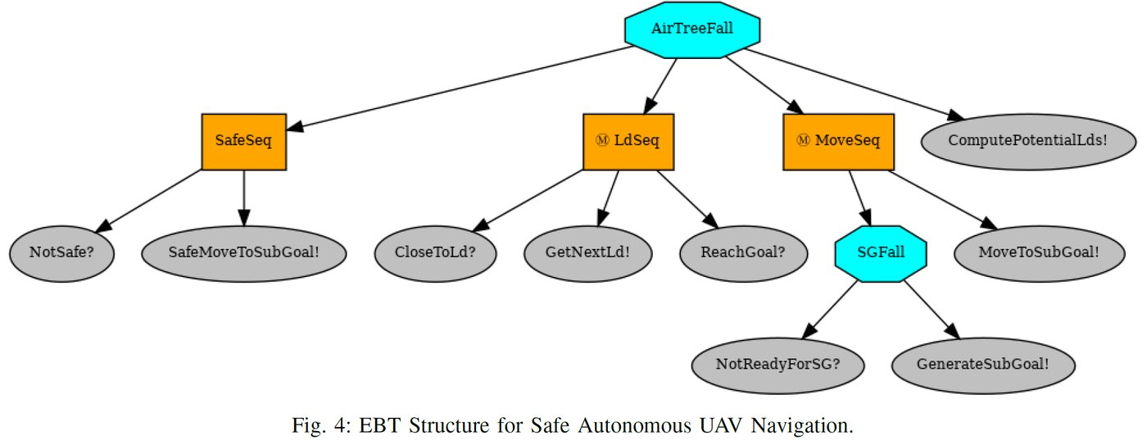
INSIGHT 08 · Autonomous planning, routing & safety
Safeguarding Autonomous UAV Navigation with Evolving Behavior Trees
N. Potteiger & X. Koutsoukos · Vanderbilt University, USA
GOAL
• Ensure safe autonomous UAV navigation in dynamic environments.
CHALLENGE
• Learning-enabled components must handle dynamics while guaranteeing safety.
METHOD
• Evolving Behavior Trees (EBTs) with explicit safety components
• Automated EBT construction via genetic programming
• Optimize learning components with hierarchical RL; safe transfer to new environments
NOVELTY
• Safe-by-design EBTs combining genetic-programming structure search with hierarchical RL.
IMPACT
Evolving behavior trees with explicit safety components for UAV navigation.
• Collision-free UAV missions that transfer to unseen environments.
[8] N. Potteiger & X. Koutsoukos, “Safeguarding Autonomous UAV Navigation: Agent Design using Evolving Behavior Trees,” IEEE SysCon 2024.

Slide 12
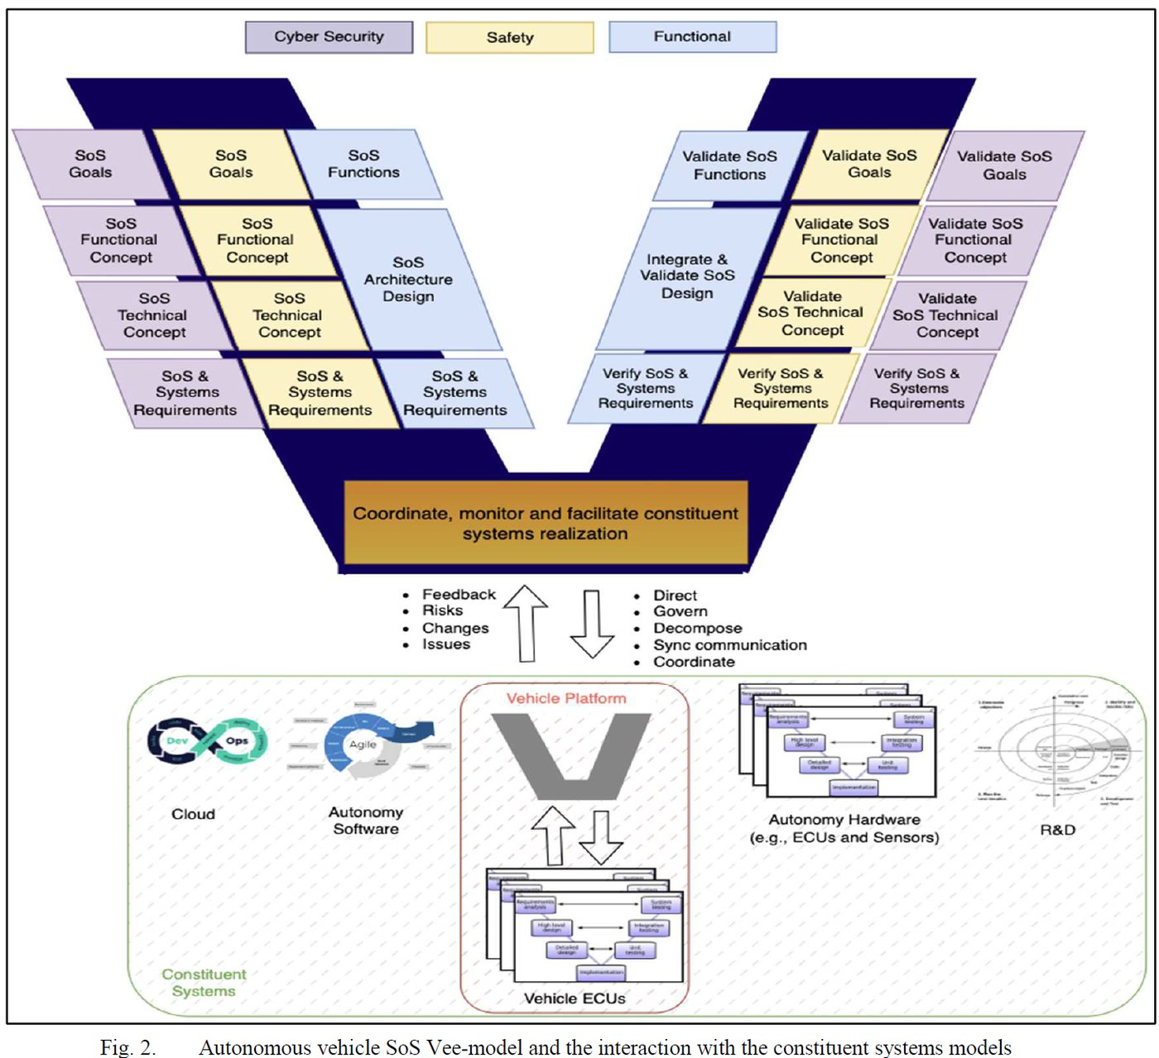
INSIGHT 09 · Autonomous planning, routing & safety
Autonomous Vehicle Development as a System of Systems
A. Elhadeedy & J. Daily · Colorado State University, USA
GOAL
• Coordinate AV development across many vendors as a System of Systems (SoS).
CHALLENGE
• Disparate global vendors cause coordination errors across perception, decision, control and comms.
METHOD
• A tailored SoS model integrating safety + security and feedback loops
• Compare Named Data Networking (NDN) vs SOME/IP for communication
• A queuing model for certificate authentication at scale
NOVELTY
• SoS governance for AV constituent systems, with NDN security advantages at scale.
IMPACT
Autonomous-vehicle development modeled as a System of Systems with NDN communication.
• Fewer integration errors and stronger security in multi-vendor AV programs.
[9] A. Elhadeedy & J. Daily, “Autonomous Vehicle Development as a System of Systems and Constituent Systems Networking,” IEEE SysCon 2024.

Slide 13
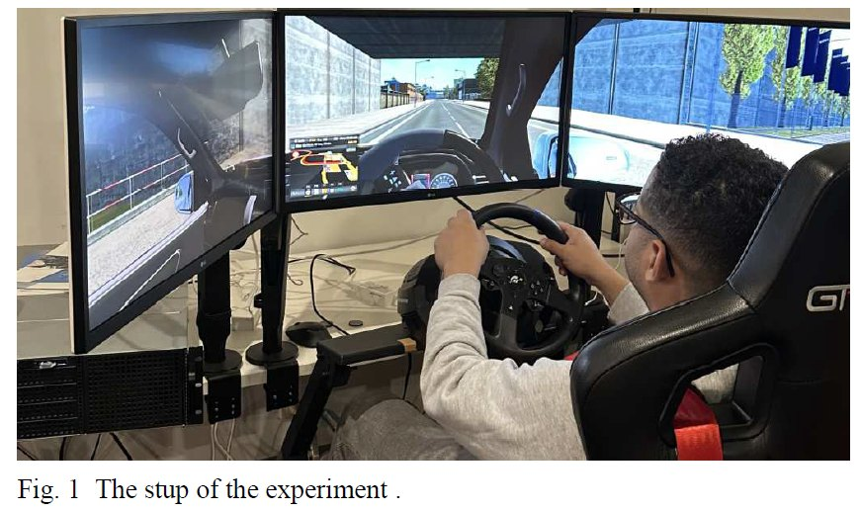
INSIGHT 10 · Prediction, AI & neuromorphic
Vehicle Trajectory Prediction with Deep Learning for ADAS & AVs
Shehab Alsanwy et al. · Deakin University, Australia
GOAL
• Predict vehicle trajectories for collision avoidance and path planning.
CHALLENGE
• Traditional models ignore driver-behavior variability (especially braking), hurting accuracy.
METHOD
• LSTM and GRU networks
• Incorporate driver braking patterns plus vehicle dynamics
• Evaluate with RMSE / MAE
NOVELTY
• Adding braking patterns markedly improves prediction; LSTM beats GRU.
IMPACT
LSTM / GRU trajectory prediction incorporating driver braking patterns.
• More accurate ADAS / AV trajectory prediction and safer driving.
[10] S. Alsanwy et al., “Vehicle Trajectory Prediction Using Deep Learning for ADAS and Autonomous Vehicles,” IEEE SysCon 2024.

Slide 14
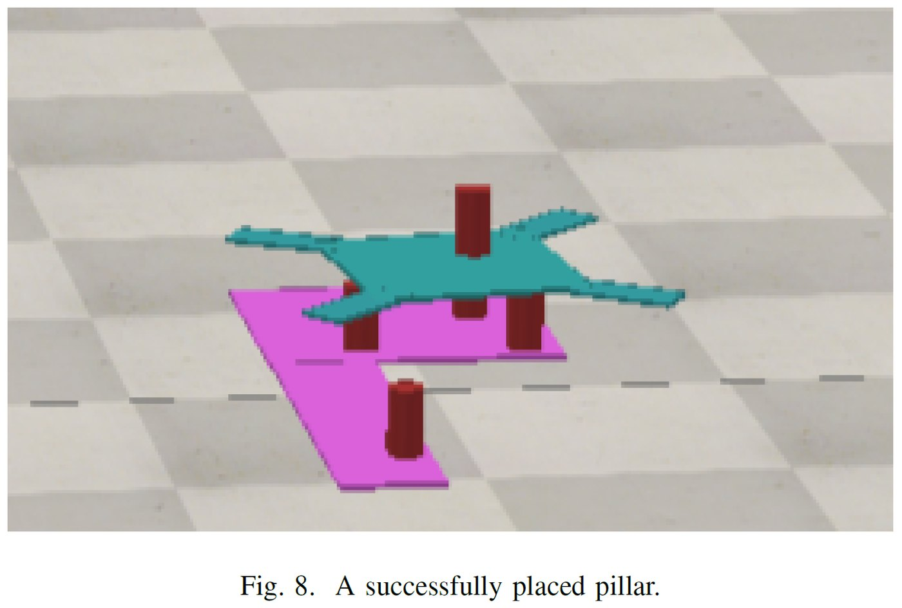
INSIGHT 11 · Prediction, AI & neuromorphic
Deep RL Agents for Decision Making in Cooperative Gameplay
J. Heaton & S. Givigi · Queen's University, Canada
GOAL
• Build cooperative AI agents for the tower-building game Menara, to help children with disabilities.
CHALLENGE
• Agents must make good pillar / tile placement decisions under uncertainty.
METHOD
• RL (Q-learning, deep Q, soft actor-critic) per decision type
• Separate agents for pillar vs tile placement, trained independently
• Simplified tower mechanics for training
NOVELTY
• Decomposed cooperative-game agents trained independently per decision.
IMPACT
Deep-RL agents placing pillars and tiles in the cooperative game Menara.
• Tile agent 62% / pillar agent 88% success — toward assistive cooperative play.
[11] J. Heaton & S. Givigi, “Deep Reinforcement Learning Agents for Decision Making for Gameplay,” IEEE SysCon 2024.

Slide 15
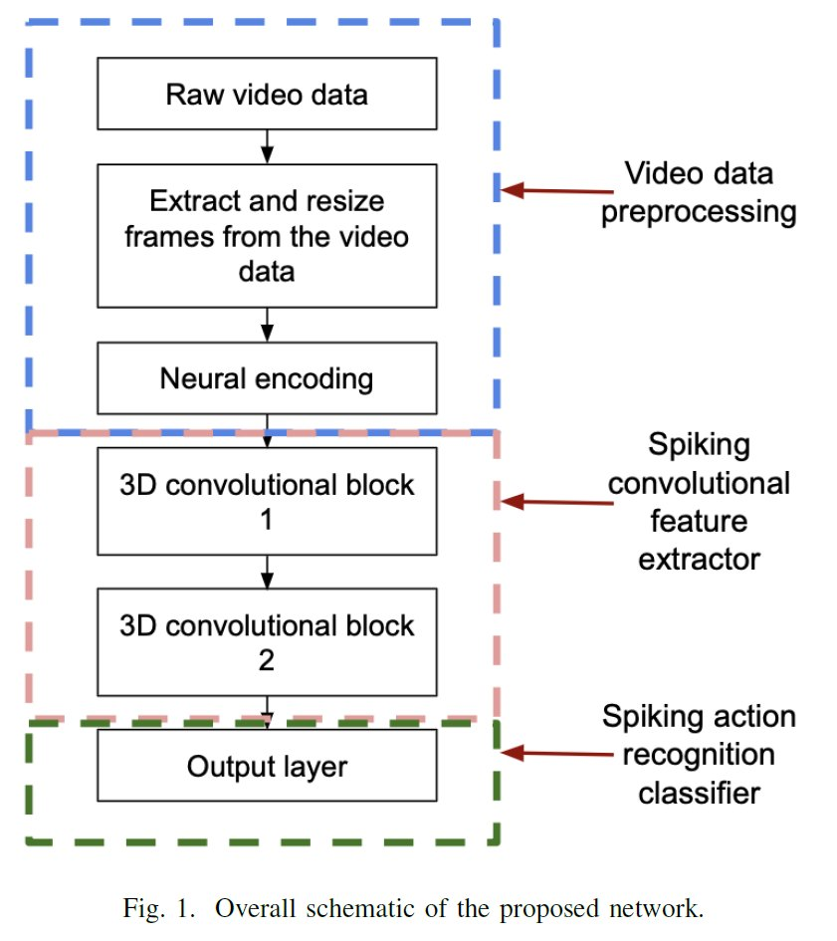
INSIGHT 12 · Prediction, AI & neuromorphic
3D Convolutional Spiking Neural Network for Human Action Recognition
T. Mohottalalage & H. Leung · University of Calgary, Canada
GOAL
• Energy-efficient video action recognition.
CHALLENGE
• 3D CNNs are accurate but memory- and compute-heavy.
METHOD
• A 3D Convolutional Spiking NN with Leaky-Integrate-and-Fire neurons
• Modulating STDP supervised learning via global error feedback
• Two 3D convolutional layers + two spiking layers
NOVELTY
• A supervised-STDP spiking CNN competitive with 3D CNNs at far lower power and memory.
IMPACT
A 3D convolutional spiking neural network with LIF neurons for action recognition.
• Real-time, low-power action recognition for edge video analysis.
[12] T. M. N. B. Mohottalalage & H. Leung, “3D Convolutional Spiking Neural Network for Human Action Recognition Using Modulating STDP With Global Error Feedback,” IEEE SysCon 2024.

Slide 16
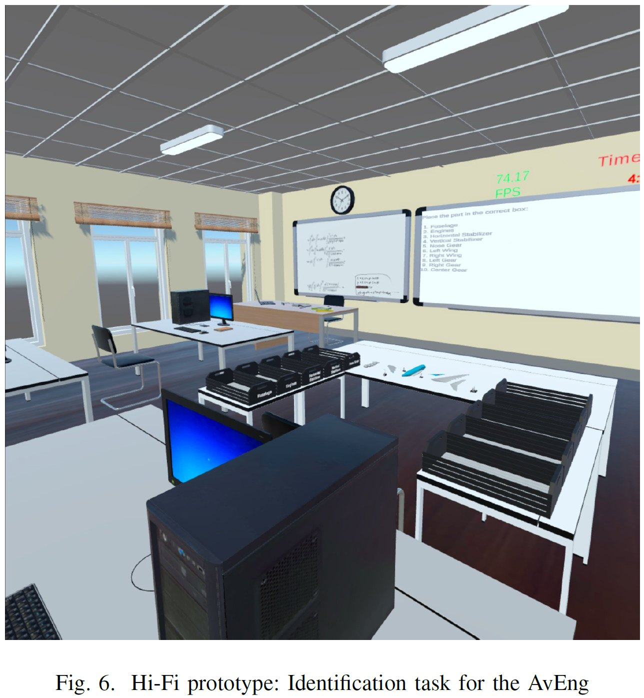
INSIGHT 13 · Digital twins & MBSE
Trainee Perspectives on VR Environments with Haptic Feedback
O. K. Xanthidou et al. · Brunel University London, UK
GOAL
• Evaluate adaptable haptic feedback in single-user VR training environments.
CHALLENGE
• Understand how haptic vibrations affect immersion and learning.
METHOD
• A trainee study in standard classroom settings
• Tasks involving haptic feedback
• Non-probability sampling
NOVELTY
• Trainee-centered evidence that haptic feedback enhances immersive VR training.
IMPACT
Trainee study of haptic feedback in immersive VR training environments.
• Guidance for designing effective VR / haptic education.
[13] O. K. Xanthidou et al., “Investigating Trainee Perspectives on Virtual Reality Environments with Haptic Feedback,” IEEE SysCon 2024.

Slide 17
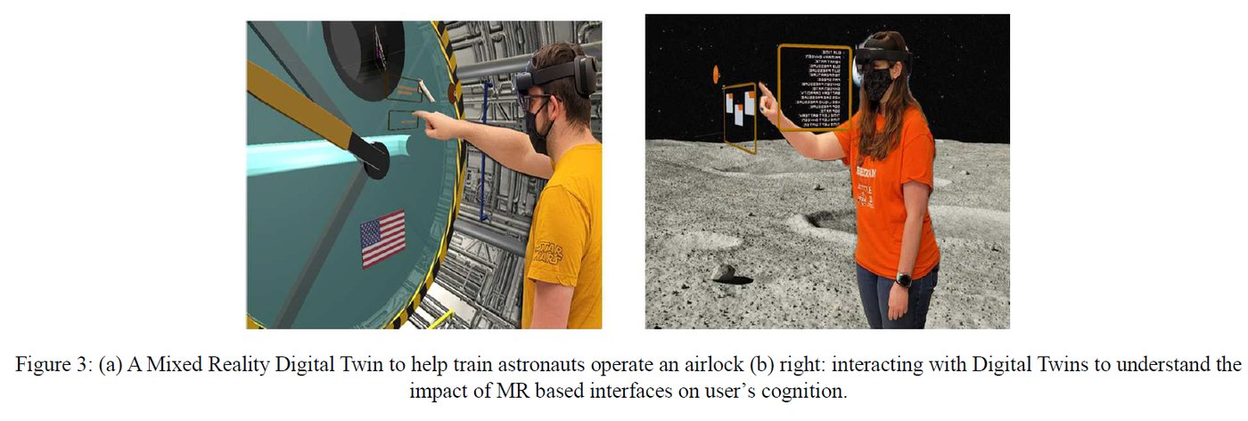
INSIGHT 14 · Digital twins & MBSE
Next-Generation Digital-Twin Robotic Frameworks for Cyber-Human-Physical Contexts
Joe Cecil · Oklahoma State University, USA
GOAL
• Link cyber, human and physical facets with 3D digital twins and VR / MR.
CHALLENGE
• Advanced robots (lunar missions, rehab cobots) need training, layout and immersive analysis.
METHOD
• 3D digital twins for training and layout modification
• Cobot applications with safety / efficiency control
• Support Cyber-Physical Systems and Industry 4.0
NOVELTY
• Next-gen digital-twin frameworks spanning cyber-human-physical robotics.
IMPACT
Digital-twin robotic frameworks linking cyber, human and physical contexts.
• Better cobot support, including automated mobility aids for challenged individuals.
[14] J. Cecil, “Emergence of Next-generation Digital Twin based Robotic Frameworks for Cyber-Human-Physical Contexts,” IEEE SysCon 2024.

Slide 18
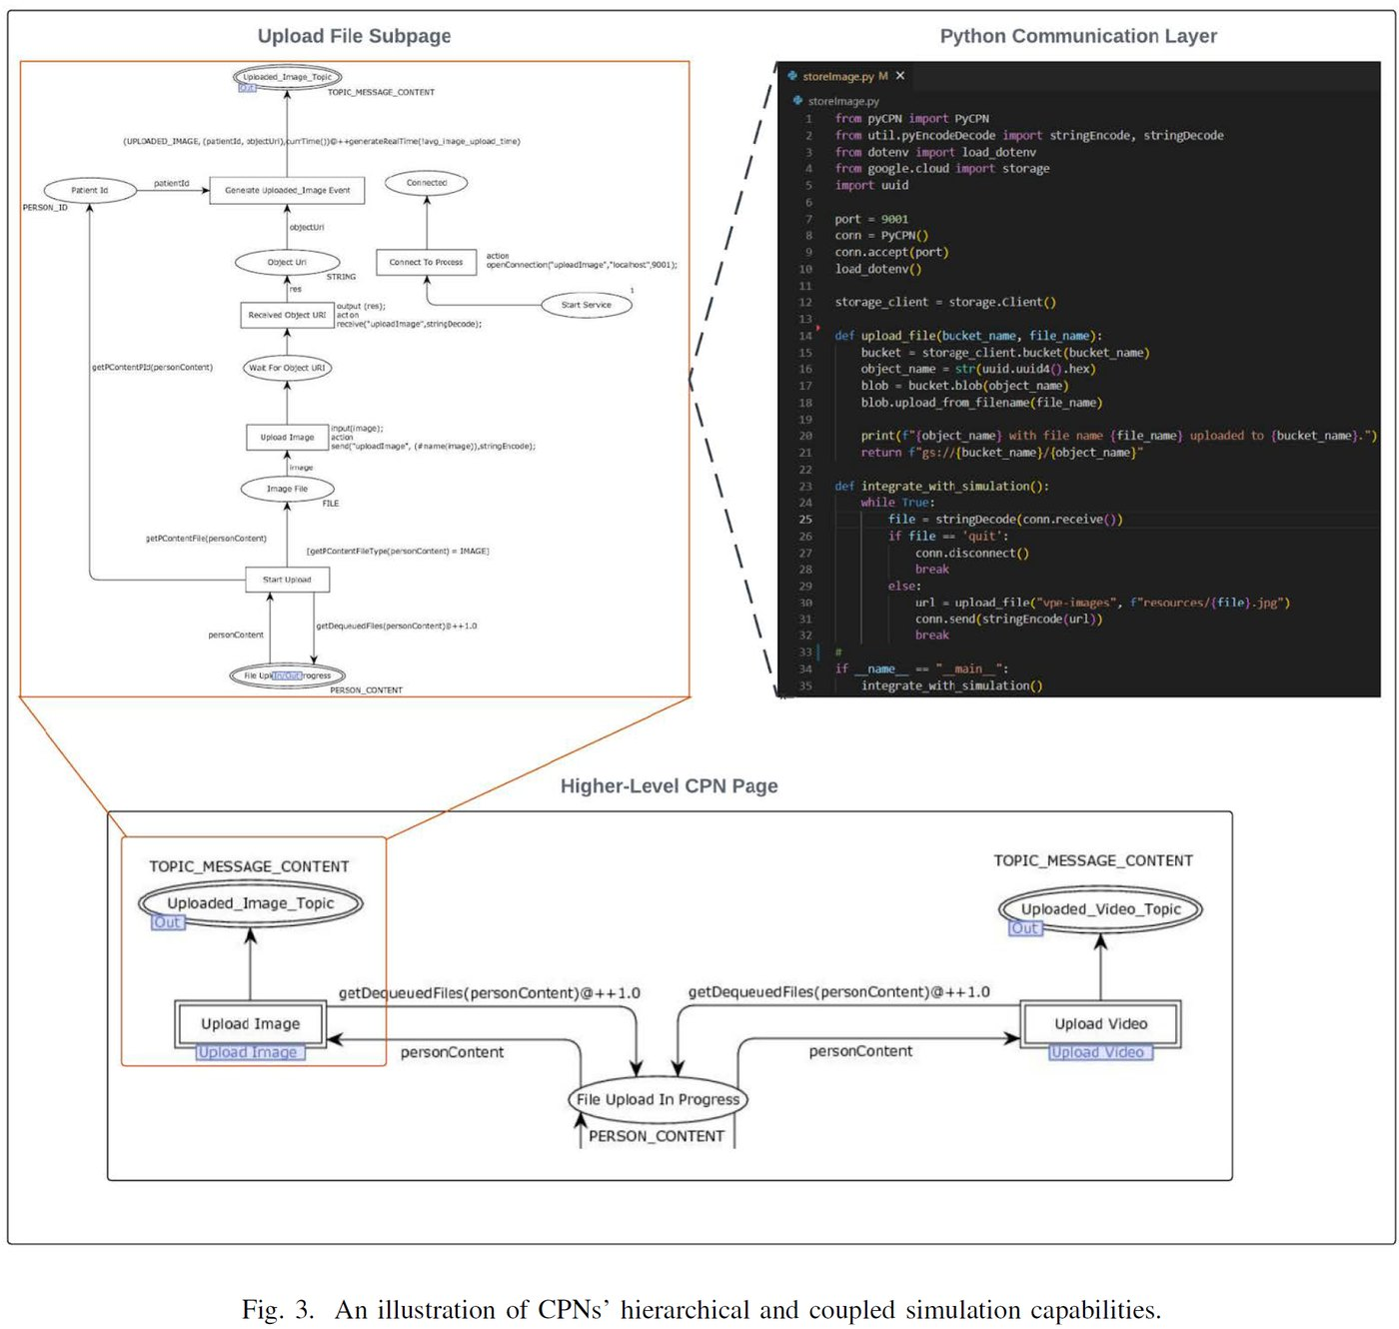
INSIGHT 15 · Digital twins & MBSE
Model-Driven Cloud-Based Healthcare App Using Colored Petri Nets
A. Cagaanan & V. Gehlot · Villanova University, USA
GOAL
• Improve software quality during cloud integration of consumer-oriented apps.
CHALLENGE
• Cloud adoption rushes features, risking security, performance and standards.
METHOD
• A model-driven approach with Colored Petri Nets (CPNs) for design-implementation harmony
• A cloud-based healthcare app for verification and prototyping
• ML integration in the simulations
NOVELTY
• CPN-based model-driven development that bridges design and implementation.
IMPACT
A Colored-Petri-Net model driving a cloud-based healthcare application.
• Higher-quality, adaptable cloud software via up-front formal design.
[15] A. Cagaanan & V. Gehlot, “Model-Driven System Development for a Cloud-Based Healthcare Application Using Colored Petri Nets,” IEEE SysCon 2024.

Slide 19
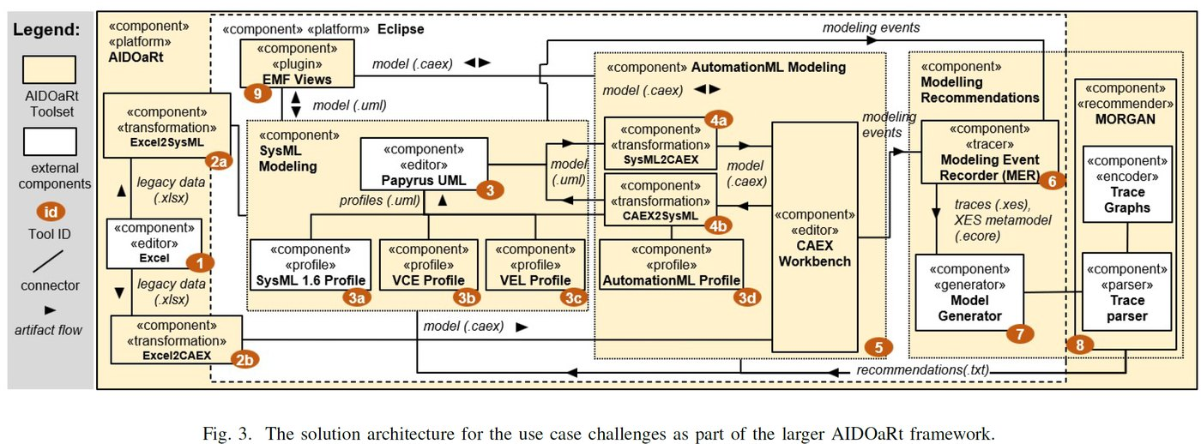
INSIGHT 16 · Digital twins & MBSE
Towards Automating MBSE in Industry — An Experience Report
Johan Cederbladh et al. · Mälardalen University, Sweden (+ EU partners)
GOAL
• Automate Cyber-Physical-System design by combining MBSE, DevOps and AI.
CHALLENGE
• CPS design is hard (heterogeneity, concurrency, timing); plus CAEX interoperability, legacy artifacts and the academia–industry gap.
METHOD
• Prescriptive modeling with model transformations and views
• Modeling-process mining
• AI-based modeling recommendations
NOVELTY
• An industry experience report on automating MBSE end-to-end.
IMPACT
Automating MBSE in industry — prescriptive modeling, transformations and AI recommendations.
• A practical path to adopting automated MBSE in industry.
[16] J. Cederbladh et al., “Towards Automating Model-Based Systems Engineering in Industry — An Experience Report,” IEEE SysCon 2024.

Slide 20
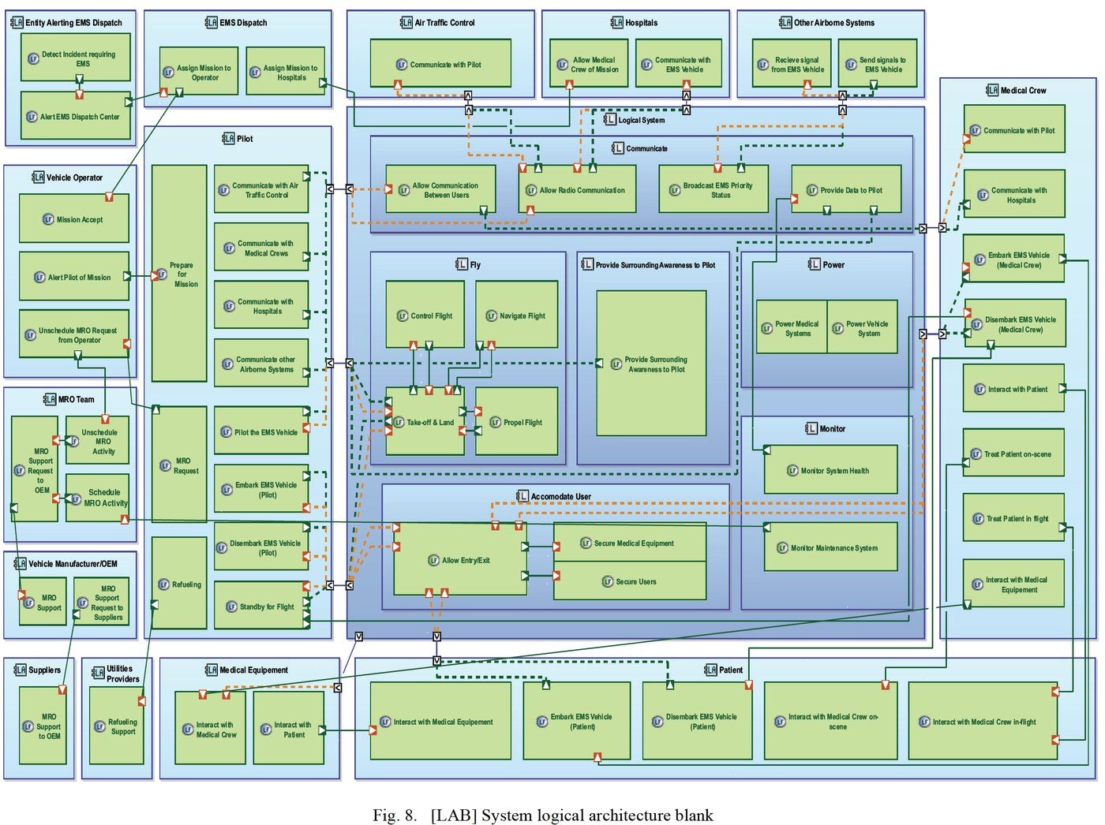
INSIGHT 17 · Digital twins & MBSE
MBSE for eVTOL Development in Air-Ambulance Service
Yue Liu et al. · COMAC, China; ISAE-SUPAERO, France
GOAL
• Apply MBSE to develop an eVTOL air-ambulance for Urban Air Mobility (UAM).
CHALLENGE
• eVTOL EMS development has integration, spatial and payload complexities.
METHOD
• MBSE with UML, Drawio and Capella
• Three phases: conceptual, system and architecture design
• A case study for patient + equipment transport
NOVELTY
• An end-to-end MBSE case study for eVTOL air ambulances.
IMPACT
An MBSE (Capella / UML) workflow for an eVTOL air-ambulance.
• Stakeholder-aligned eVTOL EMS design and lessons for UAM.
[17] Y. Liu et al., “Application of MBSE Approach in eVTOL Development for Air Ambulance Service,” IEEE SysCon 2024.

Slide 21
CONCLUSIONS
Synthesis across the papers
INSIGHTS
VISION
IMPLICATIONS FOR US
• Autonomous systems dominate the program — localization / SLAM, routing, redundancy / safety and trajectory prediction.
• Learning is pervasive but safety-framed: RL, graph networks and behavior trees are paired with redundancy, verification and uncertainty tuning.
• MBSE is maturing from notation to automation — Colored Petri Nets, Capella/UML workflows and AI-assisted modeling.
• Fail-operational autonomy without a human fallback (on-demand redundancy, safe-by-design behavior trees).
• Digital twins linking cyber, human and physical systems for training and control.
• Energy-efficient, neuromorphic AI (spiking networks) for real-time edge perception.
• Treat autonomy as a System of Systems — coordinate multi-vendor constituents with integrated safety and security.
• Adopt model-driven / MBSE practices (CPN, Capella) to raise software quality and shorten CPS design.
• Invest in GPS-denied localization and uncertainty-aware planning for real industrial and emergency use.

