Slide 1
Tech Insight
Tech Insight Report
OpenMind Banff Retreat 2024
OpenMind Research Institute — Banff Research Retreat
Banff Centre, Alberta, Canada · October 18–20, 2024
Location
Banff Centre, Alberta, Canada
Dates
October 18–20, 2024
Focus
Continual Learning — Minds that Learn from a Stream of Experience

Slide 2
CONTENTS
Topics covered, by theme
A · Minds, and why continual learning
C · From batch to streaming
01
OpenMind & the RL-first Bet on Intelligence
07
Batch vs Streaming Learning
02
What Is a Mind? Goal-seeking, Adaptive, Situated
D · Industry relevance
03
Constant vs Continual Learning
08
Where Continual Learning Pays Off
B · Agents in a big world
09
Challenges & Limitations of Continual Learning
04
A Common Architecture for Continual RL Agents
05
A Little Agent in a Big World
06
Efficiency vs Generality: Bias, Compute & the Bitter Lesson

Slide 3
RETREAT AT A GLANCE
OpenMind Research Institute — Banff Research Retreat — Banff Centre, Alberta, Canada
3 days
Banff Centre
OpenMind
9 topics
18–20 Oct 2024
Alberta, Canada
host institute
one talk, deep-dived
About: An invitational retreat of the OpenMind Research Institute — a Canadian non-profit, fully virtual organization whose roadmap is the Alberta Plan for AI Research. This report distills one talk, “Continual Learning,” topic by topic.
The through-line is Sutton's thesis: the biggest AI advances are still ahead, progress is a marathon, and reinforcement learning — not generative AI — is the path to intelligent agents; the main bottleneck is the lack of effective continual-learning algorithms.

Slide 4
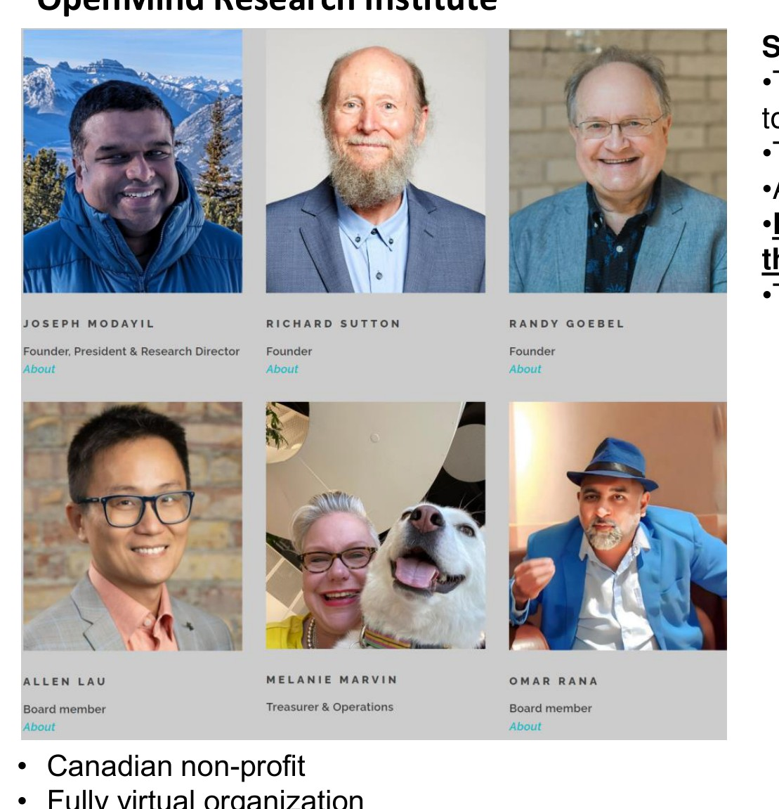
INSIGHT 01 · Minds, and why continual learning
OpenMind & the RL-first Bet on Intelligence
OpenMind Research Institute · Banff Retreat · Sutton's perspective
ABOUT OPENMIND
• Canadian non-profit, fully virtual research institute
• Motto: understand minds well enough to build some — how minds arise from a stream of experience
• Roadmap: the Alberta Plan for AI Research
• Objective: do fundamental research and share it openly with the world
SUTTON'S PERSPECTIVE
• Super-intelligent agents and augmented humans will bring great benefits to the world
• The most significant AI advancements are still ahead of us
• AI development is more of a marathon than a sprint
• Reinforcement learning (RL) — not generative AI — is the key path to developing intelligent agents
• The main challenge is the lack of effective learning algorithms
The OpenMind Research Institute — a virtual, non-profit lab behind the Alberta Plan.
[1] R. Sutton et al., “The Alberta Plan for AI Research,” arXiv:2208.11173, 2022.

Slide 5
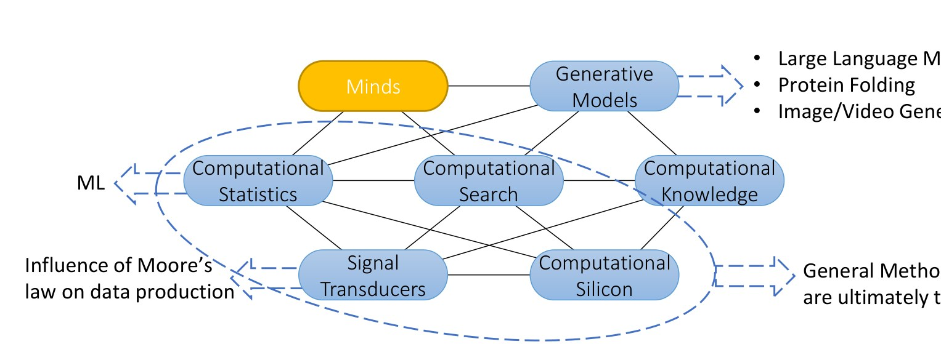
INSIGHT 02 · Minds, and why continual learning
What Is a Mind? Goal-seeking, Adaptive, Situated
Continual Learning (talk) · McCarthy · Sutton — ‘reward is enough’
GOAL-SEEKING
• Intelligence is the computational part of the ability to achieve goals (McCarthy & Sutton)
• Reward hypothesis: goals & purposes = maximizing the expected cumulative scalar reward
• Reward-is-enough hypothesis: intelligence and its abilities subserve reward maximization
ADAPTING BEHAVIOR
• Biological minds naturally adapt behavior to goals in complex, dynamic environments
• Society is comfortable with the adaptive behavior of animals
• Most ML / engineering systems are fixed and non-adaptive, built on static models of predefined domains
SITUATED IN EXPERIENCE
• Biological minds adapt within one ongoing, open stream of experience — not independent data inputs
• Most ML assumes i.i.d. data, making it hard to adapt to real-time, open-world settings
• Open-world learning needs online learning, incremental updates and real-time adaptability — not captured by current ML theory
Where do minds sit in AI research? — minds amid generative models, search and computation.
[2] D. Silver et al., “Reward is Enough,” Artificial Intelligence, vol. 299, 2021.

Slide 6
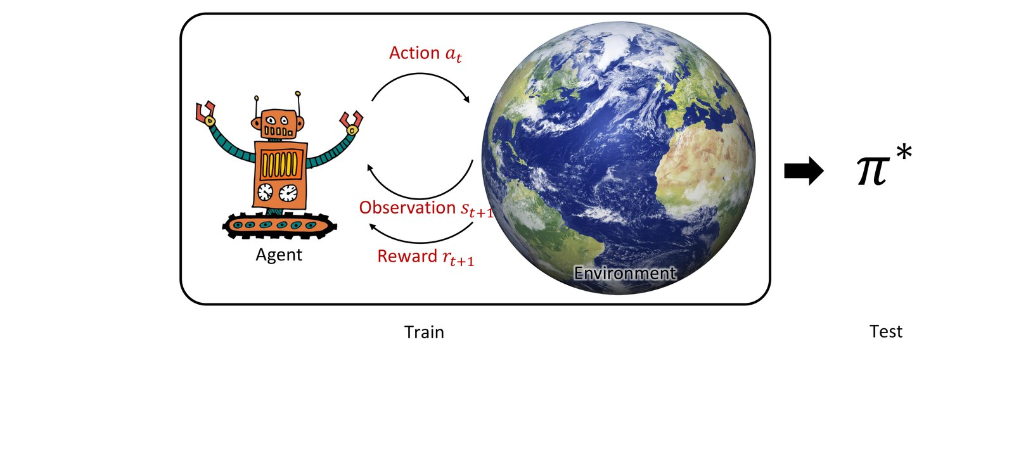
INSIGHT 03 · Minds, and why continual learning
Constant vs Continual Learning
Continual Learning (talk) · OpenMind Banff Retreat
THE DISTINCTION
• Constant learning: a train phase, then a frozen model used for test
• Continual learning: the agent stays in the state–action–reward loop and keeps learning past ‘test’
AGENTS THAT LEARN AND ADAPT
• Learning/adapting agents face non-stationary environments — changing data, policies and value functions
• Reinforcement learning can handle some degree of non-stationarity naturally
• Continual learning in open environments is a central challenge for minds
Constant vs continual learning — the agent stays in the loop, π keeps updating past ‘test’.
[3] OpenMind Research Institute, “Continual Learning,” Banff Retreat, Oct 2024.

Slide 7
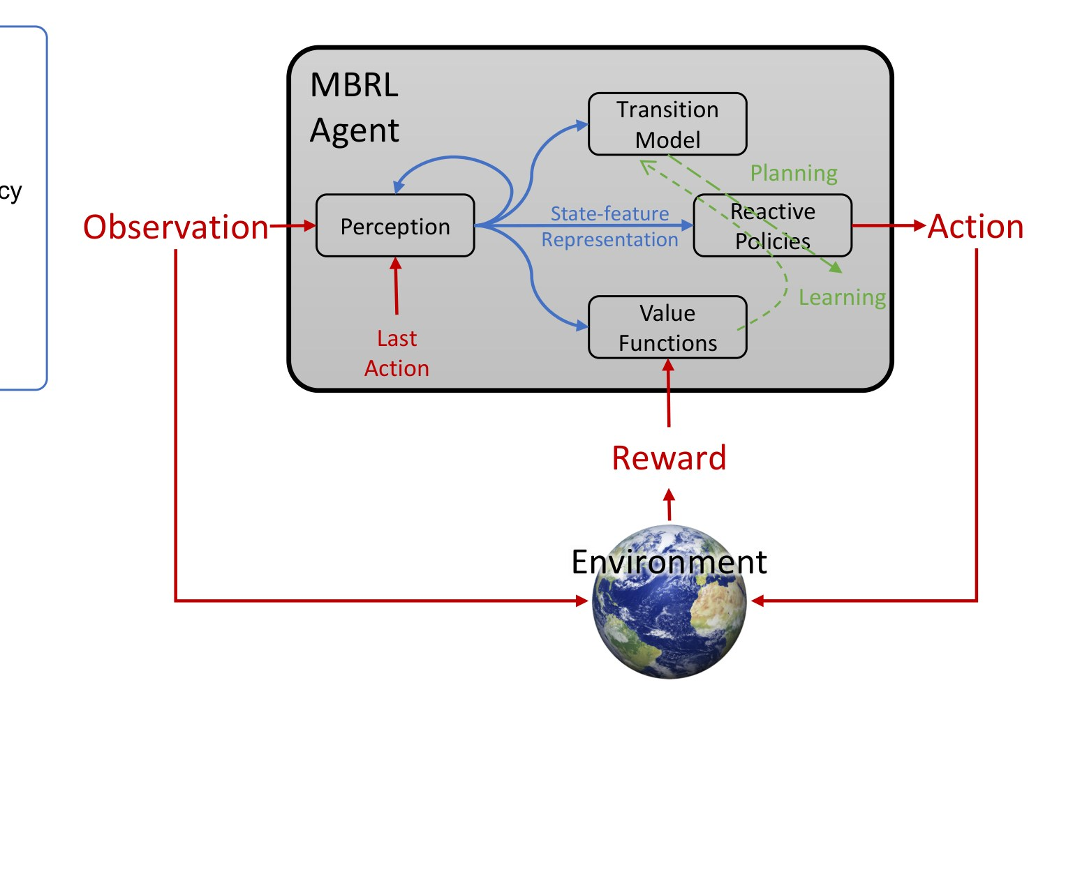
INSIGHT 04 · Agents in a big world
A Common Architecture for Continual RL Agents
Continual Learning (talk) · the Alberta Plan agent model
THE FOUR COMPONENTS
• Perception — produces the state representation used by all other components
• Reactive policies — quickly produce actions that achieve high reward or features
• Value functions — evaluate how well things are going and change the policy (learning)
• Transition model — predict consequences of alternative choices and change the policy (planning)
WHAT EACH LEARNS, CONTINUALLY
• Continual supervised representation / feature finding; continual generalized value-function prediction
• Continual actor-critic control; planning with reward, search control and exploration
PROTOTYPE SYSTEMS
• One-step model-based RL with continual function approximation
• STOMP — Stochastic Trajectory Optimization for Motion Planning
• Intelligence amplification — enhancing human decision-making with AI
A common agent architecture — perception, reactive policies, value functions, transition model.
[4] OpenMind Research Institute, “Continual Learning — RL Agent Architecture,” Banff Retreat, 2024.

Slide 8
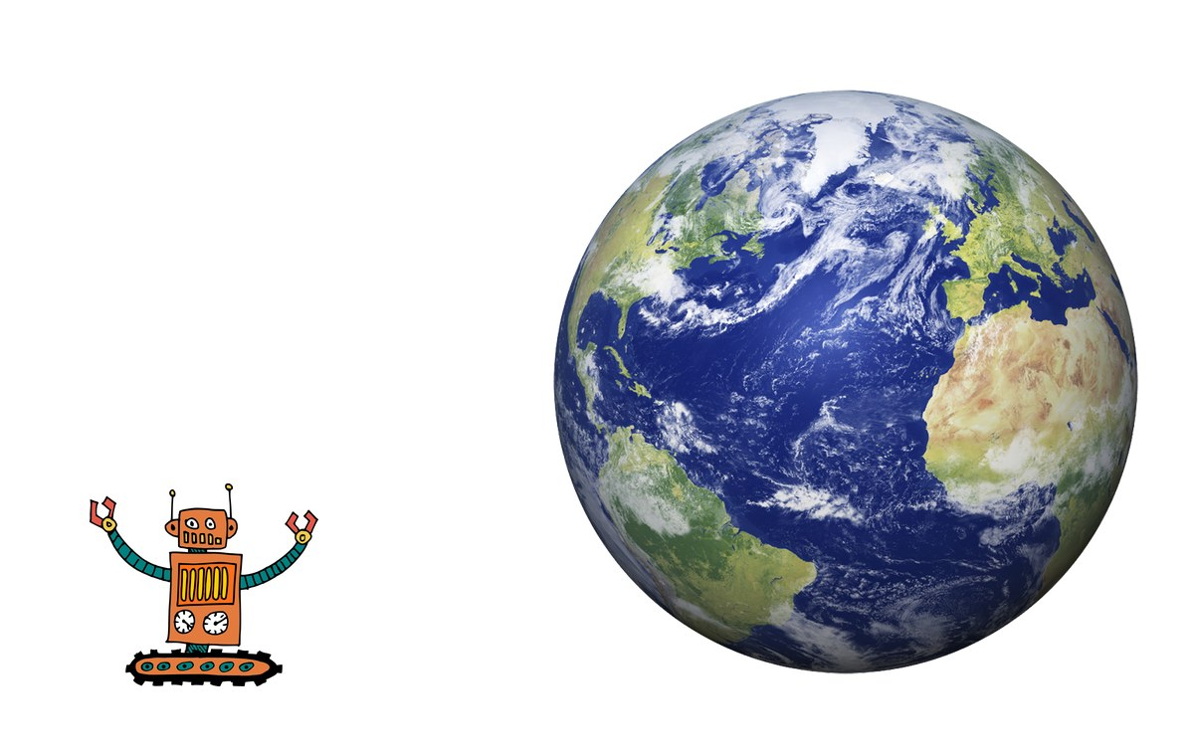
INSIGHT 05 · Agents in a big world
A Little Agent in a Big World
K. Javed & R. Sutton · Big World Hypothesis, 2024
WHAT MAKES AN AGENT SMALL
• The agent is constrained relative to the world: an information-capacity limit = the entropy of agent state, in bits
• Traditional theory: hone in on good actions and refine over time, with vanishing benefit to exploration
• Small agent, big world ⇒ want more capacity; non-stationary exploration ⇒ acquire info relevant to the future, forget the rest
DECISION-AWARE MODEL LEARNING
• Model what matters for decisions: Value-Aware (VAML) & Policy-Aware (PAML) model learning, distributional-equivalent variants
• Much recent work: Predictron, VPN, TreeQN, GAMPS, value-targeted regression, muZero, value-equivalent sampling
• Continual Knowledge Re-Grounding (KnoReG): benefit from an approximate model, then continually correct it against the real world (OS-VI update)
THERE IS HOPE
• There are new ways an approximate model of the world can help a small agent
• You are not limited to choosing only an inaccurate or only an accurate model
A little agent in a big world — the core framing of the Big World Hypothesis.
[5] K. Javed & R. Sutton, “The Big World Hypothesis and its Ramifications for AI,” RLC, 2024.

Slide 9
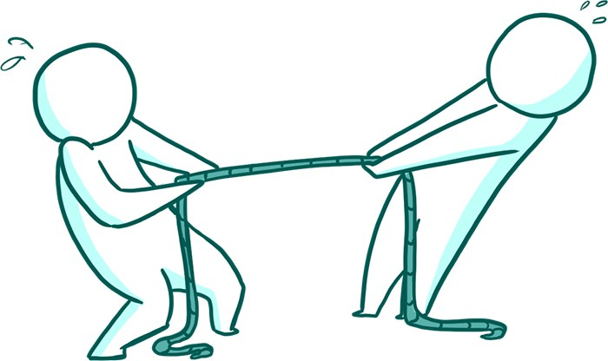
INSIGHT 06 · Agents in a big world
Efficiency vs Generality: Bias, Compute & the Bitter Lesson
R. Sutton — ‘The Bitter Lesson’ · vs the Big World Hypothesis
THE TRADE-OFF
• A trade-off between generality and sample efficiency
• You can improve efficiency by adding bias, at the cost of generality
• RL defines an extremely general set of problems
TWO LEVERS, TWO CONFLICTS
• Add bias to the agent — in conflict with the Bitter Lesson and the Big World Hypothesis
• Use more computation — in conflict with the Big World Hypothesis
THE BITTER LESSON
• Building in knowledge helps short-term and is satisfying, but plateaus and even inhibits progress long-term
• Breakthroughs eventually arrive from scaling computation via search and learning
BIG WORLD HYPOTHESIS
Efficiency vs generality — adding bias wins short-term; scaling computation wins long-term.
• The environment is significantly larger and more complex than the agent acting within it
• As compute grows, environment complexity grows too — the world stays much larger than the agent (Javed & Sutton, 2024)
[6] R. Sutton, “The Bitter Lesson,” incompleteideas.net, 2019.

Slide 10
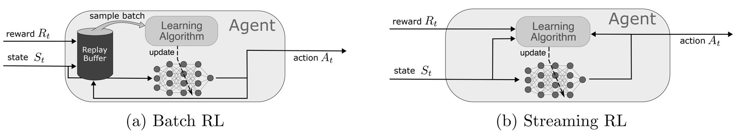
INSIGHT 07 · From batch to streaming
Batch vs Streaming Learning
M. Elsayed et al. · “Streaming Deep RL Finally Works”, 2024
STREAMING VS BATCH METHODS
• Classic streaming — TD(λ), Q(λ), SARSA(λ), AC(λ) — do not work with deep networks
• Batch — PPO, SAC, DQN, Rainbow — do work with deep networks, but need replay buffers
WHY STREAMING MATTERS
• Natural intelligence processes experience as a continuous stream — sense, act and learn moment-by-moment
• Update immediately per sample, without storing it — resource-friendly and privacy-preserving
• Promise: on-board learning on phones & microcontrollers; micro/nano-second decisions; democratize deep RL to billions of devices
THE STATUS QUO
• Batch RL's success is credited to data efficiency: reusing samples and averaging i.i.d. gradients for reliable updates
• Streaming RL's failure is blamed on sample inefficiency, instability, and hard step-size choice (per-sample gradient outliers)
OVERCOMING THE STREAM BARRIER
• Stability: a step-size-controlling optimizer, reward scaling, observation normalization
• Trainability: fix the pre-activation distribution with layer norm
• Sample efficiency: eligibility traces + sparse initialization (Stream-x)
Batch vs streaming deep-RL setups — streaming learns sample-by-sample, with no replay buffer.
[7] M. Elsayed et al., “Streaming Deep Reinforcement Learning Finally Works,” arXiv:2410.14606, 2024.

Slide 11

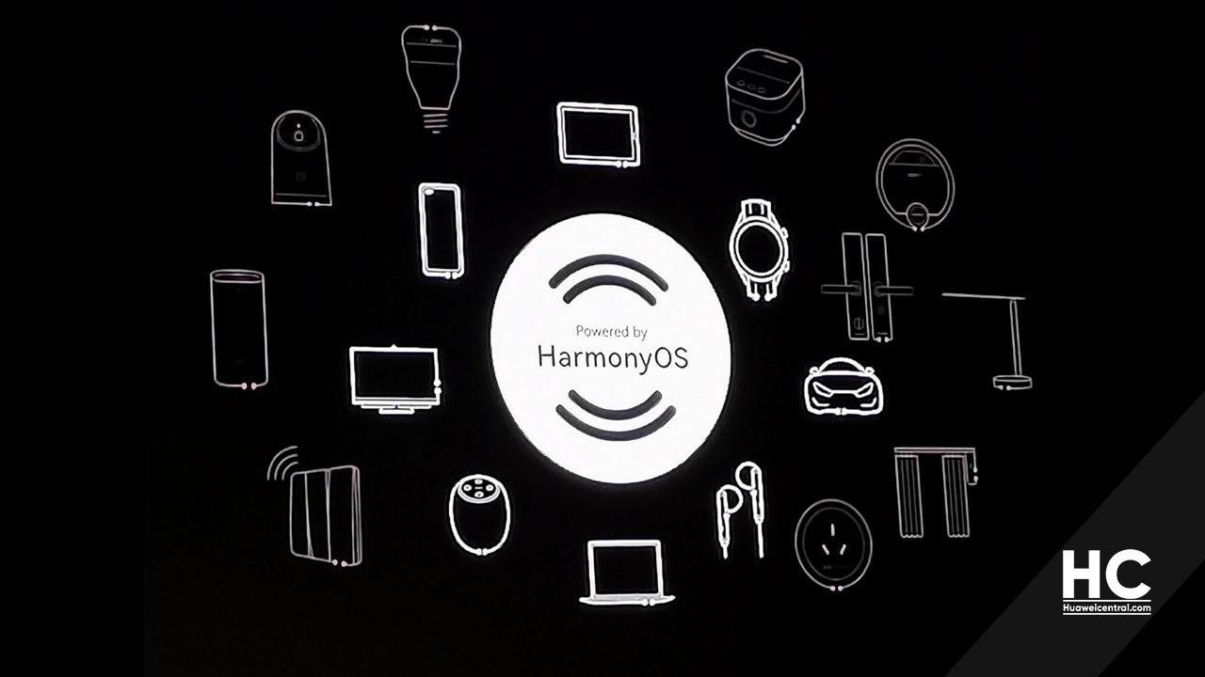
INSIGHT 08 · Industry relevance
Where Continual Learning Pays Off
Applications · Continual Learning talk · industry scenarios
SMART HOME & IOT
• Adapt to user preferences over time without manual updates
• Learn and anticipate changing user habits (e.g. a HarmonyOS smart home)
PERSONALIZED HEALTHCARE
• Continuously improve diagnosis & treatment recommendations as more patient data arrives
• Tailor treatments over time from a live stream (e.g. a watch / fit band)
GAMING, FINANCE, AGRICULTURE
• Gaming: adapt difficulty and NPC behavior to player skill
• Finance: adjust trading and portfolio strategies to evolving markets
• Agriculture: optimize crop management across changing climate, soil and seasons
WHY CONTINUAL LEARNING HERE
• Any system in a dynamic environment benefits from real-time adaptation — no periodic re-training
• Evolve progressively, avoiding costly full re-training cycles (model drift / degradation)
• Fits memory- and resource-constrained embedded & IoT devices — incremental, low-resource updates
[8] OpenMind Research Institute, “Continual Learning — Applications,” Banff Retreat, 2024.

Slide 12
INSIGHT 09 · Industry relevance
Challenges & Limitations of Continual Learning
Challenges & limitations · Continual Learning talk
IMPLEMENTATION & DATA
• Complexity of implementation — must manage knowledge retention while integrating new information
• Data management — relies on a continuous data stream, often infeasible (e.g. autonomous vehicles need manual labeled data)
• Overhead in training time and compute to accommodate ongoing updates and refinements
• Task & data complexity — as tasks grow, model architecture may need to expand, complicating training and inference
LEARNING FAILURES
• Catastrophic forgetting — forgets earlier tasks/classes when trained on new data, especially when data is non-sequential
• Performance degradation in non-stationary environments where distributions change frequently or unpredictably
• Risk of overfitting to recent data while failing to generalize across all tasks or classes
• Real-time adaptation is technically challenging when immediate updates on new data are required
ECOSYSTEM GAPS
• Limited benchmarking & evaluation standards — hard to compare approaches or judge effectiveness
• No validation for safety-critical systems — run-time learning has no controlled-environment validation; dangerous for autonomous vehicles
[9] OpenMind Research Institute, “Continual Learning — Challenges,” Banff Retreat, 2024.

Slide 13
CONCLUSIONS
Synthesis — trends, vision, implications
TRENDS
VISION
IMPLICATIONS FOR US
• Growing demand for autonomous, smart systems that learn continually from their environment.
• A shift toward real-time adaptation — fewer manual interventions and re-training cycles.
• Edge & IoT push toward lightweight, resource-efficient continual learning on-device.
• Adaptive, lifelong-learning systems that evolve without forgetting — like human learning.
• Resource-efficient, scalable AI that runs well under tight compute and memory budgets.
• Real-time decision-making and genuine human-AI collaboration from live feedback.
• Reduced retraining cost and a smaller carbon footprint — cheaper, greener AI.
• Scalability across devices (IoT, edge) and minimized catastrophic forgetting.
• A strategic edge for autonomous systems and clear cross-sector market differentiation.

