Slide 1
Tech Insight
Tech Insight Report
Huawei 2024 — Large Models Strategy Workshop
Huawei Strategy Workshop — Large Models & Distributed Systems
Shenzhen & Dongguan, China · May 2024
Location
Shenzhen & Dongguan, China
Date
May 2024
Focus
Large Models — Scaling, Capabilities & Distributed Systems

Slide 2
CONTENTS
Topics covered, by theme
A · Why large models work
C · Systems: distributed training & MoE
01
Evolution Pattern of Large Models: Scaling Laws
08
From Human Intelligence to AI 2.0
02
Technical Nature of Large Models: Generative Compression
09
Domain-Specific Small Models (Infini-3B)
03
R&D Mode: Big Engineering × Disruptive Innovation
10
Accelerating Distributed MoE & the All-to-All Bottleneck
B · 2024 progress & the road ahead
11
Memory Capacity & DLRM Motivation
04
The Year's Progress: Capability, Context, Trust & Cost
05
Future Outlook of Large Multi-Modality Models
06
Open-Source Reference Point: InternLM2
07
Large-Model Evolution vs Biological Intelligence

Slide 3
WORKSHOP AT A GLANCE
Huawei Strategy Workshop — Large Models & Distributed Systems
May 2024
Huawei
11 topics
Large models
Shenzhen · Dongguan
strategy workshop
deep-dived here
the theme
About: An internal Huawei AI strategy workshop surveying large-model fundamentals, 2024 progress, and the distributed-systems engineering (MoE) behind training at scale. Slides reference Pangu, Tsinghua NICS-efc and CAS / ICT.
Two laws anchor LLMs — power-law scaling and lossy compression; 2024's gains are measurable (reasoning, 2M context, less hallucination, cheaper inference); the frontier is multimodal world models; and efficiency is a systems problem — chip↔model↔interconnect co-design and all-to-all communication in distributed MoE.

Slide 4
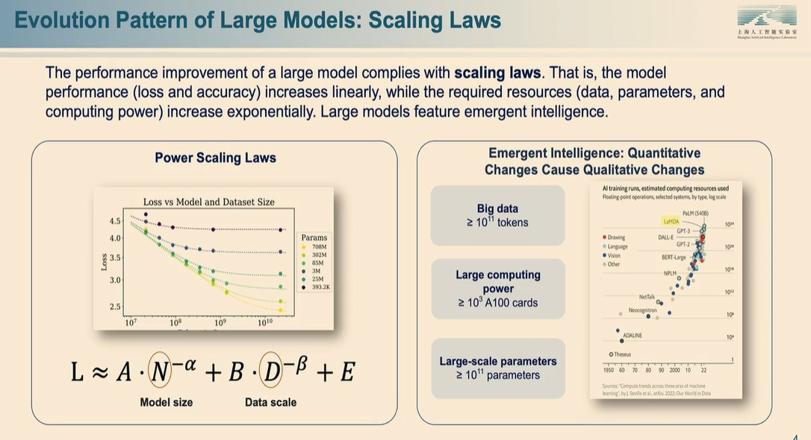
INSIGHT 01 · Why large models work
Evolution Pattern of Large Models: Scaling Laws
Large Models strategy · scaling laws & emergence
POWER SCALING LAWS
• Model performance (loss, accuracy) improves linearly as resources (data, parameters, compute) grow exponentially
• Loss ≈ A·N^(−α) + B·D^(−β) + E, where N = model size and D = data scale
• Loss-vs-size curves hold across parameter counts
EMERGENT INTELLIGENCE — QUANTITY → QUALITY
• Big data: ≥ 10¹¹ tokens
• Large compute: ≥ 10³ A100 cards
• Large parameters: ≥ 10¹¹ parameters
Power-law scaling — loss falls predictably as model / data / compute grow; emergence at scale.
[1] “Evolution Pattern of Large Models: Scaling Laws,” Huawei Large Models Strategy Workshop, 2024.

Slide 5
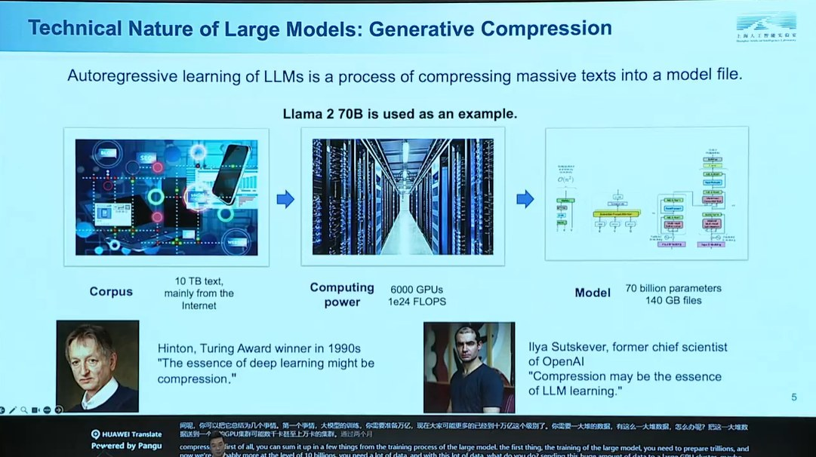
INSIGHT 02 · Why large models work
Technical Nature of Large Models: Generative Compression
Large Models strategy · generative compression
CORE IDEA
• Autoregressive LLM training compresses massive text into a model file (example: Llama 2 70B)
THE COMPRESSION PIPELINE (CORPUS → COMPUTE → MODEL)
• Corpus: ~10 TB of mostly-Internet text
• Compute: ~6,000 GPUs, ~1e24 FLOPs
• Model: 70B parameters, ~140 GB file
WHY IT MATTERS
• Hinton: ‘the essence of deep learning might be compression’
• Ilya Sutskever: ‘compression may be the essence of LLM learning’
Generative compression — ~10 TB of corpus compressed into a 140 GB, 70B-parameter model.
[2] “Technical Nature of Large Models: Generative Compression,” Huawei Large Models Strategy Workshop, 2024.

Slide 6
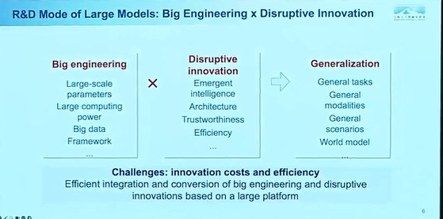
INSIGHT 03 · Why large models work
R&D Mode: Big Engineering × Disruptive Innovation
Large Models strategy · R&D operating model
BIG ENGINEERING
• Large-scale parameters, large compute, big data, and the training framework
DISRUPTIVE INNOVATION
• Emergent intelligence, architecture, trustworthiness, efficiency
GENERALIZATION — THE PRODUCT
• General tasks, general modalities, general scenarios — toward a world model
• Challenge: efficiently integrating big engineering with disruptive innovation on one platform
Big engineering × disruptive innovation → generalization (toward a world model).
[3] “R&D Mode of Large Models: Big Engineering × Disruptive Innovation,” Huawei Large Models Strategy Workshop, 2024.

Slide 7
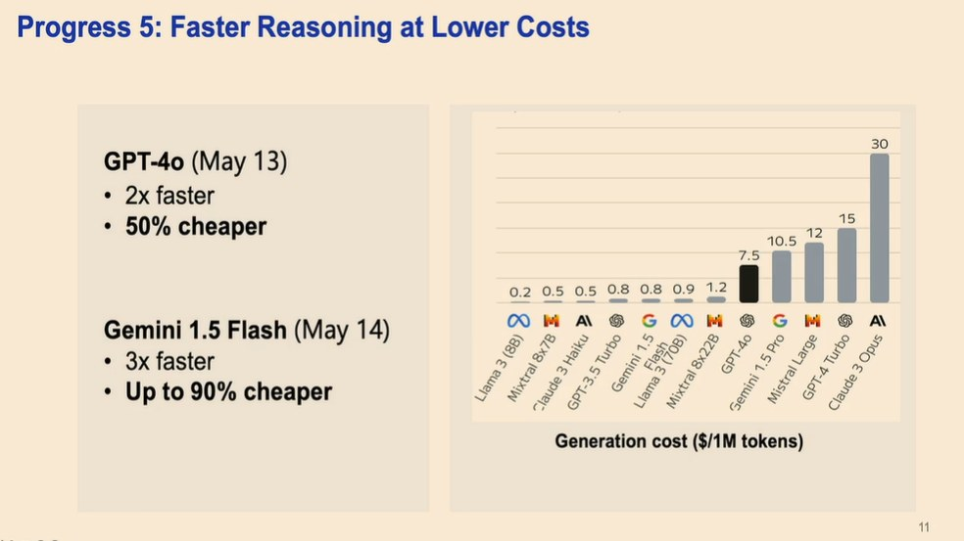
INSIGHT 04 · 2024 progress & the road ahead
The Year's Progress: Capability, Context, Trust & Cost
2024 progress · capability · context · trust · cost
REASONING, MATH & CODING
• GPT-4o markedly stronger on data, code and discipline tasks (vs GPT-4T, Claude 3 Opus, Gemini Ultra/Pro, Llama 3 400B)
• Closed-source leaders do better on harder math (primary → college tiers)
CONTEXT WINDOWS EXPLODED
• 2k (2022) → 32k+ (2023) → 100k–200k (Claude 3, GPT-4 Turbo) → 2M (KimiChat, Gemini 1.5 Pro) in ~18 months
• 2M enables full-novel analysis and project-level code — ‘context windows vs memory’
TRUST & COST
• Fewer hallucinations: GPT-4o beats GPT-4V on HallusionBench (still open for multimodal)
• Cheaper & faster: GPT-4o 2× faster / 50% cheaper; Gemini 1.5 Flash 3× faster / up to 90% cheaper; cost ~$0.2–30 per 1M tokens
2024's progress: reasoning, exploding context windows, lower hallucination and falling inference cost.
[4] “Progress of Large Models in 2024: Capability, Context, Trust and Cost,” Huawei Large Models Strategy Workshop, 2024.

Slide 8
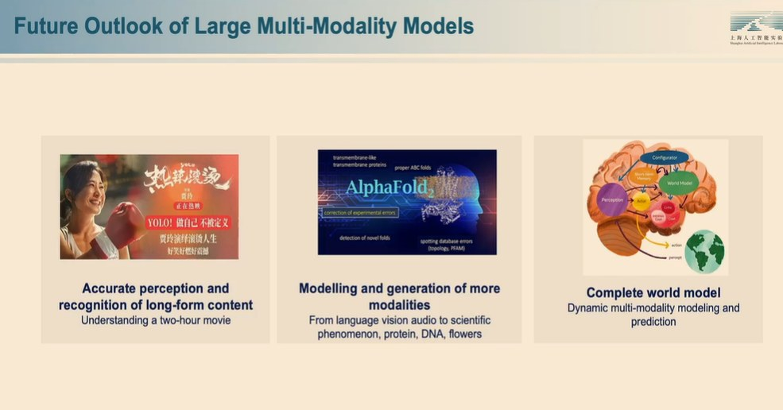
INSIGHT 05 · 2024 progress & the road ahead
Future Outlook of Large Multi-Modality Models
2024 progress · toward world models
THREE FUTURE DIRECTIONS
• Accurate perception of long-form content (e.g. understanding a two-hour movie)
• More modalities — from language / vision / audio to science: protein, DNA (AlphaFold)
• A complete world model — dynamic multi-modal modeling and prediction
Toward multimodal world models — long-video understanding and scientific modalities (AlphaFold).
[5] “Future Outlook of Large Multi-Modality Models,” Huawei Large Models Strategy Workshop, 2024.

Slide 9
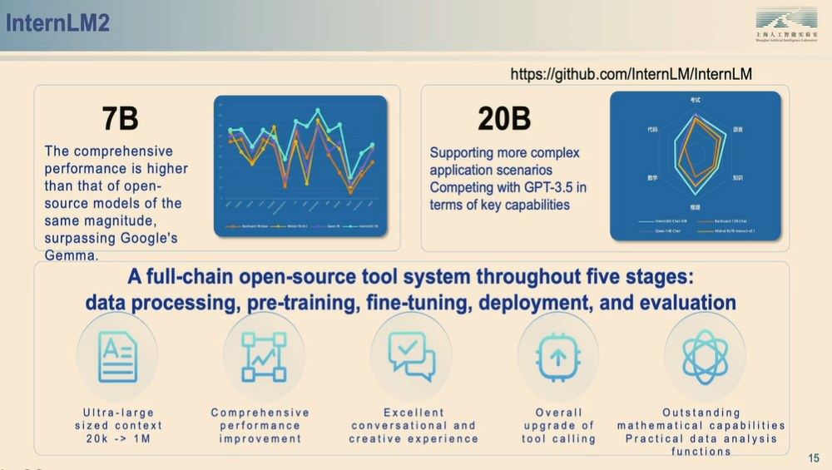
INSIGHT 06 · 2024 progress & the road ahead
Open-Source Reference Point: InternLM2
open-source reference · InternLM2
MODELS
• 7B: beats same-size open-source models, surpassing Google Gemma
• 20B: handles complex scenarios; rivals GPT-3.5 on key capabilities
FULL-CHAIN OPEN-SOURCE TOOLCHAIN
• Five stages: data processing, pre-training, fine-tuning, deployment, evaluation
• Context 20k → 1M, tool calling, strong math / data analysis
• Repo: github.com/InternLM/InternLM
InternLM2 — 7B / 20B capability and a five-stage, full-chain open-source toolchain.
[6] “Open-Source Reference Point: InternLM2,” Huawei Large Models Strategy Workshop, 2024.

Slide 10
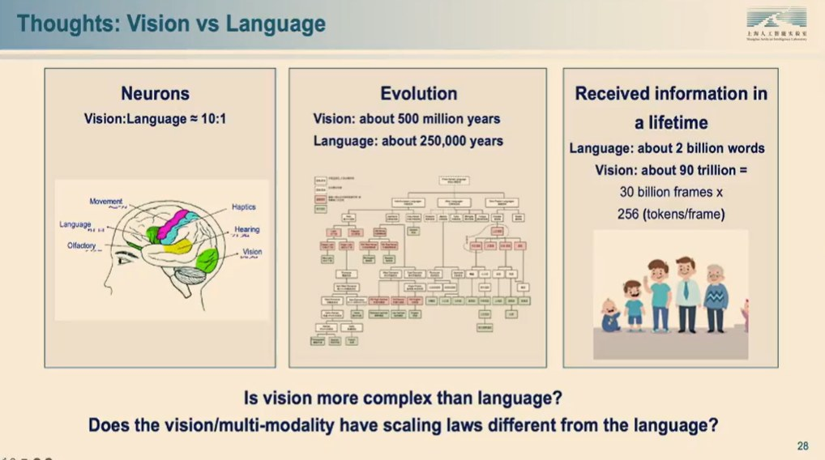
INSIGHT 07 · 2024 progress & the road ahead
Large-Model Evolution vs Biological Intelligence
closing reflections · evolution analogy & efficiency
LM EVOLUTION MIRRORS BIOLOGY
• LLM ↔ invertebrates (~500M yrs); multimodal ↔ mammals (~200M yrs); embodied ↔ humans (~3M yrs)
• Examples: ChatGPT → Gemini / InternMultiModal → RT-2, GR-1, FIGURE
IS VISION HARDER THAN LANGUAGE?
• Neurons vision:language ≈ 10:1; vision evolved ~500M yrs vs language ~250k yrs
• Lifetime info: ~2B words (language) vs ~90T tokens (vision) — do vision modalities have different scaling laws?
CHAIN-WIDE CO-OPTIMIZATION
• Innovation spans chip, interconnect, framework, data, model, evaluation, deployment
• A Chip ↔ Model ↔ Interconnection triangle to maximize full-chain energy efficiency
Is vision harder than language? Neurons, evolution time and lifetime information compared.
[7] “Large-Model Evolution vs Biological Intelligence,” Huawei Large Models Strategy Workshop, 2024.

Slide 11
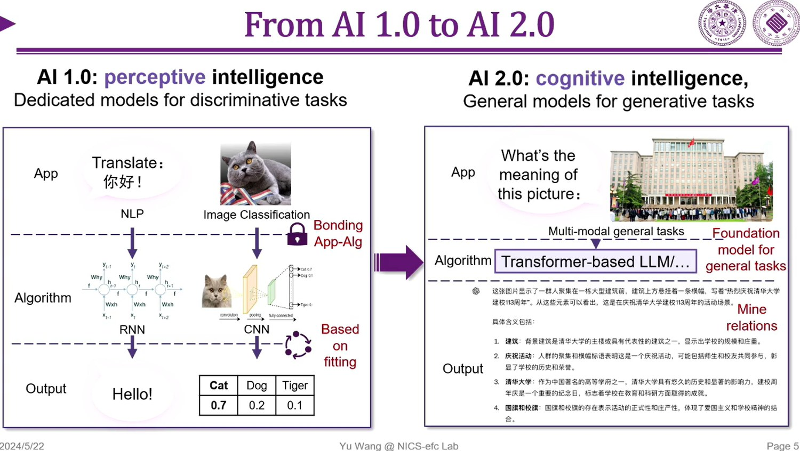
INSIGHT 08 · Systems: distributed training & MoE
From Human Intelligence to AI 2.0
Yu Wang et al. · Tsinghua NICS-efc · AI 1.0 → AI 2.0
TWO SYSTEMS OF THOUGHT (KAHNEMAN)
• System 1: fast, automatic, intuitive (perception)
• System 2: slow, analytical, reasoning (cognition) — from ‘Thinking, Fast and Slow’
AI 1.0 → AI 2.0
• AI 1.0 (perceptive): dedicated discriminative models (CNN / RNN) — ‘based on fitting’
• AI 2.0 (cognitive): general generative models; a Transformer-based LLM as the foundation model for general multimodal tasks
System 1 / System 2 thinking (Kahneman) and the shift from AI 1.0 to AI 2.0.
[8] Y. Wang et al., “From Human Intelligence to AI 2.0,” Huawei Strategy Workshop (Tsinghua NICS-efc), 2024.

Slide 12
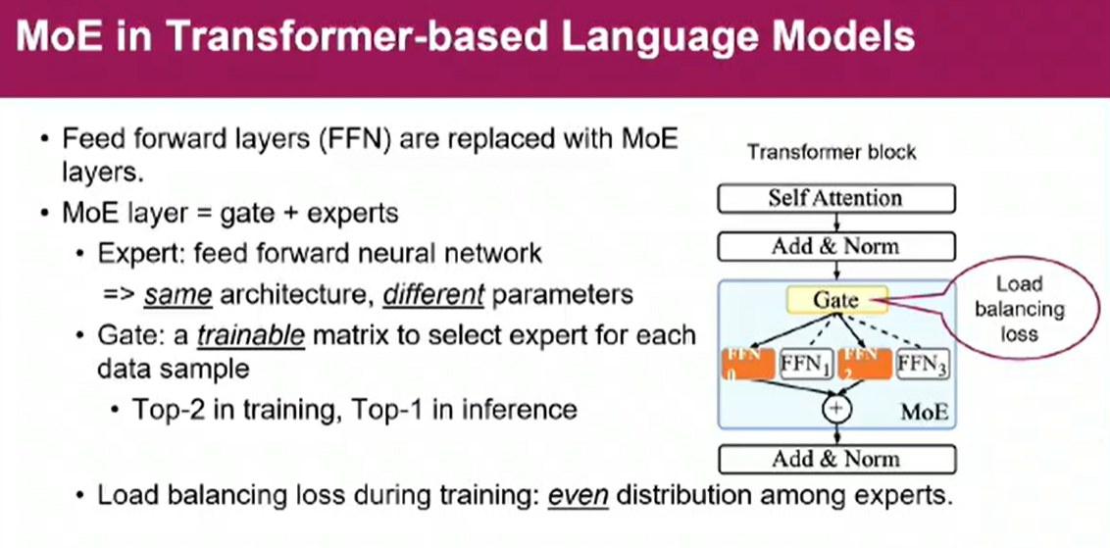
INSIGHT 09 · Systems: distributed training & MoE
Domain-Specific Small Models (Infini-3B)
systems & efficiency · small models that beat LLMs
SMALL MODELS CAN SURPASS LLMS
• Soft-hardware co-optimization + scenario customization let small models beat larger ones
• Infini-3B: 3B parameters with 7B-class performance (>50% fewer params); +15% inference vs Llama-2-7B; long context & agents
HOW
• Scenario-customized training closes the gap with ultra-large models
• High-fidelity quantization for cross-platform deployment; edge-cloud collaboration unlocks more apps
Infini-3B — 3B parameters with 7B-class performance (>50% fewer parameters).
[9] “Domain-Specific Small Models (Infini-3B),” Huawei Strategy Workshop, 2024.

Slide 13
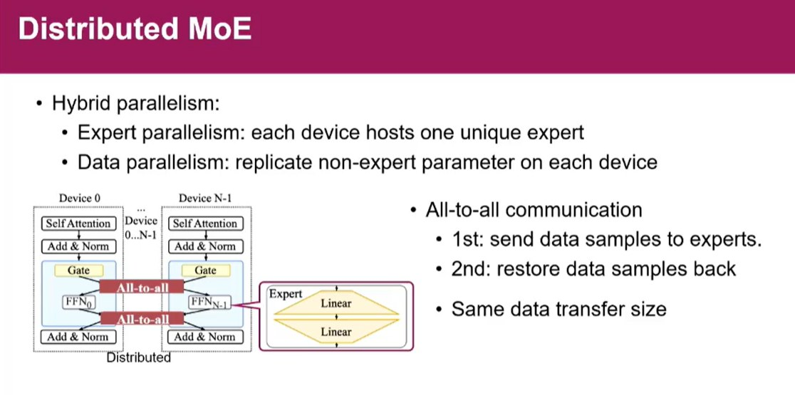
INSIGHT 10 · Systems: distributed training & MoE
Accelerating Distributed MoE & the All-to-All Bottleneck
CAS / ICT · NICS-efc · distributed Mixture-of-Experts
MOE IN TRANSFORMERS
• FFN layers are replaced by MoE layers = gate + experts; each expert is an FFN with distinct parameters
• The gate selects experts per sample (Top-2 in training, Top-1 in inference); a load-balancing loss keeps experts even
DISTRIBUTED MOE (HYBRID PARALLELISM)
• Expert parallelism: one unique expert per device; data parallelism replicates the non-expert parameters
• All-to-all communication sends samples to experts and restores them — equal-sized both ways, the core distributed cost
Distributed MoE — expert / data parallelism and the two all-to-all communication passes.
[10] “Accelerating Distributed MoE (Mixture of Experts),” Huawei Strategy Workshop (CAS / ICT), 2024.

Slide 14
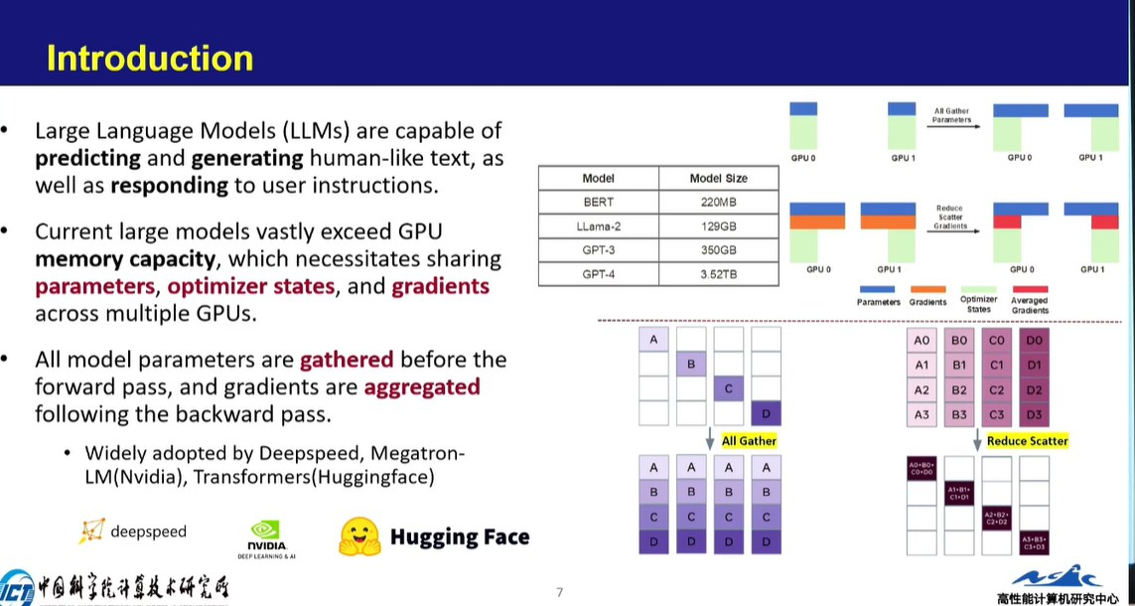
INSIGHT 11 · Systems: distributed training & MoE
Memory Capacity & DLRM Motivation
systems engineering · memory sharding · DLRM
GPU MEMORY IS THE LIMIT
• Models far exceed GPU memory (BERT 220MB, Llama-2 13GB, GPT-3 350GB, GPT-4 3.52TB) → shard parameters, optimizer states and gradients
• All-Gather params before the forward pass, Reduce-Scatter gradients after backward (DeepSpeed, Megatron-LM, HF Transformers)
DLRM RECOMMENDATION MODELS
• DLRM mixes categorical + numerical inputs; huge embedding tables force model parallelism
• Also all-to-all bound (forward & backward); a ‘butterfly shuffle’ and time breakdown show communication dominates compute
Sharding parameters and gradients (All-Gather / Reduce-Scatter) to fit models beyond GPU memory.
[11] “Memory Capacity & DLRM Motivation,” Huawei Strategy Workshop (CAS / ICT), 2024.

Slide 15
CONCLUSIONS
Synthesis across the workshop
TRENDS
VISION
IMPLICATIONS FOR US
• Two laws anchor LLMs: power-law scaling (L ≈ A·N^−α + B·D^−β + E) and training-as-lossy-compression (10 TB → 140 GB for Llama-2-70B).
• 2024's gains are measurable: stronger reasoning / math / coding, context 2k → 2M, lower hallucination, inference cost down 50–90%.
• Distributed all-to-all communication (MoE & DLRM) is the dominant bottleneck; models (GPT-4 ~3.52 TB) far exceed single-GPU memory.
• The frontier is multimodal ‘world models’ — scientific modalities (protein / DNA), long-video understanding, embodied AI.
• A bio-evolution analogy: LLM → multimodal → embodied ≈ invertebrate → mammal → human; vision may have different scaling laws.
• Domain-specific small models (Infini-3B) + quantization + edge-cloud as a practical efficiency path.
• Efficiency is a systems problem: chip↔model↔interconnect co-design and distributed-MoE acceleration are the key platform bets.
• Invest in long-context / memory mechanisms and trustworthiness (hallucination reduction).
• Treat distributed training (sharding, all-to-all optimization) as first-class for scaling.

