Slide 1
Tech Insight
Tech Insight Report
CVPR 2024 — Workshop on Autonomous Driving
IEEE/CVF CVPR 2024 — Workshop on Autonomous Driving (WAD)
Seattle, WA, USA · June 17, 2024
Location
Seattle, WA, USA
Date
June 17, 2024
Focus
Autonomous Driving — Simulation, Foundation Models & Robust Autonomy

Slide 2
CONTENTS
Talks covered, by theme
A · Simulation & benchmarking
C · Perception, forecasting & robust autonomy
01
An Open-Source Simulation Ecosystem for AV Research
05
Argoverse Challenges — Scene Flow, Forecasting & Occupancy
02
Non-Reactive AV Simulation and Benchmarking
06
Towards Scalable and Robust Autonomy
B · Foundation models & scaling
03
Next-Gen AV with Foundation Models
04
Buckle Up for the Future: Scaling Autonomous Driving

Slide 3
WORKSHOP AT A GLANCE
IEEE/CVF CVPR 2024 — Workshop on Autonomous Driving (WAD)
June 17
CVPR 2024
8 talks
6 topics
Seattle, WA
WAD workshop
+ challenges
deep-dived here
About: A full-day CVPR 2024 workshop bringing academia and industry together (UCLA, Tübingen, NVIDIA, Waymo, Zoox/MIT, Wayve, Argoverse) on the state of autonomous driving. This report distills the talks with substantive notes.
Three threads ran through the day: open-source simulation & benchmarking to close the academia–industry gap; foundation / vision-language models moving into every layer of the AV stack; and scaling to the long tail with robust, end-to-end autonomy.

Slide 4
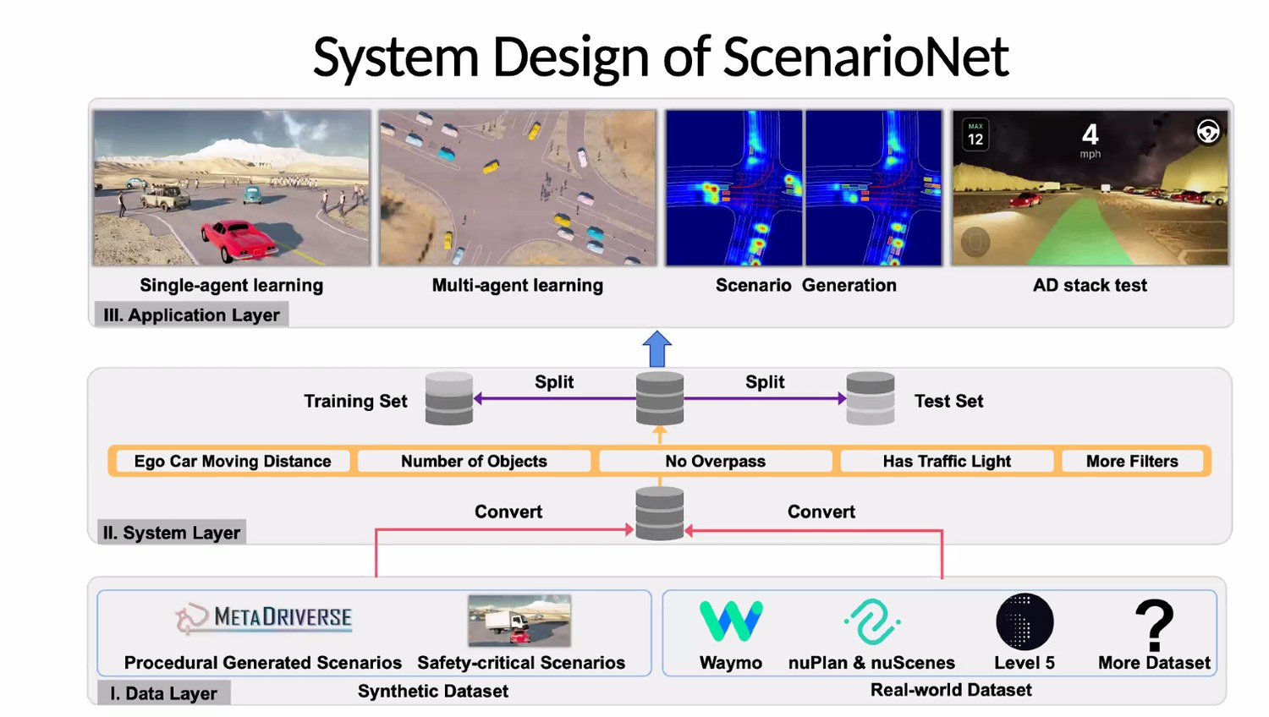
INSIGHT 01 · Simulation & benchmarking
An Open-Source Simulation Ecosystem for AV Research
Bolei Zhou · UCLA · MetaDrive / ScenarioNet
THE GAP TO CLOSE
• Academia is limited by hardware/GPU constraints; access to real-world data and simulators bridges the gap to industry
• AV companies release real-world datasets — but they need a common format
• An open-source simulator that mimics real-world quality is essential
METADRIVE & SCENARIONET
• MetaDrive: a lightweight, data-driven simulator
• ScenarioNet: a large-scale repository built from low-resolution labeled data — 500,000 scenarios so far
• Users add their own modules; a two-stage method turns noisy, fragmented data into coherent scenarios
SAFETY & REALISM
• Safety-critical scenarios are rare → closed-loop adversarial training adds adversarial scenarios and risk-aware driving
• Text-to-image VLMs create diverse, high-quality images; simulator-conditioned generation (SimGen) yields realistic scenes
• Work underway on urban environments for small-robot city simulation
ScenarioNet — turning real-world logs into large-scale, reusable driving scenarios.
[1] B. Zhou, “Building an Open-Source Simulation Ecosystem for AI and Mobility Research,” CVPR 2024 Workshop on Autonomous Driving.

Slide 5
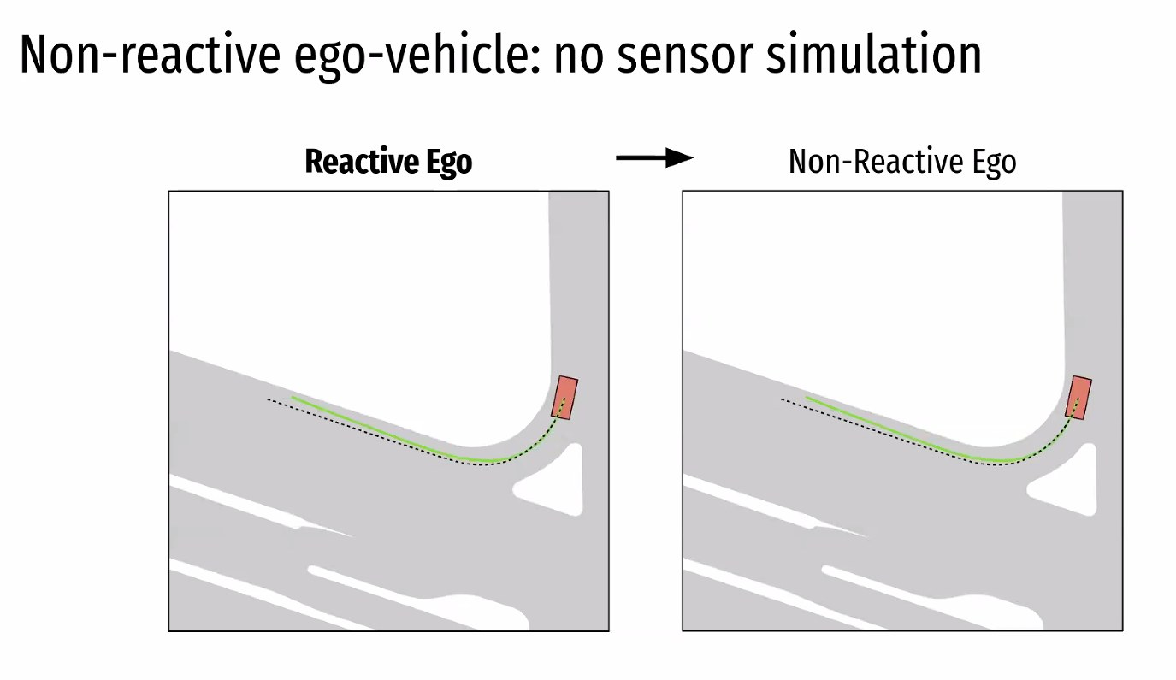
INSIGHT 02 · Simulation & benchmarking
Non-Reactive AV Simulation and Benchmarking
Kashyap Chitta · University of Tübingen · Tübingen AI Center
WHY NON-REACTIVE SIM
• 75% of driving data is just driving straight; current sims are limited, not very realistic, and GPU-hungry
• Bypass these constraints with minimal rendering in a 2D bird's-eye-view simulation
THE SETUP
• The ego vehicle is restricted to its first frame; the whole simulation runs without new sensor data (assume the initial data is complete)
• The ego vehicle is invisible to other vehicles' sensors — hence ‘non-reactive’
WHAT IT MEASURES
• No collisions · driving-area compliance · time-to-collision
• Ego progress · comfort of driving — all in a lightweight 2D BEV
Non-reactive simulation — a lightweight 2D bird's-eye view where the ego vehicle is invisible to others.
[2] K. Chitta, “Non-Reactive Autonomous Vehicle Simulation and Benchmarking,” CVPR 2024 Workshop on Autonomous Driving.

Slide 6
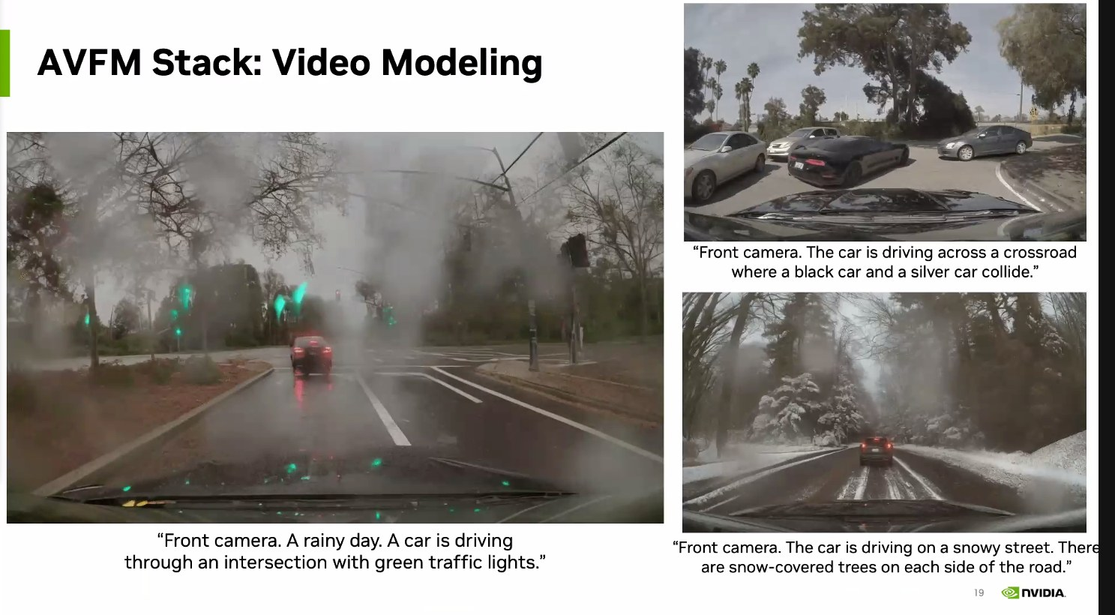
INSIGHT 03 · Foundation models & scaling
Next-Gen AV with Foundation Models
Sanja Fidler · NVIDIA
FROM RULES TO END-TO-END
• NVIDIA spans ADAS across hardware, infrastructure, simulation, NVIDIA Drive and research
• Shift from rule-based systems to AI / end-to-end models, which simplify ADS software
• Rare cases need rapid processing — slow iteration is not acceptable
FOUNDATION MODELS IN THE STACK
• Vision-Language Models enable auto-labeling, captioning and clustering; video captions feed later analysis
• New tools: Picasso (text-to-image), NeMo, ViLA (captioning), DLSS 3.0; the Blackwell GPU adds generative AI
• FM-powered AV stack: images → trajectory tokens → pretrained backbone → driving stack, benchmarked in simulation
MODELING THE LONG TAIL
• Model harsh-weather video from internet video, given the rarity of real accident data
• Use enough tokens to model small objects (e.g. pillars) without slowing down; dynamic scenes (motorcycles) stay hard
• A simulation-first approach using neural reconstruction graphics
NVIDIA's foundation-model stack generating realistic driving video, including harsh-weather scenes.
[3] S. Fidler, “Next-Gen AV with Foundation Models,” CVPR 2024 Workshop on Autonomous Driving.

Slide 7
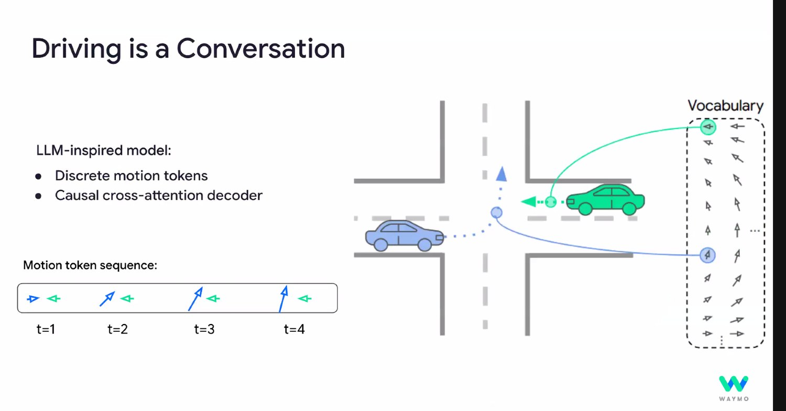
INSIGHT 04 · Foundation models & scaling
Buckle Up for the Future: Scaling Autonomous Driving
Congcong Li · Waymo
THE PROBLEM
• Each year ~50 million injuries and 1.35 million deaths occur on the streets
• Long-tail handling is the critical challenge for scaling autonomous driving
WHAT WAYMO BUILT
• Multi-modality sensor fusion; mining and augmenting rare examples
• Auto-labeling plus an efficient ML development ecosystem
• Next step: leverage the knowledge and reasoning of LLMs / VLMs
UP-VL: LABEL-FREE 3D PERCEPTION
• Human labeling is slow and inaccurate for scaling → focus on a perception database (billions of points and images)
• UP-VL: unsupervised multi-modal auto-labeling + 3D perception trained with vision-language distillation — no human annotations
• A hybrid paradigm: combine classic methods with end-to-end approaches
Waymo — ‘driving is a conversation’: LLM-inspired discrete motion tokens over a causal scene decoder.
[4] M. Najibi et al., “Unsupervised 3D Perception with 2D Vision-Language Distillation (UP-VL),” CVPR 2024 Workshop on Autonomous Driving.

Slide 8
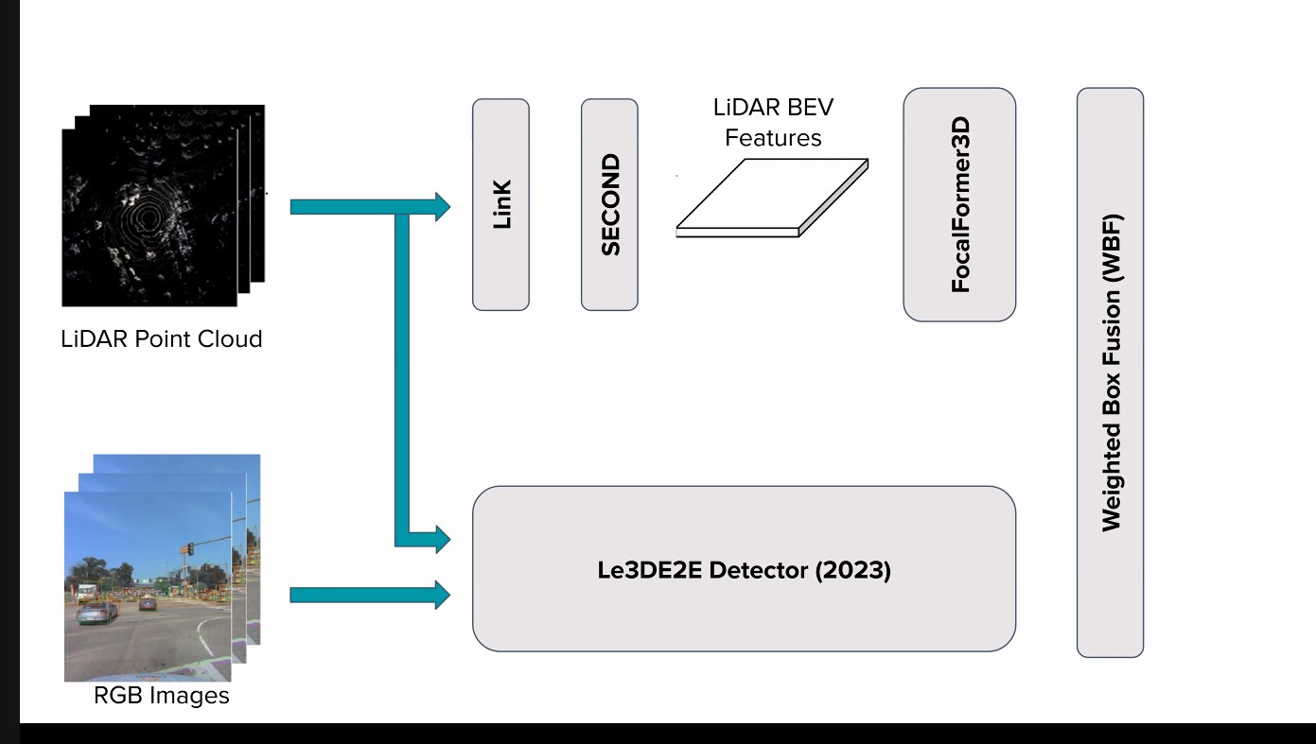
INSIGHT 05 · Perception, forecasting & robust autonomy
Argoverse Challenges — Scene Flow, Forecasting & Occupancy
Kyle Vedder (Argoverse) · CVPR 2024 Argoverse Challenges
SCENE FLOW
• Datasets of image, lidar and more; scene flow spans background, vehicles and pedestrians
• A simple Kalman filter tracked changes between consecutive frames to detect moving objects
FLOW4D & CLUSTERING
• Flow4D: early and temporal fusion, fusing lidar and camera information
• Clustering + ICP: high-quality priors; improved clustering via foreground/background estimation
FORECASTING & 4D OCCUPANCY
• End-to-end forecasting: various sensor-fusion methods, but performance issues on the AV stack — ongoing work
• 4D occupancy forecasting without annotations via an implicit model; parallel processing of large query sets
• A large receptive field helps find lidar evidence; most foreground motion is in the BEV plane
Flow4D — early fusion of multi-frame lidar into a 4D voxel network for scene-flow estimation.
[5] K. Vedder et al., “Argoverse 2 Challenges: Scene Flow, Forecasting and 4D Occupancy,” CVPR 2024 Workshop on Autonomous Driving.

Slide 9
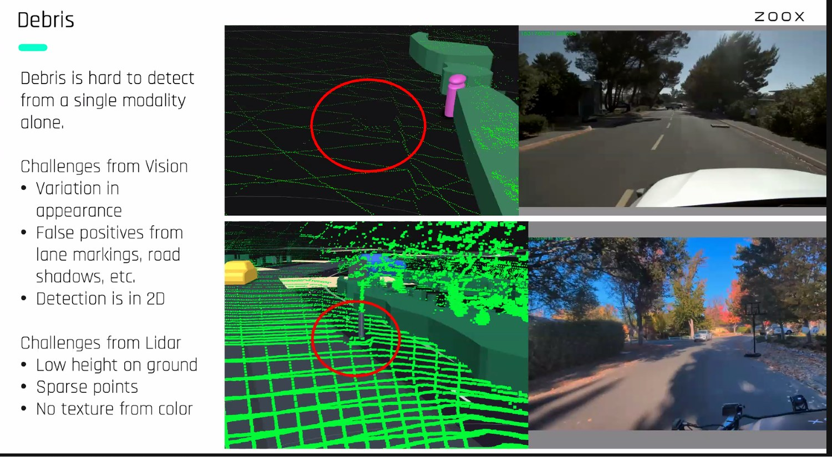
INSIGHT 06 · Perception, forecasting & robust autonomy
Towards Scalable and Robust Autonomy
Nick Roy · Zoox · MIT
ARCHITECTURE & END-TO-END
• A general ADS architecture; end-to-end AI can replace individual modules, connecting sensors directly to motors
• Learned estimators trained with domain knowledge help generate data — but the number of sensors is a challenge
ROBUSTNESS IN THE WILD
• Debris is hard to detect and is often mistaken for noise; buses must be perceived and avoided
• Significant out-of-domain uncertainty is computationally heavy and vulnerable to aliasing
PLANNING
• Reinforcement learning is used for the planning module
• Open question: how to match standard methods with end-to-end approaches
Robust autonomy in the wild — detecting road debris and other rare, out-of-domain hazards.
[6] N. Roy, “Towards Scalable and Robust Autonomy,” CVPR 2024 Workshop on Autonomous Driving.

Slide 10
CONCLUSIONS
Synthesis across the workshop
TRENDS
VISION
IMPLICATIONS FOR US
• Open-source simulators and a common scenario format (MetaDrive / ScenarioNet) are closing the academia–industry gap.
• Foundation / vision-language models are moving into every layer of the AV stack — labeling, generation, planning.
• The field is converging on end-to-end, simulation-first development.
• Label-free 3D perception at scale (UP-VL) and auto-generated safety-critical scenarios.
• Realistic generative simulation — harsh weather and accidents — from internet-scale video.
• Robust autonomy that handles the long tail: debris, rare events, out-of-domain uncertainty.
• Invest in open simulation, benchmarking and a shared scenario format.
• Adopt VLM-powered auto-labeling and generative data to cover rare cases cheaply.
• Treat long-tail robustness and safety validation as first-class, not add-ons.

