Slide 1
Tech Insight
Tech Insight Report
AAAI 2024 — Innovations in AI
38th Annual AAAI Conference on Artificial Intelligence (AAAI-24)
Vancouver, Canada · February 20–27, 2024
Location
Vancouver, Canada
Dates
February 20–27, 2024
Focus
Reliable LLMs, Foundation Models, Simulation & Autonomous Driving

Slide 2
CONTENTS
Papers covered, by theme
A · Reliable LLM reasoning & generation
C · Simulation, perception & autonomous driving
01
Chain-of-Thought Improves Text Generation with Citations in LLMs
09
SPDiff: Social-Physics-Informed Diffusion Model for Crowd Simulation
02
Can LLMs Serve as Rational Players in Game Theory?
10
Vampire: Regulating Intermediate 3D Features for Vision-Centric Autonomous Driving
03
Frugal LMs Trained to Invoke Symbolic Solvers (SYRELM)
11
Accelerating AVs with the Next Generation of Generative AI (Keynote)
B · LLM agents & applied foundation models
D · Robust & efficient learning
04
PromptGAT: Sim-to-Real Transfer for Traffic Signal Control with Prompt Learning
12
Efficient Knowledge Transfer for Spiking Neural Networks from Static to Event Domain
05
Building Conversational Artifacts for APIs and RPAs
13
Graph Invariant Learning with Subgraph Co-mixup for OOD Generalization
06
PathAsst: A Generative Foundation AI Assistant for Pathology
07
Bootstrapping Cognitive Agents with a Large Language Model
08
KG-TREAT: Treatment Effect Estimation by Synergizing Patient Data with Knowledge Graphs

Slide 3
CONFERENCE STATISTICS
38th Annual AAAI Conference on Artificial Intelligence (AAAI-24)
12,100
2,342
23.8%
Vancouver
submissions
accepted
acceptance
Feb 20–27
Also: The 38th AAAI Conference at the Vancouver Convention Centre — the 4th-ranked AI venue by h5-index. This report covers 13 papers, including a Waabi keynote.
LLMs dominate, but the focus is reliability — citations, symbolic reasoning, grounding and rationality limits — alongside multimodal foundation models in medicine, physics-informed generative simulation, and interpretable autonomous-driving AI.

Slide 4
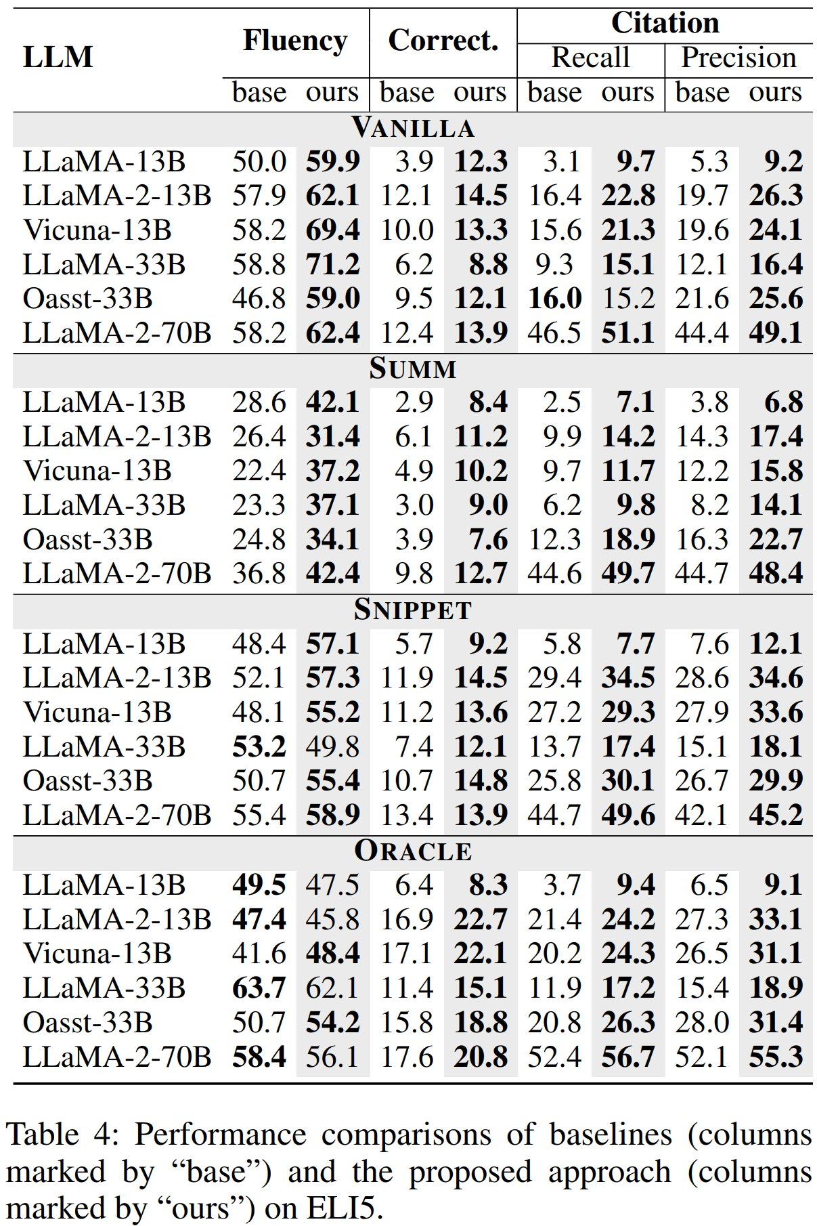
INSIGHT 01 · Reliable LLM reasoning & generation
Chain-of-Thought Improves Text Generation with Citations in LLMs
CoT + Citation Insurance Mechanism · AAAI 2024
GOAL
• Enable LLMs to generate text with accurate citations, improving answer correctness and citation quality.
CHALLENGE
• LLMs hallucinate and struggle to synthesize and properly cite across multiple documents.
METHOD
• Chain-of-Thought prompting to synthesize answers with citations
• Four prompting strategies: Vanilla, Summ, Snippet, Oracle
• A Citation Insurance Mechanism (CIM) detects and fixes missing citations (LLM- and IR-based)
NOVELTY
• Combines CoT reasoning with a citation-insurance mechanism to guarantee citations.
IMPACT
Chain-of-Thought prompting with a Citation Insurance Mechanism for citeable LLM answers.
• Consistent gains in citation recall/precision, correctness and fluency on ALCE across six LLMs (13–70B).
[1] “Chain-of-Thought Improves Text Generation with Citations in Large Language Models,” AAAI 2024.

Slide 5
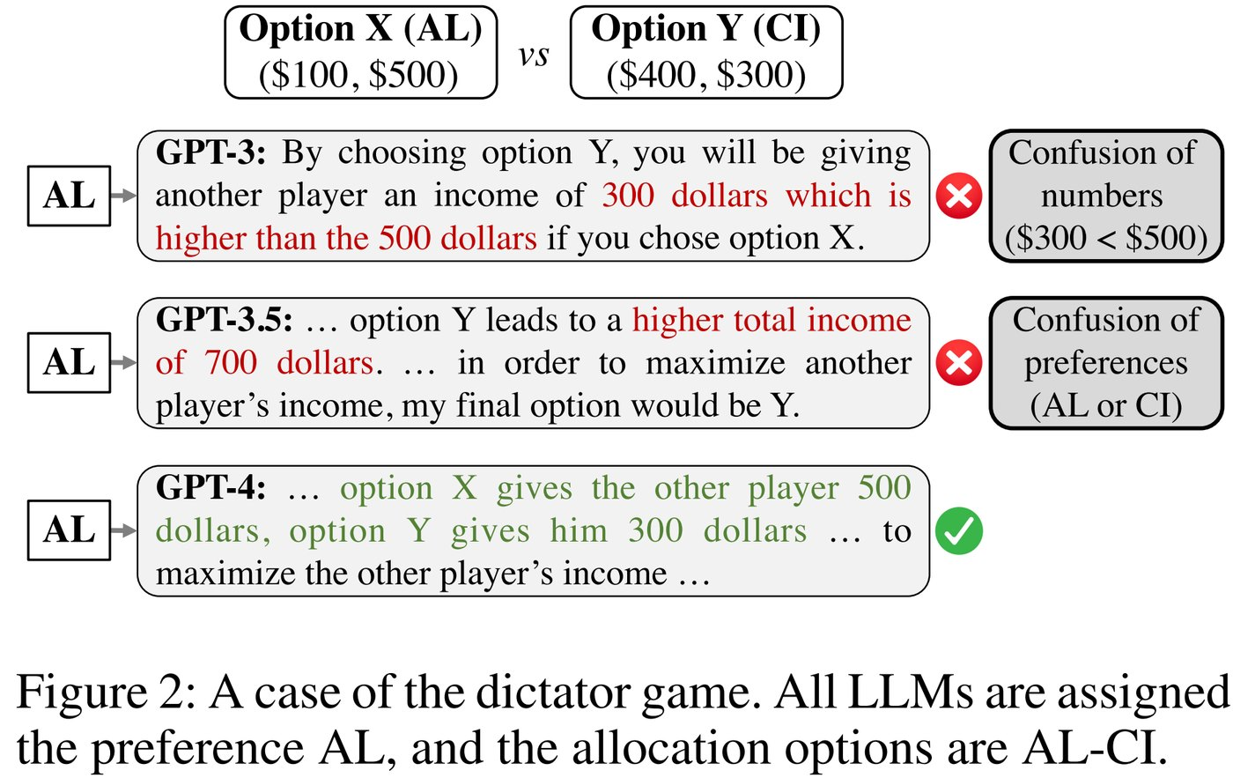
INSIGHT 02 · Reliable LLM reasoning & generation
Can LLMs Serve as Rational Players in Game Theory?
LLMs as rational players · AAAI 2024
GOAL
• Assess whether LLMs can act as rational players in social-science game experiments.
CHALLENGE
• Rationality requires building desires, refining beliefs under uncertainty, and taking optimal actions.
METHOD
• Three classic games: dictator, rock-paper-scissors, ring-network
• Evaluate desire, belief refinement and optimal action
• Systematic analysis across LLMs including GPT-4
NOVELTY
• A systematic framework for probing the rationality boundaries of LLMs in game theory.
IMPACT
Probing LLM rationality across the dictator, rock-paper-scissors and ring-network games.
• LLMs show basic desire but struggle with belief refinement; GPT-4 is sometimes human-like — guidance for social-science use.
[2] “Can Large Language Models Serve as Rational Players in Game Theory? A Systematic Analysis,” AAAI 2024.

Slide 6
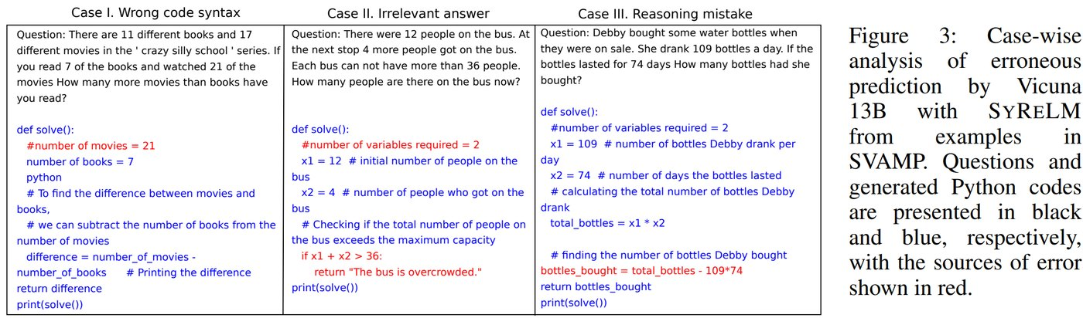
INSIGHT 03 · Reliable LLM reasoning & generation
Frugal LMs Trained to Invoke Symbolic Solvers (SYRELM)
SYRELM · AAAI 2024
GOAL
• Achieve parameter-efficient, interpretable arithmetic reasoning without massive LLMs.
CHALLENGE
• LLMs are resource-intensive and unreliable for arithmetic reasoning.
METHOD
• Translate natural-language questions into formal language (e.g. Python) for a symbolic solver
• Fine-tune a small LM with a Low-Rank Adapter (LoRA)
• Optimize with PPO using a reasoning-specific reward (compilation, variable/operator match, answer error)
NOVELTY
• A frugal LM + symbolic solver, with middle-school-math pedagogy shaping the reward.
IMPACT
SYRELM translates questions to formal language for a symbolic solver (LoRA + PPO).
• Strong arithmetic gains with a small, accessible, interpretable alternative to huge LLMs.
[3] “Frugal LMs Trained to Invoke Symbolic Solvers Achieve Parameter-Efficient Arithmetic Reasoning,” AAAI 2024.

Slide 7
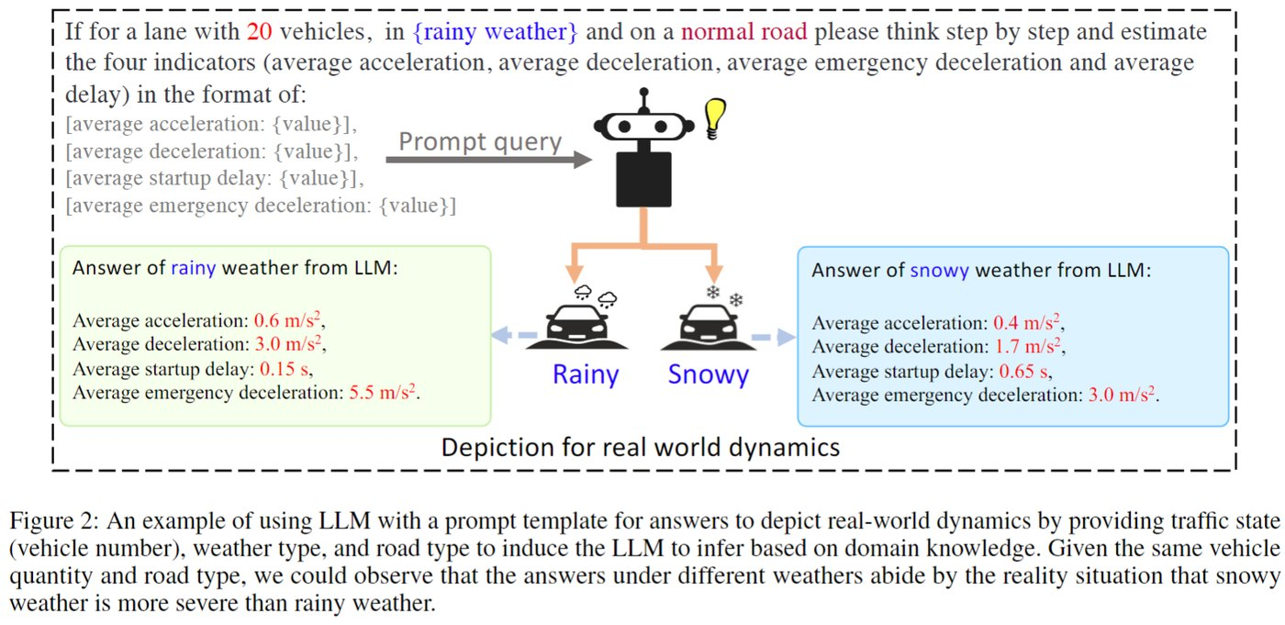
INSIGHT 04 · LLM agents & applied foundation models
PromptGAT: Sim-to-Real Transfer for Traffic Signal Control with Prompt Learning
PromptGAT · AAAI 2024
GOAL
• Close the sim-to-real gap for reinforcement-learning traffic signal control.
CHALLENGE
• Grounded Action Transformation (GAT) struggles with unobserved states; prompt learning was untried for sim-to-real.
METHOD
• Use LLMs to improve GAT's forward (dynamics) model
• Prompt-based grounded action transformation aligns policy with realistic dynamics
• Evaluate on four traffic-signal-control scenarios
NOVELTY
• First to bring prompt learning (LLMs) into sim-to-real grounded action transformation.
IMPACT
PromptGAT — LLM-improved grounded action transformation for sim-to-real traffic control.
• Mitigates the RL sim-to-real performance gap for urban traffic control.
[4] “Prompt to Transfer: Sim-to-Real Transfer for Traffic Signal Control with Prompt Learning,” AAAI 2024.

Slide 8
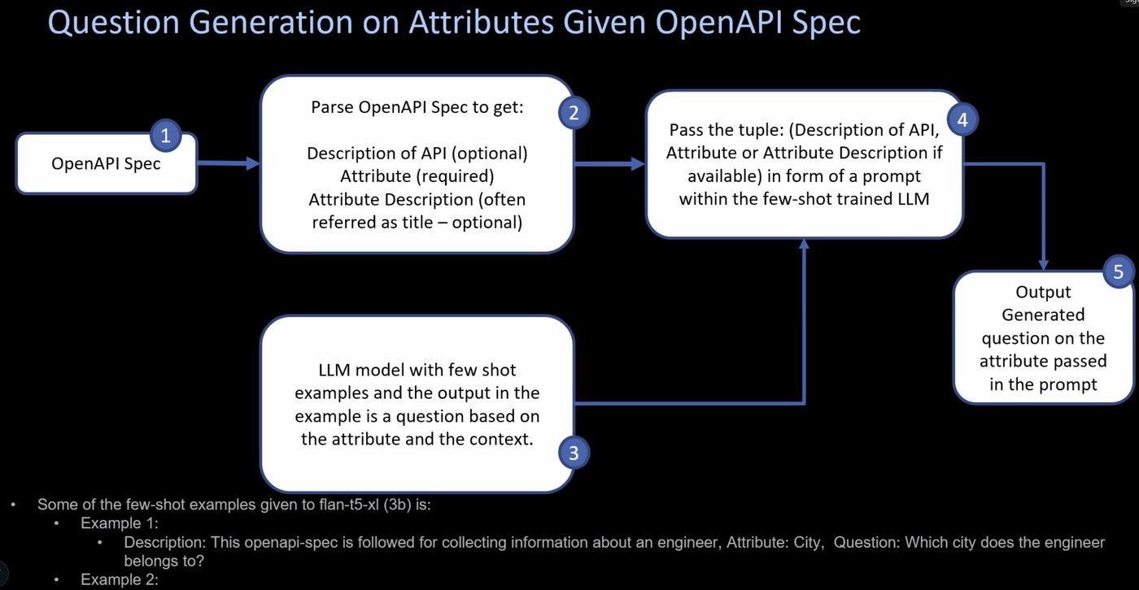
INSIGHT 05 · LLM agents & applied foundation models
Building Conversational Artifacts for APIs and RPAs
Conversational artifacts · AAAI 2024
GOAL
• Make API/RPA automation usable by non-technical users via conversational digital assistants.
CHALLENGE
• Domain knowledge and LLM fine-tuning are costly (esp. for SMEs); LLMs at runtime risk trust and indemnity.
METHOD
• Human-guided authoring of API services as chatbot skills
• LLMs used only in the build phase — pre-generate and review conversational artifacts
• Intent classification, question generation and Next-Best-Agent via ChromaDB + MiniLM
NOVELTY
• Pre-generated, reviewed artifacts remove LLMs from user interactions entirely.
IMPACT
Pre-generated conversational artifacts turn APIs / RPAs into chatbot skills.
• Lower build effort, trustworthy automation and an automated DevOps deployment pipeline.
[5] “Building Conversational Artifacts to Enable Digital Assistant for APIs and RPAs,” AAAI 2024.

Slide 9
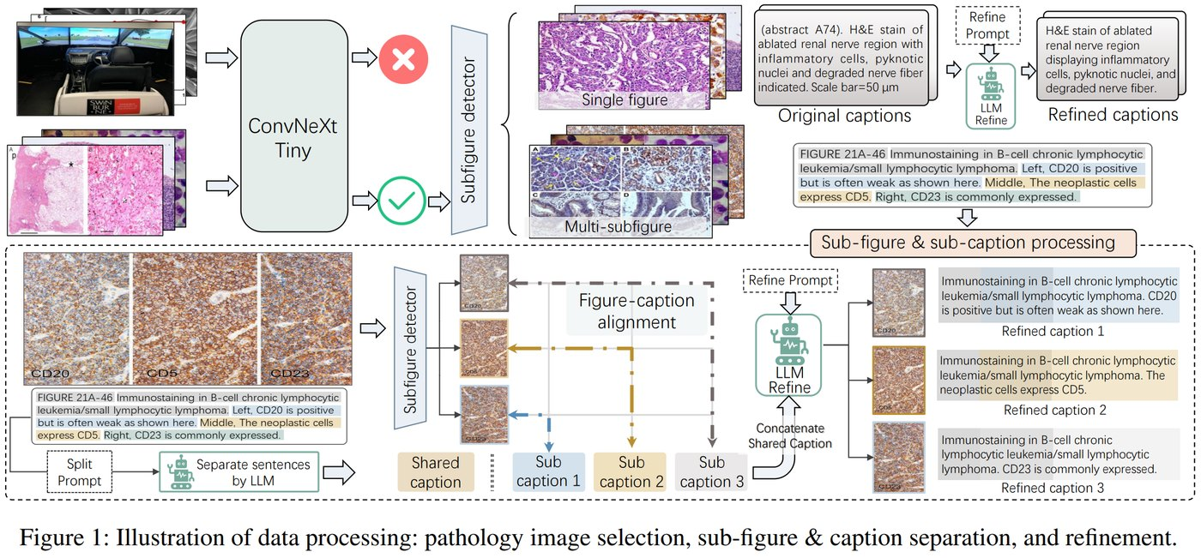
INSIGHT 06 · LLM agents & applied foundation models
PathAsst: A Generative Foundation AI Assistant for Pathology
PathAsst · AAAI 2024
GOAL
• Build a multimodal generative foundation assistant for diagnostic and predictive pathology.
CHALLENGE
• Pathology multimodal models are limited by scarce tailored data and model frameworks.
METHOD
• Collect 207K pathology image-text pairs + 180K ChatGPT instruction samples (PathCap, PathInstruct)
• Build PathCLIP, a pathology-dedicated CLIP model
• Integrate PathCLIP with Vicuna-13B, plus eight pathology-specific sub-models
NOVELTY
• A pathology-dedicated CLIP + instruction-tuned assistant toward pathology AGI.
IMPACT
PathAsst — PathCLIP + Vicuna-13B, a generative foundation assistant for pathology.
• Stronger diagnostic and predictive analytics on digitized histopathology.
[6] “PathAsst: A Generative Foundation AI Assistant towards AGI of Pathology,” AAAI 2024.

Slide 10
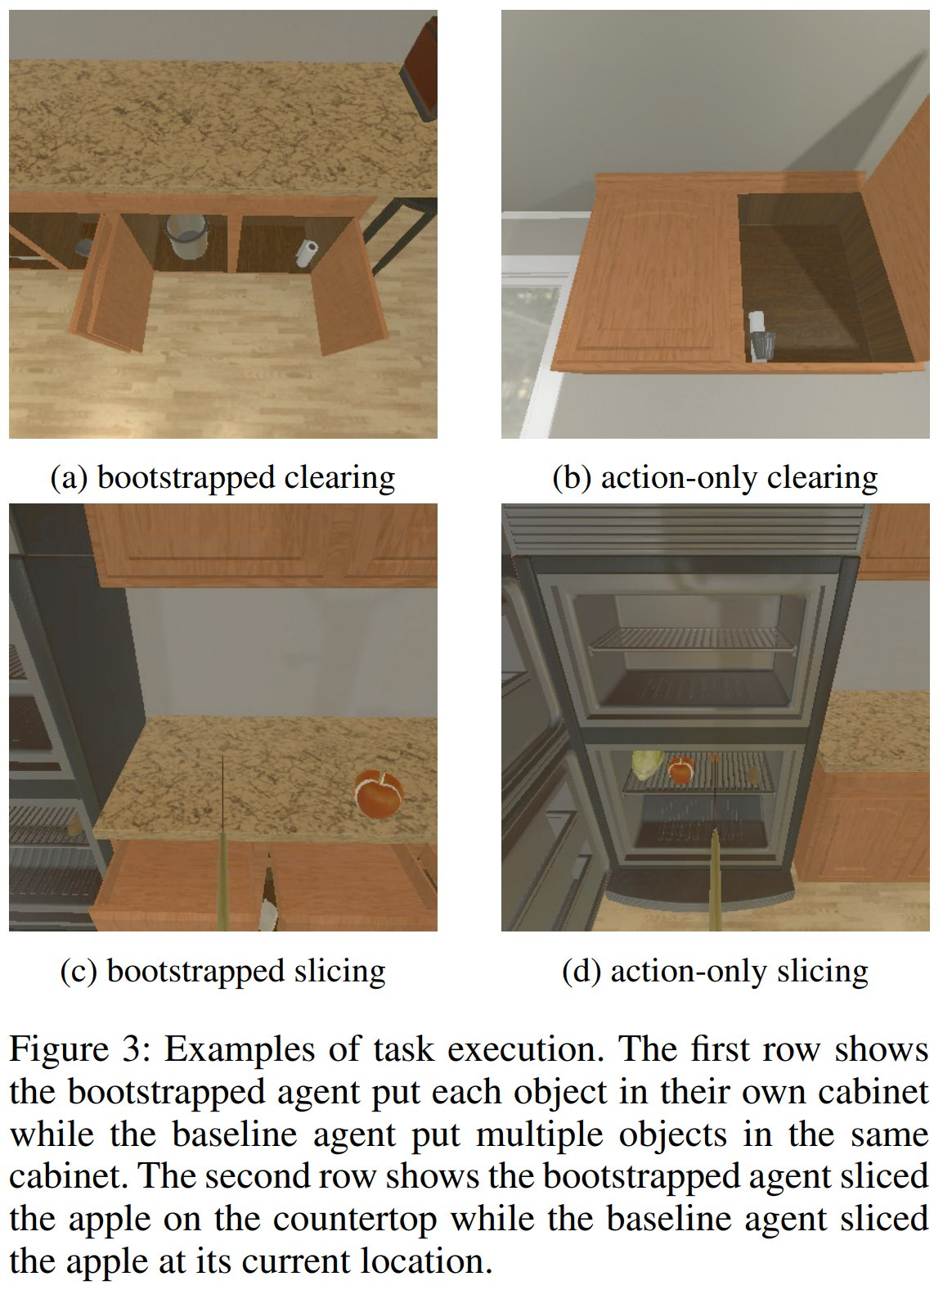
INSIGHT 07 · LLM agents & applied foundation models
Bootstrapping Cognitive Agents with a Large Language Model
LLM-bootstrapped cognitive agents · AAAI 2024
GOAL
• Combine LLM common-sense with a cognitive architecture for embodied tasks.
CHALLENGE
• Cognitive architectures need knowledge; LLMs hallucinate and need grounding.
METHOD
• Separate knowledge generation (LLM) from application (cognitive architecture)
• Generate English action descriptions → executable Python production rules; a critic LLM improves them
• Production reinforcement updates utilities; evaluate in AI2THOR kitchens (find / slice / clear)
NOVELTY
• A modular LLM + cognitive-architecture bootstrap that curbs hallucination and generalizes.
IMPACT
Bootstrapping a cognitive agent with an LLM that generates and refines production rules.
• More efficient, adaptable embodied agents that need minimal LLM help at runtime.
[7] “Bootstrapping Cognitive Agents with a Large Language Model,” AAAI 2024.

Slide 11
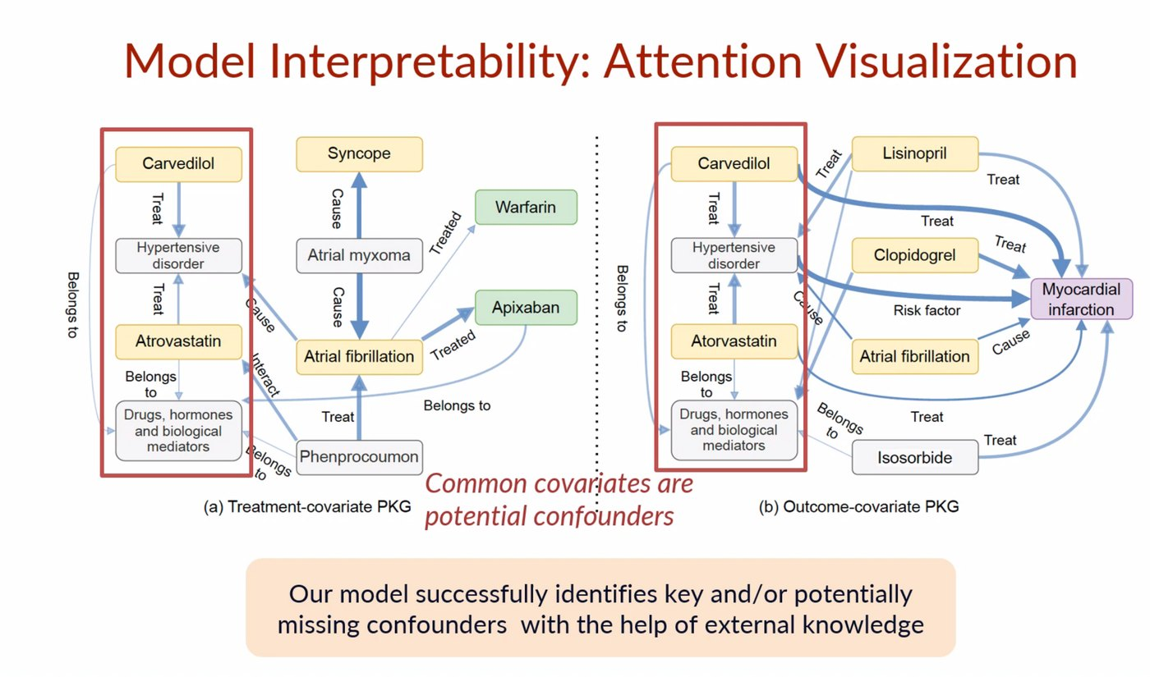
INSIGHT 08 · LLM agents & applied foundation models
KG-TREAT: Treatment Effect Estimation by Synergizing Patient Data with Knowledge Graphs
KG-TREAT · AAAI 2024
GOAL
• Improve treatment-effect estimation (TEE) by combining patient data with biomedical knowledge graphs.
CHALLENGE
• Small labeled data and sparse, high-dimensional records; full KGs add noise and miss causal links.
METHOD
• Dual-focus personalized KGs (treatment-covariate and outcome-covariate)
• Deep bi-level attention synergy (DIVE) across covariates, treatments and outcomes
• Pre-train with masked-code + link prediction, then fine-tune for TEE
NOVELTY
• Dual-focus PKGs + bi-level attention deeply fuse patient data and knowledge graphs.
IMPACT
KG-TREAT — dual-focus personalized knowledge graphs fused with patient data (DIVE).
• Beats baselines on AUC / AUPR / IF-PEHE — better, generalizable treatment-effect estimation.
[8] “KG-TREAT: Pre-training for Treatment Effect Estimation by Synergizing Patient Data with Knowledge Graphs,” AAAI 2024.

Slide 12
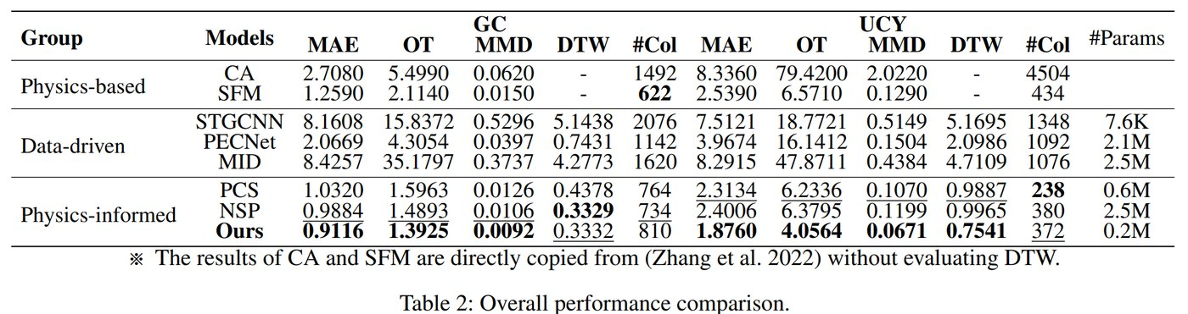
INSIGHT 09 · Simulation, perception & autonomous driving
SPDiff: Social-Physics-Informed Diffusion Model for Crowd Simulation
SPDiff · AAAI 2024
GOAL
• Produce realistic, generalizable crowd simulation for urban planning and traffic.
CHALLENGE
• Physics models miss micro motion; data-driven methods don't generalize; trajectories are complex and heterogeneous.
METHOD
• A conditional denoising diffusion model infused with Social-Force physics
• Equivariant / invariant constraints on position, velocity and acceleration
• Multi-frame rollout training for long horizons; a graph network for interactions
NOVELTY
• Infuses physical knowledge and equivariance into a diffusion model for crowds.
IMPACT
SPDiff — a social-physics-informed diffusion model for crowd simulation.
• More realistic, generalizable long-horizon crowd simulation.
[9] “Social Physics Informed Diffusion Model for Crowd Simulation,” AAAI 2024.

Slide 13
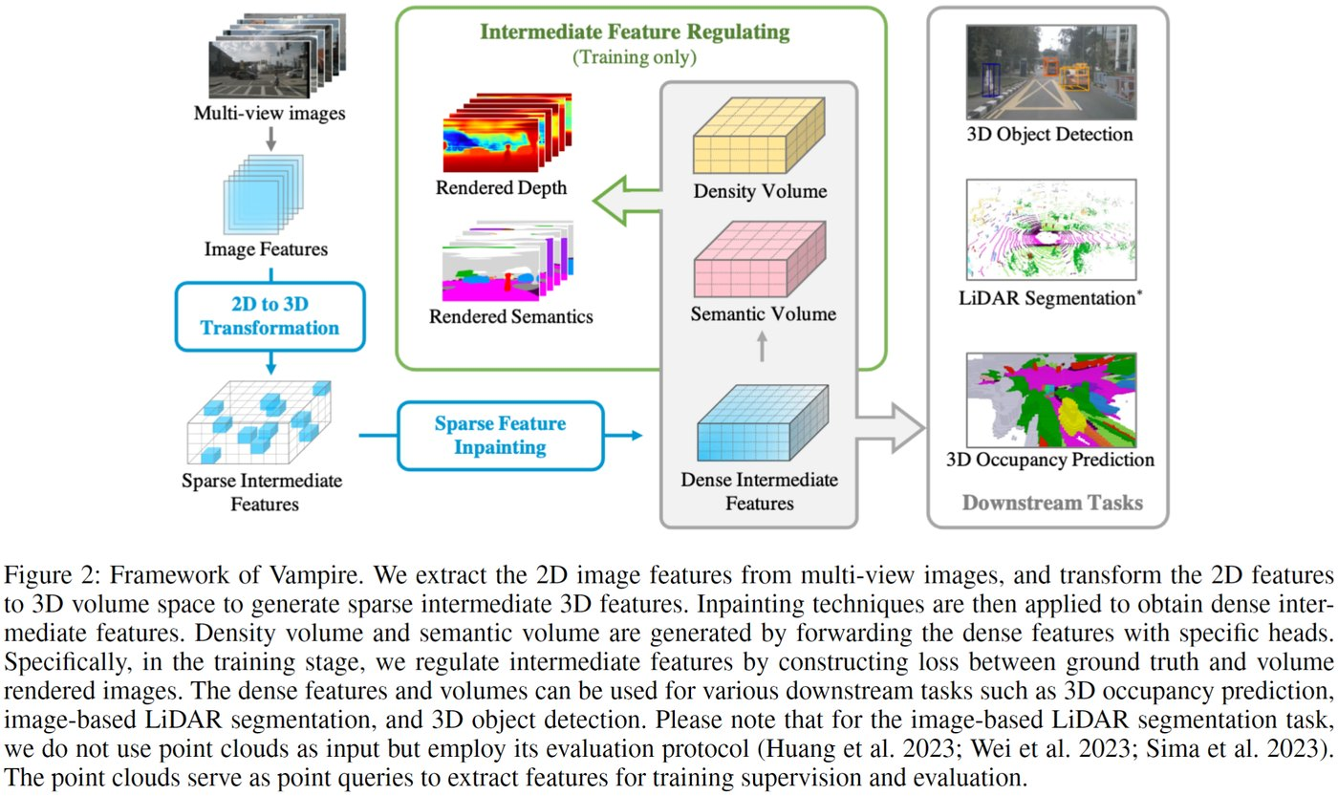
INSIGHT 10 · Simulation, perception & autonomous driving
Vampire: Regulating Intermediate 3D Features for Vision-Centric Autonomous Driving
Vampire · AAAI 2024
GOAL
• Generate better dense 3D features for multi-camera autonomous-driving perception.
CHALLENGE
• Multi-camera perception struggles to produce dense, useful 3D features.
METHOD
• LSS 2D→3D transform; a 3D hourglass inpaints sparse features into dense ones
• Volume rendering as a regulator for dense 3D features (camera and bird's-eye view)
• Signed-Distance-Function-modeled density + semantic volumes
NOVELTY
• Uses volume rendering as a regulator for intermediate 3D features across tasks.
IMPACT
Vampire — volume rendering regulates dense intermediate 3D features for AV perception.
• Competitive 3D occupancy, LiDAR segmentation and 3D detection from cameras alone.
[10] “Regulating Intermediate 3D Features for Vision-Centric Autonomous Driving,” AAAI 2024.

Slide 14
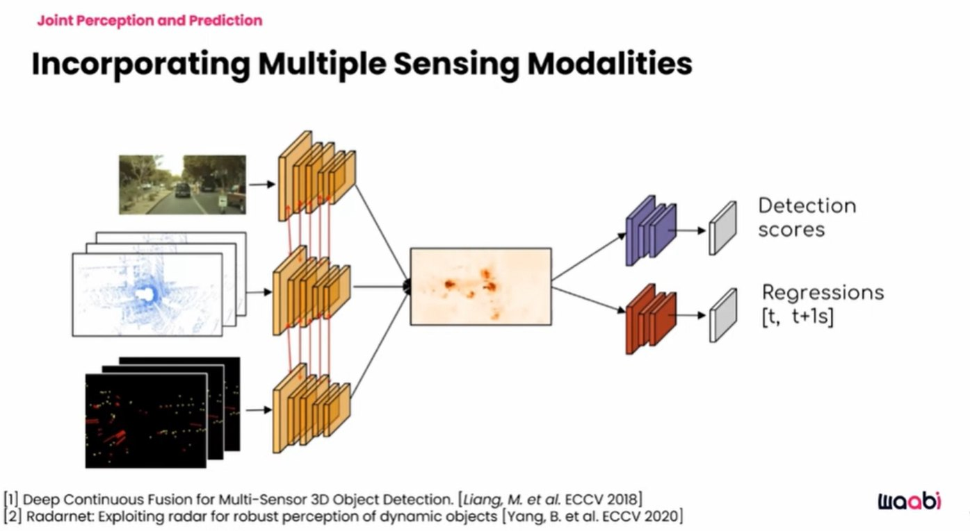
INSIGHT 11 · Simulation, perception & autonomous driving
Accelerating AVs with the Next Generation of Generative AI (Keynote)
Raquel Urtasun (keynote) · Waabi
GOAL
• Rethink autonomous driving with scalable generative-AI simulation and foundation models.
CHALLENGE
• Real-world AV testing is labor- and capital-intensive; rare events are hard; the industry is consolidating.
METHOD
• Deep structure models — scalable, affordable optimization
• Waabi World: an AI simulator that builds digital twins from raw sensor data
• Waabi Driver: an interpretable foundation model learning from simulation + real data
NOVELTY
• Generative-AI simulation plus an interpretable, verifiable AV foundation model.
IMPACT
Waabi World + Waabi Driver — generative-AI simulation and an interpretable AV foundation model.
• Faster, safer, more scalable AV deployment without endless real-world miles.
[11] R. Urtasun, “Accelerating AVs with the Next Generation of Generative AI,” AAAI 2024 (invited talk).

Slide 15
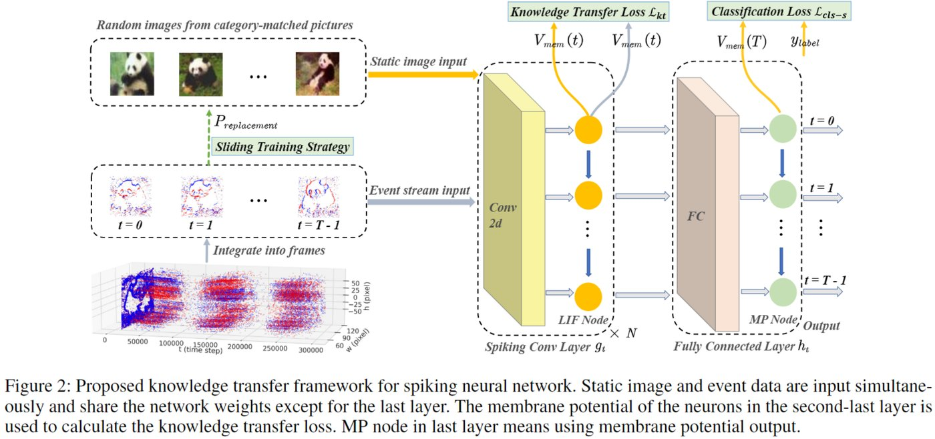
INSIGHT 12 · Robust & efficient learning
Efficient Knowledge Transfer for Spiking Neural Networks from Static to Event Domain
SNN static→event transfer · AAAI 2024
GOAL
• Train spiking neural networks (SNNs) well on scarce event-based neuromorphic data.
CHALLENGE
• Event datasets are small and under-annotated → SNNs overfit; there is a static↔event domain mismatch.
METHOD
• Use static images to assist SNN training
• A knowledge-transfer loss: domain-alignment + spatio-temporal regularization
• A sliding training strategy from static-invariant features to full event processing
NOVELTY
• A domain-alignment + spatio-temporal transfer that fuses static and event features.
IMPACT
Static→event knowledge transfer for spiking neural networks via domain alignment.
• Better-generalizing, less-overfit SNNs for neuromorphic event vision.
[12] “An Efficient Knowledge Transfer Strategy for Spiking Neural Networks from Static to Event Domain,” AAAI 2024.

Slide 16
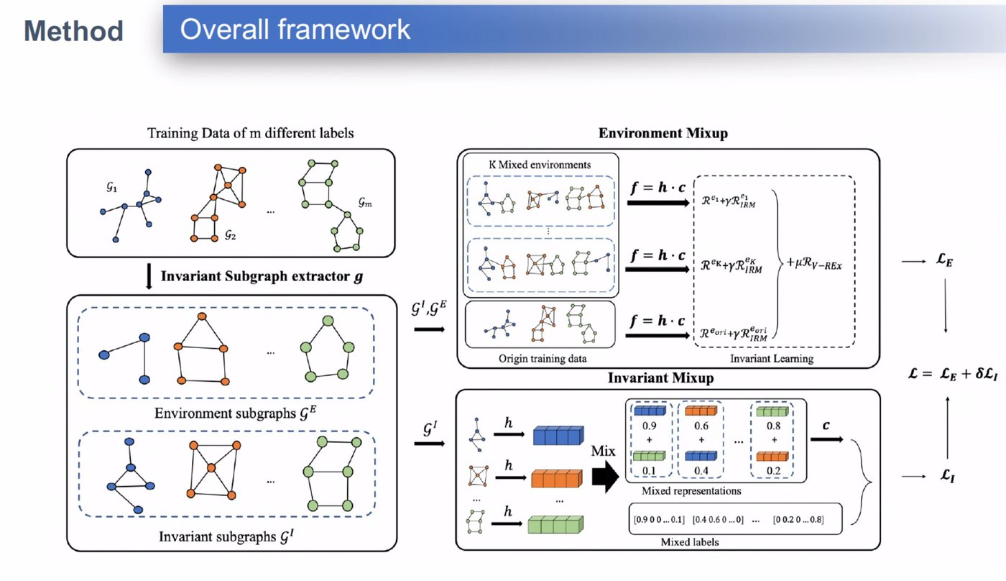
INSIGHT 13 · Robust & efficient learning
Graph Invariant Learning with Subgraph Co-mixup for OOD Generalization
Graph invariant learning (co-mixup) · AAAI 2024
GOAL
• Make graph neural networks generalize under distribution shift (out-of-distribution).
CHALLENGE
• GNNs generalize poorly OOD; invariant learning needs diverse environments; mixup blurs invariant vs environment subgraphs.
METHOD
• An invariant-subgraph extractor separates invariant vs environment subgraphs
• Environment Mixup + Invariant Mixup generate diverse training environments
• Retain only invariant information, removing spurious correlations
NOVELTY
• Subgraph co-mixup combining invariant learning with environment mixing.
IMPACT
Graph invariant learning with environment / invariant subgraph co-mixup for OOD.
• Stronger OOD generalization for molecular, protein and social graphs.
[13] “Graph Invariant Learning with Subgraph Co-mixup for Out-of-Distribution Generalization,” AAAI 2024.

Slide 17
CONCLUSIONS
Synthesis across the papers
INSIGHTS
VISION
IMPLICATIONS FOR US
• LLMs dominate AAAI 2024, but the theme is reliability — citations (CoT + CIM), symbolic solvers (SYRELM), grounding (cognitive agents) and probing rationality limits.
• Foundation / multimodal models reach high-stakes domains — pathology (PathAsst) and healthcare treatment effects with knowledge graphs (KG-TREAT).
• Physics- and structure-informed generative models (SPDiff, Vampire, Waabi) bring realism and verifiability to simulation and autonomous driving.
• Interpretable, verifiable foundation models (Urtasun / Waabi) over black boxes.
• Hybrid neuro-symbolic and LLM + cognitive-architecture systems that curb hallucination.
• Efficiency and robustness: frugal LMs, neuromorphic SNNs and OOD-robust GNNs.
• Pair LLMs with retrieval, symbolic solvers and knowledge graphs for trustworthy, citeable outputs.
• Use generative simulation and digital twins to cut real-world data and testing cost.
• Invest in domain-adapted foundation models and OOD / robustness for deployment.

