Slide 1


Retail Banking
System
Java FSD AWS Angular Training Batch 10
Team Members
Ain Nurizzati Mustafa (236051)
Muhammad Syazwan Rosli (236055)
Nurin Annisha Abdul Razak (236049)
Trainer
Venkatesh Manda

Slide 2
The retail bank has historically been served by a large monolith system.
This system covers four main modules which are customers, accounts, transactions and rules modules.
Introduction
Retail Banking System

Slide 3





Front end: Angular Framework
Back end: Java, SpringBoot, RESTFul Services
Databases: MySQLWorkbench
Tools: Spring Tool Suite, Postman
Technologies
used in Retail Banking System

Slide 4
Create Customer
Employee shall be able to register all customers
Get Customer Details
Employee shall be able to view all customer details
Customer Module
Operations

Slide 5
Create Account
Employee shall be able to create customer's account once customer is successfully registered.
Get Customer Account(s)
Employee shall be able to view all customer account's by Customer ID.
Get Account Statement
Customer shall be able to view their bank account statement
Accounts Module
Operations

Slide 6
Transfer
Customer shall be able to transfer an amount of money to other bank accounts
Deposit
Deposit operates at the back end of retail banking system only
Withdraw
Withdraw operates at the back end of retail banking system only
Transactions Module
Operations

Slide 7
Home
Customer shall be able to log in to the retail banking system and system will operate all functionalities.
Employee
Employee shall be able to create customer's account once customer is successfully registered.
Customer
Customer shall be able to view their bank account statement
UI Portal
Operations

Slide 8
Login
Employee and customer shall be able to login to the system successfully.
Logout
Employee and customer shall be able to logout from the system successfully.
Authentication Module
Operations

Slide 9
Evaluate Minimum Balance
The retail banking system shall be able to evaluate minimum balance of a customer's account during transaction process.
Rules Module
Operations

Slide 10
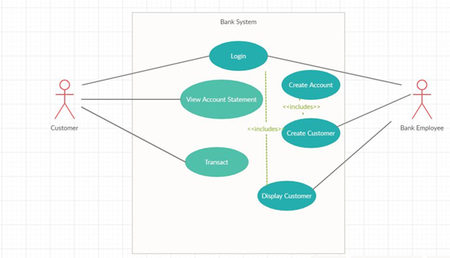
Use Case
Diagram

Slide 11
This system covers four main modules which are customers, accounts, transactions and rules modules.
Databases: MySQLWorkbench
Tools: Spring Tool Suite, Postman
Backend

Slide 12
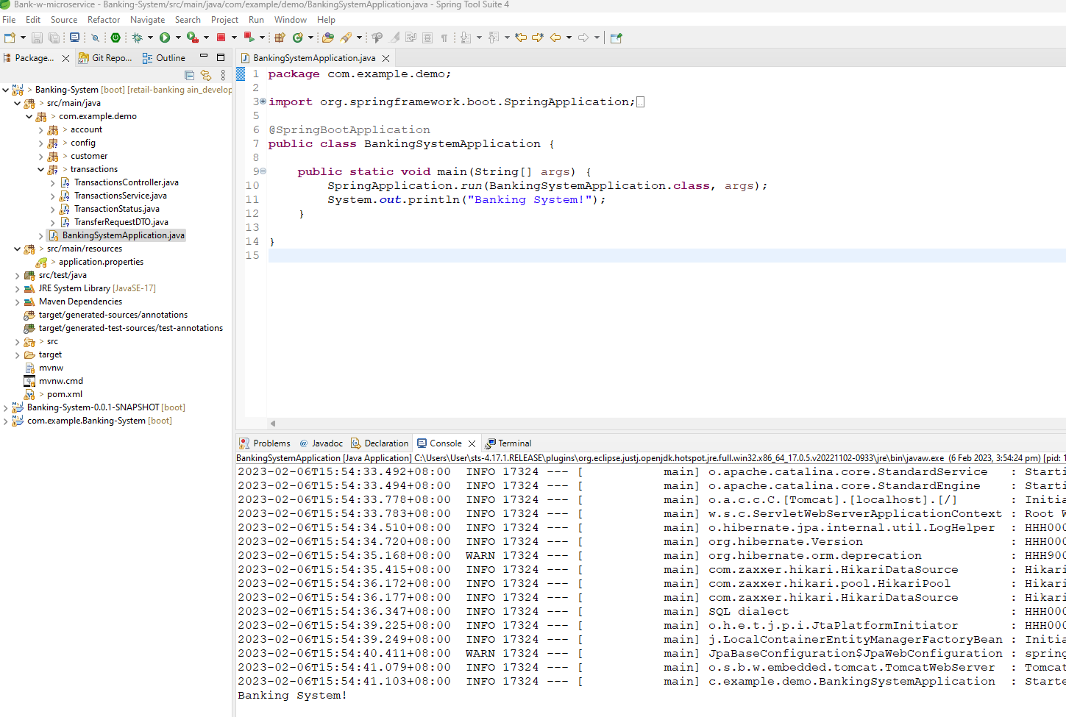
Spring Tool Suite

Slide 13
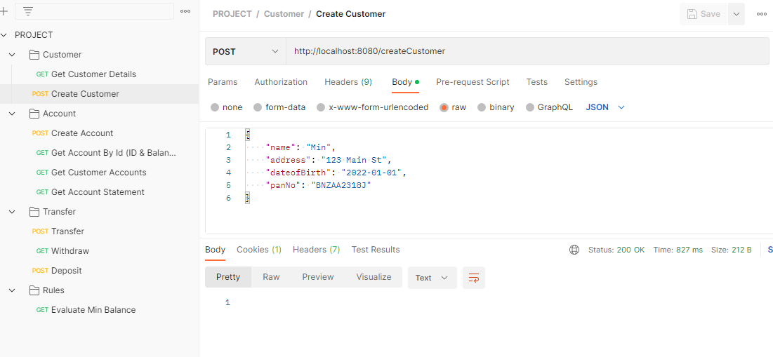
Postman Workspace

Slide 14
Homepage
Employee
Customer
Frontend

Slide 15
Homepage

Slide 16
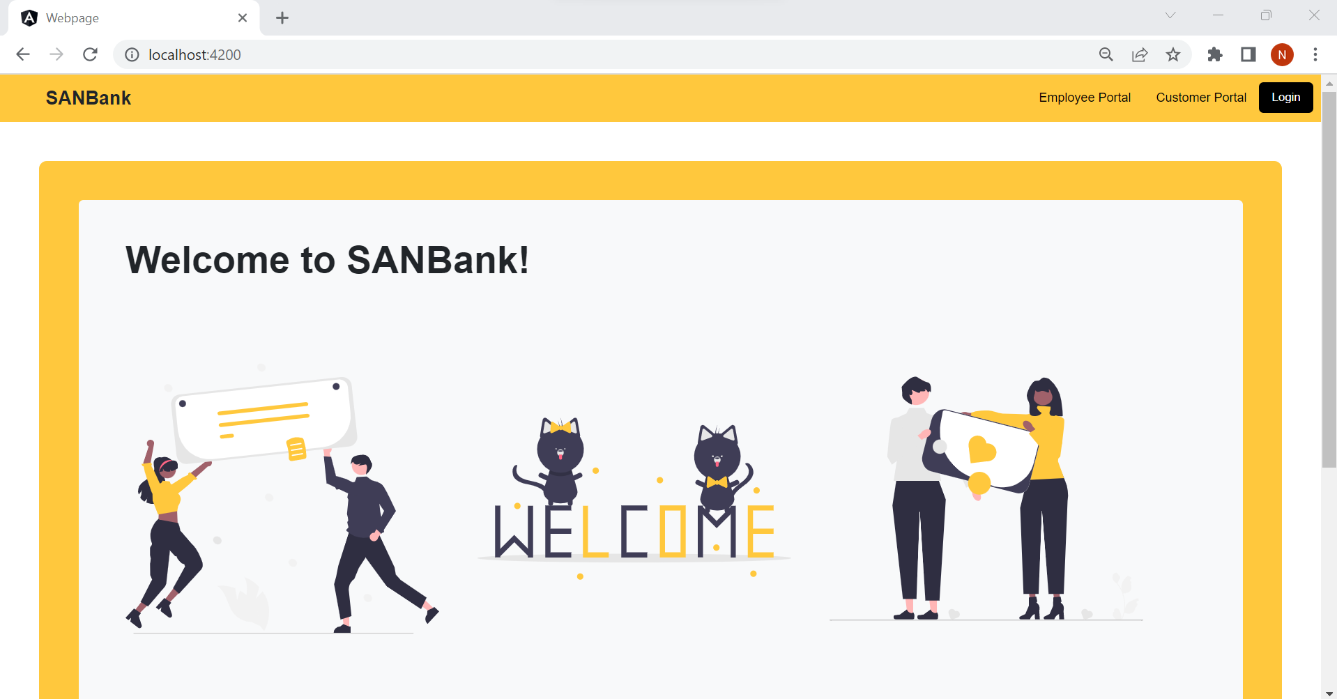

Slide 17
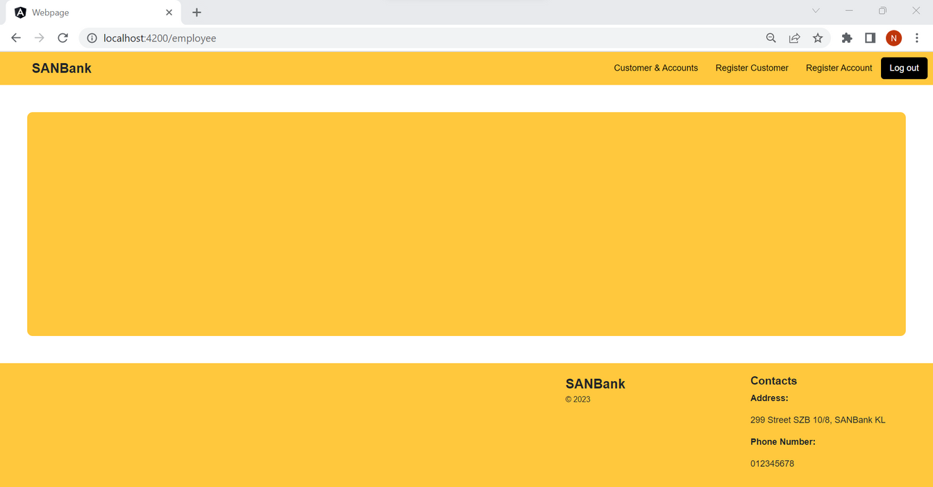
Employee

Slide 18
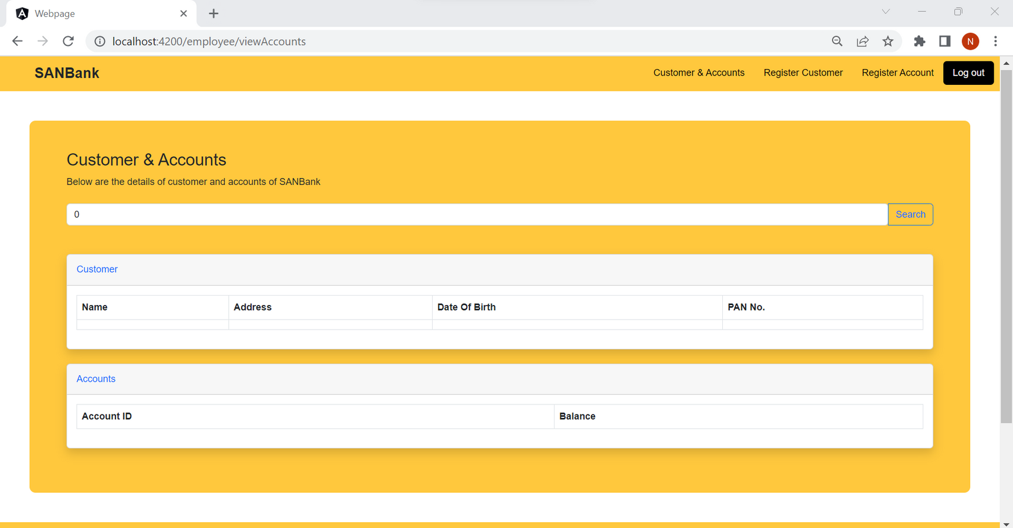
Customer & Accounts

Slide 19
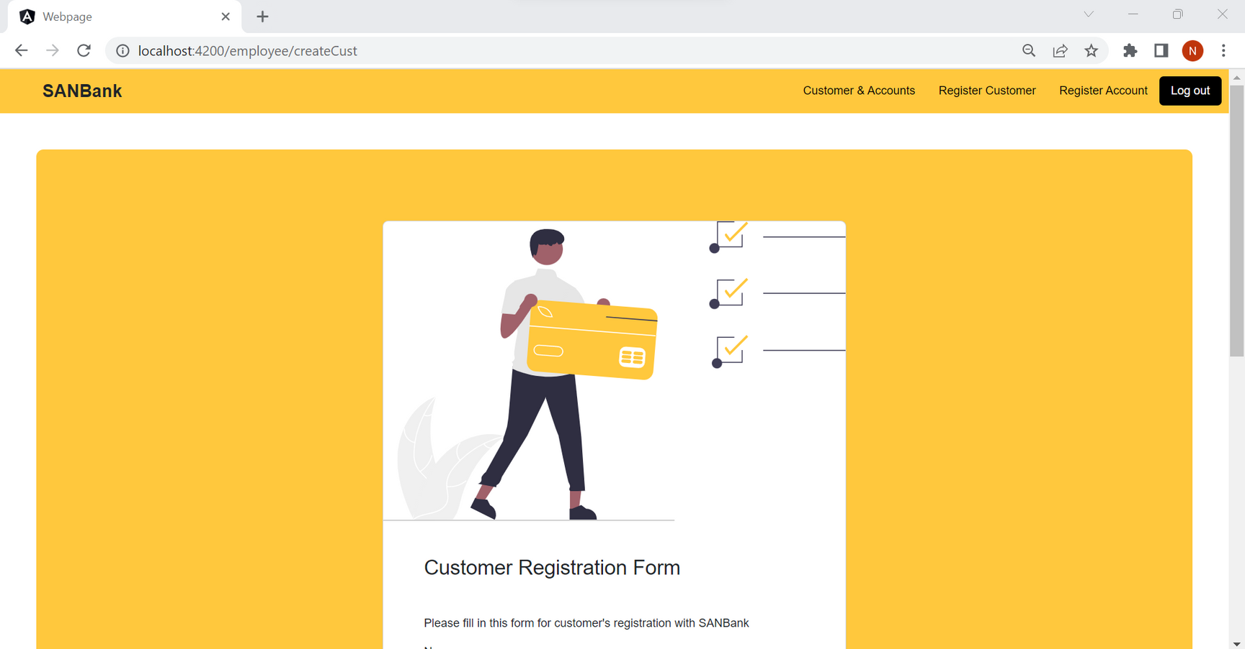
Register Customer

Slide 20
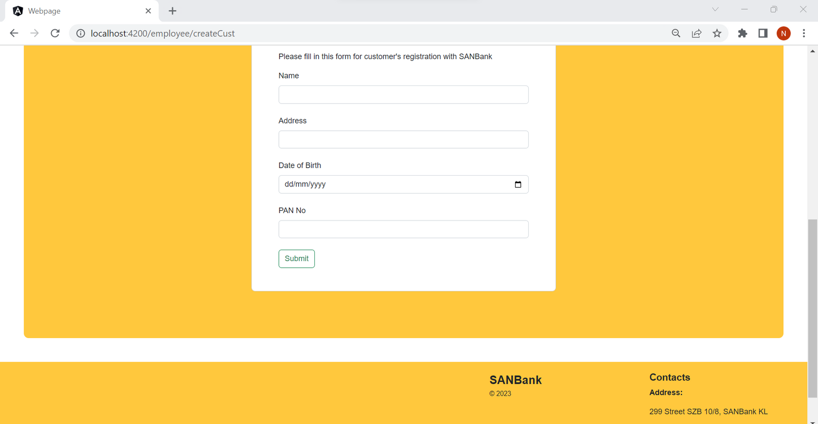
Register Customer

Slide 21
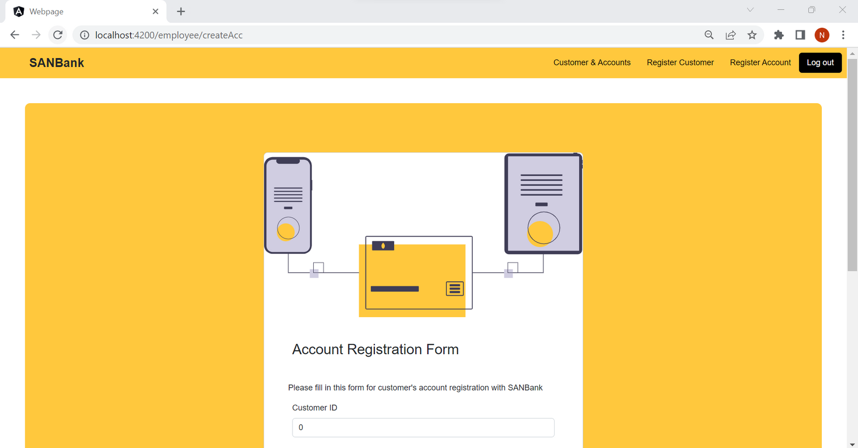
Register Account

Slide 22
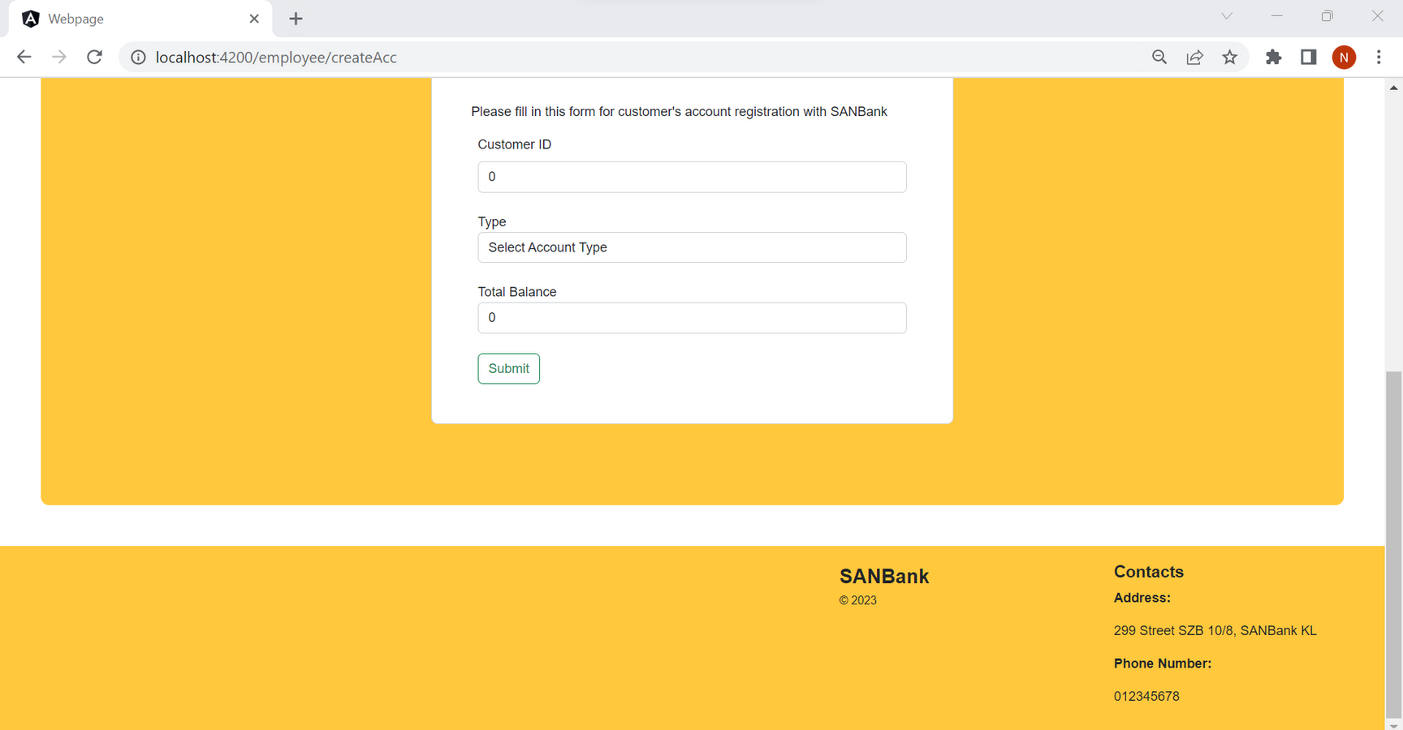
Register Account

Slide 23
Customer

Slide 24
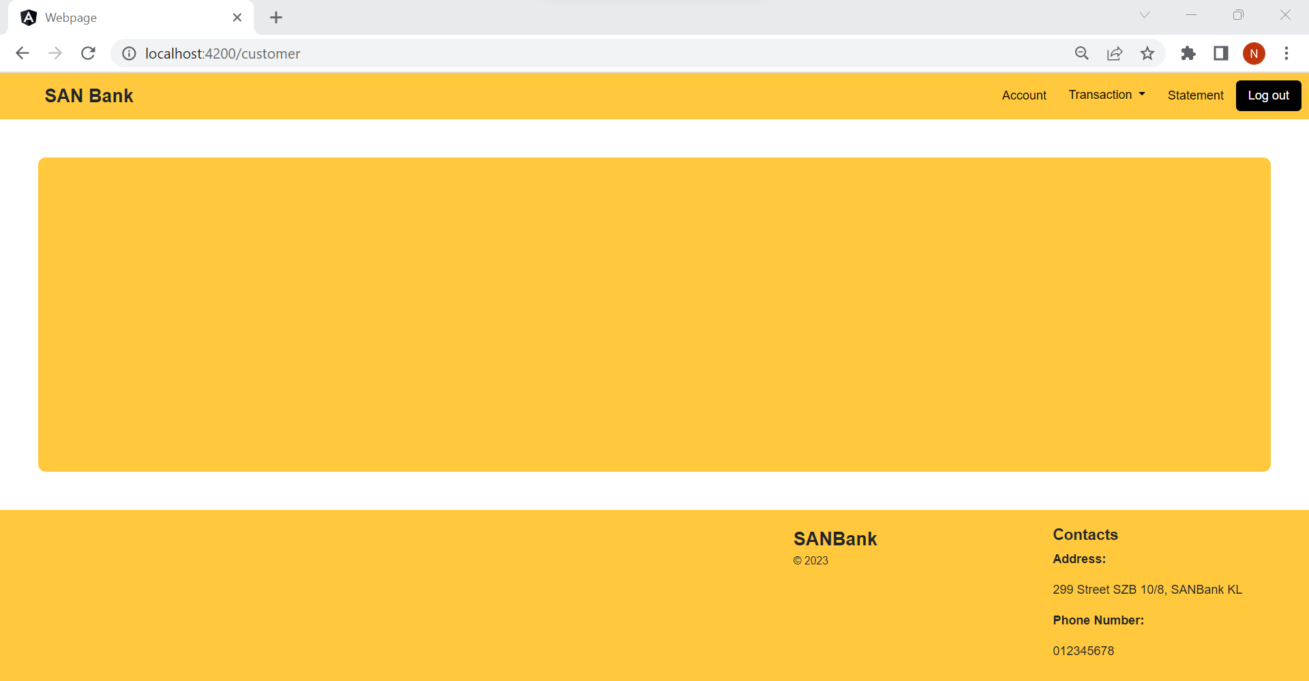

Slide 25
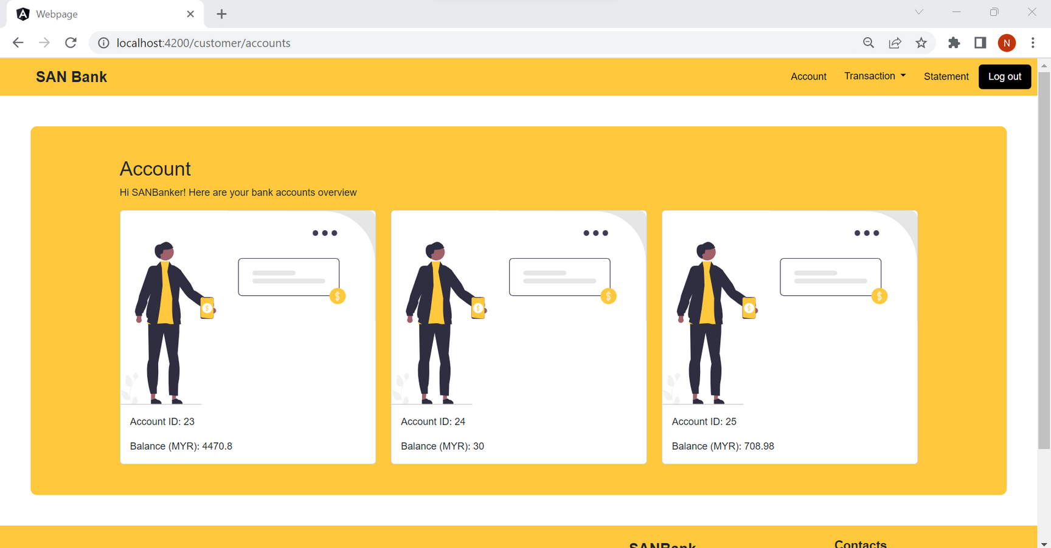
Account

Slide 26
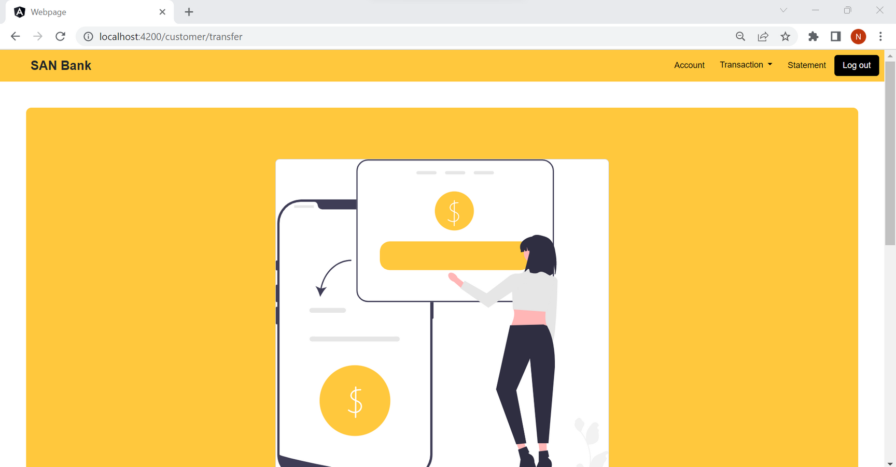
Transactions

Slide 27
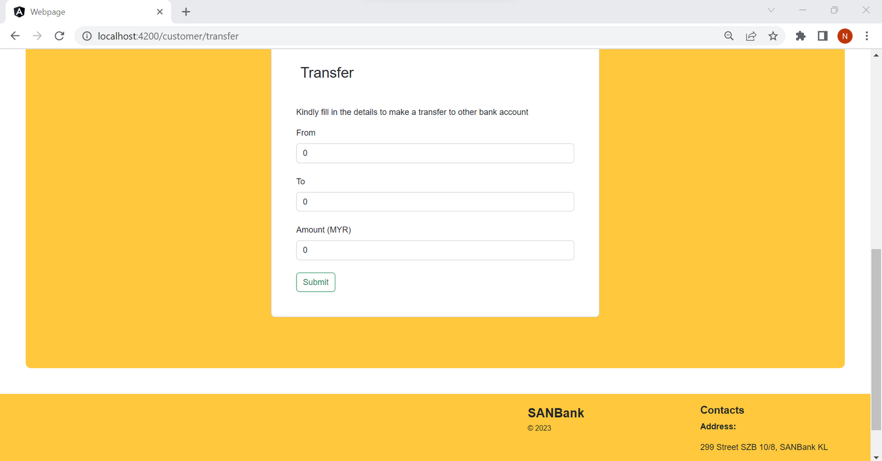
Transactions

Slide 28
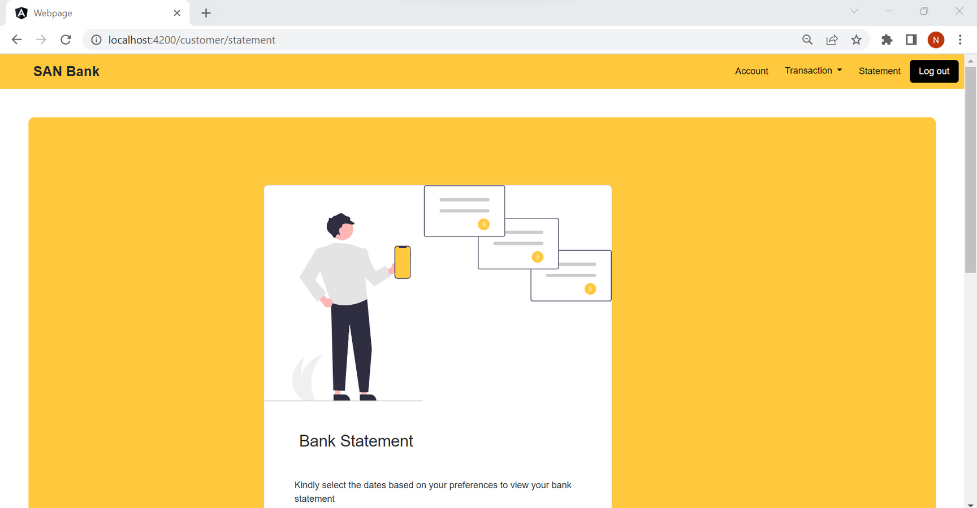
Statement

Slide 29
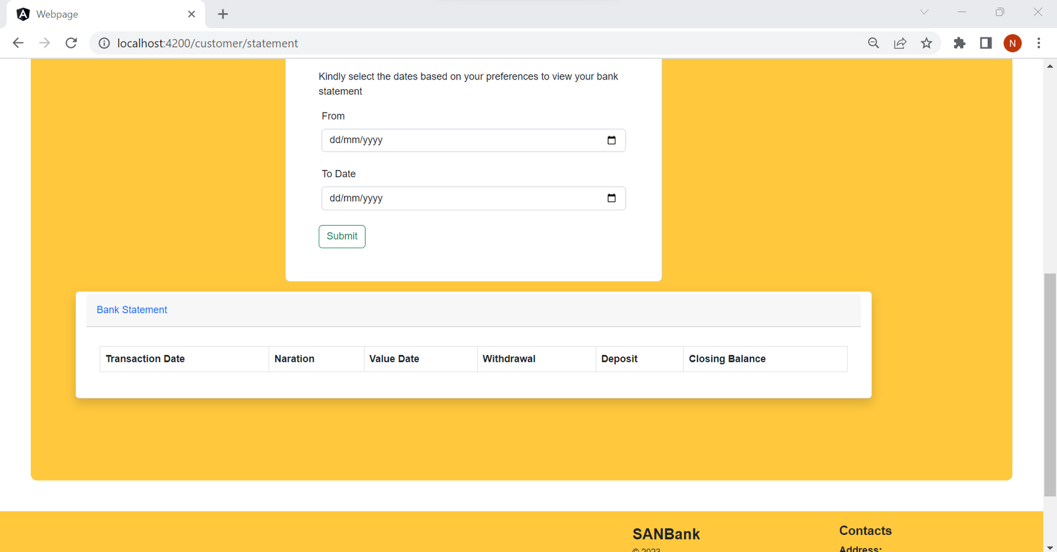
Statement

Slide 30
Thank You!

