Slide 1


Predicting Party Affiliation from Demographics
Testing conventional wisdom about age, income, and gender as predictors of partisanship in New York State
2021 New York Voter File Analysis
n ≈ 84,000 registered voters | 1% representative sample
By: Samari, Matthew, and Ainsley

Slide 2



What Conventional Wisdom Says
In political science and polling, demographic variables like age, income, and gender are widely treated as strong, reliable predictors of party identification. These factors reflect generational political socialization patterns and create predictable voting blocs observed across multiple electoral cycles. But does this hold when we test it on real individual-level data?
Age
Income
Gender

Slide 3
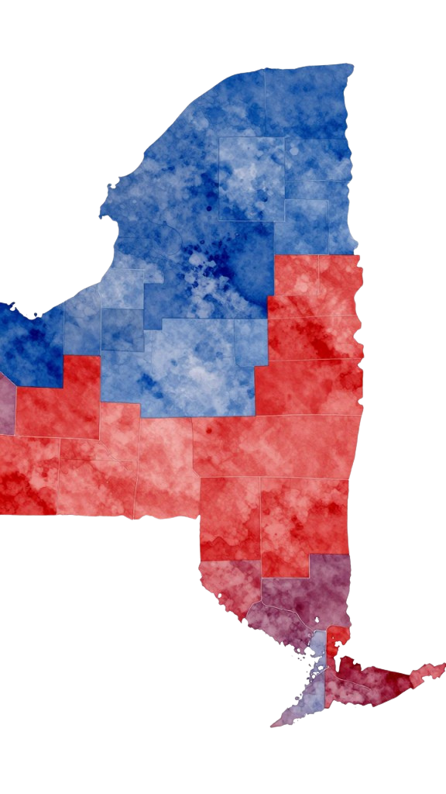



Why New York?
Internal diversity
Individual-level analysis
Real data
While New York votes solidly Democratic in aggregate, it contains significant regional and demographic variation - making it an ideal test case where patterns aren't obvious at first glance.
Our findings are based on real voter records and actual behavior, not surveys or predictive models - providing concrete evidence rather than projections.
We analyze actual voter behavior at the individual level, cutting against typical state-level polling that often masks important micro-level variations.

Slide 4
Data: 2021 New York Voter File
L2 2021 New York Voter File (1% sample, N ≈ 84,000 voters)
1
Exclusions
●
Inactive & non-partisan voters excluded for simplicity
●
Education/ethnicity data excluded due to quality issues

Slide 5
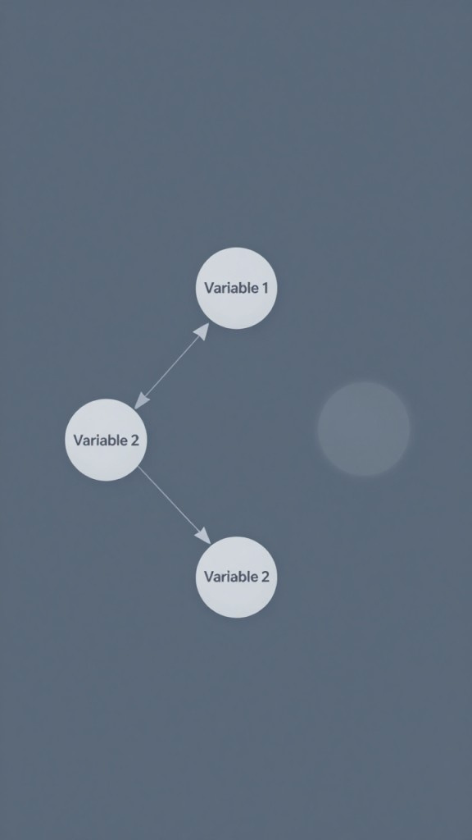
What We Expected to Find
Based on socioeconomic theory and prior research, we expected:
1. Income
2. Age
3. Gender
Strongest predictor of party identification
Moderate predictor of party identification
Weakest predictor of party identification

Slide 6


Our Hypothesis
1. Income
2. Age
3. Gender
Hypothesized as strongest predictor of party affiliation based on socioeconomic status theories
Hypothesized as moderate predictor due to generational political socialization patterns
Hypothesized as weakest predictor given recent convergence in political attitudes

Slide 7

The Analytical Journey
1
2
3
4
Raw Data
Define Variables
Build Model
Discover Insight
84,000 voters from NY file
Modest predictive power
Linear regression through R
Age, Income, Gender
Processed through Redivis
Graphics through R

Slide 8



The Gap: Expected vs. Actual
Conventional Expectation
What the Data Shows
Income strongest, Age moderate, Gender weakest
Income and Age similar strength, Gender adds little
Income
1
Income
Age
2
Age
Gender
3
Gender

Slide 9
Individual-Level Predictions
Predicted Probabilities by Income Here
Age Effect Visualization Here
(placeholder for scatter plot or trend line showing how income relates to predicted party affiliation probability)
(placeholder for line chart or heatmap showing age-based predictive patterns)

Slide 10
Model Performance & Results
Variable Importance Chart Here
Model Accuracy Visualization Here
Placeholder for bar chart showing income, age, gender predictive strength
Placeholder for confusion matrix, ROC curve, or classification metrics chart

Slide 11
Study Constraints & Gaps
Non-Partisan Voters Excluded
Limited Time Snapshot
Missing Key Variables
State-Level Only
2021 data only; party affiliation rarely updates in official records
No education, religion, race/ethnicity data due to quality concerns
Findings limited to New York; regional patterns may differ elsewhere
26,108 voters omitted due to focus on binary Dem/Rep affiliation

Slide 12
Why This Matters: Rethinking Voter Prediction
Generalization is risky
Hidden factors
Complexity matters
State-level or national averages obscure individual variation
Education, religion, family history, cultural identity likely matter more than simple demographics
Treating all Democrats or Republicans as a homogeneous demographic bloc is fundamentally flawed

Slide 13
Limitations and Future Work
Limitations
Future Directions
Excluded 26K non-partisan voters
Limited to 2021 snapshot
Multi-state comparison
Incorporate unmeasured variables via survey
Missing key variables (education, religion, race/ethnicity)
Explore non-partisan voters separately

Slide 14
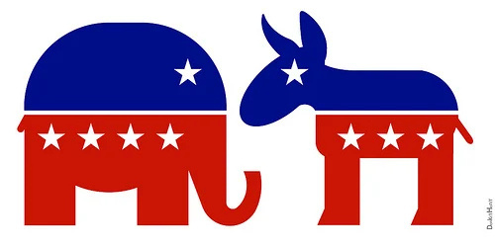
I

