Slide 1
April 18th meeting
Spectrogram recreation
Visually identifying + adding sine waves of certain frequencies
Truncating Cepstrum, ‘undoing’ back to signal, creating cepstrum (error-prone?)

Slide 2
Visually Identifying Frequencies

Slide 3
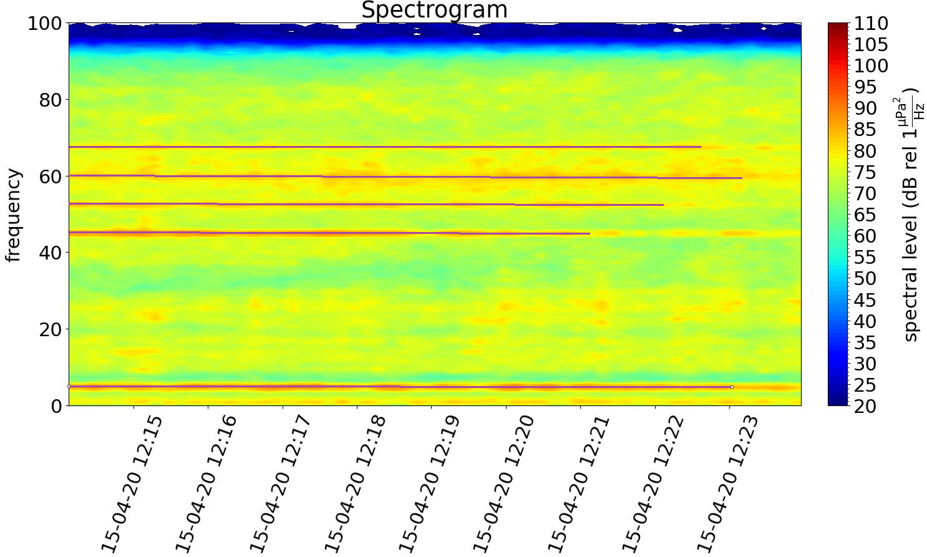
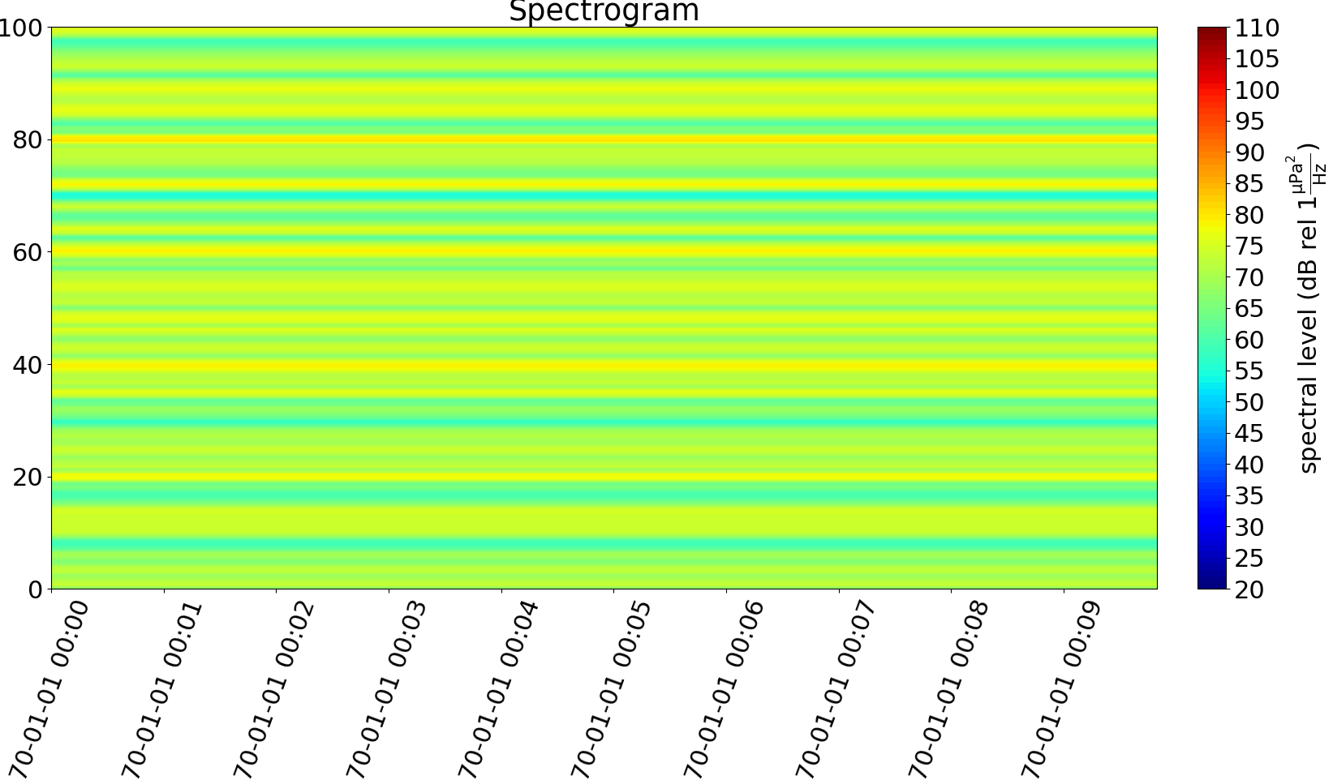
Frequencies at [5, 45, 52, 60, 68]
Lines ‘denote’ sampled/used frequencies (estimated)
Time stamps different since created hdata object has no specific time data

Slide 4
Truncating Cepstrogram

Slide 5
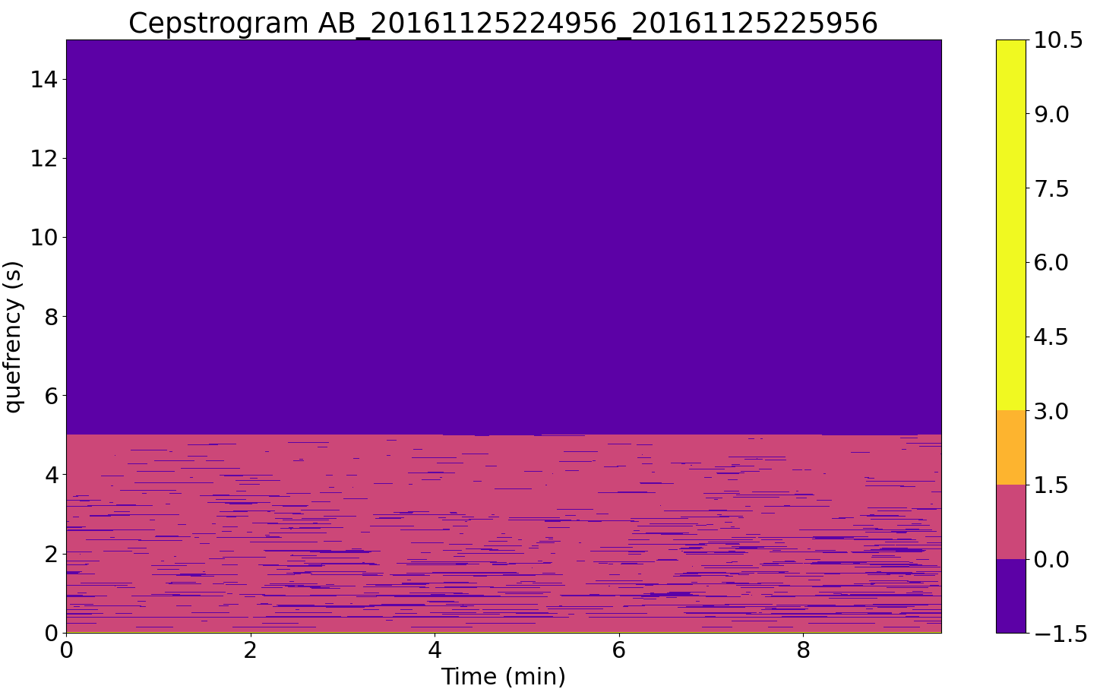
Zeroing out 2/3rd of cepstrogram

Slide 6
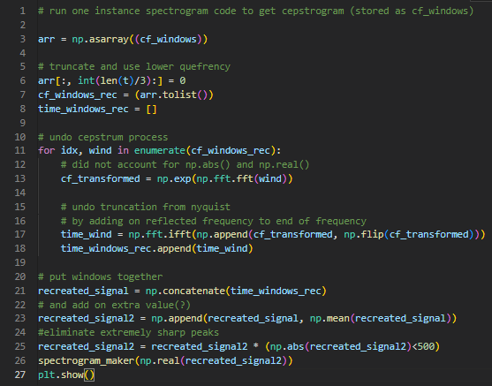

Slide 7
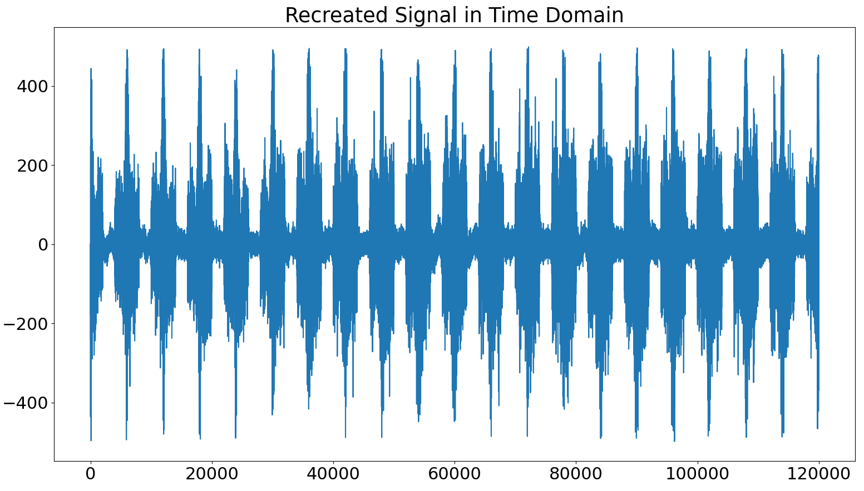

Slide 8
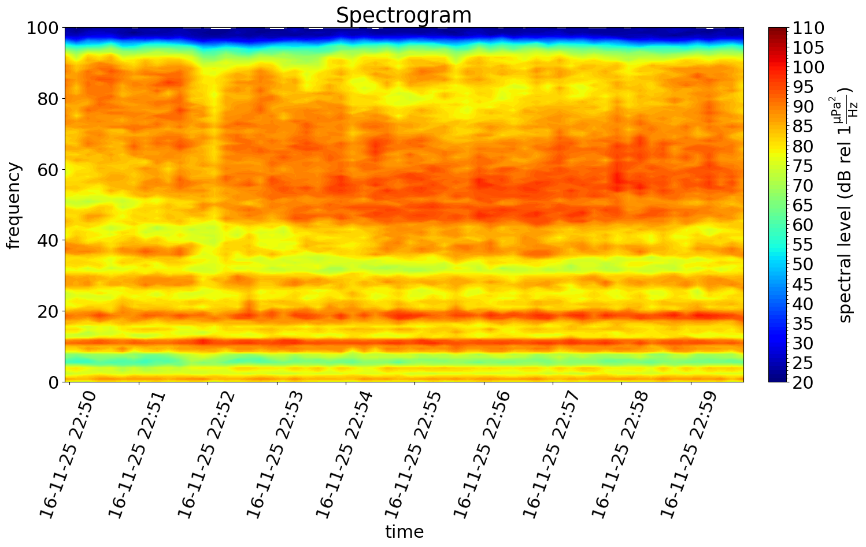
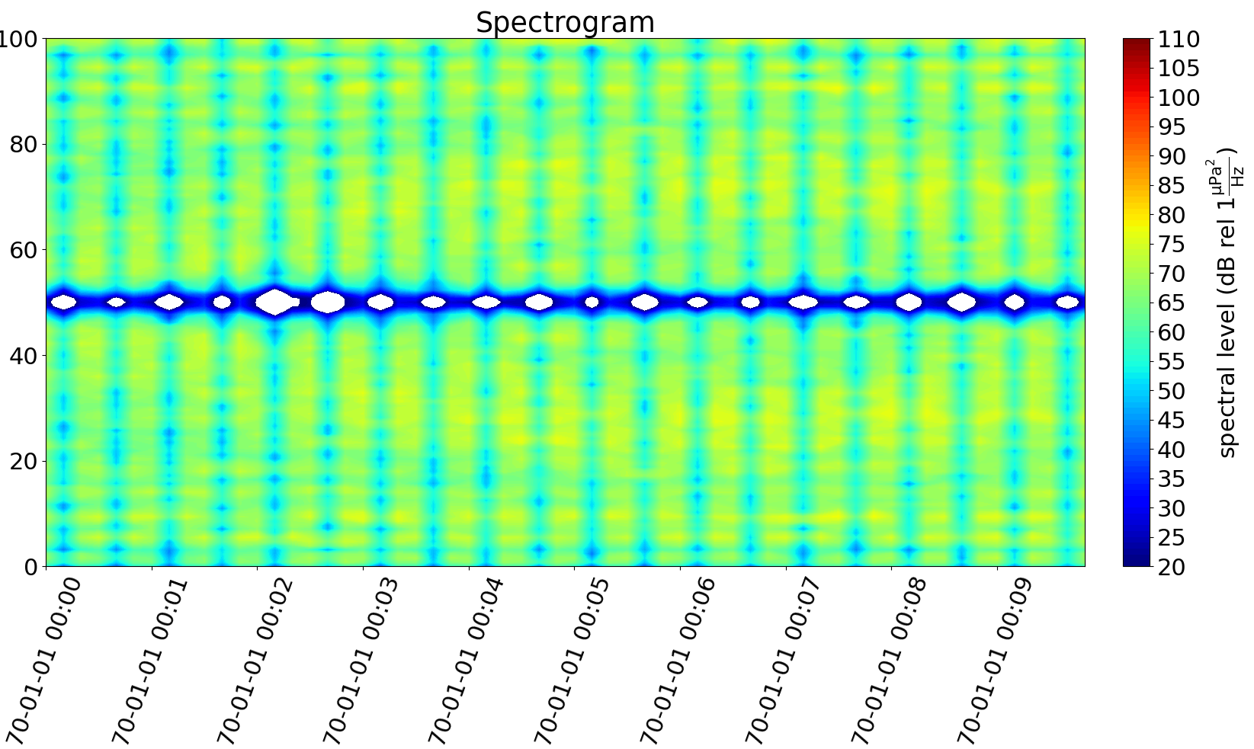
Undoing functions in windowing and concatenating windows back together

Slide 9
Non-windowing Cepstrum Approaches

Slide 10
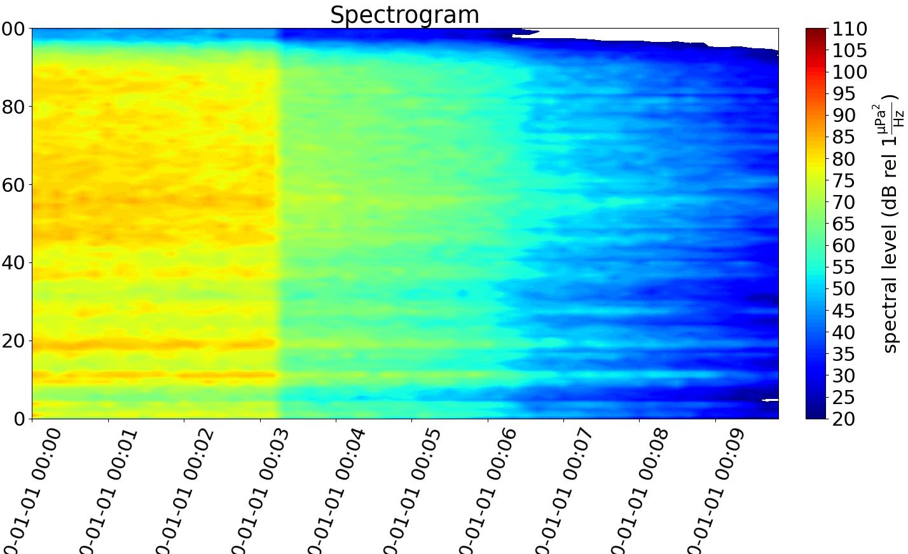
Taking lower 1/3 of quefrency from WHOLE signal (no windowing)

Slide 11
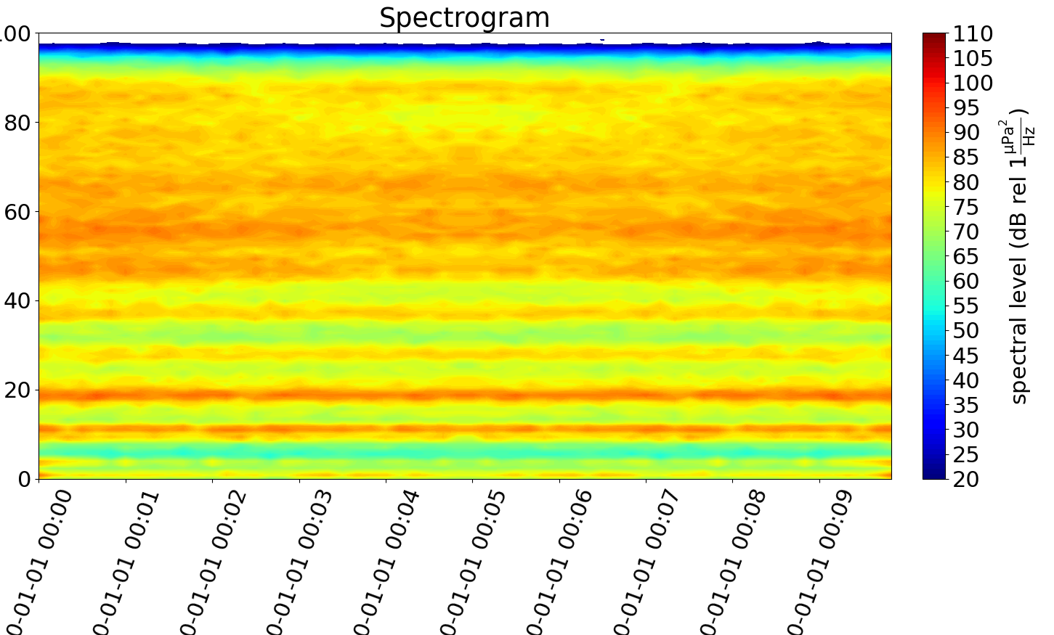

Slide 12
Undoing whole quefrency from WHOLE signal (no windowing)

