Slide 1
March 27th Meeting
Ainsley Lai

Slide 2
Code here: https://github.com/ainsleylaiuw/OcDa-Files/blob/main/PSD_by_Type.ipynb
Currently for Axial Base location
Generates cepstral SPDF for vessel type based on 1-minute average
Probable issues may occur in generation of PSD using OOIPY internal method or in formulation of average 1-minute cepstrum across all instances of vessel type

Slide 3
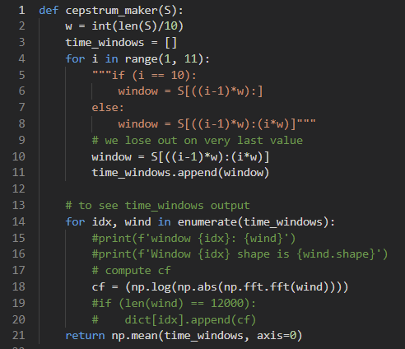
Average 1-minute cepstrum

Slide 4
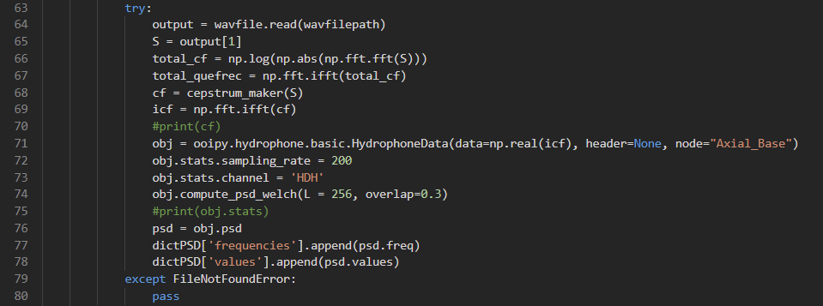
PSD generation code
Reads in .wav file of ship audio

Slide 5
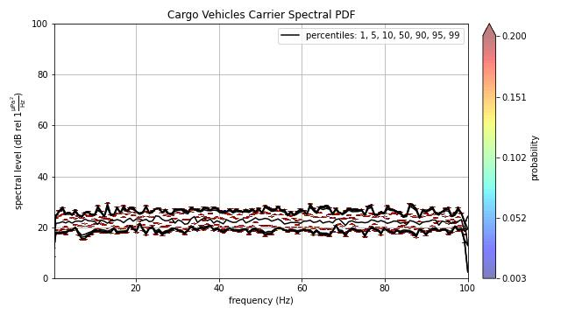
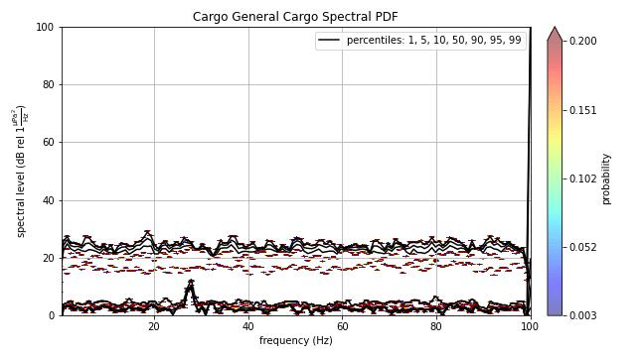
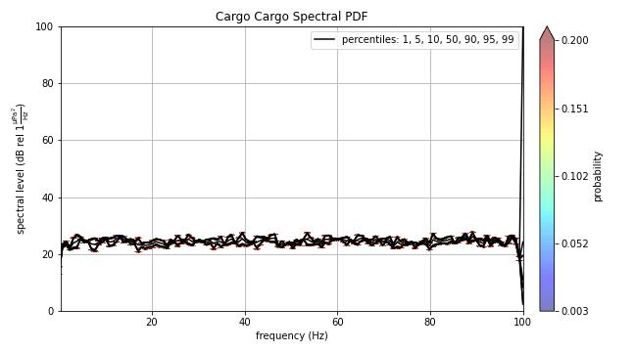
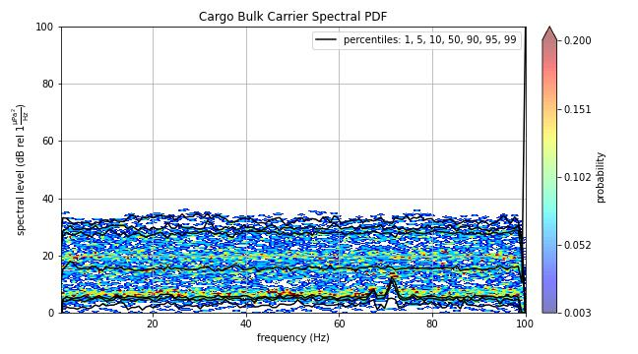
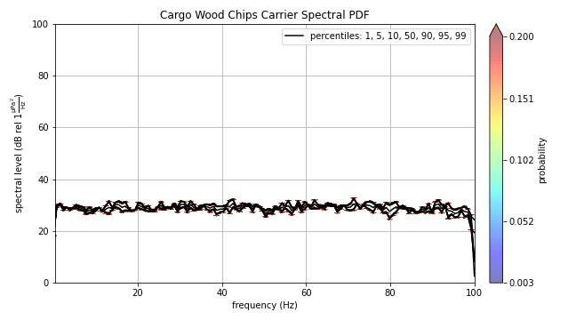

Slide 6
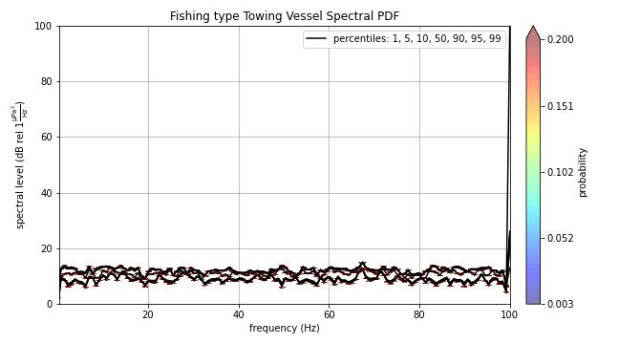
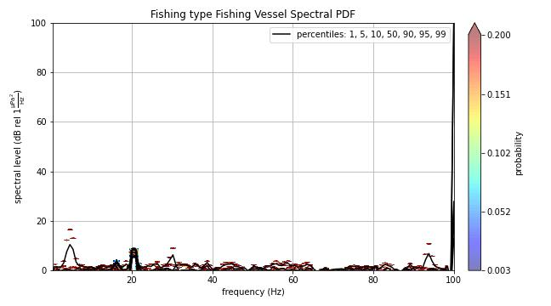
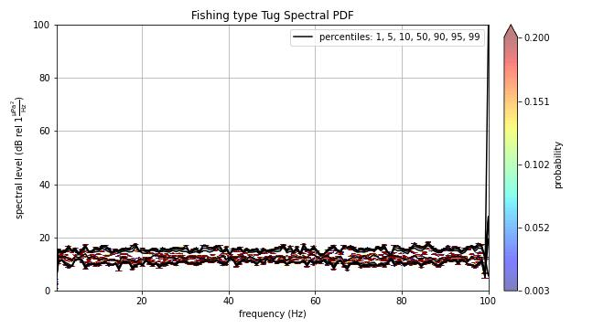

Slide 7
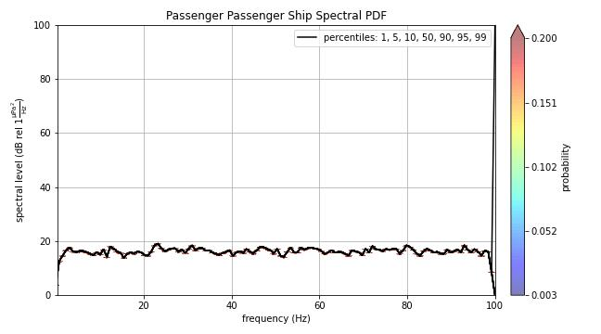

Slide 8
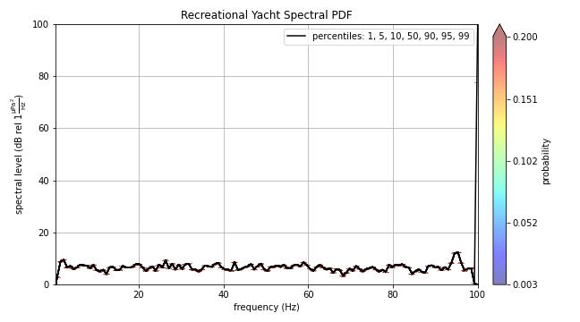
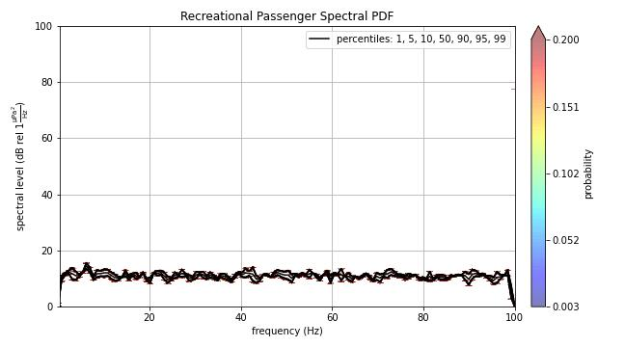

Slide 9
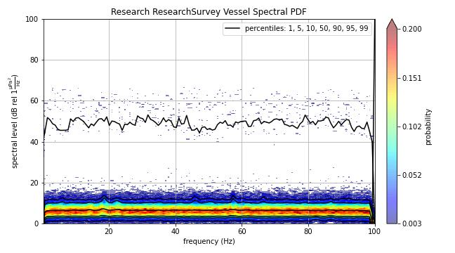
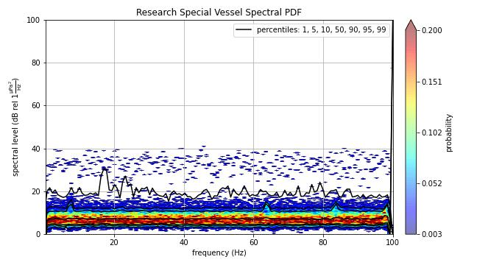

Slide 10
