Slide 1
March 6th meeting
Questions about Cepstrum/Frequency Plotting
Signal time units → frequency conversion (100 frequencies in given PSDs)
Spring Break Scheduling
In Hong Kong
Next quarter, less credits (more time)
Finals workload, sending rest of plots a bit later

Slide 2
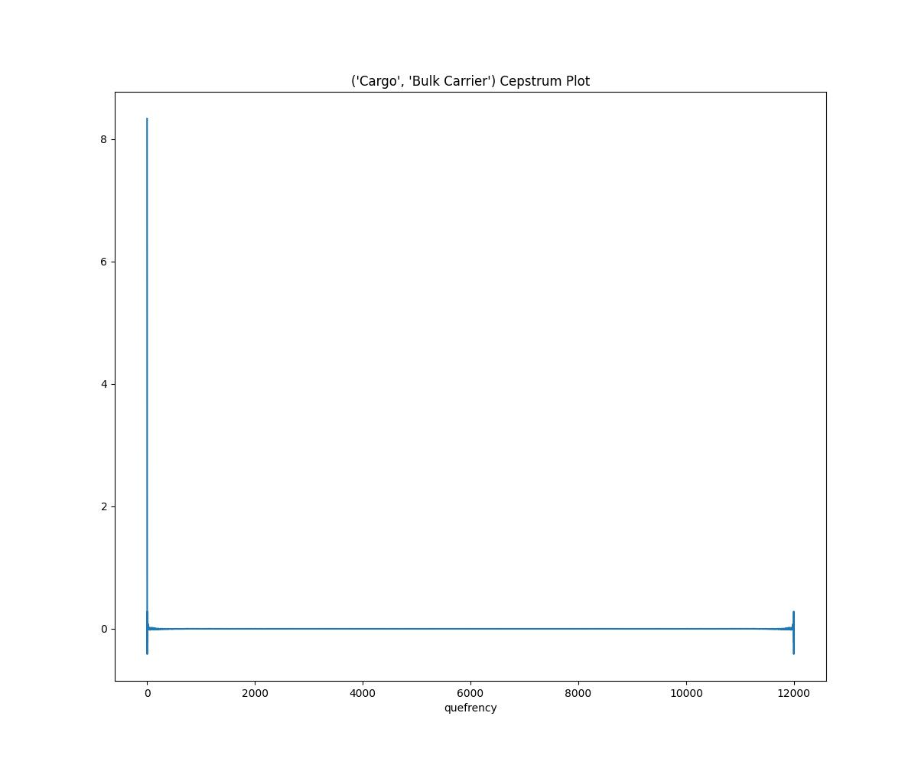
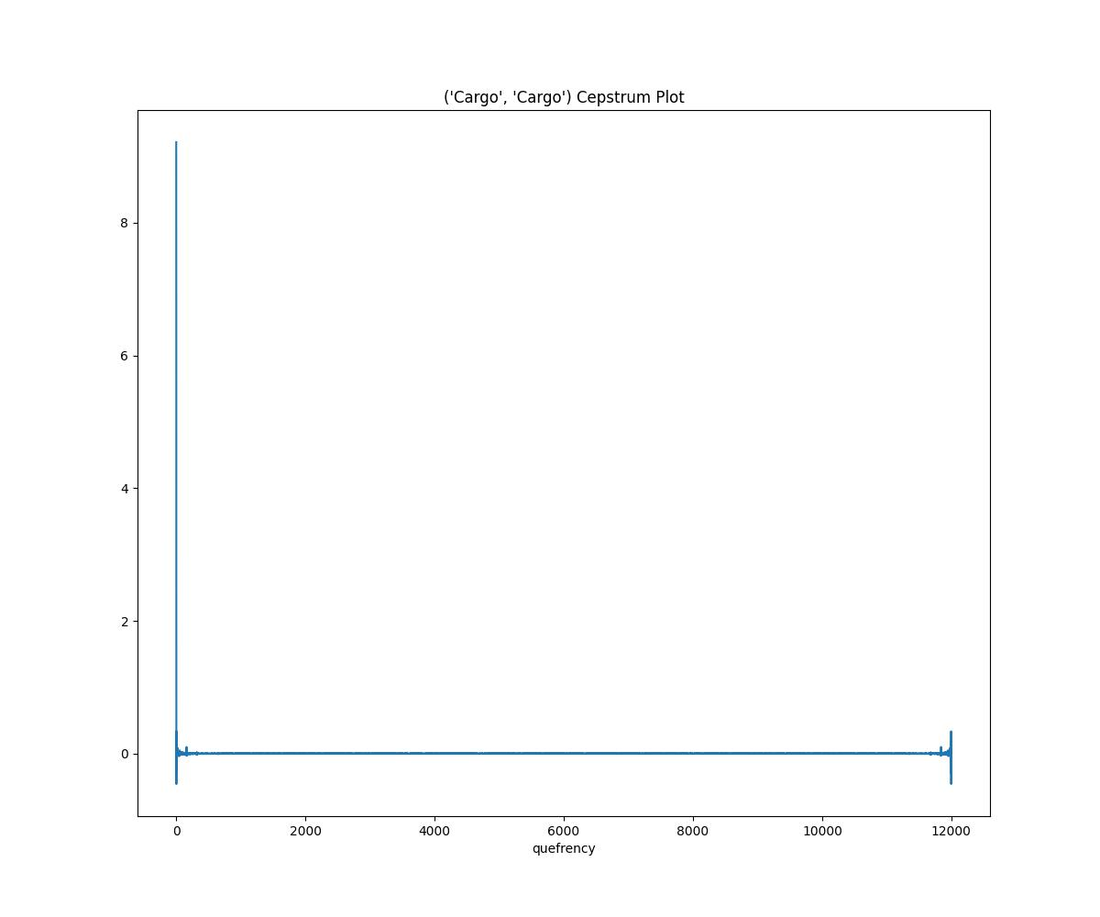
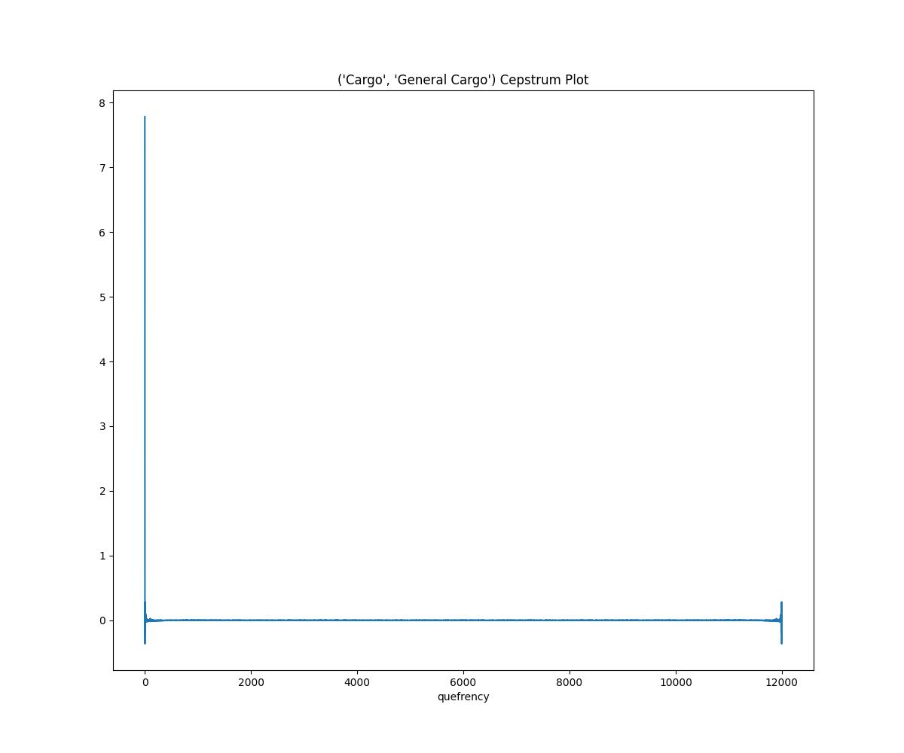
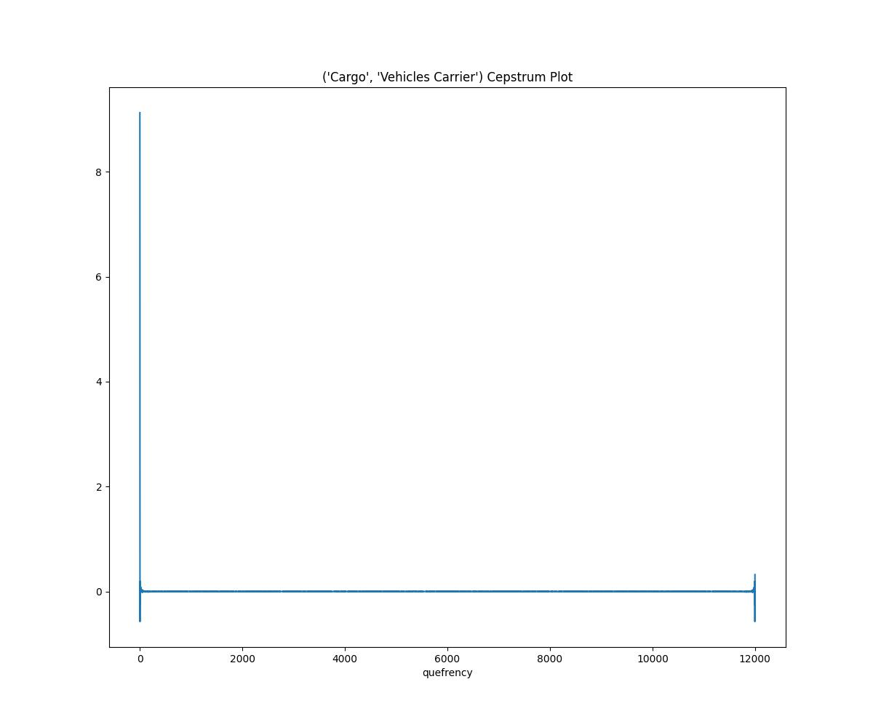
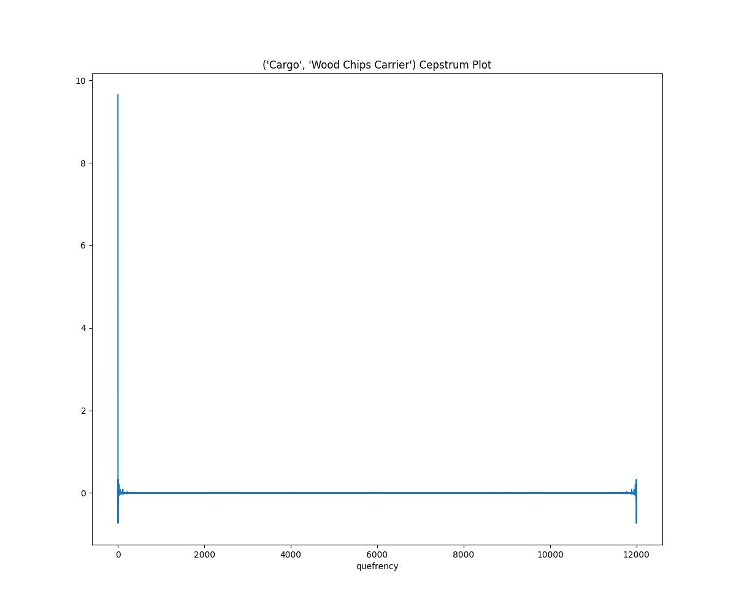

Slide 3
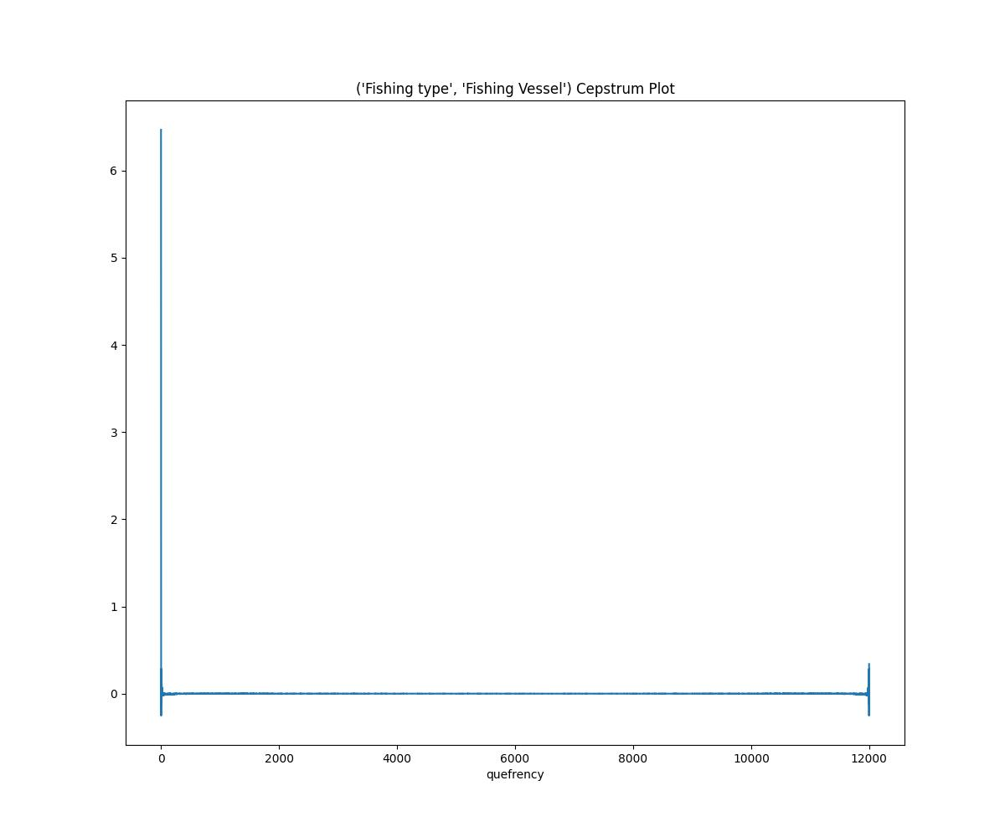
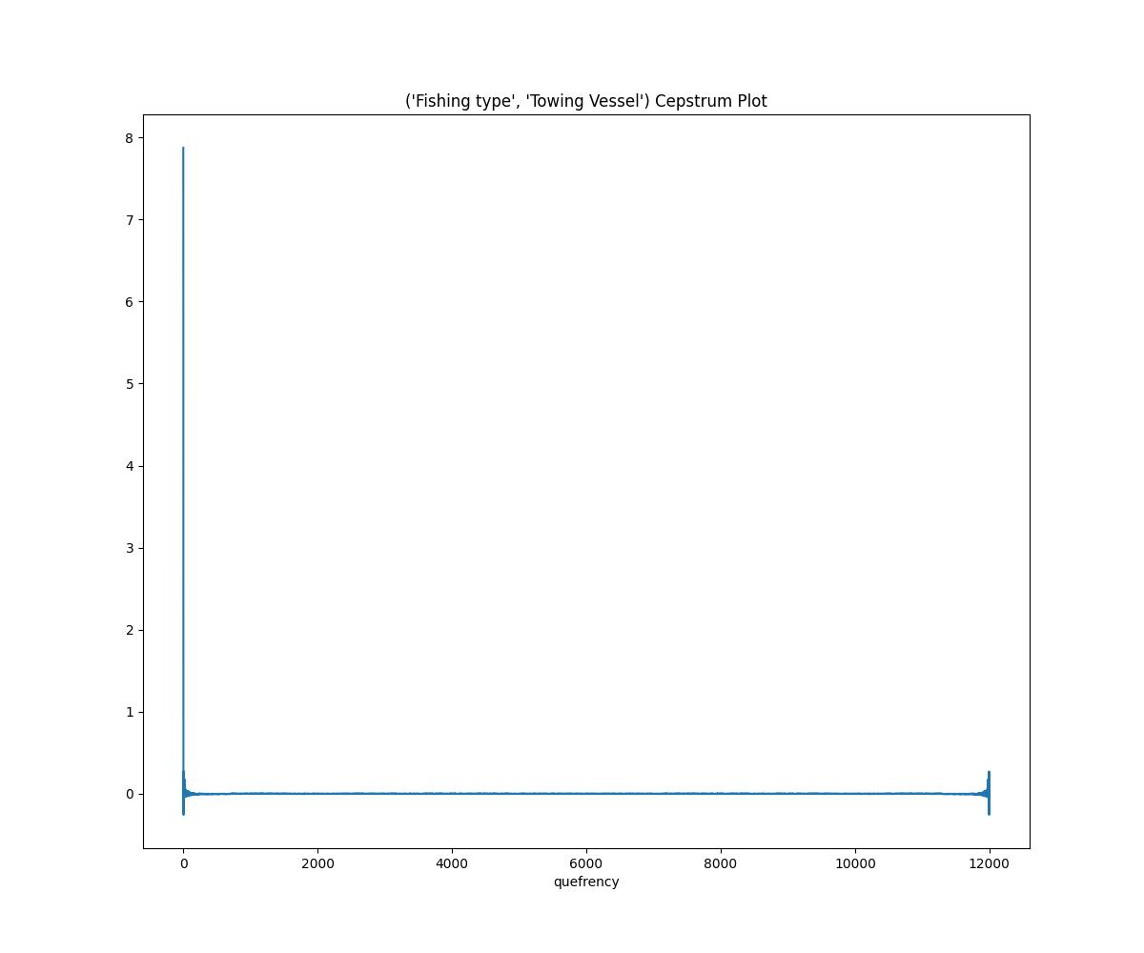
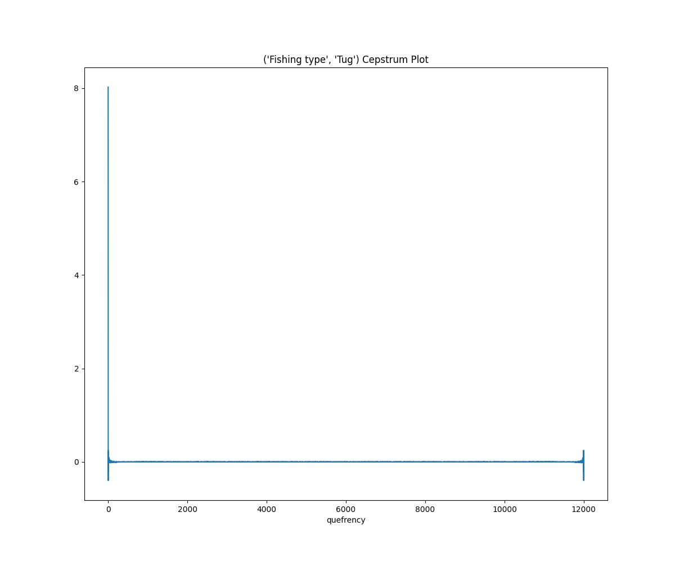

Slide 4
