Slide 1
April 4th meeting
Cepstrum Spectrogram bugs

Slide 2
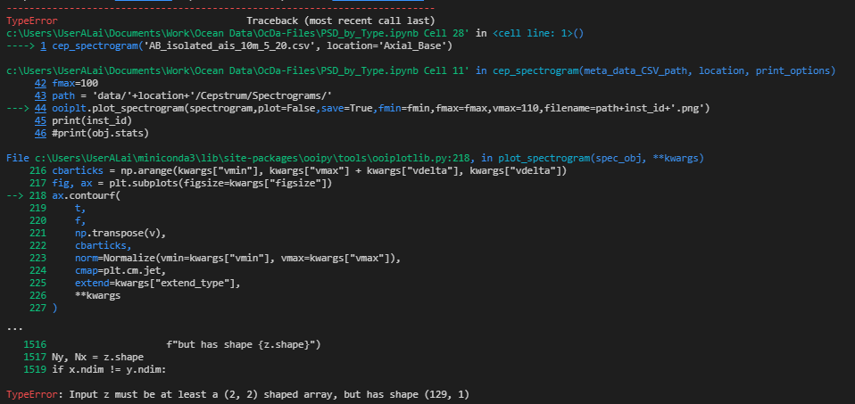

Slide 3
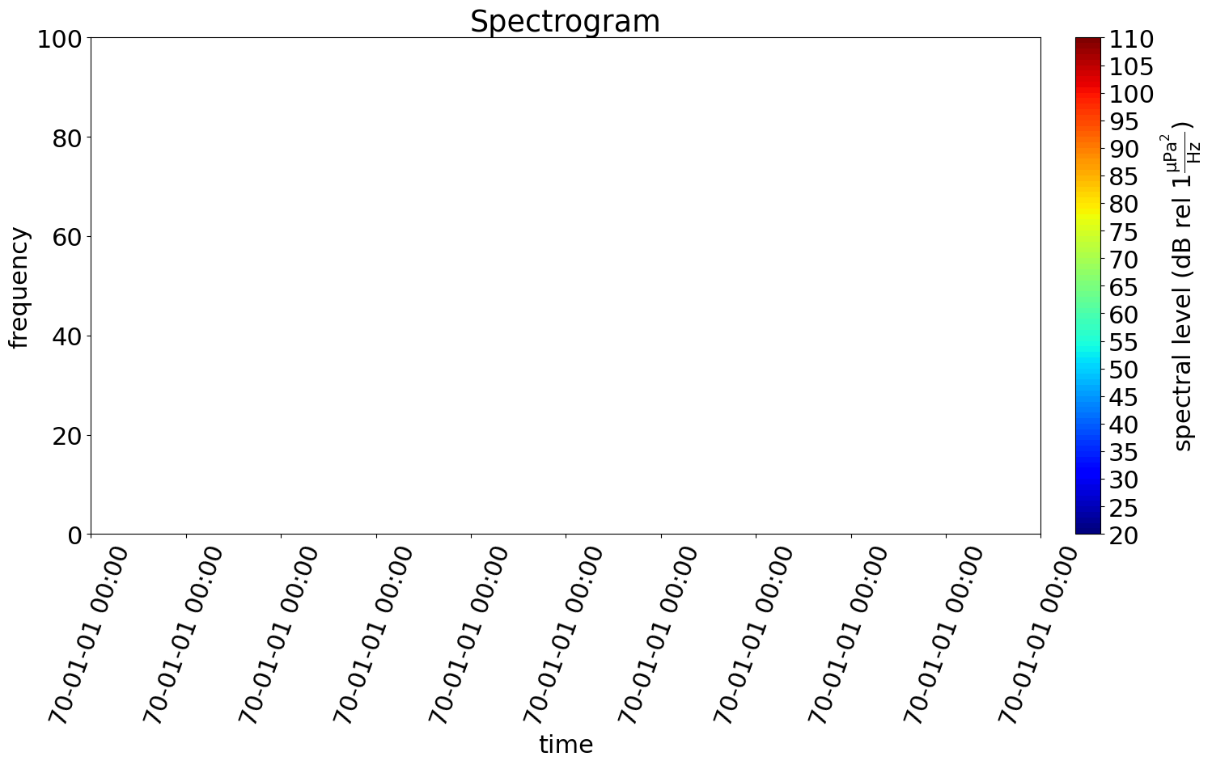

Slide 4
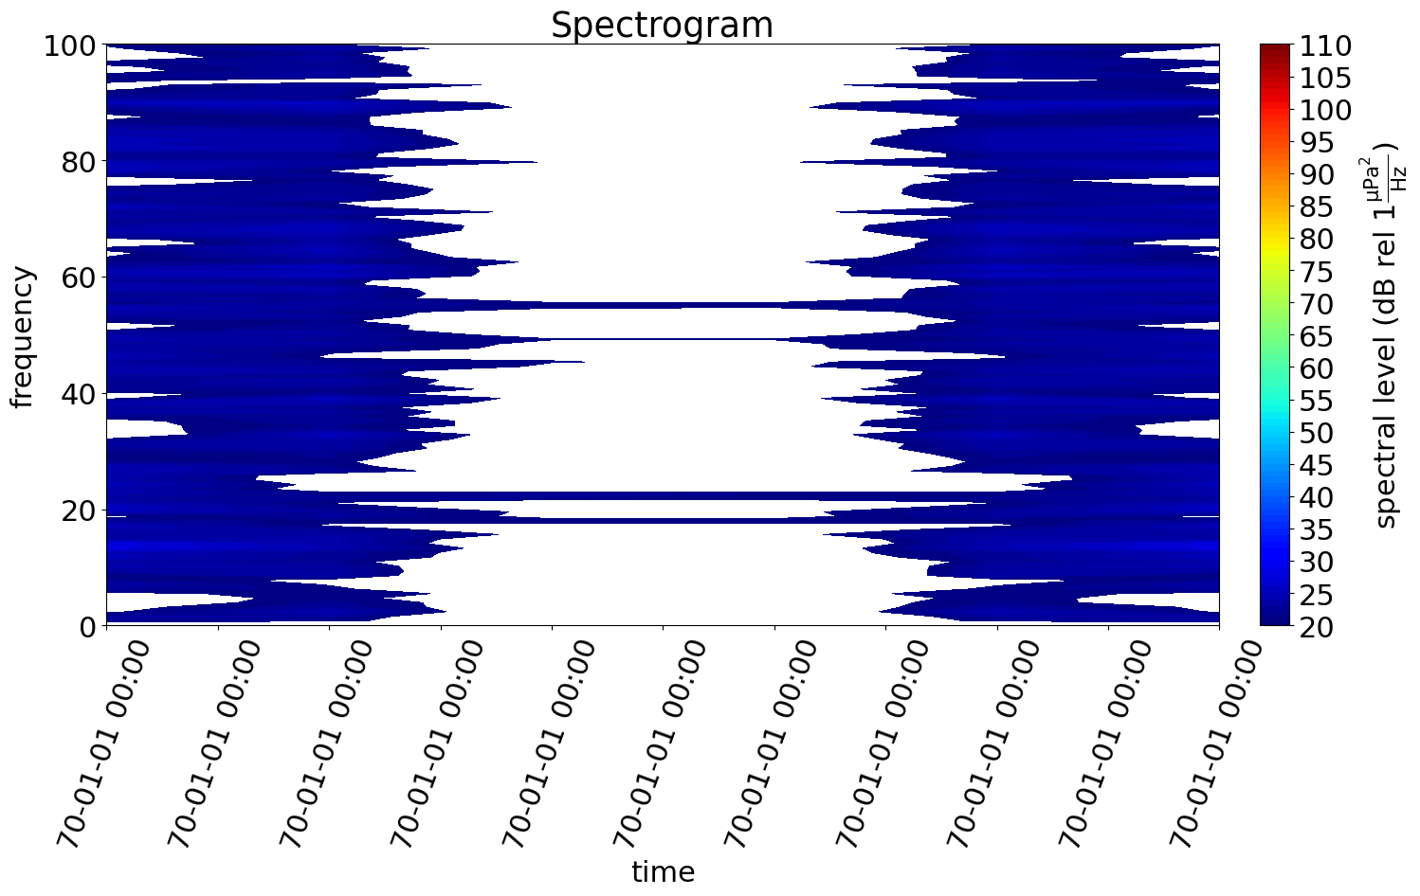
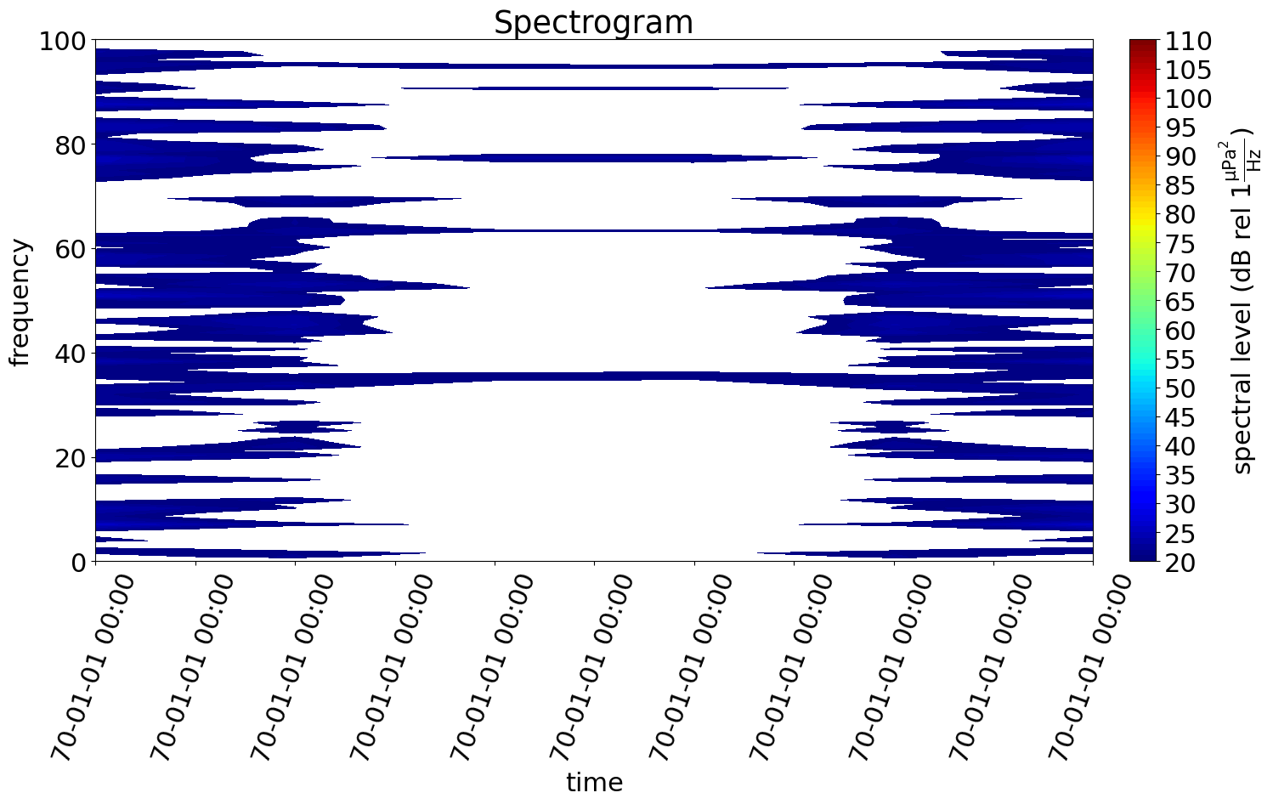
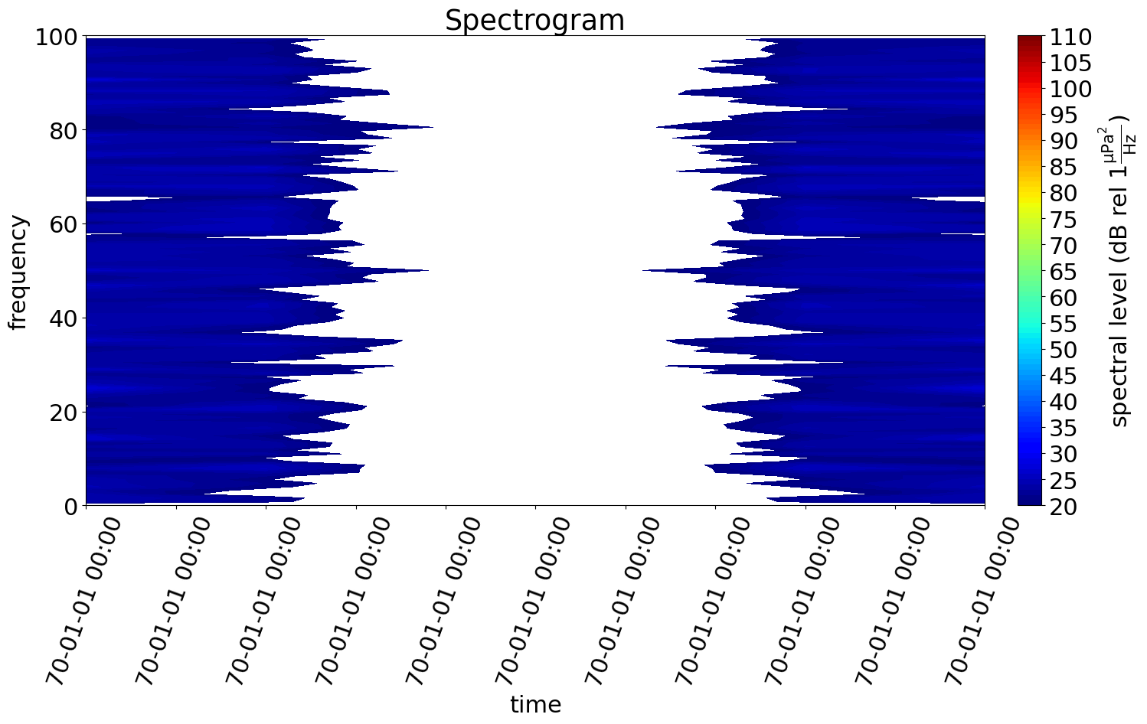
A few resultant cepstral spectrograms
0-100 frequency (quefrency) scale happens automatically

