Slide 1
Meta-Analysis: Methods and Applications
Comprehensive overview for epidemiology and health research

Slide 2
Learning Objectives
Understand the purpose of meta-analysis
Differentiate systematic reviews and meta-analyses
Understand fixed- and random-effects models
Interpret heterogeneity statistics
Conduct and report a meta-analysis

Slide 3
What is a Meta-Analysis?
Quantitative synthesis of results from multiple studies
Increases statistical power and precision
Provides summary effect estimate
Often denoted as summary relative risk effect (SRRE), meta-RR, etc.
Forms the top of many evidence hierarchies

Slide 4
Meta-Analysis Workflow
Develop protocol (PRISMA, PICO, MOOSE)
https://www.prisma-statement.org/
https://legacyfileshare.elsevier.com/promis_misc/ISSM_MOOSE_Checklist.pdf
https://www.nlm.nih.gov/oet/ed/pubmed/pubmed_in_ebp/02-100.html
Conduct systematic literature search
Screen studies
Extract data
Calculate effect sizes
Pool results and interpret findings

Slide 5

Developing the Research Question (PICO)
Population
Intervention/Exposure
Comparison
Outcome
Pre-specify inclusion/exclusion criteria

Slide 6

MOOSE

Slide 7

Literature Search and PRISMA
Search multiple databases
Document search strategy
Screen titles/abstracts and full texts
Report study selection using PRISMA flow diagram

Slide 8
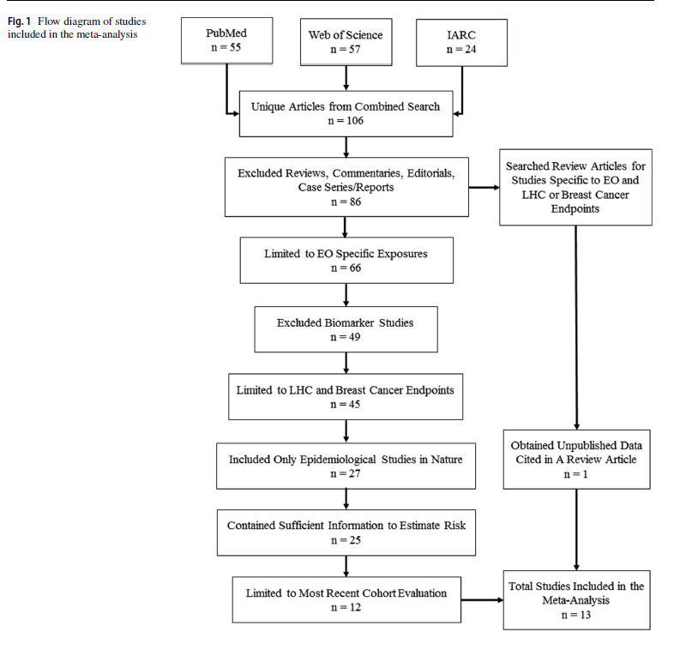
Flow Chart

Slide 9
Data Extraction and Study Quality
Effect estimates and confidence intervals
Sample sizes and person-time
Exposure definitions
Country/geographic region
Job/occupational titles
Risk of bias assessment

Slide 10
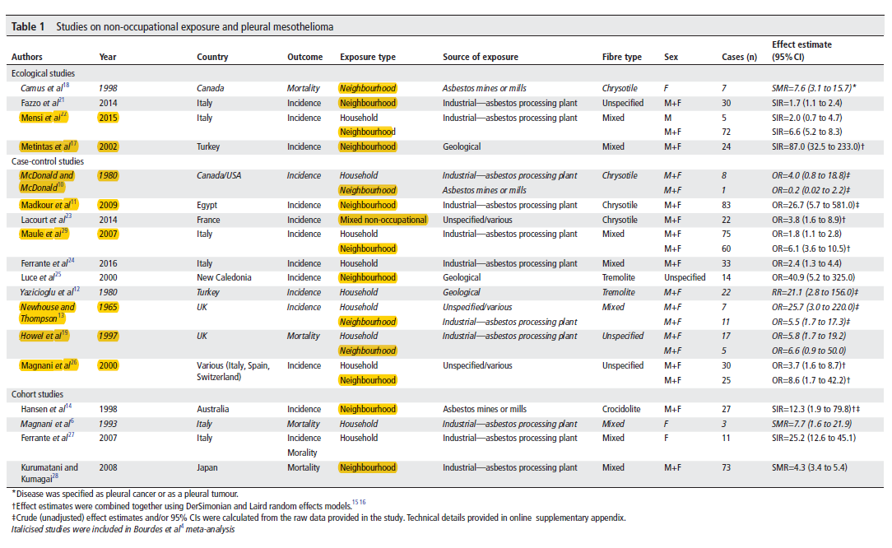

Slide 11
Common Effect Measures
Odds Ratios (OR)
Risk Ratios (RR)
Hazard Ratios (HR)
Standardized Mean Differences (SMD)
Log-transform ratios before pooling

Slide 12
Weighting Studies
Larger, more precise studies receive greater weight
Inverse-variance weighting is most common
Weight = 1 / Variance

Slide 13
Fixed-Effect Model
Assumes one true underlying effect
Observed differences arise only from sampling error
Appropriate when heterogeneity is minimal
Typically yields narrower confidence intervals

Slide 14
Random-Effects Model
Assumes true effects vary across studies
Accounts for within- and between-study variability
Includes between-study variance (τ²)
Usually preferred in epidemiology

Slide 15
Fixed vs Random Effects
Fixed: one common effect
Random: distribution of true effects
Random effects often gives smaller study weights
Interpretation differs substantially

Slide 16
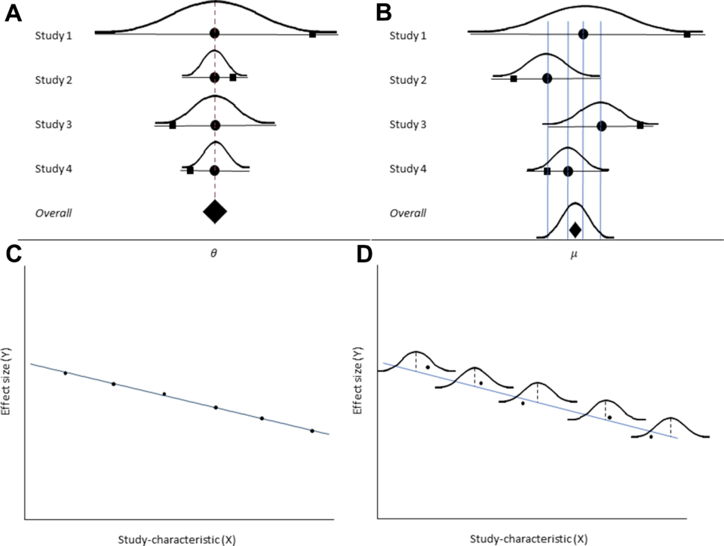

Slide 17
Forest Plots
Displays individual study estimates
Shows study weights
Provides pooled estimate
Visual assessment of heterogeneity

Slide 18
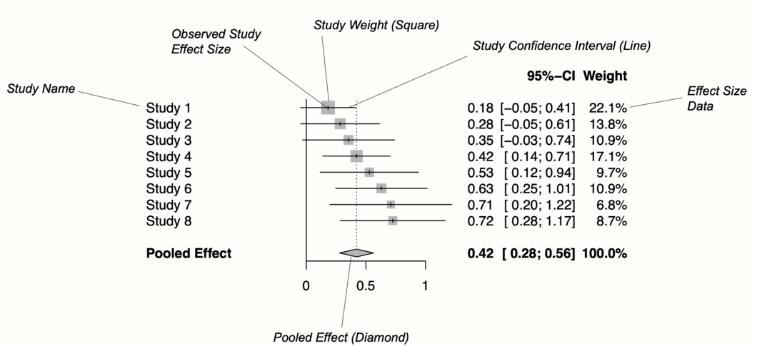

Slide 19
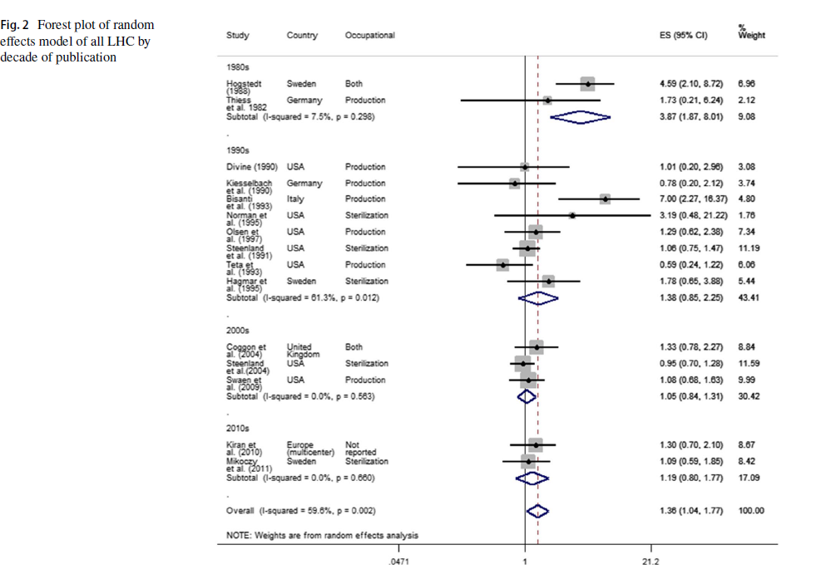

Slide 20
Understanding Heterogeneity
Clinical heterogeneity
Methodological heterogeneity
Statistical heterogeneity
Can affect validity of pooled estimates

Slide 21
Quantifying Heterogeneity
Cochran's Q test
Tau-squared (τ²)
I² statistic

Slide 22
Cochran's Q Statistic
Tests whether observed variability exceeds chance
Chi-square based test
Limited power when few studies are available

Slide 23
Tau-Squared (τ²)
Estimate of between-study variance
Used in random-effects models
Larger values indicate greater heterogeneity

Slide 24
I² Statistic
Percentage of total variation due to heterogeneity
0% = no observed heterogeneity
Not dependent on effect size scale
Most commonly reported heterogeneity metric
0% to 40%: Might indicate unimportant heterogeneity.
30% to 60%: May represent moderate heterogeneity.
50% to 90%: May represent substantial heterogeneity.
75% to 100%: Implies considerable heterogeneity

Slide 25
Publication Bias
Positive studies more likely to be published
Can distort pooled estimates
Assess using funnel plots

Slide 26
Funnel Plots and Small-Study Effects
Visual assessment of asymmetry
Egger's test
Trim-and-fill methods

Slide 27
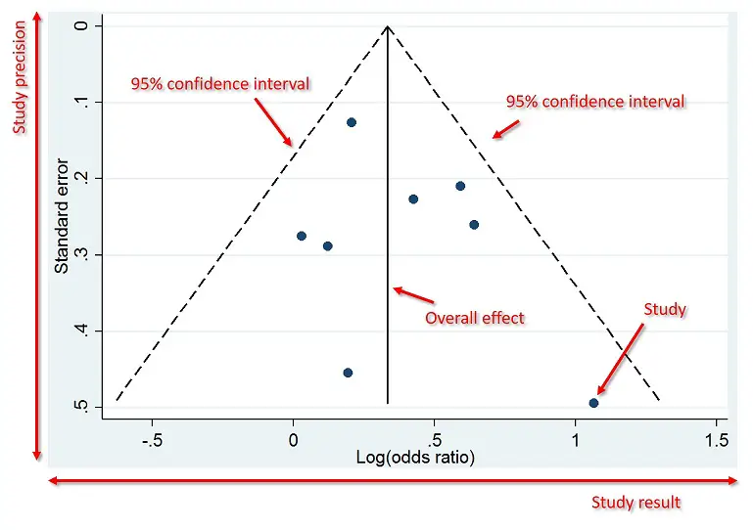

Slide 28
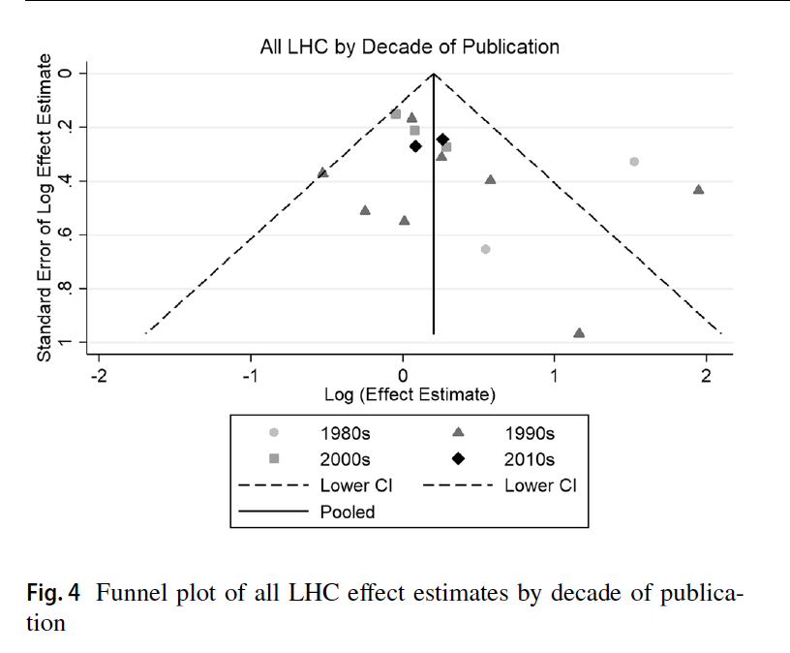

Slide 29
Sensitivity Analyses
Leave-one-out analyses
Alternative effect metrics
Alternative inclusion criteria
Assess robustness of findings

Slide 30
Subgroup Analyses
Explore sources of heterogeneity
Exposure level
Study design
Population characteristics

Slide 31
Meta-Regression
Extension of subgroup analysis
Continuous study-level predictors
Examines effect modification
Useful for epidemiologic datasets

Slide 32
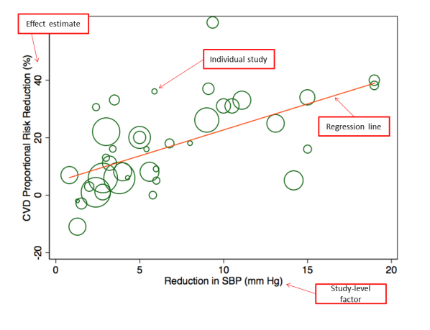
Meta-regression

Slide 33
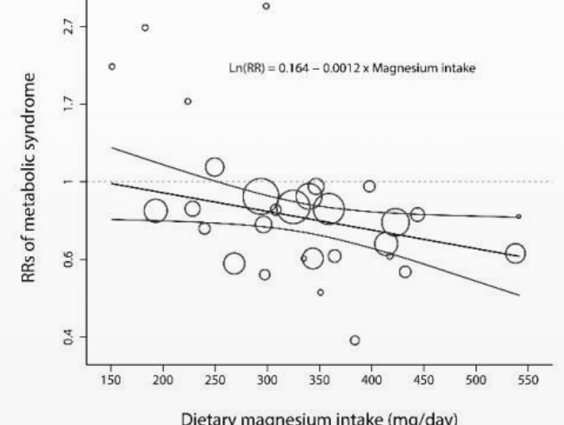
Notes:
Association between the risk of metabolic syndrome and dietary magnesium intake: dose-response meta-regression. The levels of magnesium intake (mg/day) were modeled using a linear trend with random-effects meta-regression models. The solid black line represents the weighted regression line based on variance-weighted least squares. The gray line shows the 95% CI around the regression line. The circles indicate RRs in each study. The circle size is proportional to the precision of the RR. The vertical axis is on a log scale

Slide 34
Reporting Results
PRISMA 2020 guidelines
Forest plot
Heterogeneity metrics
Risk of bias
Publication bias assessment

Slide 35
R Packages for Meta-Analysis
metafor
meta
dmetar
forest(), funnel(), rma() functions

Slide 36
Key Takeaways
Meta-analysis strengthens evidence synthesis
Random-effects models are common in epidemiology
Heterogeneity must always be assessed
Transparent reporting is critical

