Slide 1
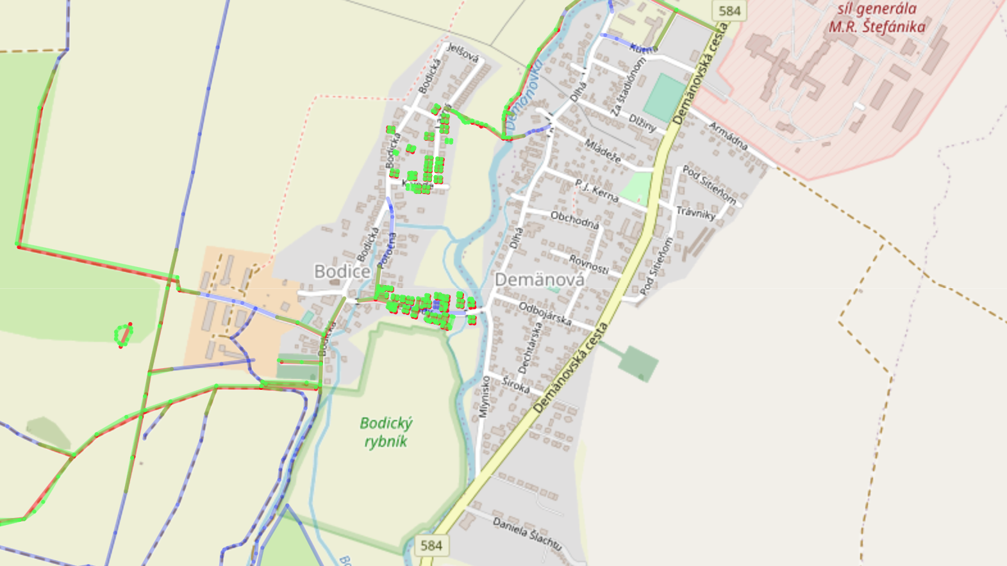
Open Street Maps
my notes

Slide 2
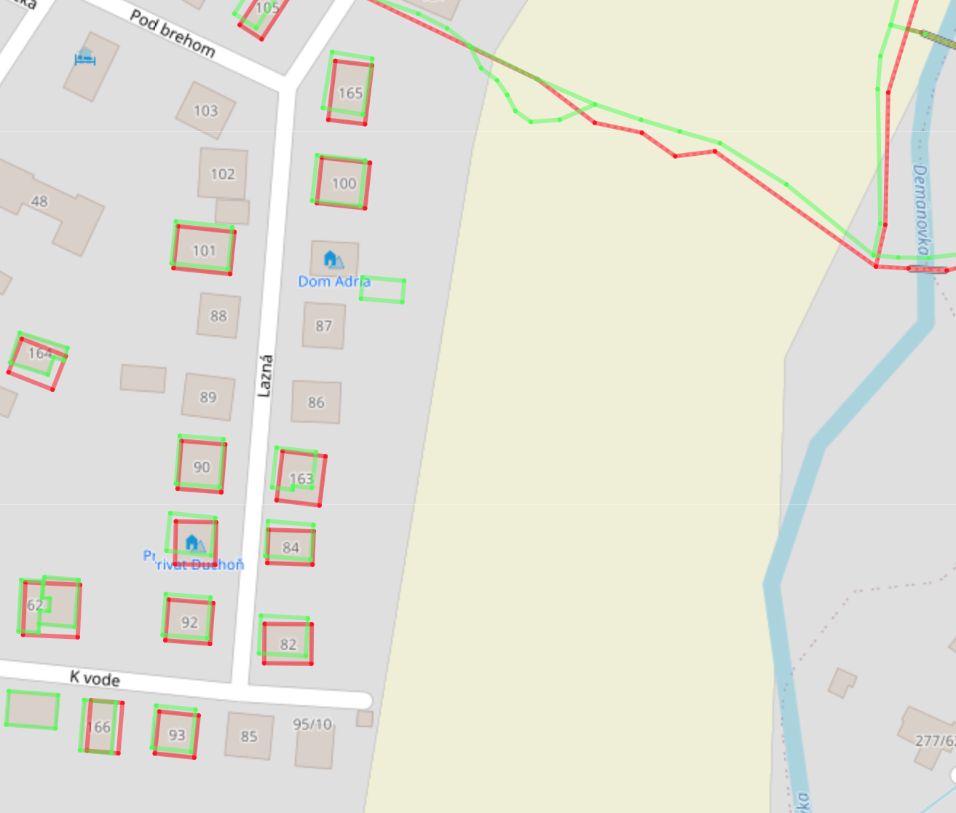
OSM History Viewer
https://osmhv.openstreetmap.de/changeset.jsp?id=102345296

Slide 3
Extracting reivers from DMR 5.0
step1: https://www.youtube.com/watch?v=yX18Yn_e3QY&t=23s

