Slide 1
Collection of Algorithms

Slide 2
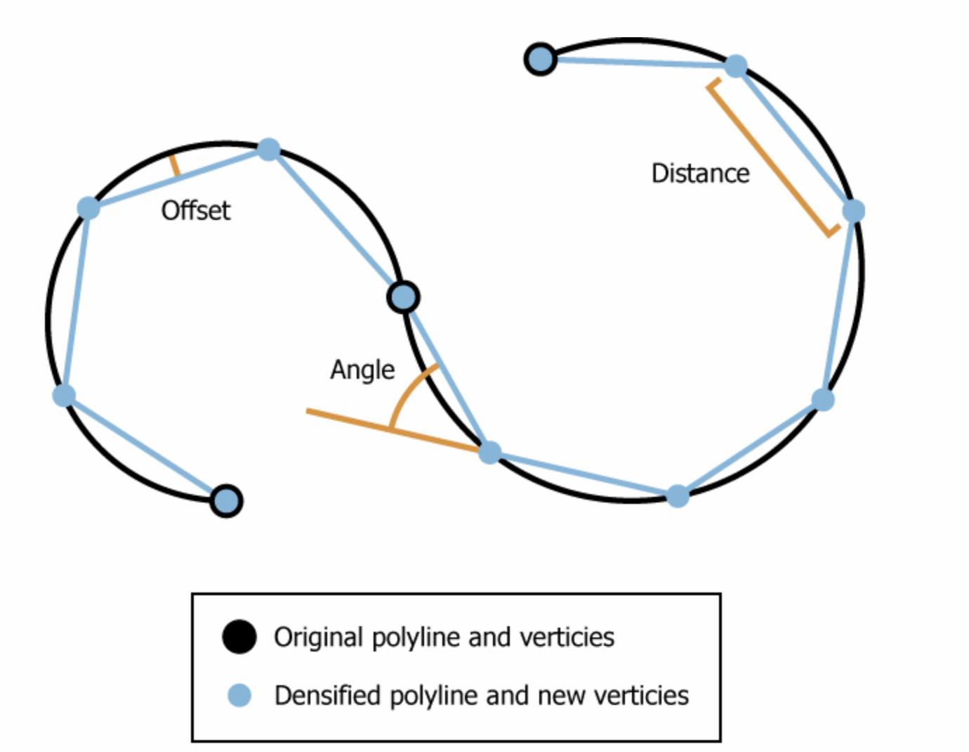
Densify

