Slide 1
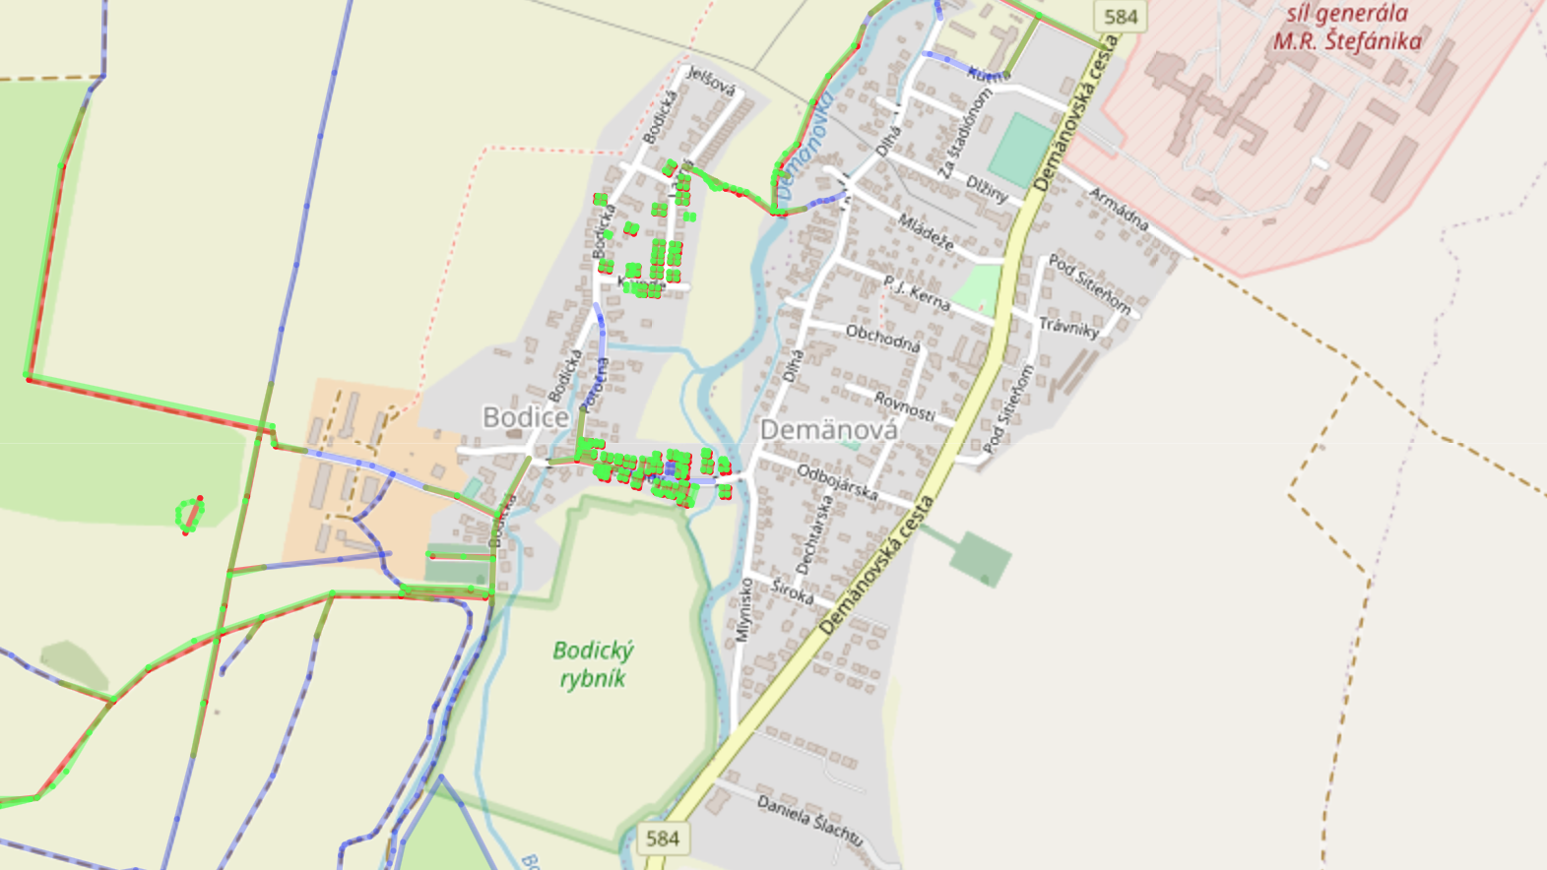
Open Street Maps
my notes

Slide 2
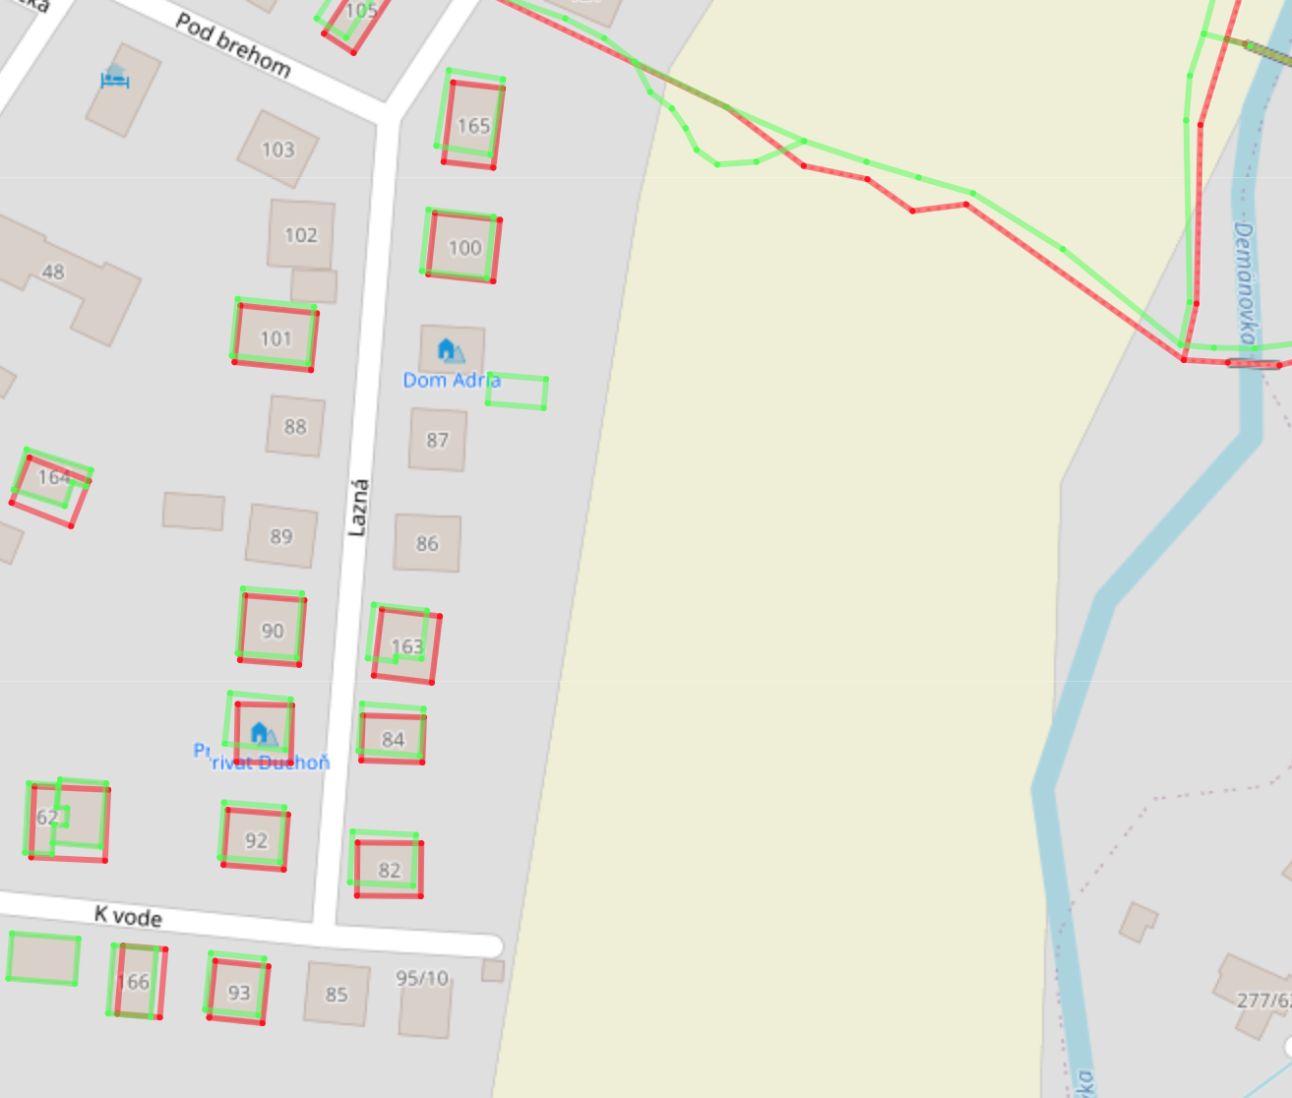
OSM History Viewer
https://osmhv.openstreetmap.de/changeset.jsp?id=102345296

