Slide 2
waterway=river

Slide 3
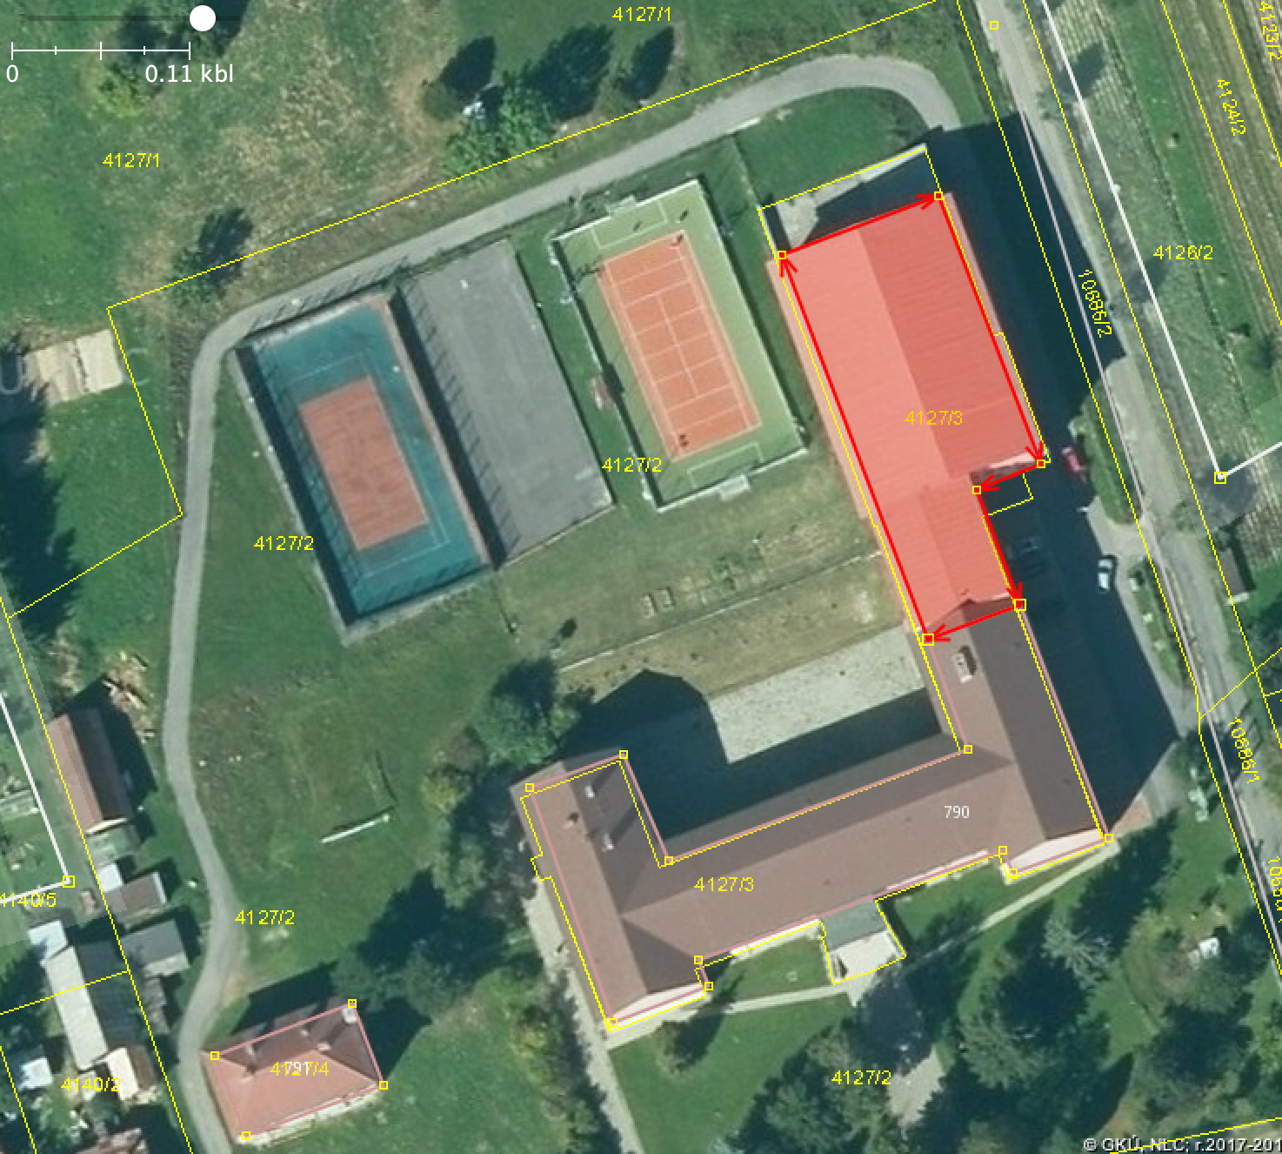
leisure=pitch

Slide 4
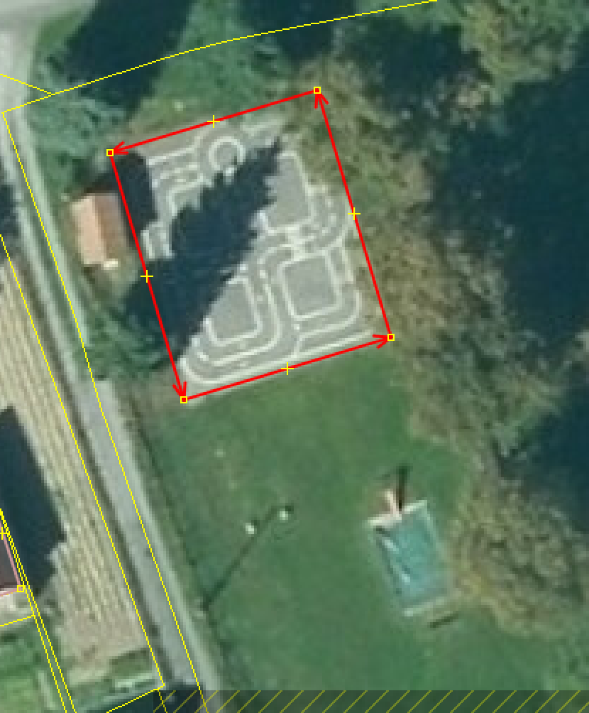
dopravné inhrisko

Slide 5
building=hut

